Slide 1
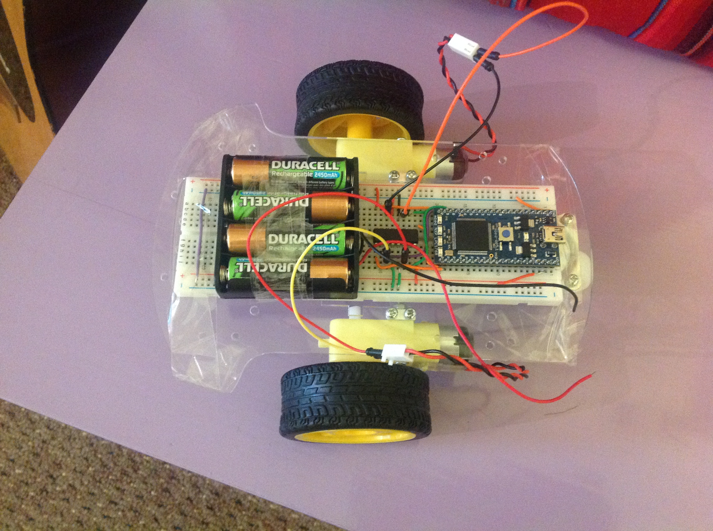
Top Gear Code Off

Slide 2
Course Outline
An introduction to programming: 30mins
Programming problem Solving: 45mins
Top Gear Code Off Challenge: 1hr 15mins

Slide 3
Programming

Slide 4


Builders have bricks

Slide 5
Bakers have ingredients

Slide 6
Programmers have code

Slide 7
What is code?

Slide 8
Fields and Types

Slide 9
Operations

Slide 10
Control flow

Slide 11
Objects and Classes

Slide 12
Methods

Slide 13
People, Teachers, Pupils

