Slide 1
Elect 1002 System On Chip
Project

Slide 2
Project Description
You are required to build Two Convolution Layer in between them there is a FIFO.
The FIFO stores the output from the first convolution layer and the second convolution layer uses what’s inside the FIFO to perform its convolution operation as an input.
You are required to implement the system twice. The first implementation using systemC not synthesizable code.
The first convolution layer you should use sc_has_process so that the data type and size of the input and kernel to be dynamic. The second convolution layer use sc_method.
In the first layer you are expected to know how to read csv file using SystemC.
The second implementation using C++ which is a synthesizable code (double data type).

Slide 3
Project Description
First Convolution Layer :
The input is a (28*28) matrix, (2*2) filter , Stride = 2 , Output (14*14).
Second Convolution Layer :
The input is a (14*14) matrix, (2*2) filter , Stride = 2 , Output (7*7).

Slide 4
Time-Plan
Weeks | Submission | Synthesis
 | Convolution Layer 1&2 System C | No synthesis
 | Convolution Layer 1&2 C++ | Synthesizable Code
 | FIFO SystemC & C++ | SystemC (No synthesis ) C++ (Synthesizable)
 | Integration both systems | SystemC (No synthesis ) C++ (Synthesizable)
Deadline on Thursday
11/5/2023
Deadline on Thursday
18/5/2023

Slide 5
Requirement
The project is in pairs.
You are required to submit a report and the code files for each milestone (Online).
The report should include the output for each milestone.
If you can’t attach the files please put each milestone on your google drive and send me the drive link by mail.
Mail : rola.adly@guc.edu.eg

Slide 6

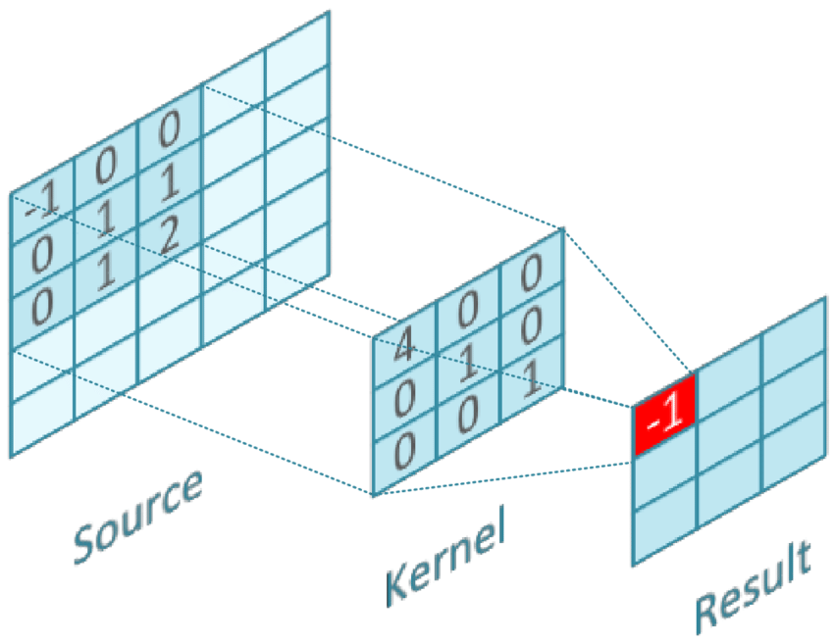
Project Description
FIFO

Slide 7
Convolution Layer
Please run the slides using power point to see the animation.
The 3×3 matrix is called a ‘filter‘ or ‘kernel’ or ‘feature detector’.
Stride is the number of pixels shifts over the input matrix. When the stride is 1 then we move the filters to 1 pixel at a time. When the stride is 2 then we move the filters to 2 pixels at a time and so on.
The stride in the animation is 1.

Slide 8
Example:
In the following slides there is an explanation for (7*7) input matrix with (3*3) filter matrix and output matrix (3*3) with stride of 2.
Stride is the number of pixels shifts over the input matrix. When the stride is 1 then we move the filters to 1 pixel at a time. When the stride is 2 then we move the filters to 2 pixels at a time and so on.

Slide 9
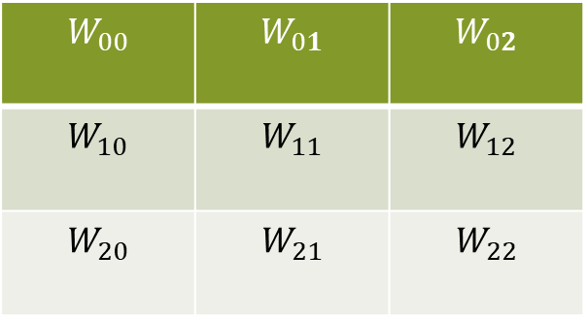
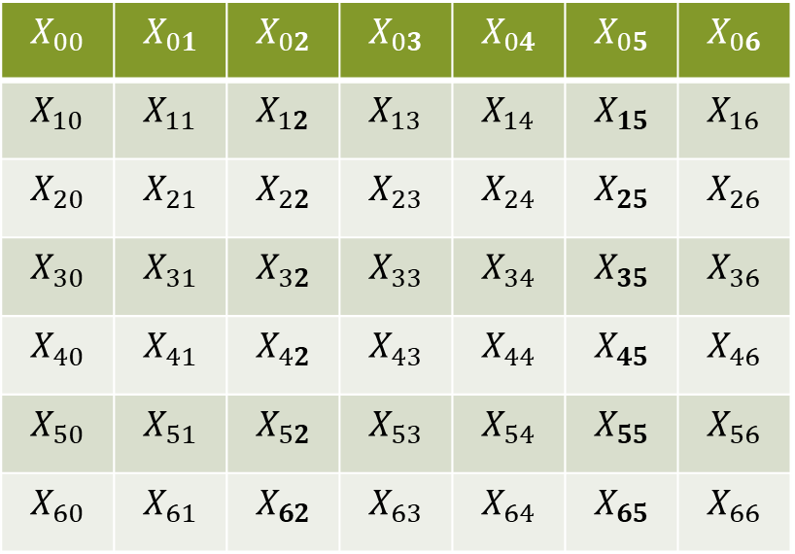
Convolution
$$X_{00}$$ | $$X_{01}$$ | $$X_{02}$$ | $$X_{03}$$ | $$X_{04}$$ | $$X_{05}$$ | $$X_{06}$$
$$X_{10}$$ | $$X_{11}$$ | $$X_{12}$$ | $$X_{13}$$ | $$X_{14}$$ | $$X_{15}$$ | $$X_{16}$$
$$X_{20}$$ | $$X_{21}$$ | $$X_{22}$$ | $$X_{23}$$ | $$X_{24}$$ | $$X_{25}$$ | $$X_{26}$$
$$X_{30}$$ | $$X_{31}$$ | $$X_{32}$$ | $$X_{33}$$ | $$X_{34}$$ | $$X_{35}$$ | $$X_{36}$$
$$X_{40}$$ | $$X_{41}$$ | $$X_{42}$$ | $$X_{43}$$ | $$X_{44}$$ | $$X_{45}$$ | $$X_{46}$$
$$X_{50}$$ | $$X_{51}$$ | $$X_{52}$$ | $$X_{53}$$ | $$X_{54}$$ | $$X_{55}$$ | $$X_{56}$$
$$X_{60}$$ | $$X_{61}$$ | $$X_{62}$$ | $$X_{63}$$ | $$X_{64}$$ | $$X_{65}$$ | $$X_{66}$$
$$W_{00}$$ | $$W_{01}$$ | $$W_{02}$$
$$W_{10}$$ | $$W_{11}$$ | $$W_{12}$$
$$W_{20}$$ | $$W_{21}$$ | $$W_{22}$$
Filter
Input

Slide 10
Convolution
0 | 0 | 0 | 0 | 0 | 0 | 0
0 | 0 | 0 | 1 | 0 | 2 | 0
0 | 1 | 0 | 2 | 0 | 1 | 0
0 | 1 | 0 | 2 | 2 | 0 | 1
0 | 2 | 0 | 0 | 2 | 0 | 0
0 | 2 | 1 | 2 | 2 | 0 | 0
0 | 0 | 0 | 0 | 0 | 0 | 0
-1 | 0 | 1
0 | 0 | 1
1 | -1 | 1
Filter
Input

Slide 11
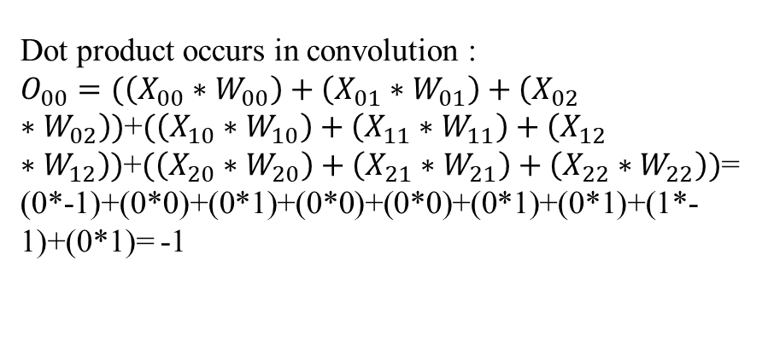
Convolution
0 | 0 | 0 | 0 | 0 | 0 | 0
0 | 0 | 0 | 1 | 0 | 2 | 0
0 | 1 | 0 | 2 | 0 | 1 | 0
0 | 1 | 0 | 2 | 2 | 0 | 1
0 | 2 | 0 | 0 | 2 | 0 | 0
0 | 2 | 1 | 2 | 2 | 0 | 0
0 | 0 | 0 | 0 | 0 | 0 | 0
Filter
-1 | 0 | 1
0 | 0 | 1
1 | -1 | 1
Dot product occurs in convolution :
$O_{00}=(\left(X_{00}∗W_{00}\right)+\left(X_{01}∗W_{01}\right)+\left(X_{02}∗W_{02}\right))$+$(\left(X_{10}∗W_{10}\right)+\left(X_{11}∗W_{11}\right)+\left(X_{12}∗W_{12}\right))$+$(\left(X_{20}∗W_{20}\right)+\left(X_{21}∗W_{21}\right)+\left(X_{22}∗W_{22}\right))$=
(0*-1)+(0*0)+(0*1)+(0*0)+(0*0)+(0*1)+(0*1)+(1*-1)+(0*1)= -1
Input

Slide 12
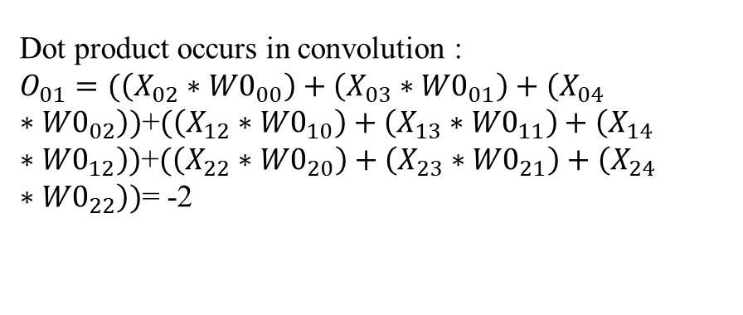
Convolution
0 | 0 | 0 | 0 | 0 | 0 | 0
0 | 0 | 0 | 1 | 0 | 2 | 0
0 | 1 | 0 | 2 | 0 | 1 | 0
0 | 1 | 0 | 2 | 2 | 0 | 1
0 | 2 | 0 | 0 | 2 | 0 | 0
0 | 2 | 1 | 2 | 2 | 0 | 0
0 | 0 | 0 | 0 | 0 | 0 | 0
Filter
-1 | 0 | 1
0 | 0 | 1
1 | -1 | 1
Dot product occurs in convolution :
$O_{01}=(\left(X_{02}∗{W0}_{00}\right)+\left(X_{03}∗{W0}_{01}\right)+\left(X_{04}∗{W0}_{02}\right))$+$(\left(X_{12}∗{W0}_{10}\right)+\left(X_{13}∗{W0}_{11}\right)+\left(X_{14}∗{W0}_{12}\right))$+$(\left(X_{22}∗{W0}_{20}\right)+\left(X_{23}∗{W0}_{21}\right)+\left(X_{24}∗{W0}_{22}\right))$= -2
Input

Slide 13
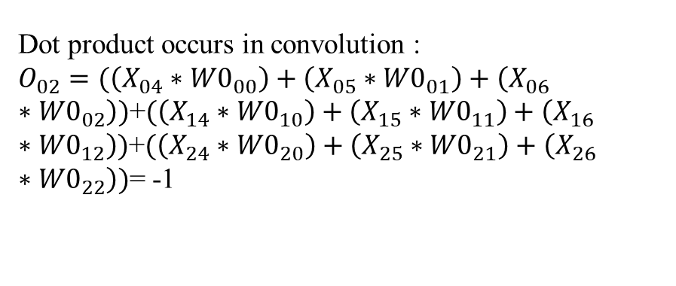
Convolution
Filter
0 | 0 | 0 | 0 | 0 | 0 | 0
0 | 0 | 0 | 1 | 0 | 2 | 0
0 | 1 | 0 | 2 | 0 | 1 | 0
0 | 1 | 0 | 2 | 2 | 0 | 1
0 | 2 | 0 | 0 | 2 | 0 | 0
0 | 2 | 1 | 2 | 2 | 0 | 0
0 | 0 | 0 | 0 | 0 | 0 | 0
-1 | 0 | 1
0 | 0 | 1
1 | -1 | 1
Dot product occurs in convolution :
$O_{02}=(\left(X_{04}∗{W0}_{00}\right)+\left(X_{05}∗{W0}_{01}\right)+\left(X_{06}∗{W0}_{02}\right))$+$(\left(X_{14}∗{W0}_{10}\right)+\left(X_{15}∗{W0}_{11}\right)+\left(X_{16}∗{W0}_{12}\right))$+$(\left(X_{24}∗{W0}_{20}\right)+\left(X_{25}∗{W0}_{21}\right)+\left(X_{26}∗{W0}_{22}\right))$= -1
Input

Slide 14
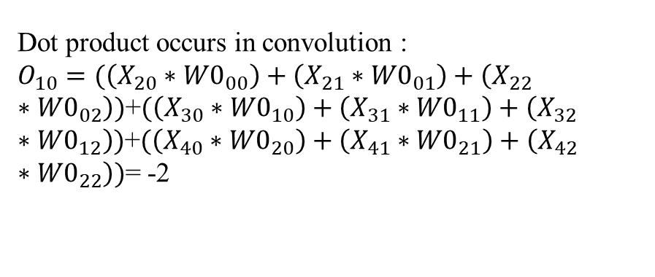
Convolution
0 | 0 | 0 | 0 | 0 | 0 | 0
0 | 0 | 0 | 1 | 0 | 2 | 0
0 | 1 | 0 | 2 | 0 | 1 | 0
0 | 1 | 0 | 2 | 2 | 0 | 1
0 | 2 | 0 | 0 | 2 | 0 | 0
0 | 2 | 1 | 2 | 2 | 0 | 0
0 | 0 | 0 | 0 | 0 | 0 | 0
Filter
-1 | 0 | 1
0 | 0 | 1
1 | -1 | 1
Dot product occurs in convolution :
$O_{10}=(\left(X_{20}∗{W0}_{00}\right)+\left(X_{21}∗{W0}_{01}\right)+\left(X_{22}∗{W0}_{02}\right))$+$(\left(X_{30}∗{W0}_{10}\right)+\left(X_{31}∗{W0}_{11}\right)+\left(X_{32}∗{W0}_{12}\right))$+$(\left(X_{40}∗{W0}_{20}\right)+\left(X_{41}∗{W0}_{21}\right)+\left(X_{42}∗{W0}_{22}\right))$= -2
Input

Slide 15
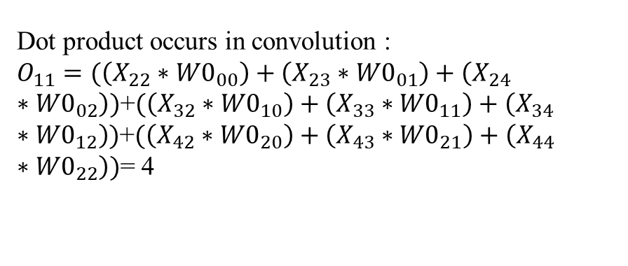
Convolution
0 | 0 | 0 | 0 | 0 | 0 | 0
0 | 0 | 0 | 1 | 0 | 2 | 0
0 | 1 | 0 | 2 | 0 | 1 | 0
0 | 1 | 0 | 2 | 2 | 0 | 1
0 | 2 | 0 | 0 | 2 | 0 | 0
0 | 2 | 1 | 2 | 2 | 0 | 0
0 | 0 | 0 | 0 | 0 | 0 | 0
Filter
-1 | 0 | 1
0 | 0 | 1
1 | -1 | 1
Dot product occurs in convolution :
$O_{11}=(\left(X_{22}∗{W0}_{00}\right)+\left(X_{23}∗{W0}_{01}\right)+\left(X_{24}∗{W0}_{02}\right))$+$(\left(X_{32}∗{W0}_{10}\right)+\left(X_{33}∗{W0}_{11}\right)+\left(X_{34}∗{W0}_{12}\right))$+$(\left(X_{42}∗{W0}_{20}\right)+\left(X_{43}∗{W0}_{21}\right)+\left(X_{44}∗{W0}_{22}\right))$= 4
Input

Slide 16
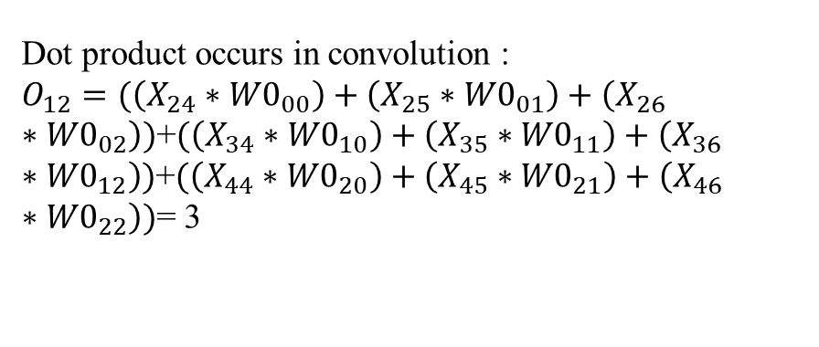
Convolution
0 | 0 | 0 | 0 | 0 | 0 | 0
0 | 0 | 0 | 1 | 0 | 2 | 0
0 | 1 | 0 | 2 | 0 | 1 | 0
0 | 1 | 0 | 2 | 2 | 0 | 1
0 | 2 | 0 | 0 | 2 | 0 | 0
0 | 2 | 1 | 2 | 2 | 0 | 0
0 | 0 | 0 | 0 | 0 | 0 | 0
Filter
-1 | 0 | 1
0 | 0 | 1
1 | -1 | 1
Dot product occurs in convolution :
$O_{12}=(\left(X_{24}∗{W0}_{00}\right)+\left(X_{25}∗{W0}_{01}\right)+\left(X_{26}∗{W0}_{02}\right))$+$(\left(X_{34}∗{W0}_{10}\right)+\left(X_{35}∗{W0}_{11}\right)+\left(X_{36}∗{W0}_{12}\right))$+$(\left(X_{44}∗{W0}_{20}\right)+\left(X_{45}∗{W0}_{21}\right)+\left(X_{46}∗{W0}_{22}\right))$= 3
Input

Slide 17
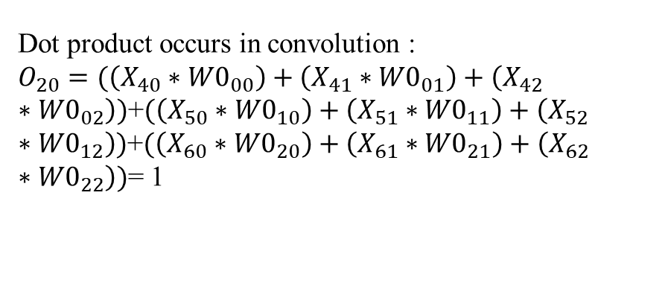
Convolution
0 | 0 | 0 | 0 | 0 | 0 | 0
0 | 0 | 0 | 1 | 0 | 2 | 0
0 | 1 | 0 | 2 | 0 | 1 | 0
0 | 1 | 0 | 2 | 2 | 0 | 1
0 | 2 | 0 | 0 | 2 | 0 | 0
0 | 2 | 1 | 2 | 2 | 0 | 0
0 | 0 | 0 | 0 | 0 | 0 | 0
Filter
-1 | 0 | 1
0 | 0 | 1
1 | -1 | 1
Dot product occurs in convolution :
$O_{20}=(\left(X_{40}∗{W0}_{00}\right)+\left(X_{41}∗{W0}_{01}\right)+\left(X_{42}∗{W0}_{02}\right))$+$(\left(X_{50}∗{W0}_{10}\right)+\left(X_{51}∗{W0}_{11}\right)+\left(X_{52}∗{W0}_{12}\right))$+$(\left(X_{60}∗{W0}_{20}\right)+\left(X_{61}∗{W0}_{21}\right)+\left(X_{62}∗{W0}_{22}\right))$= 1
Input

Slide 18
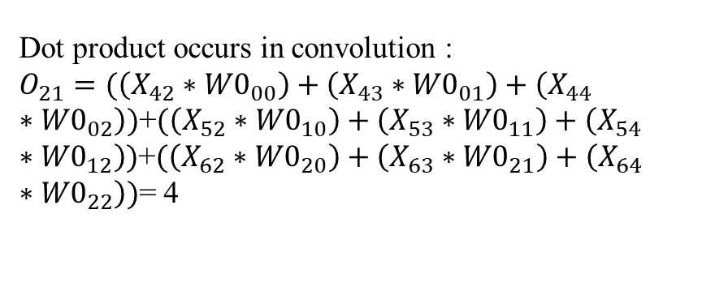
Convolution
0 | 0 | 0 | 0 | 0 | 0 | 0
0 | 0 | 0 | 1 | 0 | 2 | 0
0 | 1 | 0 | 2 | 0 | 1 | 0
0 | 1 | 0 | 2 | 2 | 0 | 1
0 | 2 | 0 | 0 | 2 | 0 | 0
0 | 2 | 1 | 2 | 2 | 0 | 0
0 | 0 | 0 | 0 | 0 | 0 | 0
Filter
-1 | 0 | 1
0 | 0 | 1
1 | -1 | 1
Dot product occurs in convolution :
$O_{21}=(\left(X_{42}∗{W0}_{00}\right)+\left(X_{43}∗{W0}_{01}\right)+\left(X_{44}∗{W0}_{02}\right))$+$(\left(X_{52}∗{W0}_{10}\right)+\left(X_{53}∗{W0}_{11}\right)+\left(X_{54}∗{W0}_{12}\right))$+$(\left(X_{62}∗{W0}_{20}\right)+\left(X_{63}∗{W0}_{21}\right)+\left(X_{64}∗{W0}_{22}\right))$= 4
Input

Slide 19
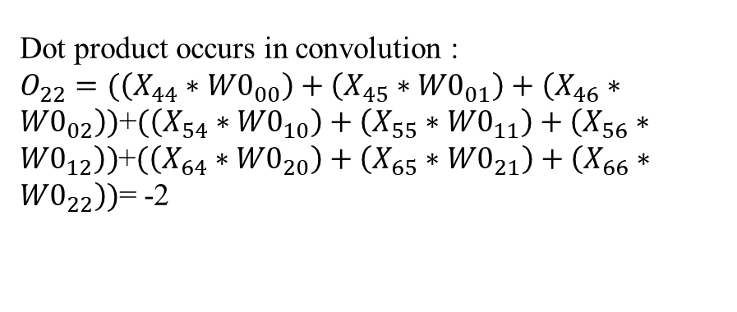
Convolution
Input
0 | 0 | 0 | 0 | 0 | 0 | 0
0 | 0 | 0 | 1 | 0 | 2 | 0
0 | 1 | 0 | 2 | 0 | 1 | 0
0 | 1 | 0 | 2 | 2 | 0 | 1
0 | 2 | 0 | 0 | 2 | 0 | 0
0 | 2 | 1 | 2 | 2 | 0 | 0
0 | 0 | 0 | 0 | 0 | 0 | 0
Filter
-1 | 0 | 1
0 | 0 | 1
1 | -1 | 1
Dot product occurs in convolution :
$O_{22}=(\left(X_{44}∗{W0}_{00}\right)+\left(X_{45}∗{W0}_{01}\right)+\left(X_{46}∗{W0}_{02}\right))$+$(\left(X_{54}∗{W0}_{10}\right)+\left(X_{55}∗{W0}_{11}\right)+\left(X_{56}∗{W0}_{12}\right))$+$(\left(X_{64}∗{W0}_{20}\right)+\left(X_{65}∗{W0}_{21}\right)+\left(X_{66}∗{W0}_{22}\right))$= -2

Slide 20
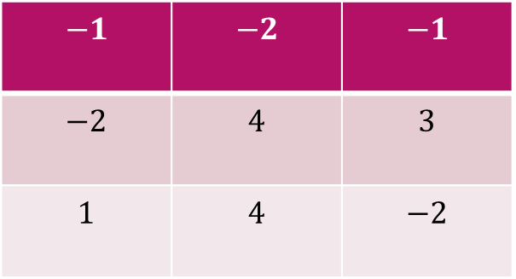
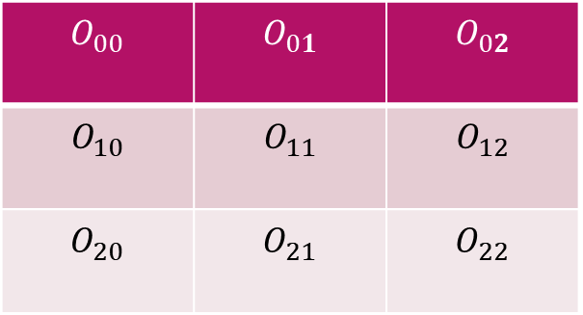
Output from convolution layer
$$O_{00}$$ | $$O_{01}$$ | $$O_{02}$$
$$O_{10}$$ | $$O_{11}$$ | $$O_{12}$$
$$O_{20}$$ | $$O_{21}$$ | $$O_{22}$$
$$−1$$ | $$−2$$ | $$−1$$
$$−2$$ | $$4$$ | $$3$$
$$1$$ | $$4$$ | $$−2$$

