Slide 1


Digital Security Threats in Healthcare:
Analysis and Recommendations for a Large Hospital System
Md Rapu, Matt Cusanov, Yousuf Laeeq
December 3rd, 2024
YWCC307

Slide 2
Introduction
The exponential growth of digital technology in the healthcare sector brings transformative benefits, including improved patient care, streamlined operations, and robust data management. However, this advancement also attracts sophisticated cyber threats. For hospital systems, maintaining digital security is paramount due to the sensitive nature of patient data, operational dependencies on IT systems, and compliance requirements such as HIPAA.
This project will examine the current state of threats, explore the various modes of cyberattacks, and provide actionable recommendations for preparation and mitigation strategies tailored for the hospital system.

Slide 3

What is Cybersecurity?
Cybersecurity refers to the practice of protecting systems, networks, and sensitive information from unauthorized access, disruption, or damage caused by digital threats. It involves a combination of technologies, processes, and practices designed to secure data and ensure the smooth operation of critical systems.
In the healthcare context, cybersecurity focuses on three main goals:
Confidentiality – Ensuring patient information is only accessible to authorized individuals.
Integrity – Guaranteeing that the data and systems are accurate and trustworthy.
Availability – Keeping systems operational so healthcare services can run without interruption.

Slide 4
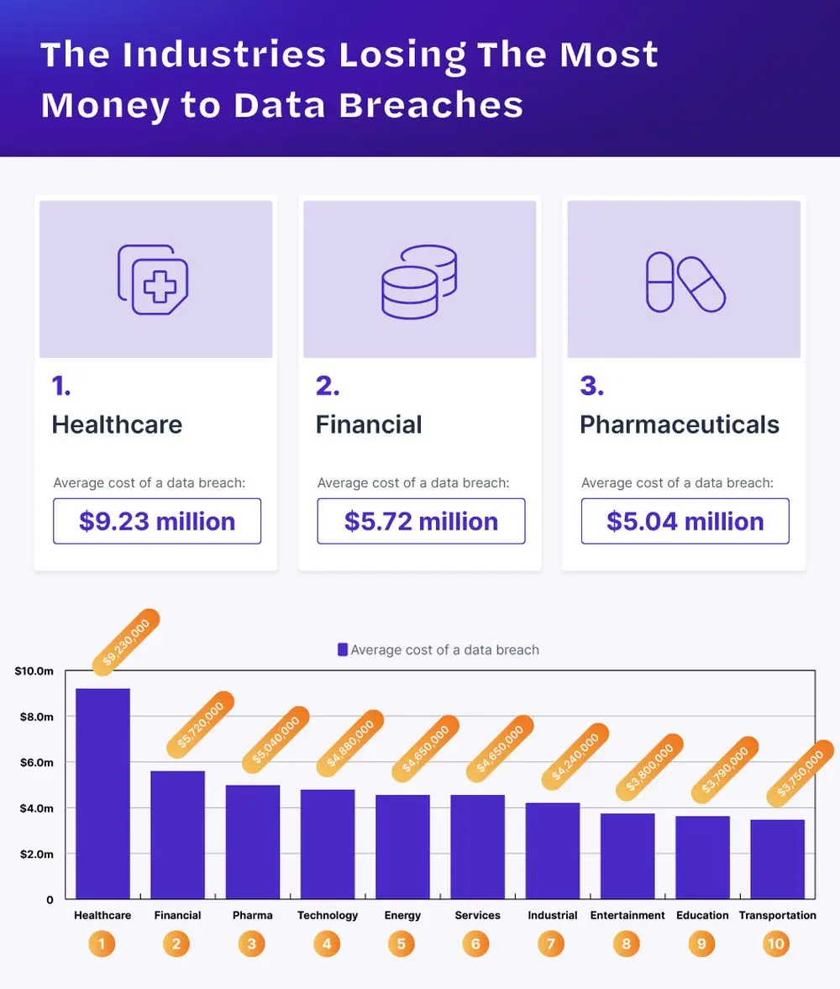
Current State of Threats in Healthcare
Healthcare systems are among the most targeted industries for cyberattacks. The rise of digital tools like Electronic Health Records (EHRs), connected medical devices, and remote monitoring has improved patient care but also created new vulnerabilities. Cybercriminals are drawn to healthcare because of the high value of sensitive patient data and the critical nature of hospital operations, which makes institutions more likely to pay ransoms to restore services
Rising Frequency of Attacks: Hospitals are increasingly being targeted by cybercriminals, with ransomware, phishing, and data breaches becoming commonplace. In 2023 alone, over 50% of healthcare organizations reported a cyberattack, highlighting that it’s not a question of if, but when an attack might happen.
The Value of Healthcare Data: Medical records and personal health information (PHI) are highly valuable on the black market. This data can be used for identity theft, insurance fraud, and other malicious activities. Because healthcare systems store vast amounts of this data, they are prime targets for hackers seeking to exploit or steal it.
https://www.proxyrack.com/blog/cost-of-a-data-breach/
Notes:
Prevalence of Cyber Attacks:
In 2023, the healthcare sector experienced a significant increase in cyberattacks, with 386 reported incidents, marking a substantial rise from previous years. citeturn0search0
Common Attack Vectors:
Ransomware Attacks: Malicious software encrypts critical data, disrupting healthcare services and compromising patient care.
Phishing Campaigns: Deceptive emails trick employees into revealing sensitive information or granting unauthorized access.
Insider Threats: Unauthorized access or data breaches initiated by employees or contractors, whether intentional or accidental.
Impact on Healthcare Organizations:
Operational Disruptions: Cyberattacks can lead to the diversion of ambulances, postponement of medical tests, and inaccessibility of patient records, severely affecting patient care. citeturn0search0
Financial Consequences: The average cost of a healthcare data breach reached $11 million in 2023, a 53% increase since 2020. citeturn0search0
Patient Safety Risks: Delays in procedures and increased mortality rates have been associated with cyberattacks on healthcare facilities. citeturn0search0
Emerging Threats:
Advanced Persistent Threats (APTs): State-sponsored groups conduct prolonged cyber espionage, targeting sensitive healthcare data.
Internet of Things (IoT) Vulnerabilities: Medical devices connected to networks present new avenues for cyber intrusions.

Slide 5
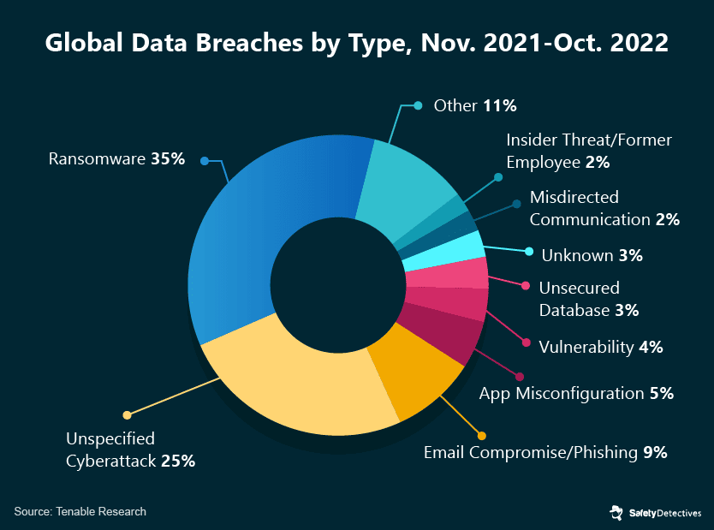
Modes of Cyber Attacks
Ransomware Attacks:
These attacks involve malicious software that locks hospital systems or encrypts data until a ransom is paid. The impact goes beyond financial loss, often causing delays in treatment and endangering patient safety. The 2017 WannaCry attack crippled hospitals worldwide, demonstrating how widespread and destructive ransomware can be.
Phishing and Social Engineering:
Phishing attacks trick employees into revealing passwords or installing malware. For example, a staff member might click a link in a fraudulent email, unknowingly giving attackers access to critical systems
IoMT (Internet of Medical Things) Vulnerabilities:
Many connected devices, such as pacemakers, infusion pumps, or imaging systems, are not designed with robust security. Hackers can exploit these weaknesses to gain access to hospital networks.
Data Breaches:
Patient data is incredibly valuable for identity theft or fraud. A single breach can expose thousands of records, costing millions in damages and eroding patient trust. Recent reports show that healthcare has the highest average cost per breach compared to any other industry.

Slide 6

The Importance of Cybersecurity in Healthcare
Protecting Patient Safety:
Cybersecurity is integral to patient safety, as cyberattacks can disrupt medical services, leading to delays in treatment and potential harm to patients.
Safeguarding Sensitive Data:
Healthcare organizations store vast amounts of personal and health
information, making them prime targets for cybercriminals. Robust
cybersecurity measures are essential to protect this sensitive data
from breaches.
Ensuring Operational Continuity:
Cyberattacks can halt hospital operations, affecting patient care and
leading to financial losses. Effective cybersecurity strategies help
maintain uninterrupted healthcare services.
Maintaining Trust and Compliance:
Patients trust healthcare providers to protect their personal information. Adhering to cybersecurity best practices and regulations, such as HIPAA, is crucial to uphold this trust and avoid legal penalties.
Notes:
The Importance of Cybersecurity in Healthcare
Protecting Patient Safety:
Cybersecurity is integral to patient safety, as cyberattacks can disrupt medical services, leading to delays in treatment and potential harm to patients. American Hospital Association
Safeguarding Sensitive Data:
Healthcare organizations store vast amounts of personal and health information, making them prime targets for cybercriminals. Robust cybersecurity measures are essential to protect this sensitive data from breaches. American Council on Science and Health
Ensuring Operational Continuity:
Cyberattacks can halt hospital operations, affecting patient care and leading to financial losses. Effective cybersecurity strategies help maintain uninterrupted healthcare services. UPMC Share
Maintaining Trust and Compliance:
Patients trust healthcare providers to protect their personal information. Adhering to cybersecurity best practices and regulations, such as HIPAA, is crucial to uphold this trust and avoid legal penalties. Rectangle Health

Slide 7
Key Insights into Healthcare Cybersecurity Threats
Data Breaches
Financial Stress
Patient Impact
Ransom Attacks
In the first half of 2024, 387 healthcare data breaches involving 500 or more records were reported, marking a 9.3% increase from the same period in 2023. This alarming rise underscores the growing vulnerability of healthcare systems to cyber threats.
The average cost of a healthcare data breach in 2023 was $10.93 million, a 53% increase since 2020. These escalating costs place a significant financial strain on healthcare organizations, diverting resources from patient care to breach mitigation.
Approximately 66% of healthcare organizations experiencing cyberattacks reported disruptions to patient care, with 23% noting increased patient mortality rates following an attack. These distressing statistics highlight the direct threat cyber incidents pose to patient safety and the essential trust in healthcare services.
In 2024, ransomware attacks on healthcare organizations reached record levels, with a significant increase in both frequency and severity compared to previous years. This surge emphasizes the urgent need for robust cybersecurity defenses to protect critical healthcare infrastructure.

Slide 8
Proactive Measures for Cybersecurity
in Healthcare
Regular Security Audits and Risk Assessments
Implementation of Advanced Security Technologies
Employee Training and Awareness Programs
Regular Software Updates and Patch Management
Notes:
Regular Security Audits and Risk Assessments:
Conducting comprehensive evaluations of systems and processes to identify vulnerabilities and implement necessary safeguards. This approach helps in anticipating potential threats and mitigating them before they can be exploited.
Employee Training and Awareness Programs:
Implementing ongoing education initiatives to ensure staff are knowledgeable about cybersecurity best practices and can recognize and respond to potential threats, such as phishing attempts.
Implementation of Advanced Security Technologies:
Deploying tools like intrusion detection systems, firewalls, and encryption protocols to protect sensitive data and monitor for suspicious activities. citeturn0search1
Regular Software Updates and Patch Management:
Ensuring all systems and applications are up-to-date with the latest security patches to close known vulnerabilities that could be exploited by attackers. citeturn0search4

Slide 9
Reactive Measures for Cybersecurity
in Healthcare
Incident Response Planning
Collaboration with Cybersecurity Experts
Post-Incident Analysis and Reporting
Notes:
Incident Response Planning:
Developing and maintaining a comprehensive incident response plan that outlines procedures for detecting, responding to, and recovering from cybersecurity incidents.
Post-Incident Analysis and Reporting:
Conducting thorough investigations after an incident to understand its cause, impact, and to develop strategies to prevent future occurrences.
Collaboration with Cybersecurity Experts:
Engaging with external specialists and organizations to assist in incident response and to stay informed about emerging threats and effective countermeasures.

Slide 10

Incident Response Plan (IRP)
A structured approach to handling cybersecurity

Slide 11
Incident Response Plan (IRP)
A structured approach to handling cybersecurity
Purpose and Scope:
Designed to keep patient data safe and healthcare services running by giving a structured way to find, manage, and reduce the effects of cybersecurity events.
Development Process:
Utilized the Coordinated Healthcare Incident Response Plan (CHIRP) as a foundational template.
Conducted thorough research to align the plan with industry best practices and regulatory requirements.
Link to our IRP:
Incident Response Plan (IRP) for Healthcare Organizations
Notes:
Key Components of the IRP:
Preparation: Establish security policies and conduct staff training.
Identification: Implement monitoring tools for prompt incident detection.
Containment: Isolate affected systems to prevent further damage.
Eradication: Remove threats and address vulnerabilities.
Recovery: Restore systems and verify data integrity.
Lessons Learned: Analyze incidents to improve future responses.
Communication Plan:
Internal: Protocols for timely information dissemination among staff and management.
External: Guidelines for communicating with patients, regulatory bodies, media, and the public, ensuring transparency and compliance.
Training and Testing:
Regular training sessions and simulation exercises to ensure staff readiness and the effectiveness of the IRP.
Continuous Improvement:
Commitment to regularly updating the IRP based on emerging threats, technological advancements, and lessons learned from past incidents.
This comprehensive approach ensures that [Healthcare Organization Name] is well-prepared to handle cybersecurity incidents, thereby safeguarding patient information and maintaining trust.

Slide 12
Implementing the IRP
Training & Awareness
Testing & Drills
Improvement & Resources
Regulatory Compliance
Regularly train staff on cybersecurity protocols and their specific roles within the IRP to ensure preparedness during incidents.
Utilize resources like the ICS Web Training Course for foundational knowledge on incident command systems.
Conduct simulations and drills to evaluate the IRP's effectiveness and identify areas for improvement.
Engage in realistic exercises to assess response times and decision-making processes.
After each drill or actual incident, review outcomes to capture lessons learned and update the IRP accordingly.
Ensure the availability of necessary tools, technologies, and personnel to support the IRP's execution.
Align the IRP with industry standards and legal requirements, such as HIPAA, to ensure compliance and protect patient data.
Regularly review and update policies to reflect changes in regulations and best practices.
Notes:
Conduct regular cybersecurity training sessions for all staff to ensure familiarity with the IRP and their specific roles during an incident.
Utilize resources such as the ICS Web Training Course (ICS-100, ICS-200 & IS-700) to provide foundational knowledge on incident command systems.
Testing and Drills:
Perform regular simulations and drills to test the effectiveness of the IRP and identify areas for improvement.
Engage in exercises that mimic real-world scenarios to assess response times and decision-making processes.
Continuous Improvement:
After each drill or actual incident, conduct a thorough review to capture lessons learned and update the IRP accordingly.
Stay informed about emerging threats and adjust the plan to address new vulnerabilities.
Resource Allocation:
Ensure that necessary tools, technologies, and personnel are in place to support the IRP's execution.
Maintain up-to-date contact lists and communication channels for efficient coordination during incidents.
Regulatory Compliance:
Align the IRP with industry standards and legal requirements, such as HIPAA, to ensure compliance and protect patient data.
Regularly review and update policies to reflect changes in regulations and best practices.

Slide 13
Conclusion
& Next Steps
Key Takeaways:
Understanding Cybersecurity Threats: Recognizing the evolving nature of cyber threats is crucial for maintaining the security of healthcare information systems.
Importance of Preparedness: Proactive planning and regular training are essential to effectively respond to potential cybersecurity incidents.
Continuous Improvement: Regularly updating and testing incident response plans ensures they remain effective against emerging threats.
Next Steps:
Finalize the Incident Response Plan (IRP)
Staff Training
Simulation Exercises
Regular Reviews
Call to Action:
Commit to Cybersecurity Excellence
Engage in Ongoing Education
Notes:
Key Takeaways:
Understanding Cybersecurity Threats: Recognizing the evolving nature of cyber threats is crucial for maintaining the security of healthcare information systems.
Importance of Preparedness: Proactive planning and regular training are essential to effectively respond to potential cybersecurity incidents.
Continuous Improvement: Regularly updating and testing incident response plans ensures they remain effective against emerging threats.
Next Steps:
Finalize the Incident Response Plan (IRP): Incorporate feedback from stakeholders to ensure the plan is comprehensive and practical.
Staff Training: Implement regular training sessions to familiarize all employees with the IRP and their specific roles during an incident.
Simulation Exercises: Conduct drills to test the IRP's effectiveness and identify areas for improvement.
Regular Reviews: Establish a schedule for periodic reviews and updates of the IRP to adapt to new cybersecurity challenges.
Call to Action:
Commit to Cybersecurity Excellence: Foster a culture of vigilance and continuous learning to protect patient data and maintain trust.
Engage in Ongoing Education: Stay informed about the latest cybersecurity trends and best practices to enhance organizational resilience.

Slide 14
Works Cited
American Hospital Association. (2024, October 7). A look at 2024’s health care cybersecurity challenges. Retrieved from https://www.aha.org/news/aha-cyber-intel/2024-10-07-look-2024s-health-care-cybersecurity-challenges
Health Sector Cybersecurity Coordination Center. (2023, December). Health care sector cybersecurity. Retrieved from https://aspr.hhs.gov/cyber/Documents/Health-Care-Sector-Cybersecurity-Dec2023-508.pdf
Associated Press. (2024, May 19). A cyberattack forces a big US health system to divert ambulances and take records offline. Retrieved from https://apnews.com/article/728ab2a0e5afaf7c344e46a5ce5ca42c
HIPAA Journal. (2023, August 17). 2023 healthcare ransomware attacks. Retrieved from https://www.hipaajournal.com/2023-healthcare-ransomware-attacks/
BDO. (2024, September 26). Healthcare security in 2024: The cyberthreat landscape. Retrieved from https://www.bdo.com/insights/industries/healthcare/healthcare-security-in-2024-the-cyberthreat-landscape
Fortified Health Security. (n.d.). OrthoNebraska hospital case study. Retrieved from https://fortifiedhealthsecurity.com/case-study/orthonebraska-hospital/
Clearwater. (n.d.). Owensboro Health case study. Retrieved from https://clearwatersecurity.com/resources/case-studies/
Digital Defynd. (n.d.). Healthcare cybersecurity case studies. Retrieved from https://digitaldefynd.com/IQ/healthcare-cybersecurity-case-studies/
California Hospital Association. (n.d.). ICS web training course (ICS-100, ICS-200 & IS-700). Retrieved from https://calhospital.org/ics-web-training-course-ics-100-ics-200-is-700/
Health Sector Cybersecurity Coordination Center. (2023, December 7). Ransomware & healthcare. Retrieved from https://www.hhs.gov/about/agencies/asa/ocio/hc3/products/index.html
American Hospital Association. (2024, October 22). AHA blog: A look at 2024’s health care cybersecurity challenges. Retrieved from https://www.aha.org/news/headline/2024-10-22-aha-blog-look-2024s-health-care-cybersecurity-challenges
Health Sector Cybersecurity Coordination Center. (2024, January 4). Monthly cybersecurity vulnerability bulletin. Retrieved from https://www.hhs.gov/sites/default/files/hc3-december-2023-monthly-vulnerability-report-tlpclear.pdf
Health Sector Cybersecurity Coordination Center. (2023, December 4). Monthly cybersecurity vulnerability bulletin. Retrieved from https://www.hhs.gov/sites/default/files/hc3_november_monthly_vulnerability_report_tlpclear.pdf
U.S. Department of Health and Human Services. (n.d.). Health sector cybersecurity coordination center (HC3). Retrieved from https://www.hhs.gov/about/agencies/asa/ocio/hc3/index.html
American Hospital Association. (2024, October 1). Providers boost cybersecurity spending in wake of Change Healthcare breach. Retrieved from https://www.aha.org/aha-center-health-innovation-market-scan/2024-10-01-providers-boost-cybersecurity-spending-wake-change-healthcare-breach
Jones Day. (2024, January 9). HHS announces upcoming federal strategies to enhance cybersecurity for health care and public health sectors. Retrieved from https://www.jonesday.com/en/insights/2024/01/hhs-announces-upcoming-federal-strategies-to-enhance-cybersecurity-for-health-care-and-public-health-sectors
ASPR TRACIE. (n.d.). Healthcare sector cybersecurity: Introduction to the strategy of the U.S. Department of Health and Human Services. Retrieved from https://asprtracie.hhs.gov/technical-resources/resource/12090/healthcare-sector-cybersecurity-introduction-to-the-strategy-of-the-us-department-of-health-and-human-services
MyBib. (n.d.). Free APA citation generator [Updated for 2024]. Retrieved from https://www.mybib.com/tools/apa-citation-generator
Scribbr. (n.d.). How to cite in APA format (7th edition) | Guide & generator. Retrieved from https://www.scribbr.com/apa.style/
ASPR TRACIE. (n.d.). Healthcare cybersecurity. Retrieved from https://asprtracie.hhs.gov/cybersecurity
American Hospital Association. (2024, May 1). AHA statement on congressional hearings on Change Healthcare cyberattack. Retrieved from https://www.aha.org/press-releases/2024-05-01-aha-statement-congressional-hearings-change-healthcare-cyberattack
The Wall Street Journal. (2024, May 19). Healthcare sector maps cyber risk posed by 'single points of failure'. Retrieved from https://www.wsj.com/articles/healthcare-sector-maps-cyber-risk-posed-by-single-points-of-failure-7f817fbc
Wired. (2024, May 19). Medical-targeted ransomware is breaking records after Change Healthcare's $22M payout. Retrieved from https://www.wired.com/story/change-healthcare-22-million-payment-ransomware-spike
Associated Press. (2024, May 19). Change Healthcare cyberattack was due to a lack of multifactor authentication, UnitedHealth CEO says. Retrieved from https://apnews.com/article/9e2fff70ce4f93566043210bdd347a1f
The Wall Street Journal. (2024, May 19). UnitedHealth braces for Capitol Hill grilling. Retrieved from https://www.wsj.com/articles/unitedhealth-braces-for-capitol-hill-grilling-53dcf4cf
The Wall Street Journal. (2024, May 19). Cybersecurity in healthcare. Retrieved from https://www.wsj.com/video/events/cybersecurity-in-healthcare/A0B362F2-5FD7-48EA-92CF-17896344A692.html
Industry Intelligence. (2024, October 22). AHA blog: A look at 2024’s health care cybersecurity challenges. Retrieved from https://www.industryintel.com/government-and-public-policy/news/aha-blog-a-look-at-2024-s-health-care-cybersecurity-challenges--166009633608
Government Accountability Office. (2024, November 15). Healthcare cybersecurity: HHS continues to have challenges as lead agency. Retrieved from https://www.gao.gov/products/gao-25-107755
Healthcare Information Sharing and Analysis Center & American Hospital Association. (2024, February 21). Executive summary for CISOs: Current and emerging healthcare cyber threat landscape. Retrieved from https://www.aha.org/h-isac-white-reports/2024-02-21-h-isac

