Slide 1

PATENT QUALITY EVALUATION
Patent Value Explorer
Scores patents against the OECD Patent Quality framework, normalized to technology-field and filing-year cohorts.
Arne Krüger, Managing Director of Moving Targets Consulting GmbH, Arndtstr. 34, 10965 Berlin
arne.krueger@mtc.berlin +49 172 5119844 LinkedIn https://www.linkedin.com/in/herrkrueger/
#supportbyheart 20+ year patent & accessibility expertise

Slide 2
The problem
Patent quality is hard to compare
Raw patent metrics are not comparable across technology fields or filing periods. Ten forward citations in biotechnology mean something different than ten in mechanical engineering. A 2002 patent has had two decades to be cited; a 2022 patent has barely started.
Manual expert assessment is slow and expensive. It does not scale to portfolios of dozens or hundreds of patents.
What is needed: a fast, reproducible first-pass screen, anchored to a published framework rather than ad-hoc heuristics.
Patent Value Explorer
The problem
2

Slide 3
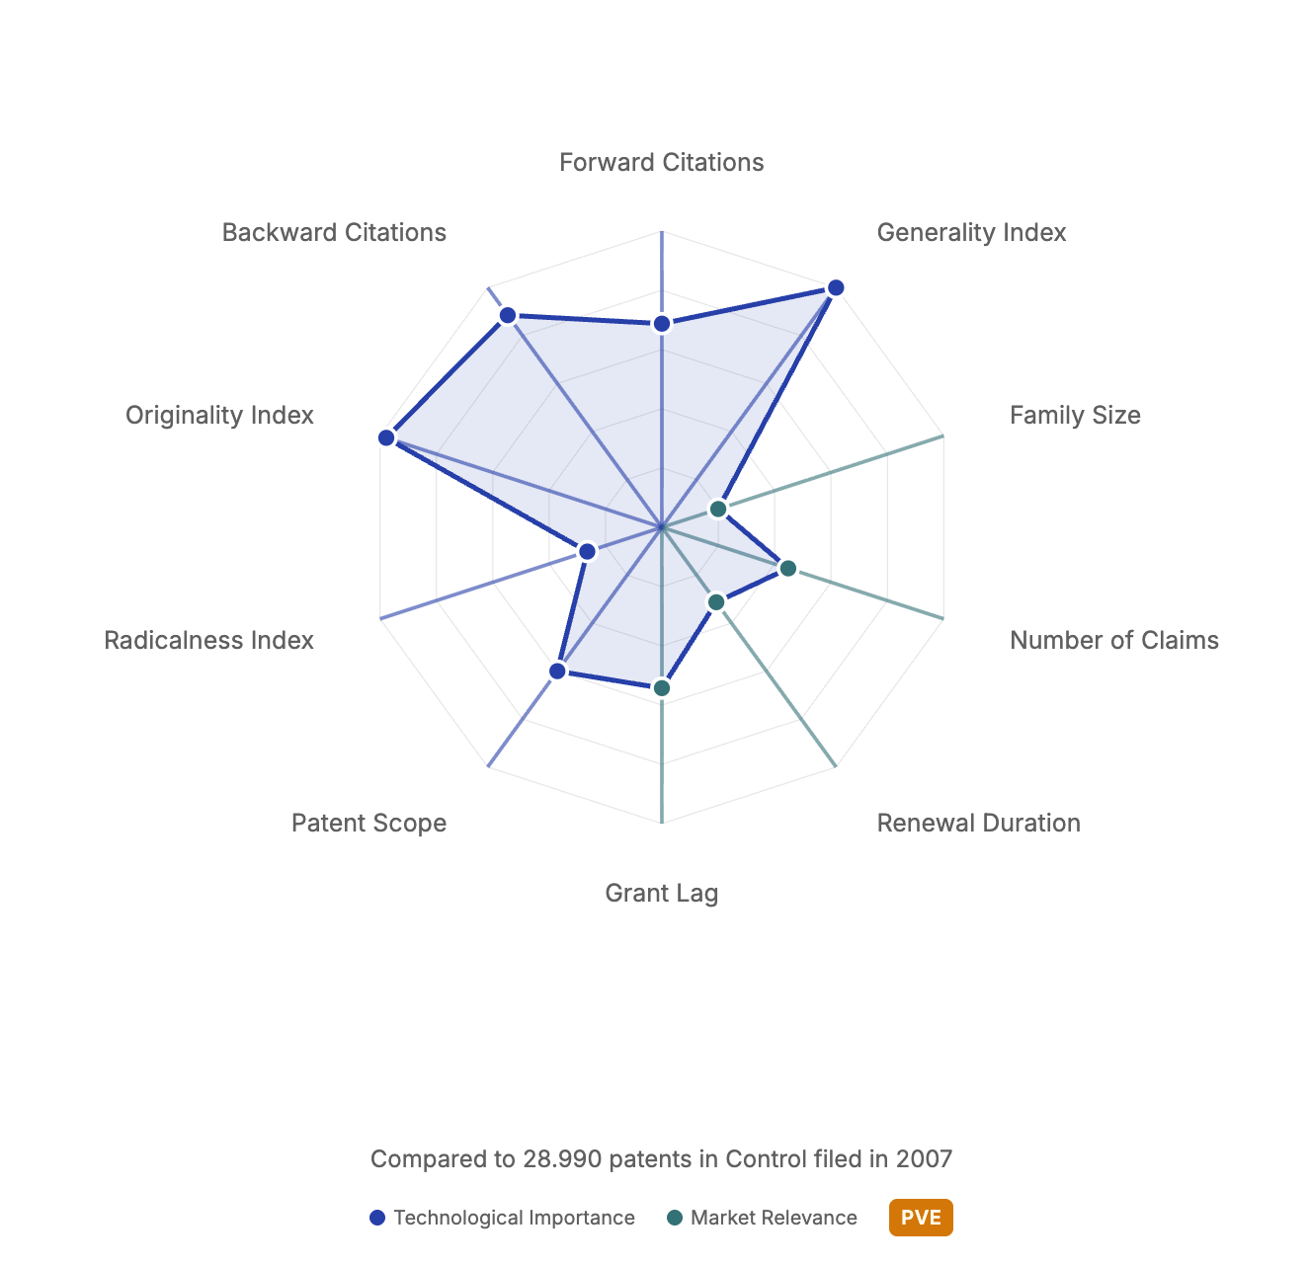
Overview
What Patent Value Explorer does
Input
A patent publication number in any common format (EP1234567, US-9,876,543, WO2020/123456, with or without kind codes).
Normalized score (0.0-1.0) for each of 10 OECD indicators
Cohort percentile and qualitative interpretation per indicator
Composite Quality Index (mean of 5 OECD components)
Radar chart grouped into Technological Importance and Market Relevance
Breakthrough or Highly-Cited badge when applicable
Optional AI narrative summary (Anthropic Claude)
Output
Patent Value Explorer
Overview
3

Slide 4
Methodological foundation
Built on the OECD Patent Quality framework
Source: Squicciarini, Dernis & Criscuolo (2013), "Measuring Patent Quality: Indicators of Technological and Economic Value", OECD Science, Technology and Industry Working Papers 2013/03.
11 / 13
10
5
OECD concepts implemented
scored indicators + Breakthrough flag
components in the composite index
Two OECD concepts are not covered: citations to non-patent literature (NPL), which requires a dataset not available in BigQuery PATSTAT, and the X/I/Y-only variant of Forward Citations, which the authors describe as essentially identical to standard forward citations.
Patent Value Explorer
Methodological foundation
4

Slide 5
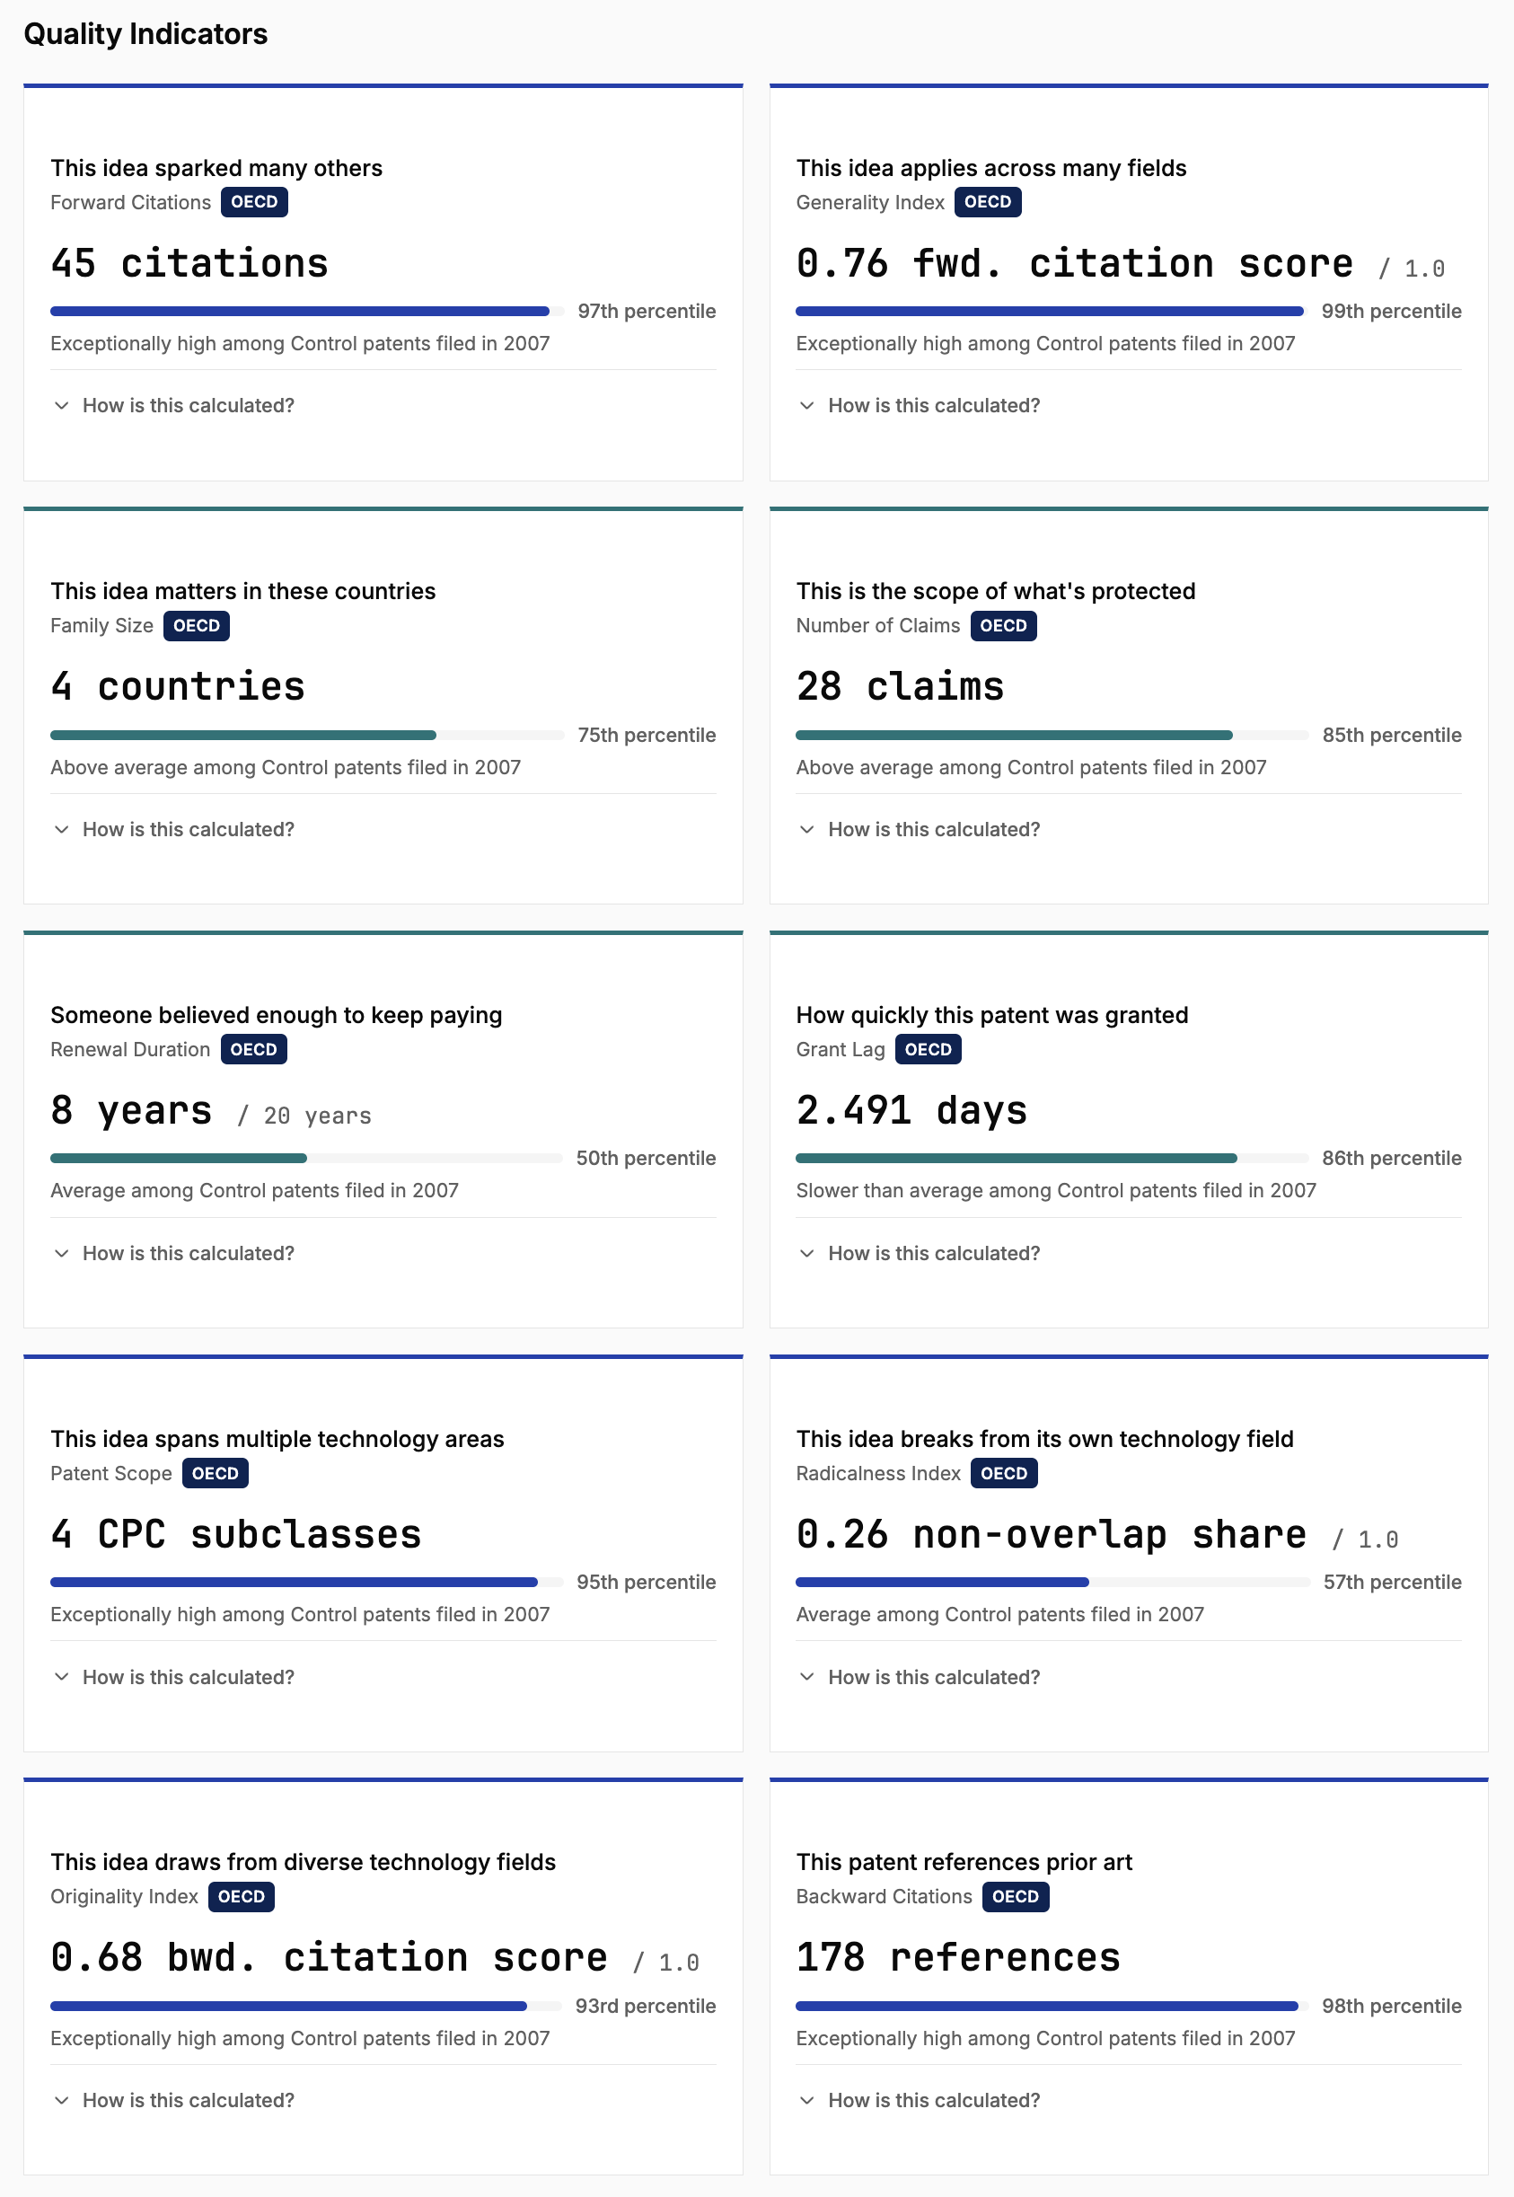
What gets measured
The ten OECD indicators
# | Indicator | Measures
1 | Forward Citations | Technological impact, how many later families cite this patent
2 | Backward Citations | Knowledge base breadth, how many prior-art references are cited
3 | Patent Scope | Technological breadth, distinct CPC subclasses on the patent
4 | Family Size | International market relevance, jurisdictions in the DOCDB family
5 | Generality Index | Cross-field applicability, diversity of citing patents' CPC sections
6 | Originality Index | Breadth of knowledge sources, diversity of cited patents' CPC sections
7 | Radicalness Index | Share of backward citations in CPC subclasses outside the focal patent
8 | Grant Lag | Examination speed, days from filing to grant
9 | Number of Claims | Scope of legal protection, number of patent claims
10 | Renewal Duration | Sustained commercial value, maximum renewal fee year paid
Plus a Breakthrough Invention flag, awarded when the forward-citation percentile reaches the top 1% of the cohort.
Patent Value Explorer
What gets measured
5

Slide 6
How scores become comparable
Cohort normalization is the core mechanism
Each indicator is normalized against the patent's primary WIPO technology field and filing-year cohort. That is what makes scores comparable across fields and across decades.
1
2
3
4
Cohort lookup
Winsorization
Linear scaling
Percentile interpolation
Retrieve the pre-computed percentile distribution (p1, p5, p25, p50, p75, p95, p99) for the (field, year, indicator) triple.
Clamp the raw value to the p1 to p99 range to suppress outliers.
Map the winsorized value to the 0.0 to 1.0 range using the cohort's p1 and p99.
Compute the patent's exact percentile inside the cohort by linear interpolation between stored breakpoints.
16,348 cohorts 35 WIPO technology fields, 47 filing years (1978 to 2024), 10 indicators. Sparse cohorts are omitted; the dataset ships as static JSON.
Patent Value Explorer
How scores become comparable
6

Slide 7
How the composite is built
The Composite Quality Index
Equal-weighted mean of five OECD composite components:
Composite = mean( Forward Citations, Family Size, Number of Claims, Originality, Radicalness )
Notes
These five components can be computed at request time without prohibitive cost.
Generality is excluded from the standard composite. It requires a ~16 GB per-patent BigQuery scan, so it is offered on-demand via a button in the UI.
Backward Citations, Patent Scope, Grant Lag, and Renewal Duration are shown as standalone indicators. Per the OECD framework, they are not part of the composite.
When a component is missing (e.g. patent not yet granted), the composite uses the remaining components and the count is shown, for example "based on 4 of 5 components."
Patent Value Explorer
Composite index
7

Slide 8
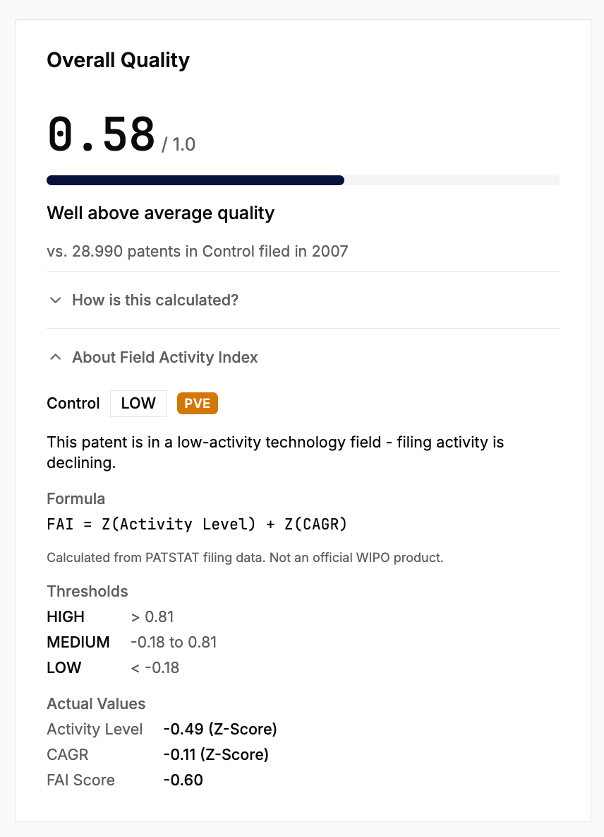
PVE-specific additions
Layered on top of the OECD baseline
Everything OECD-defined carries an OECD badge in the UI. Everything added by PVE carries a PVE badge, so the boundary between framework and interpretation stays visible.
Citation-rank title badges
Top 1% gets "Breakthrough" (amber). Top 10% gets "Highly Cited" (blue). Below the threshold, no badge; the percentile stays on the Forward Citations card.
Patent Archetype
Specialist, Generalist, Disruptor, or Incremental. Derived from the indicator profile. Used as a deterministic fallback when the AI narrative is unavailable.
Field Activity Index (FAI)
Per-field activity classification (HIGH, MEDIUM, LOW), CAGR, and a composite Z(activity) + Z(CAGR). Adapted from the WIPO Patent Momentum Indicator.
EPO dimension grouping
Indicators are visually grouped into Technological Importance and Market Relevance on the radar chart, mirroring the OECD paper's framing.
Patent Value Explorer
PVE-specific additions
8

Slide 9
How a request becomes a profile
Architecture and data flow
Patent number
3-tier lookup
9 parallel queries
Cohort normalization
Composite + display
Parsed and normalized
Reference JSON, then in-memory cache, then fresh PATSTAT
Promise.allSettled, isolated failures
Static JSON, no runtime DB
Radar, cards, optional narrative
Tier | Storage | Latency
Reference patents | Static JSON shipped with the app (14 curated patents) | < 100 ms
Patent-result cache | In-memory Map (Node process) | < 10 ms
Cohort statistics | Static JSON, 16,348 cohorts | < 50 ms
Fresh lookup | PATSTAT MCP server to BigQuery (9 parallel queries) | 10 to 25 s
Runs inside EPO TIP via a one-click Jupyter notebook launcher, or as any standard Node 20+ app.
Patent Value Explorer
Architecture
9

Slide 10
How it is built
Tech stack and code quality
Stack
Quality
SvelteKit 2 with adapter-node
Svelte 5 (Runes) for fine-grained reactivity
TypeScript 5.9, strict mode across the codebase
Tailwind CSS 4 and bits-ui (shadcn-svelte)
LayerChart 2 (D3-based) for the radar visualization
Valibot for runtime schema validation
PATSTAT access via MCP server to BigQuery
Anthropic Claude API for the optional AI narrative
231 unit tests (vitest) covering indicators, normalization, composite, formatting
JSDoc on scoring functions references the OECD section they implement
No any in scoring logic; shared types in src/lib/scoring/types.ts
Valibot validates route parameters and MCP responses at the boundary
ESLint and Prettier configured
Reproducible builds via committed package-lock.json (npm ci)
Graceful degradation: indicator failures are isolated; AI narrative is non-fatal
Patent Value Explorer
Implementation
10

Slide 11
WCAG 2.1 AA target
Accessibility
Keyboard navigation
Arrow-key cycling through radar axes. Enter to search, Escape to clear.
Screen-reader support
Semantic roles (role="search", role="application", role="meter"), ARIA labels on interactive elements, and text alternatives where applicable.
Bar-chart alternative
Tabular bar chart with role="meter" and aria-valuenow / aria-valuemin / aria-valuemax on each bar. Used on small viewports and exposed to assistive technology.
Colour contrast
EPO-dimension colour pairs (blue and teal) meet at least 3:1 against both light and dark backgrounds.
Motion safety
Tailwind motion-safe: prefix and @media (prefers-reduced-motion: reduce) suppress animations system-wide.
Patent Value Explorer
Accessibility
11

Slide 12
THANKS
Patent Value Explorer
Name | Role | Contact
Arne Krüger | Product Owner | arne.krueger@mtc.berlin
Matze Schmidbauer | Developer | matze.schmidbauer@mtc.berlin
Tom Lichtenstein | Developer | tom.lichtenstein@mtc.berlin
Repository
github.com/mtcberlin/epo-tip-patent-value-explorer
Organisation
Moving Targets Consulting, mtc.berlin

