Slide 1
IPScore, Notebook by Notebook
What Each of the Four Notebooks Does, and How They Fit Together
8_ipscore_rebuild/ · TIP4PATLIBS · PATLIB Conference 2026 · Warsaw
The goal of this deck: not just what each notebook produces, but why it exists — and exactly what it hands to the notebook after it, so the whole chain reads as one argument instead of four separate exercises.
1 · The
model
2 · Evidence
from PATSTAT
3 · Which lever
moves it?
4 · Assemble
the platform
model: EPO IPScore 3.01 · engine and course material by Arne Krüger (mtc.berlin) · scenario analysis after Riccardo Priore's NPV Target Planner
8_ipscore_rebuild/
IPScore · Notebook Logic · 1 / 11

Slide 2
BEFORE THE FOUR NOTEBOOKS
What problem is being solved?
What is IPScore actually trying to answer?
A patent is not worth anything by itself — it is worth what it lets a company earn, or stop losing, over the years it stays in force. IPScore turns that idea into a procedure: answer 40 structured questions about the patent on a 1–5 scale, and the model gives back two things — a profile of where it is strong and weak, and a single number, its Net Present Value.
Net Present Value (NPV)
Today's value of money you'll receive later. A future euro is discounted, because money in hand today is worth more than the same euro promised in five years — the model adds up ten years of future cash and converts it to one “what is this worth today” figure.
The questionnaire
40 questions in 5 sections — legal status, technology, market conditions, finance, strategy. Two people scoring the same patent are meant to reach the same numbers, because each answer option is written out, not left to gut feeling.
IPScore · Notebook Logic · 2 / 11

Slide 3
THE SHAPE OF THE MODULE
How the four notebooks are meant to be read
Two notebooks build the spine, two feed it better facts
1
2
3
4
the_model
evidence_from_patstat
valuation_and_scenarios
assemble_tool
Builds and proves the engine
Replaces guesses with facts
Ranks what to argue about
Stitches everything together
always builds report sections
contributes: a better answer set
contributes: one extra section
always builds report sections
Why this split matters
Notebook 4 always builds seven fixed report sections by itself — it never depends on 2 or 3 existing. Notebooks 2 and 3 don't add new sections to that spine; they hand over ingredients: notebook 2 hands over a better answer set (facts instead of guesses), notebook 3 hands over one extra section (which answer is worth arguing about). Skip either one and notebook 4 still produces a complete, honest report — it just says plainly what is missing.
Run order: 1 → 2 → 3 → 4
IPScore · Notebook Logic · 3 / 11

Slide 4
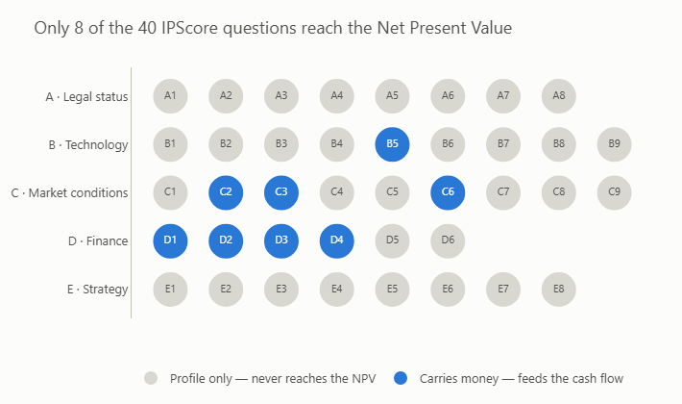
NOTEBOOK 1 · PART A
1_the_model.ipynb — runs anywhere, no TIP needed
40 questions — but only 8 of them touch the money
5 sections, 40 questions, 200 points max
A · Legal status
granted? term left? geographic reach?
B · Technology
novelty, superiority, fit with the company
C · Market conditions
is there a market, is it growing?
D · Finance
development, production, equipment cost
E · Strategy
does it serve the company's actual plan?
Only B5, C2, C3, C6 and D1–D4 (in blue, right) are “OEK” questions — each answer maps onto a real economic quantity through a fixed EPO table.
The chart notebook 1 actually draws
1_the_model.ipynb
Grey = profile only. Blue = feeds the cash flow — 8 dots out of 40.
How notebook 1 earns your trust: the acceptance test
The EPO's own workbook carries three test patents with three already-computed NPVs. Before this notebook is allowed to compute anything else, its Python engine has to reproduce all three exactly — one lands positive, one barely positive, one negative. This is what caught a real off-by-one bug once, and it is the reason every later number in this module can be trusted.
IPScore · Notebook Logic · 4 / 11

Slide 5
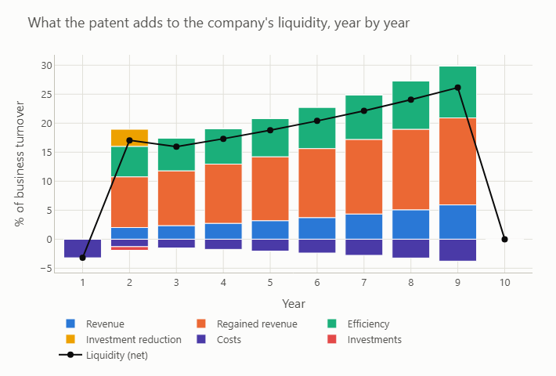
NOTEBOOK 1 · PART B
1_the_model.ipynb — how the 8 answers become one number
Two ingredients, ten years, one discounted total
Ingredient 1 — the company (7 figures)
Turnover, direct/indirect costs, depreciation and its period, share of turnover in this business area, discount rate. The 8 answers describe what the patent changes; these figures describe the company it changes it for.
Ingredient 2 — the cash flow (6 components)
+ Revenue, + regained revenue, + efficiency, + investment saved, − costs, − the one-time investment. Each year's total, discounted back to today, summed across ten years = the NPV.
The chart notebook 1 actually draws
1_the_model.ipynb
Bars above the line add liquidity, below subtract it; the black line is what remains, pre-discount.
Two things everybody gets wrong (and this notebook shows why)
1 · Entry and exit years are fractional — “2.5 years to market” means year 3 only earns half a year of revenue; treat years as whole numbers and every figure comes out too high.
2 · Investments happen once, not every year — the equipment cost lands only in the launch year. Spreading it across all ten years is the classic mistake, and it can flip a positive valuation into a negative one.
Hands off: a verified engine (ipscore_kit.py) — nothing else to hand off yet
IPScore · Notebook Logic · 5 / 11

Slide 6
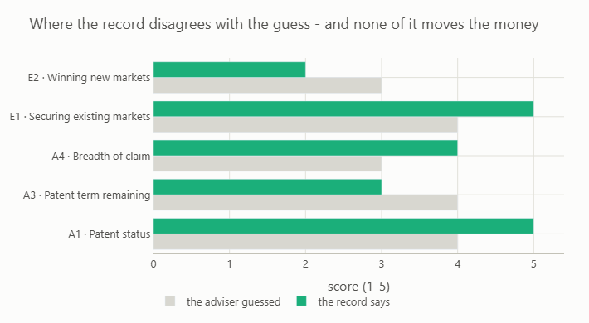
NOTEBOOK 2
2_evidence_from_patstat.ipynb — the only notebook that needs EPO TIP
What can PATSTAT actually prove — and what does it change?
11 of 40 are checkable — five answers moved
0 of those 11 carry money
None of the eleven PATSTAT-reachable questions is one of the eight that feed the NPV. Whatever this notebook finds, the euro figure computed by notebook 1 does not move — not by a cent, in either direction.
2_evidence_from_patstat.ipynb
Grey = the adviser's guess. Green = what the PATSTAT record says.
So what is notebook 2 actually for, if not the NPV?
It stops you being wrong about the record (a revoked or lapsed patent is worth nothing, whatever the market forecast says); it makes the valuation auditable — every “measured” answer carries a date and a legal-event code; and it hands over exactly one file, evidence_answers.json, which notebooks 3 and 4 pick up automatically in place of the adviser's first-pass guesses.
Hands off: evidence_answers.json (a better answer set, not a different number)
IPScore · Notebook Logic · 6 / 11

Slide 7
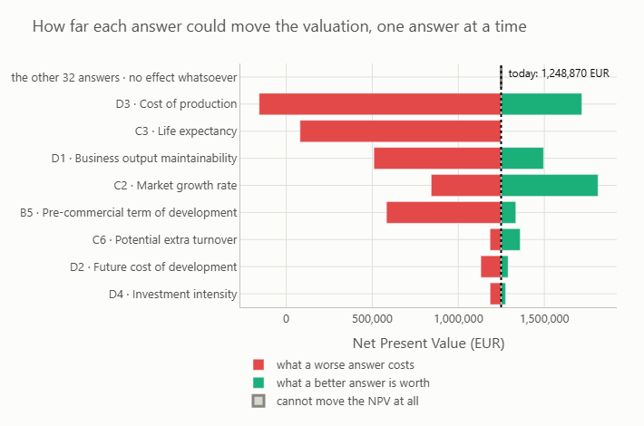
NOTEBOOK 3
3_valuation_and_scenarios.ipynb — runs anywhere, no TIP needed
Of the 8 answers that matter, which is worth arguing about?
The tornado, from notebook 3
1
Vary one lever at a time
Walk each of the 8 money-carrying questions from answer 1 to 5, everything else held still — 40 quick valuations in total.
3_valuation_and_scenarios.ipynb
2
Caveat, stated once
This is one-at-a-time. Levers interact, so widths don't add up — they rank a lever, they don't decompose the NPV.
3
Width ≠ room
A lever can be the widest bar and still offer nothing, if the current answer is already the best one on the scale.
4
The realistic version
What is one step better (or worse) actually worth? That — not the full swing — is what to put in front of a client.
Each bar: worst-answer NPV to best-answer NPV. Sorted widest first.
Reinforces notebook 2's finding: the 32 questions with no money effect show up here as bars of exactly zero width — a second, independent way of seeing the same fact.
Hands off: one report section (order 700, “which lever moves it?”)
IPScore · Notebook Logic · 7 / 11

Slide 8
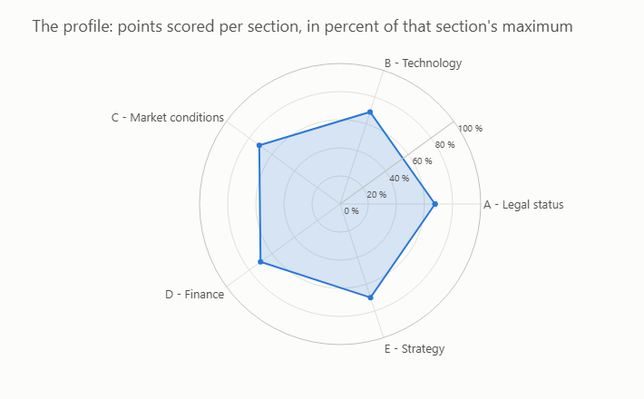
NOTEBOOK 4
4_assemble_tool.ipynb — no TIP needed, assembles whatever exists
Building the spine, then slotting in what arrived
Notebook 4 always builds seven fixed sections itself, in a fixed order — a valuation has to be read top to bottom, unlike module 6's landscape report, which could be stitched in any order.
The spine — always present
1 · The verdict — NPV, score, provenance split
2 · The patent and the company
3 · The profile — strengths and weaknesses
4 · How much of this valuation can data reach?
5 · The eight answers that carry money
6 · The ten-year cash flow
7 (900) · All forty answers, with provenance
Section 3, for real
Slotted in, if present
From notebook 2:
a better answer set — changes sections 1, 4, 7. No new section of its own
From notebook 3:
one extra section (700) — the sensitivity ranking
Missing either? Notebook 4 still runs, still complete, and says exactly what's missing (e.g. “0 measured”).
Every valuation gets one of these — this patent's shape.
Output: ipscore_valuation.html (1 self-contained page) + ipscore_valuation_data.xlsx
IPScore · Notebook Logic · 8 / 11

Slide 9
PUTTING IT ALL TOGETHER
How the files actually pass between notebooks
Everything converges in notebook 4's platform
read by every notebook — one shared source of truth
worked_example.json (the patent, 40 first-pass scores, 7 company figures) + ipscore_spec.json (the EPO's 40 questions & 8 value tables)
1 · the_model
2 · evidence_from_patstat
3 · valuation_and_scenarios
4 · assemble_tool
builds & verifies
ipscore_kit.py
writes
evidence_answers.json
writes a report
section (order 700)
reads everything
above
4_tool/ipscore_valuation.html + 4_tool/ipscore_valuation_data.xlsx
one self-contained report, one auditable workbook — opened inside TIP with open_html()
Note the one-way arrows: nothing flows backward. Notebook 3 never touches notebook 2's file; notebook 4 never edits either — it only reads.
IPScore · Notebook Logic · 9 / 11

Slide 10
WRAP-UP
The three sentences worth keeping
What this module is really demonstrating
Only 8 of 40 answers ever move the NPV.
The other 32 shape the profile, the risk map, the conversation — and change the euro figure by exactly nothing. Notebooks 1 and 3 both show this, from two angles.
The 11 questions PATSTAT can check are none of the 8 that carry money.
Notebook 2's evidence layer sharpens the picture of the patent — legal status, real geographic reach, applicant footprint — without moving the valuation by a cent.
The report always builds, and always says what it's missing.
Run only notebooks 1 and 4: a complete, honest report reading “0 measured · 40 judgement.” Add 2 and 3, and the same report gains facts and a sensitivity ranking — same shape, better evidence.
IPScore · Notebook Logic · 10 / 11

Slide 11
Thank you — questions welcome
Full chain: 8_ipscore_rebuild/ (notebooks 1–4), run order 1 → 2 → 3 → 4
The engine and its acceptance test: ipscore_kit.py (run it standalone for the test alone)
Workshop-ready original: 7_ipscore/ — stays untouched as the working reference
model: EPO IPScore 3.01 — an EPO tool; module 8 is an independent implementation
rebuilt as a TIP4PATLIBS teaching module by Arne Krüger (mtc.berlin)
scenario analysis after Riccardo Priore's NPV Target Planner
epo-tip4patlibs
IPScore · Notebook Logic · 11 / 11

