Slide 1
TIP4PATLIBS
Install an assistant. Then ask better questions.
PATLIB Workshop · Warsaw · 18 September 2026 · Arne Krüger · mtc.berlin · Riccardo Priore · AREA Science Park
You do not have to learn SQL. You have to install something that writes it — and then decide what to ask. Everything in this session is evidence for that one sentence.
THE CLAIM
THREE EXAMPLES, RISING
then, three times over
1 A question already asked
the query library
Install the assistant, persistently
it writes the SQL and the notebooks — you decide what to ask
2 The same query, as an app
PATSTAT Explorer
3 Your region, your client list
regional leads — FR and DE
Riccardo Priore adds two use cases of his own — 2 × 10 min
TIP4PATLIBS · 1 / 20

Slide 2
ARNE — THE CLAIM, THEN THE LADDER · MODULE 1
Module 1 — Install the assistant, persistently
"You have a login to a machine you do not own, which is rebuilt without warning, and which holds the largest patent database in the world. How do you get an assistant onto it that is still there on Monday?"
Why the obvious answer fails
"I will just install it." The naive install is gone by Monday — nothing was deleted, it was overwritten.
"Then I will learn SQL instead." That was the barrier for twenty years. It is the part that just stopped being hard.
"The assistant will get it wrong." Sometimes. Which is why the SQL it wrote stays on the screen, and you read it.
1_startwithtip/
TIP4PATLIBS · 2 / 20

Slide 3
ARNE — THE CLAIM, THEN THE LADDER · MODULE 1
The claim · 15 min
Install the assistant, persistently
SCREENSHOT
Claude Code running in the TIP terminal — a plain-language question, the SQL it wrote, the result
1_startwithtip/1_getting-started-with-tip.ipynb
NEEDS A TIP RUN — notebook ships with cleared outputs
1
Where your work survives
which directory persists, which is rebuilt on every start — and why nothing on screen tells you
5 min
2
Install it so it persists
notebook 1, sections 6–8: the install, the settings, the status line
7 min
3
Ask it for a query
plain language in, SQL out, result table back — and you can read every line of it
3 min
1_startwithtip/
TIP4PATLIBS · 3 / 20

Slide 4
ARNE — THE CLAIM, THEN THE LADDER · MODULE 1
Outcome
What now exists
An assistant that is still installed after the machine restarts
One query you did not write — and can read
The setup that makes it yours, not a demonstration
The one sentence to remember
The barrier was never the database. It was the SQL — and that is precisely the part you can now hand over.
1_startwithtip/
TIP4PATLIBS · 4 / 20

Slide 5
ARNE — THE CLAIM, THEN THE LADDER · MODULE 3
Module 3 — The Query Library
"A client walks in: "Who in Europe is working on solid-state batteries?""
Why the obvious answer fails
The first answer is always a keyword search. It is not wrong — it is undefendable.
Keywords miss everything phrased differently and catch everything that merely mentions the term.
Neither problem is visible in the result. You get a list, and no way to prove it is complete.
3_querylib/
TIP4PATLIBS · 5 / 20

Slide 6
ARNE — THE CLAIM, THEN THE LADDER · MODULE 3
Rung 1 · 8 min
The Query Library
SCREENSHOT
The Query Browser with a query's SQL open
3_querylib/TIP_for_PATLIBs_QueryLib.ipynb
NEEDS A TIP RUN — notebook ships with cleared outputs
1
Browse
open one query's SQL — the decisions someone made for you
3 min
2
Adapt
change country, window, field; run it; time it
3 min
3
Point and click
the same data through the interactive demo
2 min
3_querylib/
TIP4PATLIBS · 6 / 20

Slide 7
ARNE — THE CLAIM, THEN THE LADDER · MODULE 3
Outcome
What now exists
One query adapted to a question you are actually asked, with its result table
A first feel for what a PATSTAT query costs in time
The one sentence to remember
An analysis you cannot open up is one you cannot defend.
3_querylib/
TIP4PATLIBS · 7 / 20

Slide 8
ARNE — THE CLAIM, THEN THE LADDER · MODULE 4
Module 4 — PATSTAT Explorer
"A client asks how big Siemens Healthineers' patent portfolio is. You run a name search. You get 200 rows. Which one is the answer?"
Why the obvious answer fails
None of them. PATSTAT does not know companies — it knows names, as typed on each application.
One entry per spelling, per country, per subsidiary, per typo. There is no record to look up.
Take the biggest row and you have undercounted the group — as a clean, confident-looking number.
4_patstat_explorer/
TIP4PATLIBS · 8 / 20

Slide 9
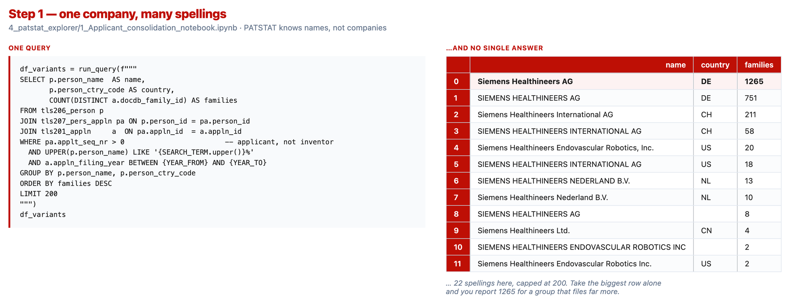
ARNE — THE CLAIM, THEN THE LADDER · MODULE 4
Rung 2 · 10 min
PATSTAT Explorer
1
Find the names
up to 200 spellings, none of them the answer
3 min
2
Decide
which belong together — the step no query can do for you
4 min
3
Count families
not applications — a number below the naive sum
3 min
4_patstat_explorer/
TIP4PATLIBS · 9 / 20

Slide 10
ARNE — THE CLAIM, THEN THE LADDER · MODULE 4
Outcome
What now exists
One consolidated applicant group — a named list of spellings you decided belong together
The group's family count, filing offices and technology profile
A written note of what your consolidation missed
The one sentence to remember
Consolidation is a judgement, not a lookup. What makes the number defensible is that you wrote the decision down.
4_patstat_explorer/
TIP4PATLIBS · 10 / 20

Slide 11
ARNE — THE CLAIM, THEN THE LADDER · MODULE 5
Module 5 — Regional Lead Generation
"Your PATLIB is asked to justify its outreach budget. Which companies in your region should you actually be talking to — and why those?"
Why the obvious answer fails
Every PATLIB has a contact list. Almost none can say how it was built.
Who walked in, who came to the last event, who somebody remembered.
The question a ranked list has to survive is not 'who is on it' but 'who is missing'.
5_lead_generation/
TIP4PATLIBS · 11 / 20

Slide 12
ARNE — THE CLAIM, THEN THE LADDER · MODULE 5
Rung 3 · 15 min
Regional Lead Generation
SCREENSHOT
The lead-tier grid and the named shortlist for Alsace
5_lead_generation/1_regional-leads.ipynb
NEEDS A TIP RUN — notebook ships with cleared outputs
1
Get the NUTS codes right
both vintages — one alone loses a third of the data
5 min
2
Two axes
portfolio depth × geographic reach
6 min
3
Segment
the grid, and the named shortlist you act on
4 min
5_lead_generation/
TIP4PATLIBS · 12 / 20

Slide 13
ARNE — THE CLAIM, THEN THE LADDER · MODULE 5
Outcome
What now exists
A named shortlist of companies in your region — family count, depth tier, reach tier, zones
The grid showing how your region distributes across the tiers
One defensible sentence about what the list does not contain
The one sentence to remember
This is the EP/PCT-active subset of your region. Roughly 70% of national families never take that route — say so under the table.
5_lead_generation/
TIP4PATLIBS · 13 / 20

Slide 14
RICCARDO — TWO USE CASES · MODULE 6
Landscape analyses after Riccardo Priore, Centro PATLIB, AREA Science Park
Module 6 — Patent Landscape Reports
"A regional cluster manager asks for a picture of what is happening in antibiotic resistance. Where do you start?"
Why the obvious answer fails
"drug resistance" is dominated by cancer — an oncology landscape wearing the wrong label.
Bare acronyms — MRSA, VRE, ESBL — are noisy and appear where the subject is not.
Neither is visible in the result: a large corpus, looking healthy, about something else.
6_patentreports/
TIP4PATLIBS · 14 / 20

Slide 15
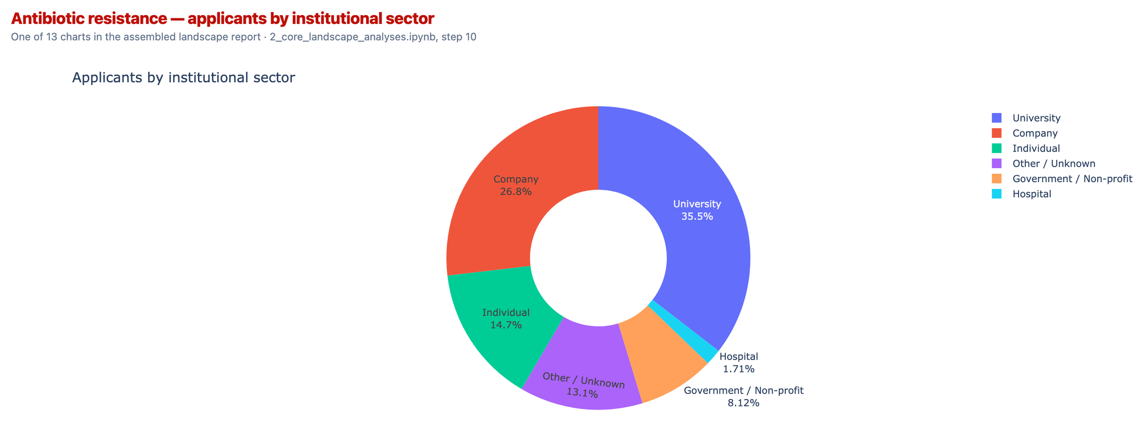
RICCARDO — TWO USE CASES · MODULE 6
Use case 1 · 10 min
Patent Landscape Reports
1
Define the corpus
keywords AND (IPC OR CPC) — recall from one half, precision from the other
3 min
2
Run the battery
13 charts: who, where, when, how it connects
4 min
3
Assemble
one self-contained HTML report + one workbook
3 min
6_patentreports/
TIP4PATLIBS · 15 / 20

Slide 16
RICCARDO — TWO USE CASES · MODULE 6
Outcome
What now exists
One self-contained HTML report, 13 charts, no internet needed
One workbook carrying the data behind every chart
A written search strategy — including its exclusions
The one sentence to remember
The analyses are generic. The corpus definition is the part that is yours, and the part you have to defend.
6_patentreports/
TIP4PATLIBS · 16 / 20

Slide 17
RICCARDO — TWO USE CASES · MODULE 8
IPScore is an EPO tool; this is the course's own implementation of the 3.01 model
Module 8 — What is this patent worth?
"A client puts a granted European patent on the table and asks what it is worth."
Why the obvious answer fails
Renewal costs, comparable licence rates, "it depends" — or that the question is unanswerable.
IPScore answers it: 40 questions, seven figures from the accounts, a ten-year discounted cash flow.
And then: all 40 answers come from a person. The engine is exact; its inputs are opinions.
8_ipscore_rebuild/
TIP4PATLIBS · 17 / 20

Slide 18
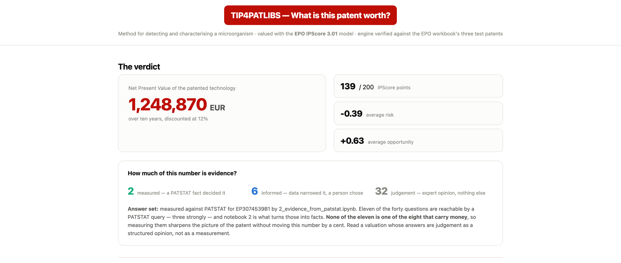
RICCARDO — TWO USE CASES · MODULE 8
Use case 2 · 10 min
What is this patent worth?
1
The model
40 questions — and only 8 of them touch the money
3 min
2
The finished report
NPV 1,248,870 EUR · 139/200 points · 2 measured, 6 informed, 32 judgement
4 min
3
The lever
widest ≠ worth pulling: C3 has an upside of exactly zero
3 min
8_ipscore_rebuild/
TIP4PATLIBS · 18 / 20

Slide 19
RICCARDO — TWO USE CASES · MODULE 8
Outcome
What now exists
A verified implementation of the EPO IPScore model, seen from the inside
One completed valuation of a real patent — NPV and profile
A statement of how much of that number is evidence
The one sentence to remember
None of the 11 questions PATSTAT can check is one of the 8 that carry money. What a database can check and what a valuation depends on barely overlap.
8_ipscore_rebuild/
TIP4PATLIBS · 19 / 20

Slide 20
What you leave with
An assistant on TIP that survives the restart — and writes the SQL you were told you had to learn
Three worked examples, in rising order of ambition: a ready question · the same query as an app · a named shortlist for your own region
Two use cases built the same way — a landscape report, and a patent valuation
And, in every one of them, the part no assistant does for you: deciding what to ask, and judging whether the answer holds
Seven A4 handouts — the full 45-minute version of every block you just saw — in 9_documentation/course/
github.com/mtcberlin/epo-tip4patlibs
Arne Krüger · mtc.berlin · Riccardo Priore · AREA Science Park
TIP4PATLIBS · 20 / 20

