Slide 1
Beginning Database and SQL
Instructors:
Anne Regel
Sharon Siegel

Slide 2
Welcome
Girl Develop It is here to provide affordable and accessible programs to learn software through mentorship and hands-on instruction.
Some "rules"
We are here for you!
Every question is important
Help each other
Have fun
Notes:
I would also like to thank Digital Workshop for Donating this great space to us. If you would like a snack, they have some for sale in the back. The coffee is free.

Slide 3
Introductions
Hi !
Go around the room and say your name and what you hope to get from the class

Slide 4
Background Information and Terms
RDBMS: relational database management system
First introduced by Oracle in the 1970’s
SQL: Structured Query Language
Special purpose language for managing data in a RDBMS
Main language to manipulate data in database platforms
SQL is an ANSI and ISO standard but there are different versions of SQL, but all versions support the major commands
Notes:
RDBMS is a common acronym for relational database management system

Slide 5
How do RDBMS work?:
“Flat” data
Notes:
This is not a relational database,
This table is pretty clear, and you can see all the information and it would be pretty fast for you to scan it and find: 1) all the songs released in 2007 or 2) all the songs that are for kids and written by KidzBob
Now imagine there are 100 songs in this table. You could use the find function and easily see all the songs released in 2015, but going through and looking at all the hip-hop songs, and then checking to see if there were written by Macklemore, would be a pain.
Now imagine there are 2 million songs in the table. At this point even using the find function for all the songs in 2007 might start to tax your computer.

Slide 6
How do RDBMS work?:
This how a relational database is organized
Artist
Id#
Name
Genre
Id#
Name
Songs
Id#
Title
Year
Artist_id
Genre_id
Notes:
Relational databases work by actually splitting up the data into individual tables. And instead of one table referencing a lot of different data, you have a lot of different tables that reference each other. For a little bit of data, this is a lot of work for nothing. But for a LOT of data, this system eliminates redundancy (you only need to type Prince once, for all the songs he’s done. And because they are related by numbers, the database system can find things very fast, and also give very detailed and complicated search results FAST.

Slide 7
A Closer Look at Tables
Table name
Songs
Id#
Title
Artist_id
Genre_id
Table ID number/ Primary Key
Column names/ fields
Foreign Keys
Notes:
You can see that each table has an ID number, that number is unique, and is called the PRIMARY KEY. That ID number is how the database program will search for that information. Just like the find function we talked about earlier, but because it’s a number not a string, the database program can find it faster, using less resources, and it can also use Math. I’m not going to talk about how a database program actually does this, first I don’t understand it completely myself, but also we don’t really need to know how it works in order to utilize it.
You might have also noticed, when you use this system you don’t need to re-enter information. In the excel table, I had to write the same album name, artist, and genre many different times, but here you can just use the number. For this beginning class, we are going to physically type in the primary and foreign keys, but know that all of that data input, and perhaps more importantly data updates is usually handled automatically by some other program. PHP is really common when you are talking about website databases, python or R can be used when you are doing “Big Data Analysis”, probably every language has the ability to interface with databases, which is why we are not going to focus on that for this class.
Title is a column in the Songs table, this is also called a Field.
Foreign keys are the ID number from other tables, this is how the DB understands how the tables relate to eachother.

Slide 8
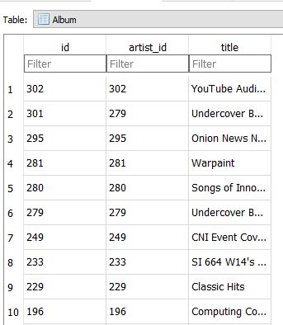
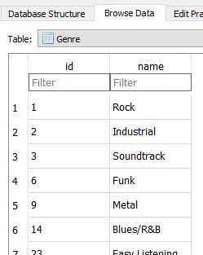
A Closer Look at the Data
Notes:
This is what the tables looks like with some data filled in.
You can see each table has a Primary Key, and at least one field/column
You can also see that the Album table has a Foreign Key that connects the Album and the Artist table.

Slide 9
Fair and Balanced
The Good
The Bad
Stable
Fast
Handles large data sets
Industry standards (SQL)
RDMS need to be planned BEFORE you put any data in
Adding tables and subtracting tables as you go is possible, but a lot of work and you run the risk of making the whole thing unstable.
Notes:
Now I think databases are awesome, and so do a lot of other people (like every big business in existence), but they are not the only game in town. Downsides: 1) you need to plan your database out first, you need to figure out all the tables and how they are going to connect BEFORE you put any data in. Adding tables and subtracting tables as you go is possible, but a lot of work and you run the risk of making the whole thing unstable. There are other downsides, and if you are interested in that you can go to this website, which gives a pretty good point by point comparison. http://dataconomy.com/sql-vs-nosql-need-know/
However, because RDBs are so popular there are industry standards. Such as everybody(Oriacle, MySQL, SQLite) all use SQL to talk to the database.

Slide 10
SQL: what does it do?
Execute queries against a database and retrieve information from a database
Create a new database and create tables in that database
Insert, update and delete records
Create stored procedures and views
Set permissions on database
Notes:
Now that you have a brief overlook of how databases work, and why you might want to use them. Let’s get into SQL. SQL stands for Structured Query Language. We are not going into the last two items, but I wanted to make you aware of them.

Slide 11
Vendors that use SQL
Microsoft SQL Server (T-SQL)
Oracle (PL-SQL)
Postgre SQL
MySQL
DB2 (IBM Product)
Sybase
Microsoft Azure

Slide 12
Why SQLite
No server
Easy to install and use
Doesn’t consume a lot of computer resources
Python compatible
Open source/free
Notes:
For this class, the big one is no server.
Also, it’s really small so no matter what condition your laptop is in you can still run SQLite
Python has a great library for it

Slide 13
Let's Develop It!
CRUD:
C: create (tables)
R: retrieve (data)
U: update (data)
D: delete
Notes:
This acronym stands for create, retrieve, update, and delete
Which are the core functions of SQL, they should be the same for any RDMS you use.

Slide 14
Time for a break
Notes:
Let’s take a 2 min break here.

Slide 15
Create table function
Generic Create Table Function
CREATE TABLE table name (
id INTEGER NOT NULL PRIMARY KEY AUTOINCREMENT UNIQUE,
column name datatype,
column name datatype
);
DataTypes
CHAR(n) | Character string. Fixed-length n
VARCHAR(128) | Character string. Variable length. Maximum length n
INTEGER | Integer numerical (no decimal). Precision 10
Notes:
Lets create three tables. This is the generic create table function. The purple color indicates information you are providing, and the black is actual SQL commands. So we are going to create three tables song, artist and genre. Remember that each table needs to have a Primary Key, so I like to always do the first column name as id.
as a side note columns are commonly called “fields” .
Anyone familiar with Java won’t be surprised that you have to tell SQL what kind of information (datatype) you are going to put into your column/field. Here is a list of common data types. These are just a few of the data types that we will be using, there are a ton more that you can find pretty easily on the internet

Slide 16
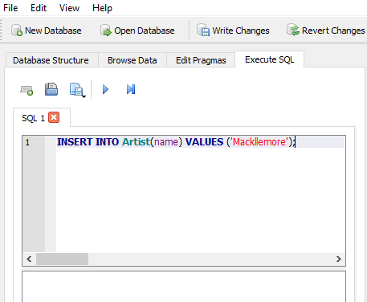
Practice Creating Tables
Song Table
Artist Table
Genre Table
CREATE TABLE song (
id INTEGER NOT NULL PRIMARY KEY AUTOINCREMENT UNIQUE,
name TEXT,
artist_id INTEGER,
genre_id INTEGER
);
CREATE TABLE artist (
id INTEGER NOT NULL PRIMARY KEY AUTOINCREMENT UNIQUE,
name TEXT
);
CREATE TABLE genre (
id INTEGER NOT NULL PRIMARY KEY AUTOINCREMENT UNIQUE,
name TEXT
);
Notes:
open SQLite browser, hit cancel if a window pops up, and navigate to the execute SQL tab. This is where we type commands.
The first window is where you type, the second is the output, and the third helps you troubleshoot.
Type in the first table commands, then hit the play button up top.

Slide 17
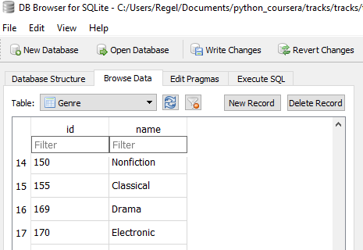
Add some data with the UX
Go to browse data tab
use drop down to change the table to Genre
click New Record (the id should fill automatically)
add a genre to the box
do about three of these

Slide 18
Add some data with SQL
INSERT INTO tablename (field1, field2)
VALUES (field1_value, field2_value);
Notes:
You can also add data using SQL. Go to Execute SQL and insert three artist names. again the id number will automatically be generated.

Slide 19
Now you try!
Add three songs
use the UX and SQL
don’t forget to add the Foreign Keys
Generic:
INSERT INTO tablename(field1, field2) VALUES (field1_value, field2_value);
Example:
INSERT INTO song(name, artist_id, genre_id) VALUES (‘Hold On’, 3, 12);
Notes:
I’m leaving the generic command to help.
This is just an example of what that command might look like.

Slide 20
Update
Generic Update Function
UPDATE tablename SET fieldname = new value WHERE condition
Example
UPDATE artist SET name = ‘Formally Known as Prince’ WHERE id = 10
You try!
Notes:
This is exactly what it sounds like, updating values that already exist in the table.
In the example I am updating the artist name to “Formally Known as Prince” everywhere the primary key = 10

Slide 21
Generic function:
UPDATE tablename SET fieldname = new value WHERE condition
Operators that can be used with WHERE
= | Equal
<> | Not equal. Note: In some versions of SQL, this may be written as !=
> | Greater than
< | Less than
>= | Greater than or equal
<= | Less than or equal
BETWEEN | Between an inclusive range
LIKE | Search for a pattern (can use a wildcard character)
IN | To specify multiple possible values for a column

Slide 22
Delete
Generic Delete Function
DELETE FROM tablename WHERE condition
Example
DELETE FROM song WHERE name = ‘Yani’
You Try It!
Notes:
So lets say there was a mistake in one of the entries. This is how we delete.
In the example I am deleting information from the table song everywhere the name of the song is “Yani”

Slide 23
DELETE FROM tablename WHERE condition
Operators that can be used with WHERE
= | Equal
<> | Not equal. Note: In some versions of SQL, this may be written as !=
> | Greater than
< | Less than
>= | Greater than or equal
<= | Less than or equal
BETWEEN | Between an inclusive range
LIKE | Search for a pattern (can use a wildcard character)
IN | To specify multiple possible values for a column

Slide 24
Retrieve (Querying)
Generic Select Functions
SELECT fieldname FROM tablename
SELECT * FROM tablename
SELECT fieldname FROM tablename WHERE condition
SELECT * FROM tablename ORDER BY field
Example
SELECT name FROM song WHERE …
Conditions
artist_id = 1
genre_id > 1
You Try It!
Notes:
Now that we have some data in our database, let’s do some querying. Again, in the execute SQL tab type these commands

Slide 25
Join
Brings information from two tables together
Generic Join function
SELECT table1.field, table2.field FROM table1 JOIN table2 ON table1.foreignkey = table2.primary key
SELECT song.name, genre.name FROM song JOIN genre ON song.genre_id = genre.id
You Try It
***There are different JOIN functions depending on the program you are using
Notes:
The Join function isn’t part of CRUD, but it is how you query multiple tables, which in my opinion is the whole point of RDMS.
When you were doing select statements, I’m sure you noticed that you ended up with columns with numbers. This will join the tables, and replace the numbers with the information.
The order of the tables doesn’t matter, but as a beginner I would just always keep the order the same. I makes it easier.

Slide 26
Generic Join Function:
SELECT table1.field, table2.field FROM table1 JOIN table2 ON table1.foreignkey = table2.primary key
Example:
SELECT song.name, genre.name FROM song JOIN genre ON song.genre_id = genre.id
Advanced:
SELECT table1.field, table2.field FROM table1 JOIN table2 ON table1.foreignkey = table2.primary key WHERE condition

Slide 27
Time for a break
Notes:
Let’s take a 10 min break here.

Slide 28
Creating a Practice Client Database
Planning
Determining the tables, and how they will be created.
Create the tables
Add information
Update information
Query information
Notes:
The first step, and arguably the most important step, in creating a database is planning.

Slide 29
Planning
On the white board
Notes:
I’m going to do this on the white board, because there is no right answer, and ultimately what information you want to manage depends on what you are going to be using it for. I’ve prepared slides on what I think it should look like, but feel free to personalize at this point.
For my example I am going to say that I am a business that offers 2 services. Service A and Service B.
And I have clients that are part of larger companies.
Before we start, a good indicator if something should be it’s own table is if we have to repeat that information. A well designed database should not have any redundancy.
Since this is a client information database, let’s start with Client information table.
Automatically, I add the Primary Key id.
* this doesn’t have to be called id, there are quite a few “best practices scheme” and ultimately you just want to be consistent

Slide 30
Create Example Tables
Client_info
Company_info
Service_A
Service_B
id
Name
Phone #
Job title
company_id
serviceA_id
service_id
id
Name
Phone #
address
id
Cost
id
Cost
Create
CREATE TABLE <table name> (
id INTEGER NOT NULL PRIMARY KEY AUTOINCREMENT UNIQUE,
<column name> datatype,
<column name> datatype
);
Notes:
So using what we learned earlier create these four tables

Slide 31
Insert Information into the tables
Use the UX and SQL
INSERT INTO tablename(field1, field2) VALUES (field1_value, field2_value);
Notes:
This is just to practice the different ways of getting information into the database, I suggest doing the Client information last, because you need to know the Foreign Keys. The command stays, so you can also only change the name. You really only need a few rows for company and client information.

Slide 32
Query the Data
Try selecting whole tables
Selecting just the names in a few tables
Try the join function
Find all the company names that used serviceA
Find the client names that used serviceB

Slide 33
Generic Select Functions:
SELECT fieldname FROM tablename
SELECT * FROM tablename
SELECT fieldname FROM tablename WHERE condition
Generic Join Function:
SELECT table1.field, table2.field FROM table1 JOIN table2 ON table1.foreignkey = table2.primary key

Slide 34
Last Things
Thank you Digital Workshop for providing the space
Thank you Sharon for being a TA!
Thank YOU!
*also, these slides will be posted on my GitHub next week

