Slide 1

Python for Beginners | @gdifortcollins

Slide 2
Welcome
Girl Develop It is here to provide affordable and accessible programs to learn software through mentorship and hands-on instruction.
Some "rules"
We are here for you!
Every question is important
Help each other
Have fun

Slide 3
Introductions
My name is Anne Regel
I have been using python for data science
I still LOVE it!
Christine Stone
Our wonderful TA

Slide 4
Mountains we will climb
Command line
Writing code in IDEL and text editors
Code that won’t run
Code not working
Not getting it right away
Notes:
I also have a mountain to climb, and that is going at the right pace. If you need more time on a slide or want to go faster PLEASE don’t hesitate to say something. I’m here to make sure each of you leaves with the confidence and tools to start programming in python

Slide 5
What we will cover today
Why Python?
The Basics in Python
Core functionality
Writing Scripts

Slide 6
Why Python?
Suitable for beginners, but powerful enough for professional applications
Readable, maintainable code
Rapid rate of development
Open source

Slide 7
What is Python used for?
System Administration (Fabric, Salt, Ansible)
3D animation and image edition (Maya, Blender, Gimp)
Science! (numpy, scipy, pandas)
Web development (Django, Flask)
Notes:
The things in the parenthesis are packages (python calls them modules) that anyone can use, that have been developed for specific purposes.

Slide 8
Who is using Python?
Disney
Dropbox
Canonical and Red Hat
Google
NASA

Slide 9
The Basics
Command line, text editors and IDE (integrated development environment)
Arithmetic and variables
Data types

Slide 10
Command line, Text Editors, IDLE
Terminal: A program that has a command line interface and issues commands to the operating system
*Apple calls it a terminal, windows calls it the Command Prompt
Text Editor: A program that opens text files and allows the user to edit and save them as a python file
IDLE: Python’s Integrated Development and Learning Environment
cross-platform (should work the same for windows and mac users)
colorized input, output, and error messages
debugger (find and fix problem’s easier)

Slide 11
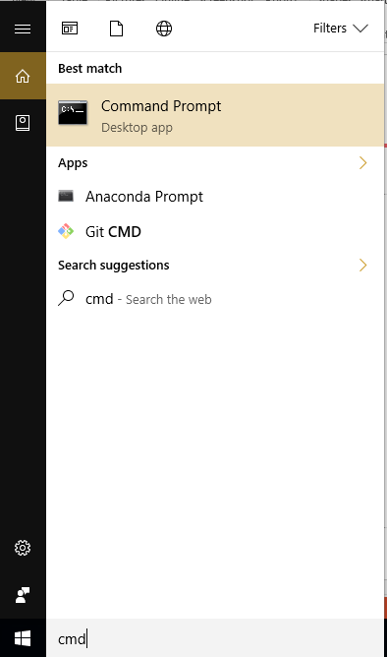
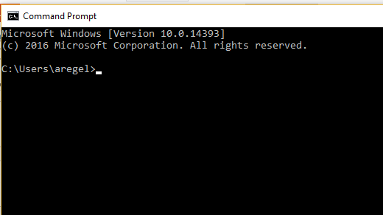
Let’s try using the command line
Using the command line:
search cmd on windows
(mac, it’s just your terminal)
Find out your python version
type
python -V
Notes:
Your command prompt (or terminal) should look something like this.

Slide 12
Arithmetic
Python has different TYPES of numbers
int (signed integers): They are often called just integers or ints, are positive or
negative whole numbers with no decimal point.
float (floating point real values) : Also called floats, they represent real numbers and are
written with a decimal point dividing the integer and fractional parts. Floats may also be
in scientific notation, with E or e indicating the power of 10 (2.5e2 = 2.5 x 102 = 250).
complex (complex numbers) : are of the form a + bJ, where a and b are floats and J
represents an imaginary number. The real part of the number is a, and the imaginary
part is b
** The standard library also includes Decimal module (a subset of float) and Fraction module (a subset of int) types.

Slide 13
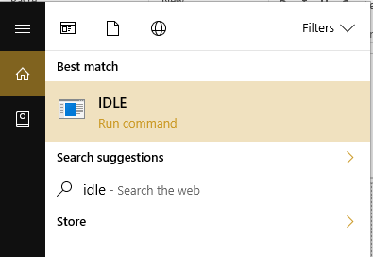
Let’s try using IDLE
Open IDLE
On a mac: go to your search in the top right and look for IDLE, it should be the first one on the list
On windows: go to you search on the bottom left and type IDLE
Notes:
Click on IDLE and wait, there might be a black screen for a minute, but then a

Slide 14
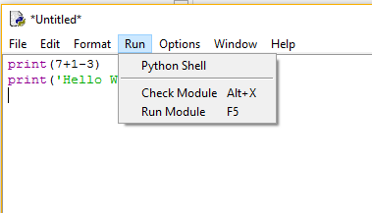
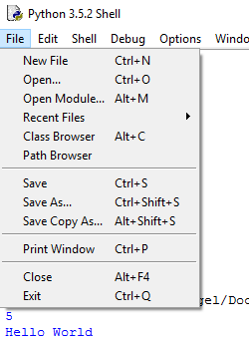
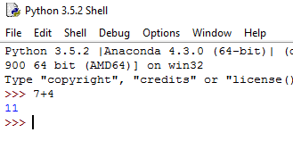
Notes:
You should get a window that looks something like this. This is the shell, you can execute lines of codes right away. You can see that across the top bar there are a few tools that will help you when you are writing programs. Go ahead and type 3+4 and hit enter, you should get the answer right away.
You can also create a file and execute multiple lines of code. Open an new file, save the file, then you can ‘Run Module’ , If you use Check Module , it will tell you if there is a syntax error. If there isn’t, then nothing will happen.

Slide 15
Arithmetic
Try one equation, but with different data types
Ints: ½
Floats: 1.0/2.0
Now try a mix: 1.0/2 or 1/2.0
Try some math on your own!
* Python follows the standard the order of operations: parenthesis, exponents, multiplication, division, addition then subtraction
Notes:
Go ahead and type ½ into IDLE and hit enter. It should immediately give you the answer. You can see that you get the same answers. You can also see that I didn’t have to explicitly tell python that I wanted to turn an integer type into a floating point type. You can see that when you mix data types, python also makes assumptions . Go ahead and try out some other equations. Just remember

Slide 16
Casting data types
Cast: forcing python to use the data type you want
int(2.7) = 2
Numbers cast with integer just snips off the decimal, it doesn’t round
float(1.5) = 1.5
float(1.500) = 1.5
In some cases those zeros might be important, this is where you might want to use the Decimal or Fraction data types
float(1.5)/int(2.7) = 0.75
If you do math with mixed types, python will still need to make assumptions about what type the outcome should be
Notes:
Sometimes you might not want python to be making assumptions, so you can explicitly tell python what data type you want to use.

Slide 17
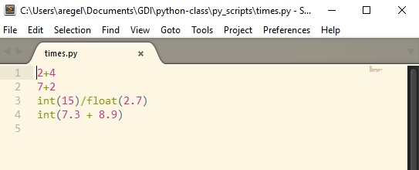
Let’s try it using a Text editor
Open your text editor and type some of the same commands
Save the file as
times.py
Save the file to
your desktop
Notes:
Notice that each operation gets it’s own line. Python is unique in the fact that it doesn’t use {} or ; to group commands. It uses new lines and spaces. I’ll go into more detail as we go on. This makes python easy to read, because everyone MUST use best practices, but if you are experienced in a different language, like java, it might be a frustration for you.
So now we have a python file with some python in it. How do we get the computer to run it?

Slide 18
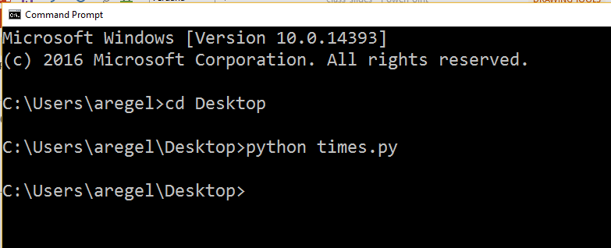
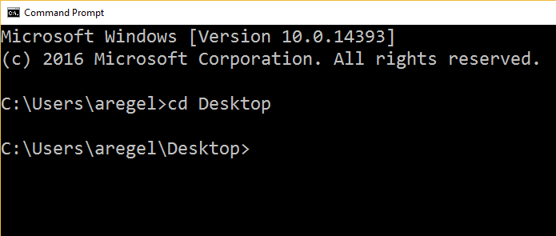
Running a python script
Open your command prompt (terminal)
Navigate to the folder (directory) your python file is in
use the change directory command, cd
Tell the computer to
use python to run the
file
cd Desktop
python times.py
Notes:
First we are going to open the command prompt (terminal for Mac users) and navigate to the folder (directory for mac) we saved our file in. To do this we will use the change directory command, cd . So in command line, type cd Desktop, you can see in the prompt that you are now in the Desktop folder.
So you ran the file, and nothing changed. The script did run, the computer did that math, but we didn’t tell it to show us the results. So let’s go back and change the py file.

Slide 19
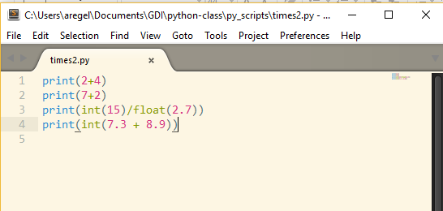
Notes:
Again, notice the way python understands that when to implement the casted data type

Slide 20
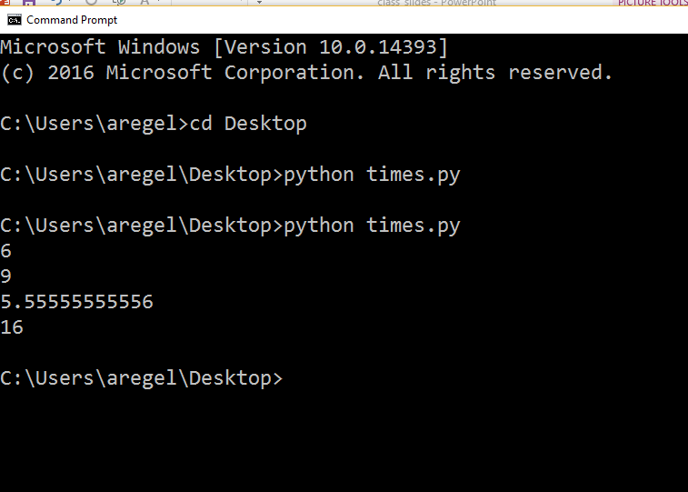

Slide 21
Now You Try!
Partner up
One try IDEL
One try Text Editor
Switch roles
Try: Long expressions with decimals,
different data types,
casting data types on a whole expression, not just individual numbers

Slide 22
Short Break (5 min)

Slide 23
Variables
Variables : reserved memory locations to store values
Assign a value to a variable using the equal sign (=)
x = 7
y = 7.000
Variables can have any data type as a value
Notes:
For these examples it is just as easy to type the information directly as it is to make a variable, but when we get to functions, you are going to want to use variables!

Slide 24
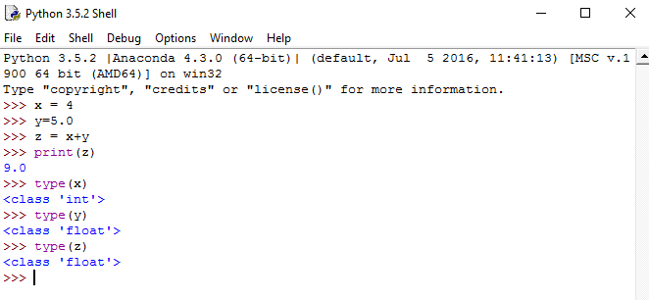
Now You Try!
Using IDEL assign some variables
x = 4.0
y = 5
z = x+y
*remember if you want to see the results use the print() method
Checking data type
Use the method type() to determine the data type of a variable
type(x)
type(y)
type(z)
Notes:
So you can see that I’ve created a few variables. Using the print method, I can print the value of the variable, using the type method I can see what data type the variable holds

Slide 25
Basic Data Types
Numbers: int, float and complex
examples: 7, 7.0, 7j
String: A string in Python is a sequence of characters. Strings are immutable
examples: “hi” , ‘bye’ , “‘Aloha’’’
Tuple: Holds python objects, and is immutable
examples: (7, “hello”, [list], {dictionary})
List: Holds python objects in order and mutable
example: [‘xyz’, 7, 4000.00, [‘a’, ‘a’], (7,8), ‘JK’]
Dictionary: Holds key,value pairs, mutable and has no order
example {key1:value1, key2:value2}
Notes:
A string in Python is a sequence of charaters. Strings are immutable. This means that once defined, they cannot be changed. You can see that I put quotes around the characters. That is how you tell python that the charater’s are strings, and not variables. Python recognizes single, double, and triple quotes as strings.
A tuple, holds 2 or more things, in a specific order, and once a tuple is created there isn’t anyway to add or subtract from it, however you can put mutable things into it.
List: a list can hold any python object, strings, numbers, tuples, other lists. A list has order, and is mutable. So there are methods to modify a list once it’s been created.
Dictionary: very similar to a list, but instead of holding single objects, it holds pairs of objects. So if you know the key, then you can access the value. However, it doesn’t have any order, so if you print an entire dictionary, then key2:value2 might be printed before key1:value1
Don’t worry if you don’t understand, we are going to use each one, so you can get a feel for how they are used,

Slide 26
Strings
Strings: are a data type just like int and float
Strings contain immutable characters
You can add strings together (concatenate)
‘Hello’ + “world” returns: Helloworld
‘7.2’ + ‘6’ returns: 7.26
You can access individual characters in a variable using an index
X = “Hello”
X[0] returns: H
X[0:3] returns: Hel
Slice
[start, up to(but not including)]

Slide 27
Indexing ordered objects
Python index always starts at 0:
index
0 1 2 3 4
H E L L O
index
0 1 2
(‘Hello’, 7.2, ’15’ )
string
tuple
index
0 1 2 3 4
[‘Hello’, 7.2, ’15’, ‘7’, ‘love’ ]
list
Notes:
There are a couple things I would like to point out here. The first is that each character in a string corresponds to an index number, and that numbering starts with 0
Second: that each object in a list or tuple is considered ONE object, no matter what type of data the object is and the objects are separated with a comma.
Third: The numbers that are in quote marks, and actually a string datatype, not a number
Fourth(and last): is that dictionaries are not on this slide, that is because they are not ordered, so they are not indexed like these other data types.

Slide 28
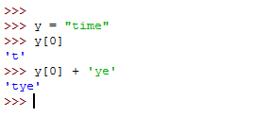
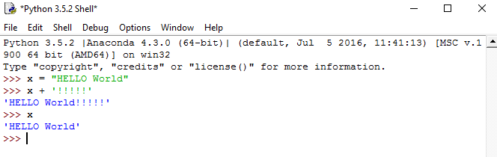

Let’s try it!

Slide 29
Now You Try!
Partner up
Use your Text Editor
Try:
Concatenating strings
Concatenating variables
Indexing variables (that hold strings)
Different quote styles
Concatenating slices of strings

Slide 30
Tuples and Lists
Tuples
(object, object, …..)
Must have at least 2 objects
Concatenate tuples
Index tuples
Slice tuples
Lists
[ object, object, …] OR []
Mutable
Concatenate lists
Methods to: Append, Modify objects in a list, and Remove objects from list
Modify slices of lists

Slide 31
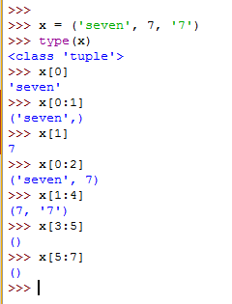
Let’s try Tuples

Slide 32
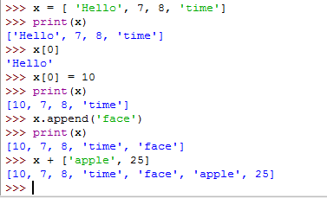
Let’s try Lists

Slide 33
Now You Try!
Partner up
Use your Text Editor
Try:
Concatenating lists
Concatenating tuples
Append a list ( list_name.append() )
Change the values in a list
Slice a list
Slice a tuple

Slide 34
Dictionary
dictionary = {key1: value1, ...} OR dictionary= {} OR
dict([(key,value), …])
Each key must be unique and hashable (stick with strings or numbers)
Values can be any data type
Mutable
Add new key value pairs
Change values
Change keys
Unordered
No numbered index
No slices

Slide 35

Let’s make some Dictionaries!
Using the dictionary method: dict()
Creating a dictionary explicitly

Slide 36


Dictionary Methods
Adding key,value pairs
Modifying a key’s value

Slide 37

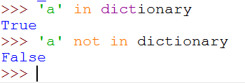
More Methods
Create a list of all the keys using .keys() method
Determining if a key is in a dictionary using in

Slide 38
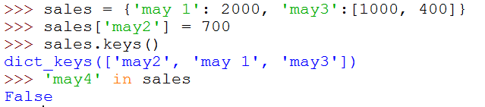
Let’s try Dictionaries
Notes:
Dictionaries might and lists are really powerful when using loops

Slide 39
Now You Try!
Partner up
Use your Text Editor
Try:
Make some dictionaries
Add key,value pairs
Modify values
Find all the keys
Determine if a key is in your dictionary

Slide 40
Break Time (15 min)

Slide 41
The Core Functionality
Boolean Expression
Conditionals
Loops
Functions

Slide 42
Boolean Operators
Boolean logic is a form of algebra in which all values are reduced to either TRUE or FALSE
Operators: or, and, not
Operation Result
x or y if x is false, then y, else x
x and y if x is false, then x, else y
not x if x is false, then True, else False

Slide 43
Boolean Comparisons
Operation Meaning
< strictly less than
<= less than or equal
> strictly greater than
>= greater than or equal
== equal
!= not equal
is object identity
is not negated object identity
* 7< x < 10 is evaluated as (7 < x) and (x < 10)

Slide 44
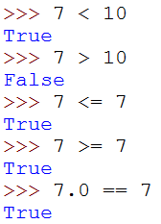
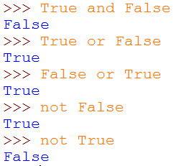
Boolean Examples

Slide 45
You try it!
Partner up
Use your Text Editor
Try:
statements with or, and, not
try some Boolean comparisons
try comparisons with operations
e.g. 7 >10 and 6<3
10<15 != 12

Slide 46
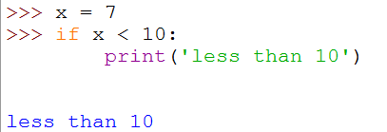
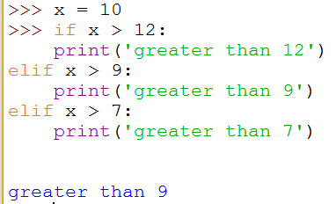
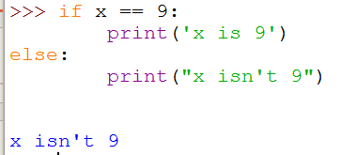
Conditionals (if else statements)
If/else statements
if (some condition) true:
#execute code block
if (some condition) true:
#execute code block
else (all other cases):
#execute code block
if (some condition) true:
#execute code block
elif (some condition) true:
# execute code block

Slide 47
You try it!
Partner up
Use your Text Editor
Try:
if statements
if/else statements with and
if/elif statments with or

Slide 48
Loops
There are two kinds of loops in python
for loop, will continue for every item in a series
for iterable_var in series:
#code performed for each iterable_var
while loop: will continue if the condition is true
while condition is true:
#code is performed until the condition is no longer true

Slide 49
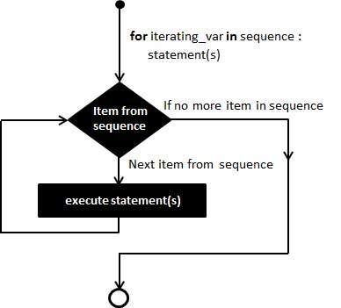
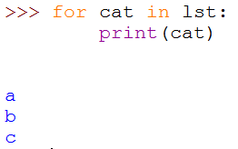
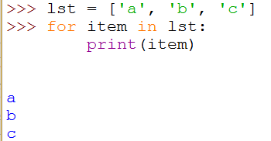
for Loops
start
Notes:
It is a little easier to see in a pictures.

Slide 50
You try it!
Partner up
Use your Text Editor
Try:
make a list and print it out using a for loop
try combining a for loop and an if statement
e.g. if the item in the list is 7, print(“woot, 7!!!!”)
Make a dictionary and loop through it

Slide 51
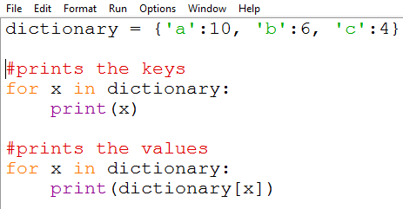
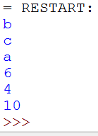
for loops and dictionaries

Slide 52
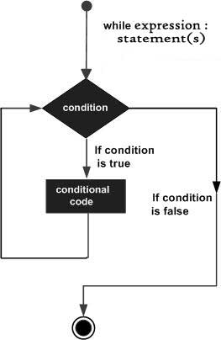
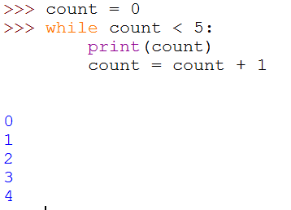
while loops
Notes:
While loops are not used as often, because there is a risk of infinite looping. Which will crash the program.

Slide 53
You try it!
Partner up
Use your Text Editor
Try:
making a while loop that counts down from 10 to 1

Slide 54
Loops, lists and dictionaries
add specific items to a list
create a count for all the different words in a book
Notes:
When you put loops and list/dictionaries together, this can become very powerful.

Slide 55
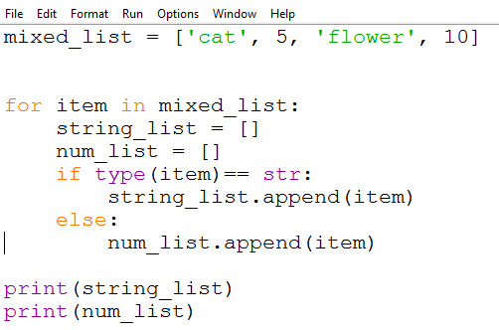
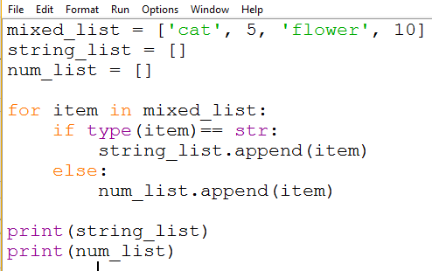


examples
Notes:
When you put loops and list/dictionaries together, this can become very powerful.

Slide 56
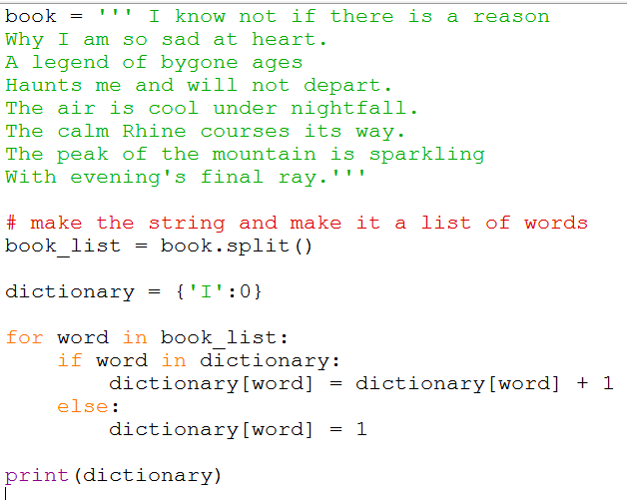
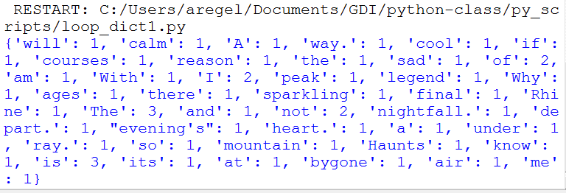
examples
Notes:
When you put loops and list/dictionaries together, this can become very powerful.

Slide 57
You try it!
Partner up
Use your Text Editor
Try:
Make a dictionary that has lists as values
Loop through the dictionary and add an item to each list

Slide 58
Short Break (5 min)
Functions are next!!!!!

Slide 59
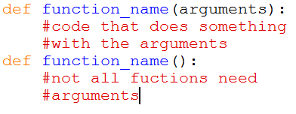

Functions
A way to execute code without re-writing it
Syntax
Call a function

Slide 60
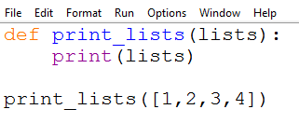



Function examples

Slide 61
Practice Functions
Using your text editor make the following functions
def addition(x,y):
answer = x + y
return answer
def subtraction(x,y):
answer = x – y
return answer

Slide 62
You Try It!
Partner UP!
write a function that concatenates two strings
write a function that prints all the objects in a list
write a function that prints the keys and values in a dictionary
for key, value in dictionary.items():
print(key)
print(value)

Slide 63
More Methods
len(x)
Counts the number of things in x (strings, lists and dictionaries all have a len() method)
‘string’.split()
Takes a string of words an makes it a list of words
Creates a new item every time there is whitespace
‘string’.split(‘,’)
Takes a string and makes a new item every time there is a comma

Slide 64
Lets Try It!
Using IDLE shell
Make a variable containing a sentence.
Use len() to find how many characters there are
Use var.split()
Try variations of var.split()
Use len() to see how many items are in your new lists

Slide 65

More methods
range(start,stop,step)
makes a range of numbers
list comprehensions
combines a for loop and a list together
generic syntax:
list_comprehension = [ x for x in iterable]

Slide 66
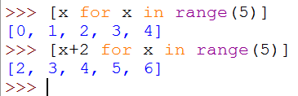

List comprehension examples

Slide 67
You Try It!
Using IDLE
partner up
Try
make a list of numbers
make a list of all the even numbers in a range 1-10

Slide 68
Whew! It’s over ☺
Now go forth and python!
You can get all these slides on my github account, user name: mtchem

