Slide 1
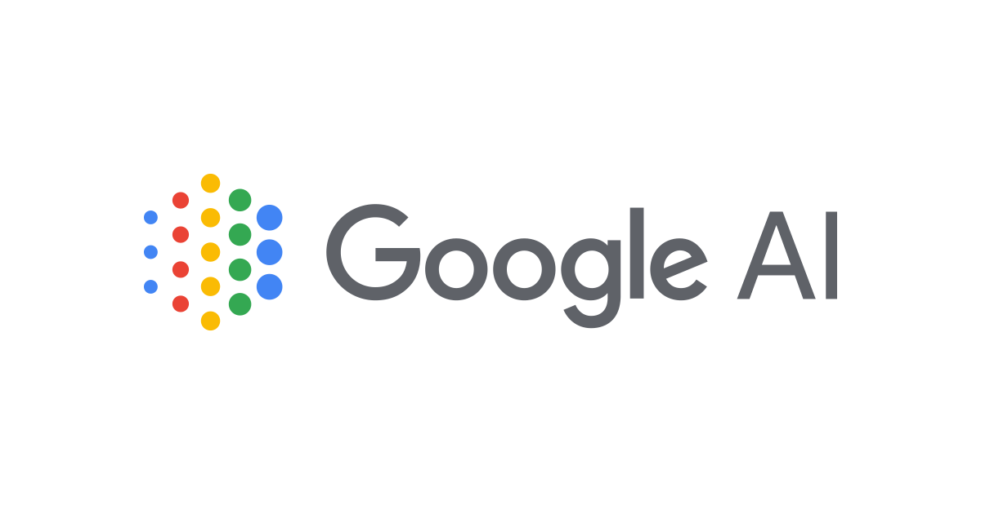
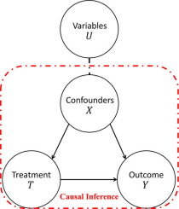


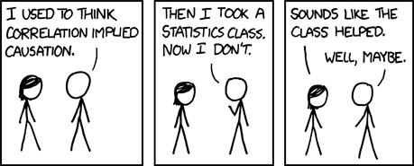
TaBERT & TAPAS
Causal Inference

Slide 2

TaBERT & TAPAS: Semantic Parsing of Tables
How to Query Tables Using Natural Language without knowing the schema ahead of time?
Maxime TCHIBOZO
July 2020 – Analytics Lab

Slide 3
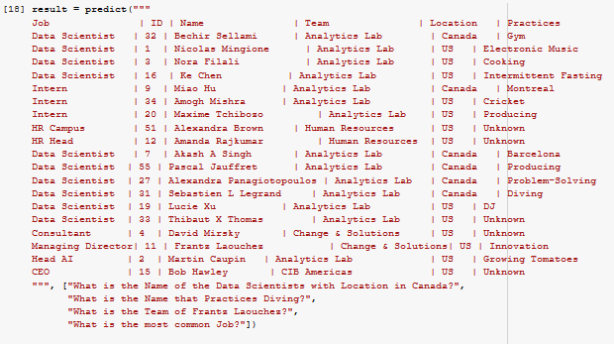
TaBERT/TAPAS: Why it should matter to you
They use pretrained/fined-tuned language models and can answer the question:
“What is the name of the intern who enjoys cricket?”
When given the following table, without knowing the schema.

Slide 4
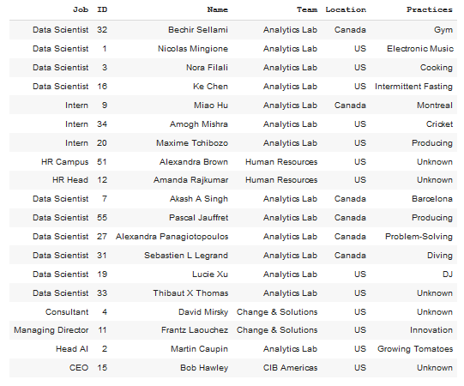
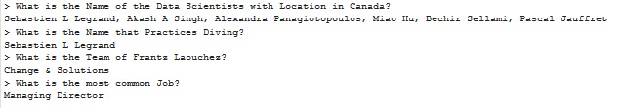
TAPAS: What do you see? Anything strange?

Slide 5
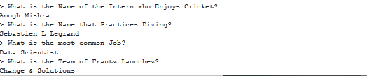
TAPAS: What do you see? Anything strange?

Slide 6
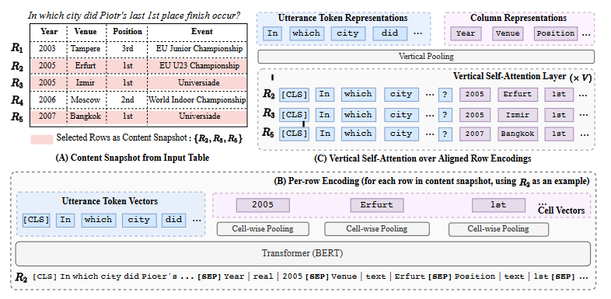
TaBERT and TAPAS use the same idea: BERT
BERT works on a text embedding (= sequence of text tokens)
TABERT and Tapas convert the Table+Uttering in embeddings that are compatible with a Transformer-based BERT model.
Embedding:
Embedding of each row + utterance (=query)
Embedding of each column (vertical self-attention)
Concatenation of row, utterance, column and cell vector embedding
Inference:
- Masked Language model
2)
1)
3)

Slide 7
Key Differences
 | TaBERT (Facebook) | TAPAS (Google)
Pre-Training | 26 million structured tables (private) | 6.2 million semi-structured Wikipedia tables
Can Handle Large Tables? | Yes, initial table snapshot before embedding | No, only works with tables of at most 500 cells
Table+Utterance Embedding | Rows,Utterance, Columns, Cell | Same as TaBERT + Query rank token
Can Handle Aggregate Queries? | No | SUM,COUNT,AVERAGE

Slide 8
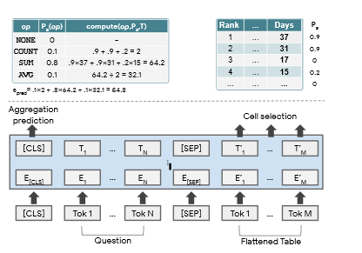
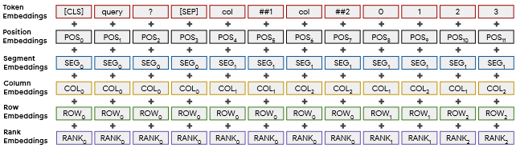
Key Differences
 | TaBERT (Facebook) | TAPAS (Google)
Pre-Training | 26 million structured tables (private) | 6.2 million semi-structured Wikipedia tables
Can Handle Large Tables? | Yes, initial table snapshot before embedding | No, only works with tables of at most 500 cells
Table+Utterance Embedding | Rows,Utterance, Columns, Cell | Same as TaBERT + Query rank token
Can Handle Aggregate Queries? | No | SUM,COUNT,AVERAGE
Tapas Aggregation Layers
TAPAS embedding (includes query rank)

Slide 9
Claimed Results vs. Reality
WikiTableQuestions | SPIDER
Wang, et al., 2019 (previous SOTA): 44.5 | RyanSQL+BERT (Choi et al., 2020) 66.6
TAPAS (April 2020): 48.8 | NA
TaBERT (May 2020): 52.3 | TABERTLarge(K=3) 62.5
Weakly Supervised Semantic Parsing (= query-to-answer)
Both TAPAS & TaBERT reached SOTA on WikiTableQuestions dataset.
Supervised Semantic Parsing (= Text-to-SQL)
“TaBERT is competitive” on the SPIDER dataset.
On Tapas: “They report top performance in semantic parsing datasets because themajority of examples in these are limited to one (small) relation and simple operations”

Slide 10
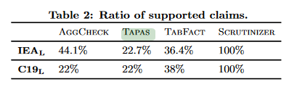
Claimed Results vs. Reality
WikiTableQuestions | SPIDER
Wang, et al., 2019 (previous SOTA): 44.5 | RyanSQL+BERT (Choi et al., 2020) 66.6
TAPAS (April 2020): 48.8 | NA
TaBERT (May 2020): 52.3 | TABERTLarge(K=3) 62.5
Weakly Supervised Semantic Parsing (= query-to-answer)
Both reached SOTA on WikiTableQuestions dataset.
Supervised Semantic Parsing (= Text-to-SQL)
“TaBERT is competitive” on the SPIDER dataset.
Reality
TaBERT: Published May 2020, cited once (by a TaBERT author)
code uploaded to GitHub 2 weeks ago.
TAPAS: Published Apr 2020, code uploaded 1.5 months ago, cited twice
In one of these citations, authors use TAPAS to Fact-check claims.
They claim that the TAPAS authors “report top performance in semantic parsing datasets because the majority of examples in these are limited to one (small) relation and simple operations”

Slide 11

Potential Use Cases
Can be used as a simple general-purpose Table+Utterance encoder to compute representations for both utterances and tables (Useful for us!)
Help personal assistants (Alexa, Siri, …) to improve accuracy in Q&A like “What’s the temperature in the afternoon?”
Fact checking and verification: Instantly verify whether a claim is true and prove an explanation by referring to the relevant database.

Slide 12
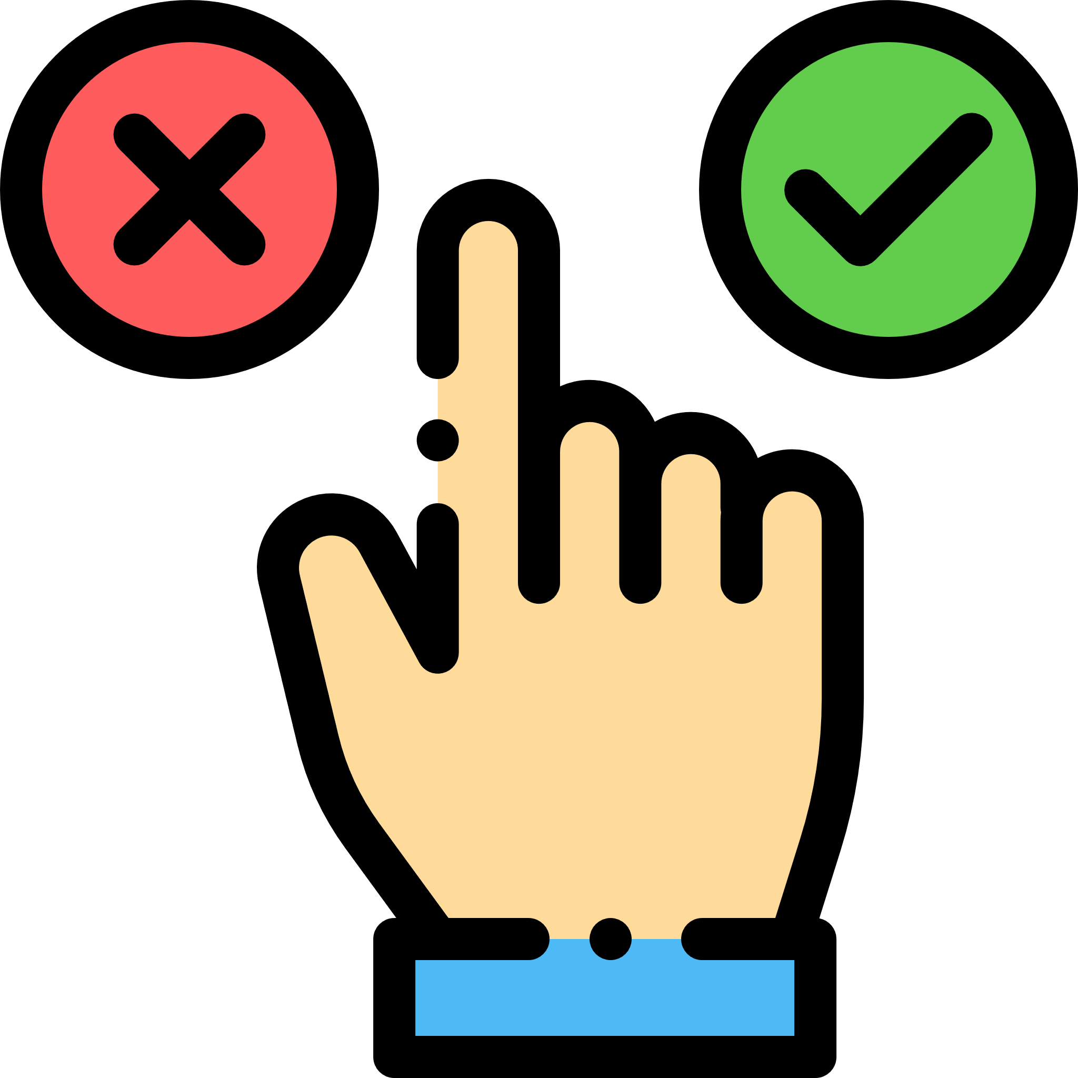
Honest Opinion / What You Should Take Away
It is not yet ready: results are not reliable and no indication so far that it could work on complicated queries across tables.
Yet, these models reach State-of-the-Art on their respective tasks, which shows we have a long way to go.
I think the goal of these publications was to make weights publicly available, so the NLP ecosystem could innovate just as it did with transformers and BERT. This is the first step, and research would come in the next years.
If you want to learn more: TAPAS publication is more detailed and clearer for reproducibility than TaBERT.

Slide 13

Break
Questions?
Message me for slides, publications, project ideas…

Slide 14

Causal Inference How Do We Measure The True Effect of a Decision?
Maxime TCHIBOZO
July 2020 – Analytics Lab

Slide 15
Why you should care about Causal Inference
It is cheap!
It only requires event logs, internal data, variables we have already measured (directly or indirectly).
It allows us to work closely with Analysts and experts with domain knowledge
It helps business developers make better data-driven decisions
It is not a black box
It relies on simple math such as linear regression and logistic regression ➔ Effective tool to convince business people.

Slide 16
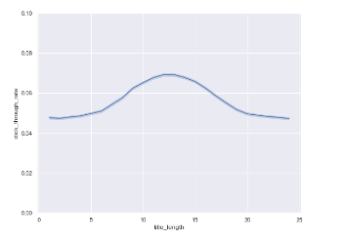
Case Study: Interpreting OFAC transactions
Let’s assume each TXN has a specific text length.
X: Length of TXN text (name of entity, context …)
Y: Proportion of Fraudulent TXNs for a given text length

Slide 17
Case Study: Interpreting OFAC transactions
Let’s assume each TXN has a specific text length.
X: Length of TXN text (name of entity, context …)
Y: Proportion of Fraudulent TXNs for a given text length
Analyst 1: “We should flag more TXNs with text between 10 and 15 characters”

Slide 18
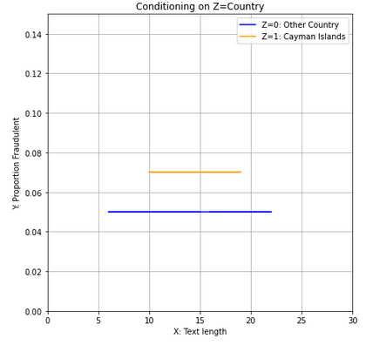
Case Study: Interpreting OFAC transactions
Analyst 2: “Just because there is correlation, doesn’t mean it is a causal relationship.”
When conditioning on country, the statistical dependence disappears!
E[Y|X,Country] = constant for each group
(i.e within each group, title length does not change the fraudulence probability)

Slide 19
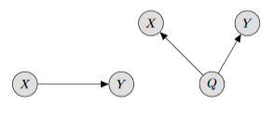
We use Directed Acyclic Graphs to model variables in Causal Inference
Analyst1’s understanding of the dependence
Title length has no effect on whether transaction is fraudulent or not.
X and Y are statistically correlated, but causally independent! The correlation is due to Country (Q).
Transactions from the Cayman Islands happen to also have a higher likelihood of having between 10 and 15 characters in the text.
So What?
True causal dependence (Q=Country)

Slide 20
We use Directed Acyclic Graphs to model variables in Causal Inference
Analyst1’s understanding of the dependence
Title length has no effect on whether transaction is fraudulent or not.
X and Y are statistically correlated, but causally independent! The correlation is due to Country (Q).
Transactions from the Cayman Islands happen to also have a higher likelihood of having between 10 and 15 characters in the text.
So What?
Analyst1’s screening algorithm punished transactions with text between 10 and 15 characters.
True causal dependence (Q=Country)

Slide 21

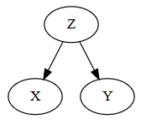

Causal Graphs – Fork
X: Number of letters of an OFAC transaction
Y: Fraudulent Transaction or not
Z: Country
Y
X
(!= 0)
In reality, X and Y are causally independent.
Artificially increasing or decreasing X without changing Z will not affect Y.
Statistically, they appear correlated.

Slide 22
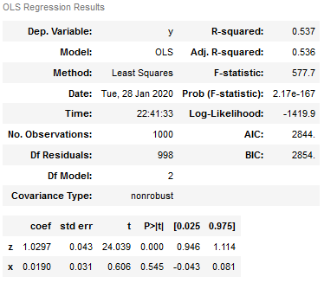
Causal Graphs – Fork
X: Number of letters of an OFAC transaction
Y: Fraudulent Transaction or not
Z: Country
Conditioning on the middle node of a fork (Z) gives a CORRECT estimate of the causal effect of X on Y.

Slide 23
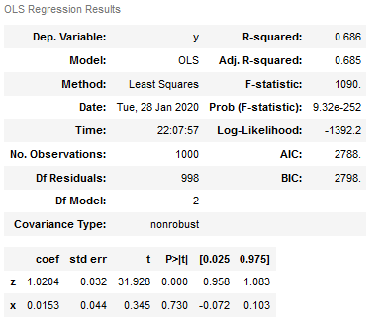

Causal Graphs – Chain
X: Measures whether a quant is working from home or not.
Y: Measures productivity (average profitability per trade)
Z: Quality of the information trader is able to get.
X and Y have causal dependence only through Z, no arrow from X into Y.
Can anyone explain why conditioning on Z gives a 0 for the X coefficient?

Slide 24
Causal Graphs – Chain
X: Measures whether a quant is working from home or not.
Y: Measures productivity (average profitability per trade)
Z: Quality of the information trader is able to get.
X and Y have causal dependence only through Z, no arrow from X into Y.
If we keep Z fixed, and change X, nothing would happen to Y.
However, if we hadn’t included Z in our regression, the parameter would not have been zero for X!
Conditioning on the middle node of a chain gives a CORRECT estimate of the causal effect of X on Y.

Slide 25


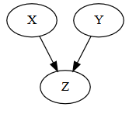
Causal Graphs - Colliders
Given Z=1, we no longer have X ⟂ Y
X: Revenue of a corporation (before potential loan with bank)
Z: Whether the bank lends money to the company or not
Y: Revenue of a bank (before potential loan)
X ⟂ Y
Y
Y
X
X
Let’s assume banks with no money never lend to companies with no money.
By conditioning on the collider Z, we unblock the path, and create statistical dependence where there was none.

Slide 26
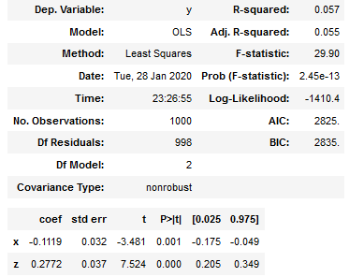
Causal Graphs - Colliders
Z=1
X: Revenue of a corporation (before potential loan with bank)
Z: Whether the bank lends money to the company or not
Y: Revenue of a bank (before potential loan)
Y
X
Conditioning on the middle node of a chain gives a INCORRECT estimate of the causal effect of X on Y.
Running the regression three times gave us 3 different results (depending on the underlying graph).
Be wary of the variables you include in your Linear Model! Think about the graph!

Slide 27
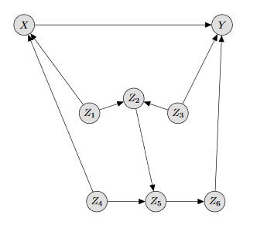
Method: How to use causal graphs
Determine the causal state (X) and the outcome of interest (Y)
Enumerate all of the causes of X and Y (ask your analyst)
Enumerate all of the confounding variables your analyst can think of (causes of both X and Y simultaneously)
Enumerate all effects of X and Y that your analyst can think of, and note any that are effects of both (colliders)
Draw the graph using these variables
Condition on a set of variables that respects the Causal Inference conditions
Use Linear Regression (or some other ML tool) to accurately estimate the effect of X on Y
You need an Analyst/Expert to understand the variables and draw the graph!

Slide 28

This is what you should take away
Causal Inference defines rules for which variables to use as regressors.
Causal Inference can help business decisions. All it takes is a simple Linear Regression.
Sanity Check: Are we sure that there is no confounding? Are we really are measuring what we think we are?
Conditioning on the wrong variables leads to the wrong conclusion (Simpson’s effect).
Conditioning on the right variables can cancel out confounding and make bias vanish.

Slide 29
Where is Causal Inference used today?
Social media companies want to know how showing a specific ad had an effect on products a user bought.
Irrelevant ads mean users on not likely to make a purchase.
Software Developers want to know what effect a change in the UI could have on sales.
A bad interface will discourage users from making purchases.
Government organizations want to know if campaigns have an effect on voter turnout in an election.
Governments do cost benefit analyses to see if these policies are worth it.
Medical experts want to know if their treatment will be effective.
Did this treatment successfully help patients recover from COVID-19?
Machine Learning professionals want to ensure their estimators are unbiased.
Adding the confounding variables to the regressor removed bias/cancelled out selection bias.

Slide 30
How could Causal Inference be used at the Bank ?
To make business decisions more robust.
“If we do this, productivity will only increase by 5%. Before considering a causal analysis, we thought productivity would increase by 20%”.
To accurately measure the effect of specific factors on our clients’ behaviour.
When accounting for all other variables, COVID-19 increased BNPP clients’ leverage ratio 1.5 times on average (just an example!).
To objectively measure how similar companies are, and how they will probably perform.
These two stocks have similar propensity scores but are not subject to the same regulations, knowing this I can say that the Basel III regulations decreases EBITDA by 4%.
To reduce the amount of human errors.
Humans are very bad at guessing, but we are very confident in our decisions. Causal Inference forces us to question what we believe to be obvious, and reduce our personal biases.

Slide 31

Thank You
Questions?
Message me for slides, books, project ideas…
Feedback:
Any honest feedback on my presenting is always welcome!
Happy Friday!

