Slide 1
ENGI 301 <ThermoBuddy> Proposal
<02/19/2024>
<Marc De Guzman>

Slide 2
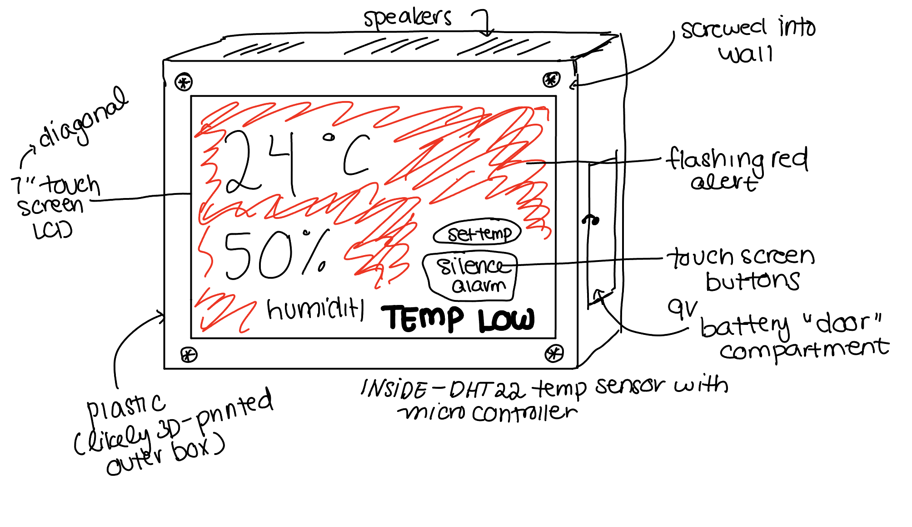
Background Information
What is being proposed?
A low-cost device that displays temperature and humidity, specifically meant for NICUs in low-income settings
It alerts nurses/clinicians when the NICU is at unsafe conditions by playing an alarm and flashing the screen
The threshold thermometer and humidity can be customized by the user
Alerts when battery is low
https://www.hackster.io/flygonial/pocketbeagle-air-quality-data-module-ad8ce1
https://www.hackster.io/romannovosad11/indoor-air-quality-monitoring-system-66d386
What improvements / additions over existing project
Runs on battery-power (Specified by clients)
Has a big screen that can be read from about 10 m away
User-friendly interface

Slide 3
System Block Diagram
https://cdn-learn.adafruit.com/downloads/pdf/dht-humidity-sensing-on-raspberry-pi-with-gdocs-logging.pdf
Create a System Block Diagram
Label interfaces / pins
Components (part numbers if possible)
Pocket Beagle
AHT10 Sensor
(P2_9)
(P2_11)
7 segment displays
(P2_9)
(P2_11)
(P2_23)
(P2_21)
May add LEDs to incorporate a blinking component to the device, but I want to focus more on putting the main functionality with the buzzer first.
Battery and Battery Detector
(P1_1)
(P1_16) (P2_1)
Buzzer

Slide 4
Power Block Diagram
Create a Power Block Diagram
Label voltages / currents of components
Pocket Beagle
5 V
(from Battery)
(P1_1)
AHT10 Sensor
5 V (P2_13)
Ground (P2_15)
7 segment displays
3.3 V (P2_23)
Ground (P2_21)
(P1_16) Ground
Buzzer

Slide 5
Components / Budget
Component | ENGI301 to Buy? | Cost
Red 7-segment Display (4 Digit) https://www.adafruit.com/product/1264 | Yes (Order 2 displays) | $15
Buzzers (3) https://www.adafruit.com/product/1536 | Yes | $2.85
AHT 10 Sensor https://www.amazon.com/HiLetgo-Precision-Temperature-Measurement-Communication/dp/B09KGVSKBY?source=ps-sl-shoppingads-lpcontext&ref_=fplfs&psc=1&smid=A30QSGOJR8LMXA | Yes | $7.99
Small 7 segment display (4 Digit) Link | Yes | $8.99
Battery Display https://www.adafruit.com/product/5383 | Yes | $2.95

