Slide 1
Assignment 5

Slide 2
Table of contents
Explanation of the algorithms used and their results as described in the report
Algorithms used:
Random local search
Gradient descent local search
Simulated annealing
Best descent local search
Guided local search
Genetic algorithm
Walrus optimization

Slide 3
Random local search
Start at a random point
Check set it to as the “best” value
Repeat for a specified number of iterations
Not very efficient, luck based
Results:
F1 – 39.623,07287
F2 – 2.651,825461
F3 - 601,5156232
F4 – 1.252,051725
F5 - 915,424312
F6 – 1,9770E+09
F7 – 4.845,596772
F8 – 4,5112E+08
F9 – 4.772,842698
F10 – 3.233,694704
F11 – 4.418,379988
F12 – 3.465,326446

Slide 4

Gradient descent local search
Start at a (random) point
Get the gradient of that point
Create neighbour based on the step size and the gradient of the previous point
Move towards the local extreme
Prone to getting stuck in them
Results:
F1 – 2,575E+10
F2 – 449,0845
F3 – 600,6169
F4 – 1.585,7874
F5 – 911,4213
F6 – 1,276E+10
F7 – 135.303,1531
F8 – 2,404E+21
F9 – 2.635,6388
F10 – 850,8437
F11 – 4.166,8010
F12 – 3.853,7515

Slide 5
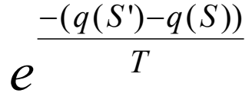
Simulated annealing
Start at a random point
Select random neighbour
If the neighbour is better, move to it
If its worse, move to it with probability
Results:
F1 – 76.658,0766
F2 – 16.645,6302
F3 – 604,6487
F4 – 1.388,4068
F5 – 975,4047
F6 – 84.850,0118
F7 – 20.775,0076
F8 – 10.465,0076
F9 – 36.848,8907
F10 – 4.980,3177
F11 – 79.726,9623
F12 – 4.040,1859

Slide 6
Best descent local search
Choose a (random) starting point
Generates a neighbourhood and computes their fitness
Chooses the neighbour with the best value as the best neighbour
If the value neighbour is better than the value of the current best point, we set the best point to the neighbour
If no better value is found, we return the local extreme
Results:
F1 – 300,0332
F2 – 468,2403
F3 – 600,0
F4 – 1.887,0
F5 – 912,5864
F6 – 3.4605,783
F7 – 5.741,258
F8 – 4.886,6506
F9 – 2.645,9548
F10 – 2.170,4255
F11 – 6.615,2529
F12 – 5.052,2950

Slide 7
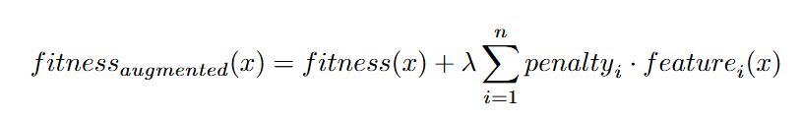
Guided local search
An improved local search with some help to avoid local extremes
Punishes continuous usage of attributes (dimensions)
The fitness function is augmented with weight * sum of the punished features that are present
Results:
F1 – 300,0610
F2 – 475,0455
F3 – 600,0
F4 – 1704,0
F5 - 907,9954
F6 – 68.701,2393
F7 – 5.958,3288
F8 – 3.185,1864
F9 – 2641,6150
F10 - -82,7019
F11 – 5.122,9910
F12 – 3.033,2159

Slide 8
Genetic algorithm
Algorithm based on the evolution of genes
Generate a population of agents (instances to test)
Select candidates for reproduction using fitness
Create new agents by combining the best candidates (crossover)
Replace old agents with new ones
Results:
F1 – 300,1552
F2 – 449,0904
F3 – 600,0
F4 – 870,0020
F5 – 900,1792
F6 – 5.8301,3322
F7 – 2.024,7913
F8 – 2.223,6992
F9 – 2.635,6417
F10 - -971,8031
F11 – 2.619,9942
F12 – 2.936,8751

Slide 9
Walrus optimization
Based upon movement of walruses, a subset of particle swarm optimization algorithms
Agents have a number that presents attraction to other walruses(alpha), attraction to the best walrus (beta) and their own desires (delta)
Always have a designated “best” agent which guides others to new positions
We take whichever fitness is better, previous or current
Results:
F1 – 302,6764
F2 – 469,8377
F3 – 600,0001
F4 – 1.068,5024
F5 -914,8667
F6 – 187.352,0377
F7 – 2.023,1090
F8 – 2.079,3809
F9 – 2.635,7372
F10 - -292,3534
F11 – 2.600,4539
F12 – 3.327,7636

Slide 10
Questions from the public

Slide 11
Thank you for listening.

