Slide 1


Slide 2
net

Slide 3

tinc VPN

Slide 4
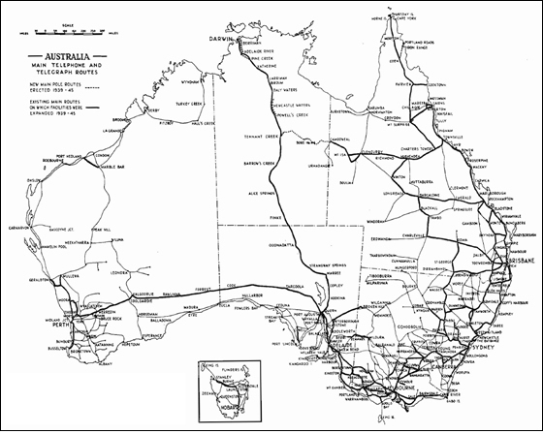


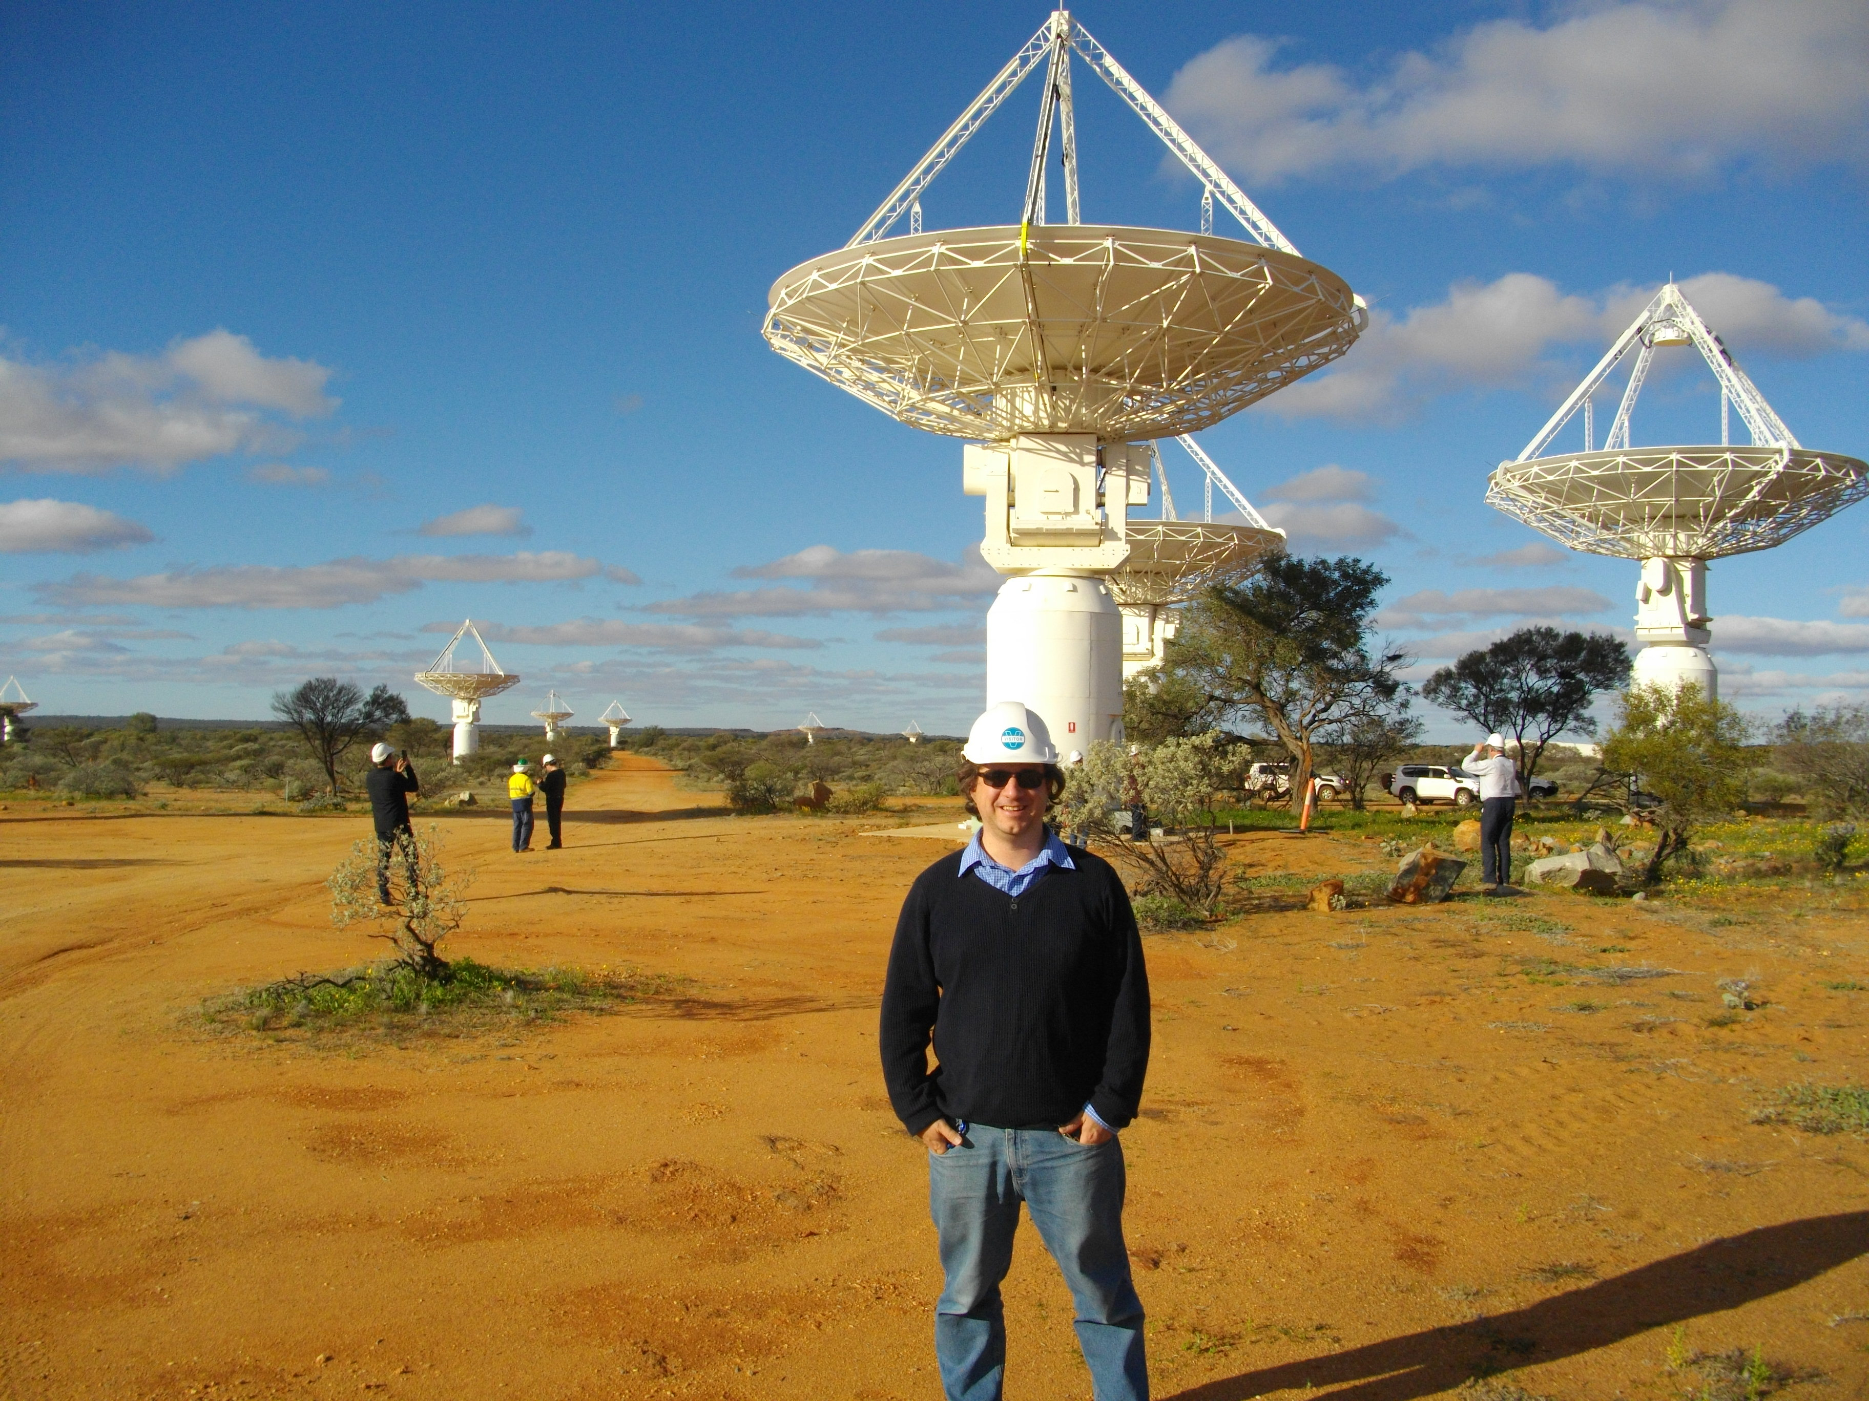
A quick introduction...
Images: TJA, gobeirne, SKAO, mtearle

Slide 5
About tinc
Info about authors
  Ivo Timmermans
  Guus Sliepen
Two current versions – 1.0 and 1.1 (in beta)
Goals are:
  Security
  Reliability
  Efficiency
  Scalability
  Ease Of Use

Slide 6
Uses for tinc
Remote Access
“VPN”
Interconnect Networks

Slide 7
What it is...
Userspace Implementation
SSL based encryption
Some support for Windows / Mac OS X / Android
Mesh and Point-to-Point (plus discovery if you want it)
Switched or Routed networks

Slide 8
What it is not ...
Standard. Uses dedicated tinc protocol over the wire
Control connection over TCP, traffic over TCP or UDP

Slide 9
Quick tour of configuration file structure
/etc/tinc/<network name>
  tinc.conf
  rsa_key.priv
  tinc-up
  tinc-down
  host-up
  host-down
  subnet-up
  subnet-down
/etc/tinc/<network name>/hosts
  <hostname>
  <hostname>-up
  <hostname>-down

Slide 10
tinc.conf
Name
Mode
ConnectTo
LocalDiscovery
Port
StrictSubnets
Name = tymnet
Port = 661
ConnectTo = bremen
ConnectTo = mitre

Slide 11
-up and -down scripts
Substitutions
Triggered on:
  Tinc startup
  Subnet
  Host
#!/bin/bash
ip link set $INTERFACE up
ip addr add 172.16.86.20/32 dev $INTERFACE
ip route add 172.16.86.0/24 dev $INTERFACE

Slide 12
Host Configuration
Address
Subnet
PUBLIC KEY
tincd -n sdinet -K 4096
Address = 192.0.2.16 661
Subnet = 172.16.86.20/32
-----BEGIN RSA PUBLIC KEY-----
MIICCgKCAgEA2SeJQsu/FUo7Kbh1hSIrbvm05BdThU0sncSSnXHeNJmgjV/IUEdq
3OUXrM3ED0uJ5AHjXYoIlotj2heKXJx9qzGnZ14nRqlceQpM0fscATSz6nO2KqqO
yXze/jYh8ys7m9v9uiy4x+tUPa0JAJ6hJATWX7HrGrziIUN4DUdNMveuUC52uv5V
7ldg9xkqffgD9YlvejvZb8ZkNewB9nNhPG7vDQPrEyqEbDDjmxKqWDbz3boJiLYC
9j5JnFyMQKL+15vYitI+BkDS2hEx0FeqEk8PbHY6mBI7Nsx9mnNRX9Iwf4rsf/j2
W3VthAa/GwtoYpFs/QFBsJqG3ZipxFcD/is6R4ihoh18NwrBsyW3iVmkEtZtfptG
PduYdOZTpVcjA7ntQLo5V3EehNEuo3Wi0OORMQrYXqMLoRC30d3XYgxfSYUsKDW4
nTpOaHYoNyrcIs+uAlixQV8f82JT7BjiHHL74GyxQu9oQ2FXuSkWFMMfWvlWWw/x
3UjPgC0aNw5i1zqf/F+Bcj4ccnxZh5u7sxPNbr37+x5soSjiMYQdyeCo3z3LkQoa
Q5JRhs6VmE25Ayiequc8hUdgkGlIFP2Wb8xQIAPCuVHW++i8r0i6DhTe0F/krCsI
CwMNdi/6IIpGSt5p0xPT534WZw2h6mMYp6qcl3D7q5Mfiblg55tISWMCAwEAAQ==
-----END RSA PUBLIC KEY-----

Slide 13
Stats
/etc/tinc/sdinet# kill -USR1 4327
Connections:
bremen at 1.1.158.105 port 58625 options c socket 8 status 00c2 outbuf 1245/0/0
mitre at 198.51.100.166 port 54192 options c socket 9 status 01c2 outbuf 1039/0/0
berkeley at 203.0.113.165 port 1026 options c socket 10 status 01c2 outbuf 1039/0/0
End of connections.
/etc/tinc/sdinet# kill -USR2 4327
Statistics for Linux tun/tap device (tun mode) /dev/net/tun:
total bytes in: 0
total bytes out: 372
Nodes:
berkeley at 203.0.113.165 port 661 cipher 91 digest 64 maclength 4 compression 0 options c status 001a nexthop berkeley via berkeley pmtu 1451 (min 1451 max 1451)
bremen at 1.1.158.105 port 661 cipher 91 digest 64 maclength 4 compression 0 options c status 001a nexthop bremen via bremen pmtu 1451 (min 1451 max 1451)
hannover at 203.0.113.165 port 661 cipher 0 digest 0 maclength 0 compression 0 options c status 0018 nexthop bremen via hannover pmtu 1518 (min 0 max 1518)
mitre at 198.51.100.166 port 661 cipher 91 digest 64 maclength 4 compression 0 options c status 001a nexthop mitre via mitre pmtu 1451 (min 1451 max 1451)
tymnet at MYSELF cipher 0 digest 0 maclength 0 compression 0 options c status 0018 nexthop tymnet via tymnet pmtu 1518 (min 0 max 1518)
End of nodes.
Edges:
berkeley to mitre at 198.51.100.166 port 661 options c weight 475
berkeley to tymnet at 192.0.2.16 port 661 options c weight 230
bremen to hannover at 203.0.113.165 port 661 options c weight 1049
bremen to mitre at 198.51.100.166 port 661 options c weight 593
bremen to tymnet at 192.0.2.16 port 661 options c weight 770
hannover to bremen at 1.1.158.105 port 661 options c weight 1049
mitre to berkeley at 203.0.113.165 port 661 options c weight 475
mitre to bremen at 1.1.158.105 port 661 options c weight 593
mitre to tymnet at 192.0.2.16 port 661 options c weight 275
tymnet to berkeley at 203.0.113.165 port 661 options c weight 230
tymnet to bremen at 1.1.158.105 port 661 options c weight 770
tymnet to mitre at 198.51.100.166 port 661 options c weight 275
End of edges.
Subnet list:
172.16.86.10/32#10 owner berkeley
172.16.86.20/32#10 owner tymnet
172.16.86.30/32#10 owner mitre
172.16.86.40/32#10 owner bremen
172.16.86.50/32#10 owner hannover
fdf1:20fe:4a33:db:0:0:0:1/128#10 owner berkeley
fdf1:20fe:4a33:db:0:0:0:5/128#10 owner hannover
End of subnet list.

Slide 14
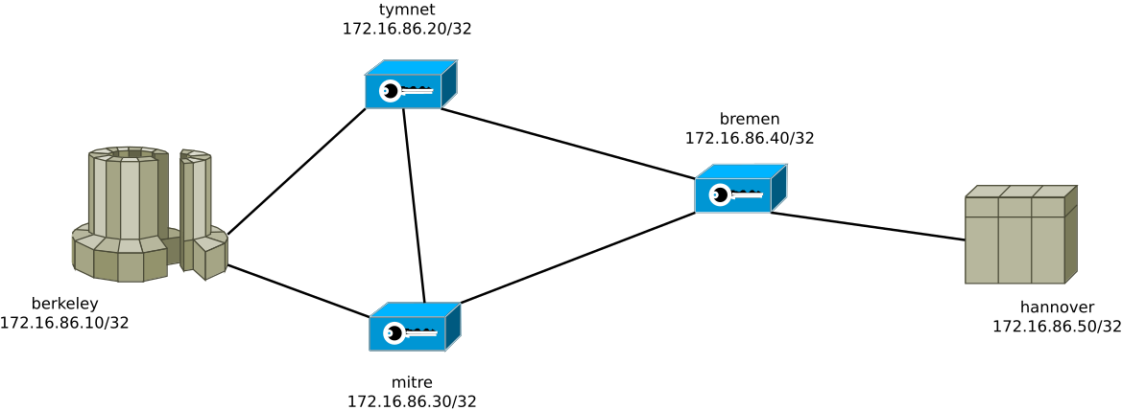
Demo 1 – Routed Network

Slide 15
Demo 2 – Yes, it does IPv6

Slide 16
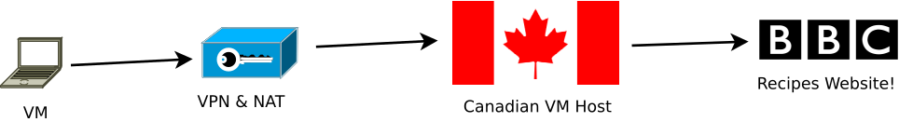
Demo 3 – Switched Network
Let’s do a simple VPN

Slide 17
Questions?
More info at: tinc-vpn.org
See also:
  https://github.com/nibalizer/tinc-presentation
  https://www.tinc-vpn.org/activities/
Talk will be uploaded at:
  https://github.com/mtearle/netmcr-talk

