Slide 1


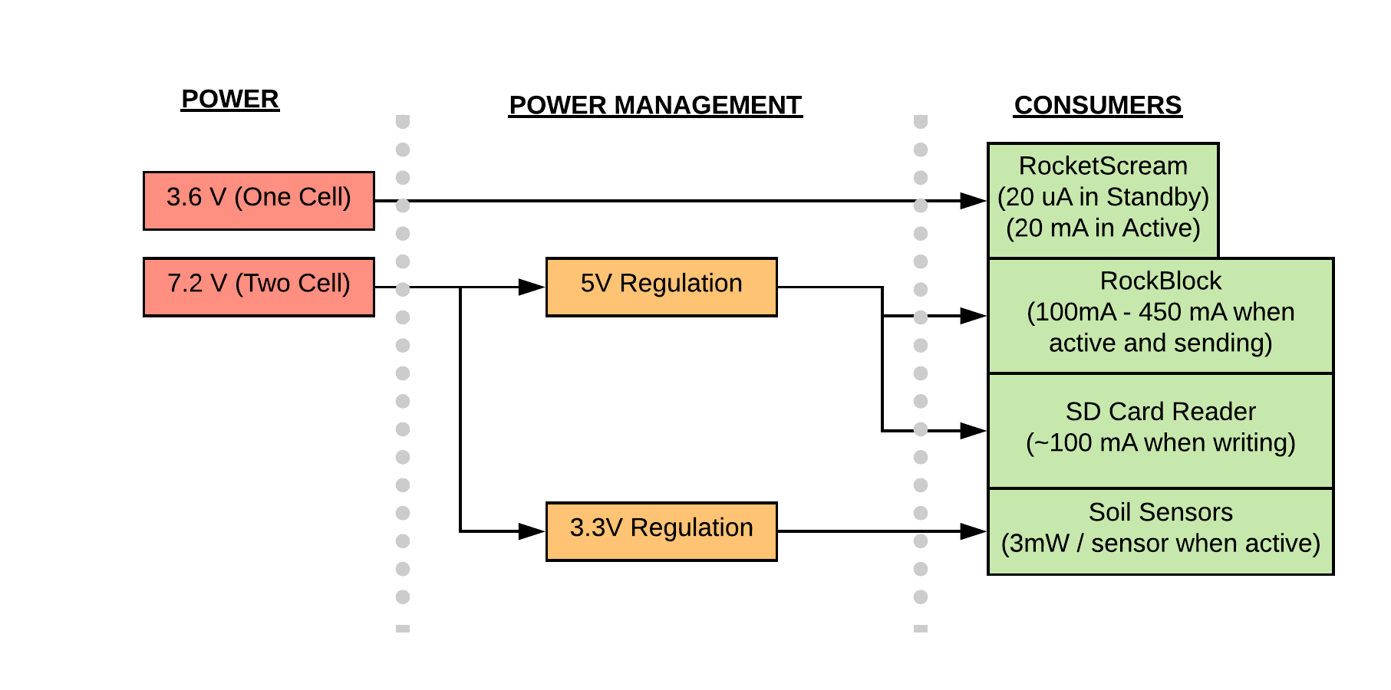
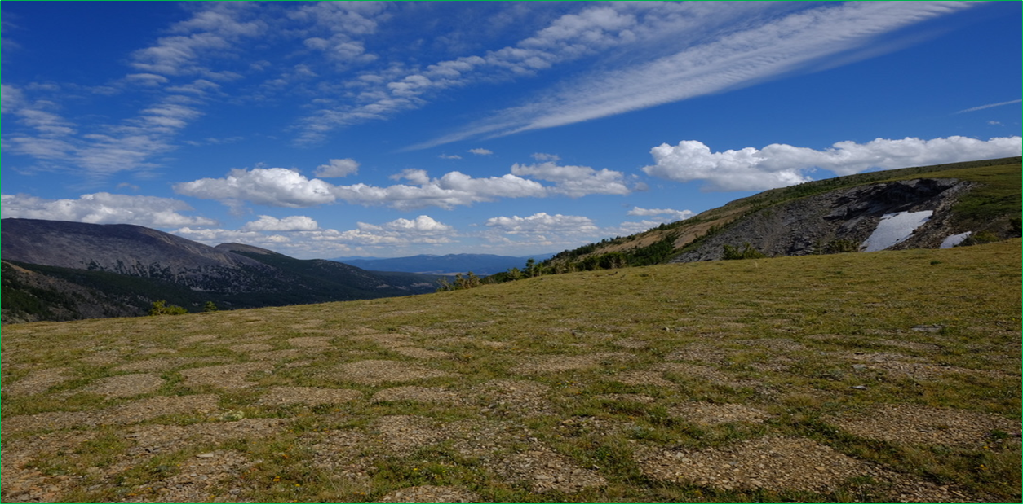
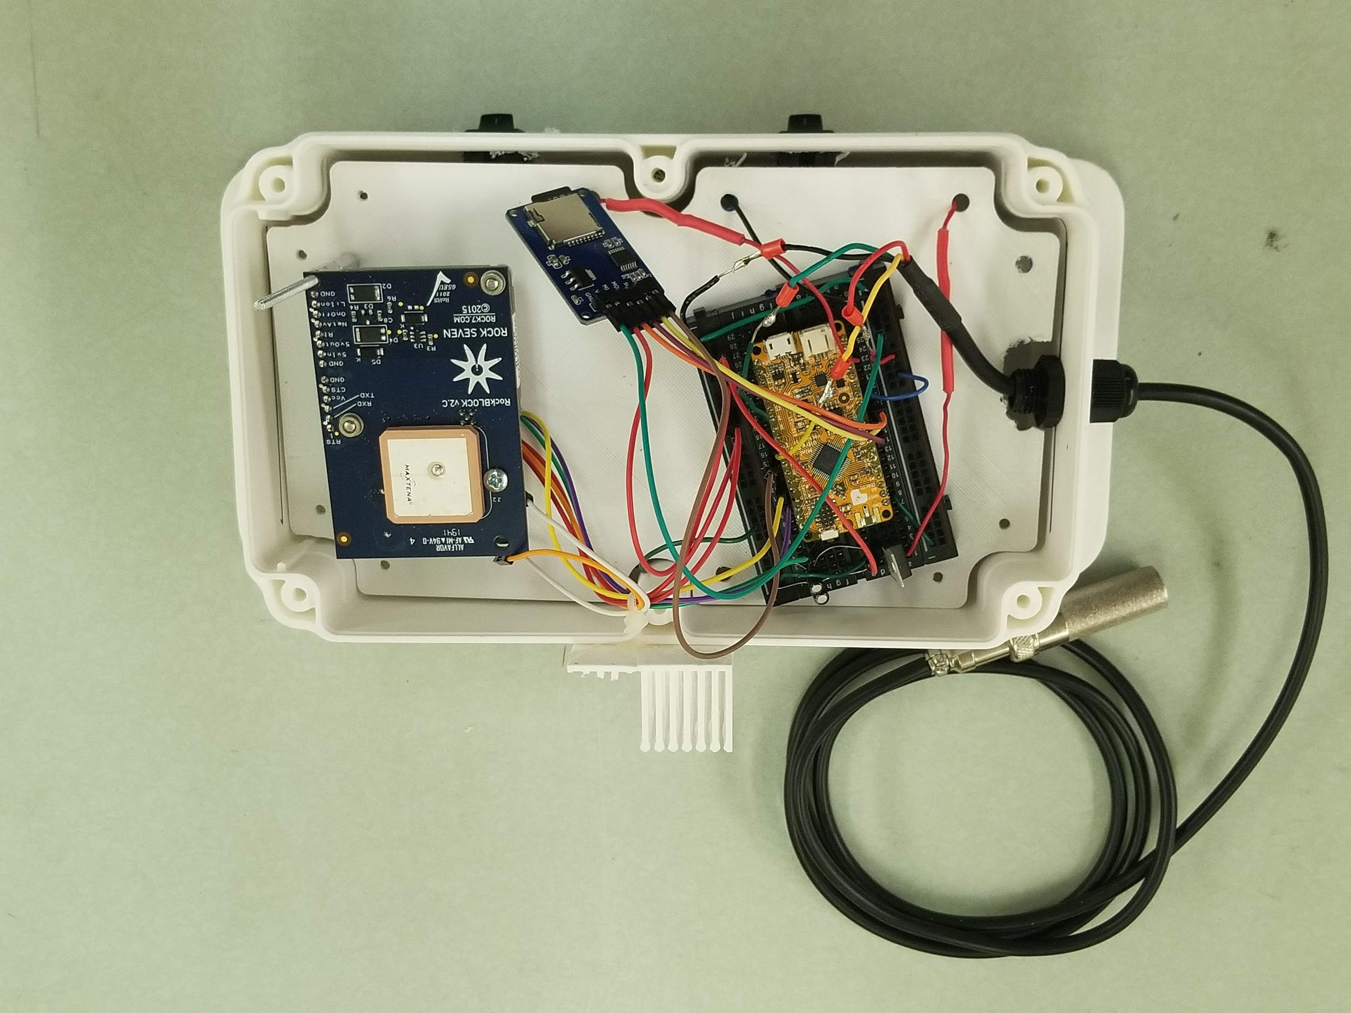
High Altitude Soil Testing: Increasing Accessibility of Data from Remote Locations
Jamison Ehlers, Undergraduate Student¹; Martha Apple, PhD²; Kevin Negus, PhD¹
1: Montana Technological University, Electrical Engineering
2: Montana Technological University, Biological Science
Abstract
Conclusions
The biology department uses temperature sensors to investigate plant species in alpine environments.
Currently:
Monitor only soil temperature.
Data can only be retrieved physically.
Only accessible during summer months.
Sensors can only be located via GPS coordinates and line-of-sight photography.
What this project hopes to achieve:
Remote access of data.
Long term data acquisition. (Target time frame is four years.)
Retrieve soil temperature and humidity.
Data logging at site for later retrieval.
This Summer
Custom circuit board designed
Overall prototype completed
Near Future
Complete and implement code
See how system responds to outdoor conditions
Far Future
Implement LoRa communication between sensor boxes
Figure 2: Power usage flow diagram
Components
For our system, we’ve implemented a RocketScream Mini-Ultra Pro v3, SD Card reader, industrial rated SD card, Iridium RockBlock Mk2 satellite modem, an SHT10 soil sensor, three 3.6V lithium-thionyl chloride (Li/SOCl₂) batteries, one IP68 rated NEMA case and IP68 rated cable glands.
The RocketScream controls the rest of the system, providing power management, a real-time clock and the Arduino coding libraries to operate each of the other components. The usual operating mode (standby) of the microcontroller will draw around 20 uA, increasing to 20 mA when active.
The RockBlock is a satellite modem, able to connect to a moving satellite in orbit around Earth, and can send an email containing a “Twitter length” string of data
The SD card reader is there to store data onto a temperature rated SD card, if the RockBlock is unable to establish a satellite connection.
The SHT10 sensor is able to read temperature and humidity. For the final system, multiple sensors will be implemented.
The lithium-thionyl batteries were chosen for their constant voltage performance over time, as well as their projected battery life. They are non rechargeable.
The IP68 rated cable glands and NEMA case were chosen for their safety rating of dust ingress and moisture incursion protection.
Figure 3: Periglacial Patterned Ground, Goat Flat, Pintler Mountains, SW Montana.
Acknowledgments
This work is based on funding provided by the ESIP Community with support from the National Aeronautics and Space Administration (NASA), National Oceanic and Atmospheric Administration (NOAA) and the United States Geologic Survey (USGS), as well as additional funding from the Montana Tech Summer Undergraduate Research Fellowship. We’d also like to acknowledge the Electrical Engineering and Biological Science departments at Montana Tech for their contributions as well.
Figure 1: Testing platform and prototype

