Slide 1
Image Processing and Machine Learning for Handwriting Recognition
https://github.com/mtech00/dst_1709981_2024 Handwriting_recognition_1709981
Muhammet Ali YILDIZ 1709981 Data Science Topics
Computer Engineering

Slide 2
Agenda (1 slide)
Introduction
<titles/themes present on/in the slides in this item>
Work Operation
<titles/themes present on/in the slides in this item>
Chosen AI Model
<titles/themes present on/in the slides in this item>
Production use
<titles/themes present on/in the slides in this item>
Conclusion and Future Work
<titles/themes present on/in the slides in this item>
References

Slide 3
Introduction
1. Introduction
2. Work Operation
3. Chosen AI Model
4. Production Use
5. Conclusion and Future Work
6. References

Slide 4
Overview of the Project:
This project aims to develop a handwriting recognition system using a combination of image processing and machine learning techniques.
The system will be capable of accurately recognizing handwritten characters and digits, with potential applications in document processing, form filling automation, and digitization.
Dataset Construction:
Description of the dataset construction process, including data collection, preprocessing, labeling, and dataset splitting.
Scripts used:
split_image.py: Splits the original handwritten image into smaller segments.
conversion_picture_to_numbers.py: Converts segmented images into numerical format (RGB values) and saves them as CSV files.
AI Construction Process:
Overview of the AI construction process, which involves image processing, feature extraction, model selection, training, and evaluation.
Scripts used:
decision_tree_regressor.py: Trains a Decision Tree Regressor model using the converted image data.
handwriting_predictor_model.py: Saves the trained model for future use.
Putting AI into Production:
Brief explanation of the deployment process, including considerations for scalability, latency, and user interface design.
Script used:
handwriting_predictor_model.py: Used to load the trained model for production use.

Slide 5
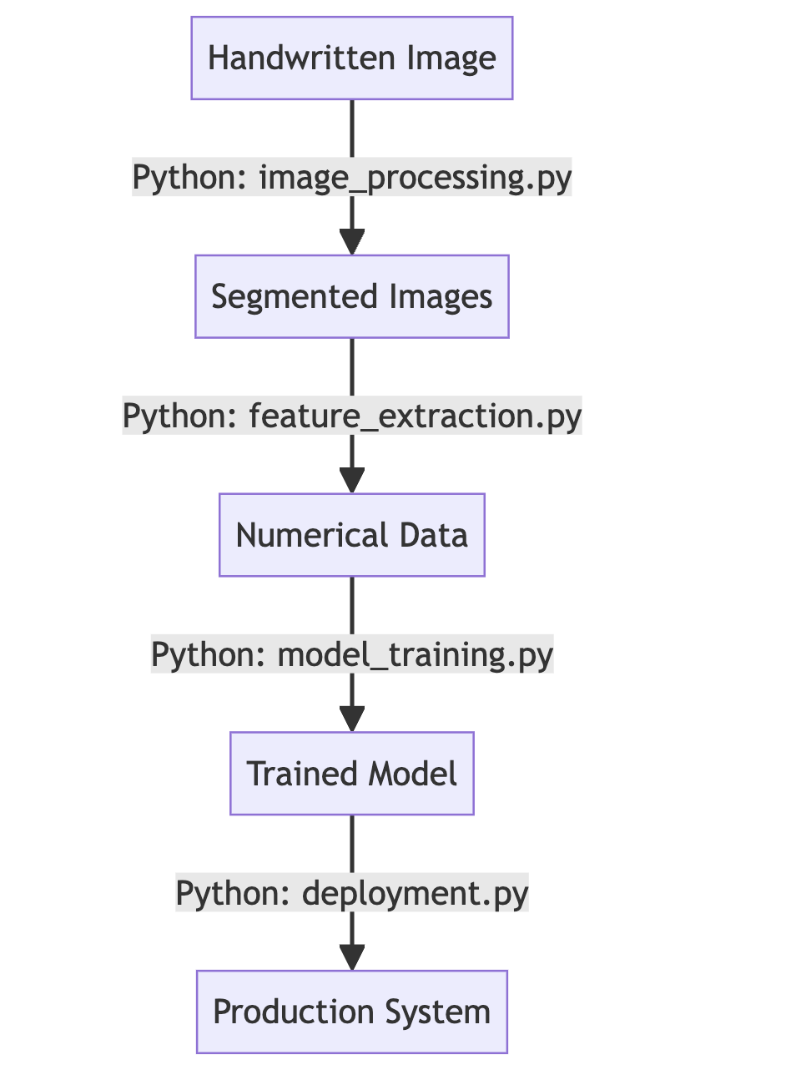
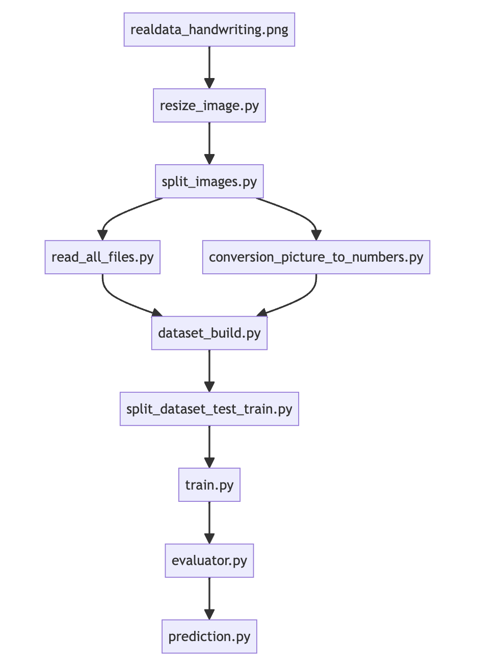

Slide 6
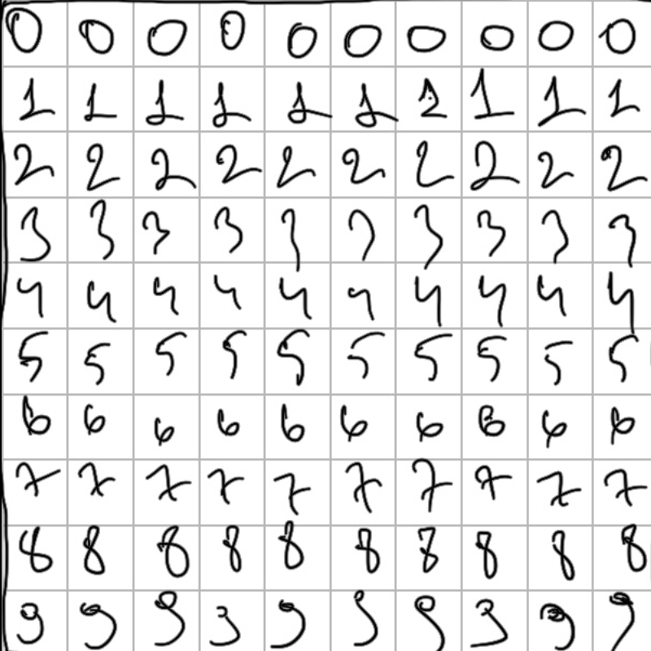

Slide 7
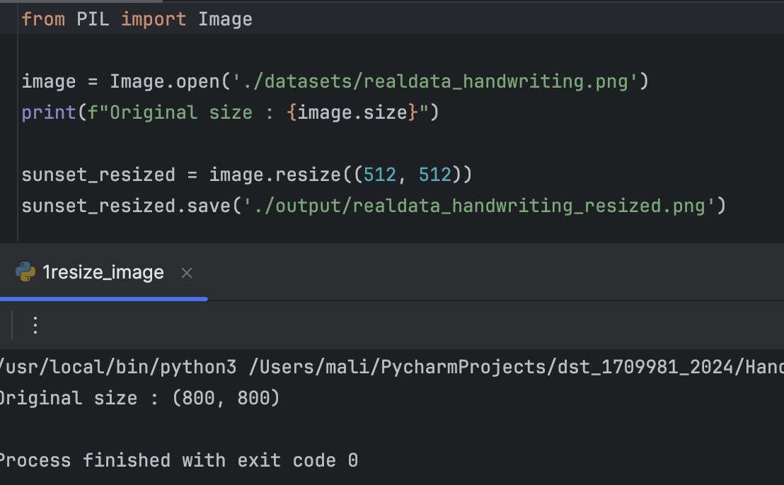
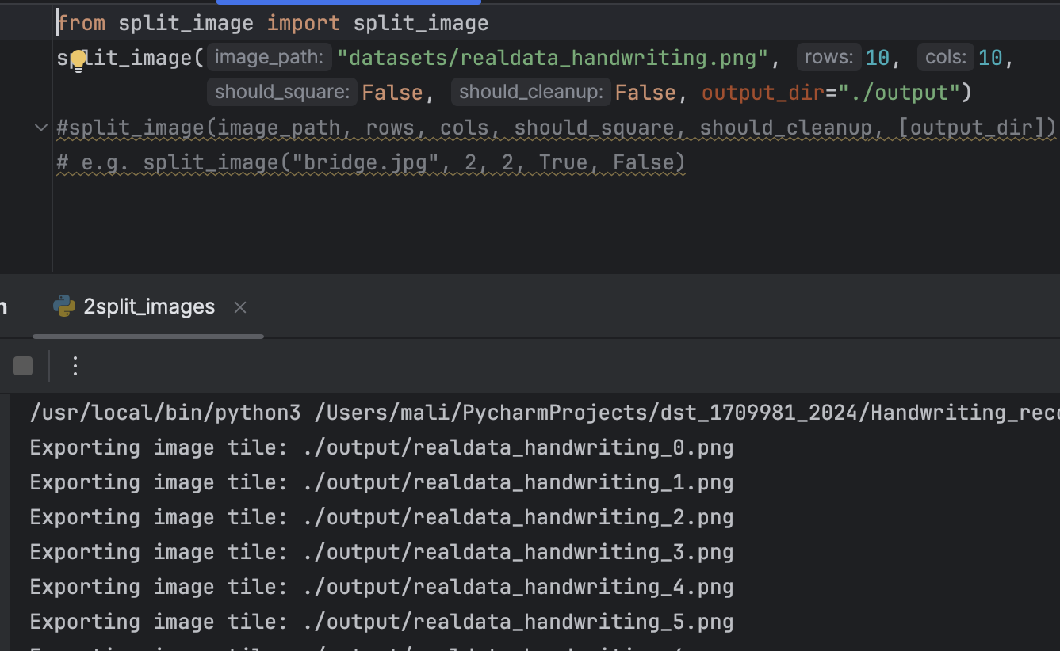
This code section uses the Python Imaging Library (PIL) to resize an image.
It opens an image file named "realdata_handwriting.png" from the './datasets/' directory.
The original size of the image is printed.
The image is resized to 512x512 pixels using the resize() function.
The resized image is saved as "realdata_handwriting_resized.png" in the './output/' directory.
This code section splits the original image into smaller segments.
It utilizes a custom function split_image imported from the 'split_image' module.
The function parameters specify the input image path, number of rows and columns for segmentation, and output directory for saving the segmented images.

Slide 8
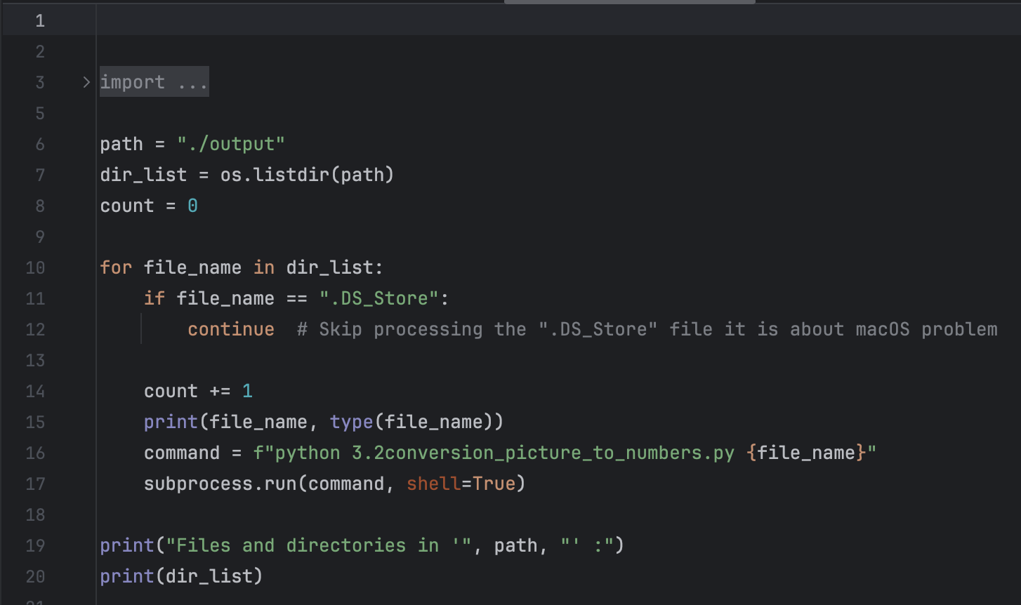
This code section converts the segmented images into numerical format (RGB values).
It iterates through the directory containing segmented images.
Each segmented image file is processed using a Python script 3.2conversion_picture_to_numbers.py for conversion.
The converted data is saved in CSV format for further analysis and model training.

Slide 9
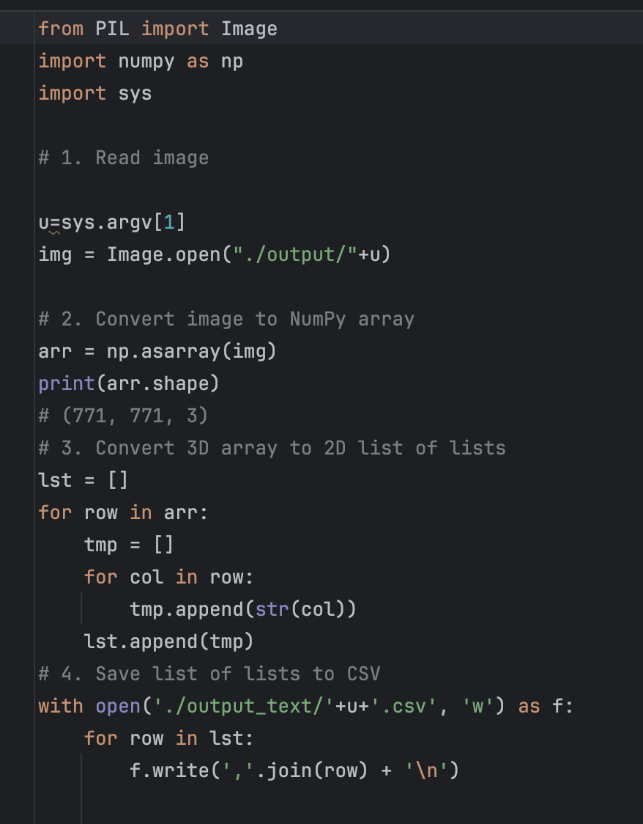
This code section reads the segmented images from the './output/' directory.
It converts each image to a NumPy array and then to a 2D list of lists, where each inner list represents a row of RGB values.
The RGB values are converted to strings and saved in CSV format, with each row representing a pixel in the image.

Slide 10
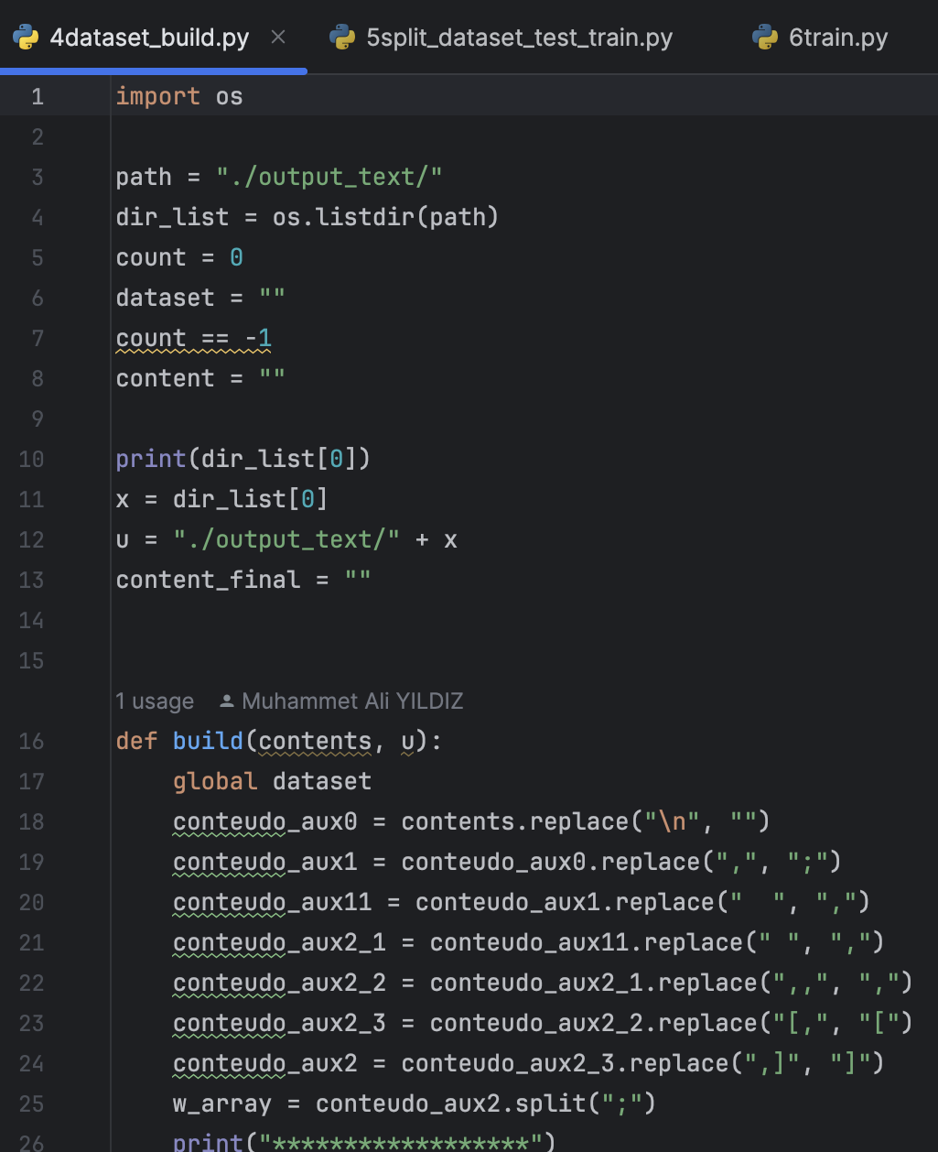
This code section prepares the training and testing datasets from the converted image data.
It reads the CSV files containing image data from the './output_text/' directory.
Rows are selected randomly for inclusion in the training dataset while ensuring a predefined ratio of training to testing data.
The selected rows are used to generate the training and testing datasets, which are then saved as CSV files in the './datasets/' directory.

Slide 11
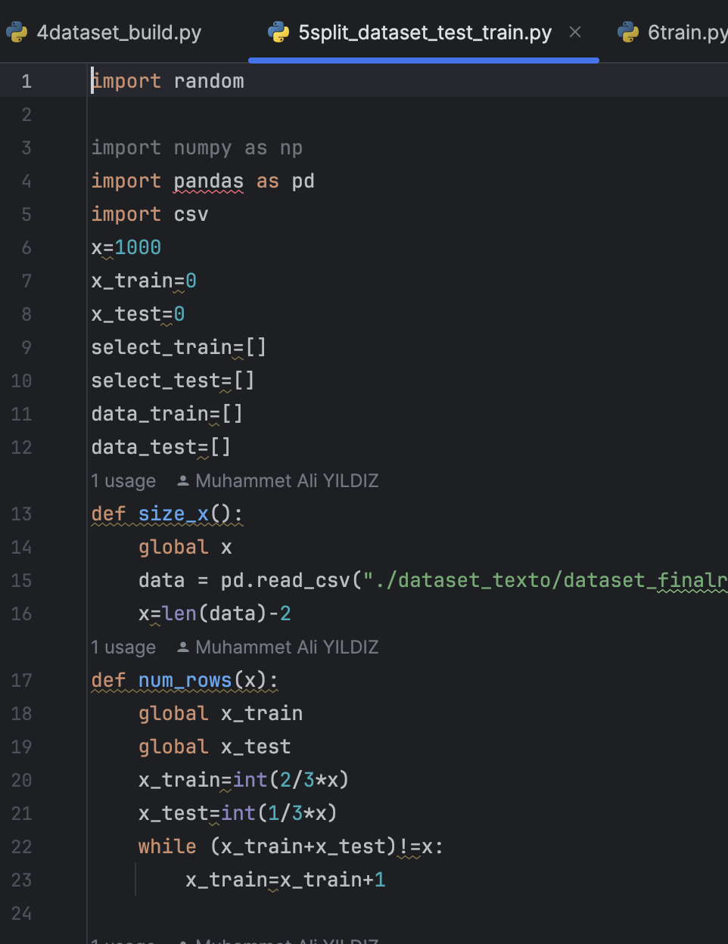
This code section defines functions to prepare the training and testing datasets for model training.
The size_x() function determines the size of the dataset.
The num_rows(x) function calculates the number of rows for training and testing based on a predefined ratio.
The select_rows(x) function randomly selects rows for inclusion in the training dataset while ensuring the correct ratio of training to testing data.
The generate_train() function generates the training and testing datasets.
Finally, the datasets are saved as CSV files for further use.

Slide 12
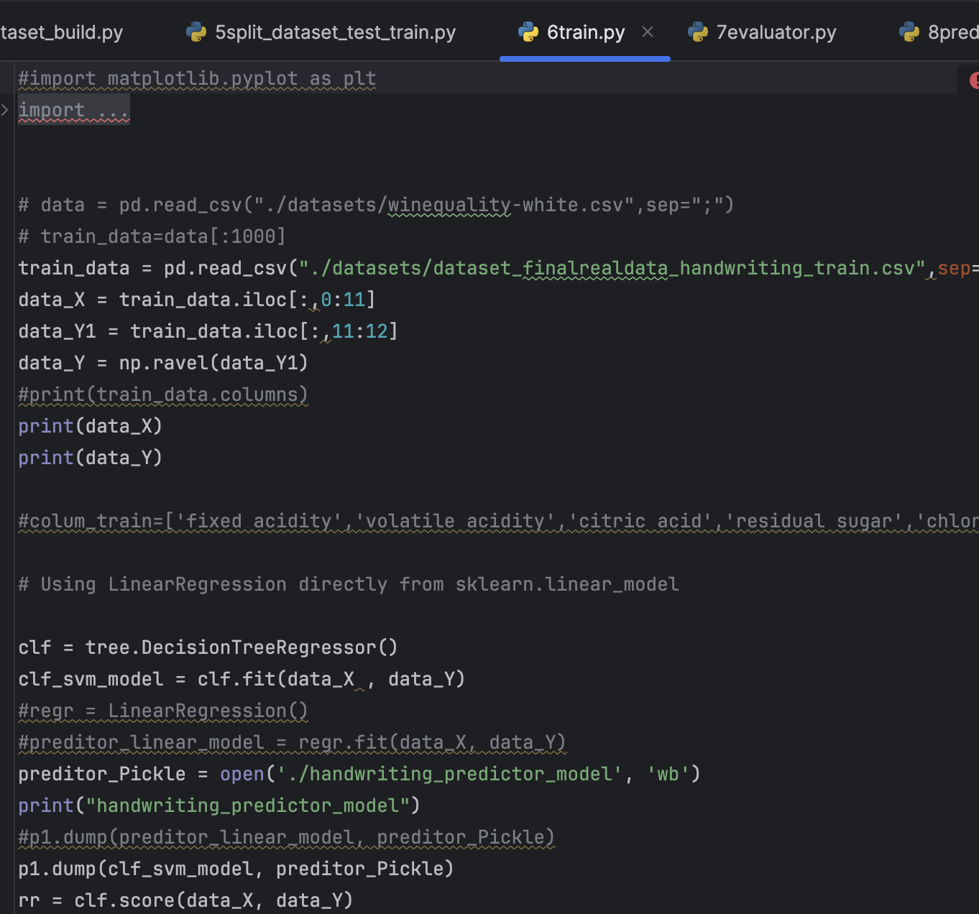
Importing Libraries: The code imports necessary libraries such as matplotlib, pickle, numpy, pandas, LinearRegression, mean_squared_error, r2_score, and DecisionTreeRegressor.
Reading Training Data: It reads the training data from the CSV file named "dataset_finalrealdata_handwriting_train.csv" and stores it in the variable train_data.
Extracting Features and Target: It extracts the input features (data_X) and the target variable (data_Y) from the training data.
Decision Tree Regression: The code initializes a DecisionTreeRegressor model (clf) and fits it to the training data using the fit method.
Saving the Model: It saves the trained model (clf_svm_model) using the pickle.dump() function to a file named "handwriting_predictor_model".
Coefficient of Correlation: Finally, it calculates the coefficient of correlation (rr) for the trained model using the score() method and prints it out.

Slide 13
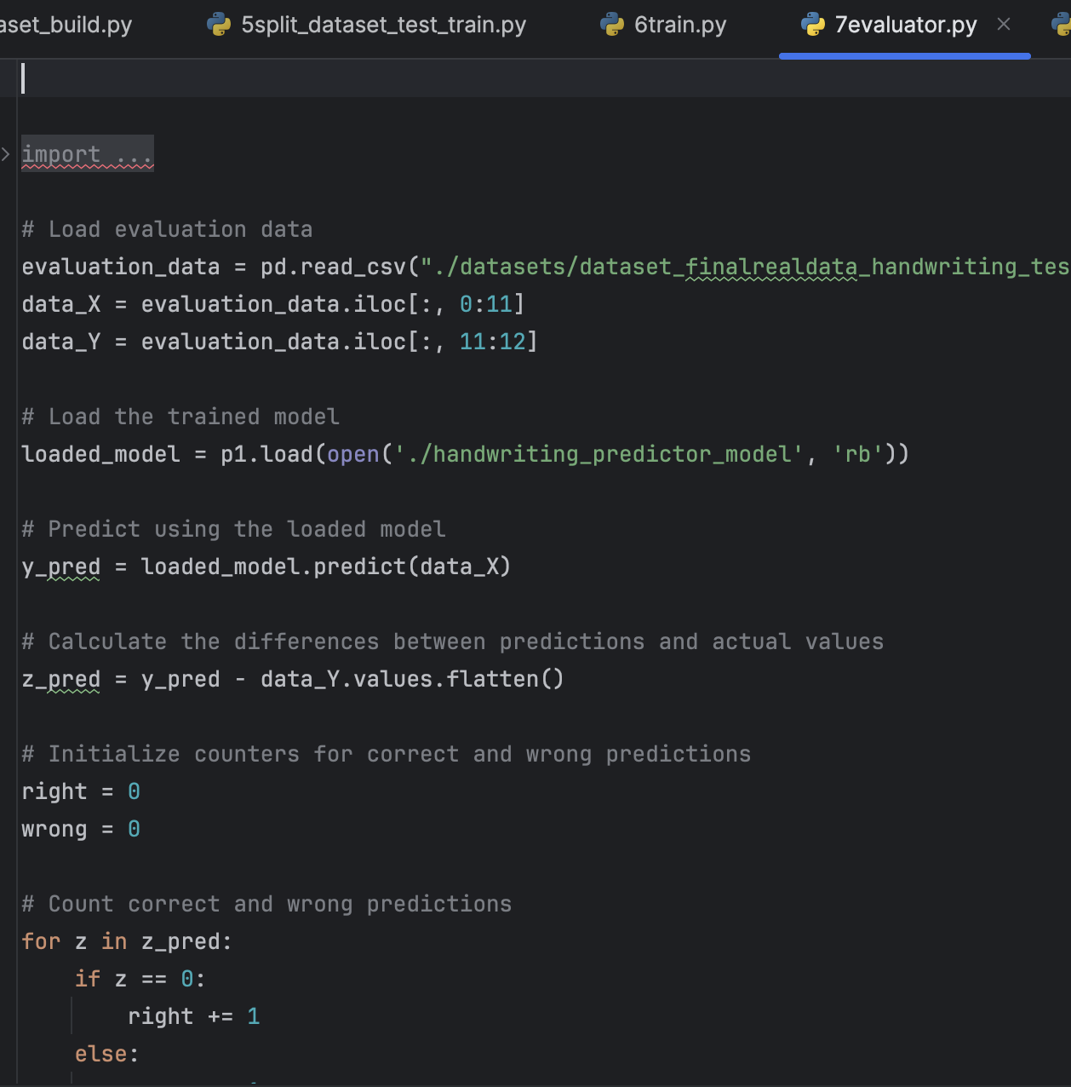
This code snippet evaluates the trained model using the evaluation dataset.
It loads the evaluation data from a CSV file and separates the features (X) and the target variable (Y).
The trained model is loaded from the saved file using pickle.
Predictions are made using the loaded model on the evaluation dataset.
Differences between predictions and actual values are calculated.
The code then counts correct and wrong predictions and calculates the accuracy of the model.
Finally, it prints the total number of correct and wrong predictions, along with the accuracy metrics.

Slide 14
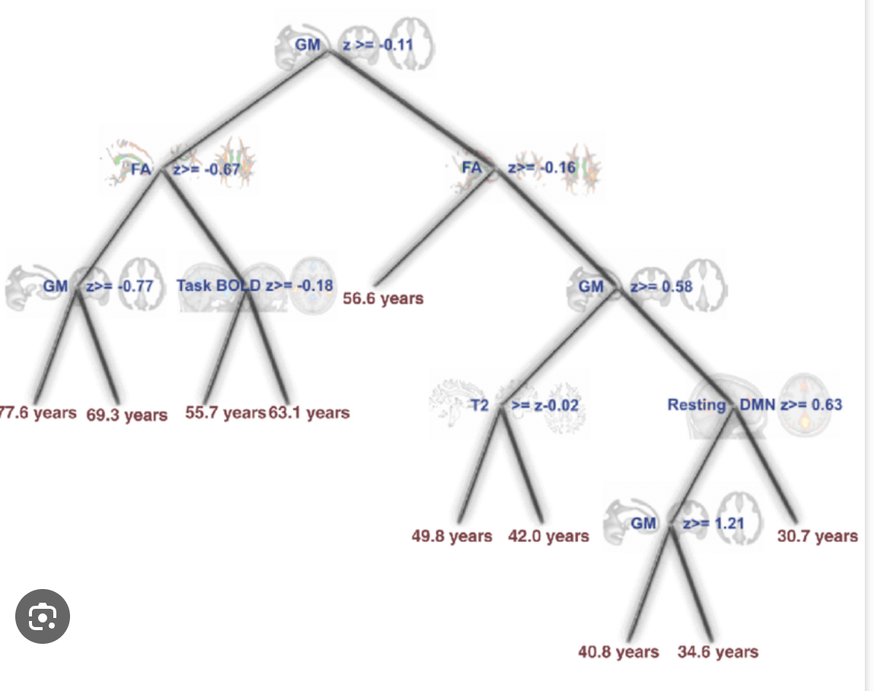
Introduction to Decision Tree Regressor:
Decision Tree Regressor is a supervised learning algorithm used for solving regression problems.
It works by recursively partitioning the feature space into regions and fitting a simple model (usually a constant) to each region.
Decision trees are intuitive to understand and visualize, making them useful for explaining the model's decision-making process.
How Decision Trees Work:
Decision trees split the feature space based on the feature that provides the best split, aiming to minimize the impurity or maximize the information gain at each node.
The splitting process continues recursively until a stopping criterion is met, such as reaching a maximum depth or minimum number of samples in a node.

Slide 15
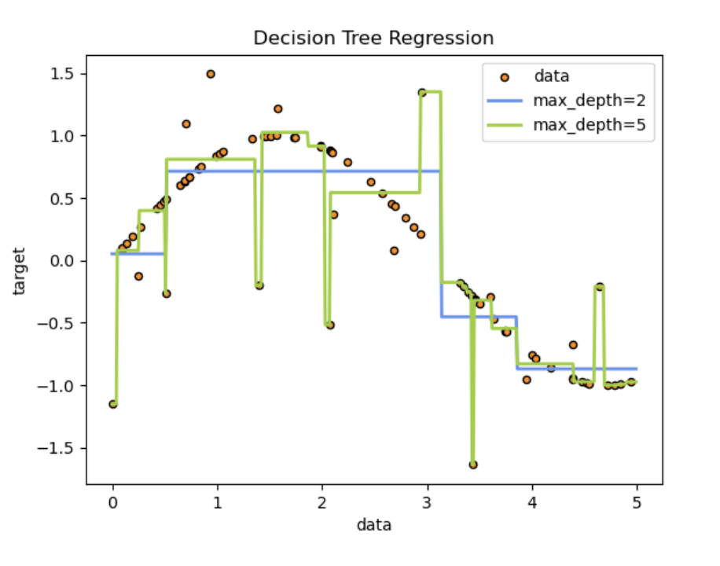
Advantages of Decision Tree Regressor:
Easy to interpret and visualize: Decision trees can be visualized graphically, allowing users to understand the model's decision-making process.
Non-parametric: Decision trees make no assumptions about the distribution of data or the relationship between features, making them flexible and adaptable to various types of data.
Handles non-linear relationships: Decision trees can capture complex non-linear relationships between features and the target variable.
Limitations of Decision Tree Regressor:
Overfitting: Decision trees tend to overfit the training data, especially when the tree depth is not properly controlled.
Instability: Small changes in the training data can lead to significantly different tree structures, making decision trees sensitive to noise.
Lack of smoothness: Decision trees produce piecewise constant predictions, which may not capture the underlying smoothness of the data well.

Slide 16
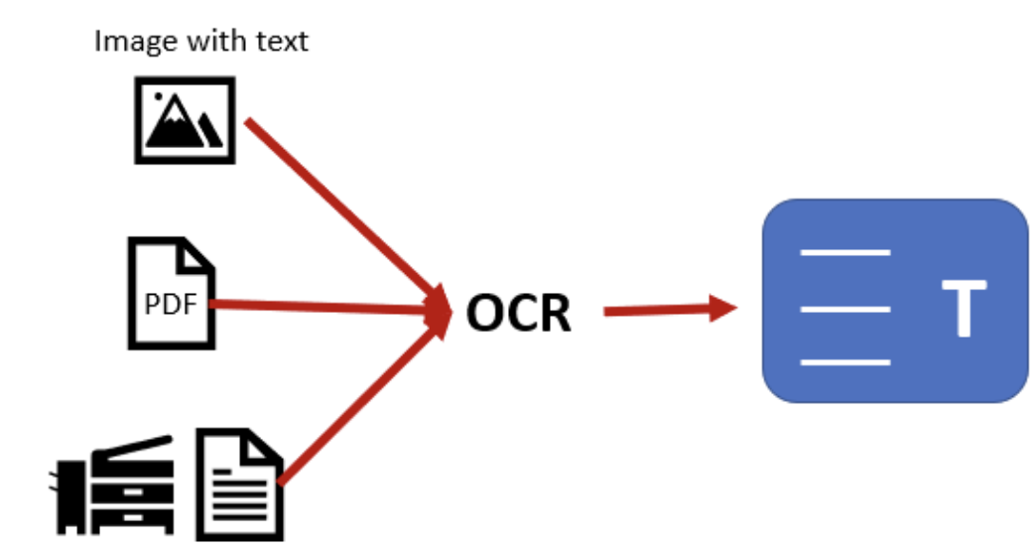
System Design for Handwriting Recognition:
In a real-life scenario, our handwriting recognition system can be integrated into various applications, such as digital document management systems, automated form processing systems, and handwriting-based authentication systems.
The system aims to accurately recognize handwritten text from images or scanned documents, enabling efficient digitization of handwritten content.

Slide 17
Technologies Used:
Python: Utilized for script development and data manipulation.
Pandas: Used for data preprocessing and manipulation.
NumPy: Employed for numerical operations and array manipulation.
scikit-learn: Leveraged for implementing machine learning algorithms and model evaluation.
PIL (Python Imaging Library): Utilized for image processing tasks such as resizing and splitting images.
Unimplemented Situations:
Integration with real-time handwriting input devices: Future work involves integrating the system with devices such as digital pens or tablets to enable real-time handwriting recognition.
Multilingual support: Enhancing the system to recognize handwriting in multiple languages, requiring additional training data and language-specific models.
Handwriting style adaptation: Developing algorithms to adapt to different handwriting styles and variations, improving recognition accuracy across diverse user inputs.

Slide 18
References
[1] Paulo Vieira Professor at IPG
[2] Python Software Foundation. Python Language Reference, version 3.x. Available online at: https://docs.python.org/3/
[3] Pillow (PIL Fork) Documentation. Python Imaging Library (Fork). Available online at: https://pillow.readthedocs.io/en/stable/
[4] NumPy Documentation. NumPy User Guide. Available online at: https://numpy.org/doc/stable/
[5] Pandas Documentation. Pandas User Guide. Available online at: https://pandas.pydata.org/docs/
[6] scikit-learn Documentation. scikit-learn: Machine Learning in Python. Available
online at: https://scikit-learn.org/stable/documentation.html
[7] DecisionTreeRegressor Documentation. scikit-learn DecisionTreeRegressor API Reference. Available online at: https://scikit- learn.org/stable/modules/generated/sklearn.tree.DecisionTreeRegressor.html
[8] Anaconda Documentation. Anaconda Distribution User Guide. Available online at: https://docs.anaconda.com/
[9] Jupyter Notebook Documentation. Project Jupyter. Available online at:
https://jupyter-notebook.readthedocs.io/en/stable/
[10] GitHub. Repository for split_image. Available online at:
https://github.com/split_image
[11] GitHub. Repository for conversion_picture_to_numbers. Available online at:
https://github.com/mtech00/conversion_picture_to_numbers
[12] Microsoft. Visual Studio Code Documentation. Visual Studio Code User Guide. Available online at: https://code.visualstudio.com/docs

