Slide 1
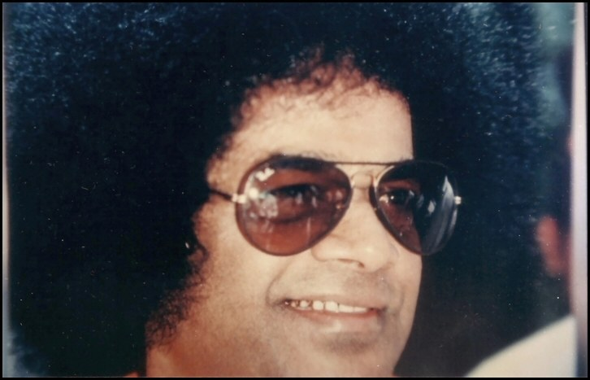

Slide 2
A Simulation Tool to Optimize Cost, Spectrum and Reach of Flex-Grid Metro Optical Networks
Industry Mentors :
Project Supervisor :
By
P.Sai Ram Reddy
II M.tech (OEC)
17704
Mr. B. Sai Kishore
Cisco systems, Inc.
Mr. Prabhat Behere
Amazon Web Services,
Dr. R. Gowrishankar
HOD, Phy. Dept.,
SSSIHL

Slide 3

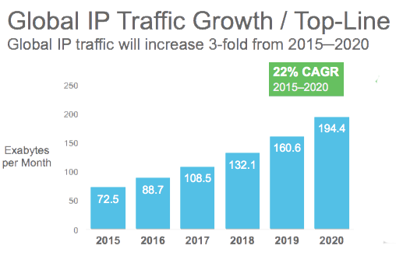
Introduction
On Demand Content Consumption and the Cloud are changing Network Requirements
Source : Cisco
Massive BANDWIDTH requirements and ON-DEMAND unpredictability are forcing new requirements on the network

Slide 4
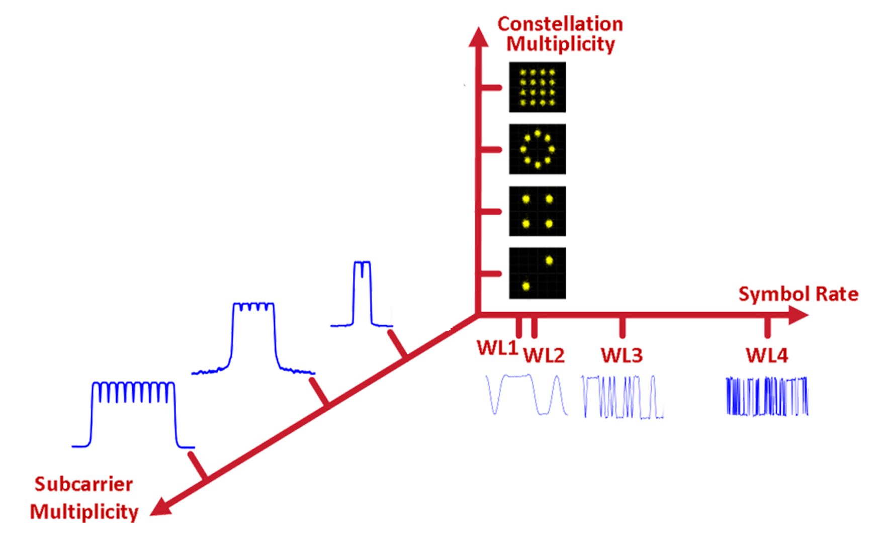
System Capacity Derived from Several Factors
Increasing Baud a.k.a Symbol rate:
More symbols are processed per second
Increasing Modulation used:
Multiple Bits per symbol (richer constellations)
Dual Polarization :
Vertical and horizontal axis
Multiple Carriers:
Increasing the number of carriers

Slide 5
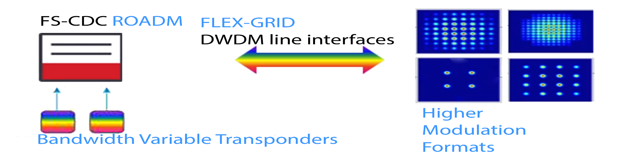
Motivation
Network Designing Algorithms are playing an increasingly critical role in solving networking business challenges
Squeezing out more from the fiber
Bandwidth Variable Transponders
FLEX SPECTRUM – ROADMS
16 contentionless ADD/DROP card
Fixed to Flex grid transmission technology
Higher Modulation Formats increasing spectral efficiency
Traditional RWA transformed to RWSA

Slide 6
Literature Survey
Planning and operation of elastic flex-grid optical networks with ofdm variable bandwidth capabilities - Christina Politi, Chris Matrakidis, Theofanis Orphanoudakis, Vassilios
Anagnostopoulos, and Alexandros Stavdas
Bottom-up framework for cost allocation to services in telecommunication networks -
Ronald Romero Reyes and Thomas Bauschert

Slide 7
Problem Statement
Given a greenfield mesh network, where each of the nodes in the network is built using SMR 20 ROADMs with Contentionless local add/drop cards and all the transponders are flex mod and flex baud transponders giving rise to different bit rates.
If this is the network scenario, how a traffic can be divided to provide a solution that is spectrum efficient, cheaper and optically feasible.
The proposed solution of the algorithm is the result of meeting the 3 parameters.

Slide 8
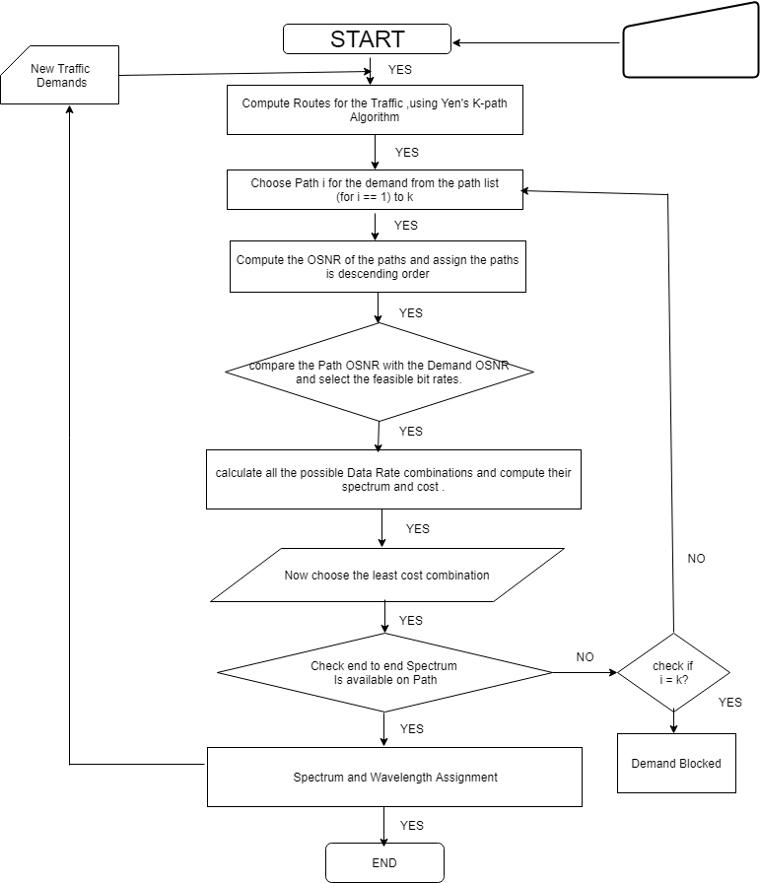
Proposed
Algorithm
Network parameter,
Traffic Matrix

Slide 9
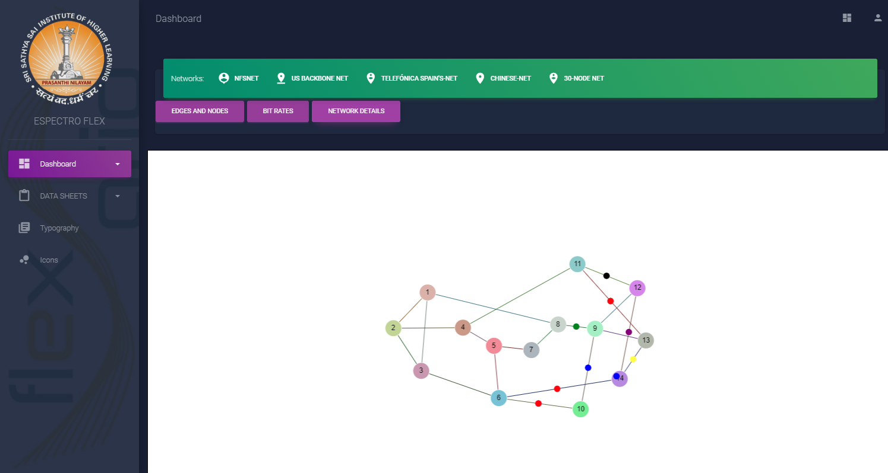
Web Interface Tool

Slide 10
NSF-NET Results
Positive Scenario
Formulae: cost of the transponders + cost of the spectrum * hops

Slide 11
Cost Analysis Of Positive Scenario
Formulae: cost of the transponders + cost of the spectrum * hops

Slide 12
Negative Scenario
Over Provisioning The Network

Slide 13
Summary
Our novel algorithm which takes into the three parameters is able to efficiently cater
the demand at reduced cost.
The algorithm has taken 3 different networks and the results obtained for all 3 networks are similar.
We conclude that efficient spectrum allocation and low network cost is achieved in
regeneration as compared to without regeneration.
Our web tool includes the algorithm and takes the topology of the network and the
traffic matrix as the input and shows the results on the web.

Slide 14
Future Work
The provision of network protection schemes using varied protection strategies such as 1+1, 1:1, M: N is of great interest. This could be implemented by disjoint path algorithm, together with the Yen’s K, to provide a disjointed set of paths
To implement a brownfield scenario and begin to solve the defragmentation problem that occurs due to network fragmentation with dynamic demands.
The physical layer impairments are a serious threat to the design and implementation of optical networks. Model the linear and non-linear effects into the algorithm.
The web interface tool can be made more interactive by providing data from the web itself. To integrate a dashboard of tools such as real - time results.

Slide 15
Thank you
Sairam

Slide 16




Slide 17

Algorithm
With
Regeneration

Slide 18
Modulation Format
DATA RATE | FORMAT | BANDWITH(NQUIST SPACING) | BAUDRATE | BANDWIDTH(ROUND OFF) | SLOTS REQUIRED | OSNR | COST UNIT
100 | QPSK | 37.5 | 34.58 | 37.5 | 3 | 12 | 1
150 | 8 QAM | 39.8 | 34.58 | 50 | 4 | 15 | 1.2
200 | QPSK | 75.4 | 69.16 | 87.5 | 7 | 12 | 1.3
200 | 16QAM | 41.14 | 34.58 | 50 | 4 | 18 | 1.5
250 | 16 QAM | 51.5 | 43.225 | 62.5 | 5 | 18 | 1.7
300 | 8QAM | 79.5 | 69.16 | 87.5 | 7 | 15 | 2.2
400 | 16QAM | 82.3 | 69.16 | 87.5 | 7 | 18 | 2.5
400 | 64QAM | 59.9 | 46.11 | 62.5 | 5 | 24 | 2.8
500 | 32QAM | 86.5 | 69.16 | 87.5 | 7 | 21 | 3.2
500 | 64QAM | 74.9 | 57.63 | 75 | 6 | 24 | 3.5
600 | 64QAM | 87.5 | 69.16 | 100 | 7 | 24 | 4

Slide 19
With & Without regeneration division explanation
traffic matrix | bitrates with regeneration | bitrates without regenerations | hops
2448 | 10 - 250 (16QAM) | 1- 100(QPSK), 12 - 200 (QPSK) | 3
2195 | 11- 200 (16QAM) | 1- 100(QPSK), 7- 300(8-QAM) | 2
2374 | 6-400(64QAM) | 6-400(64QAM) | 1
path | hops | OSNR @ 20 Km | OSNR dB @ 120Km
1>3 | 1 | 33.94 dB | 20.76
1>2>3 | 2 | 30.72 | 17.741
2>3>6>5 | 3 | 28.89 | 15.97
2>1>8>7>5 | 4 | 27.6 | 14.725
1>8>7>5>6>3 | 5 | 26.61 | 13.755

Slide 20
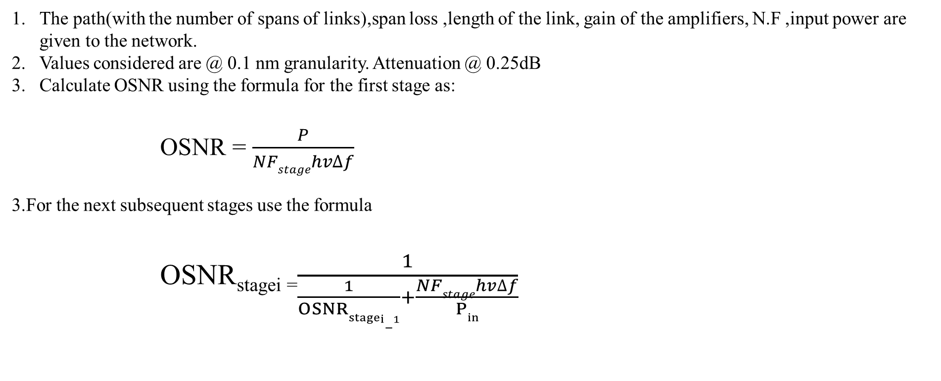
OSNR Calculations
The path(with the number of spans of links),span loss ,length of the link, gain of the amplifiers, N.F ,input power are given to the network.
Values considered are @ 0.1 nm granularity. Attenuation @ 0.25dB
Calculate OSNR using the formula for the first stage as:
OSNR = $\frac{P}{NFstagehv∆f}$
3.For the next subsequent stages use the formula
OSNR_{stagei =}$\frac{1}{\frac{1}{OSNRstagei−1}+\frac{NFstagehv∆f}{Pin}}$

