Slide 1
Data Cleaning with Machine Learning
2017 Data Readiness
Adrianna Boghozian
June 19th, 2017

Slide 2
Outline
Background
2016 Summary
2017 Initial Model
DataKind
Finalized Model
RF High-Level Overview
Data
Results
Implementation
Recommendations
2017 Line Items
Next Steps

Slide 3
Outline
Background
2016 Summary
2017 Initial Model
DataKind
Finalized Model
RF High-Level Overview
Data
Results
Implementation
Recommendations
2017 Line Items
Next Steps

Slide 4
A. 2016 Summary

Slide 5
A. 2016 Summary
Data: Applied to 2015 Line Items
How Many Line Items Affected: 3,738/3,812 (dirty line items), cleaning both Connect Category and Purpose
Resources: ~2 months, 20% of SAT, 40% DQT
Challenges:

Slide 6
A. 2016 Summary
Data: Applied to 2015 Line Items
How Many Line Items Affected: 3,738/3,812 (dirty line items), cleaning both Connect Category and Purpose
Resources: ~2 months, 20% of SAT, 40% DQT
Challenges:
Expectations – Benefits of ML are not always hard numbers.
Notes:
Models are not better than humans. In an ideal world, we would have every line item be cleaned by a DQT person, as they know more than the model does. Alas, we live in a word filled with deadlines and time constraints, thus we turn to ML to help make the data cleaning process more efficient, if possible. Setting expectations is key. We should not expect the model to magically clean X number of districts with one mass update. We should more realistically expect the model to help reduce DQT’s cleaning time per line item, and only prescribe a mass update on the line items with high prediction probabilities. I.e. the low hanging fruit

Slide 7
A. 2016 Summary
Data: Applied to 2015 Line Items
How Many Line Items Affected: 3,738/3,812 (dirty line items), cleaning both Connect Category and Purpose
Resources: ~2 months, 20% of SAT, 40% DQT
Challenges:
Expectations – Benefits of ML are not always hard numbers.
2015/2016 USAC Form – Too many differences.
Notes:
A key component of machine learning is the assumption that the patterns established in the data used to train the model hold in the data the model is applied to. Since the model is trained on the prior year’s data, the relationships between the variables must be similar to the new dataset. Since there were many changes made to the USAC form between 2015 and 2016, the patterns between the variables are less likely to hold between the years. And since the model is only evaluated on the same year’s data, the evaluation of the accuracy on the new year’s data is missing. Which is why we didn’t implement the random forest model on 2016 data.

Slide 8
A. 2016 Summary
Data: Applied to 2015 Line Items
How Many Line Items Affected: 3,738/3,812 (dirty line items), cleaning both Connect Category and Purpose
Resources: ~2 months, 20% of SAT, 40% DQT
Challenges:
Expectations – Benefits of ML are not always hard numbers.
2015/2016 USAC Form – Too many differences.
Level of Effort – Natural time constraints.
Notes:
Since it was the first time the company had ever incorporated a machine learning model into the data cleaning process, there are natural time and resource costs that can incur.

Slide 9
A. 2016 Summary
Data: Applied to 2015 Line Items
How Many Line Items Affected: 3,738/3,812 (dirty line items), cleaning both Connect Category and Purpose
Resources: ~2 months, 20% of SAT, 40% DQT
Challenges:
Expectations – Benefits of ML are not always hard numbers.
2015/2016 USAC Form – Too many differences.
Level of Effort – Natural time constraints.
Inefficient Allocation of Resources – Manual QA for 2015 data.
Notes:
From what I believe, the allocation of resources among staff was not efficient. According to a DQT member, two people were pulled from DQT for a month solid to QA the ML results.
SAT workload was also high and required the full attention of multiple members.

Slide 10
B. 2017 Initial Model

Slide 11
B. 2017 Initial Model
Data: Applied to 2017 Line Items
How Many Line Items Affected: TBD, cleaning Connect Category
Resources: ~1 week, 1 analyst (Adrianna)
Accuracy: ~80%
Challenges:
Guidance – No trained Data Scientist.
What are some ways we can fine-tune the model?
How do we go about evaluating the model correctly?
When/how is it appropriate to use the results?
Notes:
Level of Effort: This year, the level of effort was a few weeks of 1 analysts’ time. It took about a week to develop the initial model and another week to adapt the DK models to new data. Was also able to outsource some of the model finalization to DK. More comprehensive timeline later in the presentation.
Fine-Tuning: More concretely, we could use guidance on how to fine-tune and evaluate the model.

Slide 12
C. DataKind

Slide 13
C. DataKind
What did they do?
Replicated the model in Python
Provided a template for applying the model in the future
Investigated possible new variables (e.g. parsing the narrative fields)
Built multiple models to evaluate other options
Recommended best use cases for the results
Notes:
Request: Since we don’t have an established Data Scientist at the company, help finalize and evaluate our existing model. And general approval that we went about the problem correctly.
2017: This year, the level of effort was a few weeks of 1 analysts’ time. It took about a week to develop the initial model and another week to adapt the DK models to new data. Was also able to outsource some of the model finalization to DK. More comprehensive timeline later in the presentation.

Slide 14
Outline
Background
2016 Summary
2017 Initial Model
DataKind
Finalized Model
RF High-Level Overview
Data
Results
Implementation
Recommendations
2017 Line Items
Next Steps

Slide 15
A. RF High Level Overview
BUT FIRST!
Notes:
The Random Forest Model is trained on the cleaned variable that resulted from the past dirty line items, which it then uses to predict the correct variable for a future dirty line item.

Slide 16
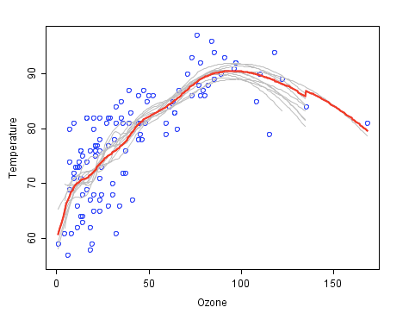
A. RF High Level Overview – Ensemble Learning
Notes:
A Random Forest utilizes a “build-and-conquer” approach to improve performance. The main principle being a group of “weak learners” can come together and form a “strong learner”.
Graph: The data to be modeled are the blue circles. Which we assume represents some underlying function + noise. Each gray curve (a “weak learner”) represents a fair approximation to the underlying data. The red curve (the ensemble “strong learner”) can be seen as a much better approximation of the underlying data.

Slide 17
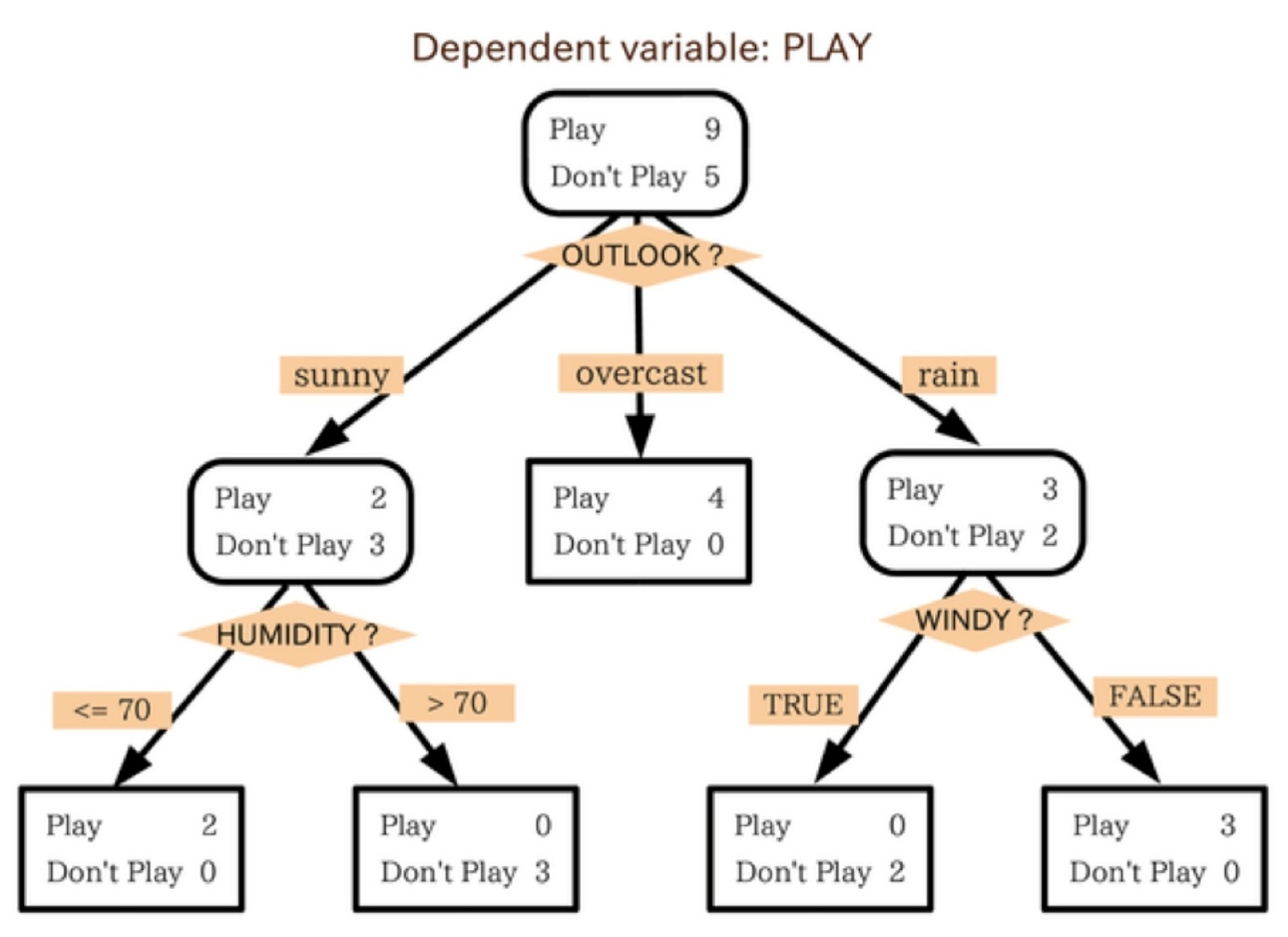
A. RF High Level Overview - Trees
Notes:
Random Forest uses a standard machine learning technique called a ”decision tree”, a weak learner.
Example: The tree advises us, based upon weather conditions, whether to play ball. For example, if the outlook is sunny and the humidity is less than or equal to 70, then it’s probably OK to play ball.

Slide 18
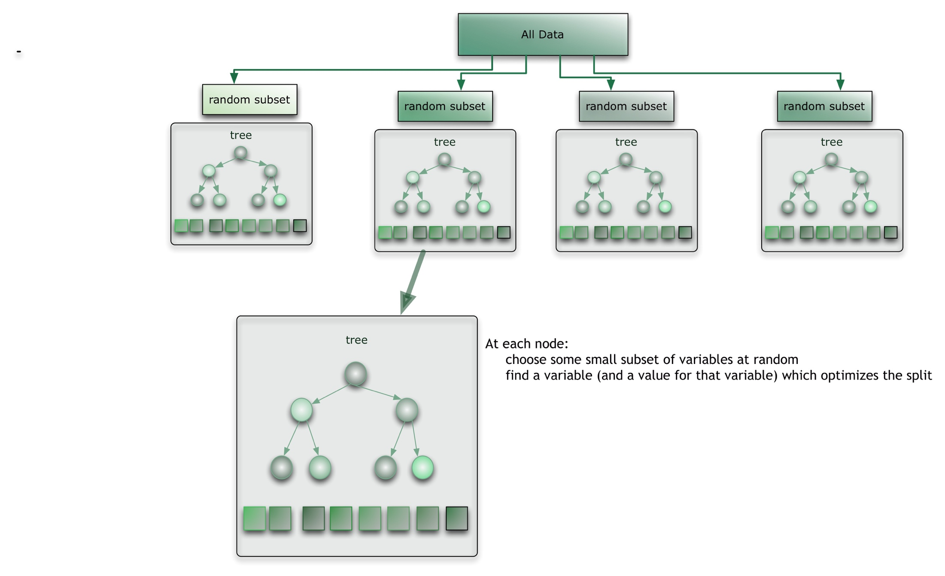
A. RF High Level Overview - Forest
Notes:
These individual trees are combined in an ensemble to create a forest, which becomes our strong learner.
In the case of categorical variables, the result is decided by a voting majority of the individual trees.

Slide 19
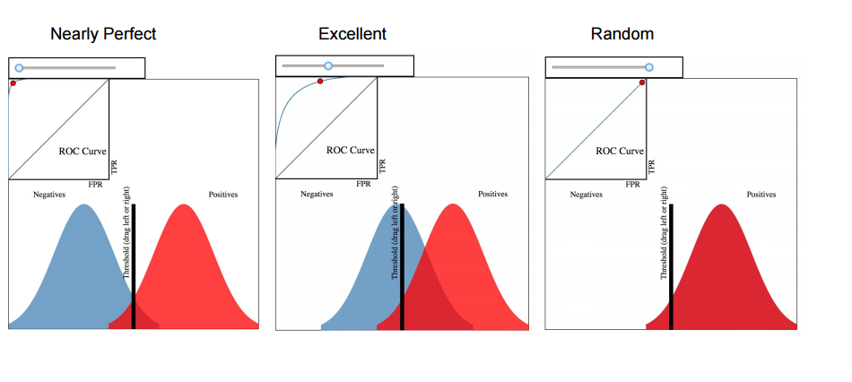
A. RF High Level Overview – Evaluating the Model
Notes:
The curves represent frequency distribution for the classifier output on the validation data (i.e. the 2016 data held out of training the model, so the model has never seen the data before). The experimental question we want to answer: does the classifier give us any more information about the CTR than just guessing?
Random: What the curve would look like if the model was just guessing.

Slide 20
A. RF High Level Overview – Strengths/Weaknesses
Strengths:
Fast Runtime
Able to deal with unbalanced and missing data
Easy to interpret results
Weaknesses:
Cannot predict beyond categories in training data
May over-fit data sets that are particularly noisy
Notes:
Cannot predict beyond categories in training data, for example if a new connect category was added to the form in 2017, the model wouldn’t know how to handle it.

Slide 21
B. Data

Slide 22
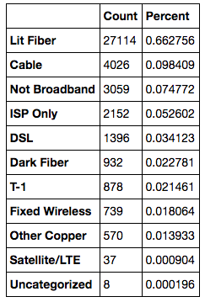
B. Data
Training Data:
2016 Metadata (FRN-level) + 2016 Line Items (Raw USAC Line Items)
Total Records: 309,545
Total Records for Analysis: 40,547 (Broadband = True & Exclude = FALSE)
Dependent Variable: Connect Category
Notes:
We are more confident that this year’s form is much more similar to last year’s, thus there is a stronger baseline assumption that the relationships established between the variables in 2016 in the model will accurately hold in 2017. We also have come up with a way to evaluate the model on the 2017 data: Since DQT has been blindly cleaning for a few weeks, we will be able to calculate the accuracy of the model projections as compared to the line items they have cleaned thus far.

Slide 23
C. Results

Slide 24
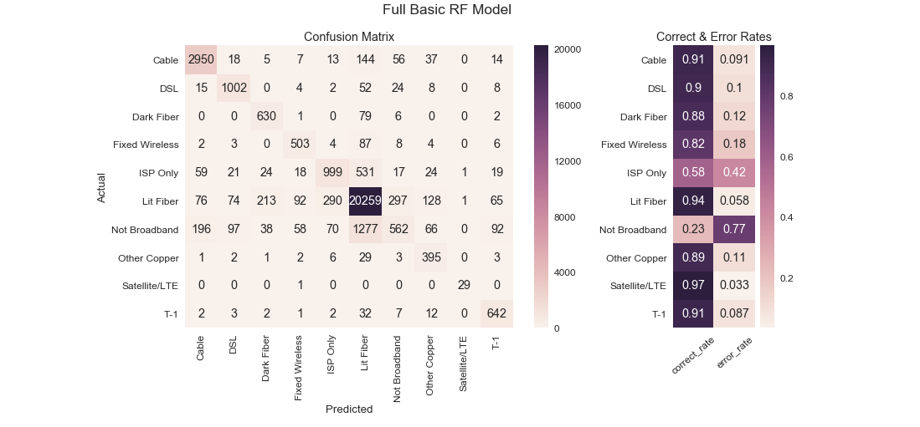
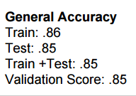
C. Results – Confusion Matrix
Notes:
Explain Results:
Naturally, the model tries to minimize the error rate on the largest group: Lit Fiber.

Slide 25
C. Results – ROC Curves (Reminder)

Slide 26
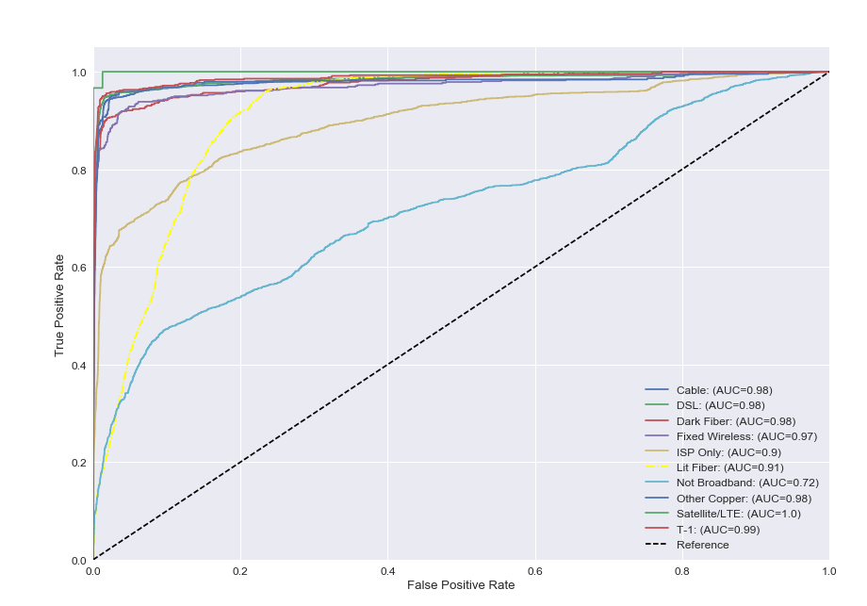
C. Results – ROC Curves
Notes:
Explain Results:
Not Broadband less accurate. Trade-offs, lose accuracy of Lit Fiber at the cost of increasing Not Broadband.

Slide 27
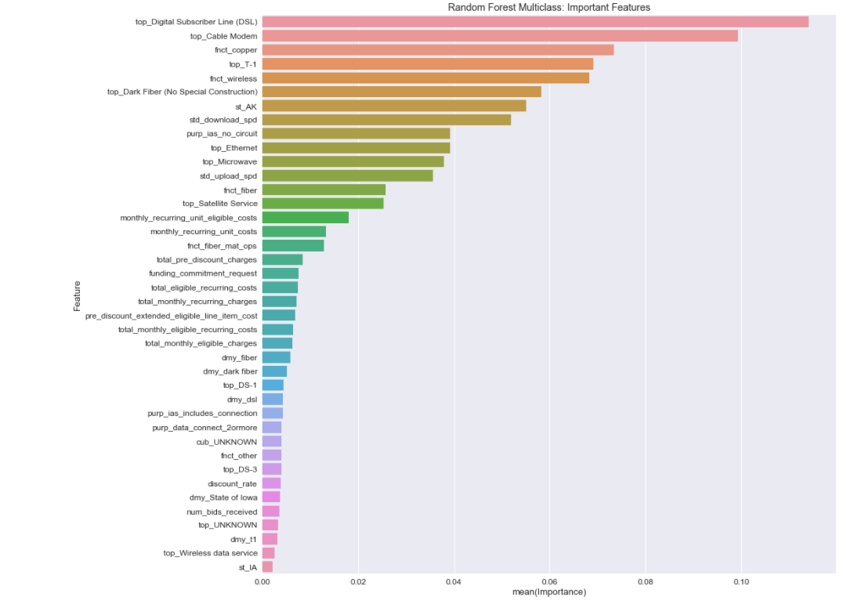
C. Results – Important Variables
Notes:
Explain Results:
Type of Products: DSL, Cable Modem, T-1, Dark Fiber (Special Construction)
Functions: Wireless
States: Alaska
Download Speed (Broadband)

Slide 28
Outline
Background
2016 Summary
2017 Initial Model
DataKind
Finalized Model
RF High-Level Overview
Data
Results
Implementation
Recommendations
2017 Line Items
Next Steps

Slide 29
A. Recommendations

Slide 30
A. Recommendations
Potential Uses:
Mass Update ”Low-Hanging Fruit” Line Items
For the harder cases, incorporate the predicted values and their probabilities in IRT to help DQT speed up cleaning and decision-making process
Also use the model results to determine “Clean” line items that may be inaccurate.
Notes:
Models are not better than humans. In an ideal world, we would have every line item be cleaned by a DQT person, as they know more than the model does. Alas, we live in a word filled with deadlines and time constraints, thus we turn to ML to help make the data cleaning process more efficient, if possible. Setting expectations is key. We should not expect the model to magically clean X number of districts with one mass update. We should more realistically expect the model to help reduce DQT’s cleaning time per line item, and only prescribe a mass update on the line items with high prediction probabilities. I.e. the low hanging fruit.
OTHER BENEFITS: Our definition of ”Clean” is removing logic flags. Thus, the line items that are “Clean” may still in fact be wrong. The model may in fact highlight records that we thought were “Clean”. For instance, if the model is highly confident in predicting a different connect category on a line item that is “Clean” according to our definition, then we may be missing something important about that line item.
2017: As stated earlier, the 2017 QA process should be much more straightforward. It is also adapted naturally from the existing DQT cleaning process and thus should not involve any extra DQT time. There will be some minimal time needed from ENG to make a few changes to IRT and create a staging DB to evaluate possible implications.

Slide 31
B. 2017 Line Items

Slide 32
B. 2017 Line Items
**PRELIMINARY RESULTS**
How many have a high probability predicted connect category that is DIFFERENT than the current connect category?
Notes:
TBD

Slide 33
C. Next Steps

Slide 34
C. Next Steps (If Approved)
SAT to finish Model B (using data transformed to ESH values and with flagging): End of this week
SAT to determine which model is best (highest accuracy): End of this week
SAT to determine threshold for possible mass update: Next Week
SAT to apply potential mass update in staging, evaluate the line items that will be affected: Next Week
ENG to implement model recommendation fields in IRT: TBD
Future:
Can also extend the model to other variables that DQT determines are especially dirty this year. (Minimal effort)
Notes:
Model Recommendation Fields = Predicted Value and Probability. Can also rank all Predicted Values with each probability.

Slide 36
Appendix

Slide 37
2017 Initial Model Details
Type: Random Forest Classifier Model
Data: 2016 Raw USAC Line Items
Dependent Variable: 2016 Cleaned Connect Category
Initial Accuracy: 80%
Notes:
Built by Adrianna, in about a week.

Slide 38
Project Timeline
April 14th: Kick-Off Call with DK
Mid-April – May 5th: DK replicates model
May 5th: DK Presentation to SAT
May 12th: DK Code Handoff
June 8th: ENG Handoff of new data
June 8th-Now: SAT adapts DK code to new data
Notes:
April 14th: Sent over the preliminary model (in R). Established about a 2 month turn-around for DataKind.
Mid-April-May 5th: DataKind replicates the model (in Python). Various check-ins with Adrianna and Jamie to help familiarize them with the data and problem. They also created a few different models to see if it could improve accuracy, but ended up recommending the original model.
May 5th: DK Presentation on Models and Results to Adrianna, Solomon, and Jamie
May 12th: DK code handoff to ESH
June 8th: Since the DK models were built using raw USAC data, we all agreed that re-running the models on the transformed, flagged version of the raw data would most likely result in more accurate predictions. So we waited for ENG to pass along those versions of the datasets for both 2016 and 2017, which had to be recreated.

