Slide 1
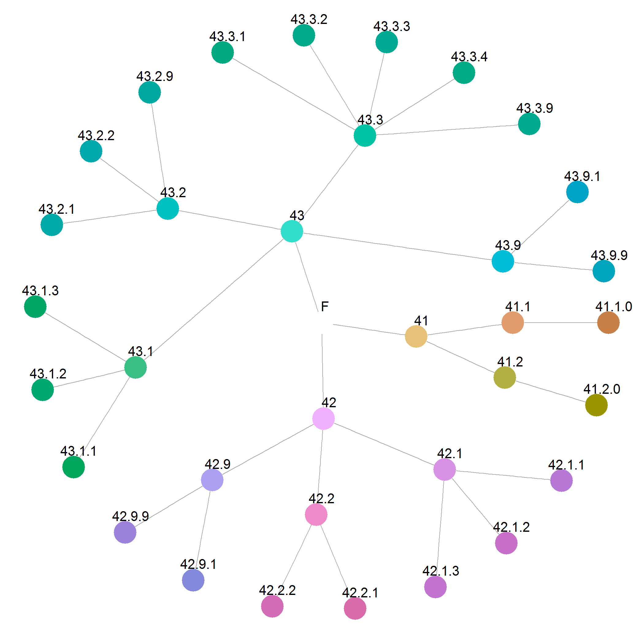
Hierarchical qualitative color palettes
Martijn Tennekes and Edwin de Jonge
Statistics Netherlands (CBS)
Used color space: Hue-Chroma-Luminance
Hue: branch of the tree
Chroma and Luminance: tree depth

Slide 2
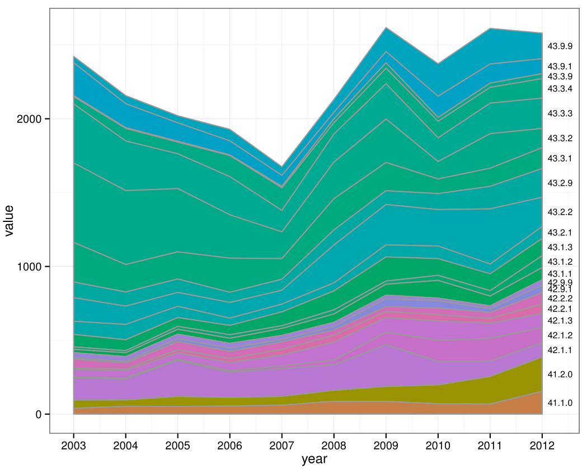
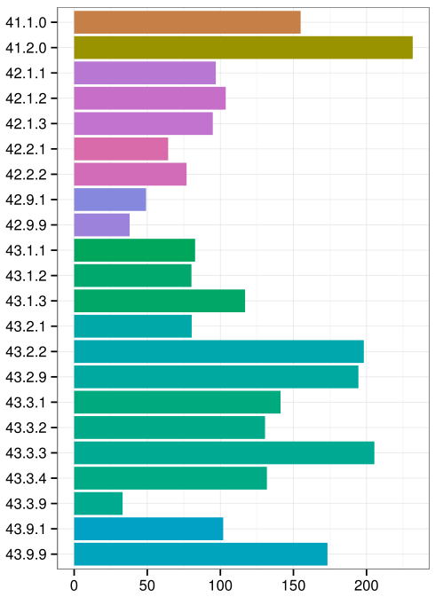
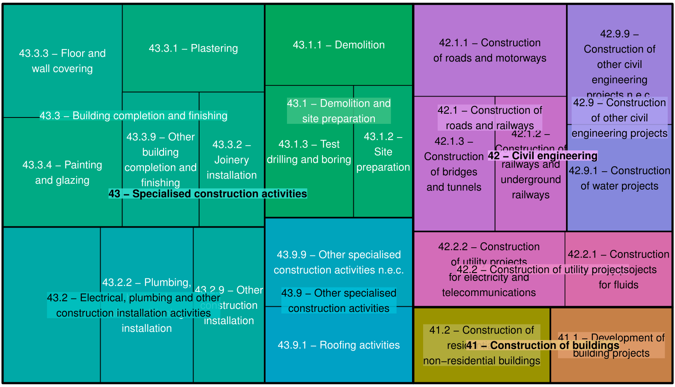
Applications
Data: turnover values per economic section
Stacked area chart
Bar chart
Treemap

