Slide 1
Tree Colors
Color Schemes for Tree-Structured Data
Martijn Tennekes m.tennekes@cbs.nl
Edwin de Jonge: e.dejonge@cbs.nl
Statistics Netherlands

Slide 2
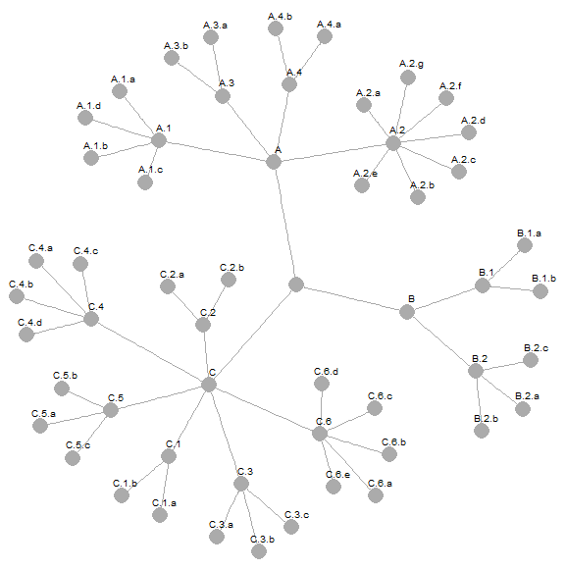
Tree-structured data
Applications within Official Statistics:
Economic activity
Goods
Jobs
Regions
Need for color schemes that reflect tree structures
Why?
To support visual analysis
Possibility to relax the tree layout for node-link diagrams
To improve attractiveness of tree visualizations

Slide 3
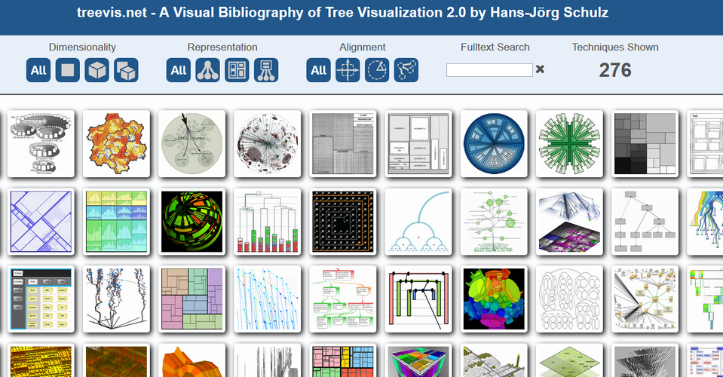
Related work
treevis.net

Slide 4
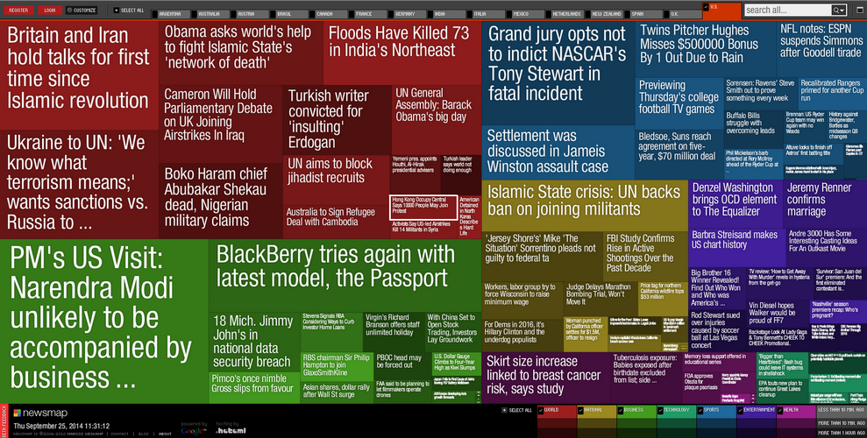
Related work
newsmap.jp

Slide 5
Tree Colors
Properties in mind:
Unique colors
No perceived order of siblings
Parent-child relations encoded
Node depths encoded

Slide 6
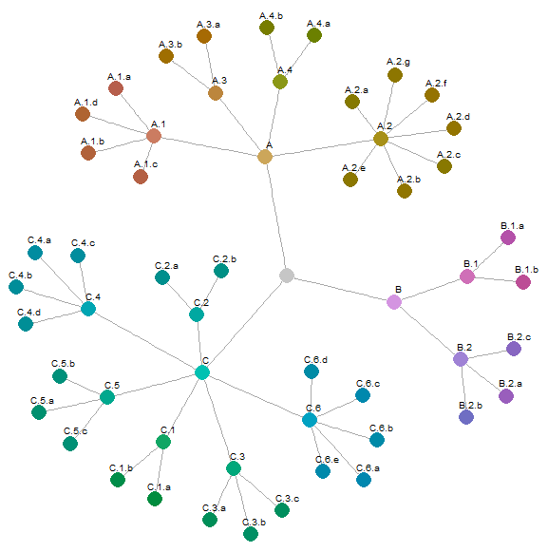
Tree Colors
Properties in mind:
Unique colors
No perceived order of siblings
Parent-child relations encoded
Node depths encoded
Approach
Hue resembles branches
Chroma and luminance discriminate hierarchical levels

Slide 7
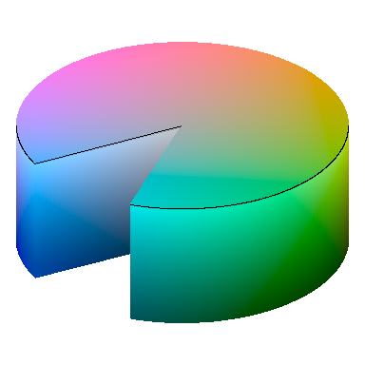
HCL color space
Chroma
Luminance
Hue
Well-balanced perceptual properties

Slide 8
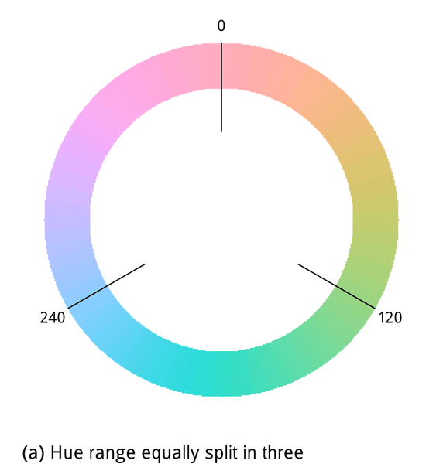
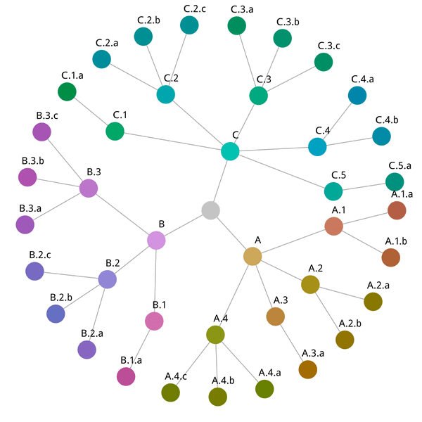
Hue allocation

Slide 9
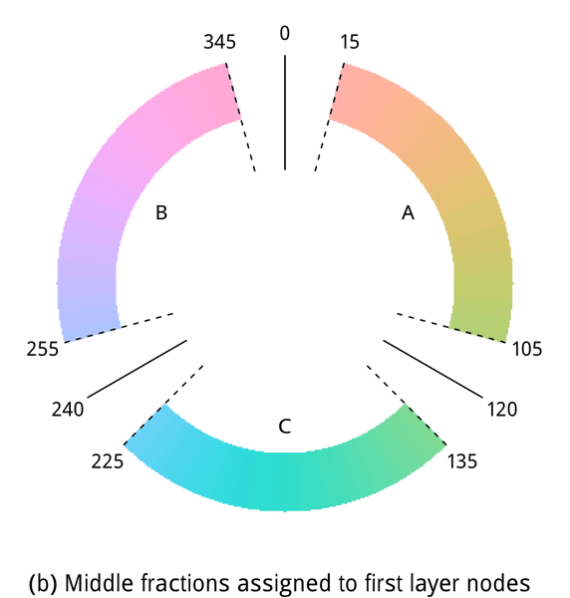
Hue allocation
Hue ranges reduced by
fraction f=0.75

Slide 10
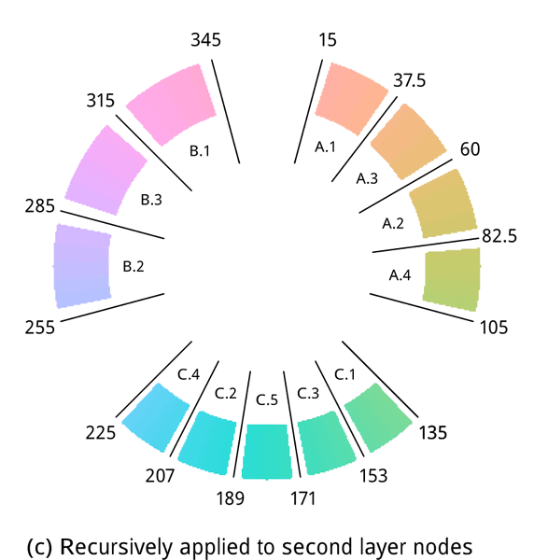
Hue allocation
Hue ranges of siblings permuted and for
odd-numbered branches reversed

Slide 11
Depth
Default method
Luminance decreases with depth
Chroma increases with depth

Slide 12
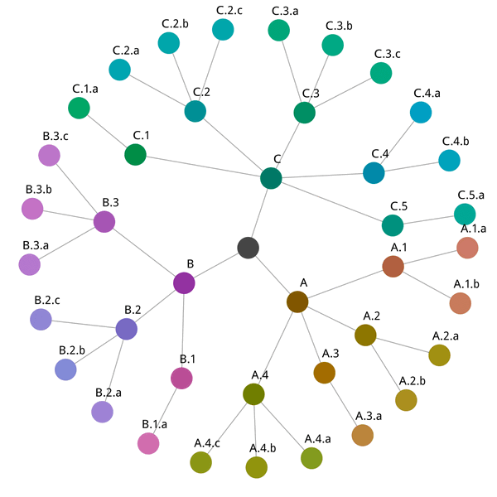
Depth
Alternative method
Luminance increases with depth
Chroma decreases with depth

Slide 13
Software
Near future: implementation as Javascript library
Tree Colors implemented in R-package treemap
library(treemap)
treecolors()

Slide 14
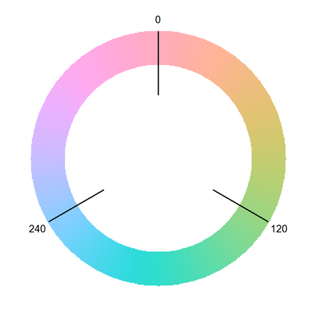
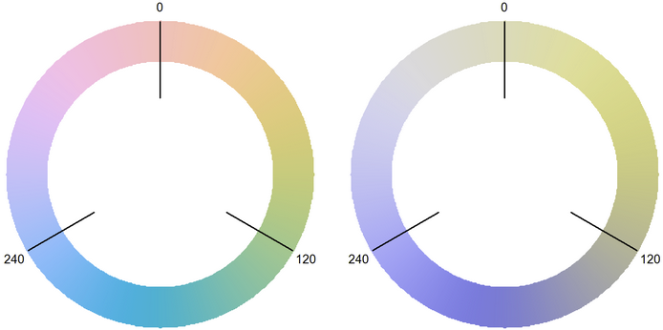
Color vision deficiency
Normal color vision
(trichromats)
Deuteranomaly
(anomalous trichromats)
Protanopia
(dichromats)

Slide 15
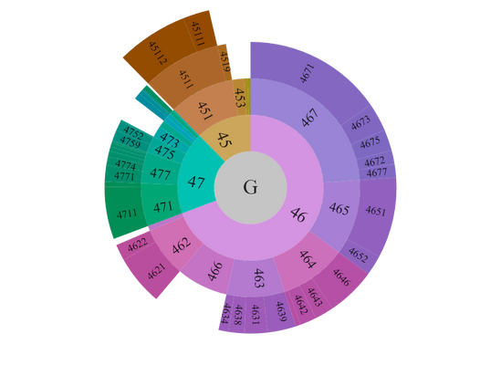
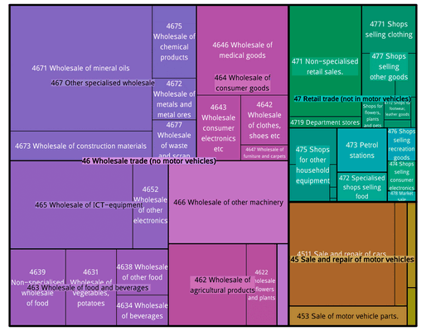
Applications (1)
(a) Sunburst diagram
(b) Treemap
Net turnover for economic activity sector G, Wholesale and retail trade

Slide 16
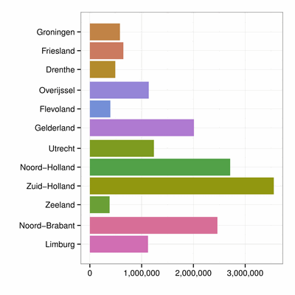
Applications (2)
Dutch population per province

Slide 17
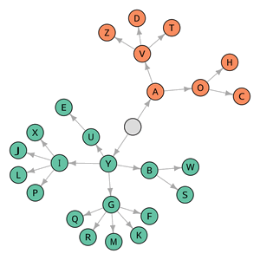
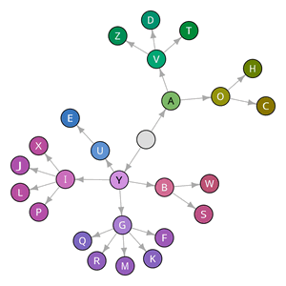
User study: setup
98 participants with normal color vision
10 participants with color vision deviciency
Reading questions:
Relations
Offspring
Evaluation questions:
Prettiness
Interpretation
Overview
Main Branch Colors
Tree Colors

Slide 18
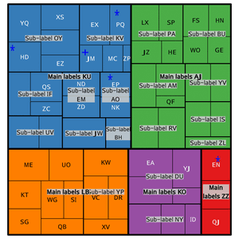
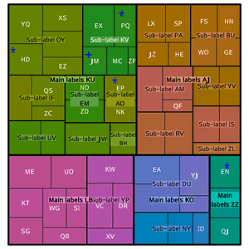
User study: setup
98 participants with normal color vision
10 participants with color vision deviciency
Reading questions:
Relations
Offspring
Evaluation questions:
Prettiness
Interpretation
Overview
Main Branch Colors
Tree Colors

Slide 19
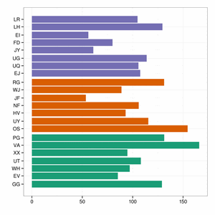
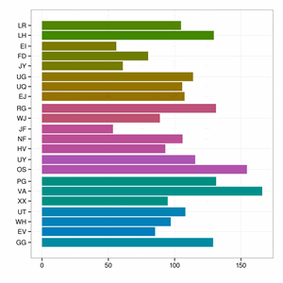
User study: setup
98 participants with normal color vision
10 participants with color vision deviciency
Reading questions:
Relations
Offspring
Evaluation questions:
Prettiness
Interpretation
Overview
Main Branch Colors
Tree Colors

Slide 20
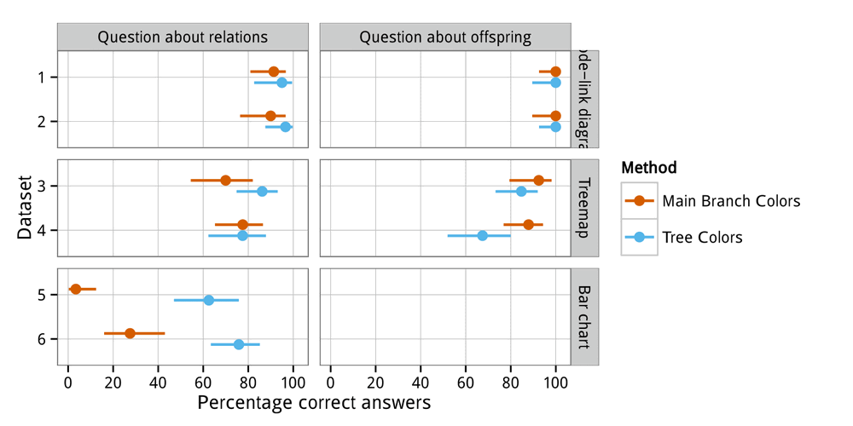
User study: results

Slide 21
Final remarks
Tree Colors can improve visualizations of tree-structured data.
Hue allocation designed for siblings that are ordered linearly or radially. More research needed on 2d visualizations (e.g. treemap).
Not suited for people with color vision deficiency.
Tree Colors can be applied to large hierarchical datasets. However, the effectiveness is unknown.

