Slide 1
Tree Colors
Color Schemes for Tree-Structured Data
Martijn Tennekes m.tennekes@cbs.nl
Edwin de Jonge: e.dejonge@cbs.nl
Statistics Netherlands

Slide 2
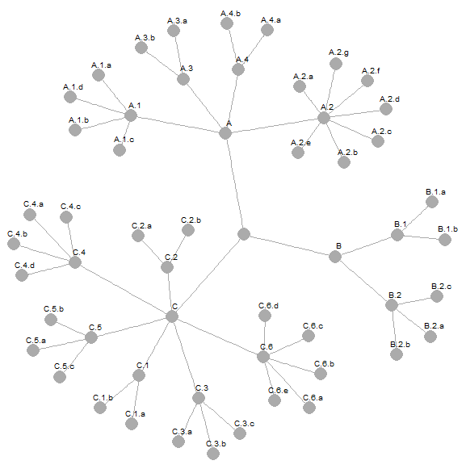
Tree-structured data
Applications within Official Statistics:
Economic activity
Products
Jobs
Regions
Need for color schemes that reflect tree structures
Why?
To support visual analysis
Possibility to relax the tree layout for node-link diagrams
To improve attractiveness of tree visualizations

Slide 3
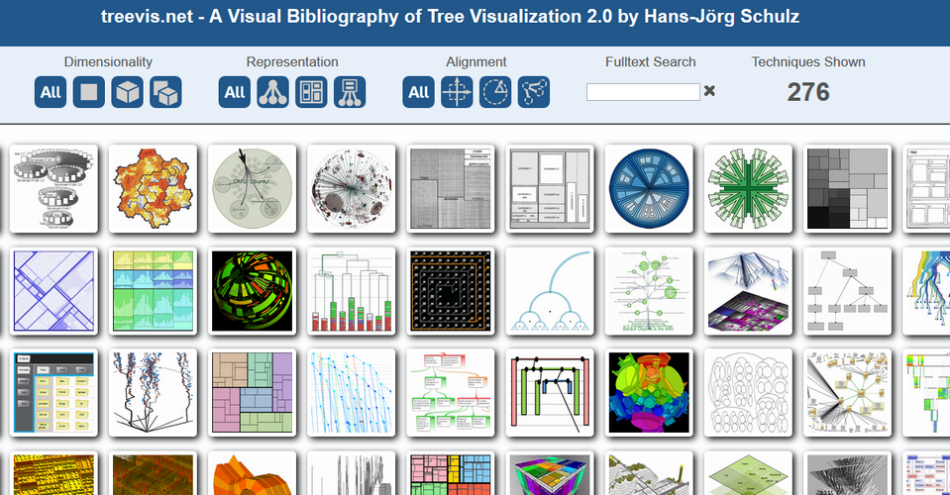
Related work
treevis.net

Slide 4
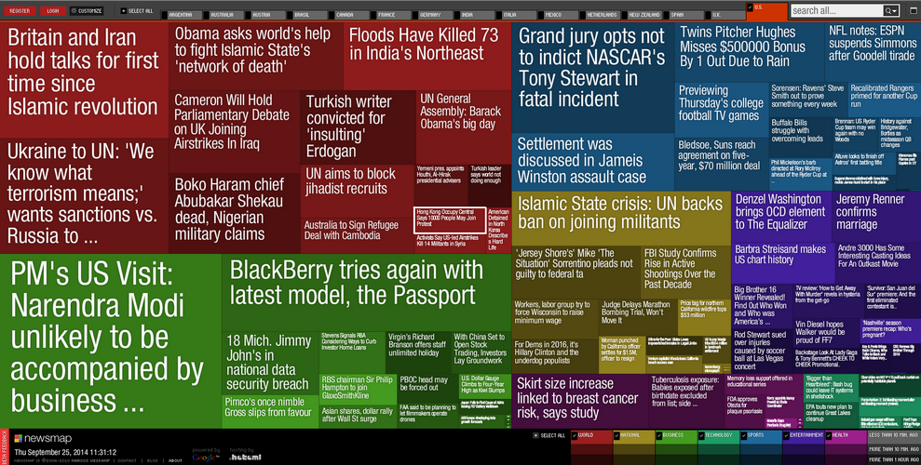
Related work
newsmap.jp

Slide 5
Tree Colors design
Properties in mind:
Unique colors
No perceived order of siblings
Parent-child relations encoded
Node depths encoded

Slide 6
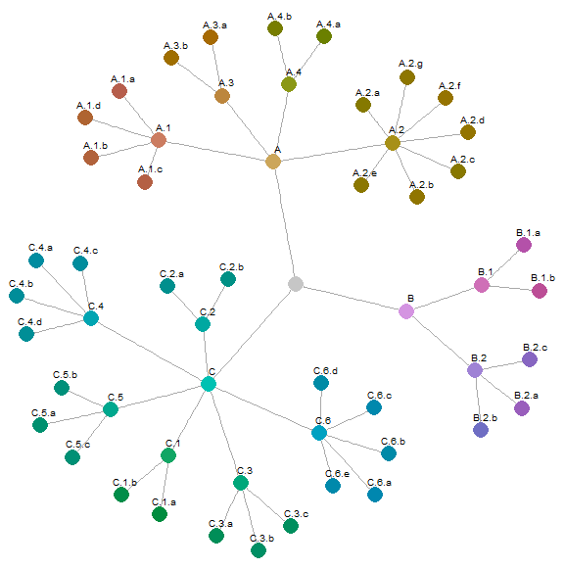
Tree Colors design
Properties in mind:
Unique colors
No perceived order of siblings
Parent-child relations encoded
Node depths encoded
Approach
Hue resembles branches
Chroma and luminance discriminate hierarchical levels

Slide 7
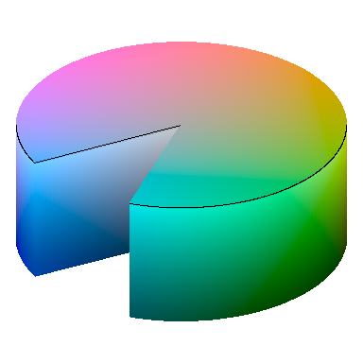
HCL color space
Chroma
Luminance
Hue
Well-balanced perceptual properties

Slide 8
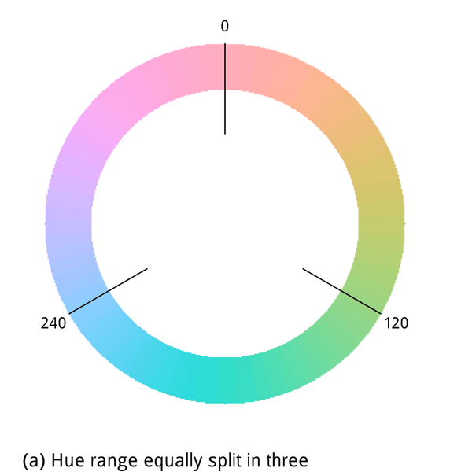
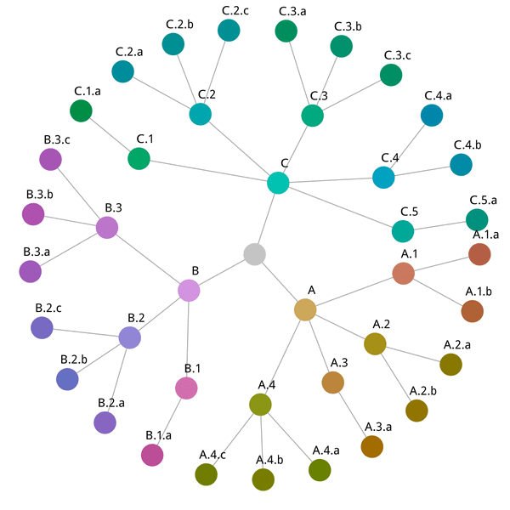
Hue allocation

Slide 9
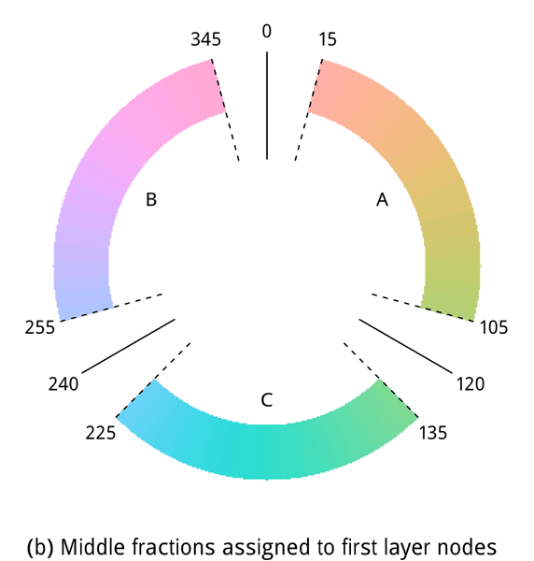
Hue allocation
Hue range for A reduced by fraction f=0.75:
120 degrees * 0.75 = 90 degrees

Slide 10
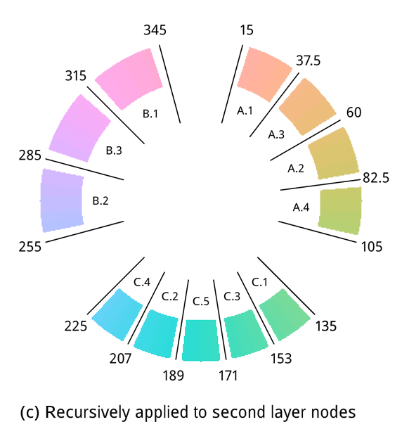
Hue allocation
Hue ranges of siblings permuted and for
odd-numbered branches reversed

Slide 11
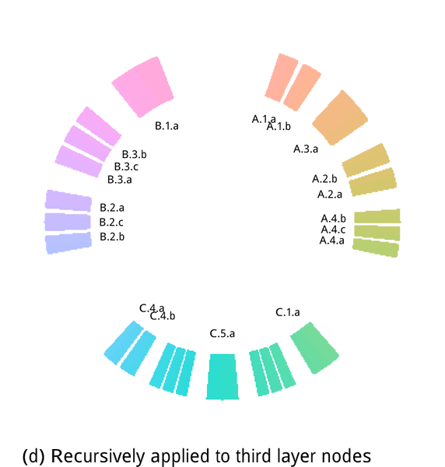
Hue allocation

Slide 12
Depth
Default method
Luminance decreases with depth
Chroma increases with depth

Slide 13
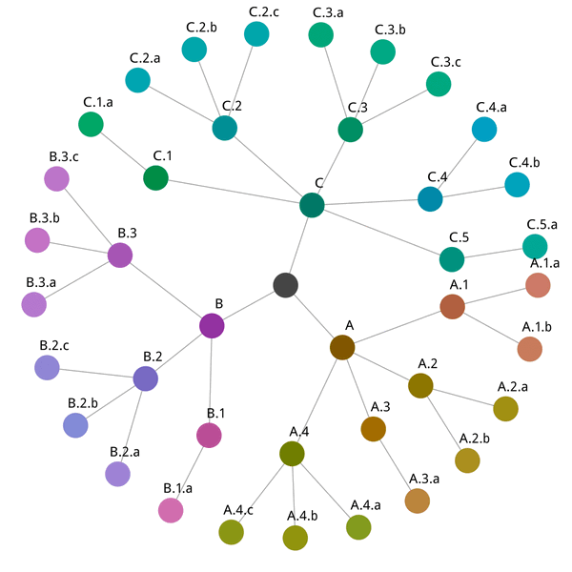
Depth
Alternative method
Luminance increases with depth
Chroma decreases with depth

Slide 14
Software
Tree Colors implemented in R-package treemap
library(treemap)
treecolors()

