Slide 1
Welcome to the party
A DevOps View of AppSec
Boyd E. Hemphill
Director of Cloud Engineering
Contrast Security

Slide 2
Presentation Overview
Know me to know where I am coming from
10 Years of DevOps evolution.
Because history repeats itself, but you don’t have to repeat all the history
Wisdom is learning from others’ mistakes
Lessons that apply to AppSec today
How to avoid the mistakes and get to the good stuff

Slide 3
Ground rules
Laugh at me
Laugh at yourself
I am

Slide 4

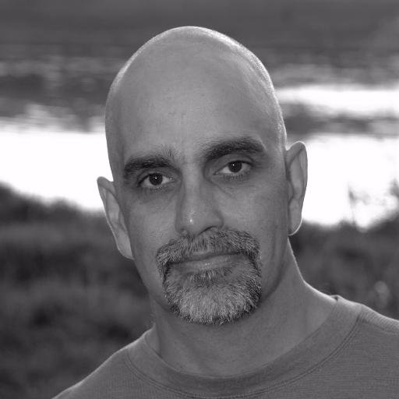
Recovering SysOp/dba
No, the DB isn’t slow
but your code sucks
Don’t touch my production
That won’t perform
That’s not secure
Don’t move my cheese

Slide 5

Bastard Operator from hell
https://bofh.bjash.com/
Is it plugged in?
Did you try rebooting it?
Did your parents have any children that lived?

Slide 6
Bit of street cred
In 2008, I may or may not have obtained the SSN of every TX certified teacher.
I may, or may not, have responsibly disclosed this
Someone may have run through the halls of TEA to unplug a server (or not)
In 2008, this may have been one of the the largest breaches of its kind at the time (>1,000,000 identities)
My wife and I are certified teachers.

Slide 7

Are you one of these people?
Do you run down the hall yelling, “Stop, you are breaking all the securities!”

Slide 8

Today
I’m a certified DBA (Oracle, MySQL)
PHP Engineer (Oxymoronic?)
DevOps Engineer (WTF does that even mean?)
DevOps Days, Austin DevOps, Container Days Organizer
Today I am the Director of Cloud Operations at Contrast Security.
I think I am allowed to say that we are buzzword compliant.
https://www.masterclass.com/articles/what-is-a-movie-director-the-responsibilities-of-a-film-director-and-tips-on-directing-actors

Slide 9
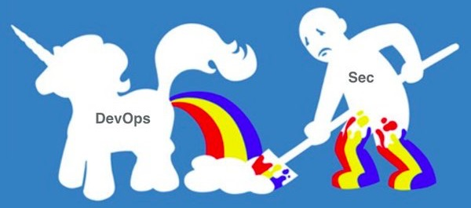
Security matters. Application security most of all.
By definition, port 443 is a hole in the firewall to “all your database”- see what I did there?

Slide 10
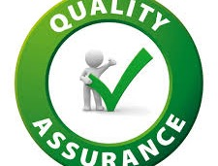
Devops a history
How Application security can avoid reinventing the wheel and make the internet a safer place in a world of unicorns, fluffy bunnies and rainbows.

Slide 11
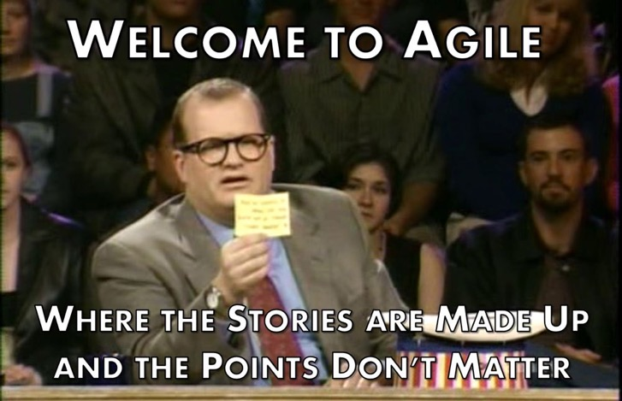
2009-2010 Dev-Agile-Ops
How can ops benefit from Agile software development practices?
Ops was, and still is to a smaller extent, an inhumane place to work
Working software sure sounds better than a runbook!

Slide 12
I mean … Who wouldn’t want in on that action?!
That work will take 42.

Slide 13
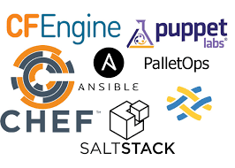
2010-2012 Dev-puppet-Ops
Infrastructure as Code
Puppet state of the DevOps
Chef’s incredible community
But consider – Blade Logic started in 2001 and was bought for $800m in 2008.

Slide 14
Notice: It’s not about who had the idea first.
Puppet made something hard available to reason about by mere mortals. <- Pattern

Slide 15
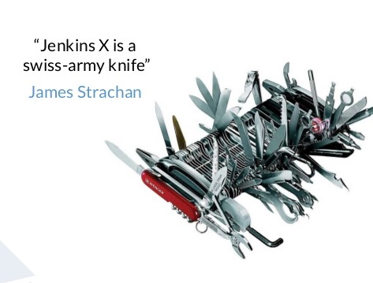
2011-2015 Dev-ci/CD-Ops
CI is largely a solved problem today
Except where security is concerned!
Build as code - The fall of Jenkins
Cruise Control - 2001

Slide 16
Notice a pattern - * as Code …
In order to take advantage of Agile software practices, we needed our work to look more like developers work!

Slide 17
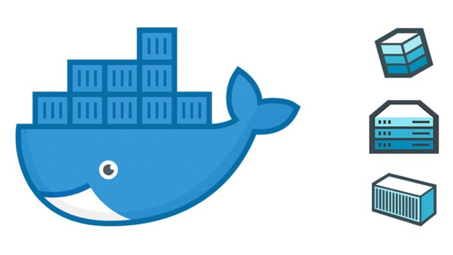
2015-2017 Dev-docker-Ops
Docker was not a great container, it was a great workflow
Developers produce infrastructure as an artifact.
Build parallelization

Slide 18
Build parallelization – put a pin in it …
At contrast, our Java agent goes through 900 containers per build. Build parallelization makes security testing in the pipeline possible. Docker makes that accessible to mortals.

Slide 19
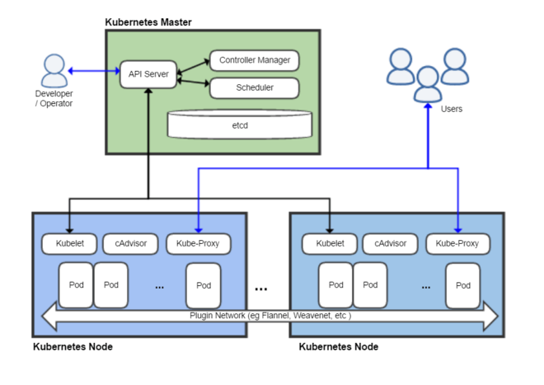
2017 - 2019 Dev-k8s-Ops
Orchestration as code
There is that ”as code” thing again
And … That time I got a sick feeling in my tummy over an ever-growing attack surface.

Slide 20
Notice a pattern of standardization …
Think back … Each DevOps ”era” was about standardization
Agile – standardizing work practices
Config Mgmt – Standardizing machine configuration
CI / CD – Standardizing builds and deploys
Docker – simplifying the standard infra to the point of eliminating the need for config mgmt.
K8S – Standardizing application orchestration

Slide 21
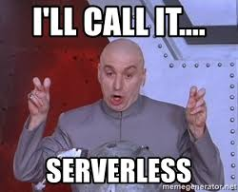
2018 - 2019 Dev-serverless-Ops
As a consultant I saw significant companies in Hippa, FERPA and PCI spaces with 100% serverless topologies
If its serverless, then it must all be code.
If it is all code then AppSec must play a meaningful role

Slide 22
Notice a pattern of elimination …
Think back … Each DevOps ”era” was about elimination
Agile – eliminate bespoke work processes
Config Mgmt – eliminate bespoke infrastructure
CI / CD – eliminate a primary need for bespoke testing
Docker – eliminate config management.
K8S –
Serverless – eliminate infrastructure (thus containers _and_ config management)

Slide 23

Security is a problem
Values bespoke practices of wizards
Manual reviews
Points out problems, but has no viable solutions
Chicken little

Slide 24
Security is, in most ways, the pre-devOps Ops. Look back at me circa 2008
DBA – don’t touch my database
BOFH – No you cannot have access to that machine
Don’t move my cheese!
High value on bespoke knowledge and behavior
Low value on standardization of practice
Except that in many ways security defects are far more devastating than operational deficiencies.

Slide 25
If you subscribe to the truth that security is the impediment to business, then there is great opportunity.
Find the constraint
Optimize the constraint
Subordinate all work in the system to the constraint
Elevate the constraint
Return to Step 1.
- Eliyahu Goldratt

Slide 26
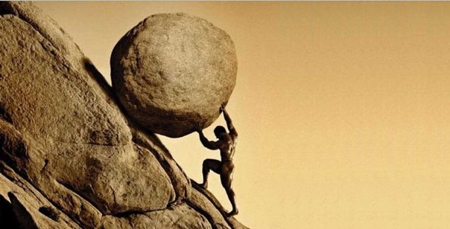
https://www.davelabowitz.com/blog/sisyphus-and-leadership/

Slide 27
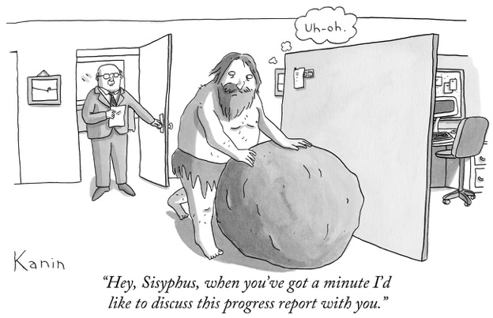
Turn toil in to code.
If it is done a third time, then it is automated before the 4th.
automated security testing in the build pipeline is key
https://blogs.getty.edu/iris/thinking-about-sisyphus-or-the-afterlife-with-some-rock-n-roll/

Slide 28
Agile says it values: Individuals and interactions over processes and tools
Should we value working automated security tests over manual processes and procedures?
Remember: While we value automation _more_ there is still important value to manual testing! (e.g. exploratory efforts)

Slide 29
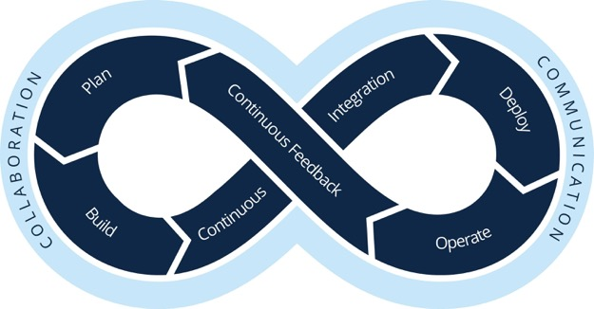
In DevOps we learned.
Automate all the things (as code)
What we value most
But first know what you are automating and why.
What we know is still valuable
What does it mean to automate security checks?
How do we gain assurance faster and _better_?
https://www.smartsheet.com/devops-tools

Slide 30
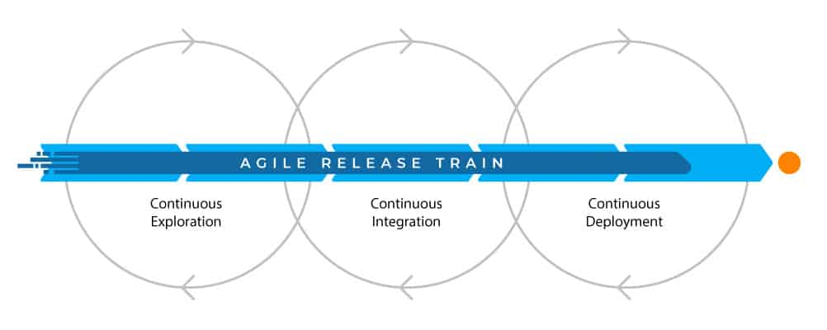
https://www.plutora.com/blog/agile-release-train

Slide 31
Agile says it values: Responding to change over following a plan
Should we value our ability to quickly assure minimum viable security over a set of checks that happen after code is complete?
Remember: While we value ensuring security during development _more_ there is still important value to testing after code is complete! (e.g. red team exercise)

Slide 32

In DevOps we learned.
Our ability to prevent mistakes early saves time, talent and treasure
What we value most
Our ability to rapidly fix a production issue is more powerful than prevention
What we value most
Our ability to identify production issues (vulns) is still an obligation
What we know is still valuable
What if you could fix a vuln within hours of finding it?

Slide 33
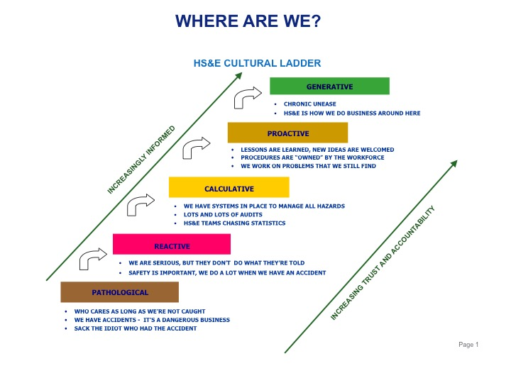
https://www.hplltd.net/wp-content/uploads/2015/01/Slide1.jpg

Slide 34
Agile principle #11: The best architectures, requirements, and designs emerge from self-organizing teams.
Culture is a pillar of Devops. Safety culture is something discussed on the fringes
Safety culture is the basis for today’s common agile ceremonies.

Slide 35
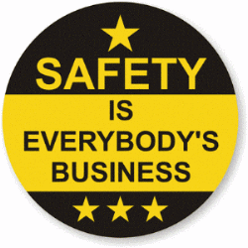
In DevOps we learned.
When you blame a person or team for a problem, they hide their mistakes.
When you make it safe to talk about a mistake, you make it safe to learn.
When learning happens maturity improves.
Empower teams. Hold them accountable to learning.

Slide 36
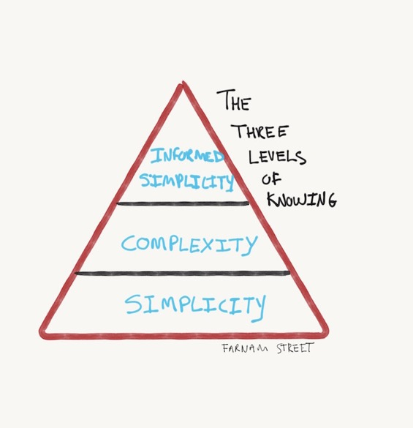
https://fs.blog/2016/06/three-levels-knowing/

Slide 37
Agile principle #10: Simplicity--the art of maximizing the amount of work not done--is essential
View this from the perspective of the Lean movement. One must strive to remove work from the system.
In Gene Kim’s The Phoenix Project, the first way is about removing unnecessary work in an effort to maximize the throughput of a system. This comes, in turn, from the work of Deming and goldratt.
https://itrevolution.com/the-three-ways-principles-underpinning-devops/

Slide 38
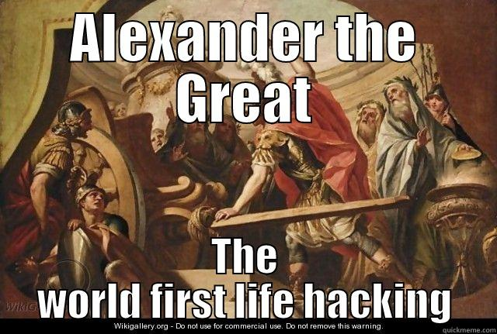
In DevOps we learned.
Complex is what smart people do
Simple is what smart people who are responsible for the results do.

Slide 39


Slide 40
Fact: jobs that create value will replace jobs that prevent business value.
This was terrifying in the early days of devops.
Turns out all of us SysAdmins got a title change and a 100% raise. While there are still SysAdmins and infrastructure jobs in the world, we value those innovating on business value far more.

Slide 41
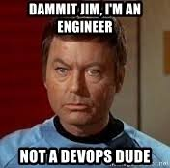
In DevOps we learned.
It’s only a matter of finding the right place to practice your craft.
That place is at the point of creation, not after creation has happened.
Resistance is futile.
Remember there are plenty of well paid cobol programmers in the world.
And sysadmins too!

Slide 42
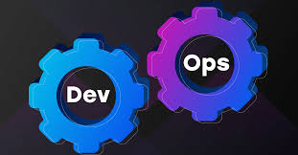

Summary: Marketing v. Reality
Not DevOps
Devops

Slide 43
Summary: Marketing V. Reality
Not DevOps
DevOps
Two clearly defined and distinct roles
The implicit idea they just fit together
Simplicity is implicit
Anyone can do it
Represents an entire system
Comes unassembled
Is messy
Beautifully simple at a glance
Devilishly difficult to do right

Slide 44


Slide 45
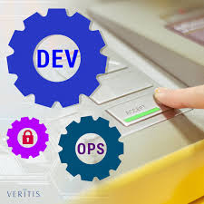
Join the devsecops movement?
Consider that creating a new movement slows adoption.
Consider that joining forces with existing devops movements gives you a platform to promulgate your concerns.
Consider that the same platform is one you can learn from.
Jeebers! The ”Sec” gear is locked in place and they are not meshed! Truth …
https://www.veritis.com/resources/blog

Slide 46
You are standing on the precipice of the devsecops revolution. Add your voice:
Bring your concerns, your cares and your talks to
Austin DevOps - https://www.meetup.com/austin-devops
Cloud Austin - https://www.meetup.com/CloudAustin/
Austin Automation Professionals (QA) - https://www.meetup.com/Austin-Automation-Professionals/
DevOps Days Austin - https://devopsdays.org/
DevSecOps Days - https://www.devsecopsdays.com/
OWASP Austin - https://www.eventbrite.com/o/owasp-austin-chapter-3022017070
Application security is a team sport. We need more people like you on our team.
Build this list for _your_ town!

Slide 47
An agile team is 2 Pizzas in size and contains all the skill sets necessary to accomplish the sprint commitments.
We cannot be agile unless appSec is on our team.
Remember: We are uncovering better ways of developing software …

