Slide 1
Simon Bennetts
The OWASP
ZAP HUD

Slide 2
What is ZAP?
A tool for finding vulnerabilities in web apps
Completely free and open source
An OWASP Flagship project
The worlds most popular free and open source web security tool
A community project

Slide 3
How can you use ZAP?
Available on Windows, Linux, Mac OS
Multiple Docker images (stable, bare, weekly, live)
Suitable for beginners and security professionals
Can run in Desktop or Daemon modes
Can be used manually at any stage in development
Ideal for automated testing

Slide 4
Demo Time!

Slide 5
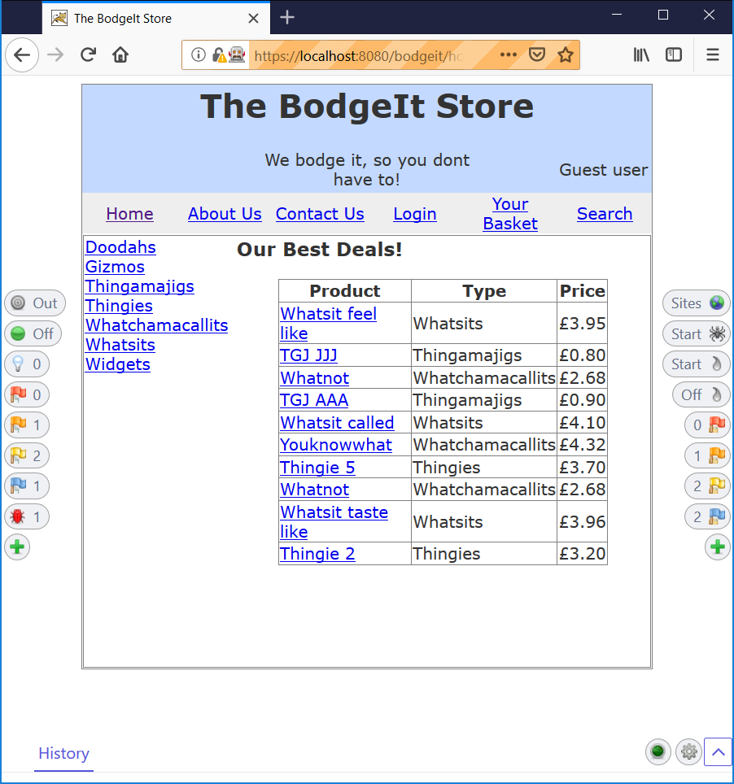

How does the HUD work?
inject.js

Slide 6

How does the HUD work?
Target Site
inject.js
Main display
Web
Sockets
postMessage
Growl
alerts
indexdb
Service Worker

Slide 7
Wrap up
ZAP is a great tool to automate in DevOps
The ZAP UIs help when setting up automation..
.. and when learning more about security
The HUD is ideal to use when manually testing
Contributors are always welcome :)
Twitter: @psiinon @zaproxy

Slide 8


Slide 9


