Slide 1
Cloud Migration FrictionLess Application Security
Anjlica Malla
Enterprise Security Architect
© Verizon 2019, All Rights Reserved. Information contained herein is provided AS IS and subject to change without notice. All trademarks used herein are property of their respective owners.

Slide 2

Table of Contents
Executive Office
Ground Zero
New Challenges
Governance
Scope Of Work
Architecture
Security Architecture
New ways of thinking
To Do
Q&A
References
Cloud Security Alliance: Cloud Controls Matrix
© Verizon 2019, All Rights Reserved. Information contained herein is provided AS IS and subject to change without notice. All trademarks used herein are property of their respective owners.

Slide 3
Cloud Migration: Executive Office
Jan April July Oct Jan April July Oct Jan
2018
2019
2020
Executive decision
Migrate to the cloud
Data center exit
With minimal on-premise
There is no bullet train
© Verizon 2019, All Rights Reserved. Information contained herein is provided AS IS and subject to change without notice. All trademarks used herein are property of their respective owners.

Slide 4
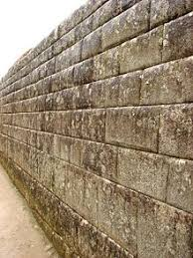


Cloud Migration: Ground Zero
Chaos, Silos
Architecture
New technologies
How do I implement DR?
I am just connecting A to B
Should I migrate the whole stack?
Nothing is allowed to migrate to the public cloud
…
…
Dev,Test
Can I serverless everything?
Legal Counsel
Network
I hear we are migrating?
Are we there yet?
Insider Threat
I hear some apps are already there?
Executive Office
Security
Executive
Security
© Verizon 2019, All Rights Reserved. Information contained herein is provided AS IS and subject to change without notice. All trademarks used herein are property of their respective owners.
Executive

Slide 5
Cloud Migration: New Challenges
Challenge | Solution
New ecosystem, new technology | Training, Certification at all levels.
New services in the cloud, managed services | Disable all services by default. Set up a process to request, assess, approve, manage.
Default configurations for the services | Disable by default. Harden the configuration.
API driven | New compute and storage can be created by using APIs. Whitelist applications that can deploy in the cloud. Manage access to APIs. Monitor.
Pay per use | Monitor which compute is unused. Set up a process to notify and shut down.
Multi-tenant environment | Encryption – disk level, transport level. Dedicated bare metal if possible. Network, Storage – shared.
Multi cloud | Start with one cloud provider. Add other cloud providers based on use cases.
Cloud specific technology | Decouple from a cloud managed technology, e.g. Cloud managed container orchestration.
© Verizon 2019, All Rights Reserved. Information contained herein is provided AS IS and subject to change without notice. All trademarks used herein are property of their respective owners.

Slide 6


Knowledge, Preparation, and Governance is power
© Verizon 2019, All Rights Reserved. Information contained herein is provided AS IS and subject to change without notice. All trademarks used herein are property of their respective owners.

Slide 7

Cloud Migration: Governance
Identify stakeholders
Identify a CONSISTENT review and approval workflow
Allow only approved applications and data in the cloud
Monitor user and network access
Communicate
© Verizon 2019, All Rights Reserved. Information contained herein is provided AS IS and subject to change without notice. All trademarks used herein are property of their respective owners.

Slide 8
Cloud Migration: Scope Of Work
Architecture
Training
Cloud Strategy
App & Data Migration Strategy
Assess Tools
Shadow IT
Secure in the Cloud
Adapt to Scale
Continuous Monitoring
Automation
Regulations, Standards
Cloud Compatibility
Governance
OpEx
Communicate
Process
Assess and Optimize
© Verizon 2019, All Rights Reserved. Information contained herein is provided AS IS and subject to change without notice. All trademarks used herein are property of their respective owners.

Slide 9
Cloud Migration: Architecture
Assess: Gap Analysis
Assess Management
Shared Responsibility
Model
Architecture patterns
Lift and Shift
Cloud provider features
New Technology
Licensing costs
Cloud Native
Data Classification
Microservices
© Verizon 2019, All Rights Reserved. Information contained herein is provided AS IS and subject to change without notice. All trademarks used herein are property of their respective owners.

Slide 10
Cloud Migration: Architecture Patterns
API Gateway
Compute
Internet Facing
Object and Block Storage
Intranet Facing
Architecture patterns
*-As-A-Service
Messaging Queues
Analytics
Notification Functions
Customer Engagement
© Verizon 2019, All Rights Reserved. Information contained herein is provided AS IS and subject to change without notice. All trademarks used herein are property of their respective owners.

Slide 11
Cloud Migration: Security Architecture
Data Privacy
Regulations, Standards
New cloud services
Connectivity
Transport encryption
Security Controls
Identity & Access Mgmt.
Encryption at rest
Continuous Monitoring
Key & Cert Management
Cloud provider native controls
© Verizon 2019, All Rights Reserved. Information contained herein is provided AS IS and subject to change without notice. All trademarks used herein are property of their respective owners.

Slide 12
Cloud Migration: Security Architecture Patterns
Data Protection
Connectivity
Application Security
Authentication
Security Controls
Build Book
Authorization
Two Way TLS
Encryption at rest
Continuous Monitoring
Key & Cert Management
Audit Logs
© Verizon 2019, All Rights Reserved. Information contained herein is provided AS IS and subject to change without notice. All trademarks used herein are property of their respective owners.

Slide 13
Cloud Migration: Automation
Standardize
Security as code
Automated CI/CD
Governance
DevSecOps
Gates before promoting
to a higher environment
Static monitoring
Continuous Monitoring
Auto-remediation
Leverage serverless services
© Verizon 2019, All Rights Reserved. Information contained herein is provided AS IS and subject to change without notice. All trademarks used herein are property of their respective owners.

Slide 14
Cloud Migration: Automation Examples
Cloud firewall templates
Enforce disk encryption
No incoming roles from
external cloud
accounts
No data store / DB
exposed to internet
Enforce, Monitor
Stop Idle instances
Tags for every instance
Stop unpatched instances
Identify passwords in the clear
© Verizon 2019, All Rights Reserved. Information contained herein is provided AS IS and subject to change without notice. All trademarks used herein are property of their respective owners.

Slide 15
Cloud Migration: New ways of thinking
Questions
Answers
But I didn't have to do this on-premise
Why is security creating new requirements?
Public cloud is elastic and not limited to a static set of hardware
My application does not have confidential data?
Specify data fields and check with organizational standards
Check the controls
Why can’t I use the cloud provider managed services?
Customer may not have control of the data or hardware.
Data privacy, security controls assessment
Why can’t I just spin up my instance?
Because we need to first secure it and also monitor cost
How am I supposed to innovate?
Let us set up an infrastructure to innovate responsibly
© Verizon 2019, All Rights Reserved. Information contained herein is provided AS IS and subject to change without notice. All trademarks used herein are property of their respective owners.

Slide 16
Cloud Migration: To Do
Verify programmatically that security controls are enforced and monitored
TLS 1.2
Specific data fields protected as per standards
Use Threat Monitoring data points as input to improve Security Architecture
Security Chaos Engineering
© Verizon 2019, All Rights Reserved. Information contained herein is provided AS IS and subject to change without notice. All trademarks used herein are property of their respective owners.

Slide 17
Cloud Migration: Q&A
© Verizon 2019, All Rights Reserved. Information contained herein is provided AS IS and subject to change without notice. All trademarks used herein are property of their respective owners.

Slide 18
Cloud Migration: References
Cloud Security Alliance
https://cloudsecurityalliance.org/
Cloud Controls Matrix
Cloud provider architecture patterns
“This is My Architecture”
https://aws.amazon.com/this-is-my-architecture/
Open source tools
https://www.capitalone.io/
© Verizon 2019, All Rights Reserved. Information contained herein is provided AS IS and subject to change without notice. All trademarks used herein are property of their respective owners.

Slide 19
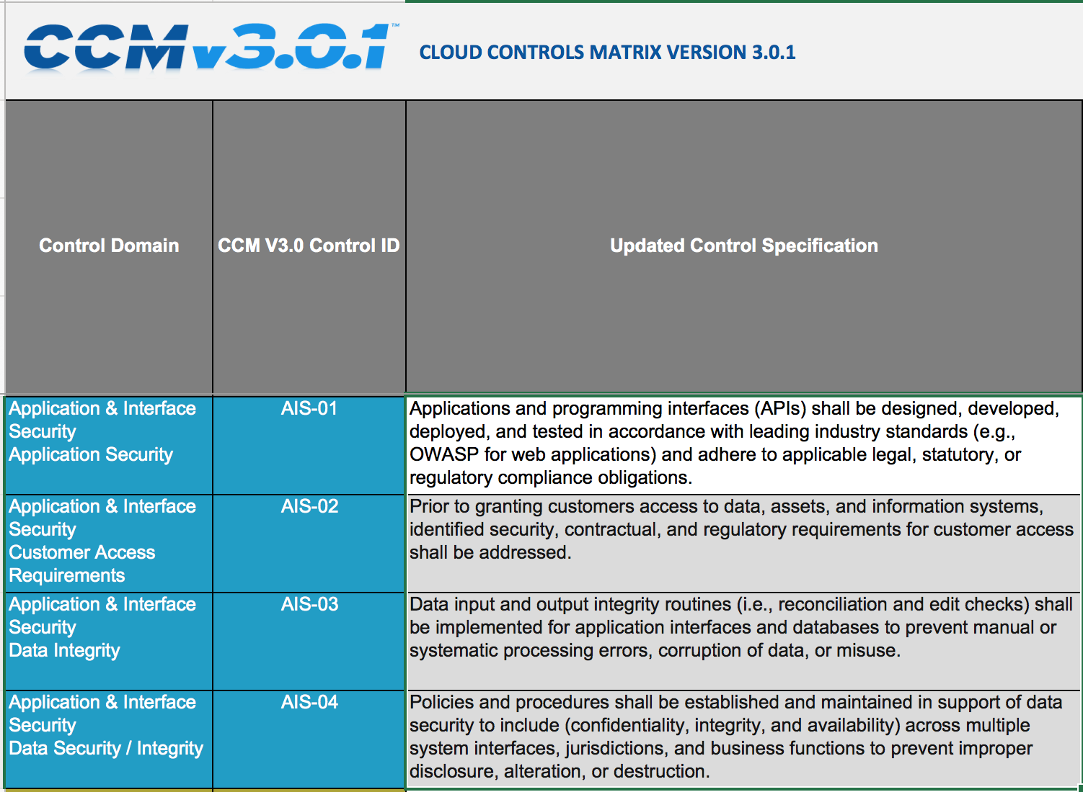
Cloud Security Alliance: Cloud Controls Matrix
© Verizon 2019, All Rights Reserved. Information contained herein is provided AS IS and subject to change without notice. All trademarks used herein are property of their respective owners.

Slide 20
© Verizon 2019, All Rights Reserved. Information contained herein is provided AS IS and subject to change without notice. All trademarks used herein are property of their respective owners.

