Slide 1
Choosing the best spot to open a Pizzeria in Paris
Mickael Tessier
28th of January 2021

Slide 2
Introduction
Where to open the new restaurant ?
According to the marketing department, we have to respect two conditions:
Condition 1: At least 3 competitors in a distance of less than 1 km
Conditions 2: It has to be a neighborhood where competitors have the lowest review rate

Slide 3
Data acquisition
Data source: Foursquare
Data cleaning: we just keep the data we need
Data format: Name, latitude, longitude, ID, note.

Slide 4
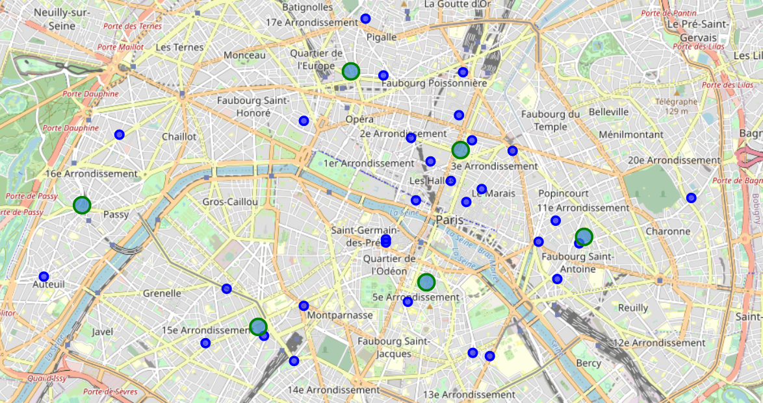
Methodology
Machine learning clustering to find 6 districts as potential candidates

Slide 5
Methodology
Use of Haversine formula to identify number of neighboring restaurants
District | Latitude district | Longitude district | Number of neighbours
District 1 | 48.866423 | 2.353877 | 8
District 2 | 48.858683 | 2.273793 | 0
District 3 | 48.848025 | 2.346564 | 3
District 4 | 48.841777 | 2.311150 | 5
District 5 | 48.854361 | 2.379942 | 4
District 6 | 48.877318 | 2.330605 | 2
District 2 and district 6 have less than 3 restaurants

Slide 6
Methodology
We calculate the review rate for each district
District | Average note
District 1 | 7.900000
District 3 | 7.300000
District 4 | 6.500000
District 5 | 7.366667
District 4 has the lowest rate

Slide 7
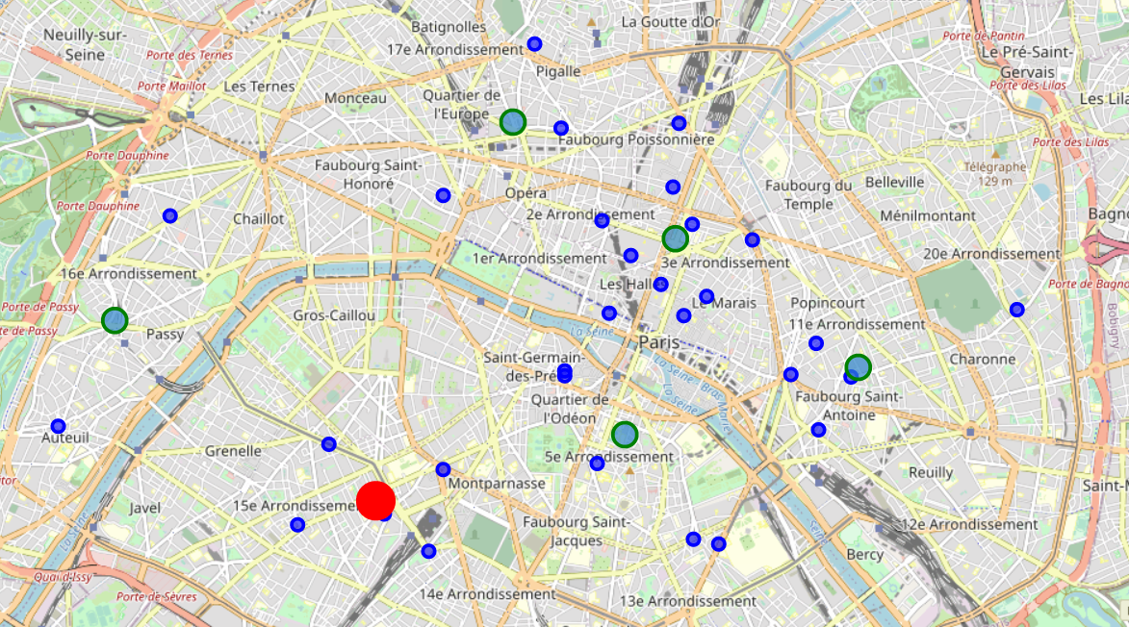
Result
The best spot has been identified in the map
We should open here !

Slide 8
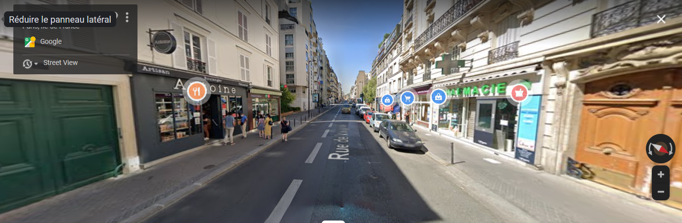
Result
The sport is in the 14th arrondissement of Paris

Slide 9
Conclusion
The best spot to open a pizzeria in Paris respecting the conditions given by the marketing department (i.e. more than 3 restaurants in less than 1 km distance and lowest reviews in the neighborhood) is in the 14th arrondissement of Paris.

