Slide 1
Entropy Sources for Seeding Pseudo-Random Number Generators
Matthias Thomann

Slide 2
Contents
Introduction
Motivation
Goals
Research Results
Information Entropy
Entropy Sources
Randomness Extraction

Slide 3
Motivation
Goals
Random number generation
Personal interest
Connection to security
How are random numbers generated?
What makes a good entropy source?

Slide 4
Information Entropy
Informational value = how much is deemed surprising
Quantifying unpredictability
Shannon-entropy
Min-entropy

Slide 5

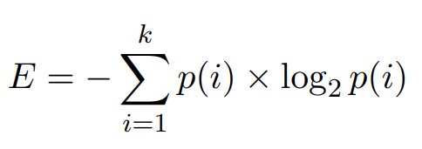
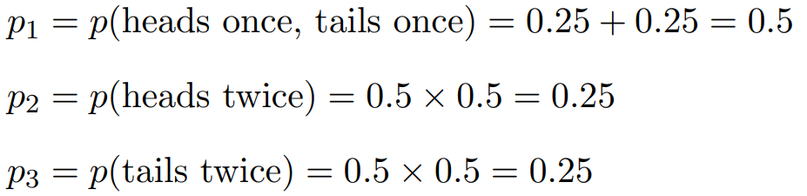

Shannon-Entropy

Slide 6


Min-Entropy

Slide 7
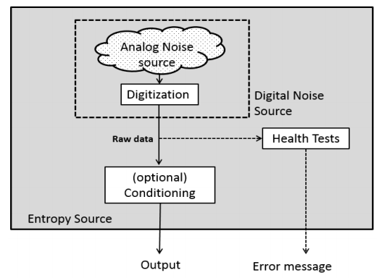
Entropy Sources

Slide 8
Entropy Sources – Noise
Measuring user dependent behavior
Mouse movement
Keyboard stroke timings
Timing of past events
Last disk operation
Thermal noise
Temperature

Slide 9
Entropy Sources – Digitizing
Quality
Performance
Additional noise sources

Slide 10
Entropy Sources – Conditioning
Applicable if noise has low entropy
Helps to reach higher entropy

Slide 11
Entropy Sources – Health tests
Necessity, as entropy source may be fragile
Temperature
Humidity
Electric fields
Deviation detection
Decrease in entropy of outputs
Noise source failures
Hardware failures

Slide 12
Randomness Extraction
Seed obtained from entropy source
Pseudo-random algorithm
Von Neumann’s middle-square method

Slide 13
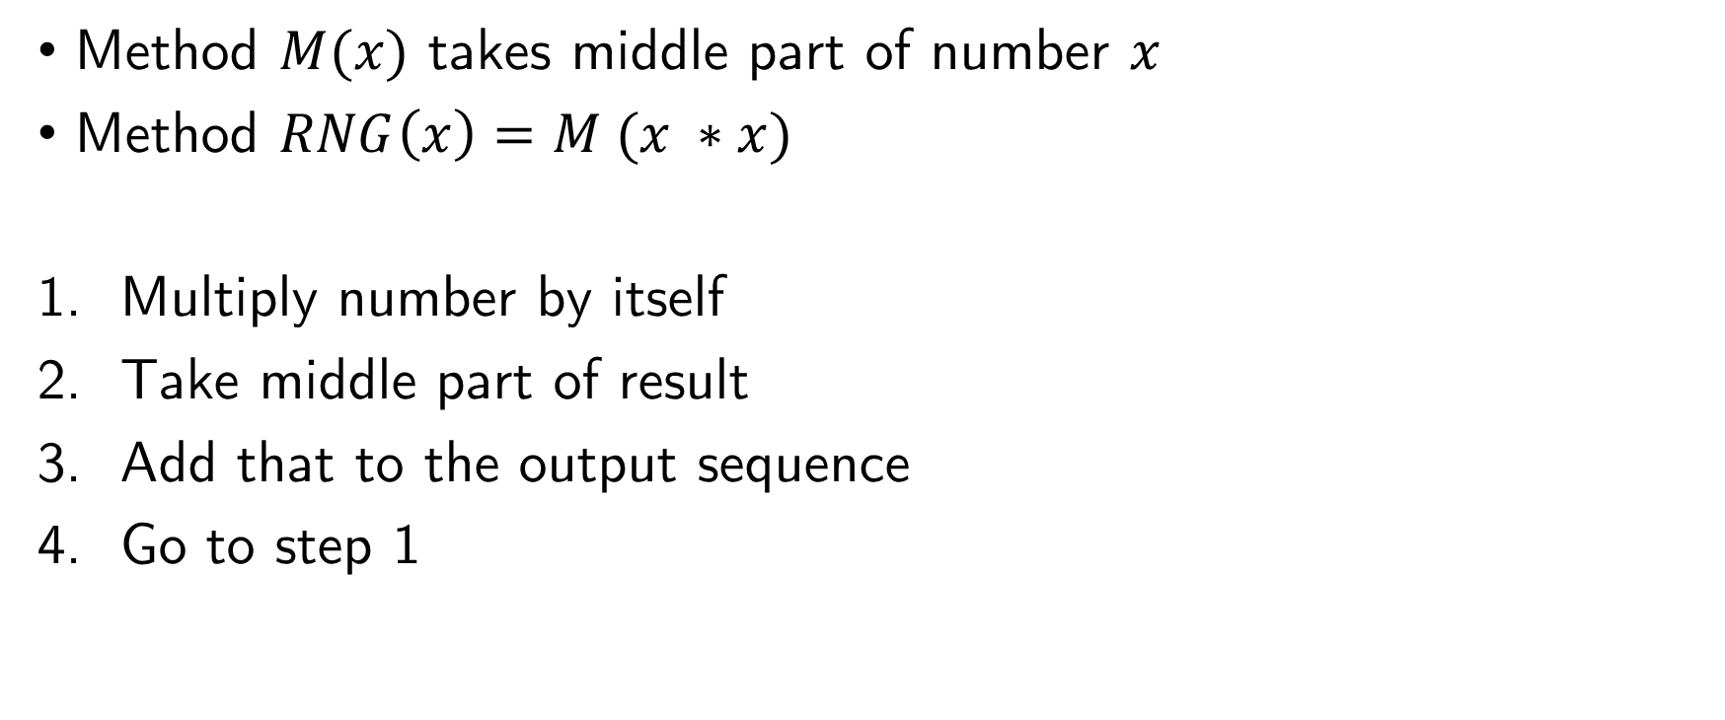
Randomness Extraction - Example
Method $M(x)$ takes middle part of number $x$
Method $RNG\left(x\right)=M (x ∗x)$
Multiply number by itself
Take middle part of result
Add that to the output sequence
Go to step 1

Slide 14
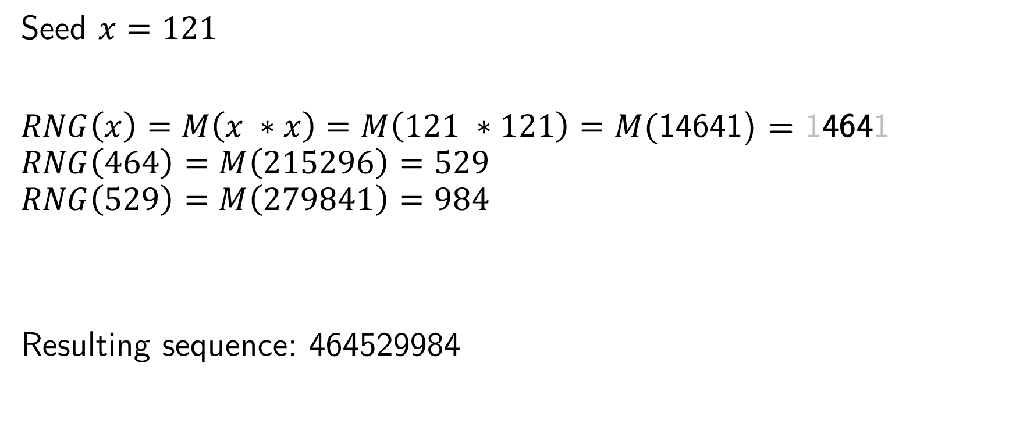
Randomness Extraction - Example
Seed $x=121$
$RNG\left(x\right)=M\left(x ∗x\right)=M\left(121 ∗121\right)=M($14641) = 14641
$$RNG\left(464\right)=M\left(215296\right)=529$$
$$RNG\left(529\right)=M\left(279841\right)=984$$
Resulting sequence: 464529984

Slide 15
Randomness Extraction - Period
Repeating after 121 is found again
Period is length of maximum runs until repetition
Period in example is 1000
Seed length determines period

Slide 16
Conclusion
Unfamiliar topics
Sometimes shied away from security/cryptography aspects
What is the perfect entropy source?
Best use for PRNG in cryptography?

