Slide 1
Description

Slide 2
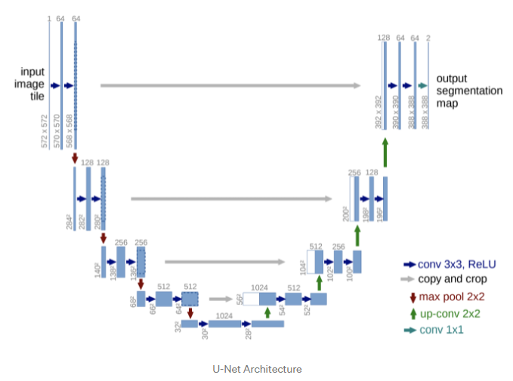
Prediction of Flow Field Using U-Net Structure
5. Further research
U-net
Google scholar: 39066 citations
Ronneberger, O., Fischer, P., & Brox, T. (2015, October). U-net: Convolutional networks for biomedical image segmentation. In International Conference on Medical image computing and computer-assisted intervention (pp. 234-241). Springer, Cham.

Slide 3
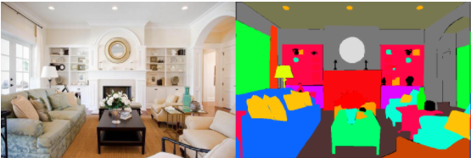
Prediction of Flow Field Using U-Net Structure
5. Further research
Original usage of U-net
Input image
Target
Semantic segmentation, or image segmentation, is the task of clustering parts of an image together which belong to the same object class.
It is a form of pixel-level prediction because each pixel in an image is classified according to a category.

Slide 4
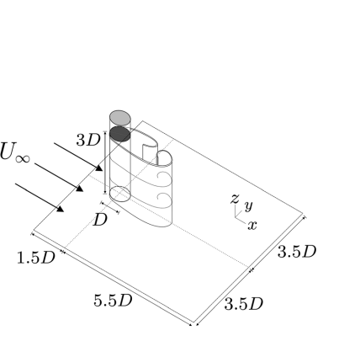
Prediction of Flow Field Using U-Net Structure
5. Further research
How to use the structure in a flow field
Input flow field
Output flow field
T=t
T=t+1
T=t+2

Slide 5




Prediction of Flow Field Using U-Net Structure
5. Further research
Modified U-net structure
Input flow field(s)
output flow field
$$R^{8×64×256×256}$$
$$R^{4×32×128×128 }$$
Residual connection
$$R^{8×16×64×64 }$$
Conv3d → BatchNorm3d → ReLU
Conv3d → BatchNorm3d → ReLU → Maxpool3d
TransConv3d → BatchNorm3d → ReLU
$$R^{16×8×32×32 }$$
concat

Slide 6
Experiment
5. Further research
Training configuration
Learning rate | 0.01
Epoch | 10
Test size | 30 %
Validation size | 10 %
Batch size | 4

Slide 7
Experiment-result
5. Further research
Performance in the training data set
MSE | 0.02
MAE | 0.07
Performance in the validation data set
MSE | 0.02
MAE | 0.07
Performance in the test data set
MSE | 0.02
MAE | 0.08
R2 | 88 %

