Slide 1
Blockchain-based Sybil Attack Resistance Protocol
Stylianos Agapiou
Melchior Thambipillai

Slide 2
Introduction
Goal is to enhance Peerster with a protocol to prevent Sybil attacks
Global idea : nodes need to solve cryptopuzzles to join the network
The puzzle should depend on all the nodes
Should expire at some point
Peers should be authenticated to verify they solved a puzzle

Slide 3
Related work
Paper 1 : nodes organized in hierarchy tree and need to solve cryptopuzzles from leaf to root
Paper 2 : each active node contributes to the creation of a global puzzle
Our solution : thanks to the blockchain, combines the 2 advantages

Slide 4
Outline of the project
Blockchain-based joining : peers need to mine blocks to join. The blockchain registers which peers are joined.
P2P authentication : use digital signatures to authenticate peers and verify their appartenance to the blockchain

Slide 5
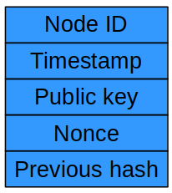
Blockchain-based joining
Each block corresponds to one
joined peer
Steps of the protocol when A
wants to join to B :
1) B checks if A’s Node ID is
valid in the blockchain
2) if not, B sends a puzzle
3) A mines a block and send it back to B

Slide 6
Blockchain-based joining
4) B verifies the block, add it to the blockchain
and gossips a rumor with the new block
5) B sends the whole blockchain to A who is now joined
Genesis : a user flag when creating a gossiper to start mining a genesis block or not
Collisions : don’t need to handle them since we replace Node ID at every hop

Slide 7
P2P Authentication
Digital signatures (RSA, SHA256)
Inspection of inactive nodes

Slide 8
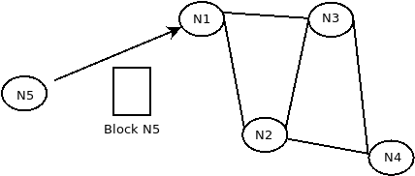
Digital Signature Algorithm
Each node creates an RSA key pair

Slide 9
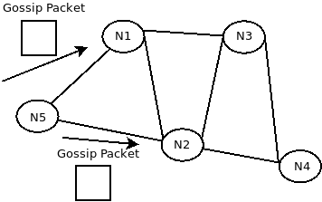
Digital Signature Algorithm
N5 hashes the message with SHA-256
Then applies RSA to sign the message with it’s Private Key

Slide 10
Inspection of Inactive Nodes
Use of Anti-Entropy mechanism
If there’s no packet from a specific node for a significant amount of time
We suspect this node as inactive and broadcast
a signed packet to all neighbors

Slide 11
Evaluation
Difficulty = 18 Difficulty = 20
  1) 1.3468796s 1) 2.873795175s
  2) 768.457822ms 2) 3.093252135s
  3) 1.053998185s 3) 2.901926432s
  4) 1.581628689s 4) 2.663215389s
  5) 1.372276421s 5) 2.775930321s
  6) 1.472019263s 6) 2.823405346s

Slide 12
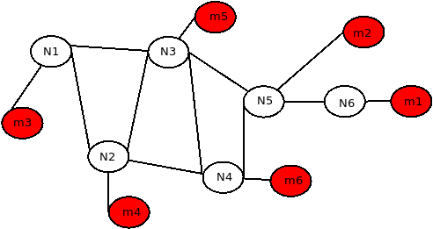
Evaluation
With difficulty 24, it
took more than 10
minutes for nodes
(m1, m2,…, m7)
to join into
the blockchain

Slide 13
Conclusion
Challenges
  Theory
  Build our project on top of Peerster
Disadvantages
  PoW
  Handling of expiration

Slide 14
Conclusion
Advantages of our solution
  Scalability
  Easy forks handling
  Completely decentralized

Slide 15

Thank you for your attention

