Slide 1
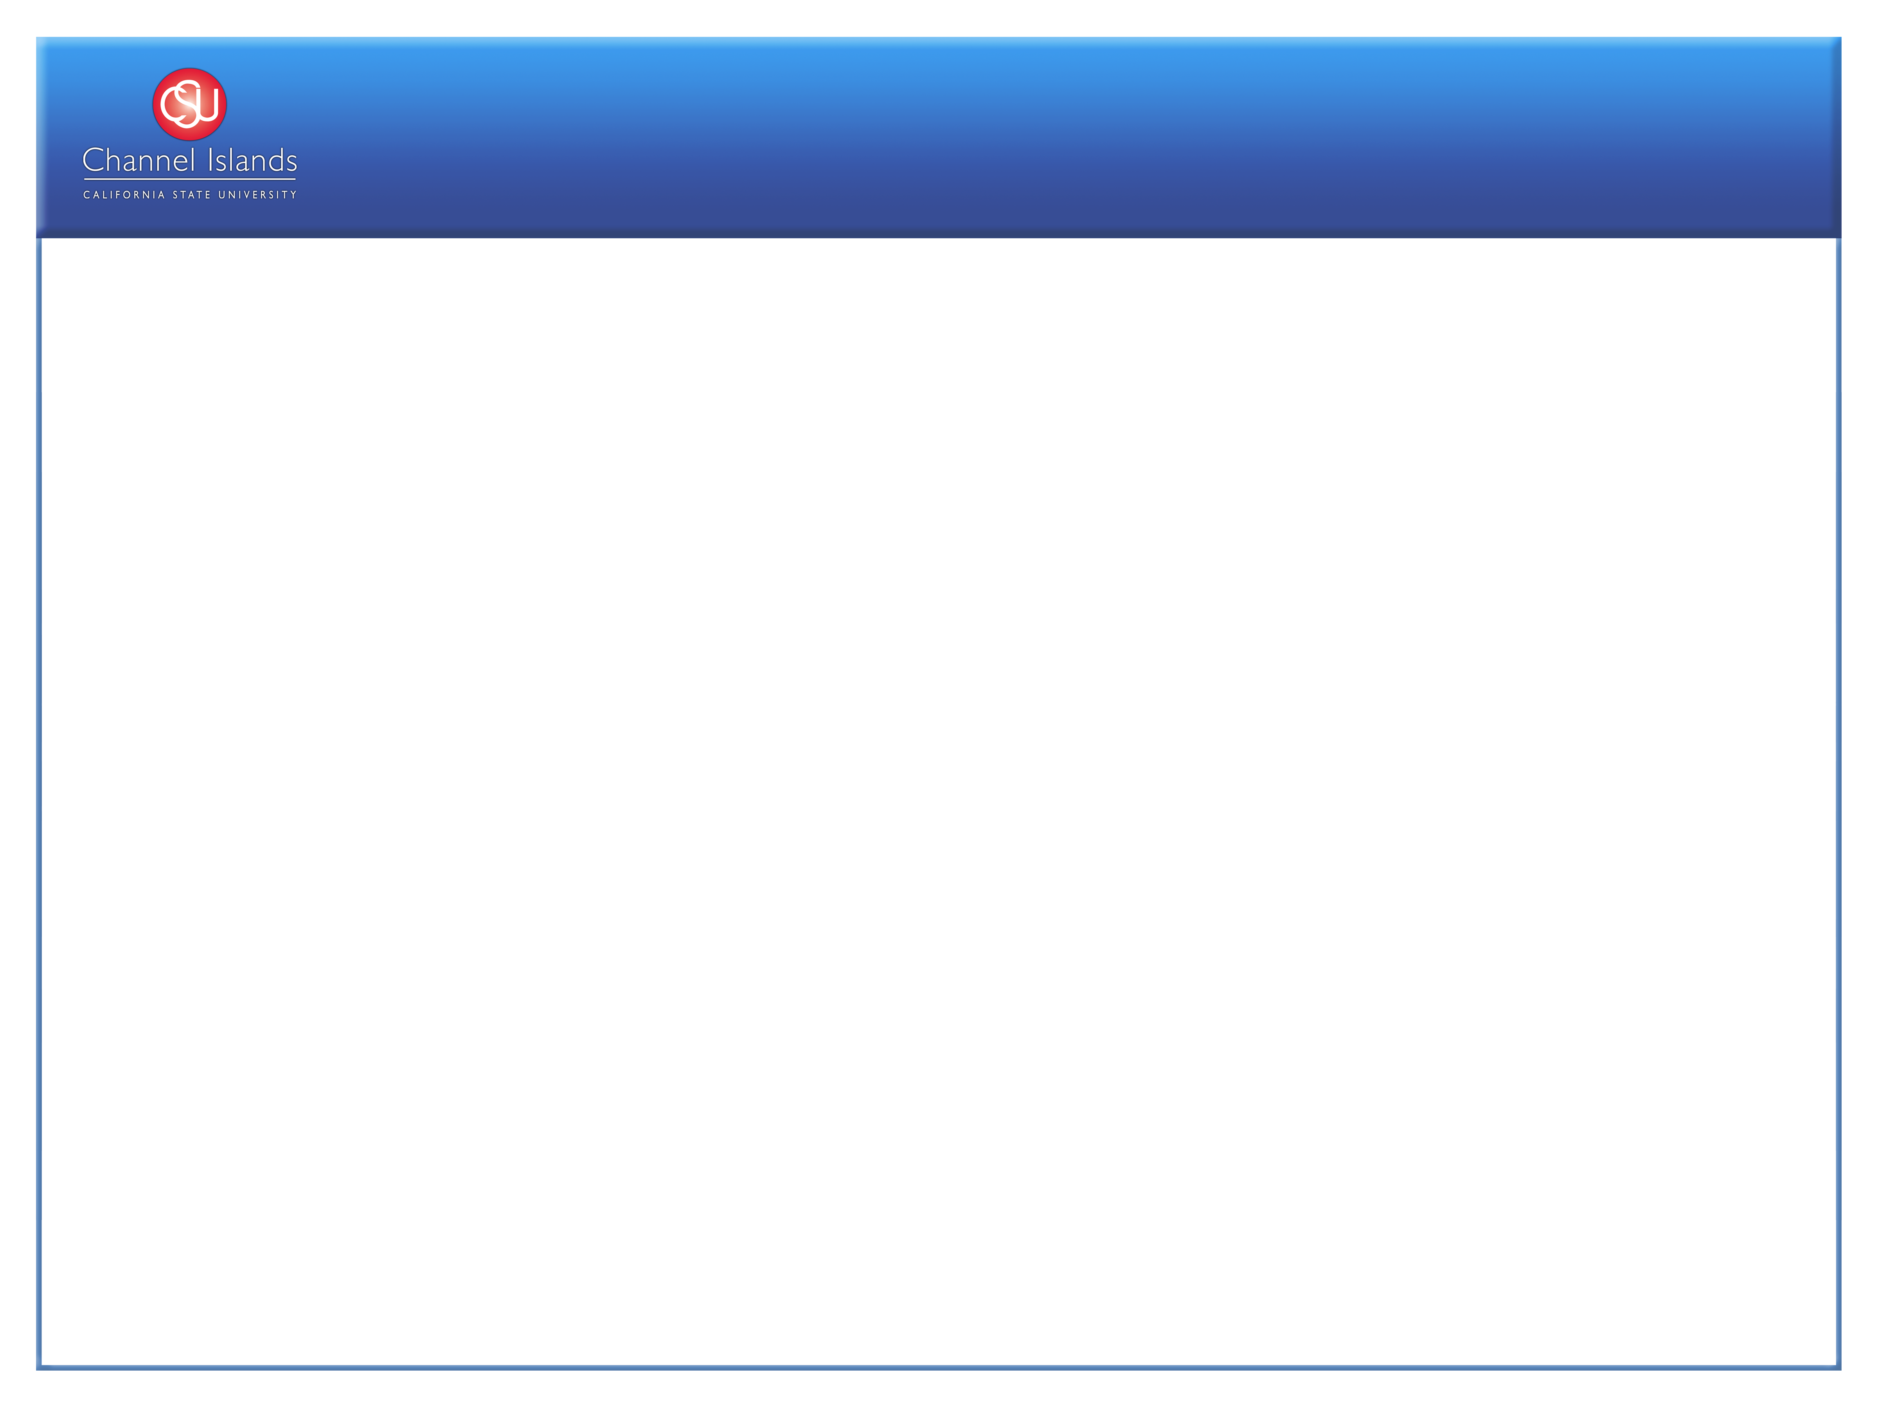
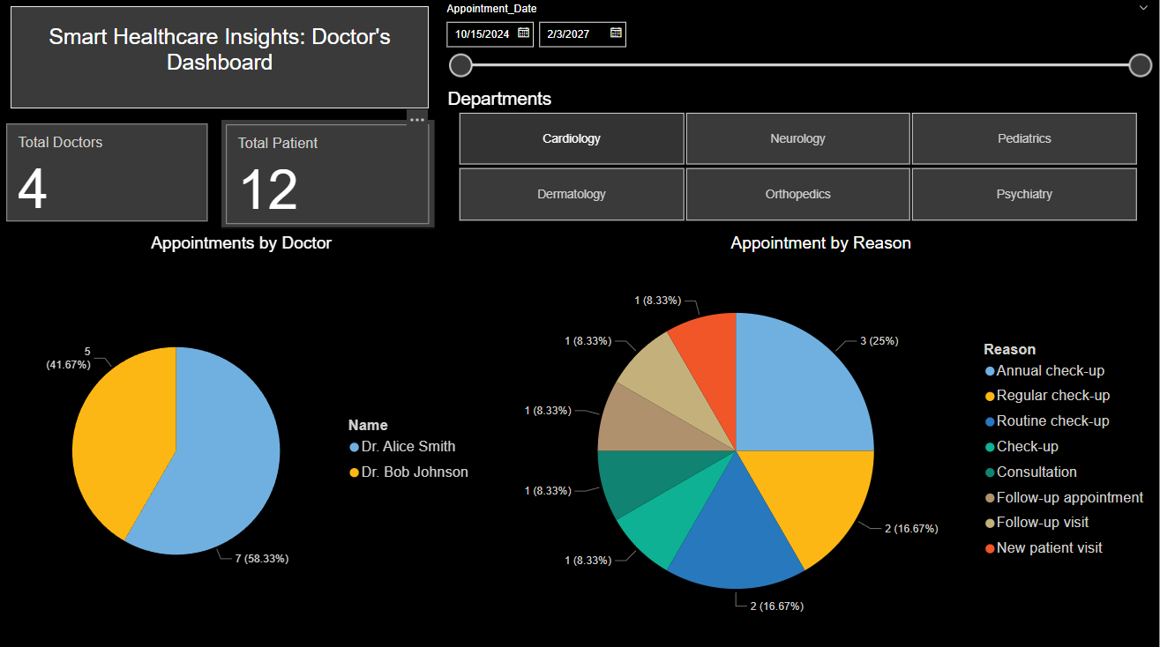
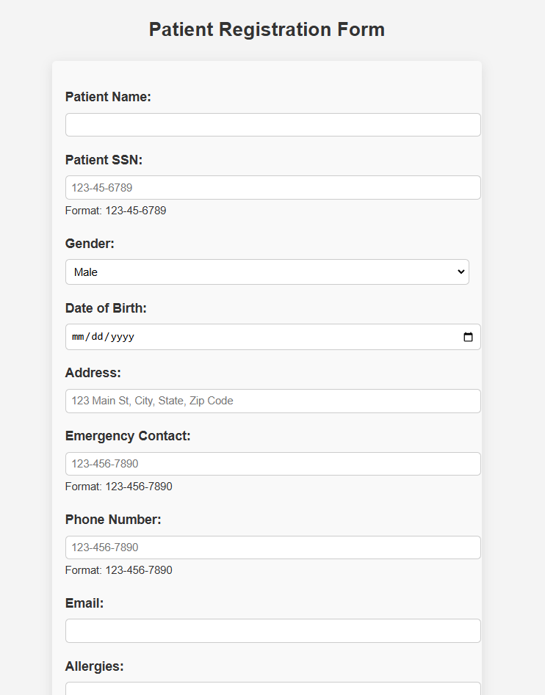
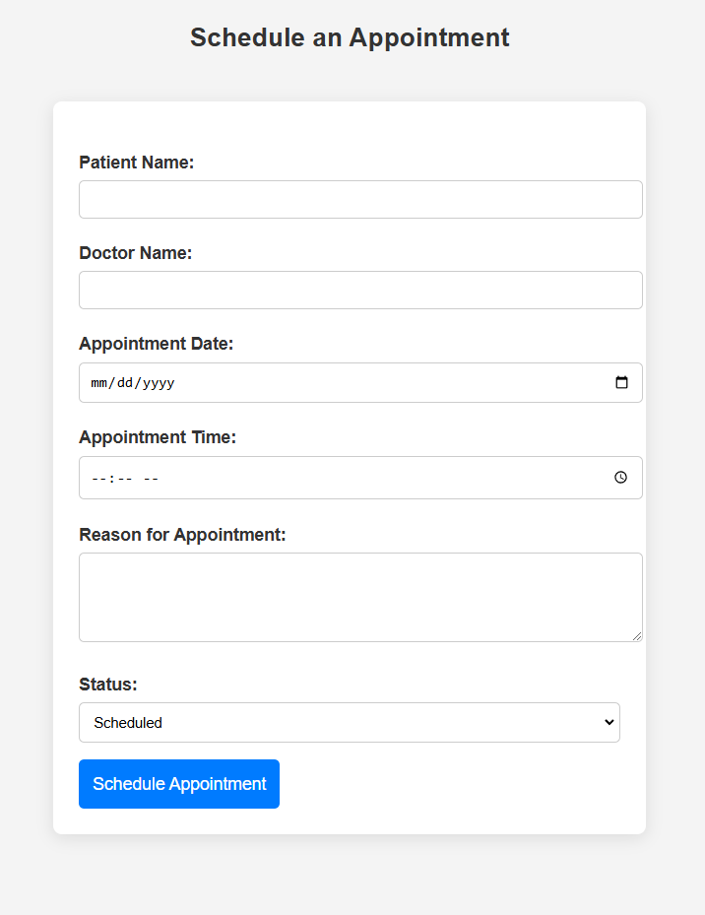
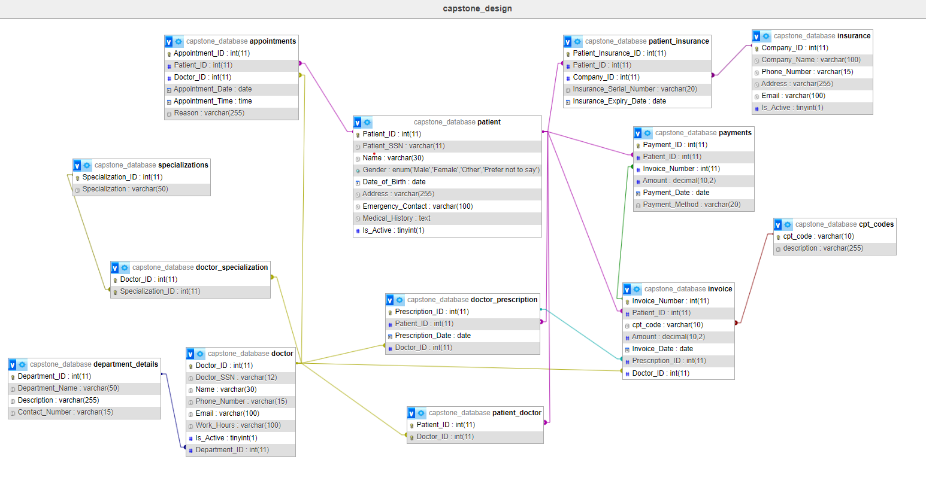
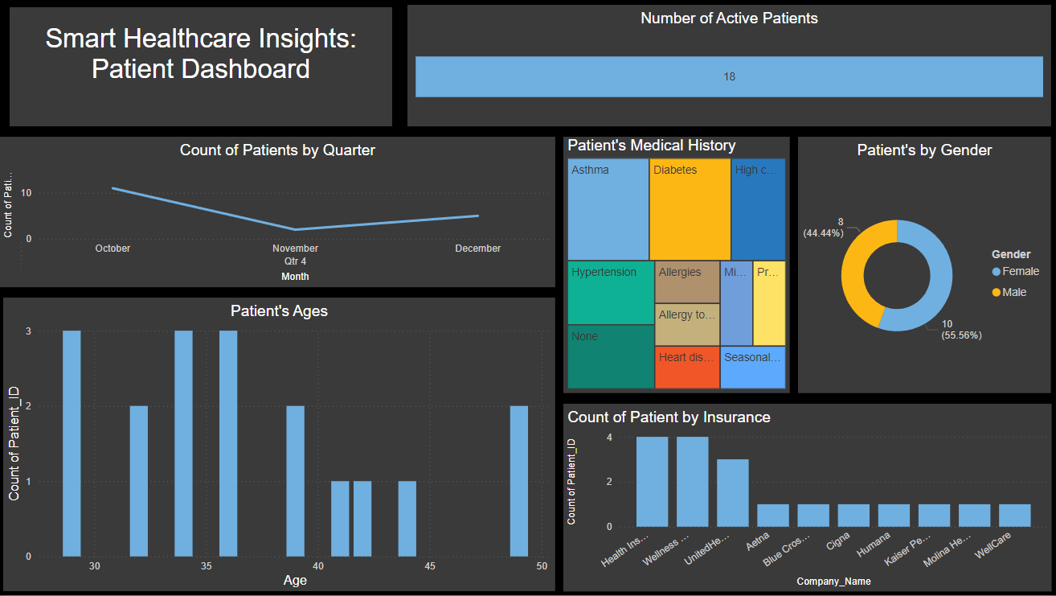
A Data-Driven Approach to Healthcare Management
Michael Thaure • Professor Puneet Sharma• IT499
Introduction
phpMyAdmin
Power BI
Healthcare centers typically consist of various departments, each managing its own record-keeping system. This approach often results in challenges such as inefficient data sharing, inconsistencies in data, and a high burden of program maintenance. To address these issues, I have developed a centralized database for the healthcare management system. This solution facilitates more efficient storage, retrieval, and sharing of patient healthcare information, ultimately enhancing the quality of patient care.
The database design is centered around managing healthcare operations, with emphasis on structured relationships between patients, doctors, departments, and services. The database is normalized and uses a series of well-defined tables, including appointments, patients, doctors, invoices, and payments, to capture various aspects of patient care and medical administration. It leverages foreign key constraints to maintain referential integrity between related entities, such as linking patients to doctors, invoices to prescriptions, and payments to invoices. The inclusion of additional tables like insurance and specializations allows for detailed tracking of patient insurance, doctor specializations, and medical billing codes through CPT codes. This design ensures data integrity, scalability, and flexibility, supporting efficient healthcare management and facilitating integration with external tools like Power BI for data insights.
Methodology
Notably, the database is designed in the third normal form (3NF), which minimizes redundancy, ensures data integrity, and simplifies querying and maintenance tasks. By standardizing data management, healthcare professionals can access accurate patient records across departments, improving coordination and decision-making.
In addition to database optimization, my project focuses on utilizing data analytics to improve healthcare management. Through the integration of software like phpMyAdmin and Power BI, I aim to deliver actionable insights from the data. These insights can help identify trends in patient demographics, monitor health outcomes, and optimize resource allocation. This data-driven approach is crucial for enhancing patient care, minimizing operational inefficiencies, and ensuring long-term sustainability in healthcare facilities.
Furthermore, the implementation of this centralized system supports better compliance with healthcare regulations and allows for scalability, accommodating future growth or changes in healthcare service delivery. The use of interactive dashboards in Power BI makes complex data more accessible, empowering healthcare administrators to make informed, timely decisions that directly impact patient outcomes and organizational efficiency.
Tools Used
PowerBI
XAMPP is an open-source, cross-platform web server solution that includes Apache, MySQL, PHP, and Perl, making it easy to set up a local development environment for web applications. It is popular for testing and development purposes, allowing developers to quickly deploy a server on their own computers without needing a remote hosting service.
phpMyAdmin is a widely-used open-source tool for managing MySQL and MariaDB databases via a web interface. It simplifies tasks like creating and managing databases, tables, and executing SQL queries, making database administration more accessible to both beginners and experienced users.
Power BI is a business analytics tool developed by Microsoft that allows users to visualize and share insights from their data. While the Power BI Desktop application is free to use, it is not open-source, and full access to its premium features requires a subscription. It helps users create interactive reports and dashboards from various data sources.
The integration of data analytics tools such as Power BI allows for real-time insights into patient demographics, health outcomes, and operational performance. These insights support better decision-making, resource optimization, and the identification of trends that can directly improve patient care and operational efficiency. Furthermore, the use of a centralized system ensures better compliance with healthcare regulations, helping healthcare providers meet industry standards while accommodating future growth.
Conclusions
Ultimately, this project demonstrates the potential of a data-driven approach in transforming healthcare management, enabling healthcare professionals to make more informed decisions, improve patient care, and streamline administrative processes. The system’s flexibility and scalability position it as a valuable asset for healthcare institutions looking to enhance their service delivery while remaining adaptable to future needs.

