Slide 1
Hackathon #3: Explainable AI
Christoph Fürböck Konstantin Miloserdov
Notes:
‹#›

Slide 2
Introduction
AI models are often “black-box” algorithm
Interpretation is difficult even for experts
Goals of Explainable AI:
Build up trust in AI Models
Finding mistakes and biases of Algorithms
Knowledge extraction from black-box models

Slide 3


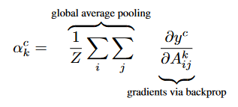
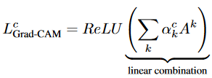
GradCAM
Machine learning models are called “black-box” algorithms, because their interpretation is challenging
Idea of Grad-CAM: Visualize what a Modell “sees” in an image
Compute gradient of prediction of class c, , with respect to feature maps activation
Perform weighted combination of feature maps followed by ReLU to obtain Grad-CAM map

Slide 4
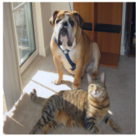
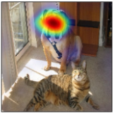
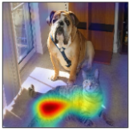
GradCAM
Grad-CAM helps us understand what a model “sees” in an image
Here a model for object classification in analyzed
Grad-CAM helps to visualize the contributing factors for “cat” and “dog”
Original Image
Grad-CAM “Dog”
Grad-CAM “Cat”

Slide 5
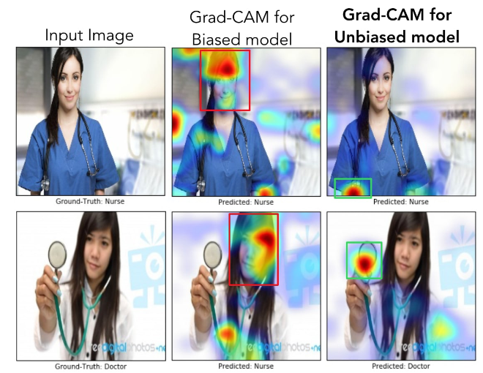
GradCAM
A model for object classification is analysed
Grad-CAM helps to visualise the bias of a model
The biased model focuses on the face of the nurse or doctor. Therefore, giving a wrong prediction

Slide 6
Learning Outcome
The main goal for today is learning about …
… how to access a specific layer in a model
… applying XAI methods
… visualisation in the form of heatmaps

Slide 7
Tasks
Use the following notebook as a basis: model_interpretation_baseline.ipynb
Load the dataset and your model
Define the target layer for the explanation
Apply explainability methods
Visualize as heatmaps
Plot latent space features optional
Notes:
‹#›

Slide 8

Getting started
Jupyter Hub: https://jupyterhub.hpc.itc.rwth-aachen.de:9651/
WiFi: FhG-Gast password: fhg-0512
Happy coding and feel free to ask questions!
Notes:
‹#›

