Slide 1

HRV and Respiration from PPG
Analysis about the different signal processing technique on ppg signals in order to extract more informations such as the heart rate variability and the respiration signal
Biomedical Signal Processing assignment
TASK 5
Benetti Diletta
De Zen Marco
Sgarbossa Matilde

Slide 2

INTRODUCTION
PROBLEM DESCRIPTION
SIGNALS DESCRIPTION
We have been provided with a photoplethysmography signal(PPG), respiratory signal and an ECG signal, of six different healthy subject
We were asked to extract the HRV and the respiratory signal from the ppg and evaluate the results with the reference signal provided
Photoplethysmography (PPG) is a non-invasive optical method for measuring blood volume changes in a specific area irradiated with light.
Systolic peak will be useful for the evaluation of HRV
PPG is affected by the baseline wandering because of the respiration artifacts. We will use this information to extract the respiratory signal
Notes:
Problem description: synchronous signals, acquired from 6 healthy subjects, are provided to be processed. These signals are: PPG (Photoplethysmography signal), RESP (respiratory signal, acquired with a chest strap), and ECG (V1 lead). The aim of this paper is to estimate the respiratory signal and the RR series from the PPG signal, using the others as reference.
SIGNALS DESCRIPTION:
-PPG: Photoplethysmography (PPG) is a non-invasive optical method for measuring blood volume changes in a specific area irradiated with light. PPG waveform, obtained from the amount of light absorbed, is characterized by a series of systolic and diastolic peaks.
RESP: PPG is affected by the baseline wandering because of the respiration artifacts. We will use this information to extract the respiratory signal, in fact filtering the signal in a lower frequency range will be a good way of extracting it.

Slide 3

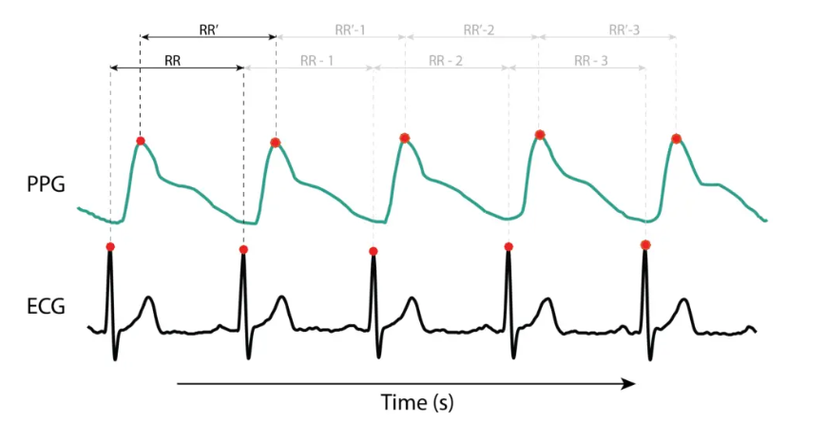
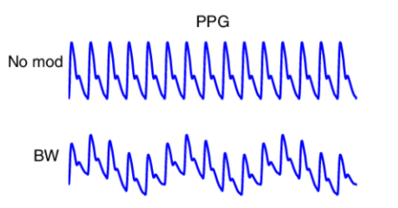
Notes:
In this slide we can see what we have just said about the shape of the ppg, it is clear the presence of the systolic peaks after every R peak. In the other image there is a representation of the behaviour of a ppg affected by a baseline wandering due to the respiration

Slide 4

MATERIALS AND METHODS
HRV evaluation’s steps
Analysis of the delays
Resp evaluation’s steps
Finding noise in the reference ecg
Evaluating the HRV reference signal with Pan-Tompkins function
Finding the peaks of the ppg signal
Computed the difference in the time axis of the peaks
Checked the HRV computed with the reference one, and perfoming the Power Spectral Density of the two signals with welch method.
Using the systolic peaks and R peaks found in the previous elaborations
Performed the delay between the peaks of the same beat
Plotted the delay of every beat
Notes:
HRV: After seeing that our signals was not affected by electrical noise, we decided to filter the signal with the typical frequencies of an ecg with a high pass filter(0.05Hz) and a low pass filter(150Hz); both are butter filter of 4° order. After that we evaluated the HRV reference signal with the pan tompkins function. Then using the systolic peaks as trustable points, thanks to the findpeaks function we found the position of them and then computed the difference in the time axis between them. Just to verify our results we plotted the two different hrv signals and their power spectral density
Analysis of the delays: we thought it would have been interesting studying the delays between the r peaks and the systolic peaks and checked the values for the different subjects. So thanks to the previous elaborations the task was really fast, after synchronizing the signal in order to have the same beat at the start, we evaluated the difference in the time axis between the peaks and the plotted in function of the number of the beat

Slide 5
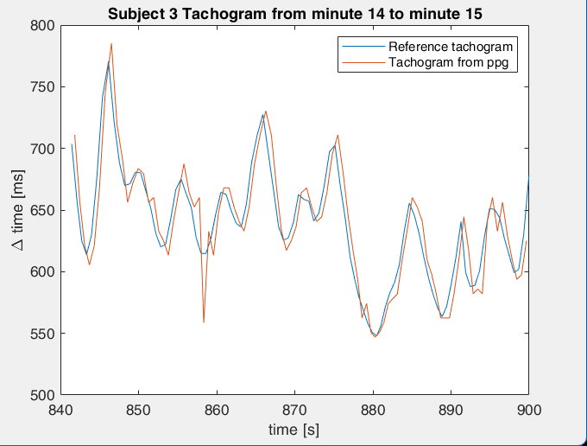
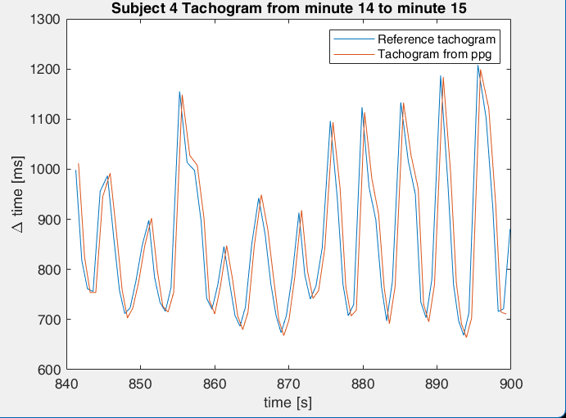
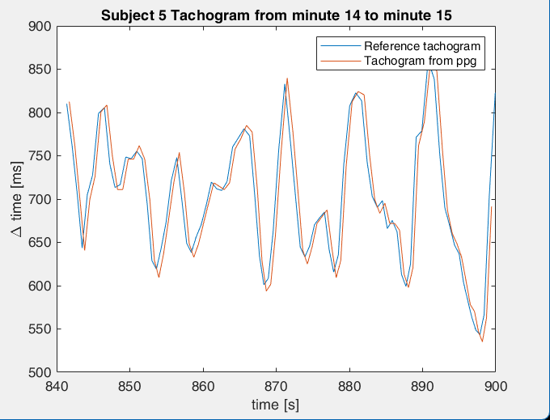
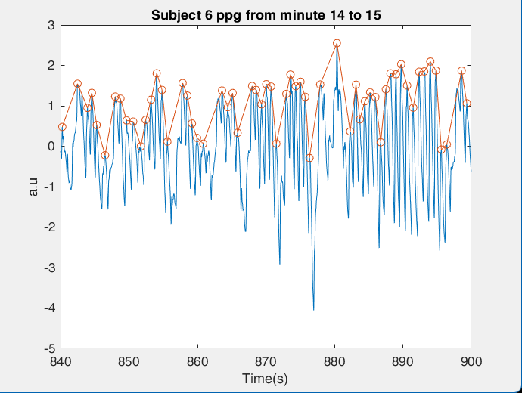
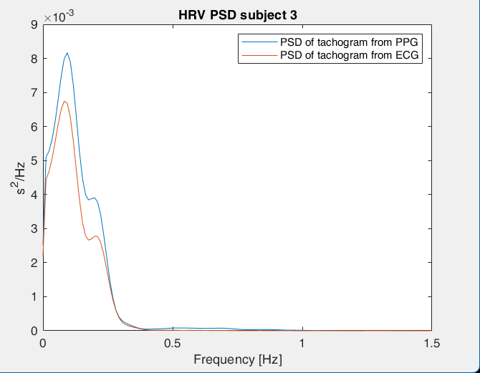
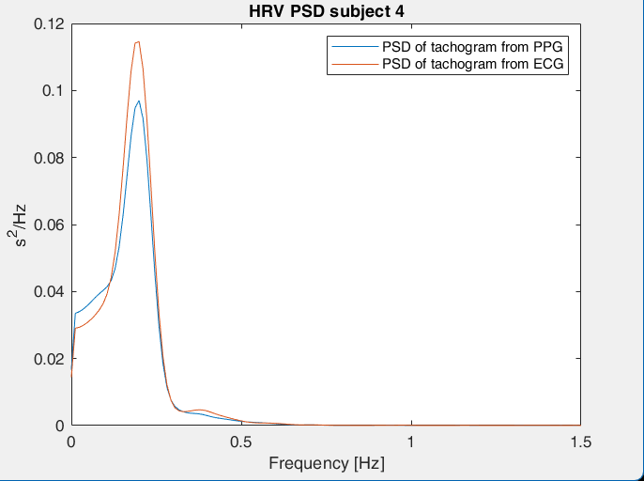
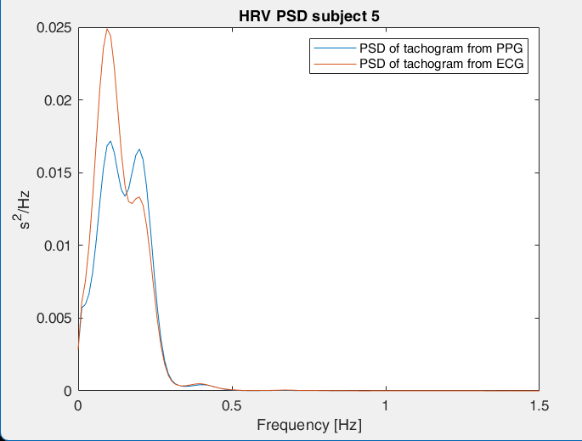
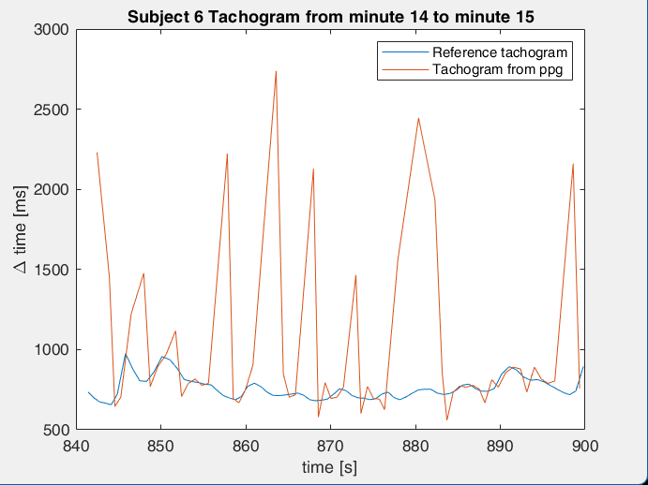
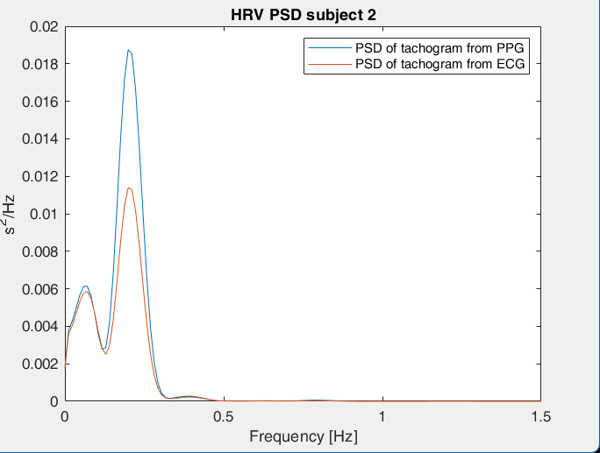
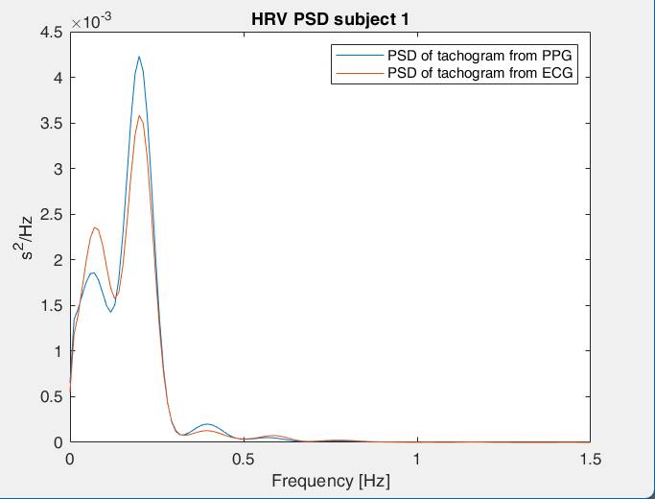
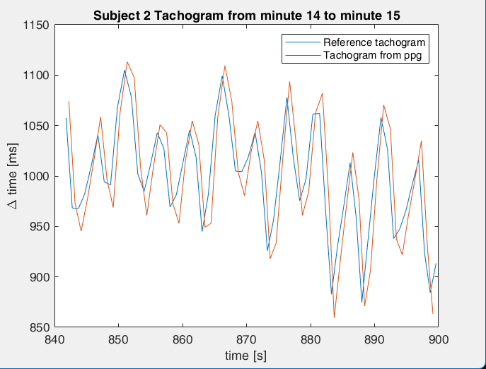
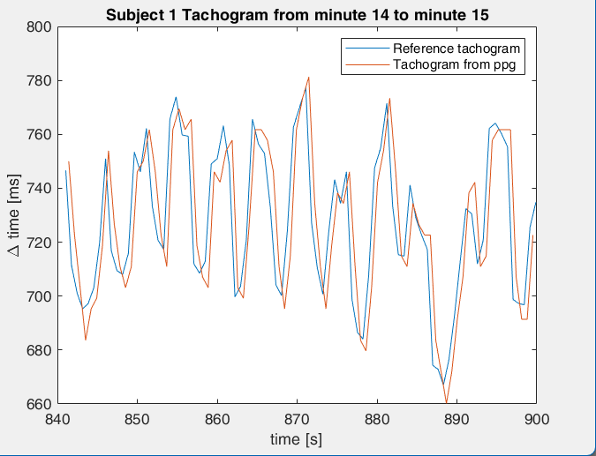
RESULTS AND DISCUSSION

Slide 6
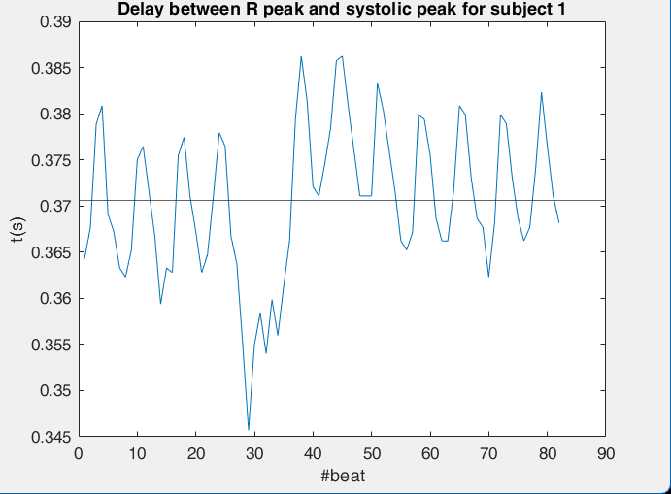
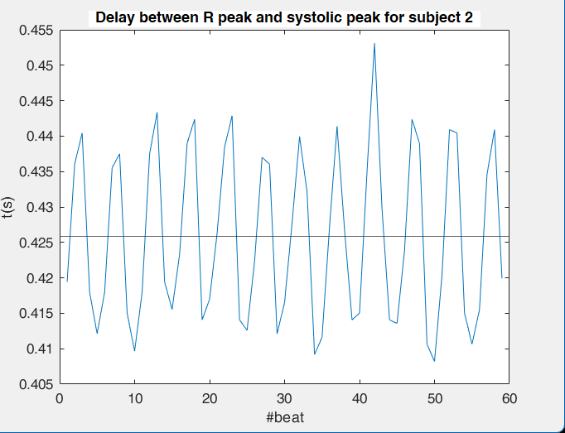
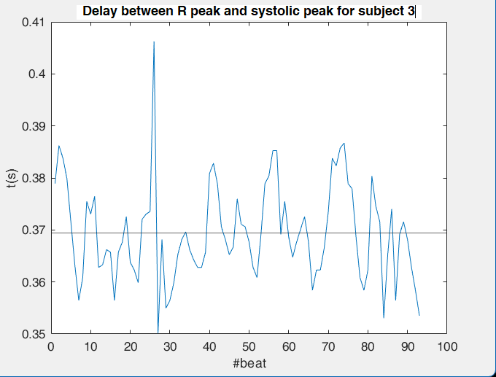
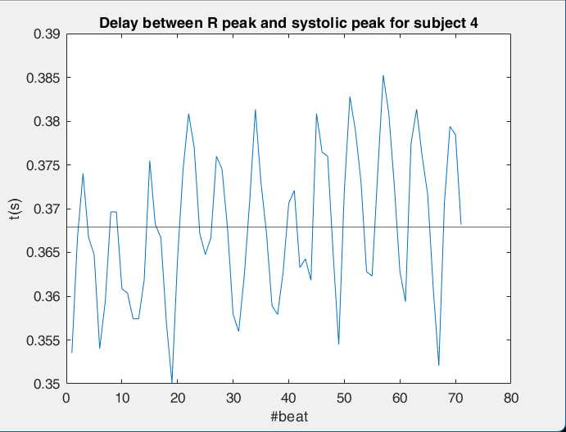
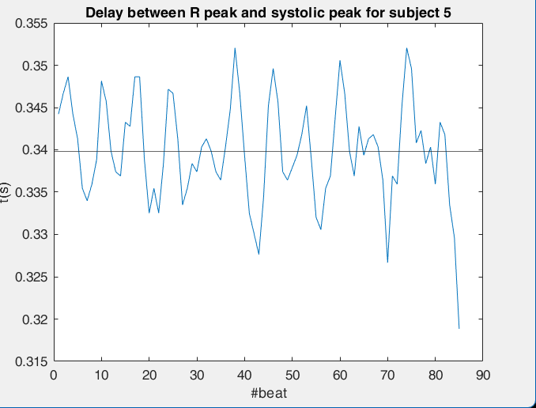
RESULTS AND DISCUSSION
MEAN: 0.3706 s ,STD: 0.0081 s
MEAN: 0.4258 s ,STD: 0.0121 s
MEAN: 0.3694 s ,STD: 0.0093 s
MEAN: 0.3679 s STD: 0.0085 s
MEAN: 0.3398 s ,STD: 0.0061 s

Slide 7
RESULTS AND DISCUSSIONS

