Slide 1
BALAJI BUILDING MATERIAL SUPPLIERS
Presented by
M.Thirupathamma
MSB2218

Slide 2
TOOLS &Technologies
Tools
Technologies
VS CODE EDITOR
ANY BROUSER
HTML
CSS
BOOTSTRAP

Slide 3
ABOUT WEBPAGE
We serve the quality building materials
All materials at one place
Time saving
Presently limited to few cities
We serve future many more

Slide 4
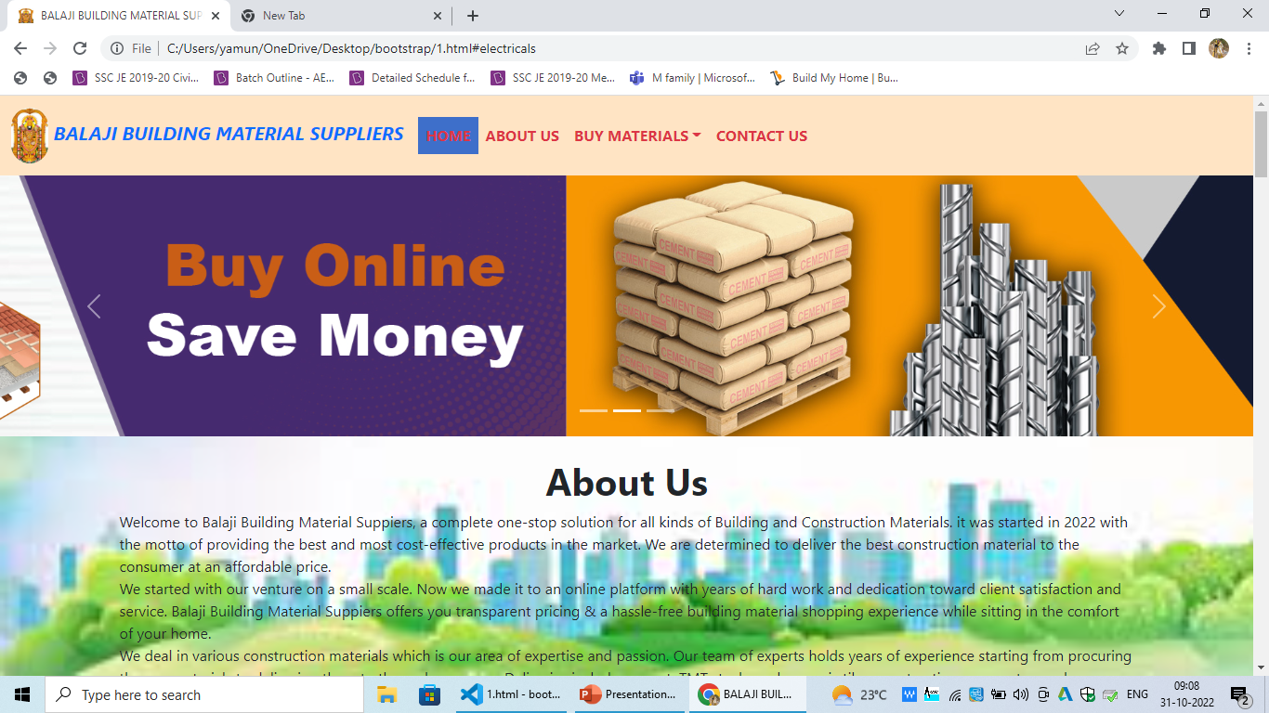
Contents of webpage

Slide 5
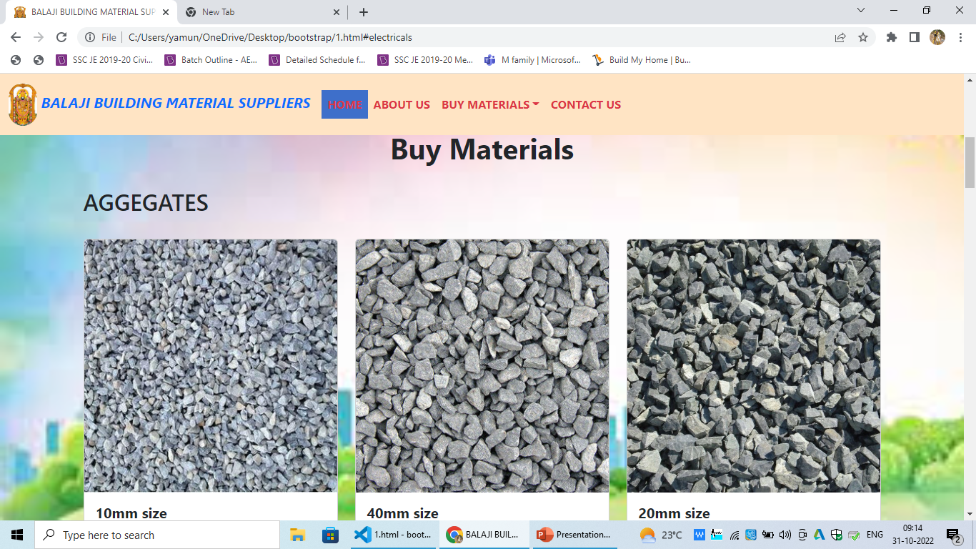

Slide 6
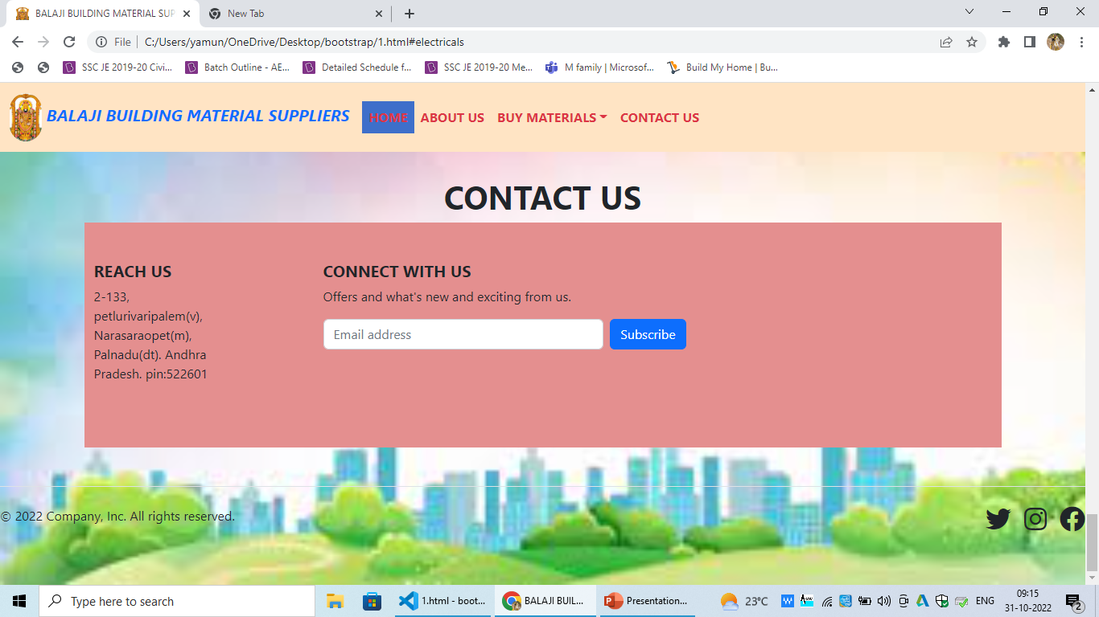

Slide 7
THANK YOU

