Slide 1


Apple Covid, Market Volatility and Liquidity
Natasha Karwal, Minh Nguyen, Abdul Tarawally

Slide 2
Summary
The purpose of this project is to explore the effects of Covid-19 on across the world.
Specifically, this data analysis will provide the COVID crisis impact on market volatility and liquidity.
Live data has been pulled from John Hopkins’s GitHub repository and financial exchanges with APIs using R.
January 22, 2020 to July 7, 2020
12 companies from 2 sectors stock market data merged with confirmed and deaths total data
Research Question: What impact will coronavirus indicators have on stock market for Apple?

Slide 3
Time Series Approach
Abdul Tarawally

Slide 4
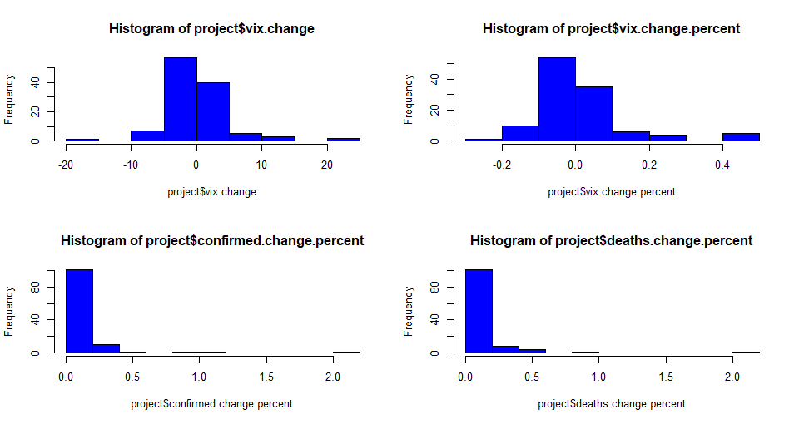
Basic Statistics
Change in VIX
Mean: 0.1437
Sd: 4.9970
Range: (-17.64, 24.86)
Confirmed Total Percent Change
Mean: 10.516%
Sd: 0.2363
Range: (0.671%, 211.052%)
Deaths Total Percent Change
Mean: 10.913%
Sd: 0.2365
Range: (0.178%, 215.385%)

Slide 5
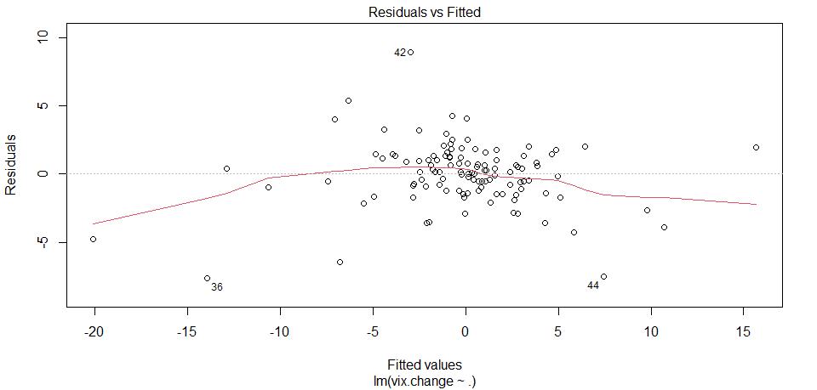
Full Model and Weighted Least Squares
Full model: lm(vix.change ~ ., data=model.data)
Use 16 predictors to predict vix.change (response variable)
Covid related predictors were not significant, very high p-values
Adjusted R-Squared 89.87%
Breusch-Pagen test – significant p-value, the errors are correlated with the predicted values → heteroscedasticity is present
Weighted Least Squares
Adjusted R-Squared 97.46%
Similar results…

Slide 6
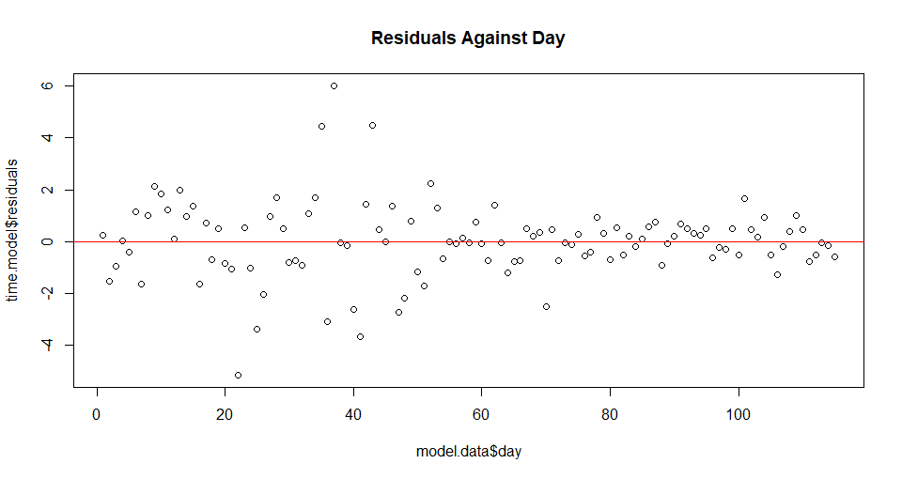
Serial Correlation
Durbin-Watson test – DW=2.0309 and p-value=0.339
DW = 0 → Extreme positive serial correlation
DW = 2 → No serial correlation
DW = 4 → Extreme negative serial correlation
1.5 < DW < 2.5 → Generally, ok for OLS regression
Lagging variables is a simple method that sometimes
corrects serial correlation

Slide 7
Non-Time Series Model
Natasha

Slide 8
Full Model and Regsubsets
Full model: lm(vix.change ~ ., data=model.data)
Use 15 predictors to predict vix.change (response variable)
We took out timestamp to avoid serial correlation
Adjusted R-Squared 89.85%
DW = 1.9593, p-value = 0.2499
Regsubsets to select bestsubset
open, high, low, previous, change.percent, vix.change.percent, confirmed.change.percent
Adjusted R-Squared 89.79%
DW = 2.0296, p-value = 0.5017
Anova test failed to reject the original model
anova(project.full, bestsub.model) – high p-value of 0.3828

Slide 9
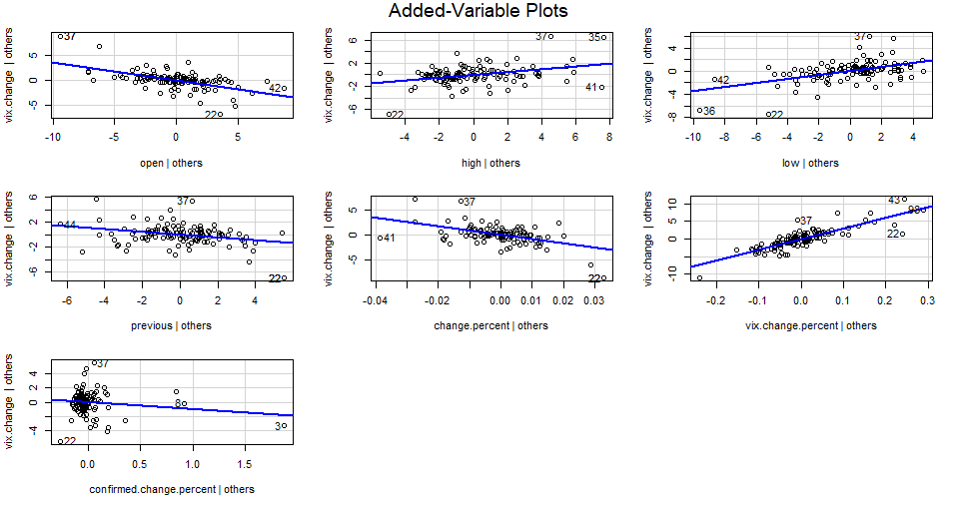
Added-Variable Plots

Slide 10
Testing for Multi-Collinearity
Condition Index to test overall collinearity condition of our models
The ratio of the highest variance (Eigenvalue 1) to the variance along the direction of the lowest variance. (> 50 means severe collinearity)
Full: 15,544,082,280.554
Bestsub: 58,953.338
Variance Inflation Factor (<10, good)
Full: volume, vix.previous, vix.change.percent
Bestsub: vix.change.percent, confirmed.total (change.percent = 11.081)

Slide 11
Model Comparison
anova(time.model, time.step.backward)
P-value: 0.7246
Fail to reject the “full” time series model
anova(project.full, bestsub.model)
P-value: 0.3828
Fail to reject the “full” non-time series model

Slide 12
Predictions
Minh

Slide 13
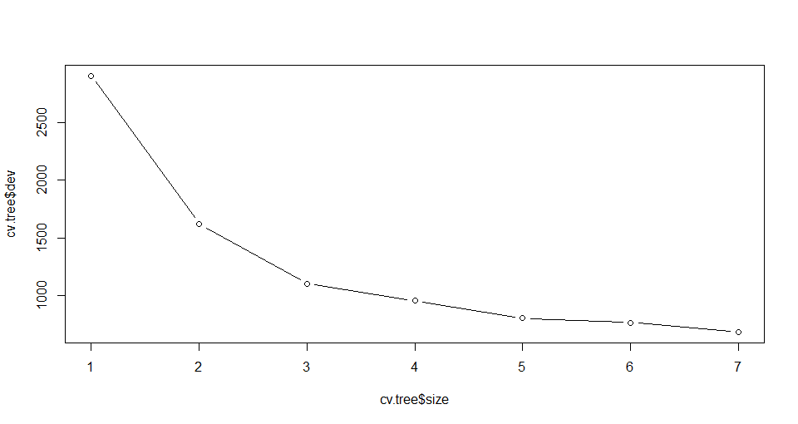
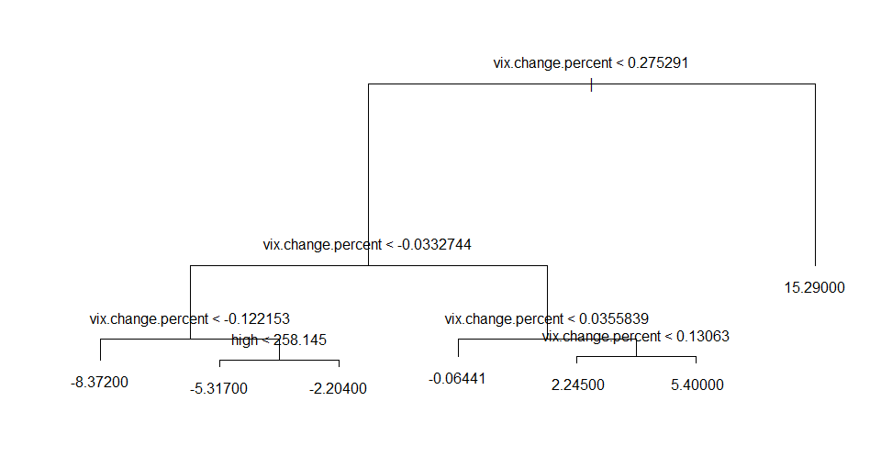
Regression Trees
Controlling Tree Size with 10-Fold Cross Validation
Min Dev – 680.9209, Tree No. – 1 and Tree Size – 7
Pruning the Tree with the “best tree”

Slide 14
Ridge and LASSO Regressions (10-Fold CV)
Ridge coefficients never shrink all the way to 0’s – they just become really small with large values of λ = ∞
Best Lambda: 0.4529819
Log(Lambda): -0.7919031
Best 10FCV MSE: 4.731551
LASSO method does shrink small coefficients all
the way to 0 with large values of λ
Best Lambda: 0.001383341
Log(Lambda): -6.583254
Best 10FCV MSE: 3.632694

Slide 15
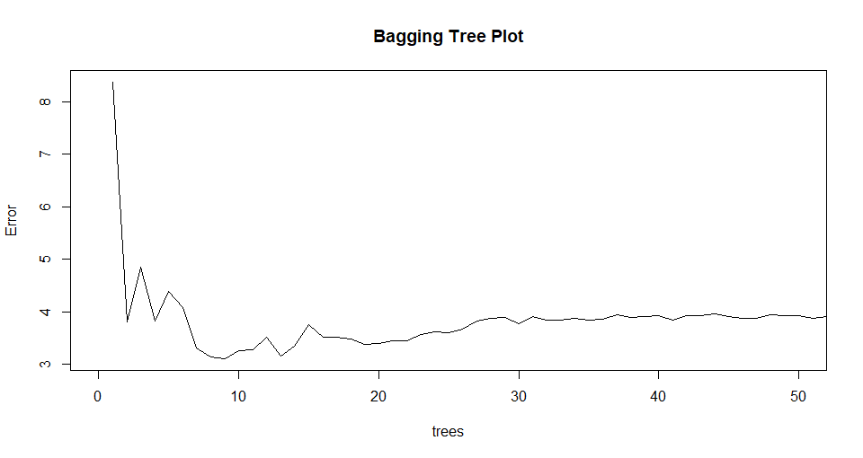
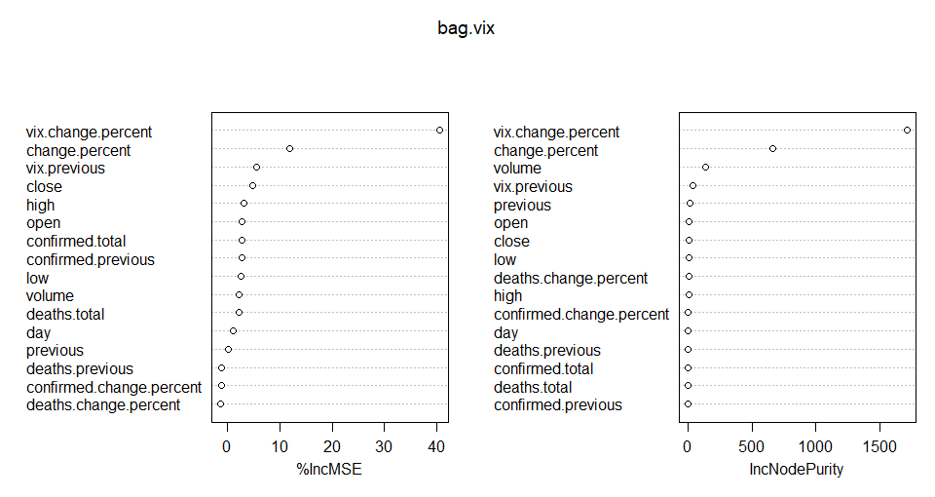
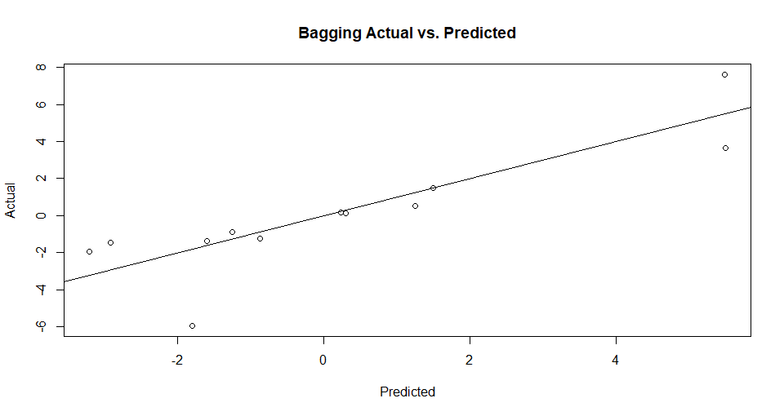
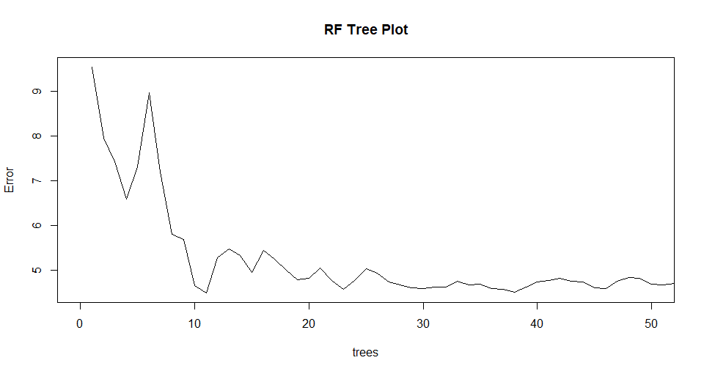
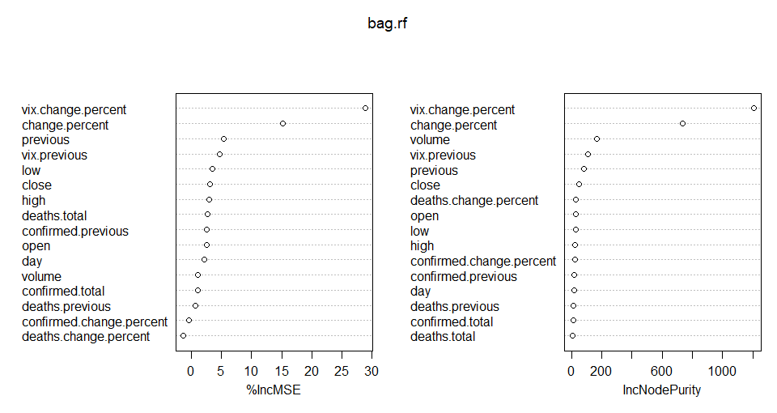
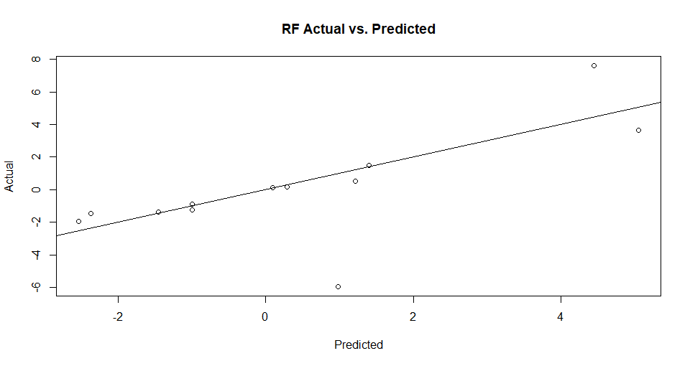
Bagging and Random Forest
Bagging (mtry=16, % Var explained: 85.42, MSE: 2.491288)
Random Forest (mtry=7, % Var explained: 80.92, MSE: 5.162328
)

Slide 16
Prediction Results
set.seed(1)
train <- sample(1:nrow(x), 0.90*nrow(x))
test <- sample(1:nrow(x), 0.10*nrow(x))
rownumbers <- c(68,39,1,34,87,43,14,82,9,51,97)
test.data <- model.data[rownumbers,2:17]
Predict()
MSE
 | mse
bagging | 2.4913
lasso.mse | 2.6759
time.mse | 2.9906
ridge.mse | 3.3432
full.mse | 3.3449
bestsub.mse | 3.3736
randomforest | 5.1623

Slide 17
Next Steps
Minh

Slide 18
Next Steps
Lagging
Help fix serial correlation issues with time series
We would also like to implement a few test for outliers
Studentized deleted residuals
Principle Component Analysis
Remedial Measures for multicollinearity in our dataset
Run more tests and comparisons

Slide 19
Q&A

Slide 20
Appendix 1 – Best Tree
RNGkind(sample.kind="default")
set.seed(1)
tree.vix <- tree(vix.change ~ ., data = model.data)
cv.tree <- cv.tree(tree.vix)
plot(cv.tree$size, cv.tree$dev, type='b')
cbind("Size"=cv.tree$size, "Deviance"=cv.tree$dev)
min.dev <- min(cv.tree$dev)
best.ind <- which(cv.tree$dev == min.dev)
best.size <- cv.tree$size[best.ind]
c("Min Dev"=min.dev, "Tree No."=best.ind, "Tree Size"=best.size)
prune.sal <- prune.tree(tree.vix, best=best.size)
plot(prune.sal)
text(prune.sal, pretty=0)

Slide 21
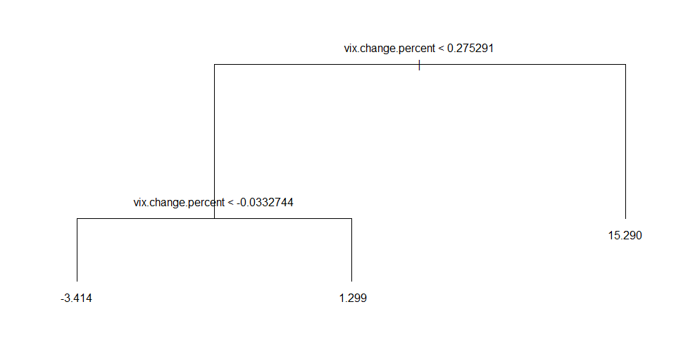
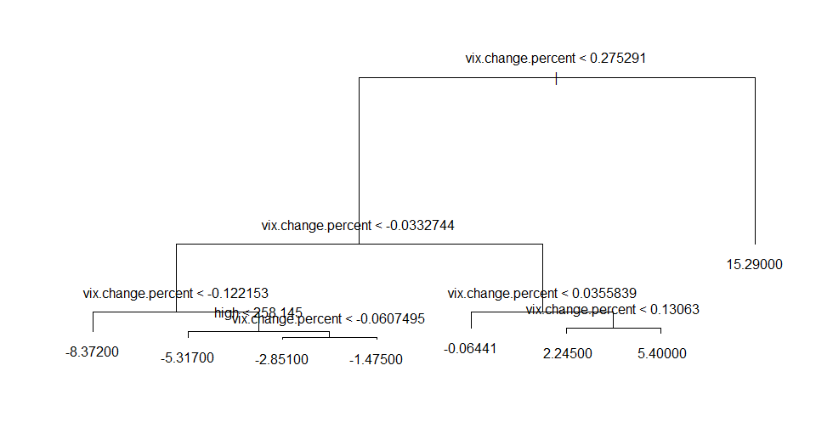
Appendix 2 – Regression Tree (small vs. large)

Slide 22
Appendix 3 – Ridge and LASSO
Optimal Ridge Lambda
Optimal LASSO Lambda
set.seed(1) # To get repeatable results
cv.10Fold <- cv.glmnet(x, y, alpha=0)
cbind("Lambda"=cv.10Fold$lambda, "10-Fold MSE"=cv.10Fold$cvm)
plot(cv.10Fold) # Plot all lambdas vs. MSEs
best.lambda <- cv.10Fold$lambda.min
min.mse <- min(cv.10Fold$cvm)
cbind("Best Lambda"=best.lambda, "Log(Lambda)"=log(best.lambda), "Best 10FCV MSE"=min.mse)
set.seed(1) # To get repeatable results
cv.10Fold.lasso <- cv.glmnet(x,y,alpha=1)
cbind("Lambda"=cv.10Fold.lasso$lambda, "10-Fold MSE"=cv.10Fold.lasso$cvm)
plot(cv.10Fold.lasso) # Plot all lambdas vs. MSEs
best.lambda.lasso <- cv.10Fold.lasso$lambda.min
log(best.lambda.lasso) # Best log(lambda)
min.mse.lasso <- min(cv.10Fold.lasso$cvm) # Lowest 10FCV MSE
cbind("Best Lambda"=best.lambda.lasso, "Log(Lambda)"=log(best.lambda.lasso), "Best 10FCV MSE"=min.mse.lasso)

Slide 23
Appendix 4 – Bagging vs. Random Forest

