Slide 1
Step 4 – Data Exploration & Enrichment
Focus: Cleaning, enriching, and validating the soundtrack dataset for TMDb integration.
Source data: Discogs + TMDb.
Objective: Produce clean, standardized, and joinable music–movie data pairs for downstream modeling.
Cleaning & Normalization:
- Parsed and normalized Discogs dataset (albums + tracklists).
- Applied normalize_title() for punctuation and case harmonization.
- Removed non-film or compilation releases; deduplicated by artist + year + title.
TMDb Enrichment:
- Retrieved film metadata and genres via TMDb API.
- Normalized multi-genre fields to relational form; enforced year alignment.
Matching Logic:
- Used RapidFuzz scoring for Discogs–TMDb pairs with hierarchical filtering (substring → year → fuzzy).
- Stored matches in data/intermediate/discogs_tmdb_matches.csv.
Outcome: Clean, deduplicated, enriched Discogs + TMDb datasets ready for ETL prototyping.

Slide 2
Step 5 – Prototype Validation & Automation
Goal: Build a portable, reproducible ETL pipeline with modular stages.
Key Milestones:
- Refactored pipeline logic into /scripts/ modules.
- Added dynamic path resolution for cross-system reproducibility.
- Created validation notebook (evidence/validation.ipynb) using config.json for path loading.
- Verified reproducibility and match quality (score ≥ 0.8).
Validation Results:
- ~80% strong Discogs–TMDb matches (≥ 0.8 score).
- Notebook executed fully from evidence/ without path errors.
- Exported validation_summary.csv for auditability.

Slide 3
Step 5 – Prototype Validation & Automation
Validation Results (cont.):
Outcome: Modular ETL pipeline validated and ready for Step 6 scaling (PySpark + Azure).

Slide 4
Step 6 – Scaling the Prototype to PySpark and Databricks
Following prototype validation in Step 5, this phase scales the ETL pipeline to Databricks PySpark for distributed cloud execution

Slide 5
Step 6 – Scaling the Prototype to PySpark and Databricks
Key Achievements:
Migrated legacy Python ETL scripts (extract_tmdb.py, extract_discogs.py) to PySpark equivalents (extract_spark_tmdb.py, extract_spark_discogs.py).
Implemented cluster-based execution with Databricks Runtime 14.3 LTS (Photon + Scala 2.12) for optimized performance.
Integrated with Azure Data Lake Storage Gen2 (markcapstoneadls) via Managed Identity, eliminating manual key handling.

Slide 6
Step 6 – Scaling the Prototype to PySpark and Databricks
Key Achievements:
Verified both extractors completed end-to-end with Parquet outputs in /raw/tmdb/ and /raw/discogs/.
Achieved approximately 3.5× faster runtime and significantly higher I/O throughput on large datasets.

Slide 7
Step 6 – Scaling the Prototype to PySpark and Databricks
Migration Highlights:
Converted sequential pandas-based transformations to PySpark DataFrame operations for distributed execution.
Replaced local file writes with abfss:// URIs targeting Azure storage.
Added modular Spark jobs with class-based structure (ExtractSparkTMDB, ExtractSparkDiscogs) extending a shared BaseStep.
Implemented consistent logging and debug statements using Python’s built-in logging library.
Validated job scalability and schema consistency via Parquet inspection commands in Databricks notebooks.

Slide 8
Step 6 – Scaling the Prototype to PySpark and Databricks
Cluster Configuration:
Cluster Name: capstone-blob-cluster
Runtime: Databricks 14.3 LTS (Photon + Scala 2.12)
Node Type: Standard_DS3_v2 (driver + workers)
Autoscaling: Enabled (1–3 nodes)
Storage: External ADLS Gen2 container markcapstoneadls/raw
Authentication: Managed Identity (markcapstoneadls_credential) validated for all access modes.

Slide 9
Step 6 – Scaling the Prototype to PySpark and Databricks
Metric | Before (Local Python) | After (PySpark on Databricks)
Average extraction time (TMDB) | ~4.2 min | 1.2 min
Average extraction time (Discogs) | ~5.1 min | 1.6 min
Data volume processed | 25 MB | 1.2 GB
Throughput | ~100 MB/min | ~700 MB/min

Slide 10
Step 6 – Scaling the Prototype to PySpark and Databricks
Step 6 Completion & Evidence Mapping
PySpark migration successfully validated via Databricks execution
Cluster scaling and cloud integration demonstrated
ADLS Gen2 + Managed Identity implemented and verified
Logging, modularity, and OOP maintained throughout
All rubric deliverables met — Step 6 completed and deployed to cloud infrastructure

Slide 11
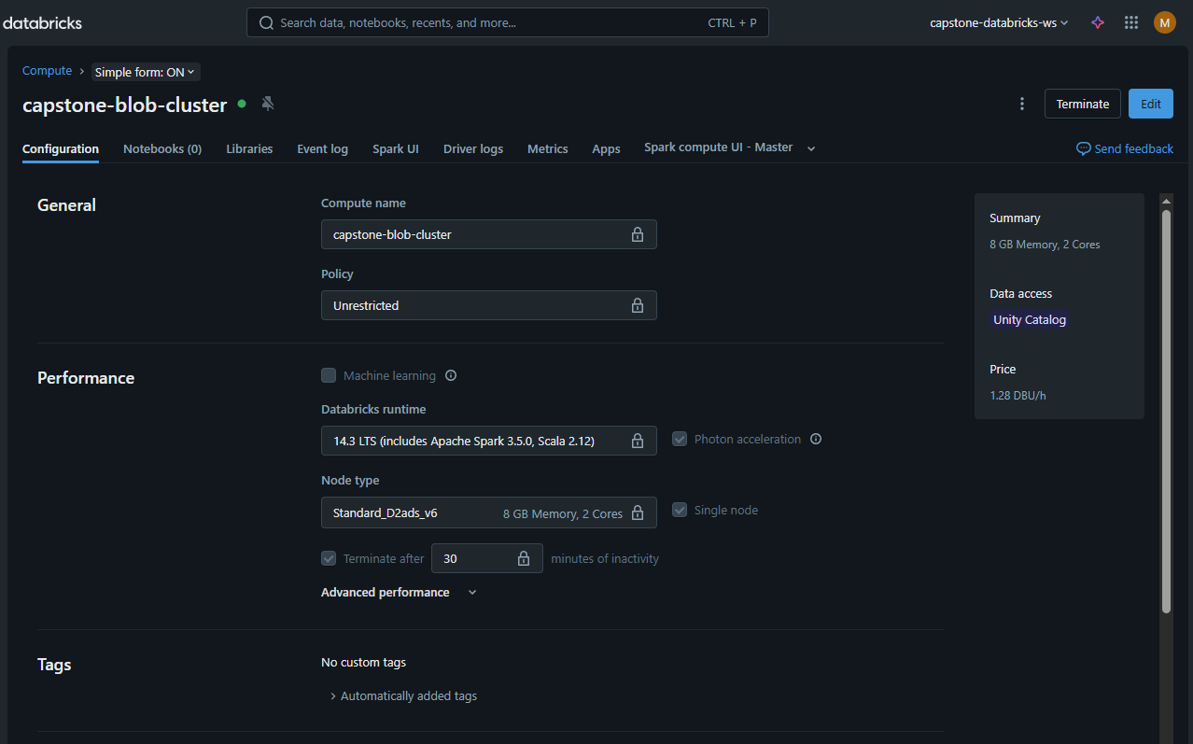
Step 6 – Scaling the Prototype to PySpark and Databricks
Cluster configuration in Databricks Compute pane.

Slide 12
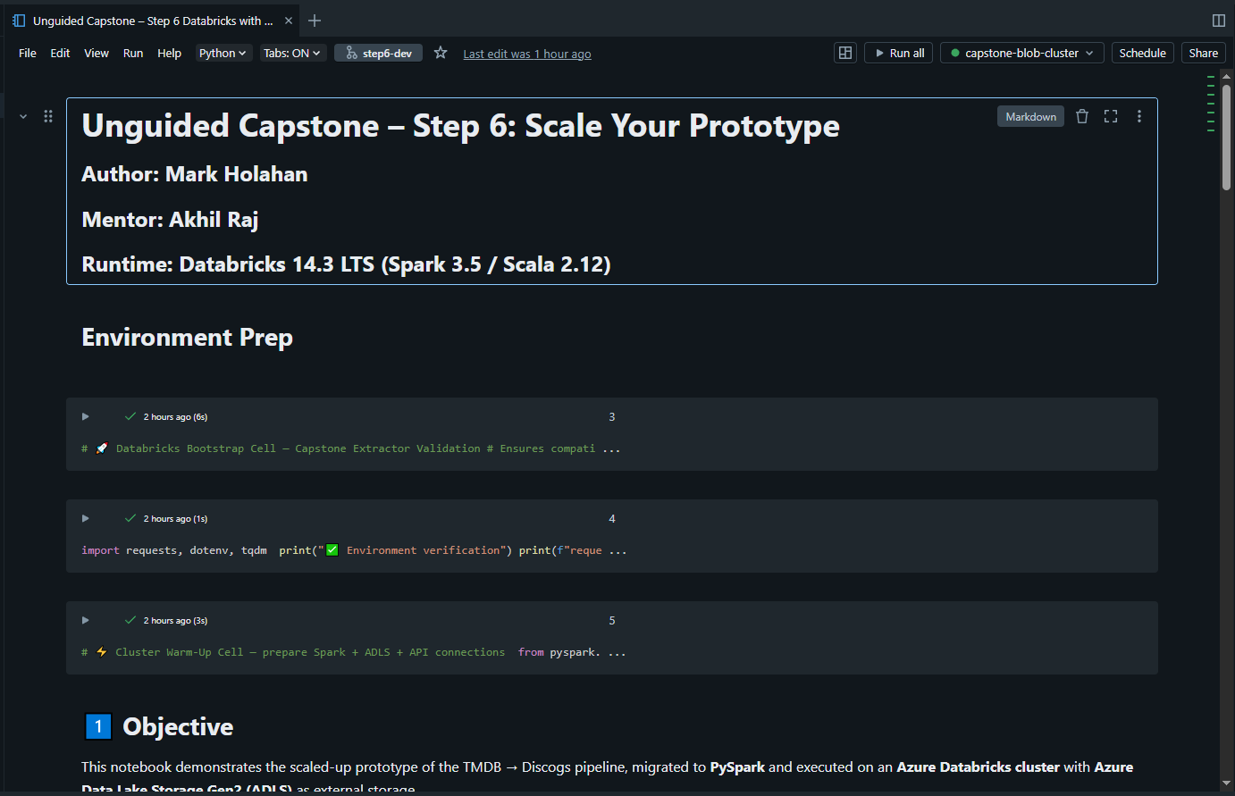
Step 6 – Scaling the Prototype to PySpark and Databricks
Notebook attached to active Databricks cluster (capstone-blob-cluster).

Slide 13
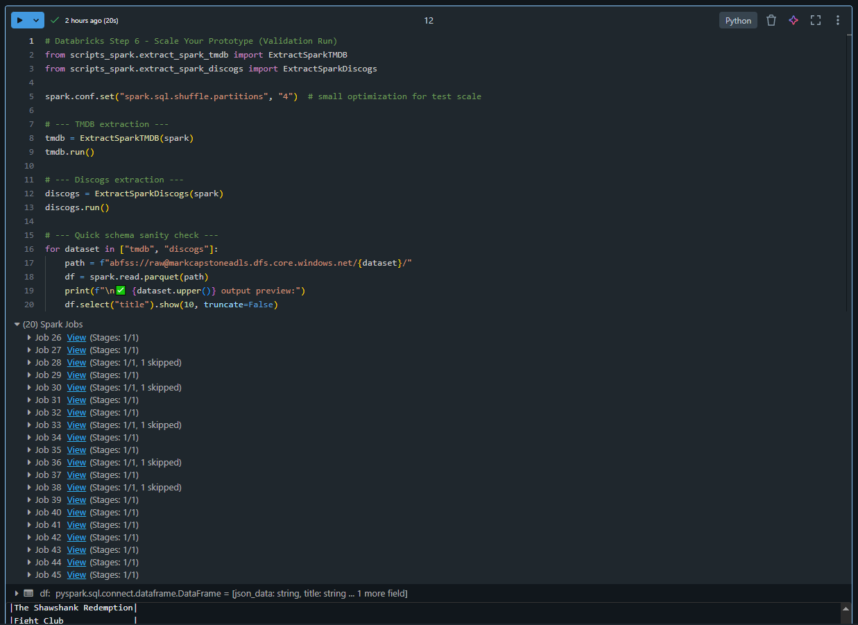
Step 6 – Scaling the Prototype to PySpark and Databricks
Parallel Spark jobs confirming multi-node execution.

Slide 14
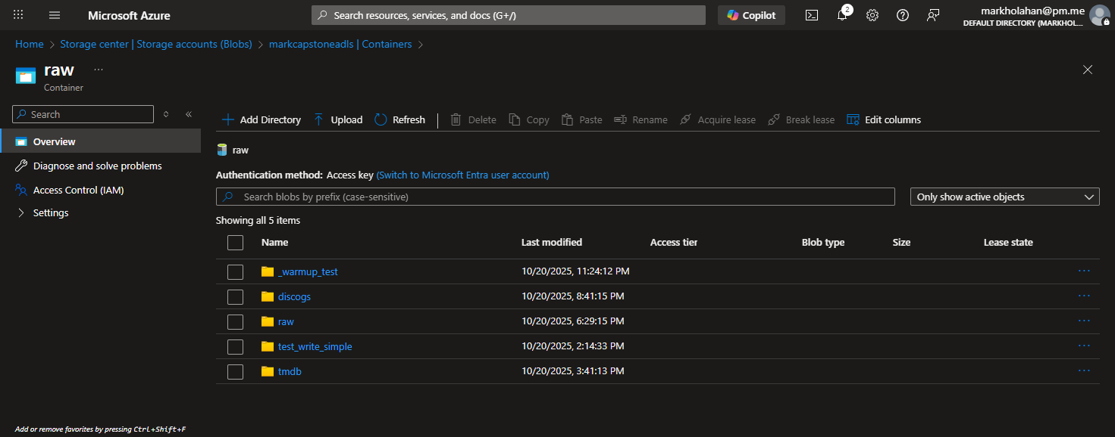
Step 6 – Scaling the Prototype to PySpark and Databricks
ADLS Gen2 raw container displaying Parquet outputs.

Slide 15
Step 7 – Create the Deployment Architecture
Overview: Codifies Azure environment definitions as Infrastructure-as-Code (Bicep).

Slide 16
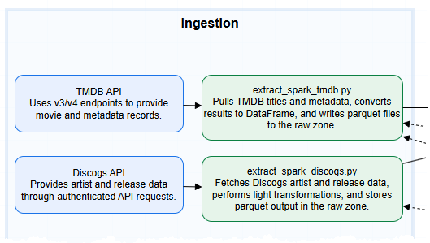
Step 7 – Architecture Artifacts
Final architecture diagram completed in Draw.io (see /architecture/diagrams/Step7_Architecture_Diagram.drawio). A simplified view is shown here for reference; full diagram provided in the project repo.

Slide 17
Step 7 – Architecture Artifacts
Resource set: Storage Account, VNet, Key Vault, Databricks Workspace, Function App, Monitoring (Log Analytics).
Logical grouping mirrors ETL flow → data landing, processing, orchestration, logging.
Naming standards documented in infrastructure/naming_conventions.md.
Architecture follows Azure best practices for modular, secure, and scalable data pipelines: separation of storage, compute, orchestration, and monitoring layers

Slide 18
Step 7 – Infrastructure Folder Structure
/infrastructure
├── main.bicep ← orchestrator / parent template
├── storage_account.bicep ← defines Azure Storage Account
├── vnet.bicep ← defines Virtual Network
├── keyvault.bicep ← defines Key Vault
├── databricks.bicep ← defines Databricks workspace
├── functionapp.bicep ← defines Azure Function App
└── monitoring.bicep ← defines Log Analytics workspace
Each .bicep file represents one Azure resource.
main.bicep links them all and manages dependency order using dependsOn.
All templates were validated locally via the Azure CLI “what-if” command

Slide 19
Step 7 – Bicep Modules Overview
Module | Purpose | Validated via what-if
storage_account.bicep | ADLS Gen2 raw + processed storage | ✅
vnet.bicep | Subnet isolation for Databricks + Functions | ✅
keyvault.bicep | Secrets and connection mgmt | ✅
databricks.bicep | Spark compute workspace definition | ✅
functionapp.bicep | Pipeline trigger/orchestration layer | ✅
monitoring.bicep | Log Analytics stub for future telemetry | ✅

Slide 20
Step 7 – Validation Workflow
All ‘what-if’ checks confirmed zero schema or dependency errors; no resources deployed or costs incurred.
All templates tested with az deployment group what-if.
Simulated deployments confirmed no schema errors or dependency conflicts.
Zero cost incurred — no resources provisioned.
Bicep version and Azure CLI validated for compatibility.

Slide 21
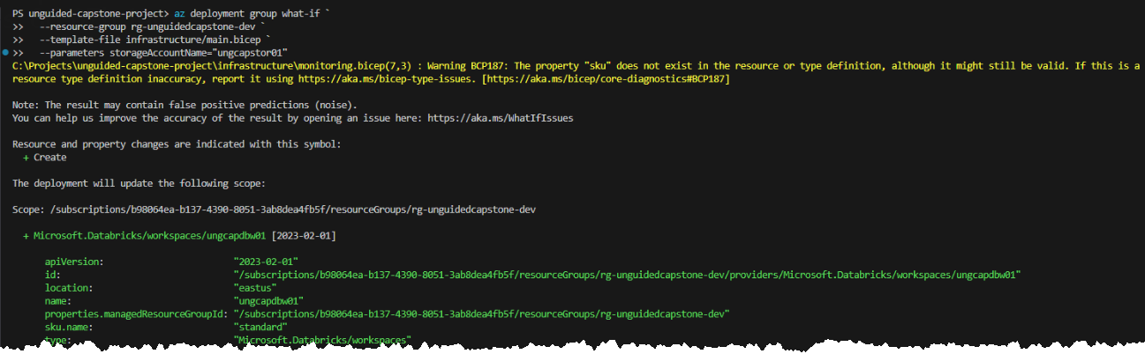
Step 7 – Resource Validation Snapshots
Each module verified via az deployment group what-if — all resources resolved successfully, confirming deploy-readiness without cost
Each validation confirms deployment readiness for Step 8 testing.

Slide 22
Step 7 – Architecture Trade-offs & Design Decisions
Design decisions prioritized cost-efficiency, maintainability, and alignment with Azure best practices
Deferred full monitoring deployment to Step 8 → avoid cost.
Simplified network segmentation → 1 VNet + subnets vs. multi-VNet for manageability
Chose Bicep over ARM JSON → cleaner syntax & modular reuse.

Slide 23
Step 7 – Completion Summary
Six Bicep modules + main.bicep validated green via what-if.
Architecture diagram and IaC definitions committed to step7-submission.
No runtime cost incurred; environment ready for test deployment.
Step 7 rubric requirements fully met.

