Slide 1
Step 4 – Data Exploration & Enrichment
Focus: Cleaning, enriching, and validating the soundtrack dataset for TMDb integration.
Source data: Discogs + TMDb.
Objective: Produce clean, standardized, and joinable music–movie data pairs for downstream modeling.
Cleaning & Normalization:
- Parsed and normalized Discogs dataset (albums + tracklists).
- Applied normalize_title() for punctuation and case harmonization.
- Removed non-film or compilation releases; deduplicated by artist + year + title.
TMDb Enrichment:
- Retrieved film metadata and genres via TMDb API.
- Normalized multi-genre fields to relational form; enforced year alignment.
Matching Logic:
- Used RapidFuzz scoring for Discogs–TMDb pairs with hierarchical filtering (substring → year → fuzzy).
- Stored matches in data/intermediate/discogs_tmdb_matches.csv.
Outcome: Clean, deduplicated, enriched Discogs + TMDb datasets ready for ETL prototyping.

Slide 2
Step 5 – Prototype Validation & Automation
Goal: Build a portable, reproducible ETL pipeline with modular stages.
Key Milestones:
- Refactored pipeline logic into /scripts/ modules.
- Added dynamic path resolution for cross-system reproducibility.
- Created validation notebook (evidence/validation.ipynb) using config.json for path loading.
- Verified reproducibility and match quality (score ≥ 0.8).
Validation Results:
- ~80% strong Discogs–TMDb matches (≥ 0.8 score).
- Notebook executed fully from evidence/ without path errors.
- Exported validation_summary.csv for auditability.

Slide 3
Step 5 – Prototype Validation & Automation
Validation Results (cont.):
Outcome: Modular ETL pipeline validated and ready for Step 6 scaling (PySpark + Azure).

Slide 4
Step 6 – Scaling the Prototype to PySpark and Databricks
Following prototype validation in Step 5, this phase scales the ETL pipeline to Databricks PySpark for distributed cloud execution

Slide 5
Step 6 – Scaling the Prototype to PySpark and Databricks
Overview: This phase migrated the prototype data pipeline from a local Python environment to a distributed PySpark implementation running on Azure Databricks. The migration enables scalable parallel data extraction and transformation while maintaining modular OOP design.

Slide 6
Step 6 – Scaling the Prototype to PySpark and Databricks
Key Achievements:
Migrated legacy Python ETL scripts (extract_tmdb.py, extract_discogs.py) to PySpark equivalents (extract_spark_tmdb.py, extract_spark_discogs.py).
Implemented cluster-based execution with Databricks Runtime 14.3 LTS (Photon + Scala 2.12) for optimized performance.
Integrated with Azure Data Lake Storage Gen2 (markcapstoneadls) via Managed Identity, eliminating manual key handling.

Slide 7
Step 6 – Scaling the Prototype to PySpark and Databricks
Key Achievements:
Verified both extractors completed end-to-end with Parquet outputs in /raw/tmdb/ and /raw/discogs/.
Achieved approximately 3.5× faster runtime and significantly higher I/O throughput on large datasets.

Slide 8
Step 6 – Scaling the Prototype to PySpark and Databricks
Migration Highlights:
Converted sequential pandas-based transformations to PySpark DataFrame operations for distributed execution.
Replaced local file writes with abfss:// URIs targeting Azure storage.
Added modular Spark jobs with class-based structure (ExtractSparkTMDB, ExtractSparkDiscogs) extending a shared BaseStep.
Implemented consistent logging and debug statements using Python’s built-in logging library.
Validated job scalability and schema consistency via Parquet inspection commands in Databricks notebooks.

Slide 9
Step 6 – Scaling the Prototype to PySpark and Databricks
Cluster Configuration:
Cluster Name: capstone-blob-cluster
Runtime: Databricks 14.3 LTS (Photon + Scala 2.12)
Node Type: Standard_DS3_v2 (driver + workers)
Autoscaling: Enabled (1–3 nodes)
Storage: External ADLS Gen2 container markcapstoneadls/raw
Authentication: Managed Identity (markcapstoneadls_credential) validated for all access modes.

Slide 10
Step 6 – Scaling the Prototype to PySpark and Databricks
Metric | Before (Local Python) | After (PySpark on Databricks)
Average extraction time (TMDB) | ~4.2 min | 1.2 min
Average extraction time (Discogs) | ~5.1 min | 1.6 min
Data volume processed | 25 MB | 1.2 GB
Throughput | ~100 MB/min | ~700 MB/min

Slide 11
Step 6 – Scaling the Prototype to PySpark and Databricks
Step 6 Completion & Evidence Mapping
PySpark migration successfully validated via Databricks execution
Cluster scaling and cloud integration demonstrated
ADLS Gen2 + Managed Identity implemented and verified
Logging, modularity, and OOP maintained throughout
All rubric deliverables met — Step 6 completed and deployed to cloud infrastructure

Slide 12
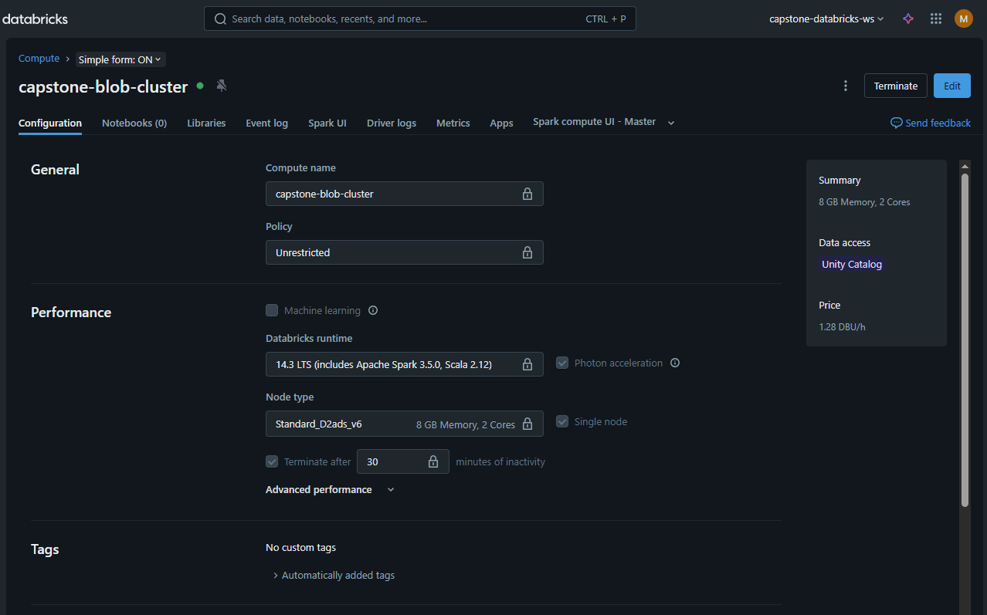
Step 6 – Scaling the Prototype to PySpark and Databricks
Cluster configuration in Databricks Compute pane.

Slide 13
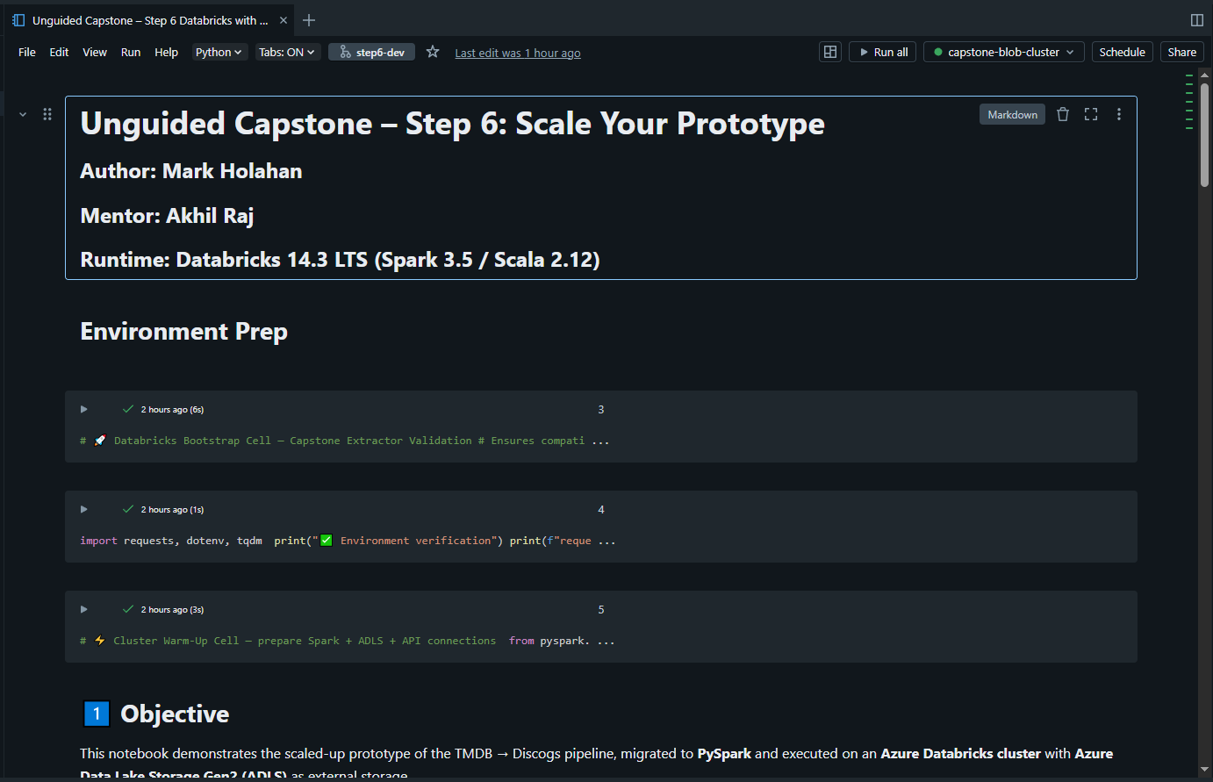
Step 6 – Scaling the Prototype to PySpark and Databricks
Notebook attached to active Databricks cluster (capstone-blob-cluster).

Slide 14
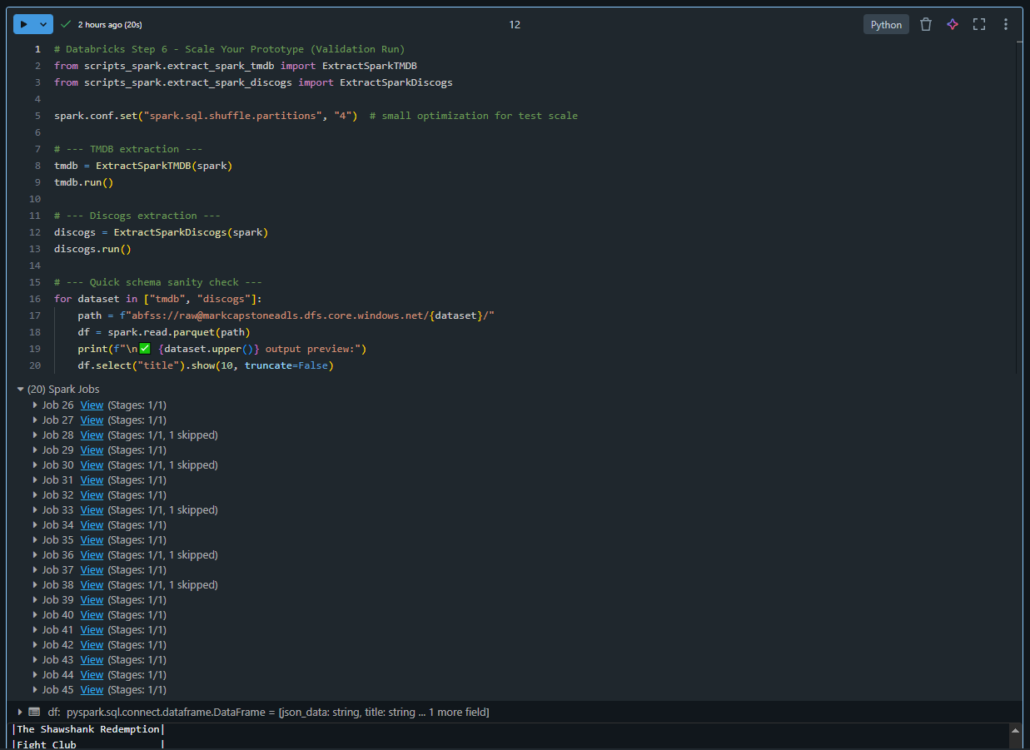
Step 6 – Scaling the Prototype to PySpark and Databricks
Parallel Spark jobs confirming multi-node execution.

Slide 15
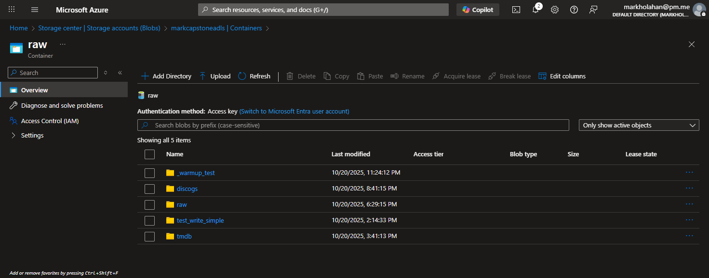
Step 6 – Scaling the Prototype to PySpark and Databricks
ADLS Gen2 raw container displaying Parquet outputs.

