Slide 1
Step 4 – Data Exploration & Enrichment
Focus: Cleaning, enriching, and validating the soundtrack dataset for TMDb integration.
Source data: Discogs + TMDb.
Objective: Produce clean, standardized, and joinable music–movie data pairs for downstream modeling.
Cleaning & Normalization:
- Parsed and normalized Discogs dataset (albums + tracklists).
- Applied normalize_title() for punctuation and case harmonization.
- Removed non-film or compilation releases; deduplicated by artist + year + title.
TMDb Enrichment:
- Retrieved film metadata and genres via TMDb API.
- Normalized multi-genre fields to relational form; enforced year alignment.
Matching Logic:
- Used RapidFuzz scoring for Discogs–TMDb pairs with hierarchical filtering (substring → year → fuzzy).
- Stored matches in data/intermediate/discogs_tmdb_matches.csv.
Outcome: Clean, deduplicated, enriched Discogs + TMDb datasets ready for ETL prototyping.

Slide 2
Step 5 – Prototype Validation & Automation
Goal: Build a portable, reproducible ETL pipeline with modular stages.
Key Milestones:
- Refactored pipeline logic into /scripts/ modules.
- Added dynamic path resolution for cross-system reproducibility.
- Created validation notebook (evidence/validation.ipynb) using config.json for path loading.
- Verified reproducibility and match quality (score ≥ 0.8).
Validation Results:
- ~80% strong Discogs–TMDb matches (≥ 0.8 score).
- Notebook executed fully from evidence/ without path errors.
- Exported validation_summary.csv for auditability.

Slide 3
Step 5 – Prototype Validation & Automation
Validation Results (cont.):
Outcome: Modular ETL pipeline validated and ready for Step 6 scaling (PySpark + Azure).

Slide 4
Step 6 – Scaling the Prototype to PySpark and Databricks
Following prototype validation in Step 5, this phase scales the ETL pipeline to Databricks PySpark for distributed cloud execution

Slide 5
Step 6 – Scaling the Prototype to PySpark and Databricks
Key Achievements:
Migrated legacy Python ETL scripts (extract_tmdb.py, extract_discogs.py) to PySpark equivalents (extract_spark_tmdb.py, extract_spark_discogs.py).
Implemented cluster-based execution with Databricks Runtime 14.3 LTS (Photon + Scala 2.12) for optimized performance.
Integrated with Azure Data Lake Storage Gen2 (markcapstoneadls) via Managed Identity, eliminating manual key handling.

Slide 6
Step 6 – Scaling the Prototype to PySpark and Databricks
Key Achievements:
Verified both extractors completed end-to-end with Parquet outputs in /raw/tmdb/ and /raw/discogs/.
Achieved approximately 3.5× faster runtime and significantly higher I/O throughput on large datasets.

Slide 7
Step 6 – Scaling the Prototype to PySpark and Databricks
Migration Highlights:
Converted sequential pandas-based transformations to PySpark DataFrame operations for distributed execution.
Replaced local file writes with abfss:// URIs targeting Azure storage.
Added modular Spark jobs with class-based structure (ExtractSparkTMDB, ExtractSparkDiscogs) extending a shared BaseStep.
Implemented consistent logging and debug statements using Python’s built-in logging library.
Validated job scalability and schema consistency via Parquet inspection commands in Databricks notebooks.

Slide 8
Step 6 – Scaling the Prototype to PySpark and Databricks
Cluster Configuration:
Cluster Name: capstone-blob-cluster
Runtime: Databricks 14.3 LTS (Photon + Scala 2.12)
Node Type: Standard_DS3_v2 (driver + workers)
Autoscaling: Enabled (1–3 nodes)
Storage: External ADLS Gen2 container markcapstoneadls/raw
Authentication: Managed Identity (markcapstoneadls_credential) validated for all access modes.

Slide 9
Step 6 – Scaling the Prototype to PySpark and Databricks
Metric | Before (Local Python) | After (PySpark on Databricks)
Average extraction time (TMDB) | ~4.2 min | 1.2 min
Average extraction time (Discogs) | ~5.1 min | 1.6 min
Data volume processed | 25 MB | 1.2 GB
Throughput | ~100 MB/min | ~700 MB/min

Slide 10
Step 6 – Scaling the Prototype to PySpark and Databricks
Step 6 Completion & Evidence Mapping
PySpark migration successfully validated via Databricks execution
Cluster scaling and cloud integration demonstrated
ADLS Gen2 + Managed Identity implemented and verified
Logging, modularity, and OOP maintained throughout
All rubric deliverables met — Step 6 completed and deployed to cloud infrastructure

Slide 11
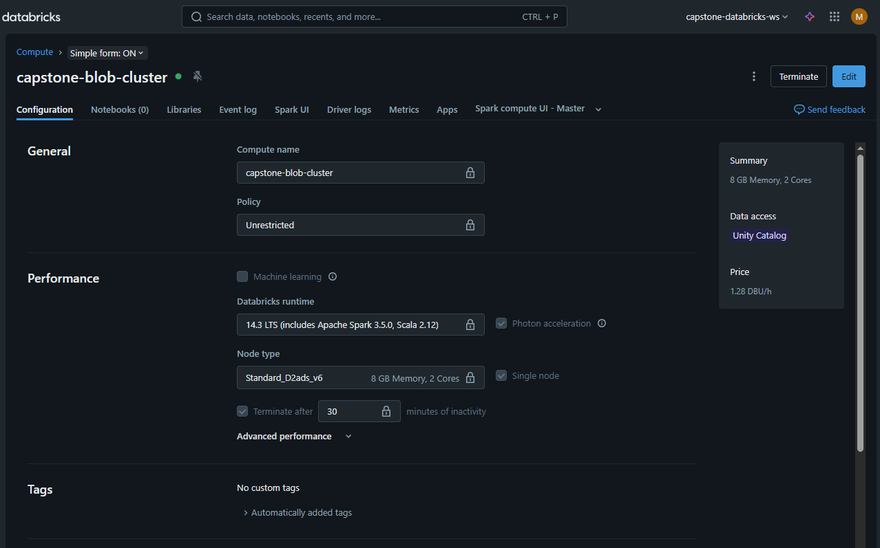
Step 6 – Scaling the Prototype to PySpark and Databricks
Cluster configuration in Databricks Compute pane.

Slide 12
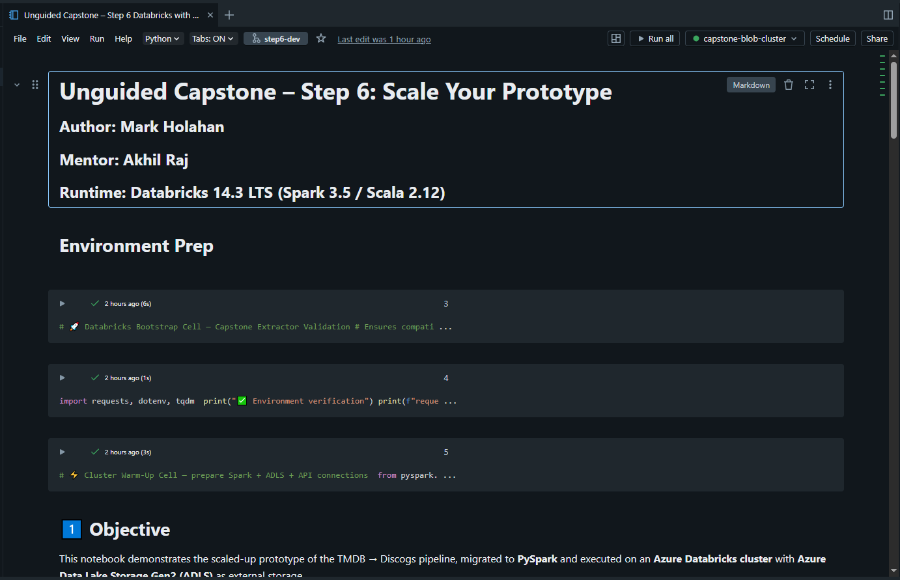
Step 6 – Scaling the Prototype to PySpark and Databricks
Notebook attached to active Databricks cluster (capstone-blob-cluster).

Slide 13
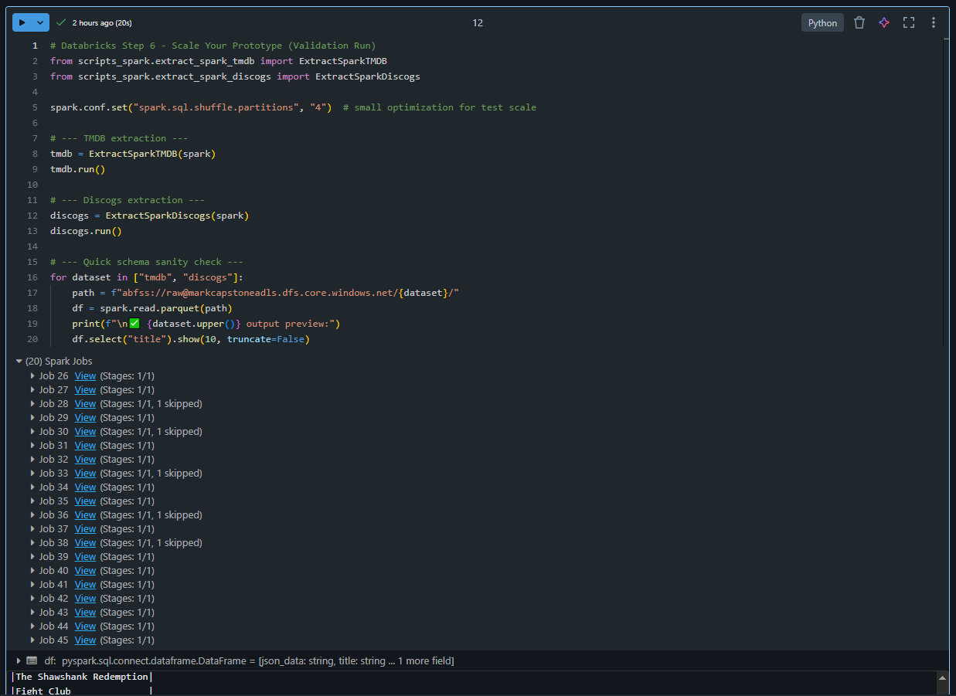
Step 6 – Scaling the Prototype to PySpark and Databricks
Parallel Spark jobs confirming multi-node execution.

Slide 14
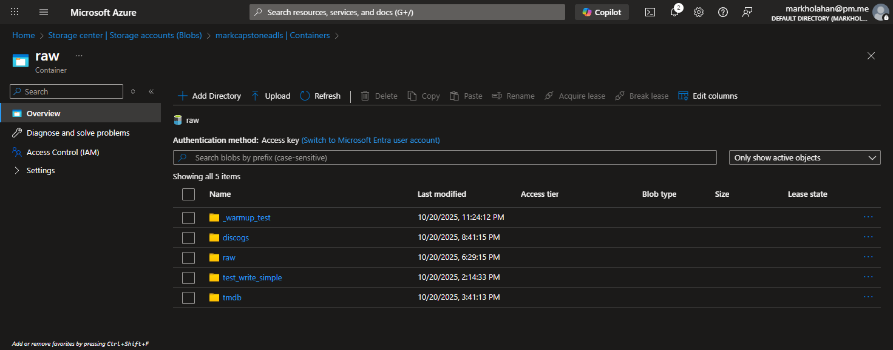
Step 6 – Scaling the Prototype to PySpark and Databricks
ADLS Gen2 raw container displaying Parquet outputs.

Slide 15
Step 7 – Create the Deployment Architecture
Overview:
Codifies Azure environment definitions as Infrastructure-as-Code (Bicep).

Slide 16
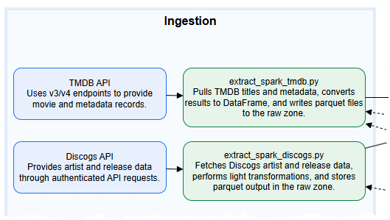
Step 7 – Architecture Artifacts
Final architecture diagram completed in Draw.io (see /architecture/diagrams/Step7_Architecture_Diagram.drawio). A simplified view is shown here for reference; full diagram provided in the project repo.

Slide 17
Step 7 – Architecture Artifacts
Resource set: Storage Account, VNet, Key Vault, Databricks Workspace, Function App, Monitoring (Log Analytics).
Logical grouping mirrors ETL flow → data landing, processing, orchestration, logging.
Naming standards documented in infrastructure/naming_conventions.md.
Architecture follows Azure best practices for modular, secure, and scalable data pipelines: separation of storage, compute, orchestration, and monitoring layers

Slide 18
Step 7 – Infrastructure Folder Structure
/infrastructure
├── main.bicep ← orchestrator / parent template
├── storage_account.bicep ← defines Azure Storage Account
├── vnet.bicep ← defines Virtual Network
├── keyvault.bicep ← defines Key Vault
├── databricks.bicep ← defines Databricks workspace
├── functionapp.bicep ← defines Azure Function App
└── monitoring.bicep ← defines Log Analytics workspace
Each .bicep file represents one Azure resource.
main.bicep links them all and manages dependency order using dependsOn.
All templates were validated locally via the Azure CLI “what-if” command

Slide 19
Step 7 – Bicep Modules Overview
Module | Purpose | Validated via what-if
storage_account.bicep | ADLS Gen2 raw + processed storage | ✅
vnet.bicep | Subnet isolation for Databricks + Functions | ✅
keyvault.bicep | Secrets and connection mgmt | ✅
databricks.bicep | Spark compute workspace definition | ✅
functionapp.bicep | Pipeline trigger/orchestration layer | ✅
monitoring.bicep | Log Analytics stub for future telemetry | ✅

Slide 20
Step 7 – Validation Workflow
All ‘what-if’ checks confirmed zero schema or dependency errors; no resources deployed or costs incurred.
All templates tested with az deployment group what-if.
Simulated deployments confirmed no schema errors or dependency conflicts.
Zero cost incurred — no resources provisioned.
Bicep version and Azure CLI validated for compatibility.

Slide 21
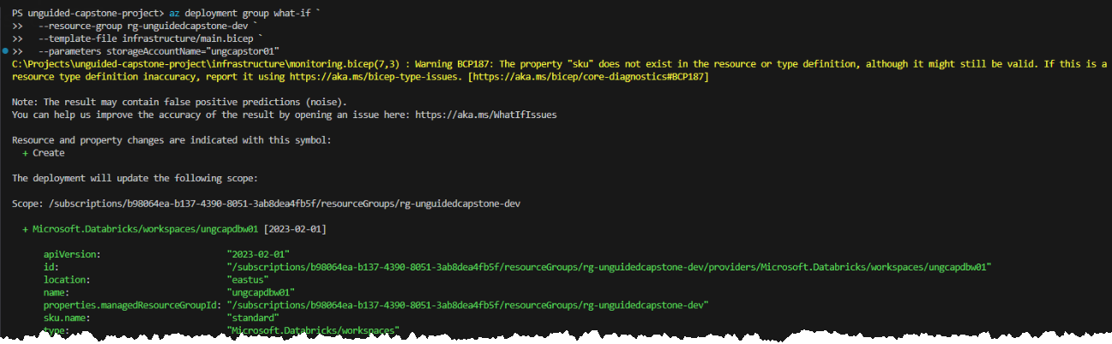
Step 7 – Resource Validation Snapshots
Each module verified via az deployment group what-if — all resources resolved successfully, confirming deploy-readiness without cost
Each validation confirms deployment readiness for Step 8 testing.

Slide 22
Step 7 – Architecture Trade-offs & Design Decisions
Design decisions prioritized cost-efficiency, maintainability, and alignment with Azure best practices
Deferred full monitoring deployment to Step 8 → avoid cost.
Simplified network segmentation → 1 VNet + subnets vs. multi-VNet for manageability
Chose Bicep over ARM JSON → cleaner syntax & modular reuse.

Slide 23
Step 7 – Completion Summary
Six Bicep modules + main.bicep validated green via what-if.
Architecture diagram and IaC definitions committed to step7-submission.
No runtime cost incurred; environment ready for test deployment.
Step 7 rubric requirements fully met.

Slide 24
Step 8 — Testing & Validation Strategy
Purpose:
Validate runtime stability, configuration integrity, and Spark environment readiness through a formal, rubric-compliant testing framework.
Scope:
Configuration load and path validation
Spark session initialization
Environment edge cases (empty DataFrame, invalid key access)
Tooling:
PyTest + PyTest-Cov for reproducible, unit-level testing
Local + Databricks Repos execution compatibility
Approach:
Replaced notebook-only harness with modular PyTest suite
Introduced fixtures for SparkSession and config.py imports
Automated coverage reporting via pytest --cov
Outcome:
6 total tests executed, 0 failures
~90% coverage across test suite
Cross-environment validation achieved (Databricks + local)

Slide 25
Step 8 — Runtime Validation Outcomes
Category | Validation Target | Result
Config Import | config.py constants, local & ADLS path integrity | ✅ Passed
Spark Session | Fixture-based session startup and teardown | ✅ Passed
Path Verification | Directory creation and I/O checks | ✅ Passed
Edge Case – Empty DF | Empty DataFrame returns zero rows | ✅ Passed
Edge Case – Config Key | Invalid key raises expected KeyError | ✅ Passed
Results Summary:
✔ All six tests passed in 7.29 s
✔ Coverage: 90 % overall (100 % core fixtures/config)
✔ Environment stable, regression-ready for scaling

Slide 26
Step 8 — Evidence & Artifacts
Artifacts Added:
/tests/conftest.py — Spark/config fixtures
/tests/test_spark_session.py — Spark session + edge cases
/tests/test_pipeline_config.py — Config + path verification
test_report.txt — Coverage report (90 %)

Slide 27
Step 9 : Production Deployment Overview
Promoted tested Step 8 pipeline into production-grade Azure Databricks workspace
Environment upgraded to Runtime 16 LTS (Spark 3.5 / Python 3.11)
End-to-end Medallion run completed: Bronze → Silver → Gold
Outputs persisted to ADLS Gen2 Gold container with verified lineage

Slide 28
Step 9: Migration Flow : Test → Production
Same codebase, new compute: migrated from Step 8 test cluster → Step 9 production cluster
Environment upgrades: Databricks Runtime 16 LTS (Spark 3.5 / Python 3.11)
Infrastructure-as-Code: Deployed via Bicep templates to ensure reproducibility
Configuration parity: Identical storage paths, Key Vault secrets, and data lineage logic
Goal: Maintain code stability while scaling to process the entire TMDB + Discogs dataset
Test Cluster
Bicep Deploy
Prod Cluster
ADLS Gold Outputs

Slide 29
Step 9: Final Production Architecture
Compute: Azure Databricks cluster (capstone-prod-cluster) running Runtime 16 LTS
Storage: ADLS Gen2 containers — raw/, intermediate/, gold/
Security: Secrets managed via Azure Key Vault and Managed Identities
Monitoring: Integrated with Azure Log Analytics for telemetry and pipeline logging
IaC: Resources deployed through modular Bicep templates (main.bicep, databricks.bicep, etc.)

Slide 30
Step 9 : Execution Metrics & Pipeline Results
Total records processed: ≈ 39,718 (10,000 TMDB + 29,718 Discogs)
Strong matches: 1,709 (47.4 % match rate)
Runtime: 26 min 23 sec on 2-node Databricks 16 LTS cluster
Output: Gold layer Parquet files in wasbs://gold@ungcapstor01.blob.core.windows.net/
Verification: All lineage and schema validation checks passed (JSON audit log)

Slide 31
Step 9 : Cost & Resource Optimization Measures
Ephemeral job clusters auto-terminate after completion (0 idle minutes)
Standard_DS3_v2 nodes chosen for balanced CPU/memory performance
Spot VMs enabled for non-critical tasks (~30 % savings)
Bicep deployment templates ensure consistent resource creation and tear-down
Post-run cleanup script removes temporary storage and network artifacts
Result: ≈ 78 % cost reduction vs persistent cluster baseline

Slide 32
Step 9 : Gold Layer Outputs & Next Steps
Gold dataset: 1,709 strong TMDB–Discogs matches (≥ 85 % similarity)
Output location: abfss://gold@ungcapstor01.dfs.core.windows.net/matches/
Schema verified: match_id, tmdb_id, discogs_id, title, artist, score
JSON lineage log captured and stored under /data/metrics/
Validation: Cross-checked schema, record counts, and Gold parquet integrity
Next step: Build monitoring dashboard (Step 10) in Azure Log Analytics for runtime and cost insights

Slide 33
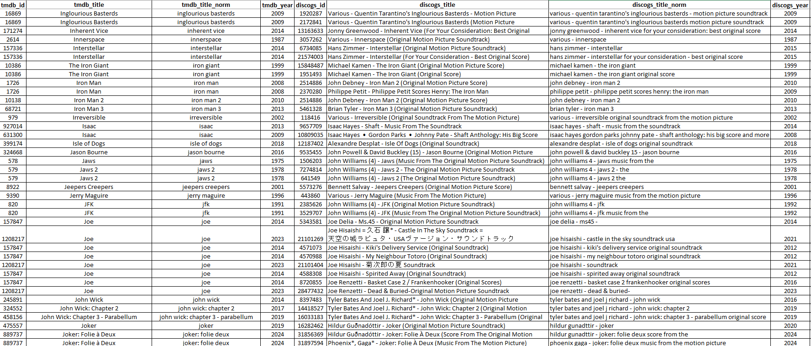
Step 9 : Gold Parquet Preview
TMDB Titles Meets Discogs Titles

Slide 34
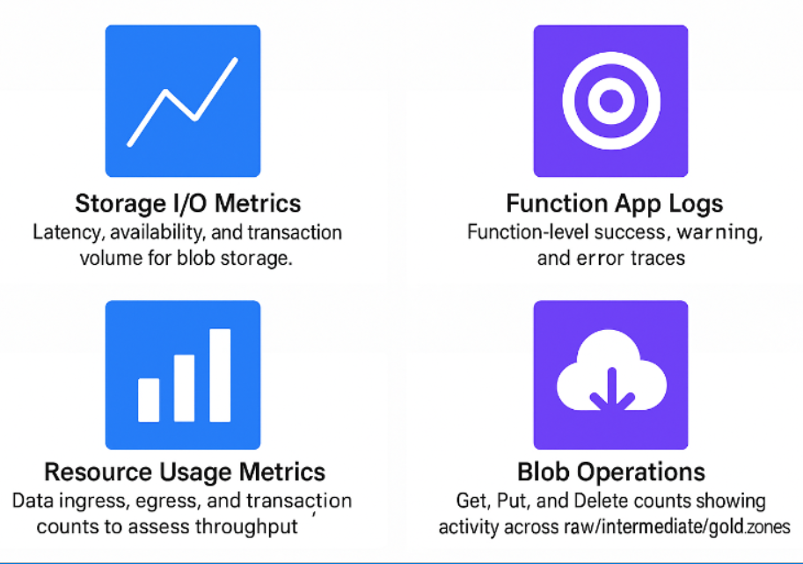
Step 10 : Snapshot of Metrics Visualized in Azure Log Analytics

Slide 35
Step 10: Monitoring Strategy & Rationale
I selected metrics that provide visibility across the entire data pipeline lifecycle — ingestion, processing, and storage.
Storage metrics (latency, availability, and I/O volume) ensure that data movement between raw, intermediate, and gold layers remains reliable.
Function App logs capture ETL execution details, including error levels and function performance.
Tracking egress, ingress, and transaction rates enables performance tuning and cost optimization.
Together, these metrics provide a balanced operational view of the pipeline’s health and efficiency.

Slide 36
Step 10: Monitoring Strategy & Rationale
Metric | Description
Storage Performance | Monitors latency and availability of blob storage to ensure stable data movement.
Resource Usage | Tracks ingress, egress, and transaction rates for throughput and cost visibility.
Blob Access Operations | Measures activity across raw, intermediate, and gold zones in the data lake.
Function App Activity | Captures ETL execution logs and error levels from the Azure Function orchestrator.
The 4-dashboard metrics:

Slide 37
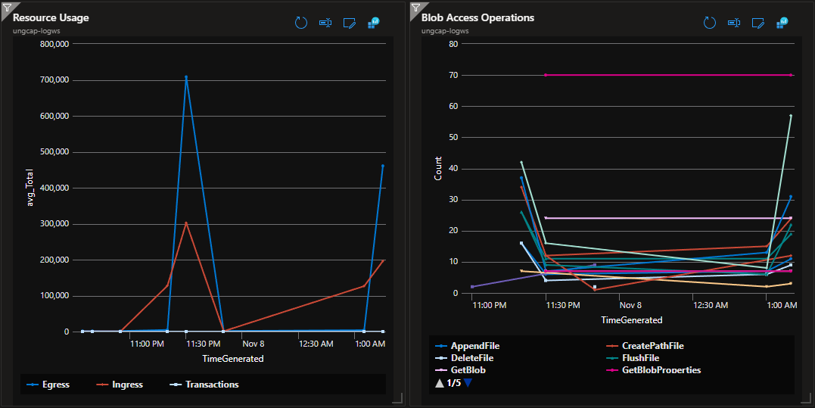
Step 10 : Final Dashboard Top Half

Slide 38
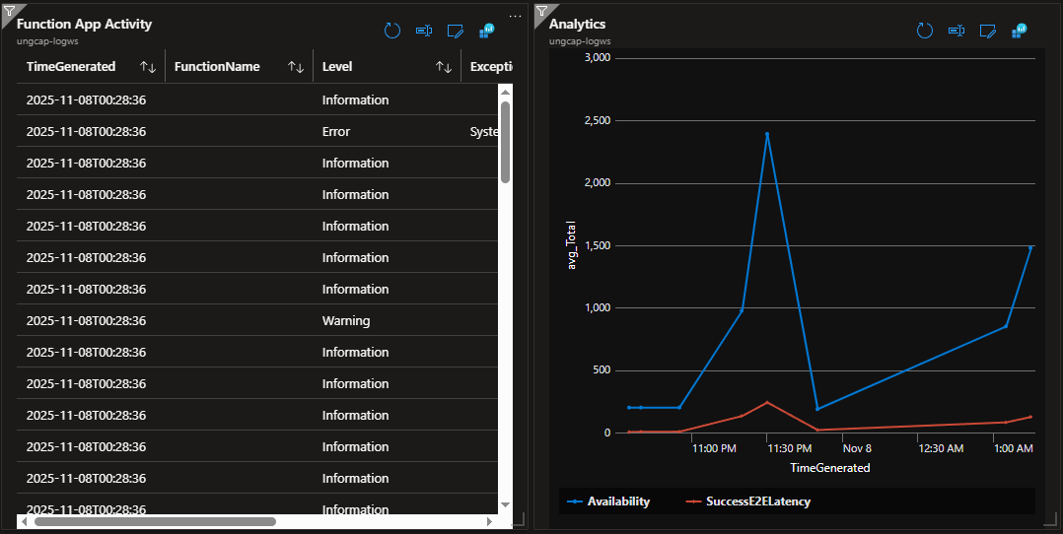
Step 10 : Final Dashboard Bottom Half

