Slide 1
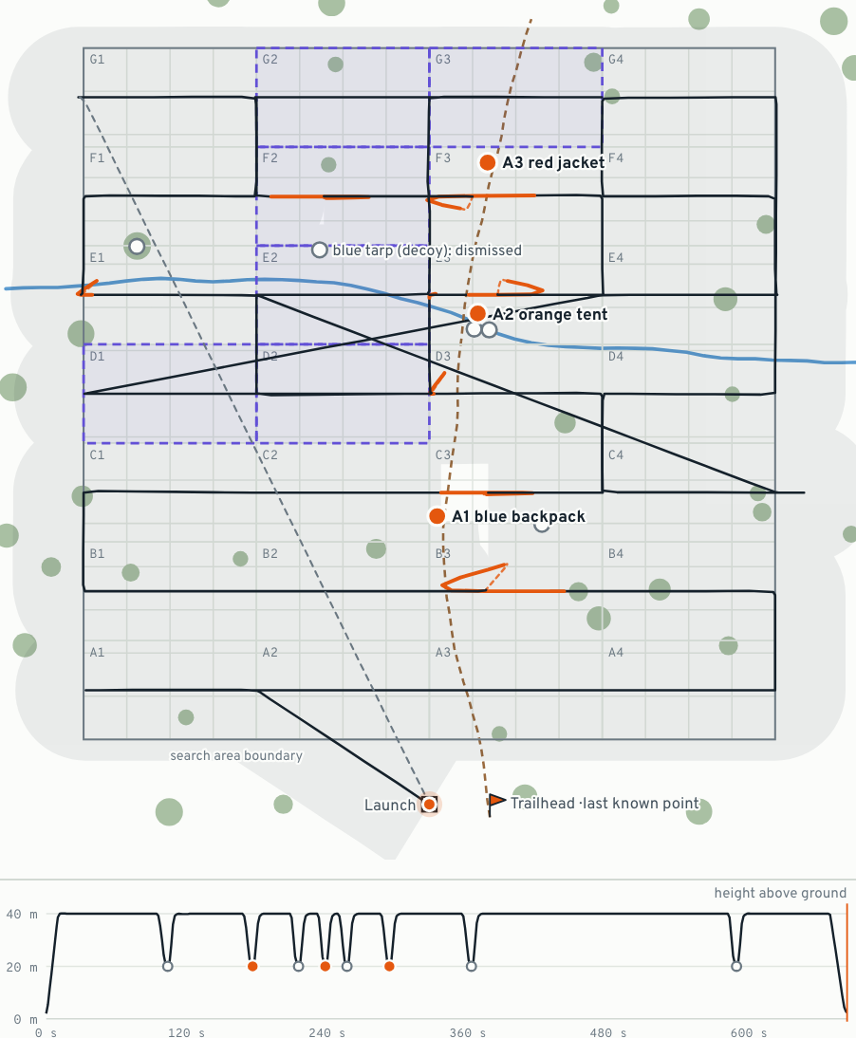
MULTI MODEL HACKATHON · SF TECH WEEK
PATROL
A search drone that looks for one missing person’s things, with no internet.
“The camper had a blue backpack, an orange tent, and a gray dog.”
3 of 3
0.32 s
things found on a real-time flight, no false alerts
median time to judge one odd-looking spot
Simulated flight, drawn from its own log

Slide 2
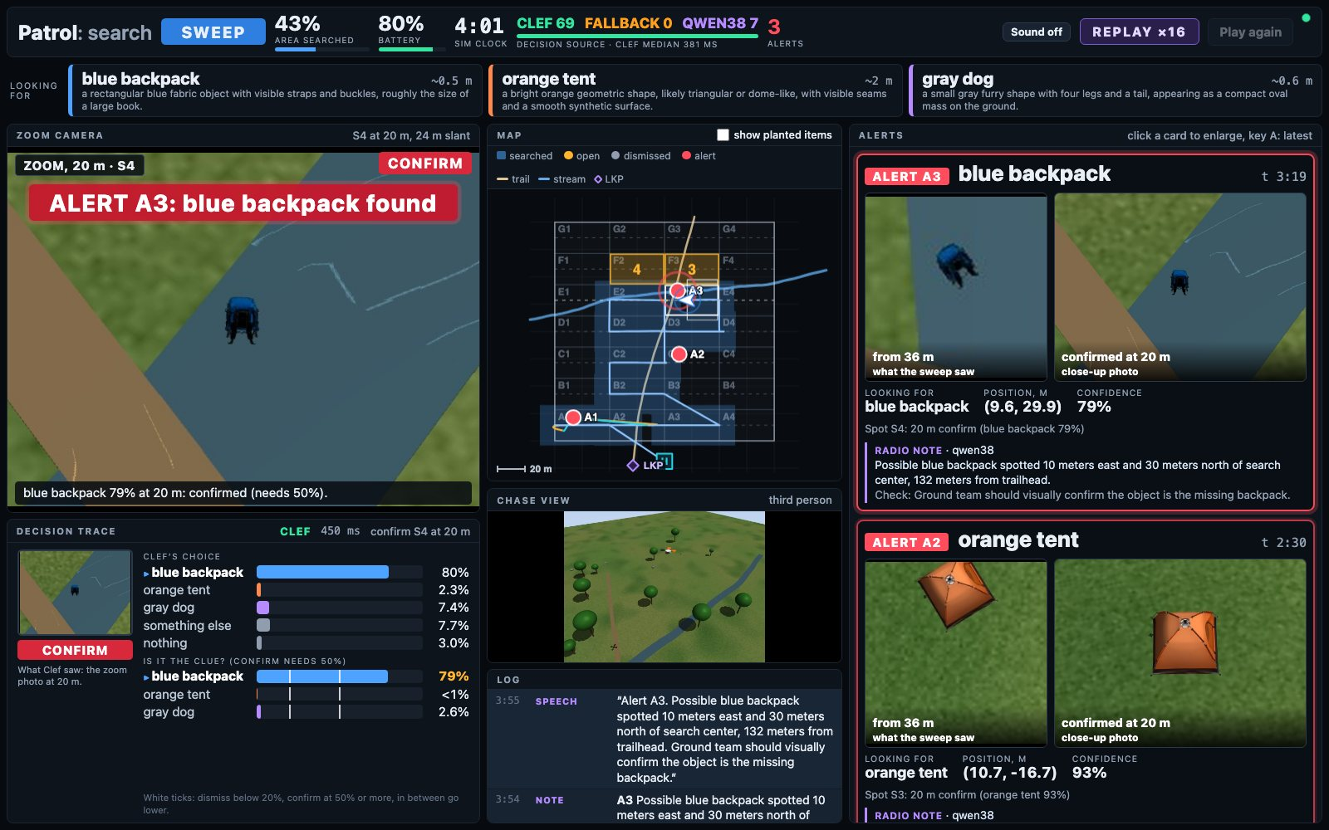
Everything it sees, thinks and finds
1
1
Header state, area searched, battery, who decided
2
3
5
8
2
Looking for the clues, in qwen38’s words
3
Camera the sweep photo, then the close-up and verdict
4
Decision trace the crop Clef-Flash judged, and its odds
5
Map lanes, trail, spots checked, alerts, next sectors
6
4
6
Chase view for the audience; no model uses it
7
Log every decision, note and spoken line
7
8
Alerts sweep crop beside the confirming close-up
The moment of an alert in the demo flight: Clef-Flash has just confirmed the blue backpack from 20 m.

Slide 3
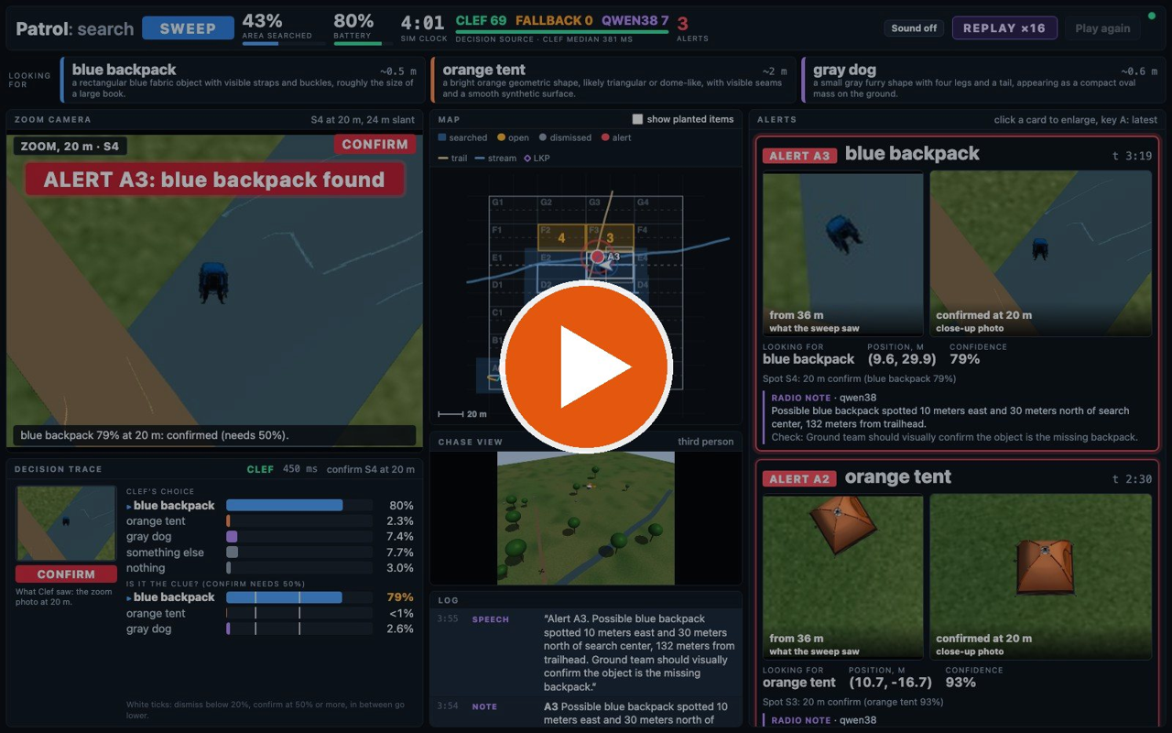
Watch the whole flight
3 min 23 s, replayed at 3.5× with the alerts read aloud.
Three finds, the tarp checked and dismissed, no false alerts.
This recording is also the stage fallback.

Slide 4
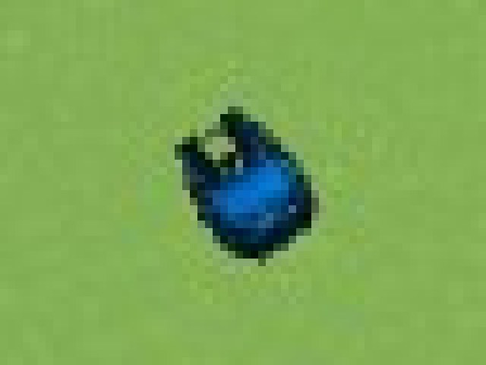
Searchers start with words, not photos
WHAT THE FAMILY SAYS
“The camper had a blue backpack, an orange tent, and a gray dog.”
Nobody has trained a detector on this person’s blue backpack.
No cell signal: an alert is about 270 bytes of text plus a 20 KB photo.
Decide in the air. After landing, every “maybe” costs another flight.
From 40 m, a backpack is a smudge
About 22 pixels across: enough to look odd, not enough to be sure.

Slide 5
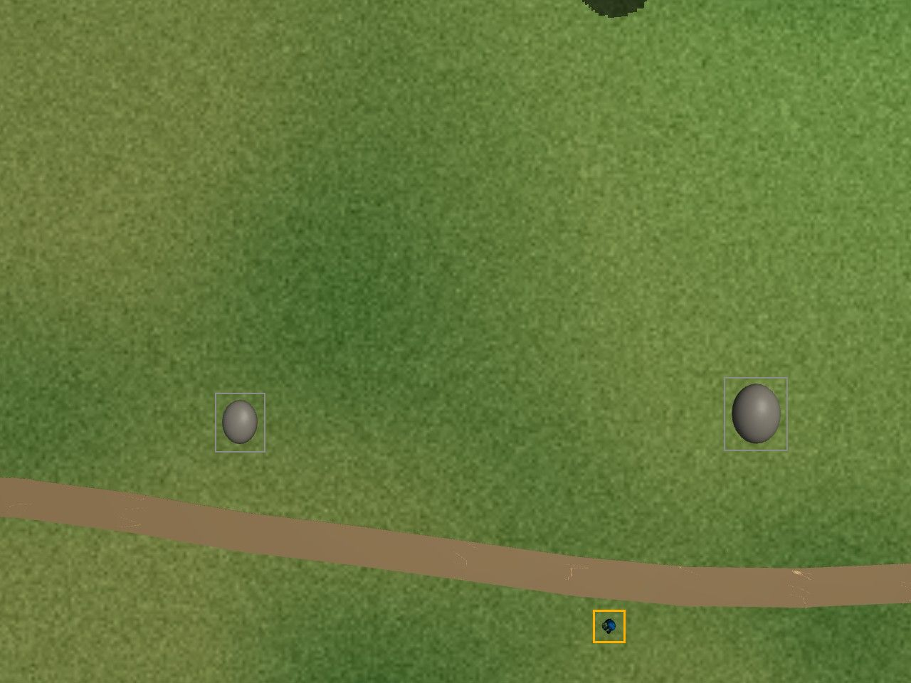
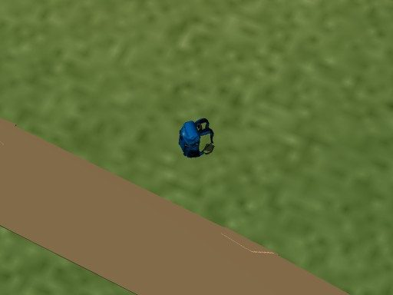
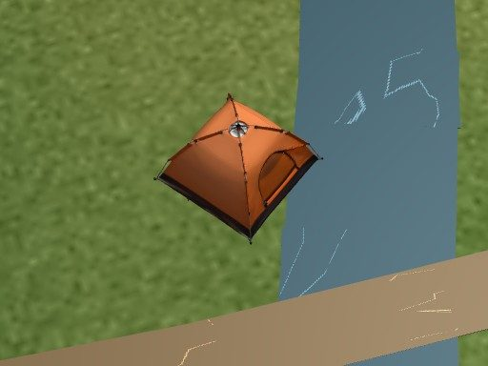
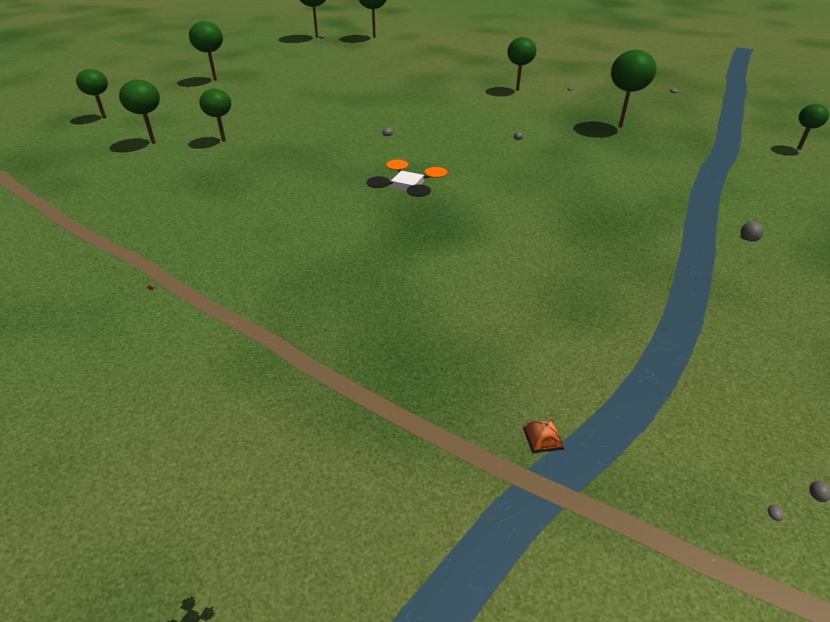
A flight in five moments
“...a blue backpack, an orange tent, and a gray dog.”
ALERT
1
Say it
2
Sweep at 40 m
3
Follow a lead
4
Alert
5
Think ahead
Parakeet writes it down. qwen38 turns each thing into a sentence about how it looks from above.
A photo every 12 m. The finder boxes odd spots; Clef-Flash says 61% backpack in about 0.3 s.
Down to 20 m for a close-up. The backpack scores 94.5%: confirmed.
A position, a photo and a spoken note. The tent alert lands 0.24 m from the tent.
qwen38 reorders the sectors. The second find came 29.5 s sooner, on average.
Real flights in the simulator, with the real models deciding.

Slide 6
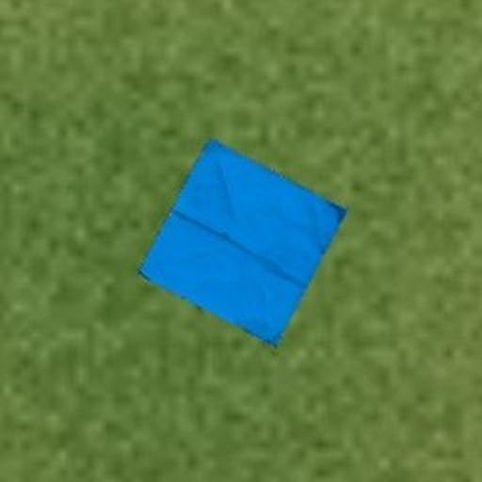
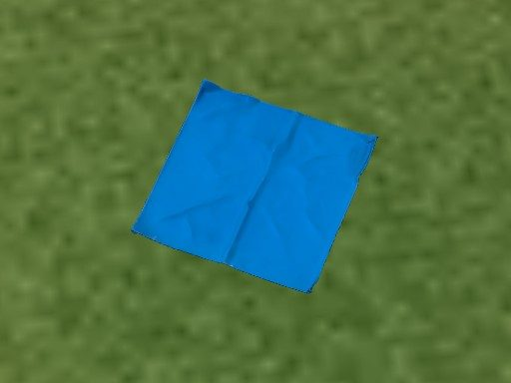
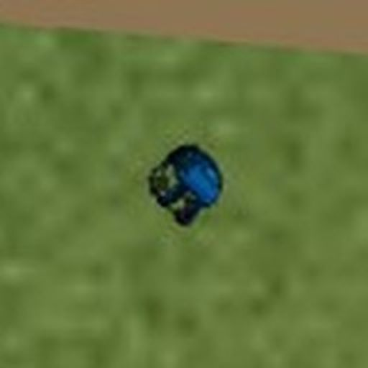
A decoy dismissed, a backpack confirmed
FROM 40 M
CLOSE-UP AT 20 M
DISMISSED
FROM 40 M
AT 20 M
17%
4%
blue backpack?
A flat sheet. Best clue score 4%.
FROM 40 M
CLOSE-UP AT 20 M
CONFIRMED
FROM 40 M
AT 20 M
61%
94.5%
blue backpack?
Straps and pockets. Back in the lane with an alert.
Scores are Clef-Flash’s probability that the spot is the blue backpack.

Slide 7
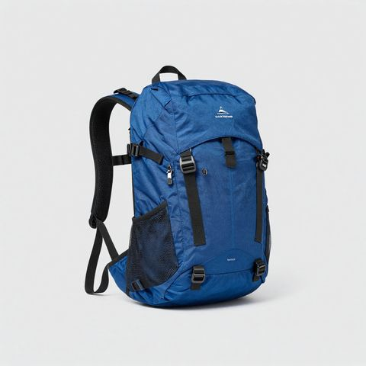
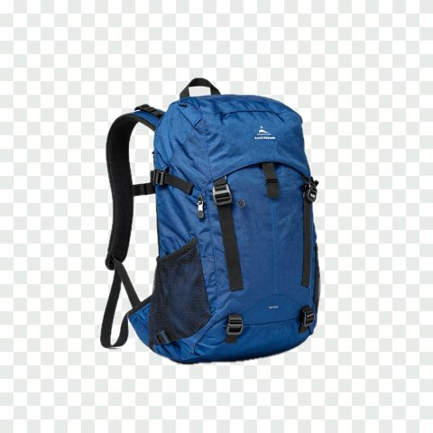
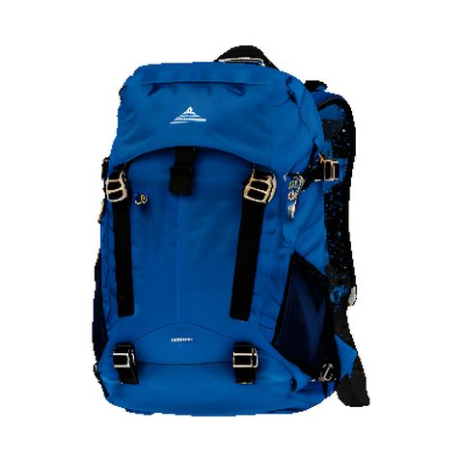
Four models fly it, three built the props
Clef-Flash
qwen38
Parakeet
Kokoro
THE FAST EYES
THE SLOW THINKER
THE EARS
THE VOICE
Judges each odd spot in about 0.3 s
Clue sentences, radio notes, trail plans, second opinions
Speech to text in 20 to 90 ms
Reads every alert aloud
Plain code flies the drone and owns safety. Models advise; no model can override it.
THREE MORE MODELS, CHAINED BY m3d, BUILT EVERY PROP FROM ONE SENTENCE
“a royal blue hiking backpack with black straps”
The sentence
Z-Image Turbo
Apple Vision
Hunyuan3D
In the simulator
“a royal blue hiking backpack”
concept picture, 20 s
cut-out, under a second
shape and textures, 260 s
photographed by the drone
About 5 minutes per item, 8 items. All of it happens before the flight.

Slide 8
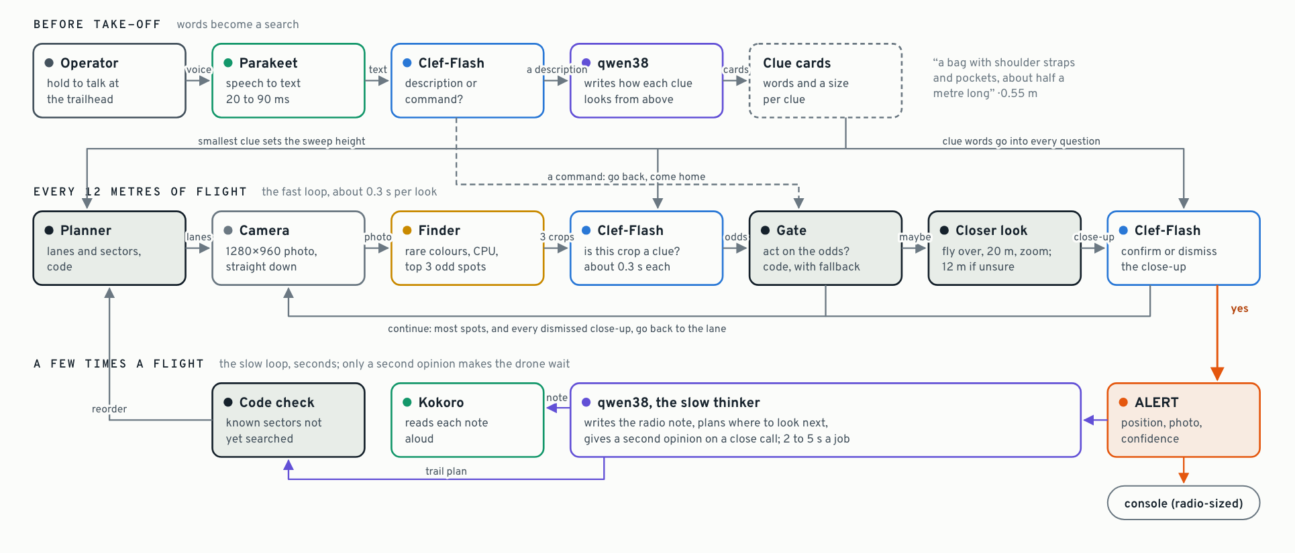
Fast loop, slow thinker, code in charge
Clef-Flash judges every photo in about 0.3 s. qwen38 does a few background jobs. Code checks every answer and owns safety.

Slide 9
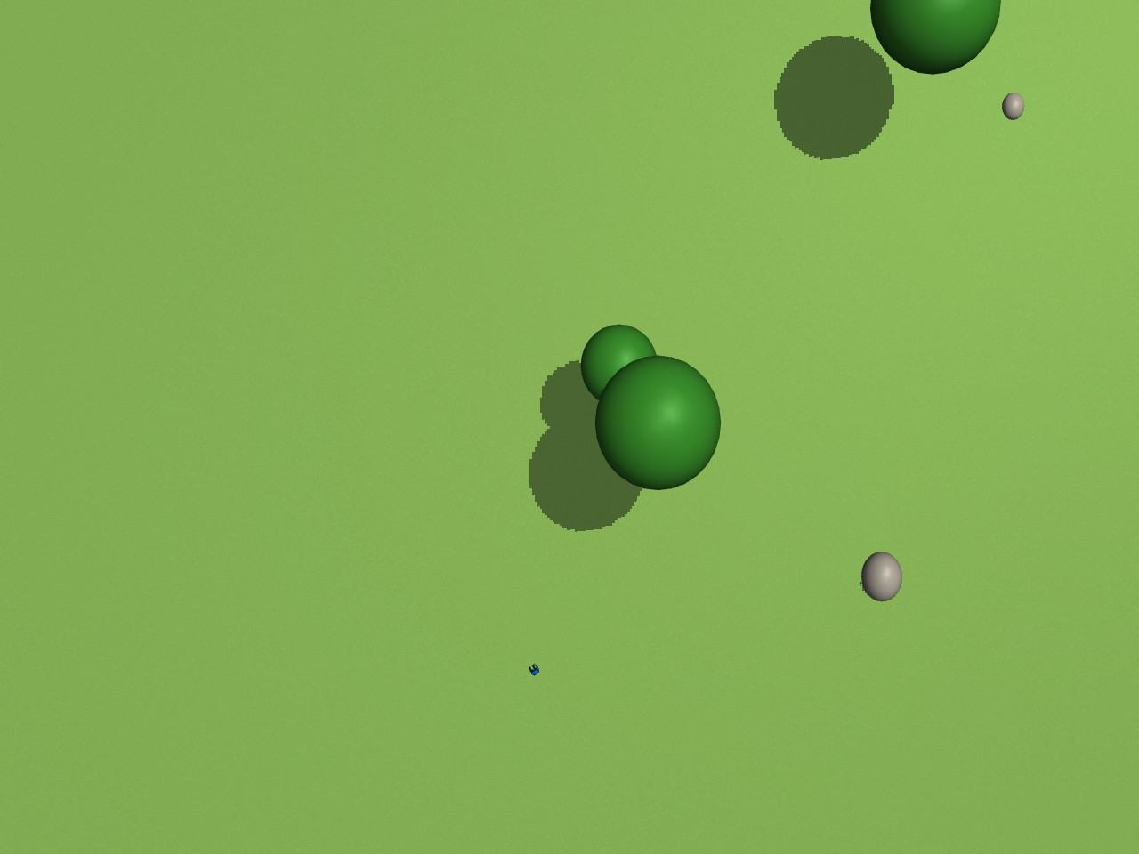
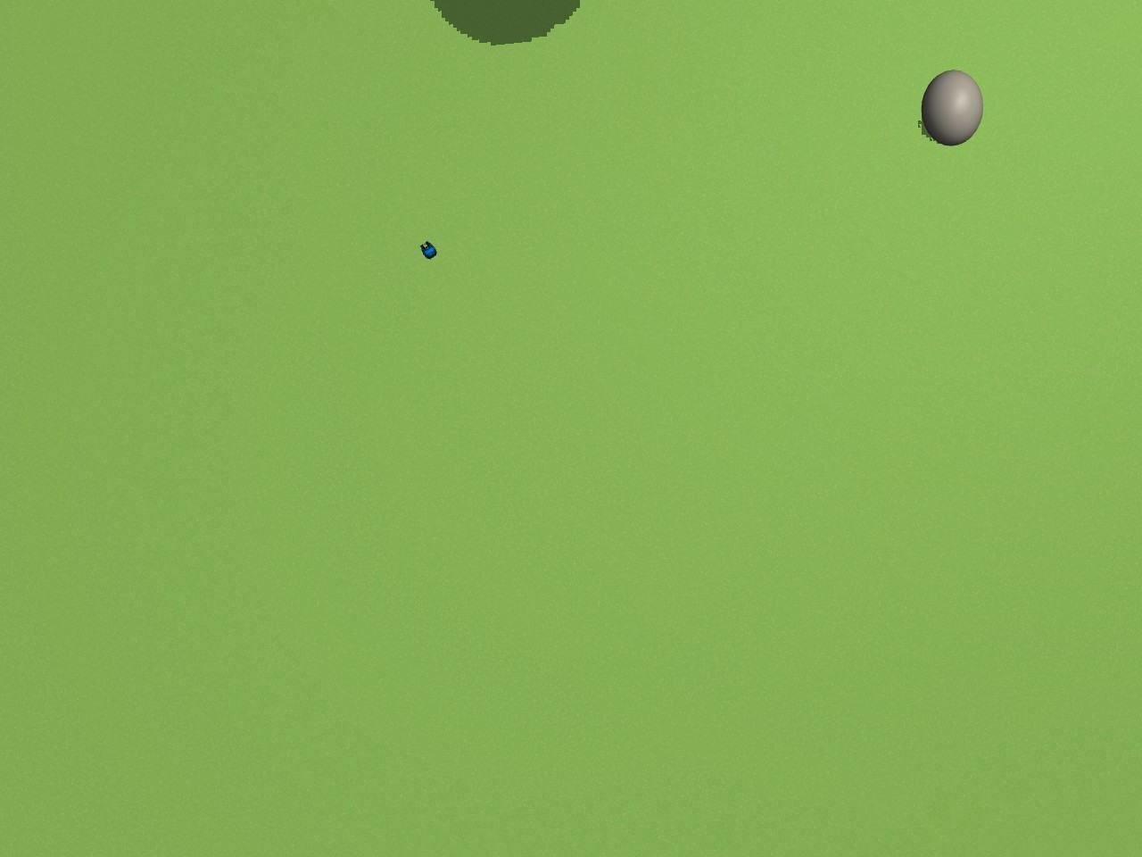
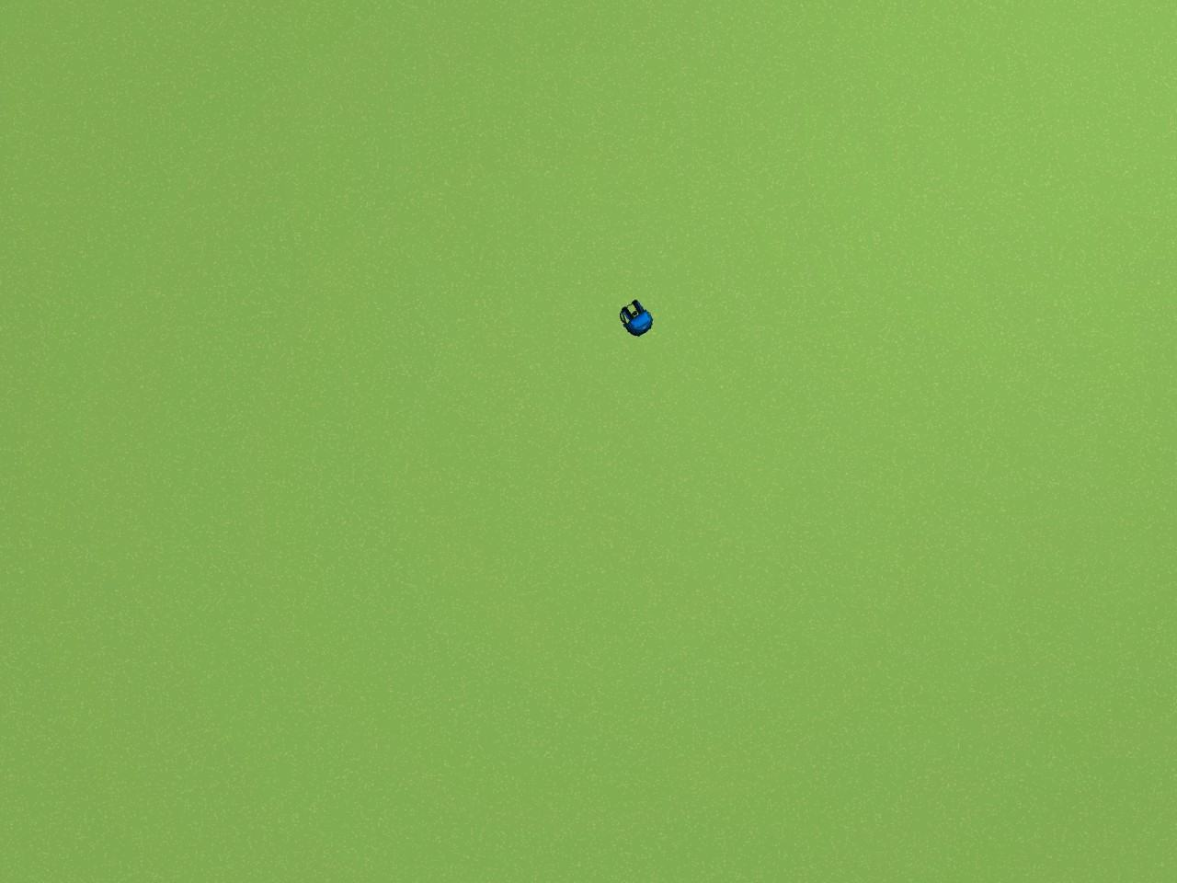
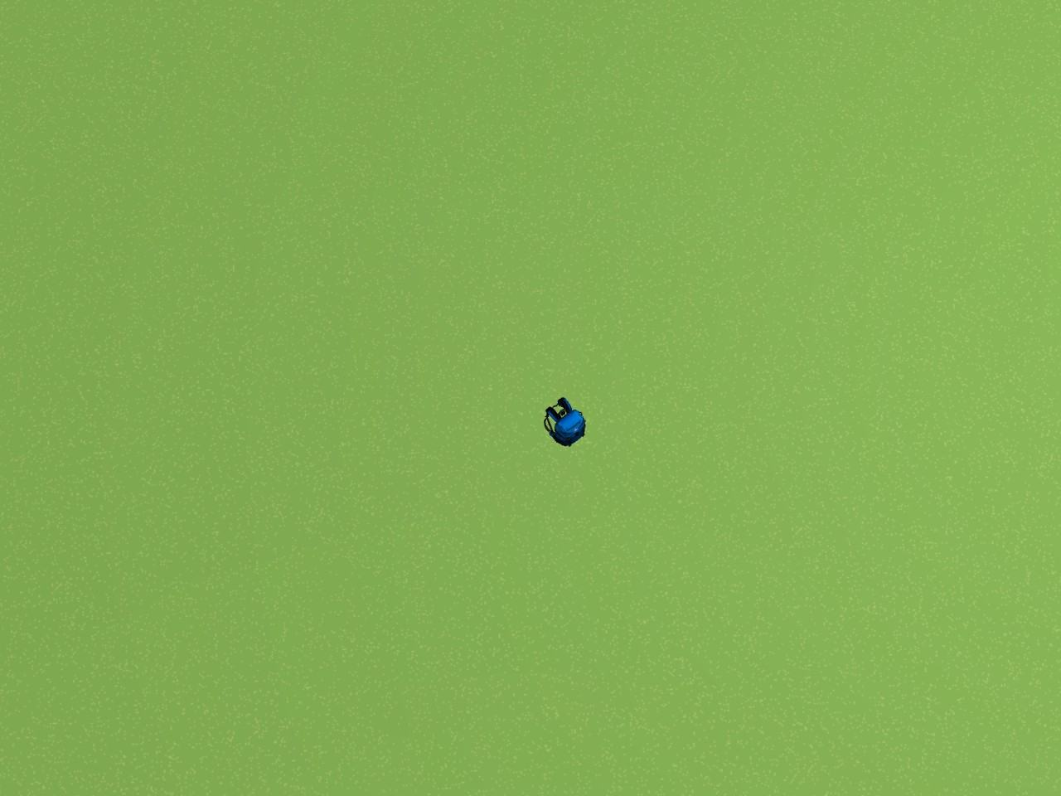
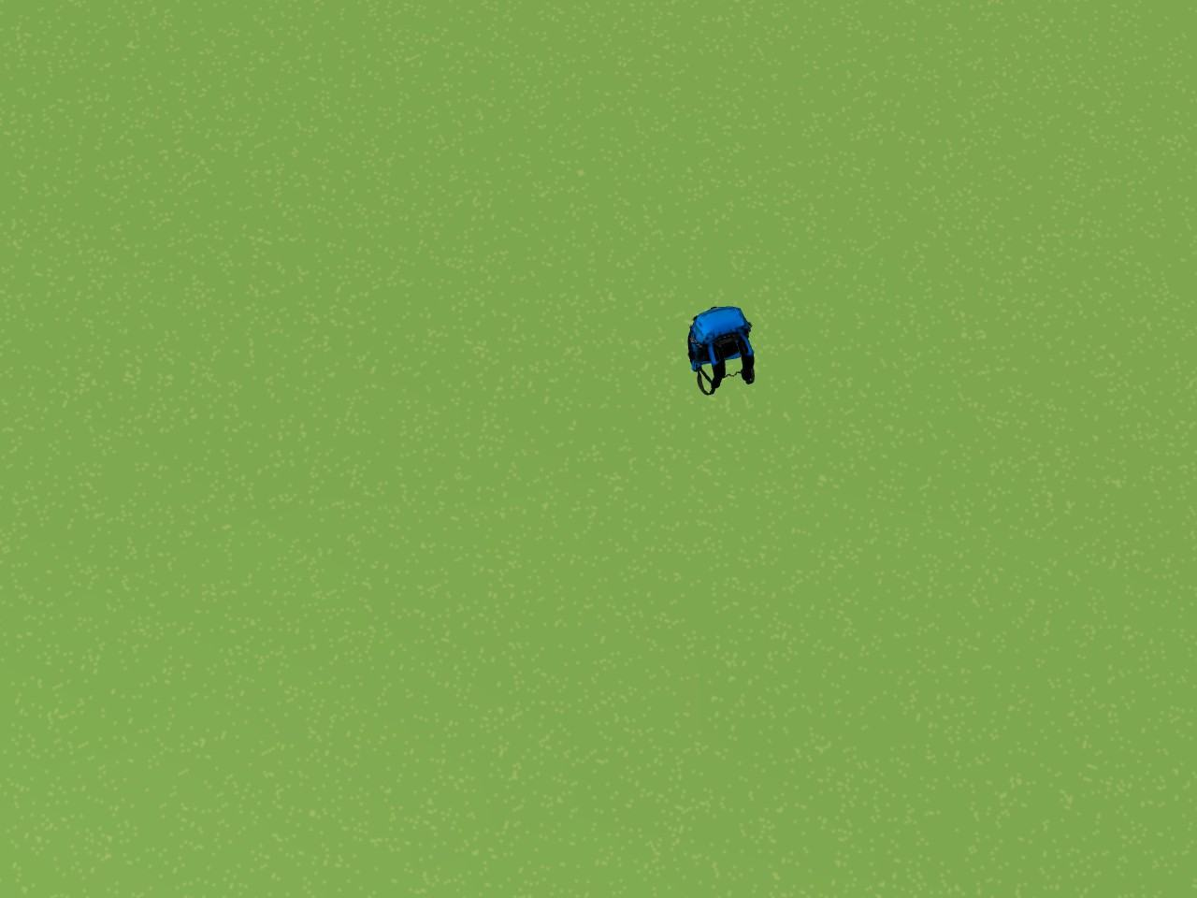
Fly high, look close
sweep · 60 m
sweep · 40 m
sweep · 20 m
zoom · 20 m
zoom · 12 m
the finder misses it
the sweep height
easy, but twice the lanes
the first closer look
only if unsure
1 of 10
10 of 10
7 vs 13
views where the finder found the backpack from 60 m
views where it found it from 40 m, so 40 m is the sweep height
lanes to cover the 160 m square from 40 m versus 20 m

Slide 10
Higher means fewer lanes
two neighbouring lanes, seen end-on
a closer look at one spot
22.9 m between lanes
40 m
hover 0.6 × the height short of the spot, about 31° off vertical; the zoom frames about 4 m of ground
20 m
first look at 20 m
12 m
second step at 12 m, only if unsure
overlap
0 m
backpack, 0.55 m
32.6 m of ground in each photo
(drawn to scale)
At 40 m, 7 lanes cover the square. At 20 m it would take 13.

Slide 11
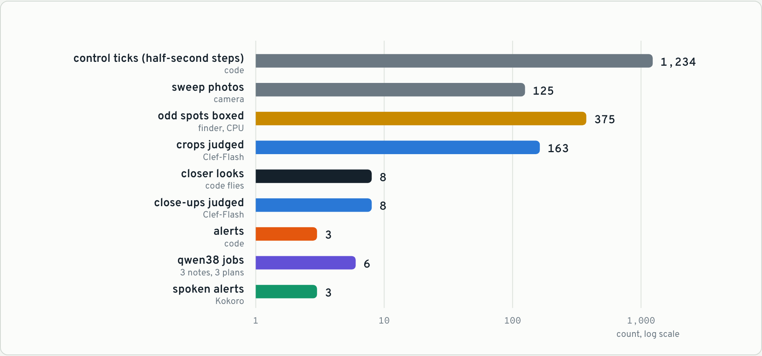
Each model sees only what it must
375
odd spots boxed by the CPU finder, on every photo
163
crops judged by Clef-Flash, plus 8 close-ups
6
One flight: 683 s over a 160 × 160 m square. Clef-Flash’s 171 calls took about 56 s of model time; qwen38’s 6 jobs about 15 s, in the background.
qwen38 jobs: 3 radio notes, 3 trail plans

Slide 12
Talking to it
THE OPERATOR SAYS
CLEF-FLASH ROUTES IT TO
WHAT HAPPENS
“Missing hiker. Blue backpack, orange tent, grey dog.”
describe
qwen38 writes the clue cards
“Start the search.”
start_search
take off and sweep
“Go back to the last alert.”
go_back_to_last_alert
fly back and look again
“Stop searching and come home.”
return_home
straight home
20 to 90 ms
45%
94.7%
Parakeet, speech to text
minimum Clef-Flash confidence to act on a command
confidence on the operator’s spoken description

Slide 13
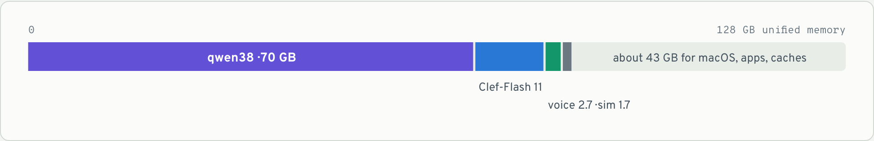
One laptop, no internet
128 GB
No internet
0.3 to 0.4 s
One MacBook Pro M5 Max
Everything is local
One GPU is the limit
A 40-core GPU and 128 GB of unified memory run every model, the simulator and the console at once.
Every model runs on the laptop and nothing in the code calls out.
Clef-Flash answers that fast when the GPU is free. With another job running, 2 to 6 s.

Slide 14
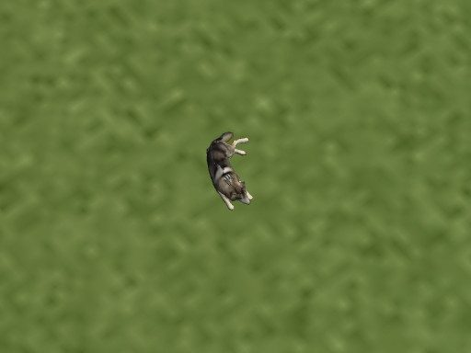
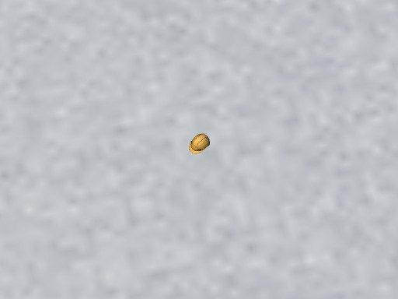
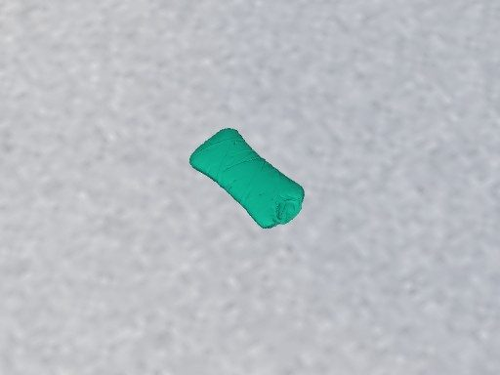
It works end to end, in a simulator
3 of 3
17 of 18
0 in 45
0 vs 7
found on a real-time flight, 683 s, no false alerts
scenario flights pass, over three sets of fresh seeds
false alerts across 45 flights and 95 alerts
false alerts, live versus reviewing photos after landing
Found from words alone
Dog, helmet (0.3 m) and sleeping bag: items never used for tuning.
Read these as “this behaviour works”, not as real-world detection rates.

Slide 15
What doesn’t work yet
The battery is the limit
The four-clue flight ran out of its simulated 20-minute battery in all three seed sets. The battery is now 30 minutes; re-runs pending.
PASSED, NARROWLY
New items lean on qwen38
Clef-Flash’s close-ups score 0.12 to 0.29 on held-out items. Two of four finds came via a second opinion.
PARTLY
It has only seen a simulator
Flat ground, no wind, no GPS error. Real aerial imagery is untested.
OPEN
No radio, no Wi-Fi-off rehearsal
The alert is radio-sized, but no radio exists. Offline is by design, not yet by test.
OPEN
Small numbers
Three seed sets per scenario, two seeds for the trail test, six flights for live versus after landing.
PARTLY

Slide 16
What’s next
1
2
3
4
5
Re-run on a 30‑minute battery
Wi-Fi-off rehearsal
Real aerial photos
Hybrid after-landing pass
Real flight software
The four-clue flight ran out of 20 minutes in every seed set. Re-runs are under way.
Run the whole demo with the network actually off. About ten minutes.
Replay HERIDAL, SARD or WiSARD imagery. Approved; dataset licences are being checked.
Re-check saved photos, but only send a team to spots no close-up cleared. A day of work.
PX4 in simulation, then a real drone. Weeks, and hardware.
From a convincing simulator to evidence that matters on real ground.

