Slide 1
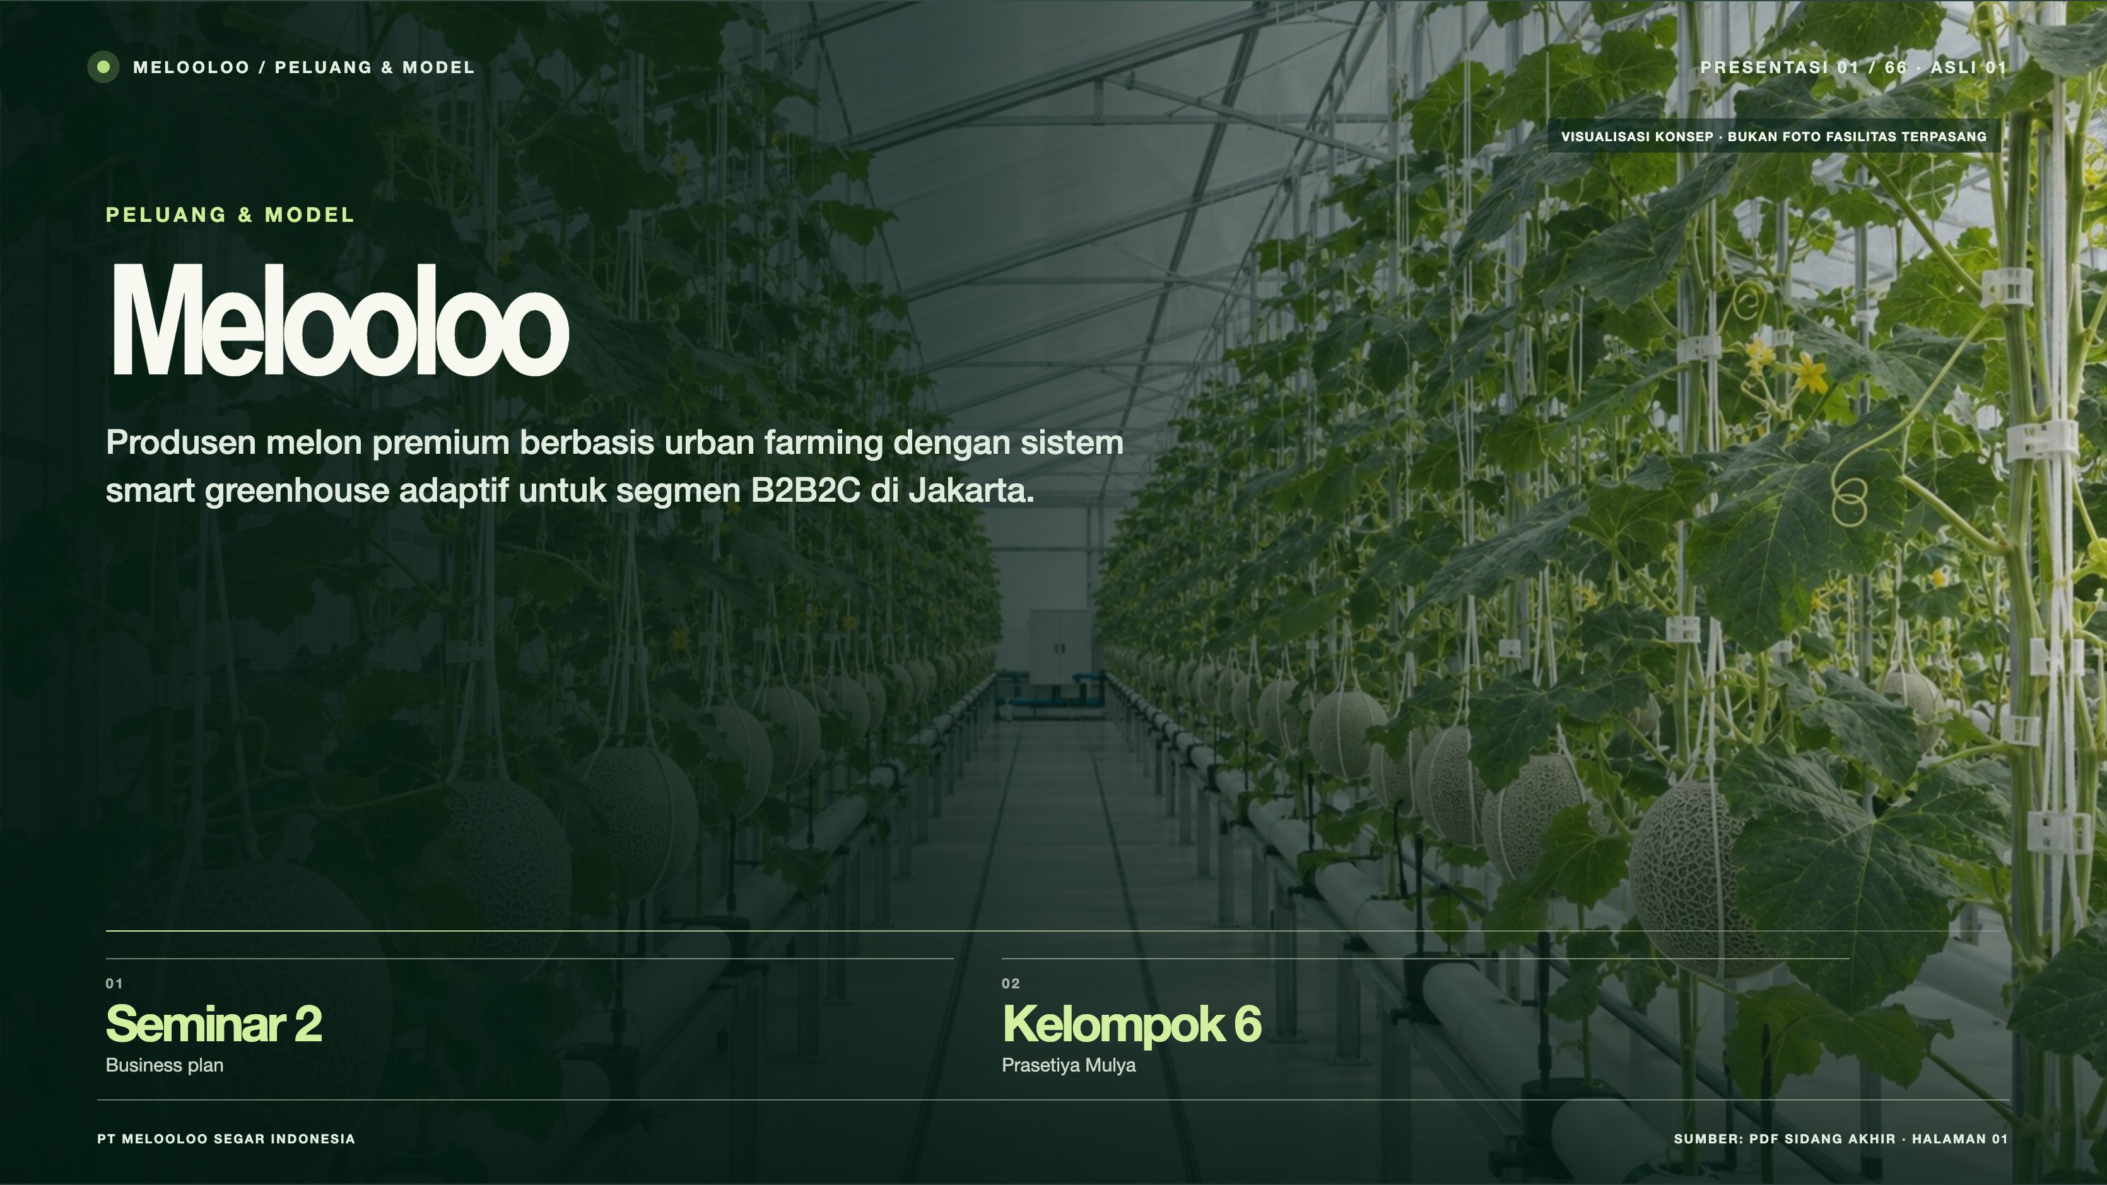
Notes:
Melooloo presentation 1/66 · source slide 1
Melooloo
Interactive web slide: https://mthoriqzi383.github.io/melooloo-project-hub/Melooloo_Final_Presentation_Web_20Oct2026/index.html#slide=1
The web version contains motion, interactive details, and links to the 3D greenhouse.

Slide 2
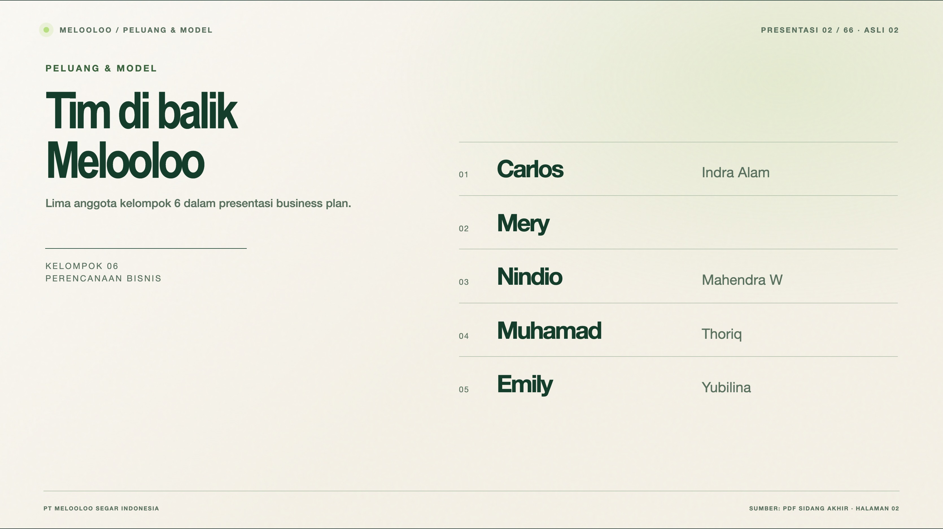
Notes:
Melooloo presentation 2/66 · source slide 2
Tim di balik Melooloo
Interactive web slide: https://mthoriqzi383.github.io/melooloo-project-hub/Melooloo_Final_Presentation_Web_20Oct2026/index.html#slide=2
The web version contains motion, interactive details, and links to the 3D greenhouse.

Slide 3
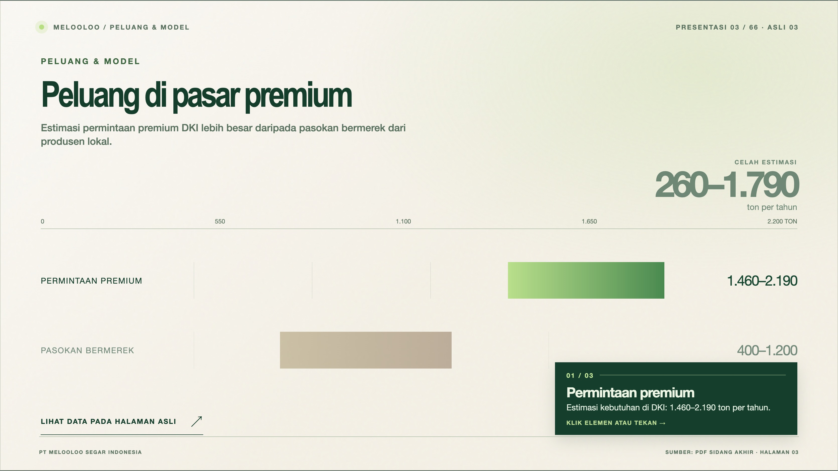
Notes:
Melooloo presentation 3/66 · source slide 3
Peluang di pasar premium
Interactive web slide: https://mthoriqzi383.github.io/melooloo-project-hub/Melooloo_Final_Presentation_Web_20Oct2026/index.html#slide=3
The web version contains motion, interactive details, and links to the 3D greenhouse.

Slide 4
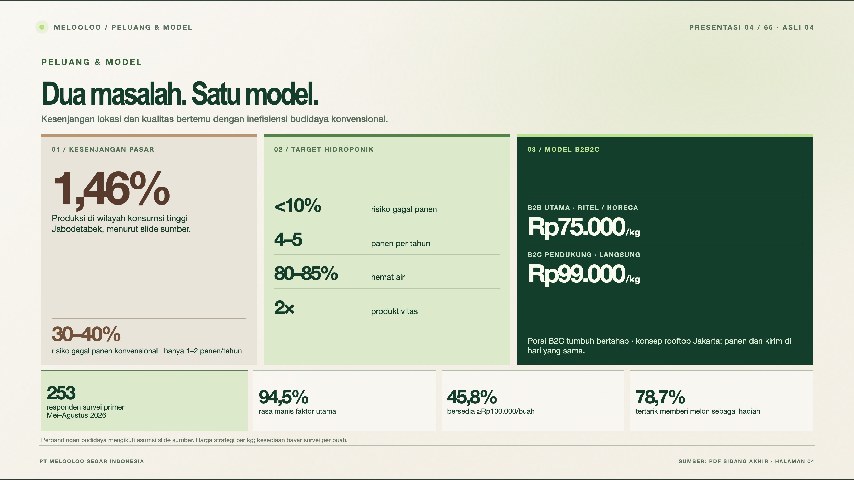
Notes:
Melooloo presentation 4/66 · source slide 4
Dua masalah. Satu model.
Interactive web slide: https://mthoriqzi383.github.io/melooloo-project-hub/Melooloo_Final_Presentation_Web_20Oct2026/index.html#slide=4
The web version contains motion, interactive details, and links to the 3D greenhouse.

Slide 5
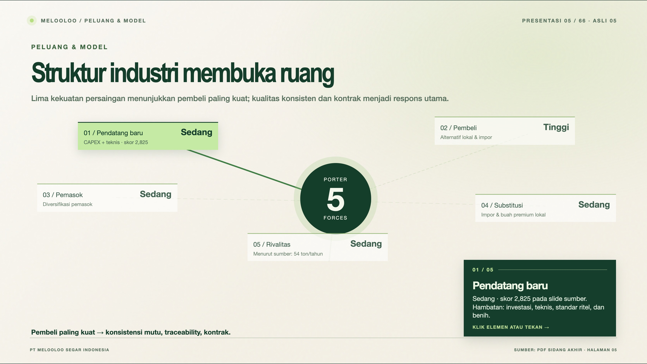
Notes:
Melooloo presentation 5/66 · source slide 5
Struktur industri membuka ruang
Interactive web slide: https://mthoriqzi383.github.io/melooloo-project-hub/Melooloo_Final_Presentation_Web_20Oct2026/index.html#slide=5
The web version contains motion, interactive details, and links to the 3D greenhouse.

Slide 6
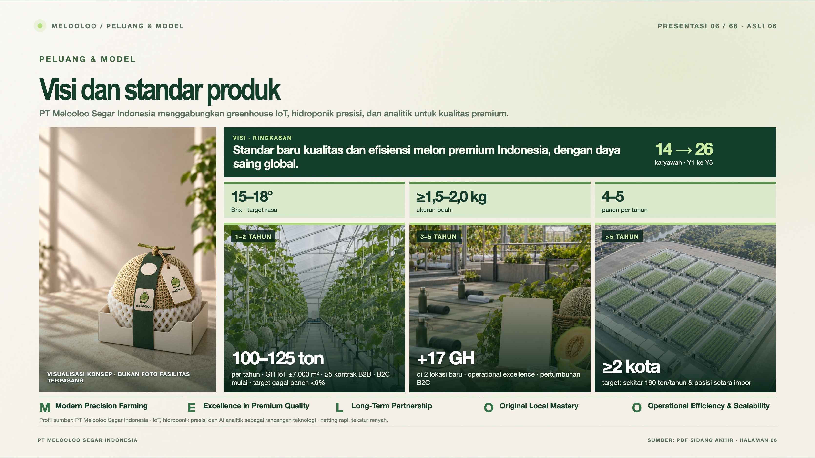
Notes:
Melooloo presentation 6/66 · source slide 6
Visi dan standar produk
Interactive web slide: https://mthoriqzi383.github.io/melooloo-project-hub/Melooloo_Final_Presentation_Web_20Oct2026/index.html#slide=6
The web version contains motion, interactive details, and links to the 3D greenhouse.

Slide 7
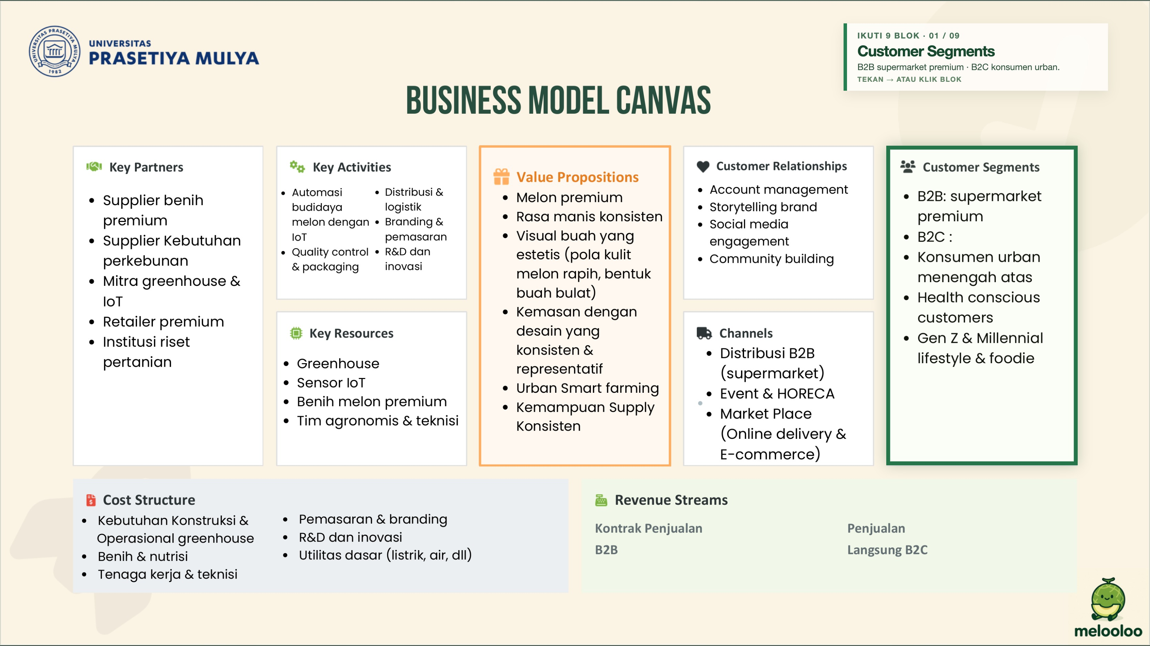
Notes:
Melooloo presentation 7/66 · source slide 7
Business Model Canvas
Interactive web slide: https://mthoriqzi383.github.io/melooloo-project-hub/Melooloo_Final_Presentation_Web_20Oct2026/index.html#slide=7
The web version contains motion, interactive details, and links to the 3D greenhouse.

Slide 8
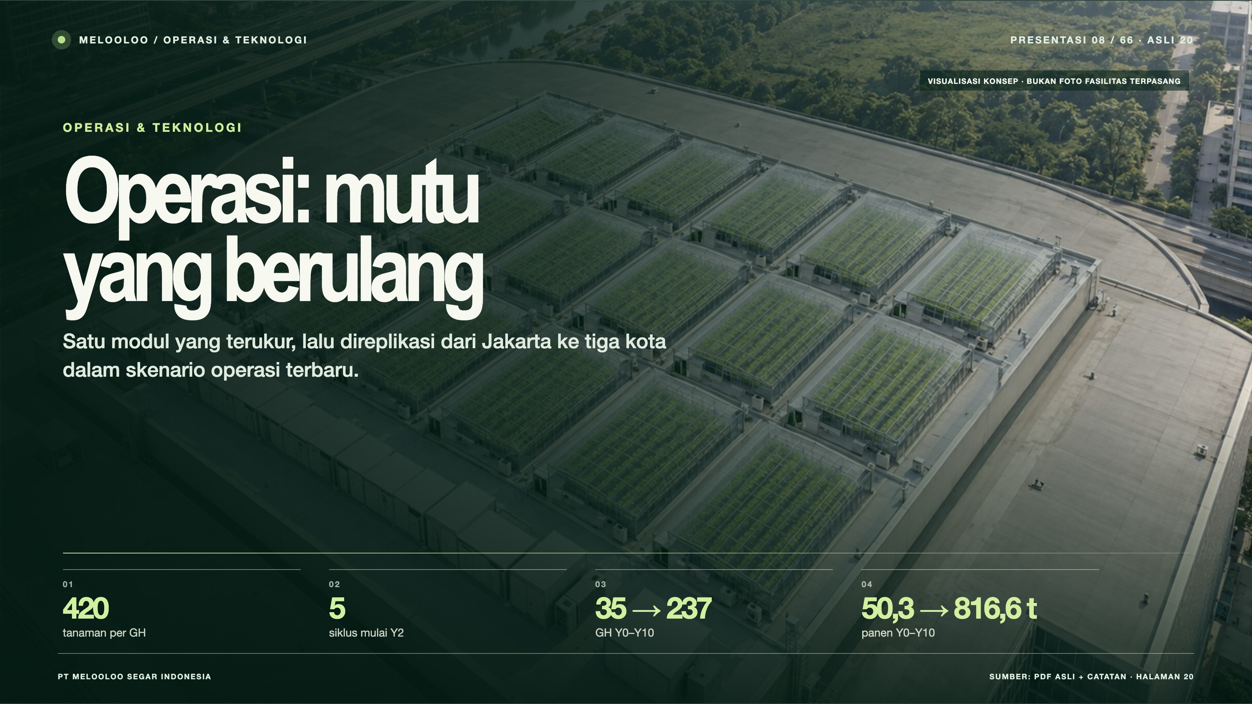
Notes:
Melooloo presentation 8/66 · source slide 20
Operasi: mutu yang berulang
Interactive web slide: https://mthoriqzi383.github.io/melooloo-project-hub/Melooloo_Final_Presentation_Web_20Oct2026/index.html#slide=20
The web version contains motion, interactive details, and links to the 3D greenhouse.

Slide 9
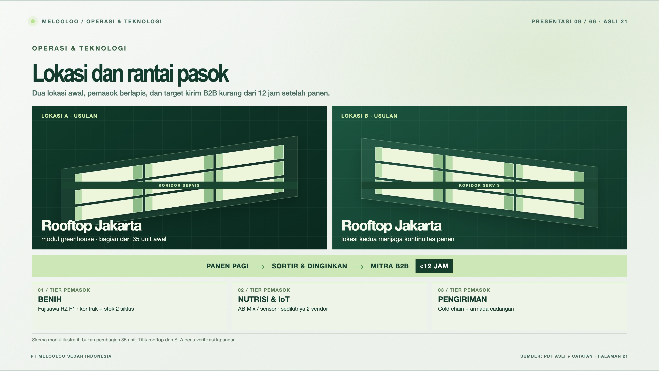
Notes:
Melooloo presentation 9/66 · source slide 21
Lokasi dan rantai pasok
Interactive web slide: https://mthoriqzi383.github.io/melooloo-project-hub/Melooloo_Final_Presentation_Web_20Oct2026/index.html#slide=21
The web version contains motion, interactive details, and links to the 3D greenhouse.

Slide 10
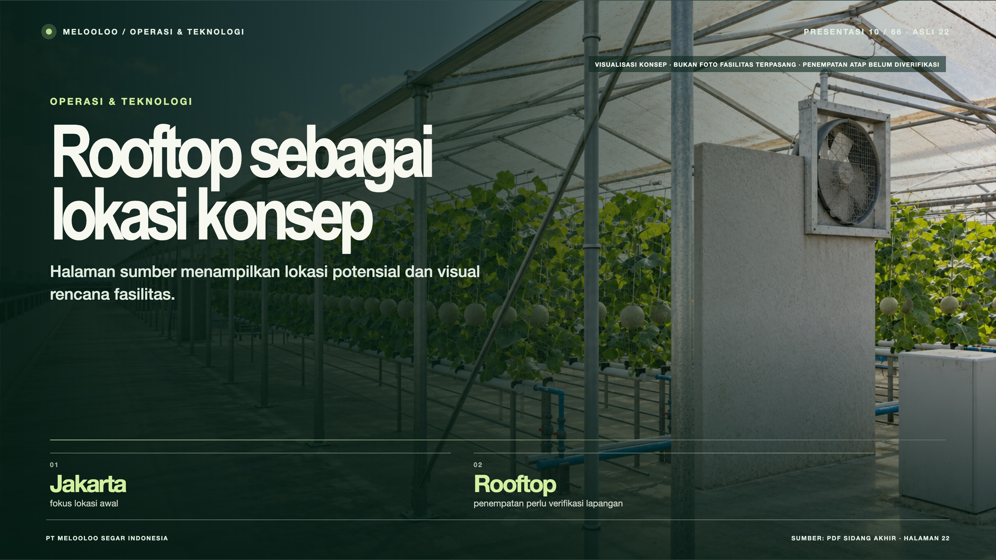
Notes:
Melooloo presentation 10/66 · source slide 22
Rooftop sebagai lokasi konsep
Interactive web slide: https://mthoriqzi383.github.io/melooloo-project-hub/Melooloo_Final_Presentation_Web_20Oct2026/index.html#slide=22
The web version contains motion, interactive details, and links to the 3D greenhouse.

Slide 11
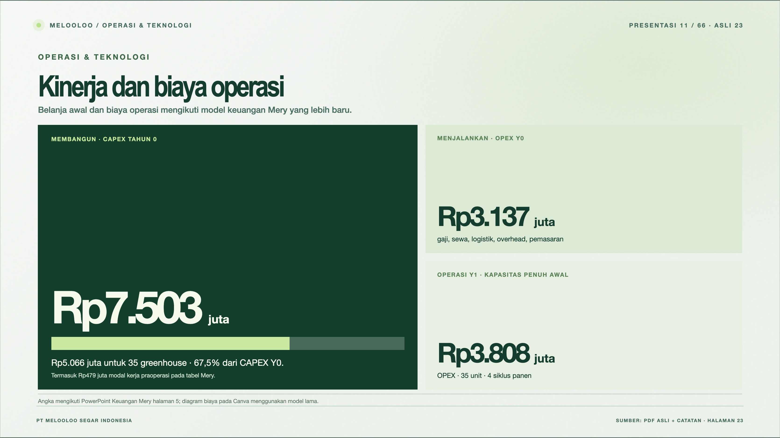
Notes:
Melooloo presentation 11/66 · source slide 23
Kinerja dan biaya operasi
Interactive web slide: https://mthoriqzi383.github.io/melooloo-project-hub/Melooloo_Final_Presentation_Web_20Oct2026/index.html#slide=23
The web version contains motion, interactive details, and links to the 3D greenhouse.

Slide 12
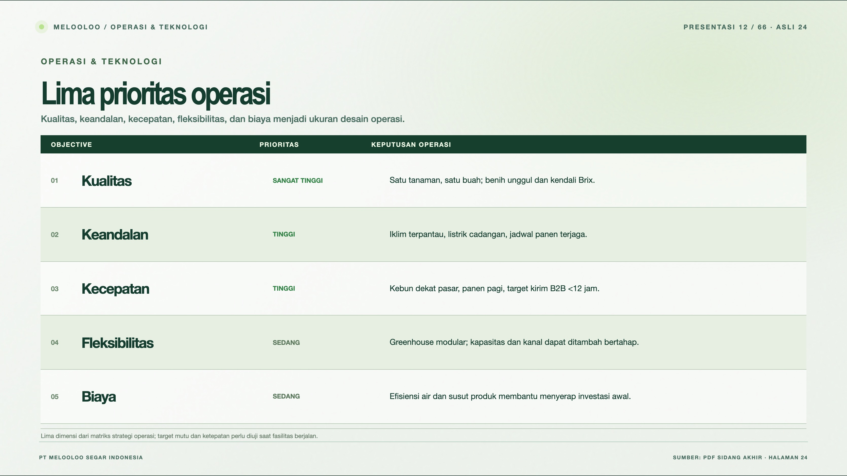
Notes:
Melooloo presentation 12/66 · source slide 24
Lima prioritas operasi
Interactive web slide: https://mthoriqzi383.github.io/melooloo-project-hub/Melooloo_Final_Presentation_Web_20Oct2026/index.html#slide=24
The web version contains motion, interactive details, and links to the 3D greenhouse.

Slide 13
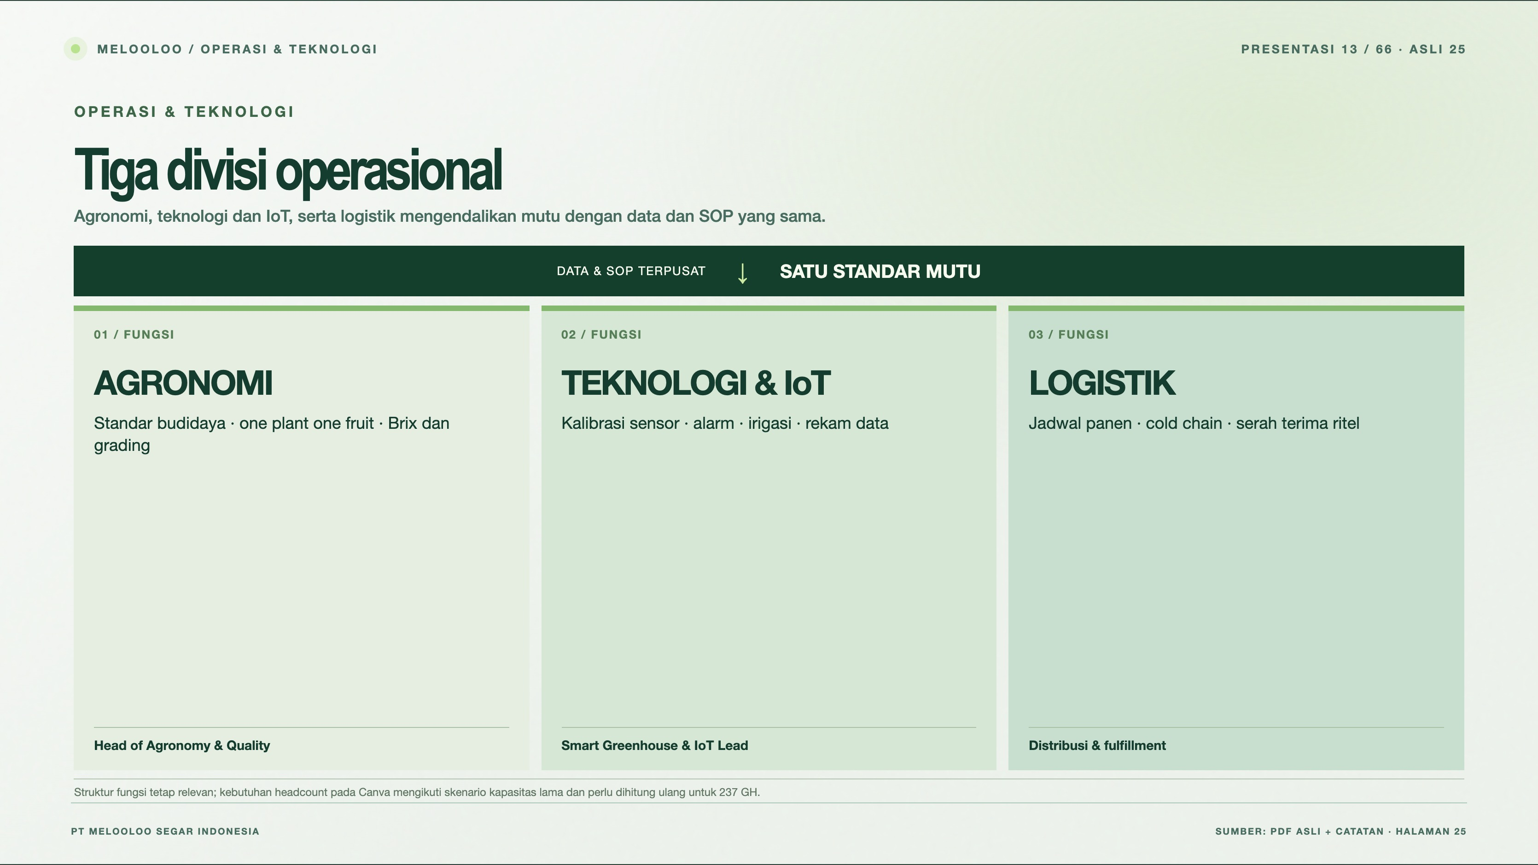
Notes:
Melooloo presentation 13/66 · source slide 25
Tiga divisi operasional
Interactive web slide: https://mthoriqzi383.github.io/melooloo-project-hub/Melooloo_Final_Presentation_Web_20Oct2026/index.html#slide=25
The web version contains motion, interactive details, and links to the 3D greenhouse.

Slide 14
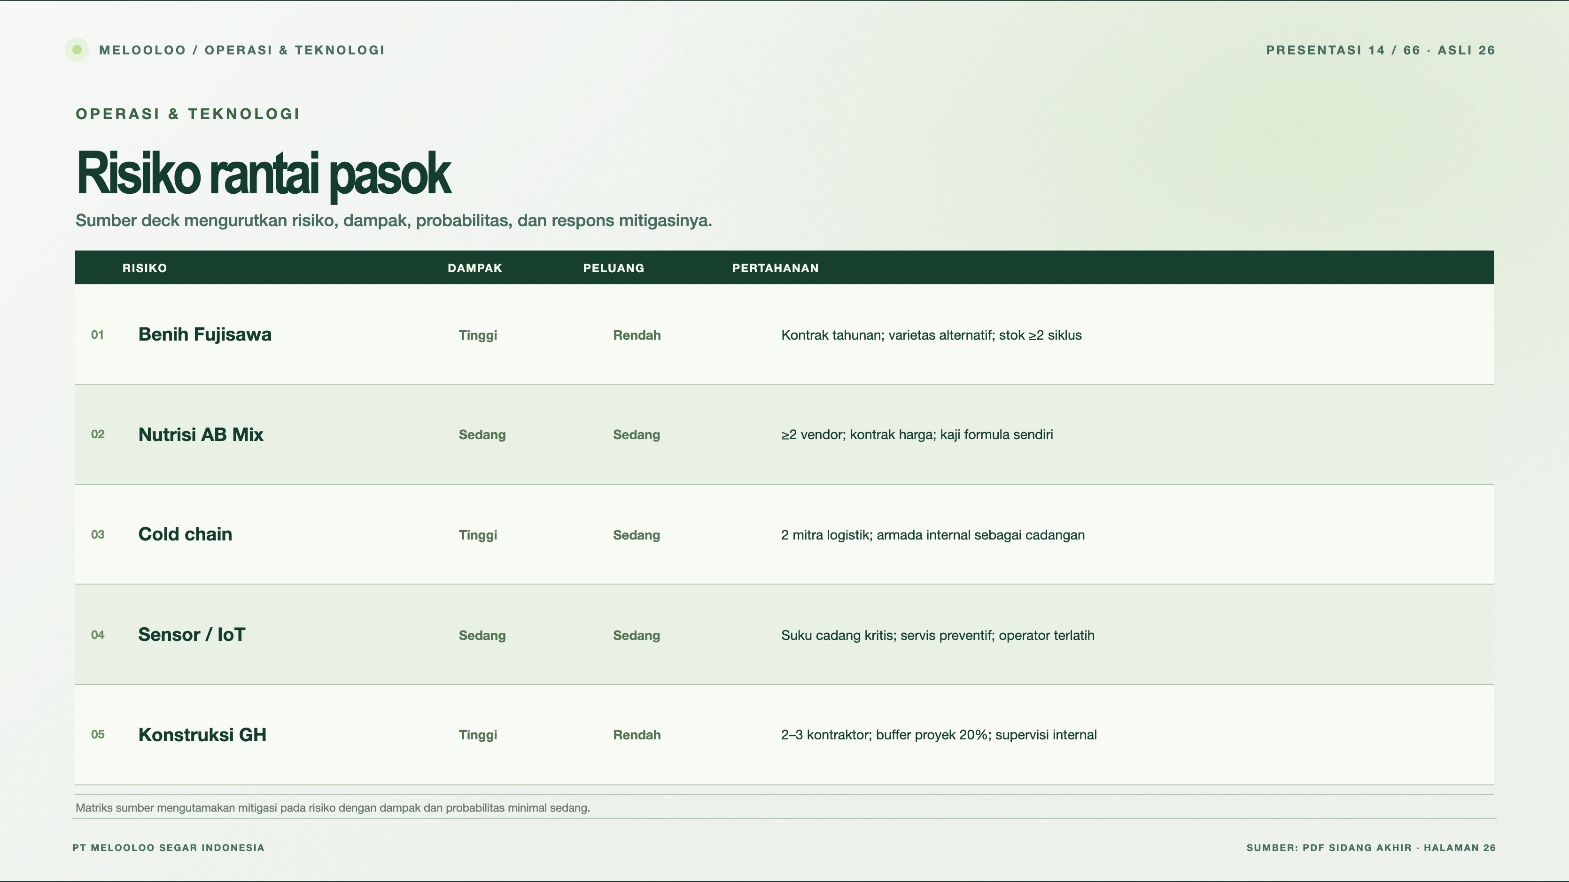
Notes:
Melooloo presentation 14/66 · source slide 26
Risiko rantai pasok
Interactive web slide: https://mthoriqzi383.github.io/melooloo-project-hub/Melooloo_Final_Presentation_Web_20Oct2026/index.html#slide=26
The web version contains motion, interactive details, and links to the 3D greenhouse.

Slide 15
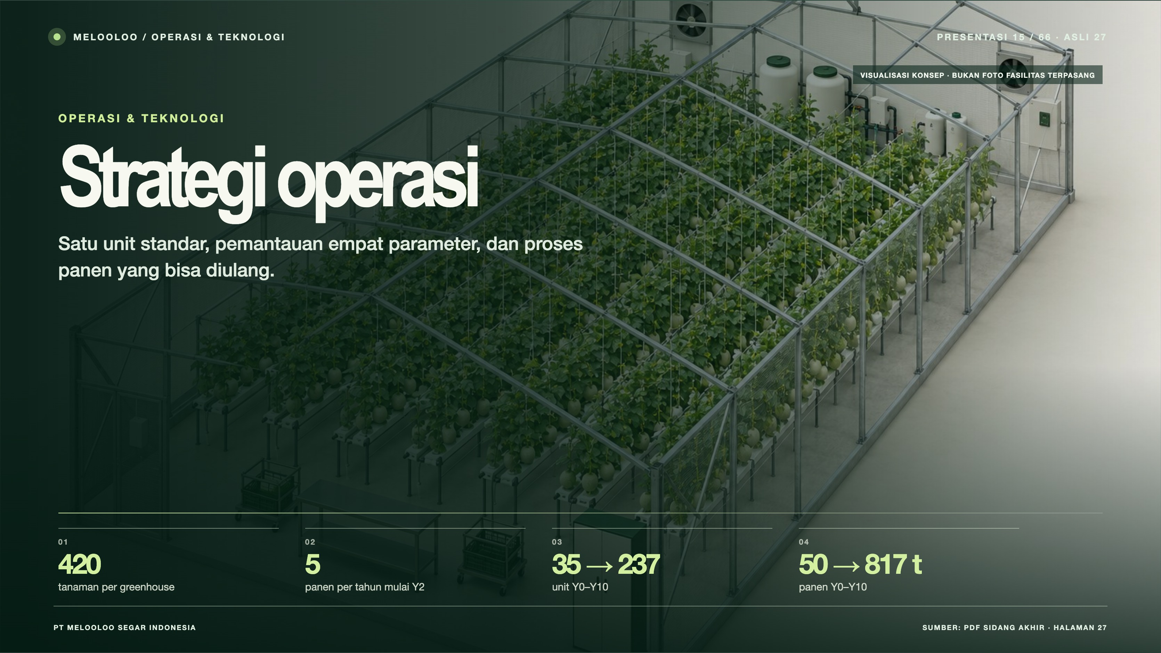
Notes:
Melooloo presentation 15/66 · source slide 27
Strategi operasi
Interactive web slide: https://mthoriqzi383.github.io/melooloo-project-hub/Melooloo_Final_Presentation_Web_20Oct2026/index.html#slide=27
The web version contains motion, interactive details, and links to the 3D greenhouse.

Slide 16
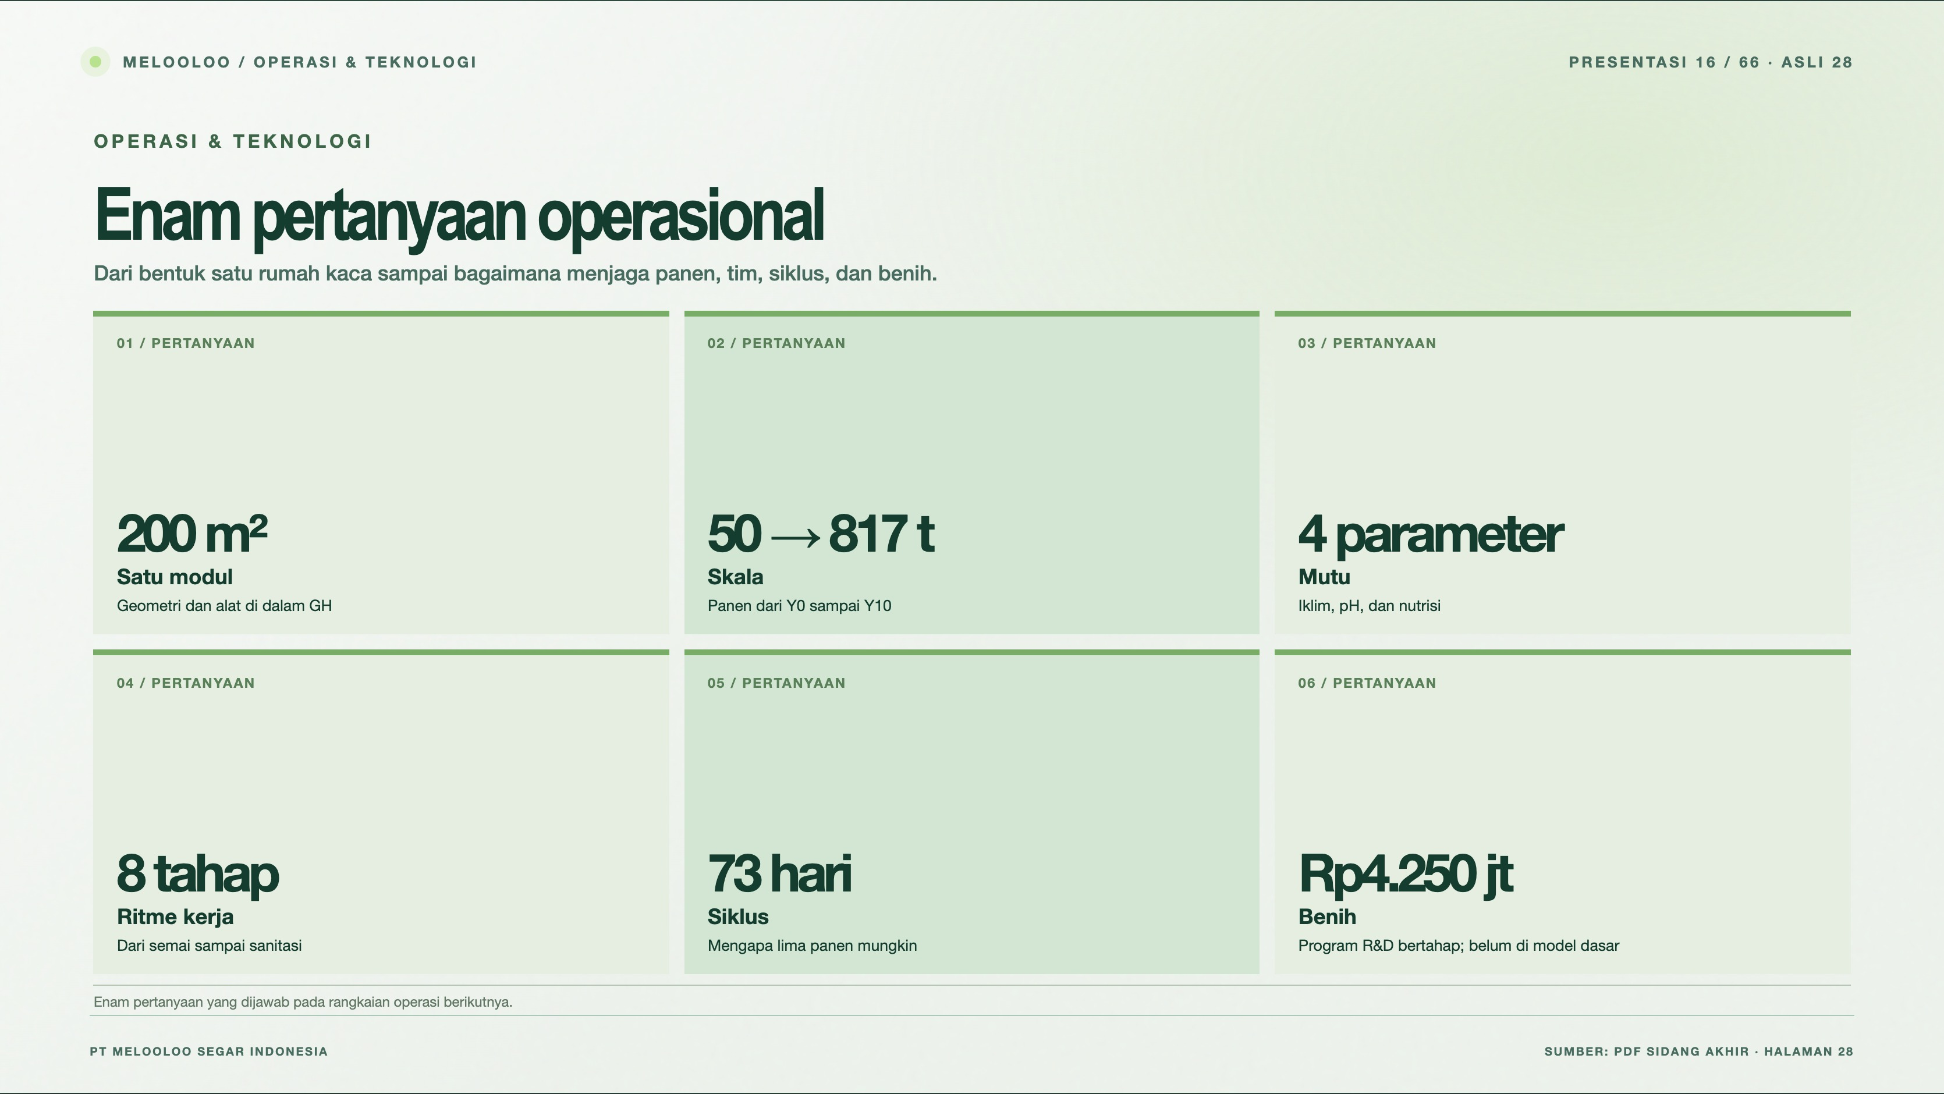
Notes:
Melooloo presentation 16/66 · source slide 28
Enam pertanyaan operasional
Interactive web slide: https://mthoriqzi383.github.io/melooloo-project-hub/Melooloo_Final_Presentation_Web_20Oct2026/index.html#slide=28
The web version contains motion, interactive details, and links to the 3D greenhouse.

Slide 17
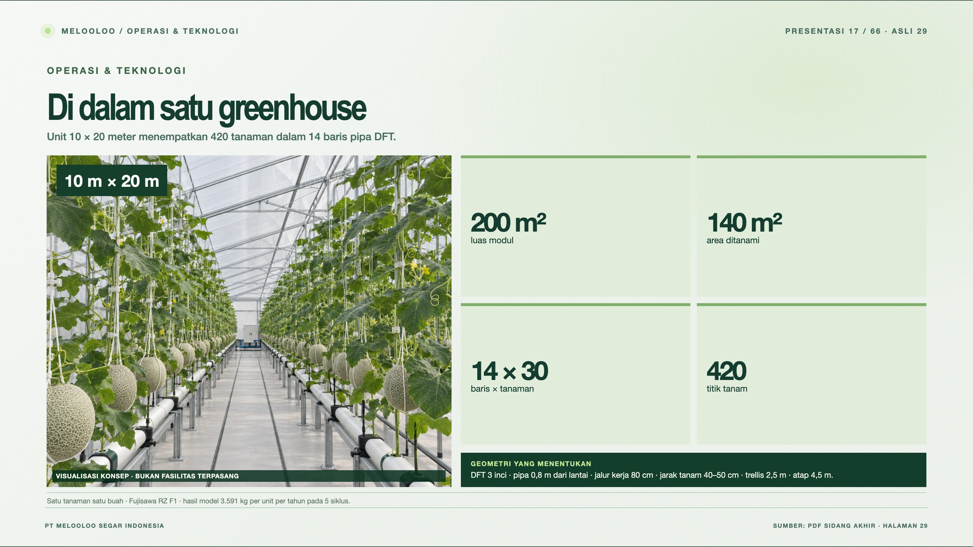
Notes:
Melooloo presentation 17/66 · source slide 29
Di dalam satu greenhouse
Interactive web slide: https://mthoriqzi383.github.io/melooloo-project-hub/Melooloo_Final_Presentation_Web_20Oct2026/index.html#slide=29
The web version contains motion, interactive details, and links to the 3D greenhouse.

Slide 18
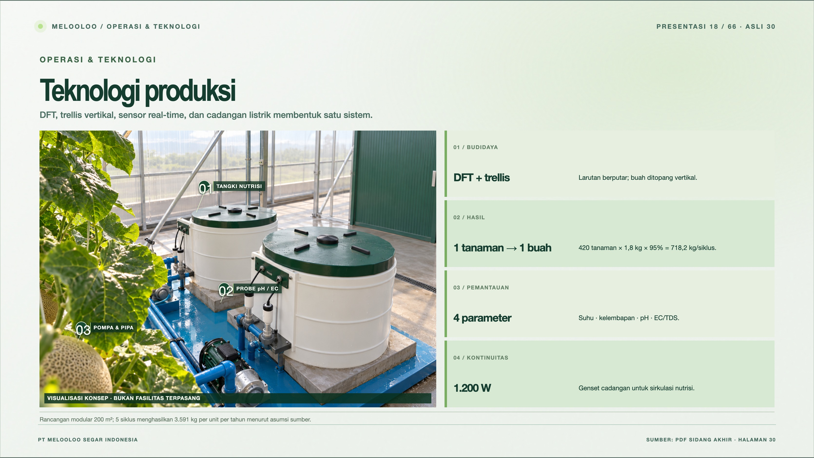
Notes:
Melooloo presentation 18/66 · source slide 30
Teknologi produksi
Interactive web slide: https://mthoriqzi383.github.io/melooloo-project-hub/Melooloo_Final_Presentation_Web_20Oct2026/index.html#slide=30
The web version contains motion, interactive details, and links to the 3D greenhouse.

Slide 19
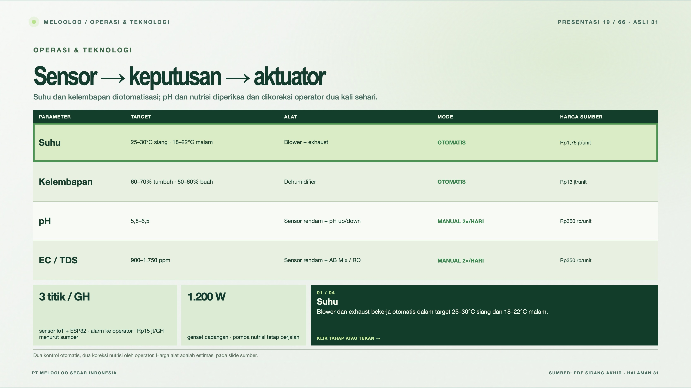
Notes:
Melooloo presentation 19/66 · source slide 31
Sensor → keputusan → aktuator
Interactive web slide: https://mthoriqzi383.github.io/melooloo-project-hub/Melooloo_Final_Presentation_Web_20Oct2026/index.html#slide=31
The web version contains motion, interactive details, and links to the 3D greenhouse.

Slide 20
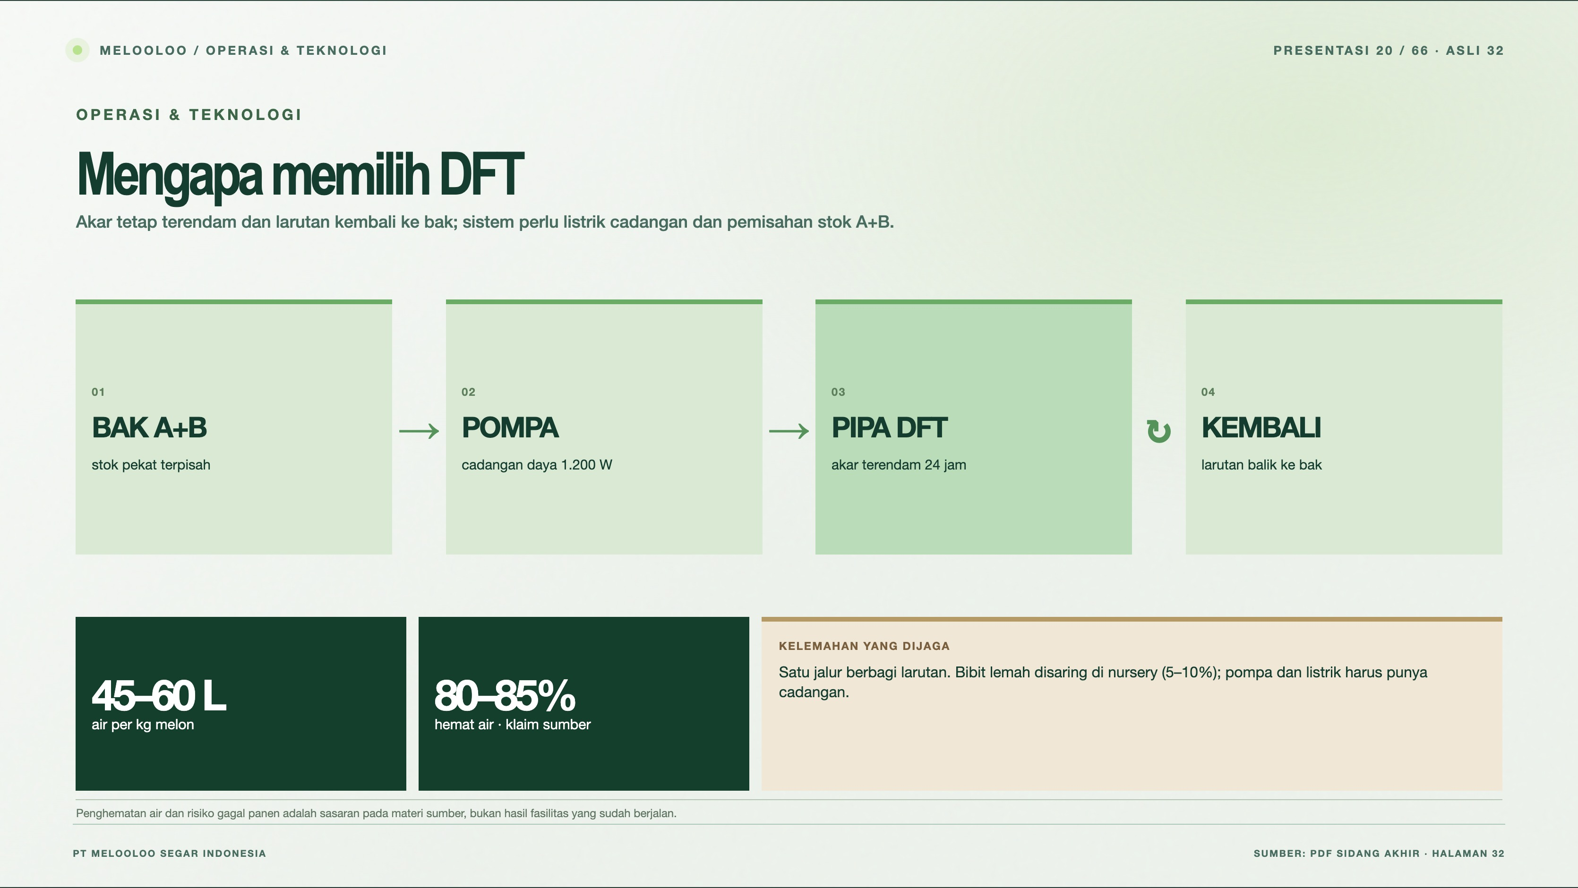
Notes:
Melooloo presentation 20/66 · source slide 32
Mengapa memilih DFT
Interactive web slide: https://mthoriqzi383.github.io/melooloo-project-hub/Melooloo_Final_Presentation_Web_20Oct2026/index.html#slide=32
The web version contains motion, interactive details, and links to the 3D greenhouse.

Slide 21
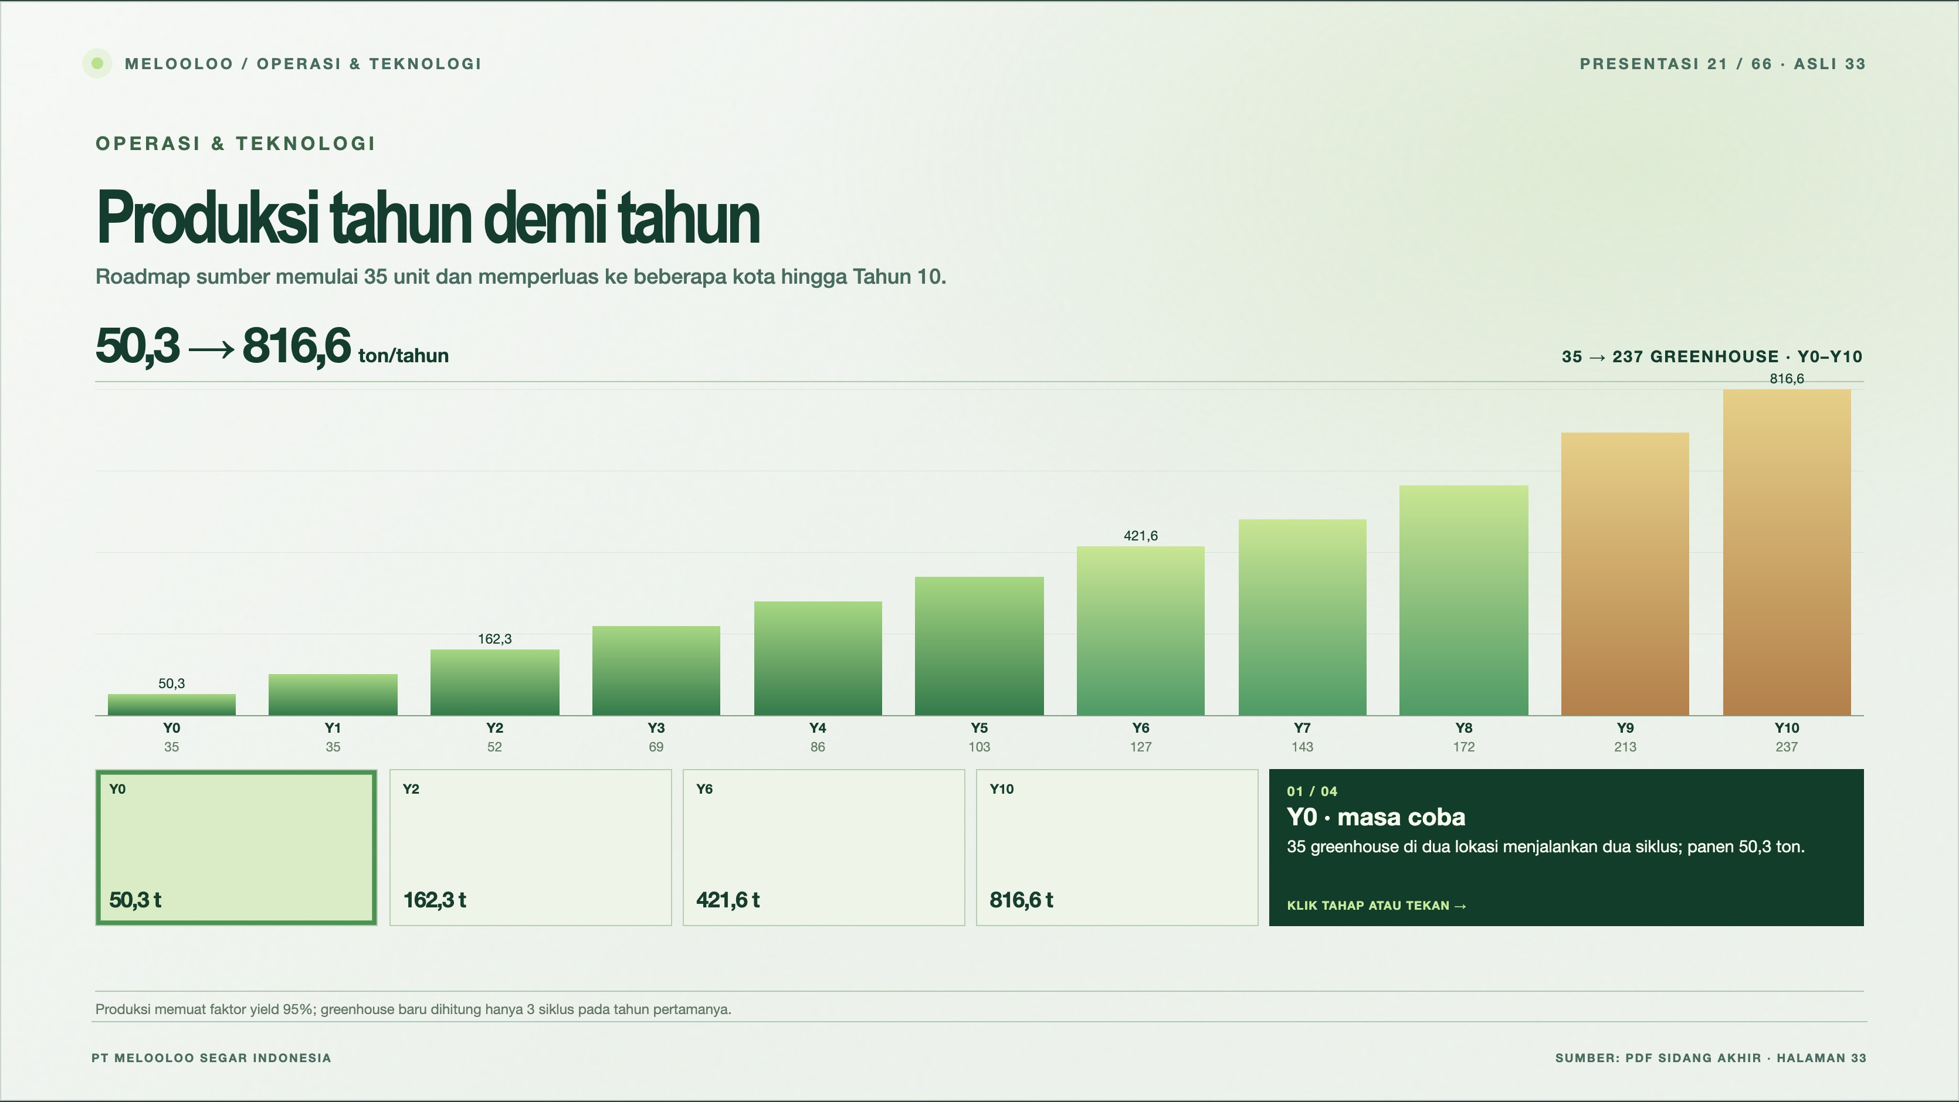
Notes:
Melooloo presentation 21/66 · source slide 33
Produksi tahun demi tahun
Interactive web slide: https://mthoriqzi383.github.io/melooloo-project-hub/Melooloo_Final_Presentation_Web_20Oct2026/index.html#slide=33
The web version contains motion, interactive details, and links to the 3D greenhouse.

Slide 22
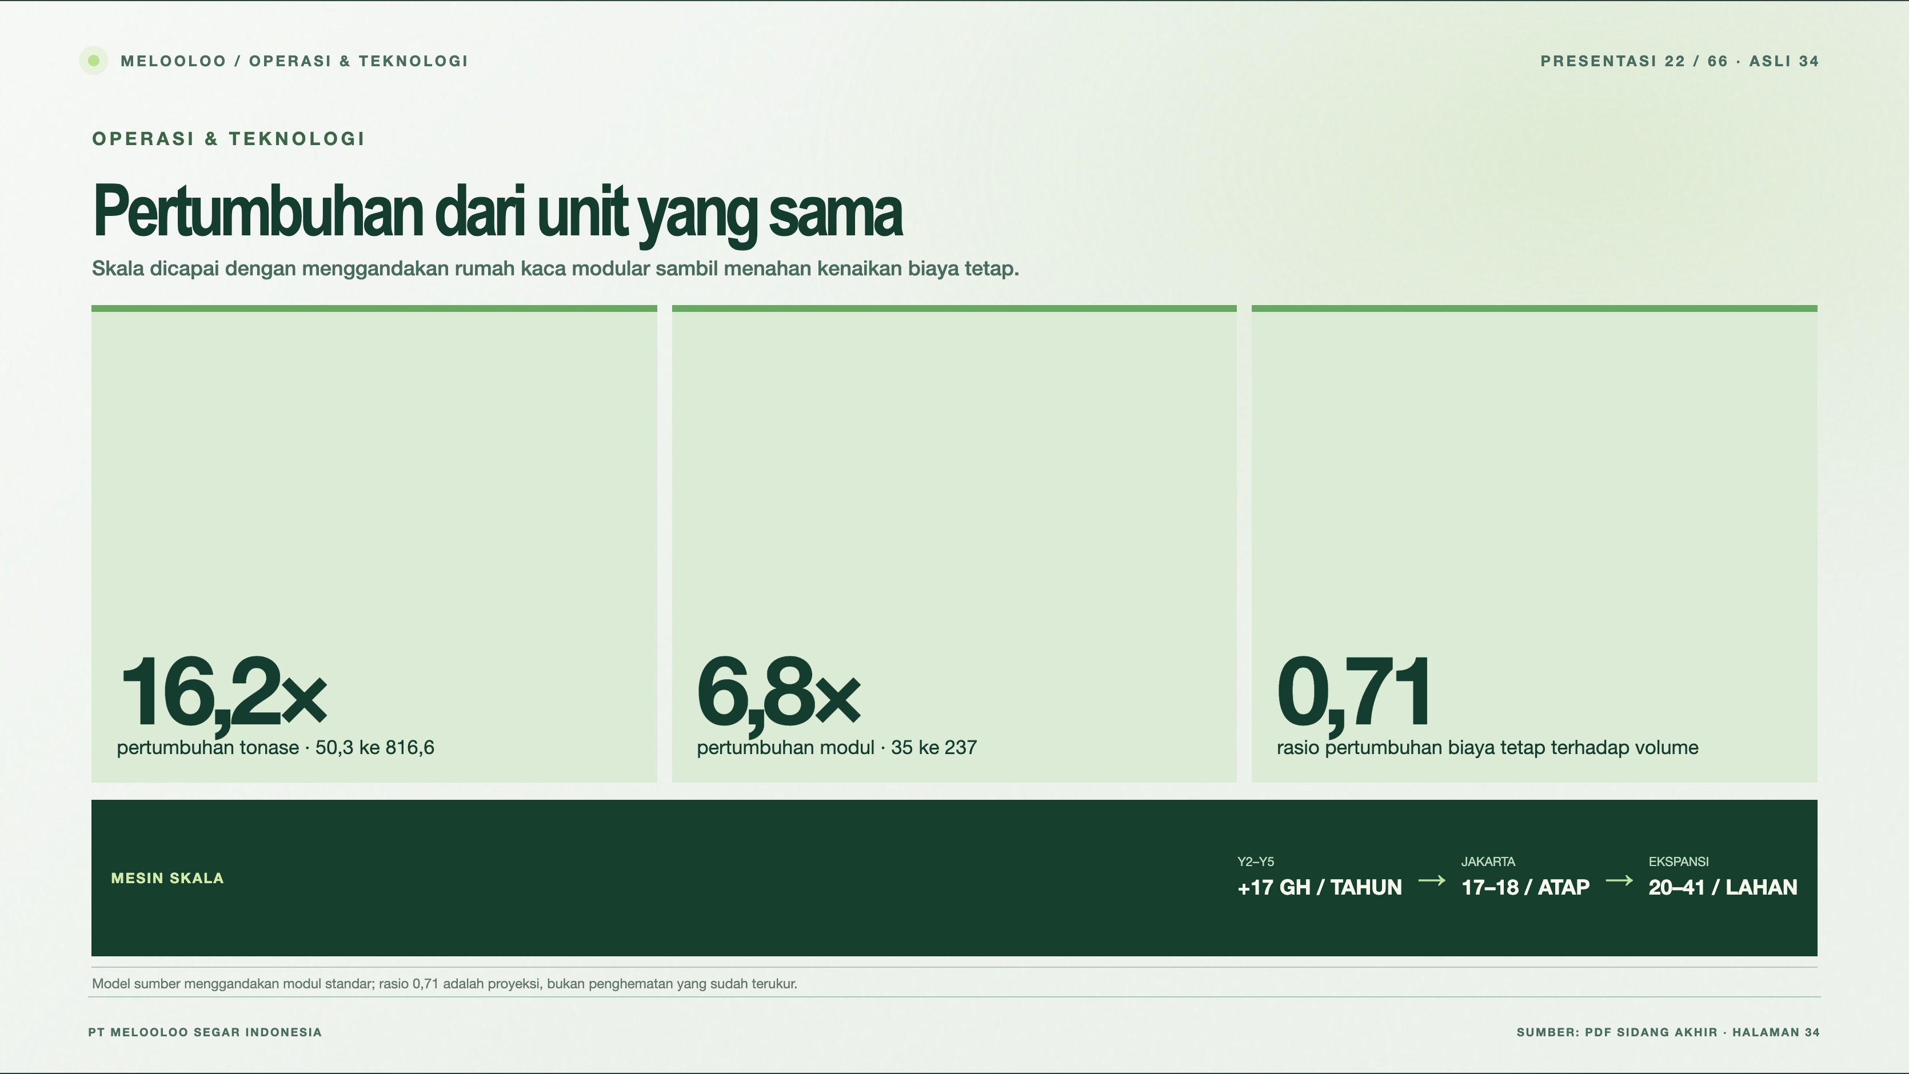
Notes:
Melooloo presentation 22/66 · source slide 34
Pertumbuhan dari unit yang sama
Interactive web slide: https://mthoriqzi383.github.io/melooloo-project-hub/Melooloo_Final_Presentation_Web_20Oct2026/index.html#slide=34
The web version contains motion, interactive details, and links to the 3D greenhouse.

Slide 23
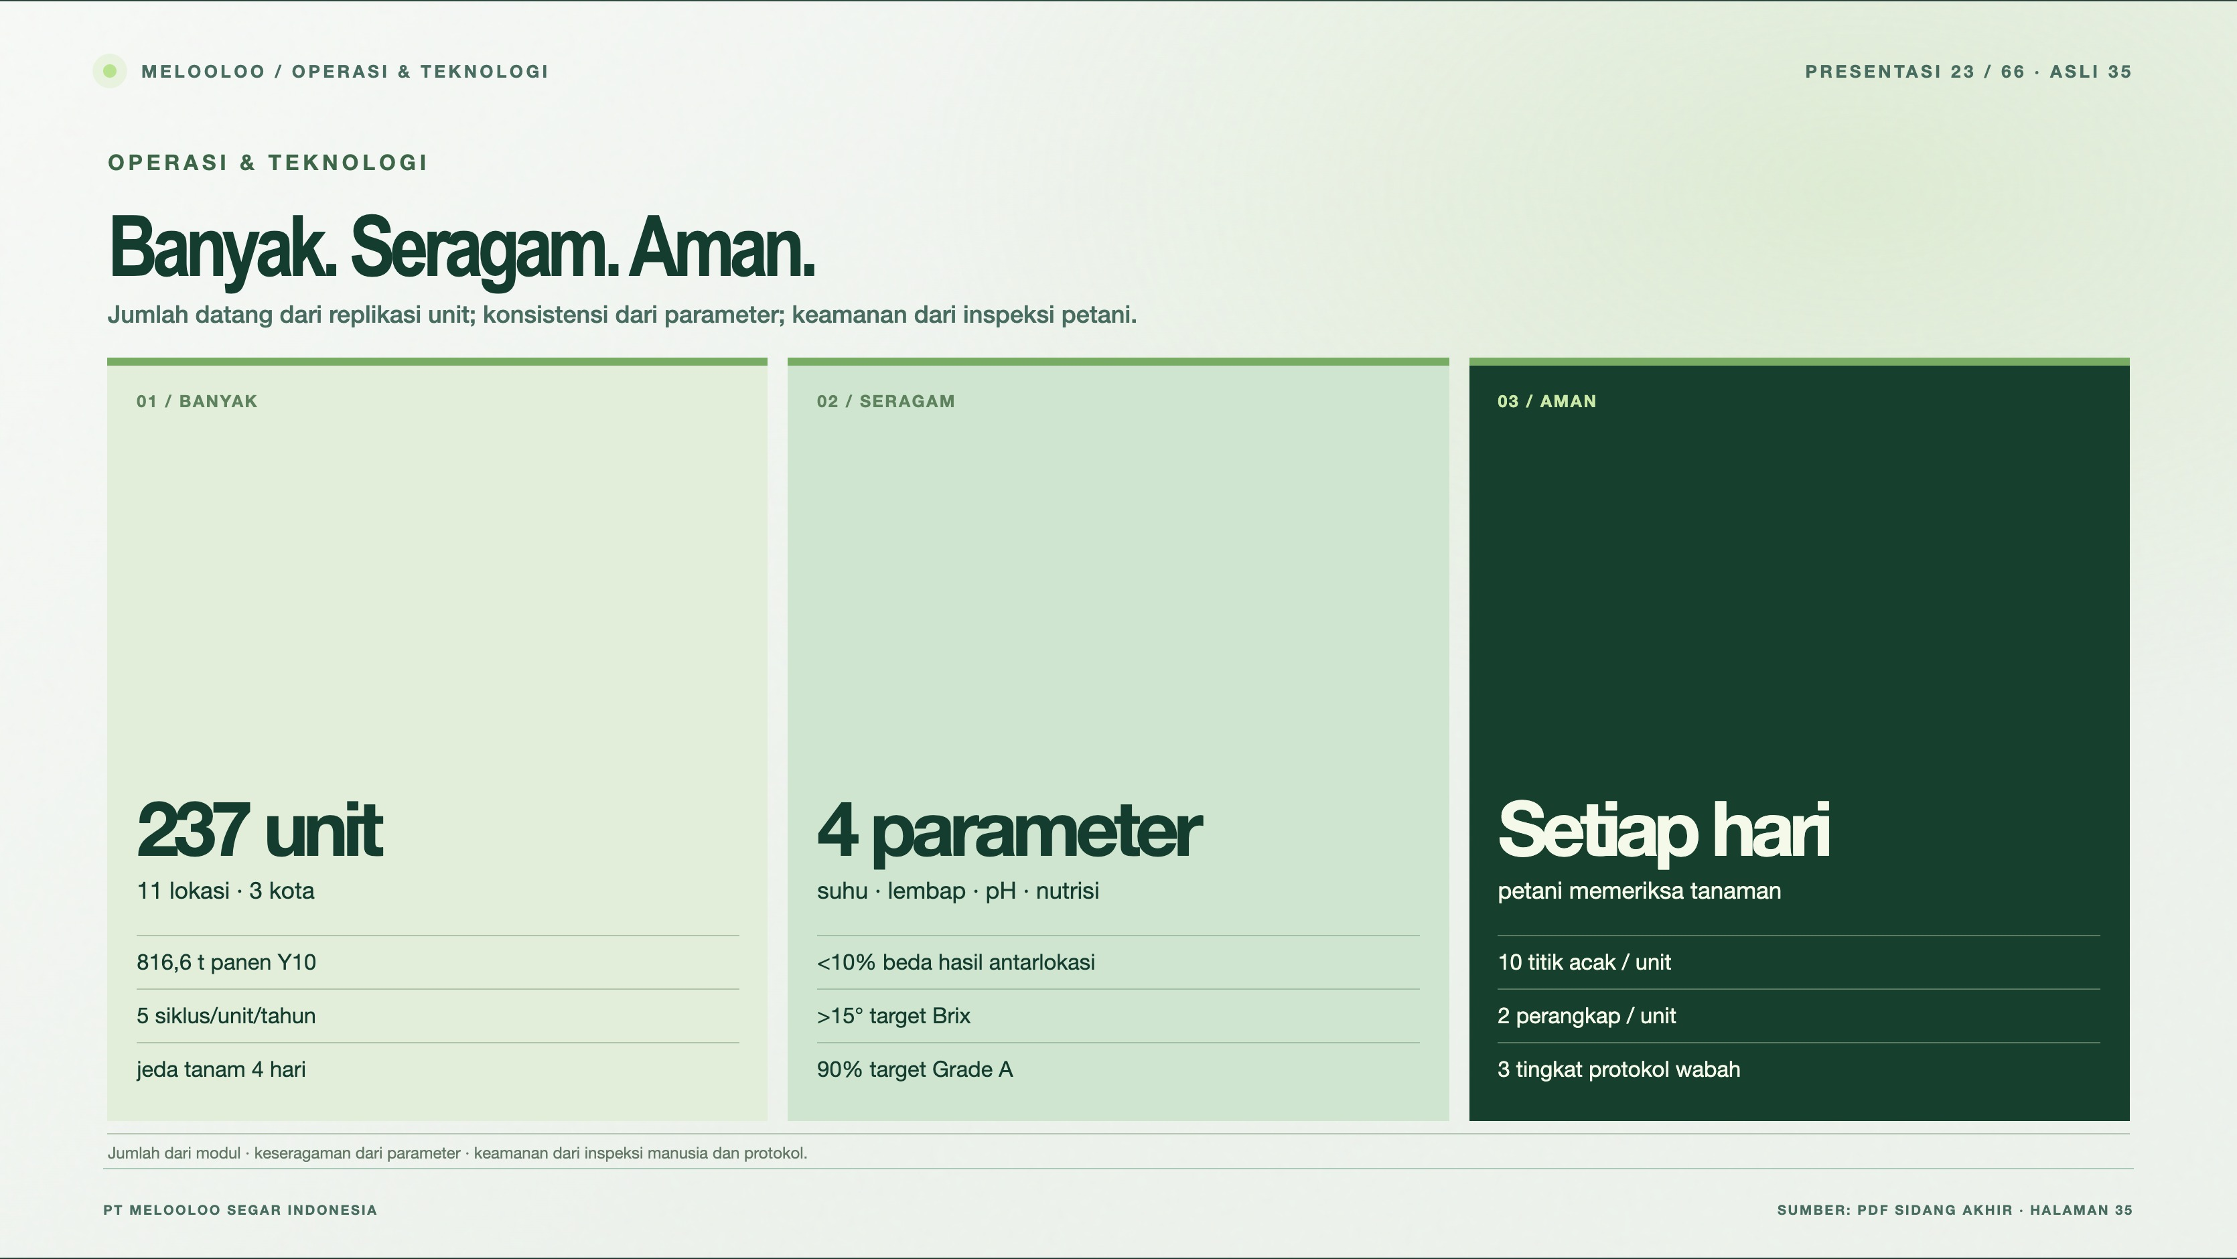
Notes:
Melooloo presentation 23/66 · source slide 35
Banyak. Seragam. Aman.
Interactive web slide: https://mthoriqzi383.github.io/melooloo-project-hub/Melooloo_Final_Presentation_Web_20Oct2026/index.html#slide=35
The web version contains motion, interactive details, and links to the 3D greenhouse.

Slide 24
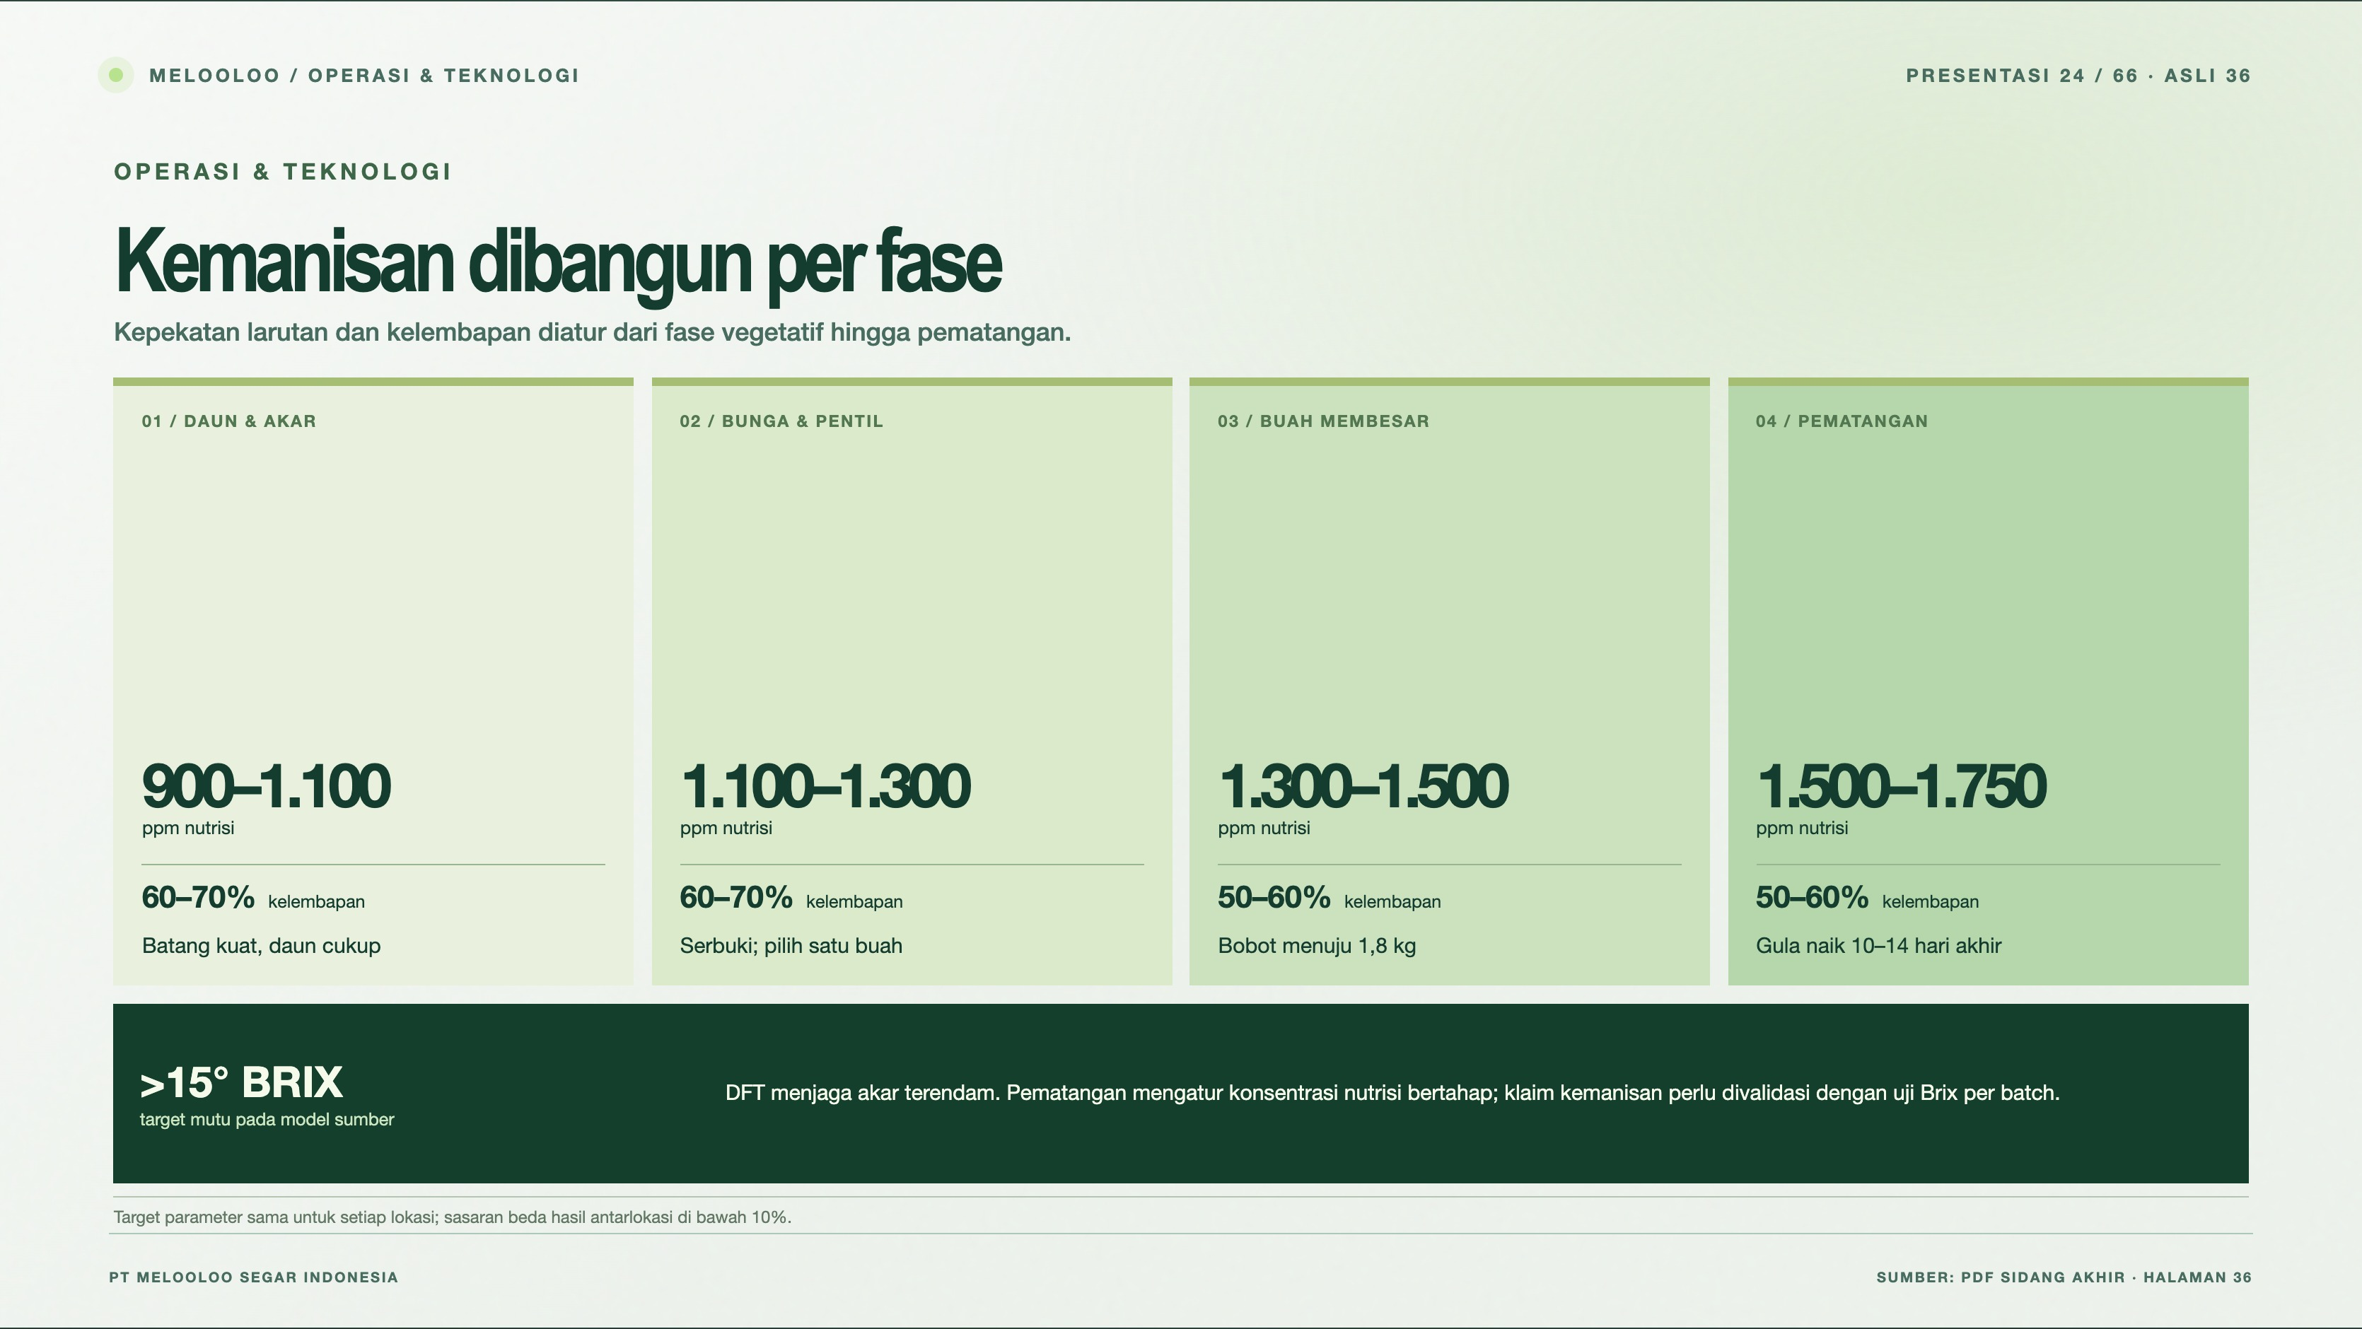
Notes:
Melooloo presentation 24/66 · source slide 36
Kemanisan dibangun per fase
Interactive web slide: https://mthoriqzi383.github.io/melooloo-project-hub/Melooloo_Final_Presentation_Web_20Oct2026/index.html#slide=36
The web version contains motion, interactive details, and links to the 3D greenhouse.

Slide 25
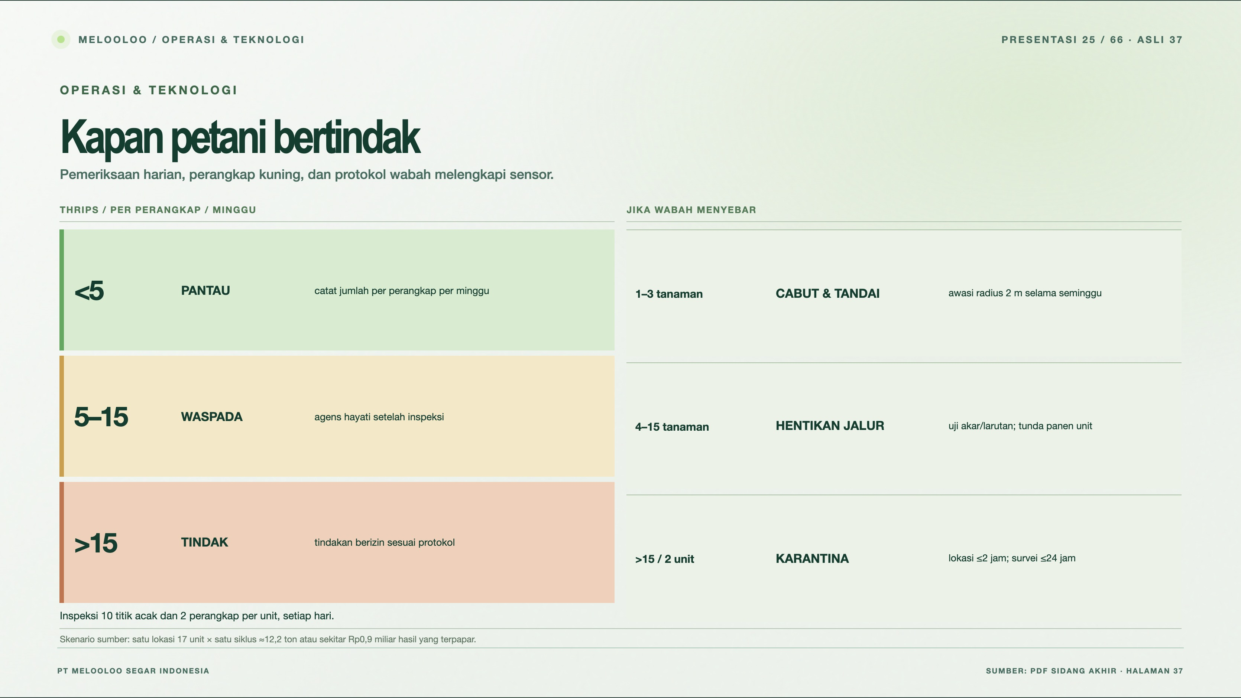
Notes:
Melooloo presentation 25/66 · source slide 37
Kapan petani bertindak
Interactive web slide: https://mthoriqzi383.github.io/melooloo-project-hub/Melooloo_Final_Presentation_Web_20Oct2026/index.html#slide=37
The web version contains motion, interactive details, and links to the 3D greenhouse.

Slide 26
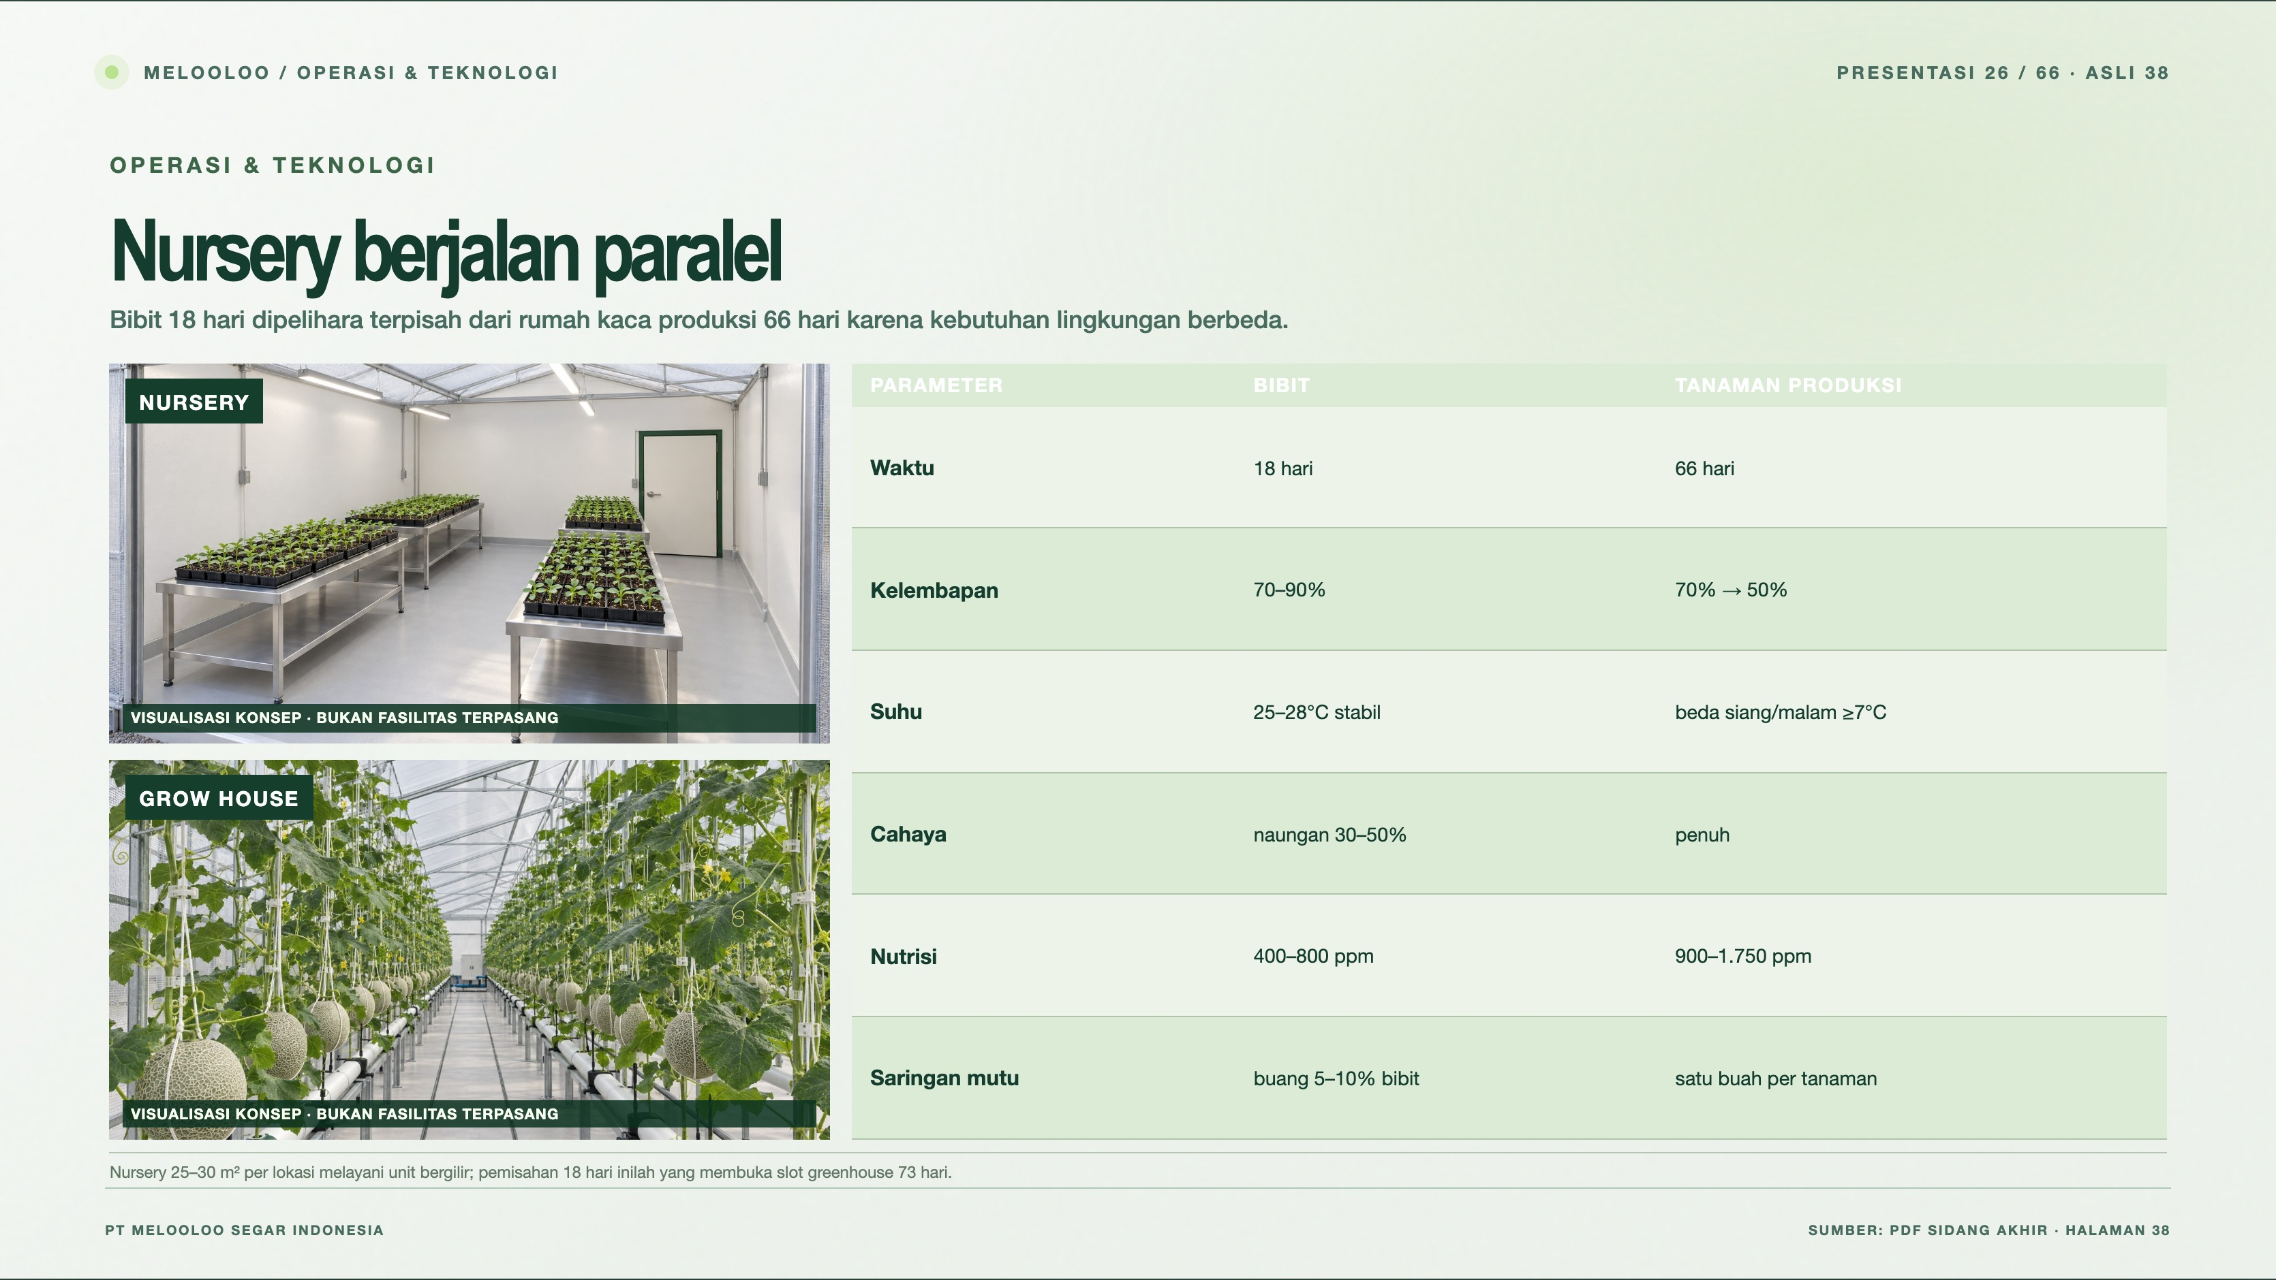
Notes:
Melooloo presentation 26/66 · source slide 38
Nursery berjalan paralel
Interactive web slide: https://mthoriqzi383.github.io/melooloo-project-hub/Melooloo_Final_Presentation_Web_20Oct2026/index.html#slide=38
The web version contains motion, interactive details, and links to the 3D greenhouse.

Slide 27
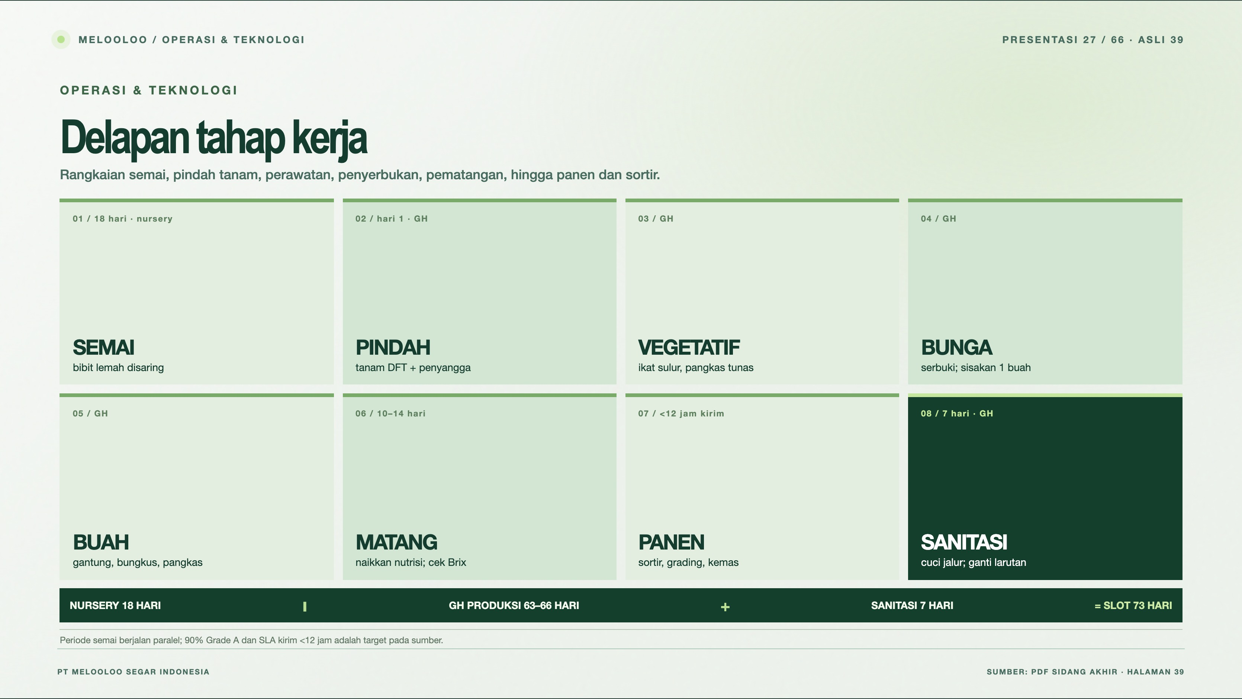
Notes:
Melooloo presentation 27/66 · source slide 39
Delapan tahap kerja
Interactive web slide: https://mthoriqzi383.github.io/melooloo-project-hub/Melooloo_Final_Presentation_Web_20Oct2026/index.html#slide=39
The web version contains motion, interactive details, and links to the 3D greenhouse.

Slide 28
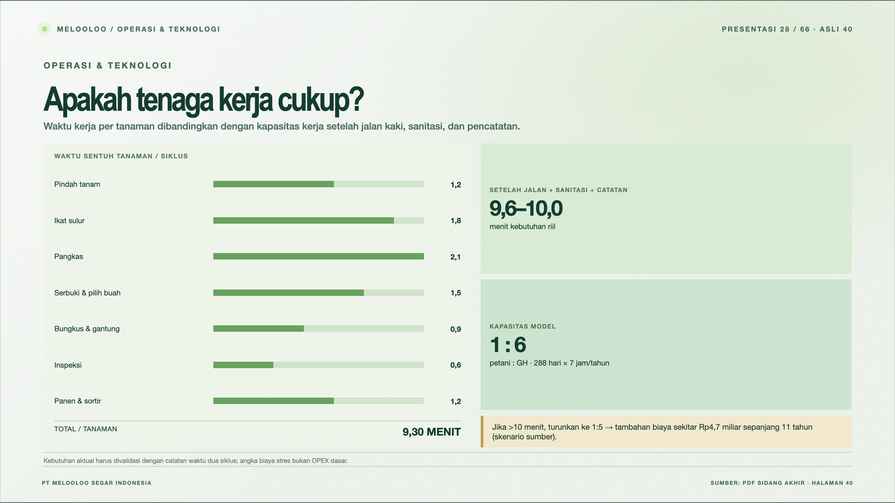
Notes:
Melooloo presentation 28/66 · source slide 40
Apakah tenaga kerja cukup?
Interactive web slide: https://mthoriqzi383.github.io/melooloo-project-hub/Melooloo_Final_Presentation_Web_20Oct2026/index.html#slide=40
The web version contains motion, interactive details, and links to the 3D greenhouse.

Slide 29
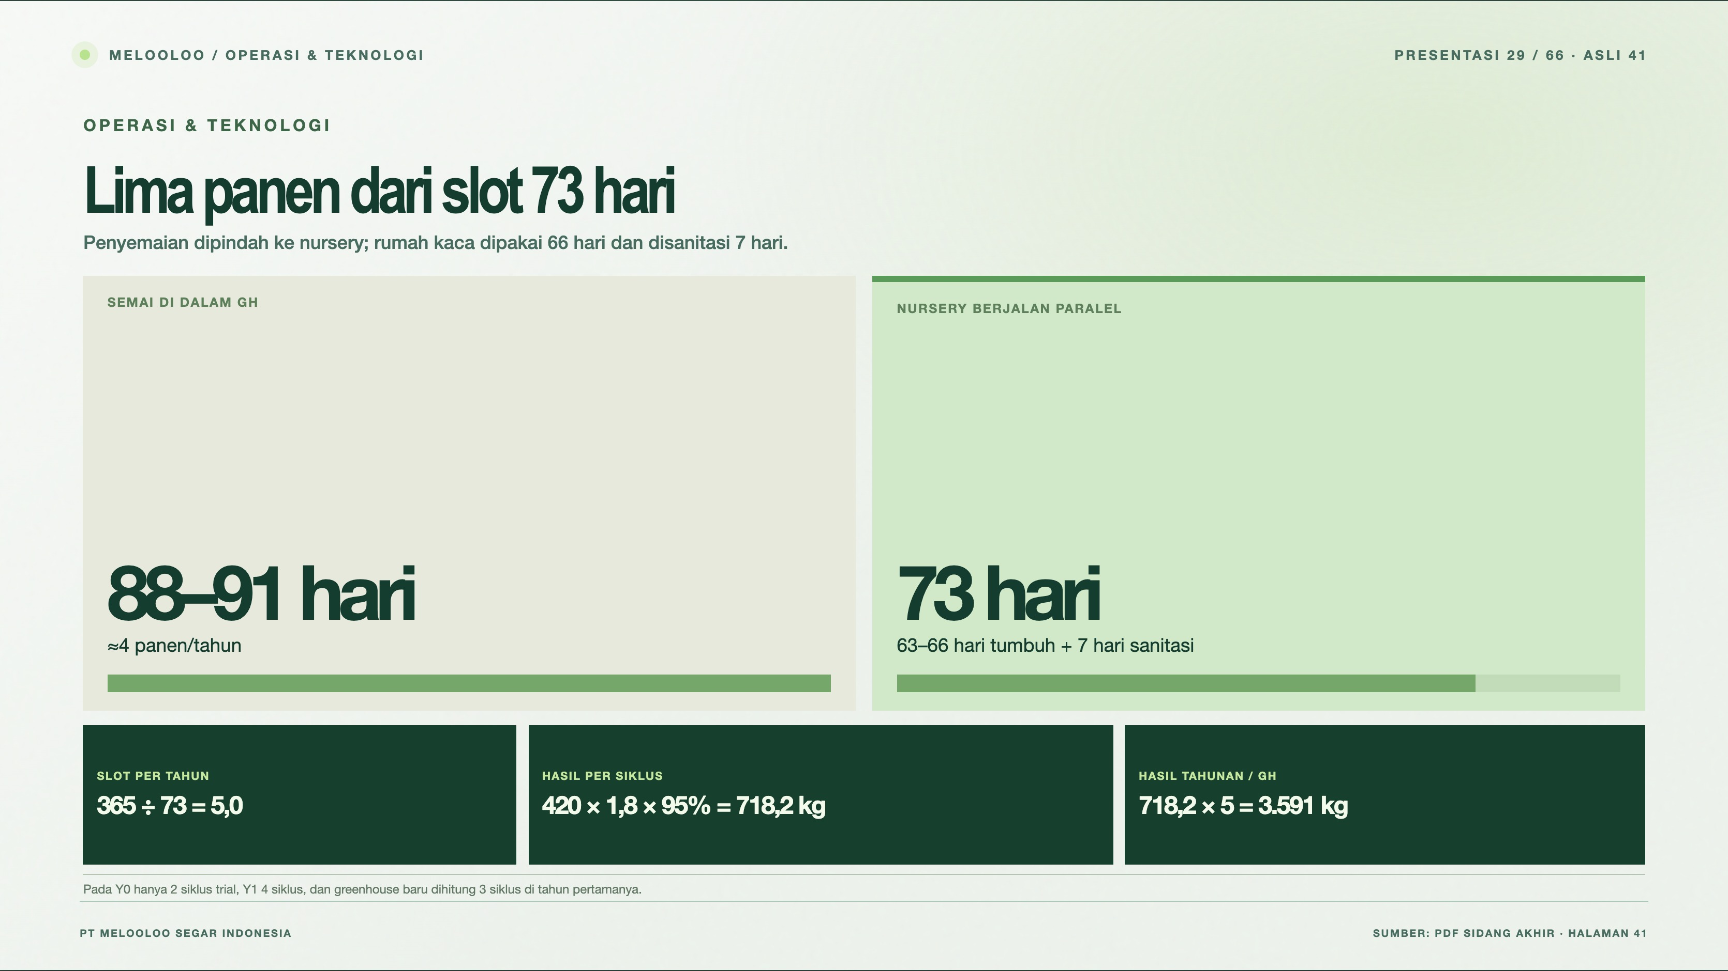
Notes:
Melooloo presentation 29/66 · source slide 41
Lima panen dari slot 73 hari
Interactive web slide: https://mthoriqzi383.github.io/melooloo-project-hub/Melooloo_Final_Presentation_Web_20Oct2026/index.html#slide=41
The web version contains motion, interactive details, and links to the 3D greenhouse.

Slide 30
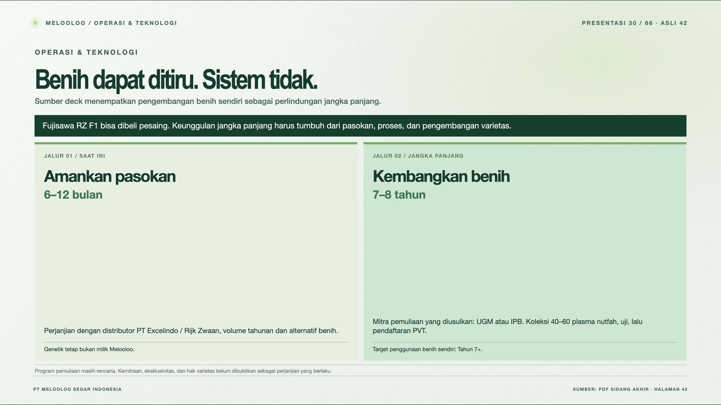
Notes:
Melooloo presentation 30/66 · source slide 42
Benih dapat ditiru. Sistem tidak.
Interactive web slide: https://mthoriqzi383.github.io/melooloo-project-hub/Melooloo_Final_Presentation_Web_20Oct2026/index.html#slide=42
The web version contains motion, interactive details, and links to the 3D greenhouse.

Slide 31
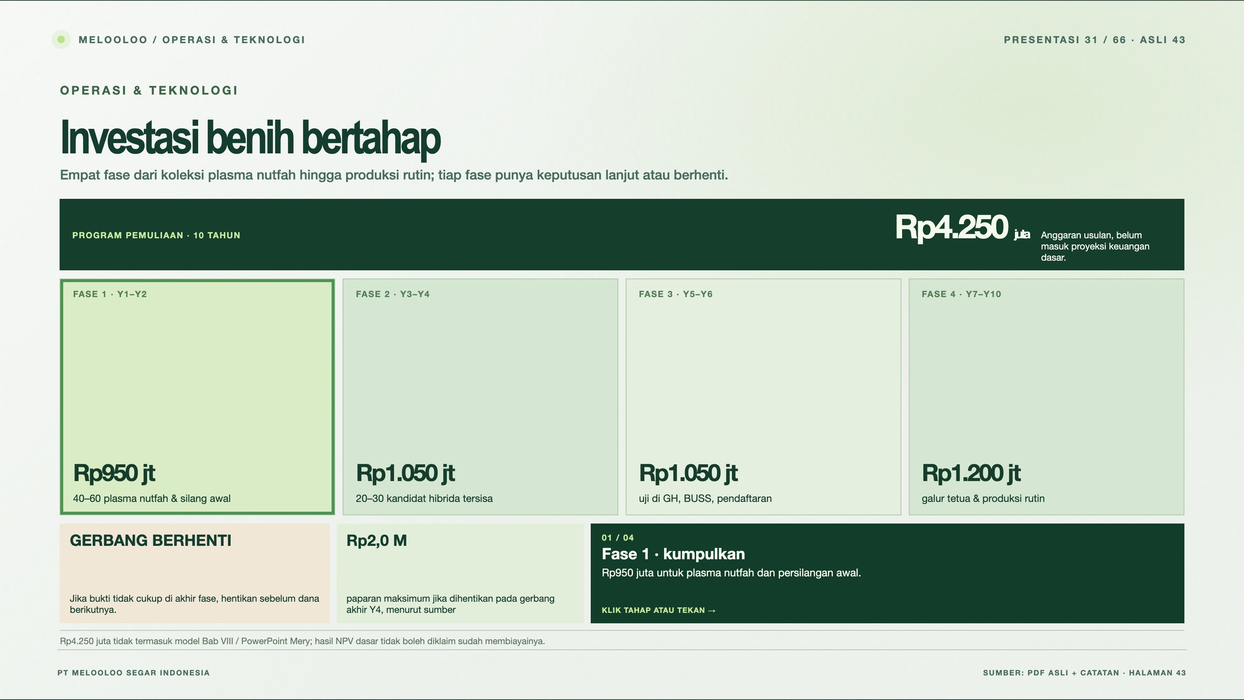
Notes:
Melooloo presentation 31/66 · source slide 43
Investasi benih bertahap
Interactive web slide: https://mthoriqzi383.github.io/melooloo-project-hub/Melooloo_Final_Presentation_Web_20Oct2026/index.html#slide=43
The web version contains motion, interactive details, and links to the 3D greenhouse.

Slide 32
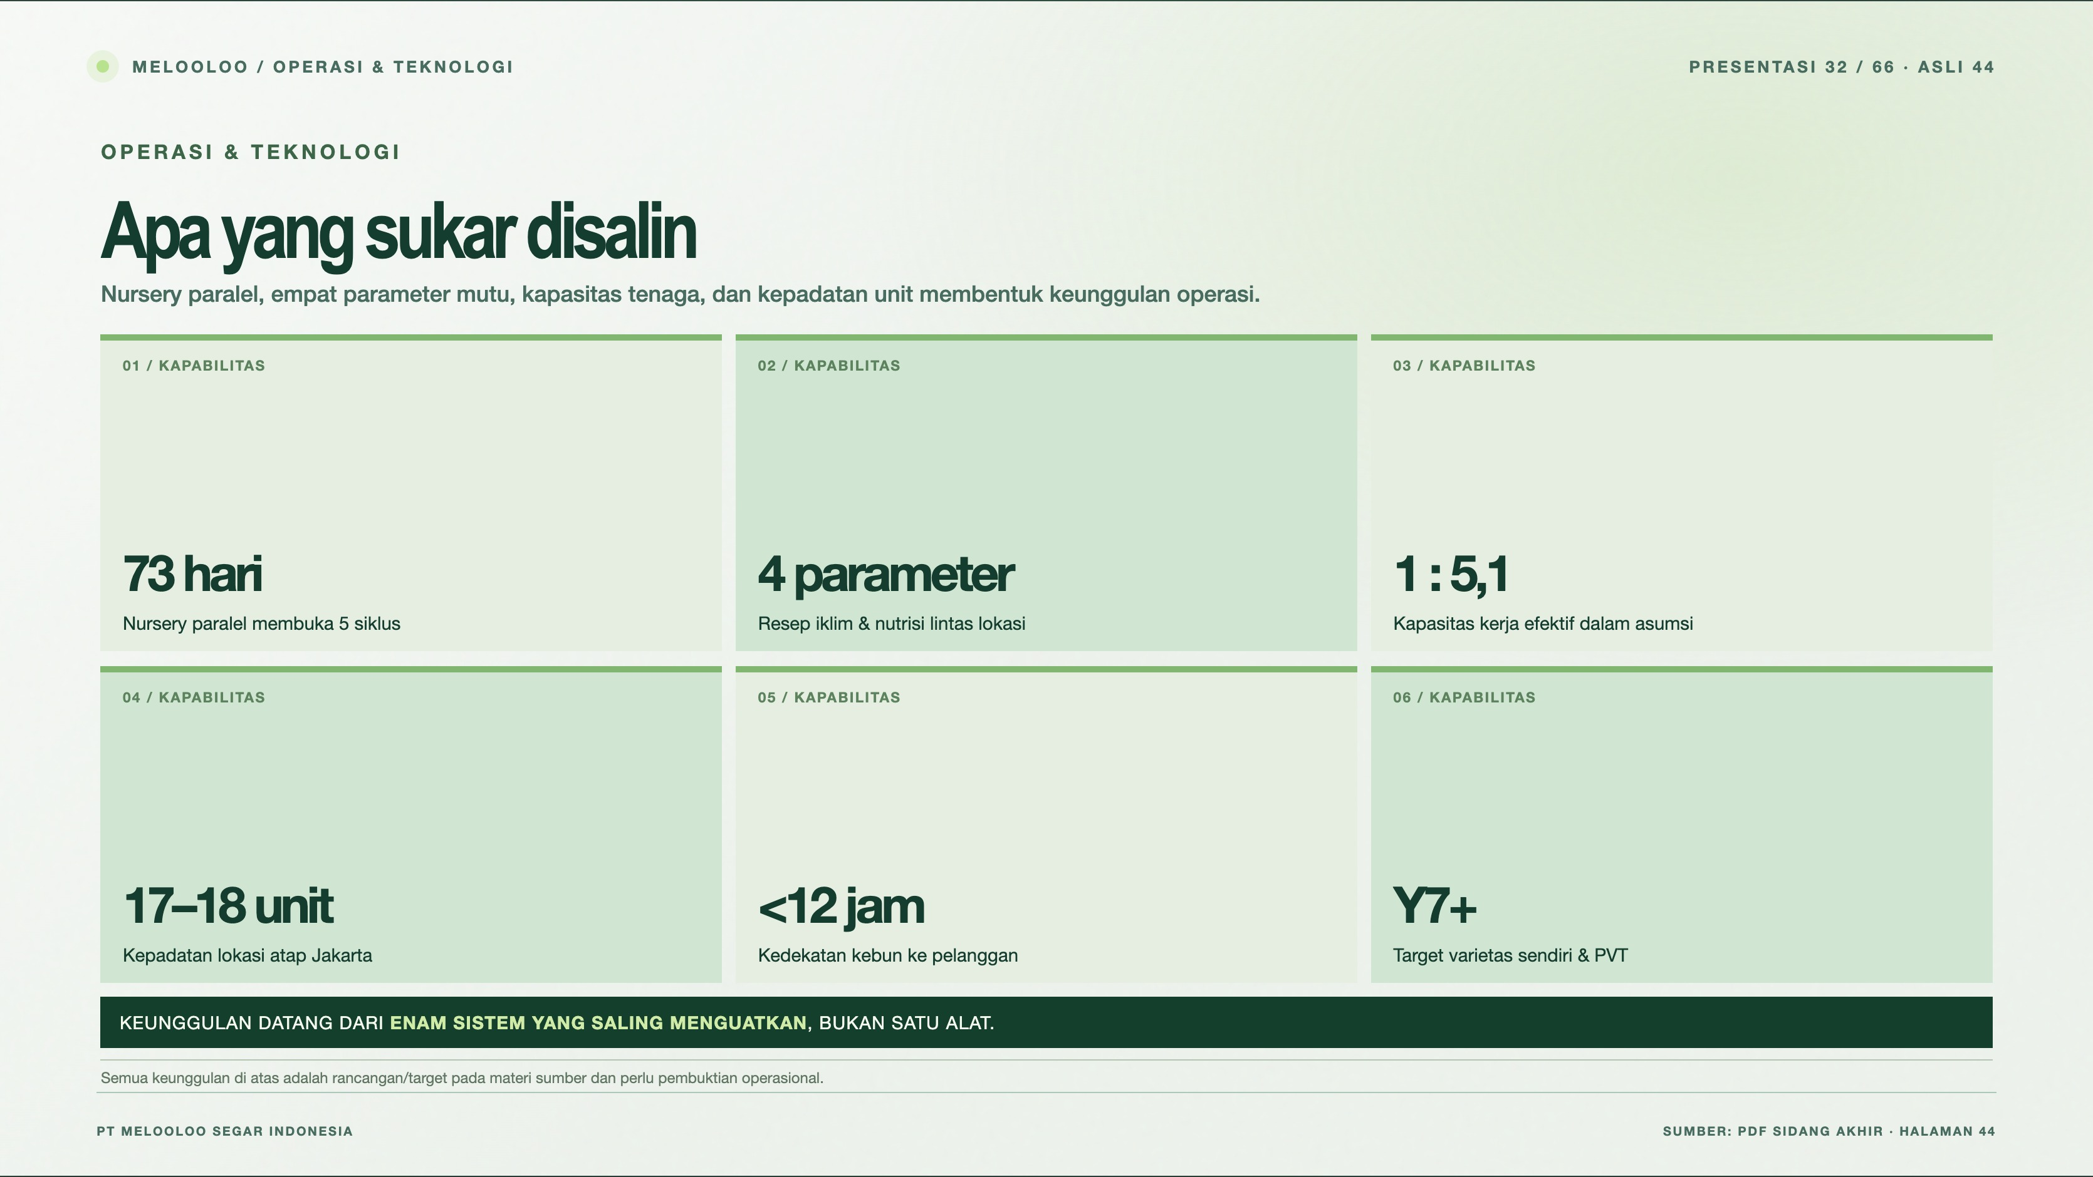
Notes:
Melooloo presentation 32/66 · source slide 44
Apa yang sukar disalin
Interactive web slide: https://mthoriqzi383.github.io/melooloo-project-hub/Melooloo_Final_Presentation_Web_20Oct2026/index.html#slide=44
The web version contains motion, interactive details, and links to the 3D greenhouse.

Slide 33
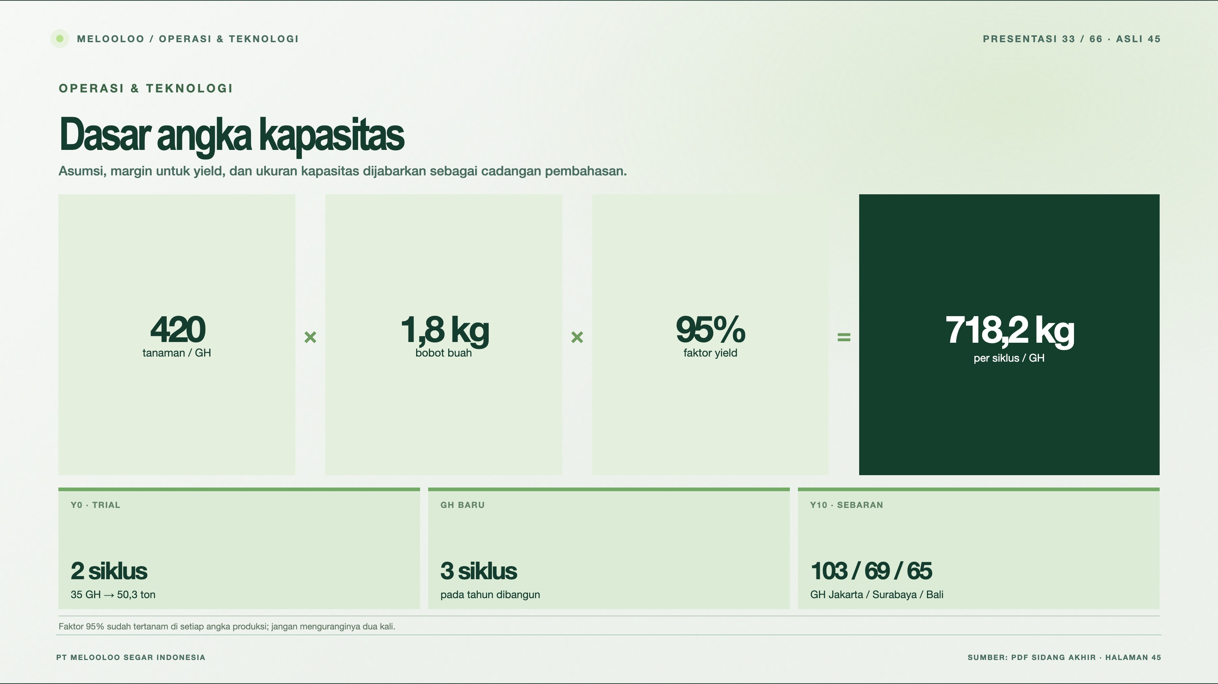
Notes:
Melooloo presentation 33/66 · source slide 45
Dasar angka kapasitas
Interactive web slide: https://mthoriqzi383.github.io/melooloo-project-hub/Melooloo_Final_Presentation_Web_20Oct2026/index.html#slide=45
The web version contains motion, interactive details, and links to the 3D greenhouse.

Slide 34
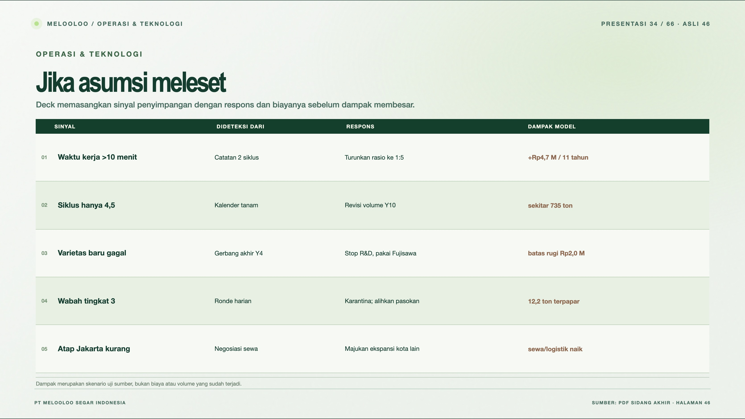
Notes:
Melooloo presentation 34/66 · source slide 46
Jika asumsi meleset
Interactive web slide: https://mthoriqzi383.github.io/melooloo-project-hub/Melooloo_Final_Presentation_Web_20Oct2026/index.html#slide=46
The web version contains motion, interactive details, and links to the 3D greenhouse.

Slide 35
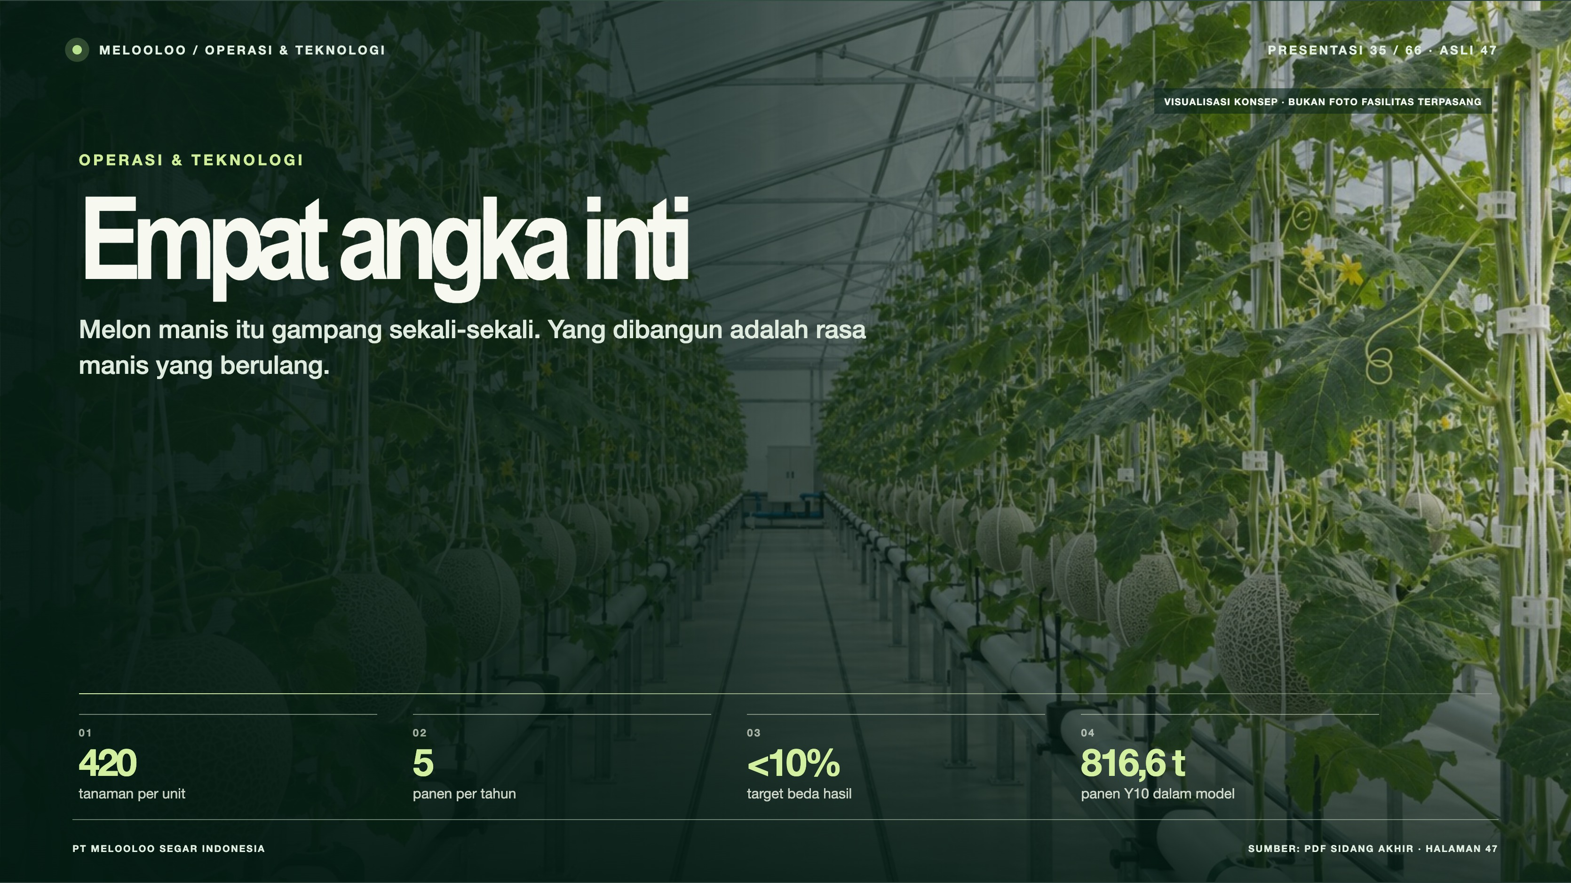
Notes:
Melooloo presentation 35/66 · source slide 47
Empat angka inti
Interactive web slide: https://mthoriqzi383.github.io/melooloo-project-hub/Melooloo_Final_Presentation_Web_20Oct2026/index.html#slide=47
The web version contains motion, interactive details, and links to the 3D greenhouse.

Slide 36
Notes:
Melooloo presentation 36/66 · source slide 48
Manusia menjaga hasil
Interactive web slide: https://mthoriqzi383.github.io/melooloo-project-hub/Melooloo_Final_Presentation_Web_20Oct2026/index.html#slide=48
The web version contains motion, interactive details, and links to the 3D greenhouse.

Slide 37
Notes:
Melooloo presentation 37/66 · source slide 49
Bangun tim, uji kompetensi
Interactive web slide: https://mthoriqzi383.github.io/melooloo-project-hub/Melooloo_Final_Presentation_Web_20Oct2026/index.html#slide=49
The web version contains motion, interactive details, and links to the 3D greenhouse.

Slide 38
Notes:
Melooloo presentation 38/66 · source slide 50
Siapa menjaga apa?
Interactive web slide: https://mthoriqzi383.github.io/melooloo-project-hub/Melooloo_Final_Presentation_Web_20Oct2026/index.html#slide=50
The web version contains motion, interactive details, and links to the 3D greenhouse.

Slide 39
Notes:
Melooloo presentation 39/66 · source slide 51
Tim tumbuh bersama unit
Interactive web slide: https://mthoriqzi383.github.io/melooloo-project-hub/Melooloo_Final_Presentation_Web_20Oct2026/index.html#slide=51
The web version contains motion, interactive details, and links to the 3D greenhouse.

Slide 40
Notes:
Melooloo presentation 40/66 · source slide 52
Biaya orang, tahun demi tahun
Interactive web slide: https://mthoriqzi383.github.io/melooloo-project-hub/Melooloo_Final_Presentation_Web_20Oct2026/index.html#slide=52
The web version contains motion, interactive details, and links to the 3D greenhouse.

Slide 41
Notes:
Melooloo presentation 41/66 · source slide 53
Rencana keuangan Melooloo
Interactive web slide: https://mthoriqzi383.github.io/melooloo-project-hub/Melooloo_Final_Presentation_Web_20Oct2026/index.html#slide=53
The web version contains motion, interactive details, and links to the 3D greenhouse.

Slide 42
Notes:
Melooloo presentation 42/66 · source slide 54
Asumsi yang menggerakkan model
Interactive web slide: https://mthoriqzi383.github.io/melooloo-project-hub/Melooloo_Final_Presentation_Web_20Oct2026/index.html#slide=54
The web version contains motion, interactive details, and links to the 3D greenhouse.

Slide 43
Notes:
Melooloo presentation 43/66 · source slide 55
Rp10.462 juta untuk memulai
Interactive web slide: https://mthoriqzi383.github.io/melooloo-project-hub/Melooloo_Final_Presentation_Web_20Oct2026/index.html#slide=55
The web version contains motion, interactive details, and links to the 3D greenhouse.

Slide 44
Notes:
Melooloo presentation 44/66 · source slide 56
Pendanaan sesuai fase pertumbuhan
Interactive web slide: https://mthoriqzi383.github.io/melooloo-project-hub/Melooloo_Final_Presentation_Web_20Oct2026/index.html#slide=56
The web version contains motion, interactive details, and links to the 3D greenhouse.

Slide 45
Notes:
Melooloo presentation 45/66 · source slide 57
Belanja bangun, biaya jalan
Interactive web slide: https://mthoriqzi383.github.io/melooloo-project-hub/Melooloo_Final_Presentation_Web_20Oct2026/index.html#slide=57
The web version contains motion, interactive details, and links to the 3D greenhouse.

Slide 46
Notes:
Melooloo presentation 46/66 · source slide 58
Pendapatan tumbuh, laba positif sejak Y1
Interactive web slide: https://mthoriqzi383.github.io/melooloo-project-hub/Melooloo_Final_Presentation_Web_20Oct2026/index.html#slide=58
The web version contains motion, interactive details, and links to the 3D greenhouse.

Slide 47
Notes:
Melooloo presentation 47/66 · source slide 59
Aset dan ekuitas bertumbuh
Interactive web slide: https://mthoriqzi383.github.io/melooloo-project-hub/Melooloo_Final_Presentation_Web_20Oct2026/index.html#slide=59
The web version contains motion, interactive details, and links to the 3D greenhouse.

Slide 48
Notes:
Melooloo presentation 48/66 · source slide 60
Kas kembali pada Tahun 6
Interactive web slide: https://mthoriqzi383.github.io/melooloo-project-hub/Melooloo_Final_Presentation_Web_20Oct2026/index.html#slide=60
The web version contains motion, interactive details, and links to the 3D greenhouse.

Slide 49
Notes:
Melooloo presentation 49/66 · source slide 61
Tahun 1 adalah titik kritis
Interactive web slide: https://mthoriqzi383.github.io/melooloo-project-hub/Melooloo_Final_Presentation_Web_20Oct2026/index.html#slide=61
The web version contains motion, interactive details, and links to the 3D greenhouse.

Slide 50
Notes:
Melooloo presentation 50/66 · source slide 62
Indikator kelayakan melewati ambang
Interactive web slide: https://mthoriqzi383.github.io/melooloo-project-hub/Melooloo_Final_Presentation_Web_20Oct2026/index.html#slide=62
The web version contains motion, interactive details, and links to the 3D greenhouse.

Slide 51
Notes:
Melooloo presentation 51/66 · source slide 63
Pendapatan adalah variabel paling peka
Interactive web slide: https://mthoriqzi383.github.io/melooloo-project-hub/Melooloo_Final_Presentation_Web_20Oct2026/index.html#slide=63
The web version contains motion, interactive details, and links to the 3D greenhouse.

Slide 52
Notes:
Melooloo presentation 52/66 · source slide 64
Layak, dengan tiga risiko yang dikawal
Interactive web slide: https://mthoriqzi383.github.io/melooloo-project-hub/Melooloo_Final_Presentation_Web_20Oct2026/index.html#slide=64
The web version contains motion, interactive details, and links to the 3D greenhouse.

Slide 53
Notes:
Melooloo presentation 53/66 · source slide 8
Tiga sasaran pemasaran
Interactive web slide: https://mthoriqzi383.github.io/melooloo-project-hub/Melooloo_Final_Presentation_Web_20Oct2026/index.html#slide=8
The web version contains motion, interactive details, and links to the 3D greenhouse.

Slide 54
Notes:
Melooloo presentation 54/66 · source slide 9
Enam segmen, dua jalur
Interactive web slide: https://mthoriqzi383.github.io/melooloo-project-hub/Melooloo_Final_Presentation_Web_20Oct2026/index.html#slide=9
The web version contains motion, interactive details, and links to the 3D greenhouse.

Slide 55
Notes:
Melooloo presentation 55/66 · source slide 10
Dari TAM ke SOM
Interactive web slide: https://mthoriqzi383.github.io/melooloo-project-hub/Melooloo_Final_Presentation_Web_20Oct2026/index.html#slide=10
The web version contains motion, interactive details, and links to the 3D greenhouse.

Slide 56
Notes:
Melooloo presentation 56/66 · source slide 11
Apa yang setara. Apa yang berbeda.
Interactive web slide: https://mthoriqzi383.github.io/melooloo-project-hub/Melooloo_Final_Presentation_Web_20Oct2026/index.html#slide=11
The web version contains motion, interactive details, and links to the 3D greenhouse.

Slide 57
Notes:
Melooloo presentation 57/66 · source slide 12
Peta kompetitif
Interactive web slide: https://mthoriqzi383.github.io/melooloo-project-hub/Melooloo_Final_Presentation_Web_20Oct2026/index.html#slide=12
The web version contains motion, interactive details, and links to the 3D greenhouse.

Slide 58
Notes:
Melooloo presentation 58/66 · source slide 13
Ruang menuju titik ideal
Interactive web slide: https://mthoriqzi383.github.io/melooloo-project-hub/Melooloo_Final_Presentation_Web_20Oct2026/index.html#slide=13
The web version contains motion, interactive details, and links to the 3D greenhouse.

Slide 59
Notes:
Melooloo presentation 59/66 · source slide 14
Posisi merek: kebun di kota
Interactive web slide: https://mthoriqzi383.github.io/melooloo-project-hub/Melooloo_Final_Presentation_Web_20Oct2026/index.html#slide=14
The web version contains motion, interactive details, and links to the 3D greenhouse.

Slide 60
Notes:
Melooloo presentation 60/66 · source slide 15
Produk dan harga
Interactive web slide: https://mthoriqzi383.github.io/melooloo-project-hub/Melooloo_Final_Presentation_Web_20Oct2026/index.html#slide=15
The web version contains motion, interactive details, and links to the 3D greenhouse.

Slide 61
Notes:
Melooloo presentation 61/66 · source slide 16
Lima kanal distribusi
Interactive web slide: https://mthoriqzi383.github.io/melooloo-project-hub/Melooloo_Final_Presentation_Web_20Oct2026/index.html#slide=16
The web version contains motion, interactive details, and links to the 3D greenhouse.

Slide 62
Notes:
Melooloo presentation 62/66 · source slide 17
Komunikasi yang terukur
Interactive web slide: https://mthoriqzi383.github.io/melooloo-project-hub/Melooloo_Final_Presentation_Web_20Oct2026/index.html#slide=17
The web version contains motion, interactive details, and links to the 3D greenhouse.

Slide 63
Notes:
Melooloo presentation 63/66 · source slide 18
Brand di titik temu pelanggan
Interactive web slide: https://mthoriqzi383.github.io/melooloo-project-hub/Melooloo_Final_Presentation_Web_20Oct2026/index.html#slide=18
The web version contains motion, interactive details, and links to the 3D greenhouse.

Slide 64
Notes:
Melooloo presentation 64/66 · source slide 19
Ekonomi pemasaran
Interactive web slide: https://mthoriqzi383.github.io/melooloo-project-hub/Melooloo_Final_Presentation_Web_20Oct2026/index.html#slide=19
The web version contains motion, interactive details, and links to the 3D greenhouse.

Slide 65
Notes:
Melooloo presentation 65/66 · source slide 65
Dari peluang ke keputusan
Interactive web slide: https://mthoriqzi383.github.io/melooloo-project-hub/Melooloo_Final_Presentation_Web_20Oct2026/index.html#slide=65
The web version contains motion, interactive details, and links to the 3D greenhouse.

Slide 66
Notes:
Melooloo presentation 66/66 · source slide 66
Terima kasih.
Interactive web slide: https://mthoriqzi383.github.io/melooloo-project-hub/Melooloo_Final_Presentation_Web_20Oct2026/index.html#slide=66
The web version contains motion, interactive details, and links to the 3D greenhouse.

