Slide 1

Machine Learning: Forecasting FIFA Player’s Overall Rating

Slide 2
Overview
Introduction
Task
Similar Work
Experiment setup (data, methods, metrics)
Results (plots are important, along with incorrect predictions)
Conclusion (Impact of work and contributions)

Slide 3
Introduction
Modern sports use statistical data analysis.
Higher demand for accurate models
Zebra Technologies , NFL, introducing RFID
Importance of player's overall rating in FIFA games
Accurate player's stats improves sports betting
Solution domain:
Physical : Limited to none applications
Virtual : 1. Data analytics platforms
2. Simulation environments

Slide 4
Task
Use team and player data to predict future player's overall rating
Investigate which ML algorithms are suited for context and dataset
Pipeline 1 : Random Forest Regressor XGBoost
Pipeline 2: Support Vector Machine Neural Network

Slide 5
Similar Work
Giannakoulas, Papageorgiou and Tjortjis predicted the expected number of goals :
Random Forest, Linear Regression and Multilayer Perceptron.
LR was the best algorithm with a Mean Absolute Error (MAE) of 7.06 [14].
Yu et.al. Predicted the game result in CSL:
Random Forest, Linear Regression and SVM
SVM had an 85% accuracy

Slide 6
Similar Work (Continued)
Delano Ramdas predicted performance of footballers in Fantasy Premier League:
CNN with time-series input data LSTM RNN
CNN a lower MSE average value of 1.35 while other models averaged 8.36

Slide 7
Experiment Setup
Dataset: EA Sports FIFA 2018 to 2023 consolidated dataset.
Methods: Neural Network SVM Random Forest Regressor XBGBoost
Metrics:
Training and Testing accuracy
Mean Absolute Value (MAE) and R-squared value
Macro Precision, Macro Recall, F1 score

Slide 8
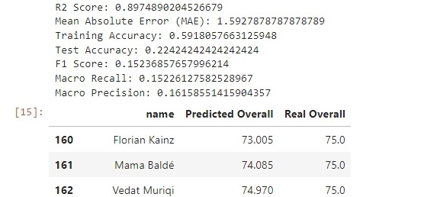
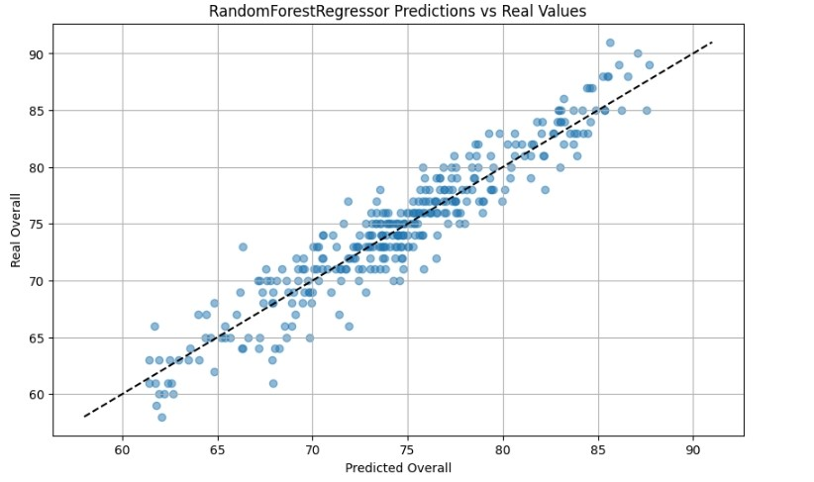
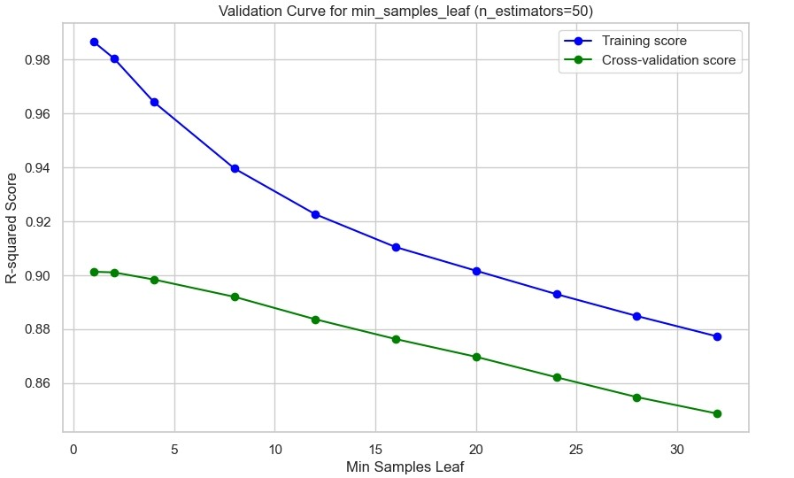
Results (Pipeline 1 : Random Forest Regressor)

Slide 9
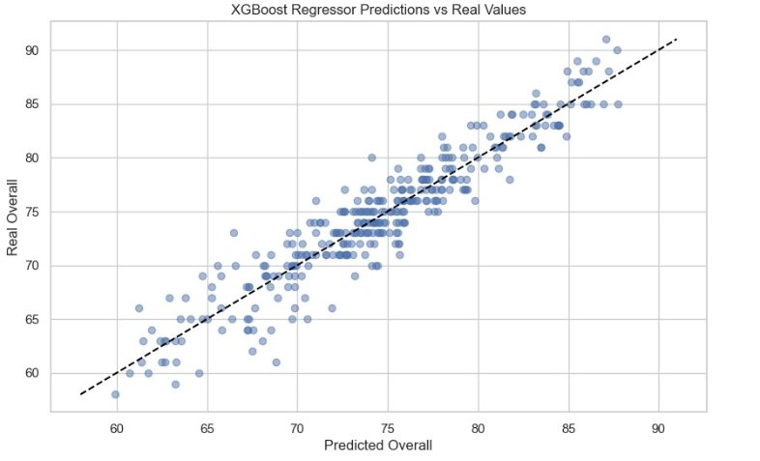
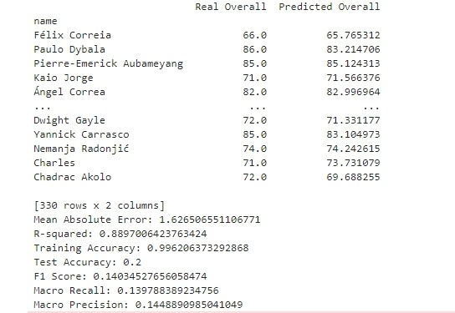
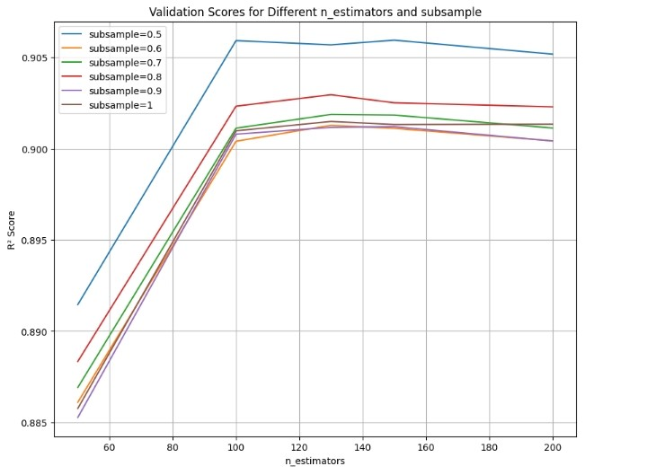
Results (Pipeline 1: XGBoost Regressor )

Slide 10
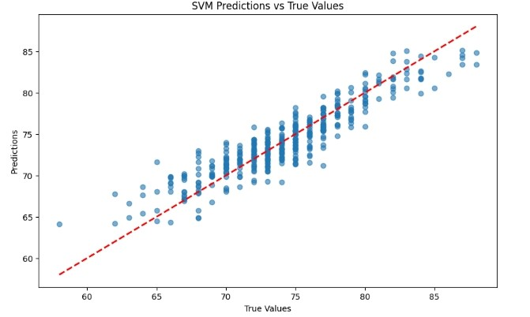
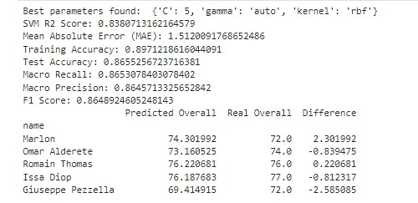
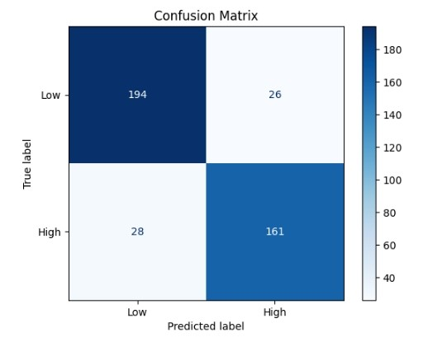
Results (Pipeline 2: SVM )

Slide 11
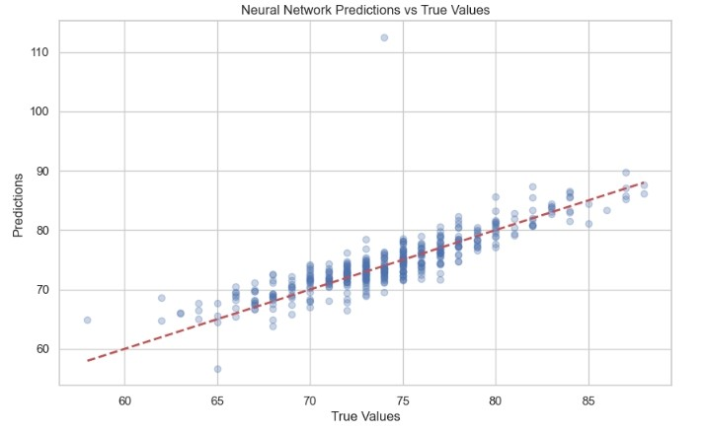
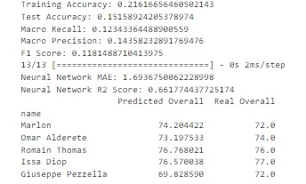
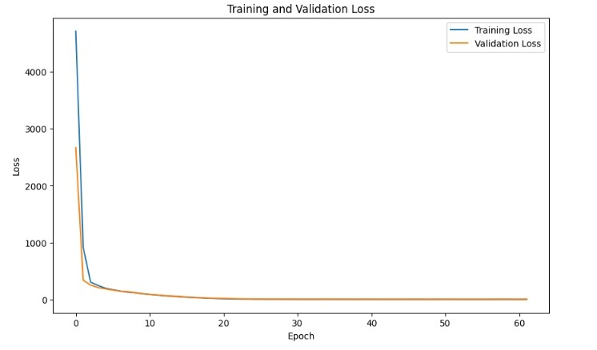
Results (Pipeline 2: Neural Network )

Slide 12
Conclusion
SVM well trained for predicting a player's overall value
Contributions:
Insights into overfitting
New evaluation metrics to football context
Impact of work:
Enhanced decision-making (Sports betting, FPL)
Performance Optimization

