Slide 1
Categorical Model Bayesian Checks

Slide 2
read imputed data

Slide 3
Run Zoib Model

Slide 4
Load results

Slide 5
Convergence Plots

Slide 6
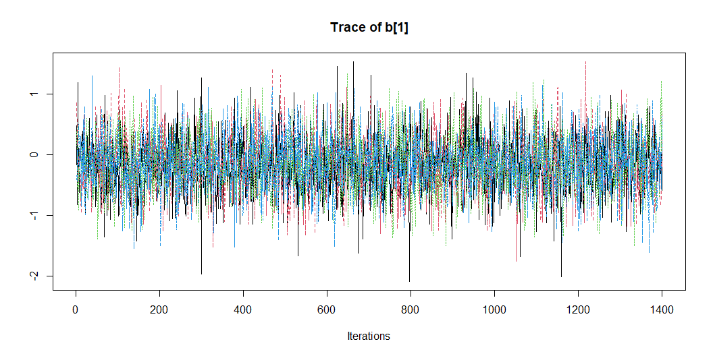
Traceplots
Pre-op

Slide 7
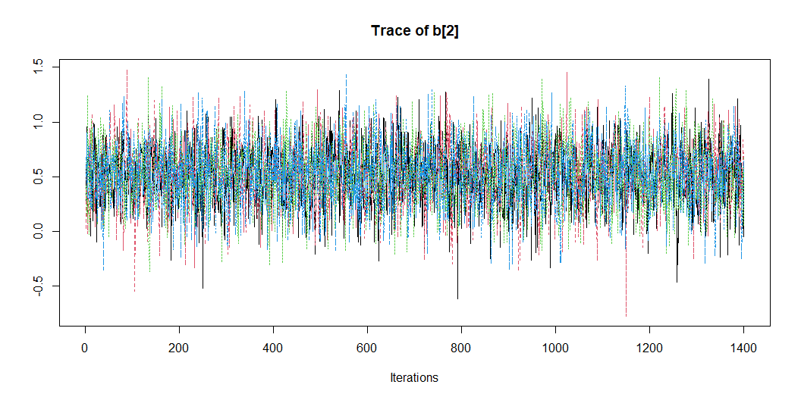

Slide 8
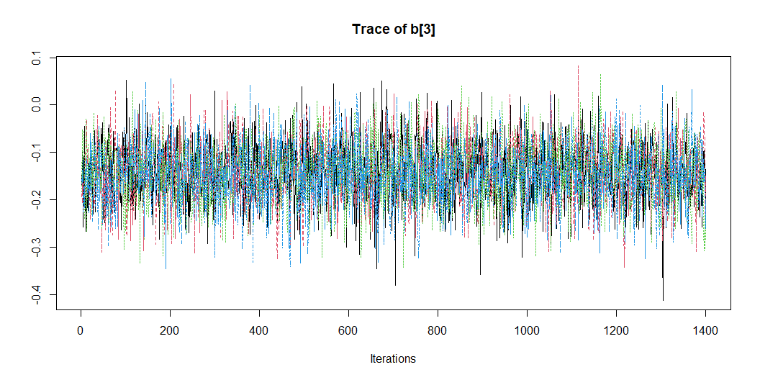

Slide 9
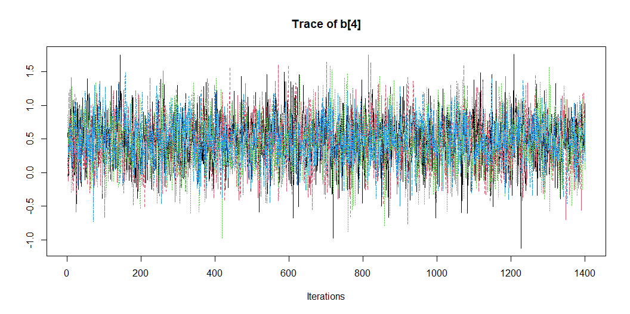

Slide 10
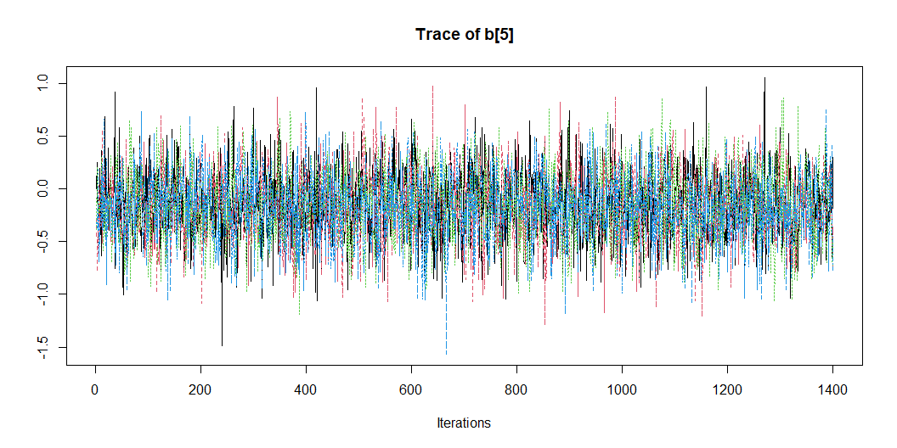

Slide 11
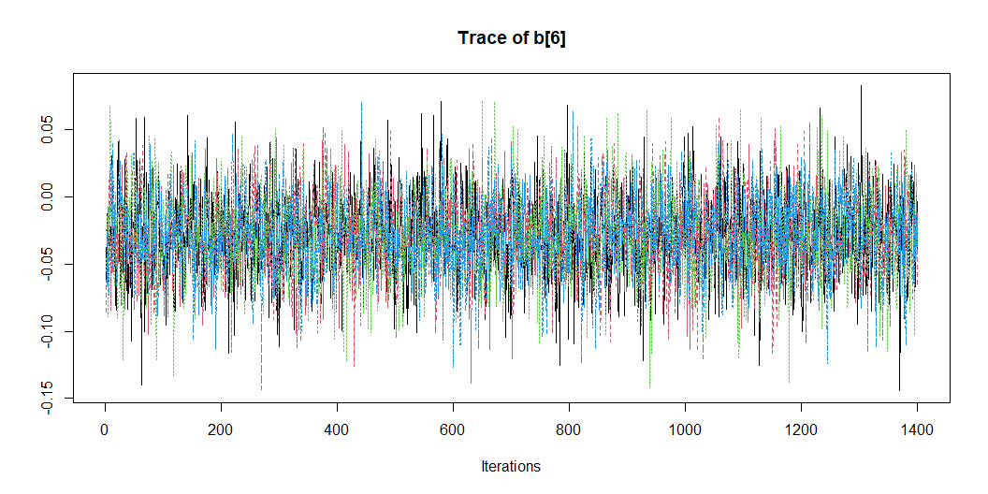

Slide 12
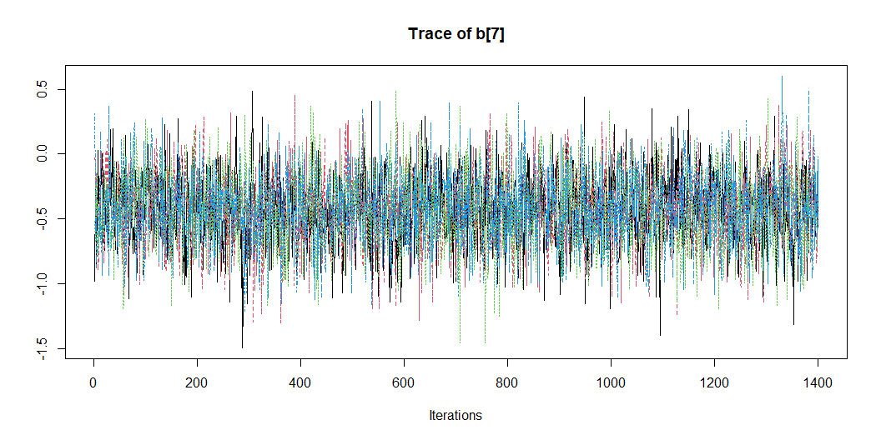

Slide 13
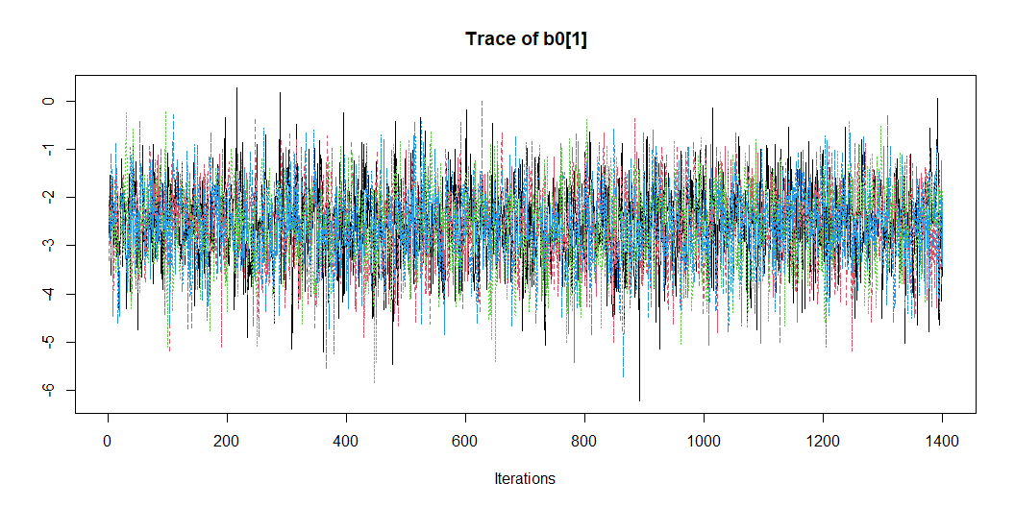

Slide 14
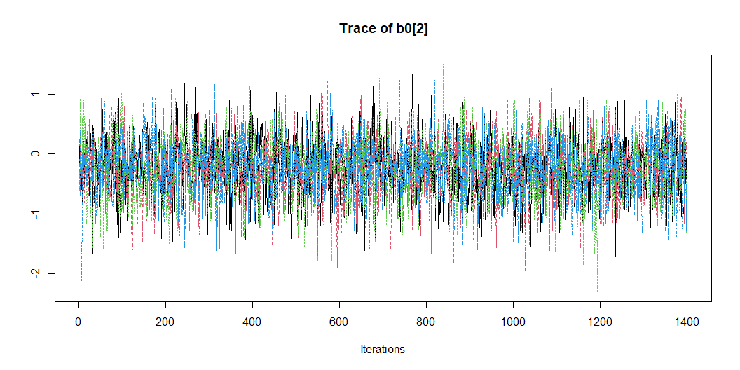

Slide 15
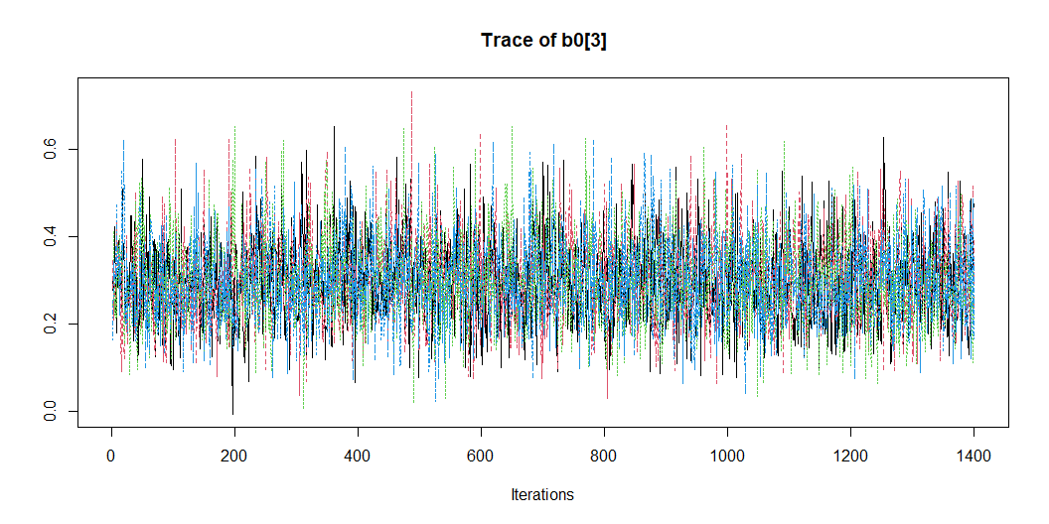

Slide 16
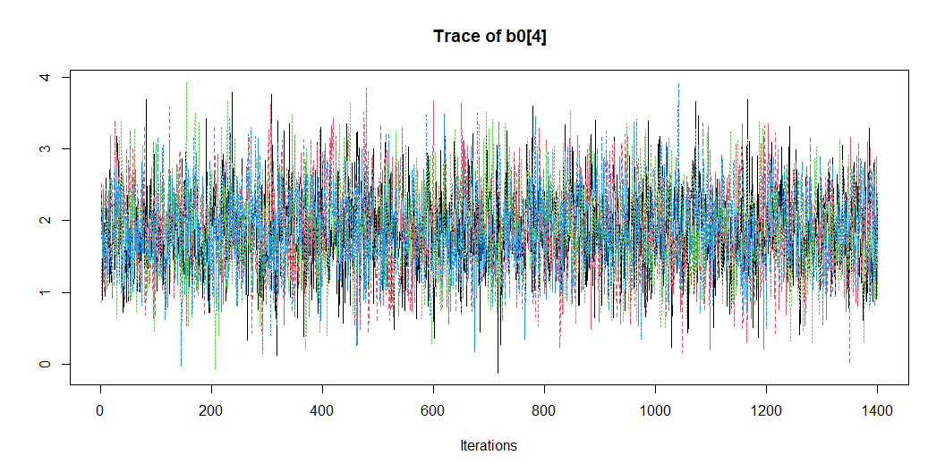

Slide 17
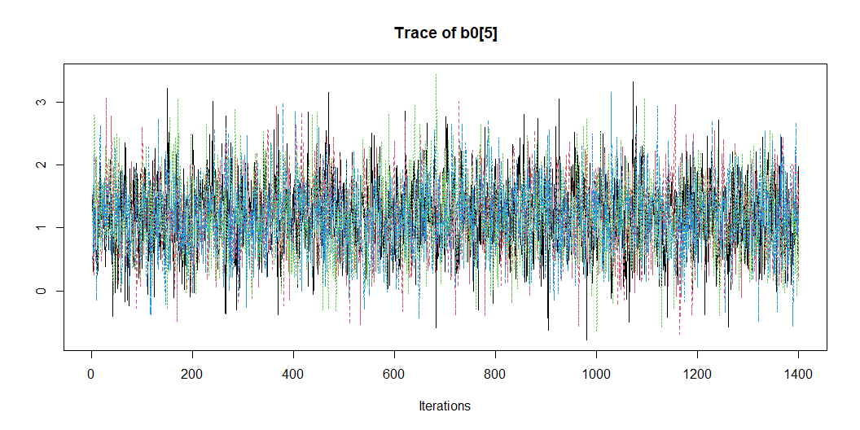

Slide 18
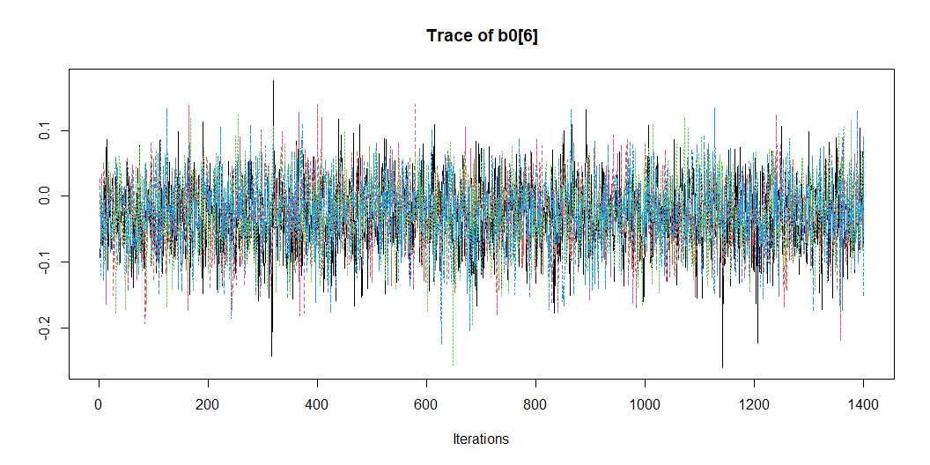

Slide 19
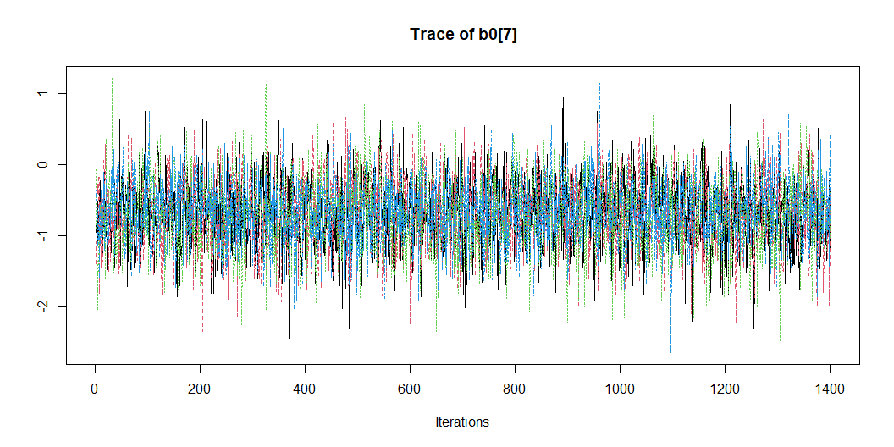

Slide 20
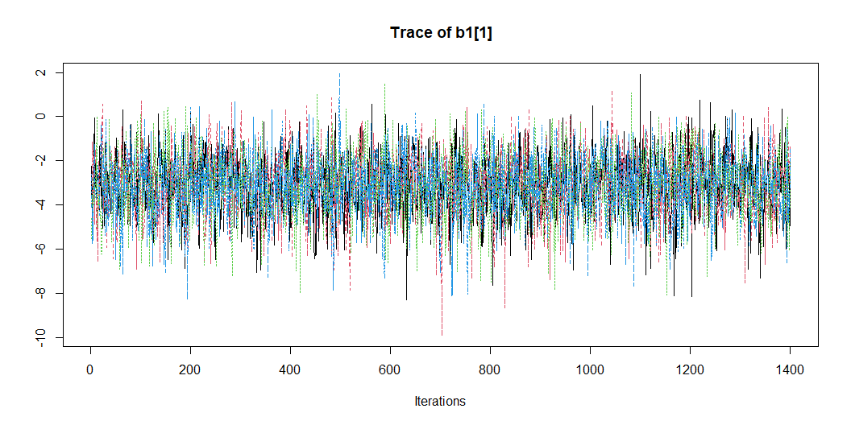

Slide 21
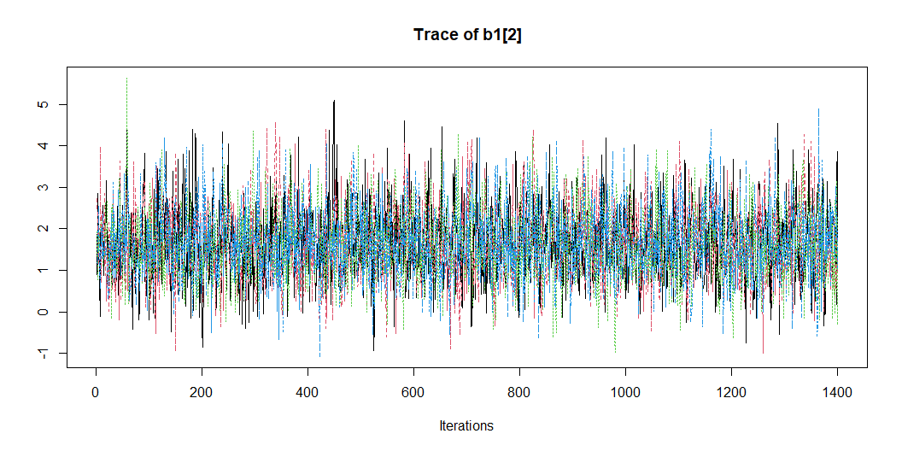

Slide 22
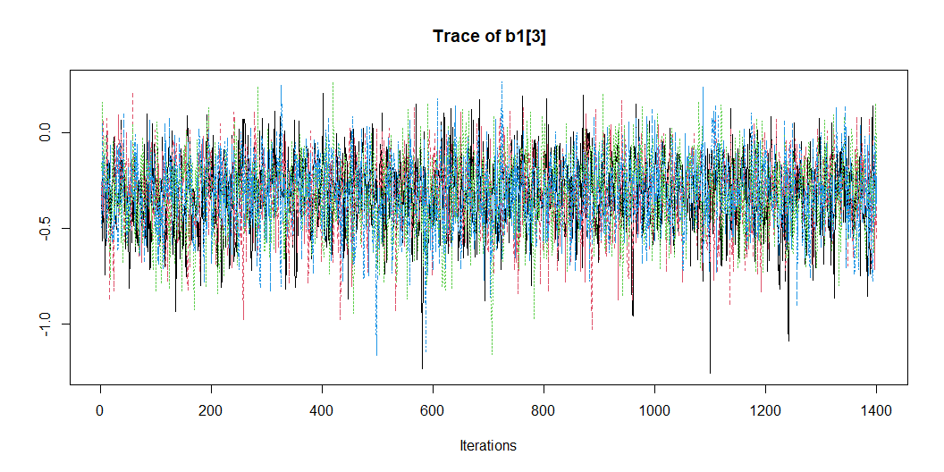

Slide 23
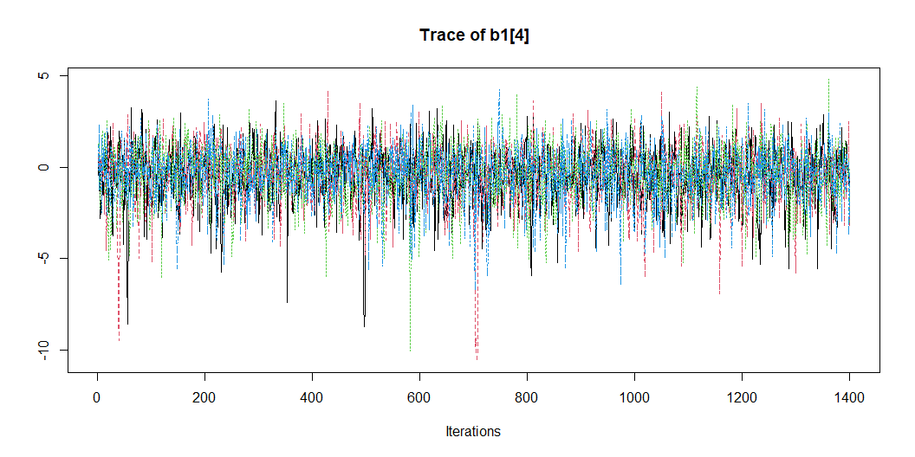

Slide 24
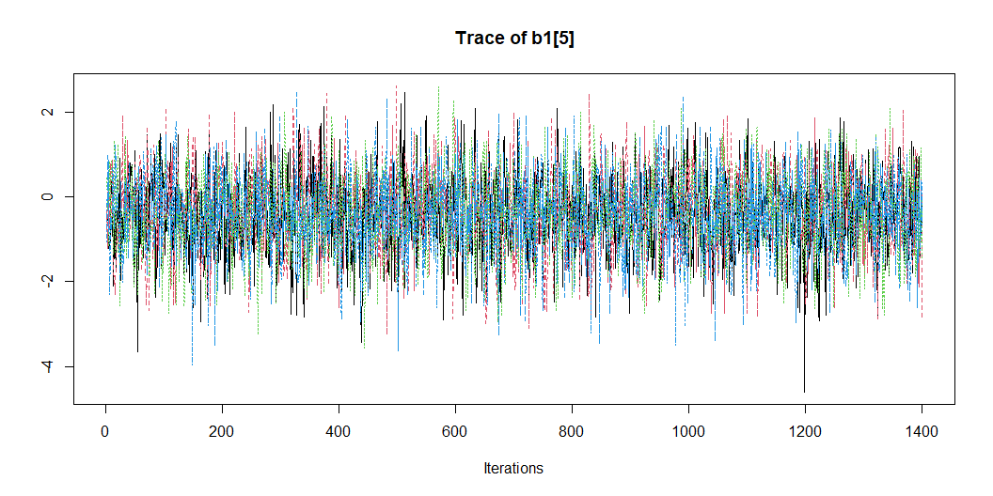

Slide 25
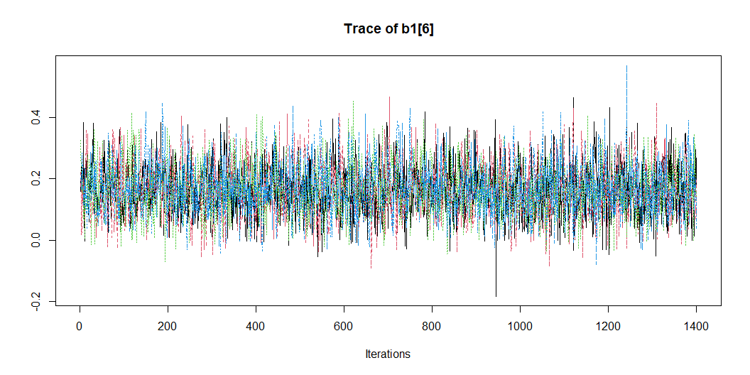

Slide 26
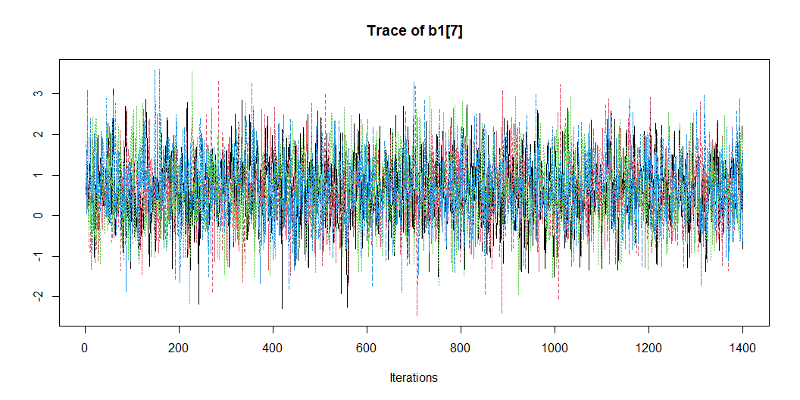

Slide 27
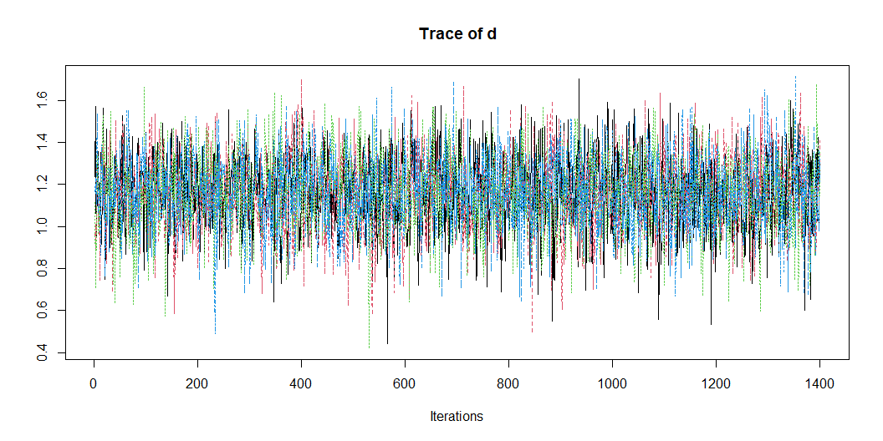

Slide 28
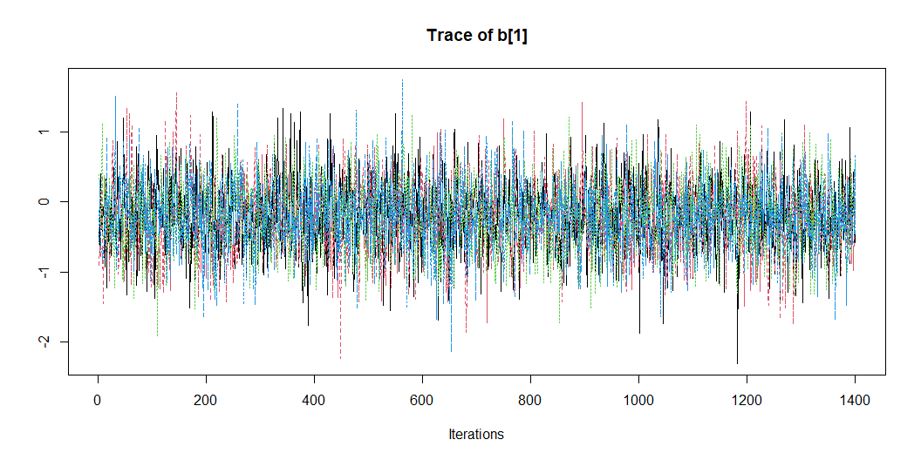
Post-op

Slide 29
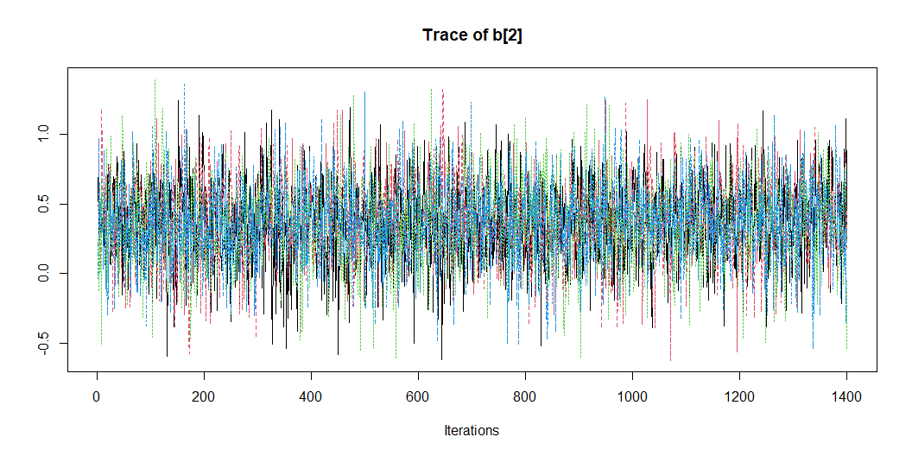

Slide 30
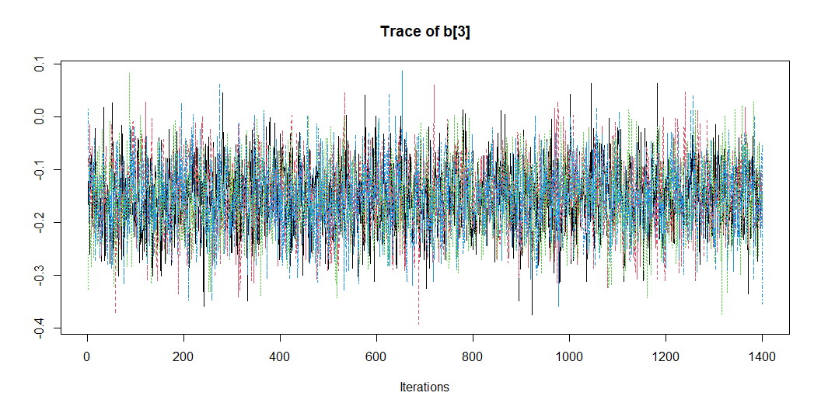

Slide 31
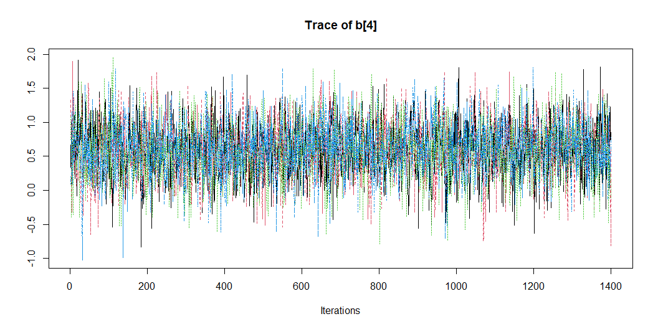

Slide 32
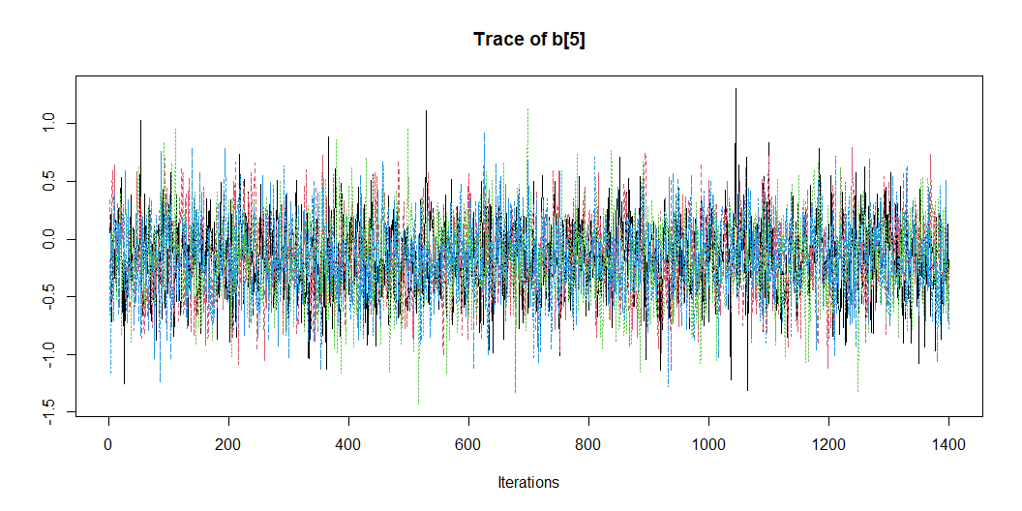

Slide 33
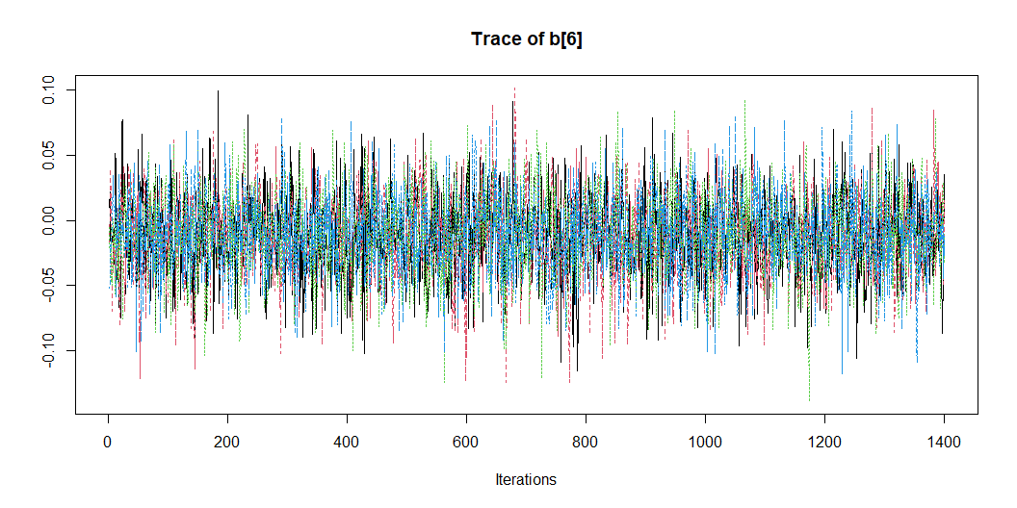

Slide 34
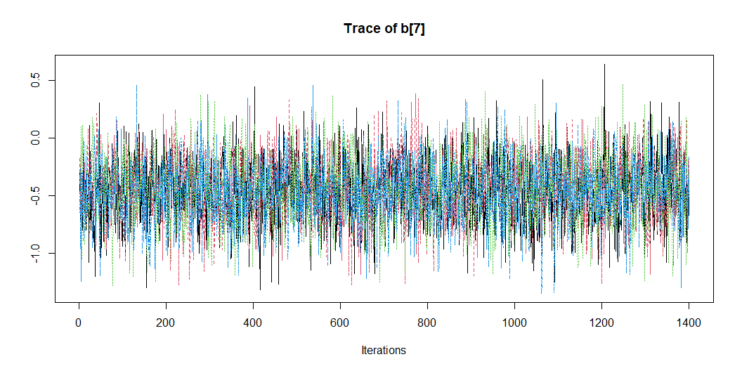

Slide 35
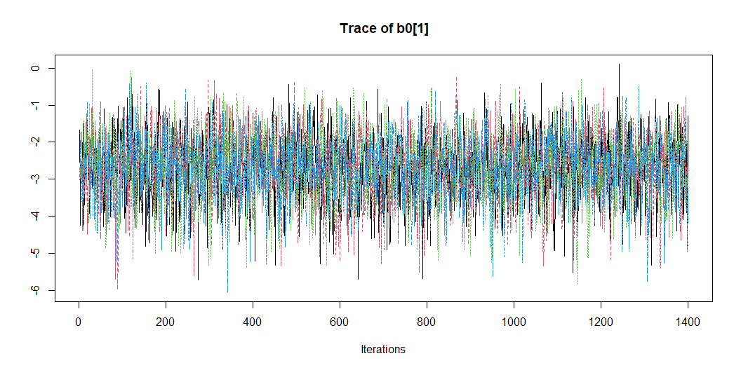

Slide 36
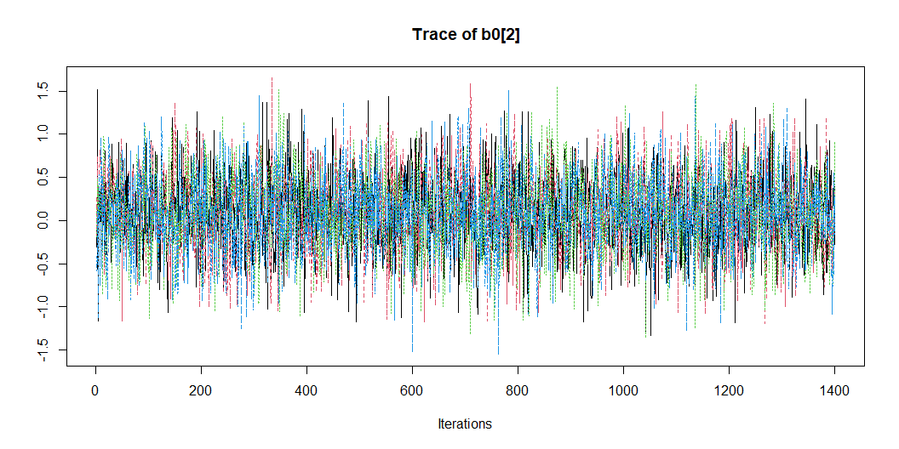

Slide 37
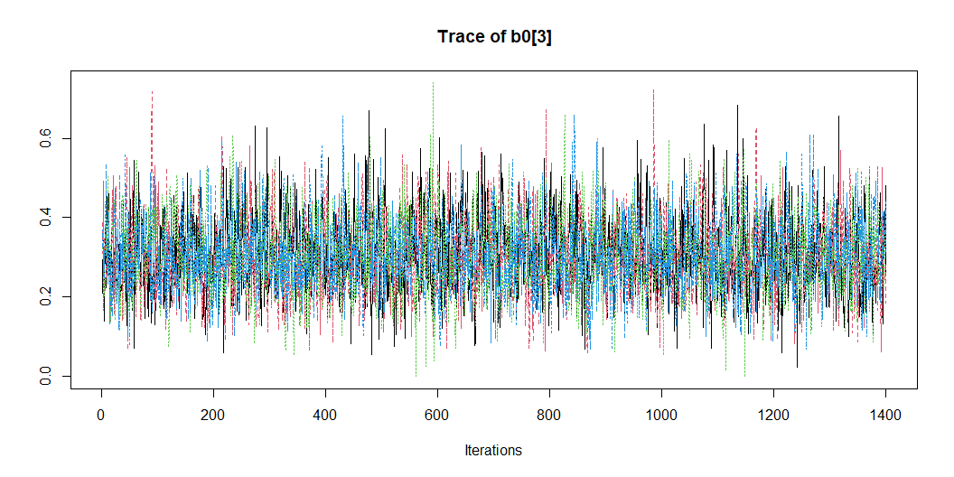

Slide 38
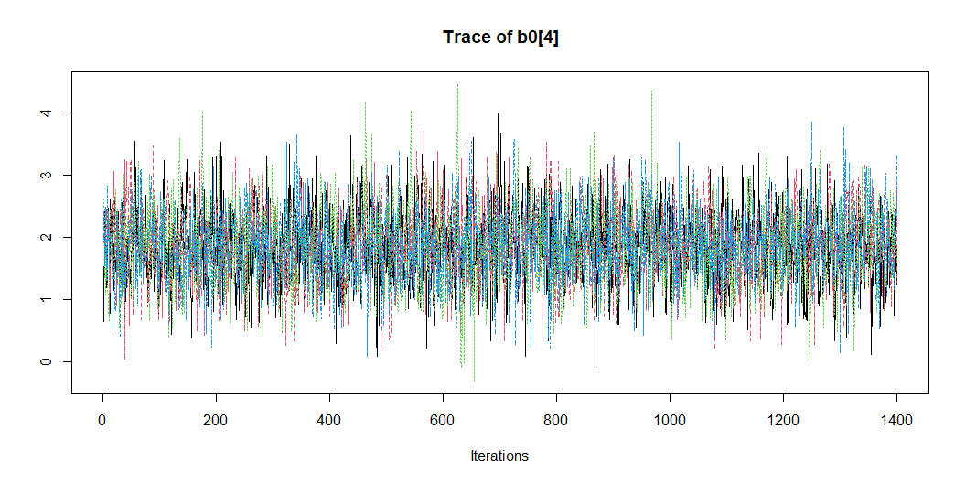

Slide 39
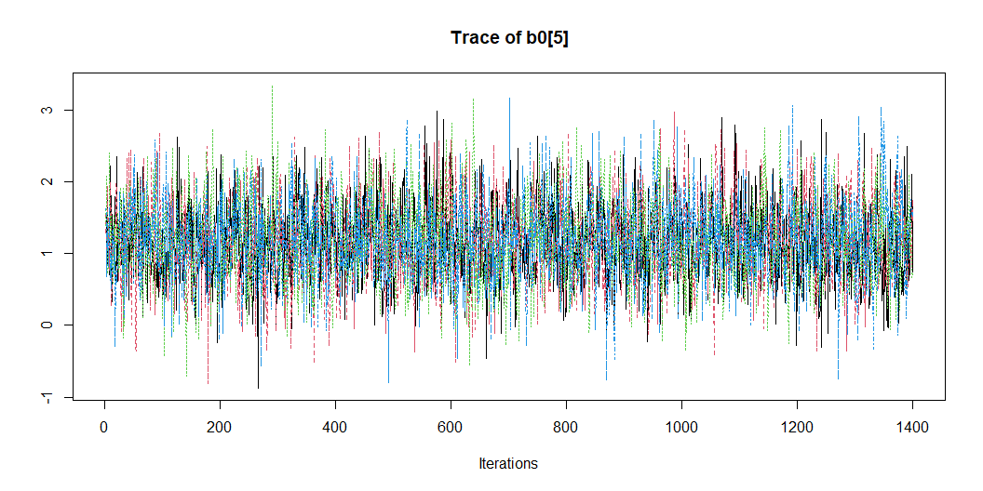

Slide 40
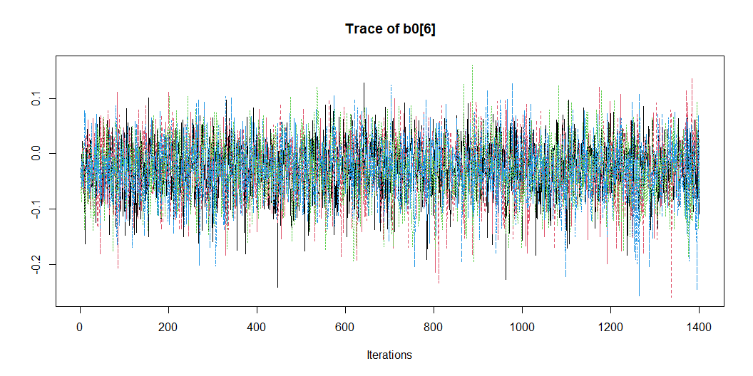

Slide 41
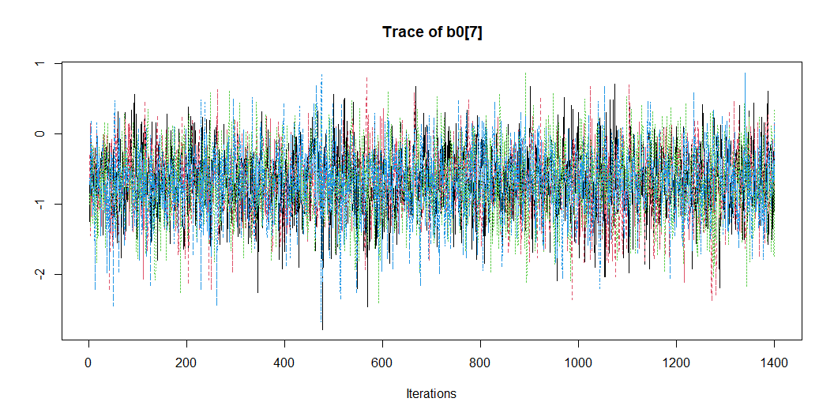

Slide 42
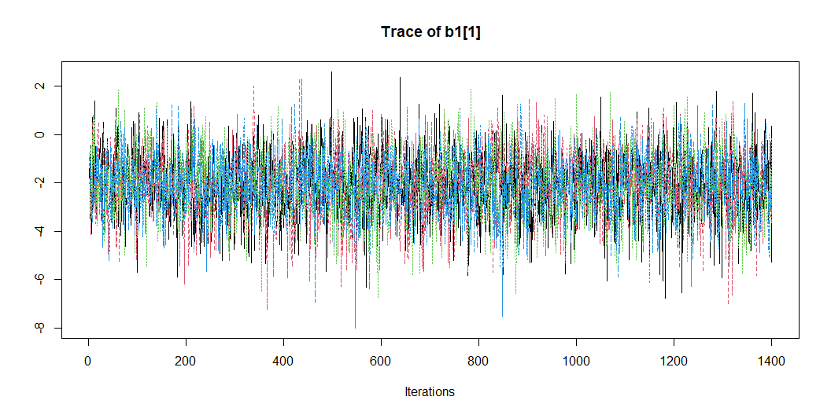

Slide 43
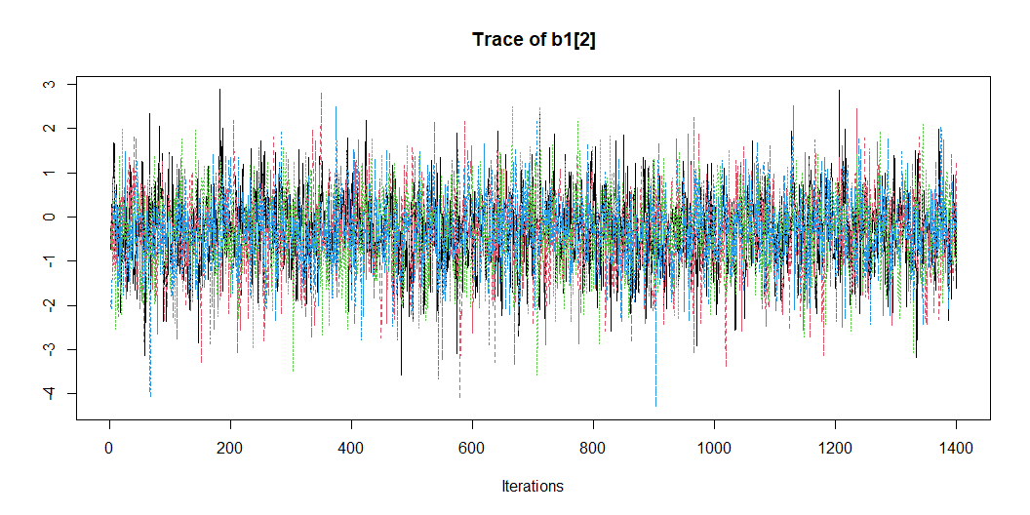

Slide 44
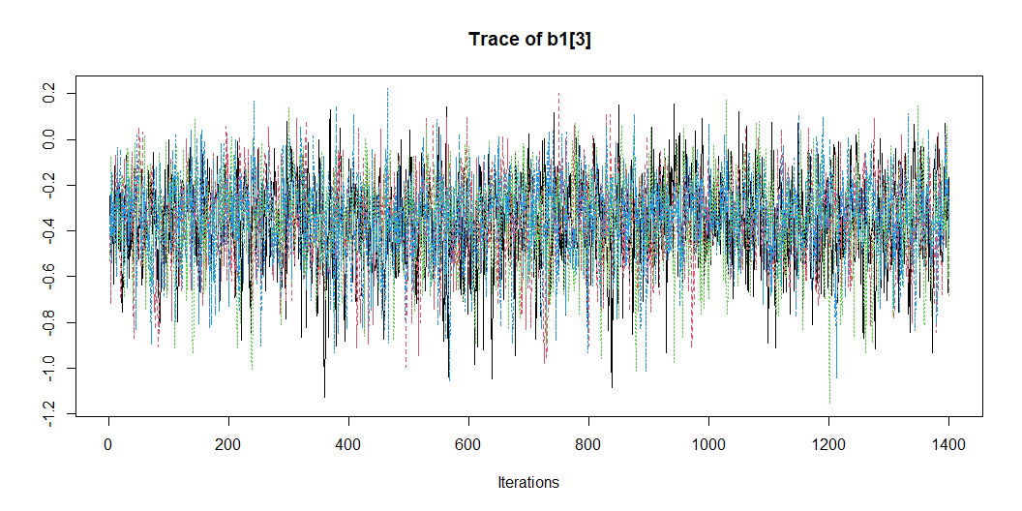

Slide 45
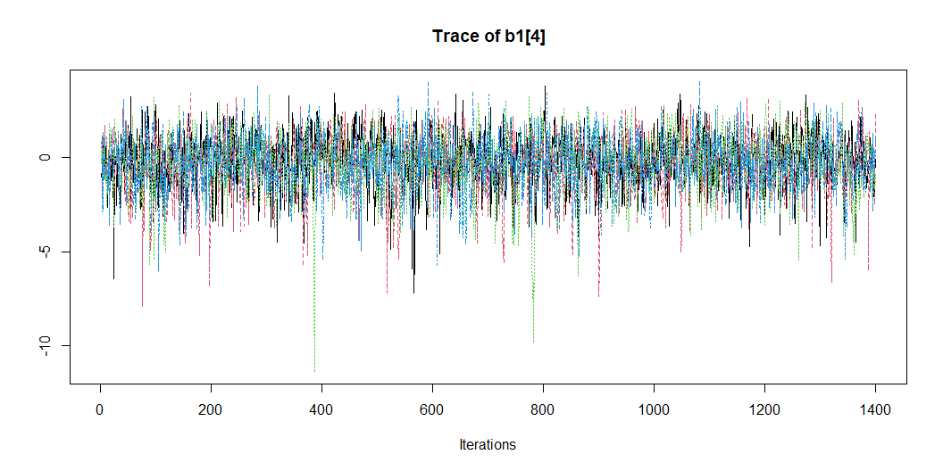

Slide 46
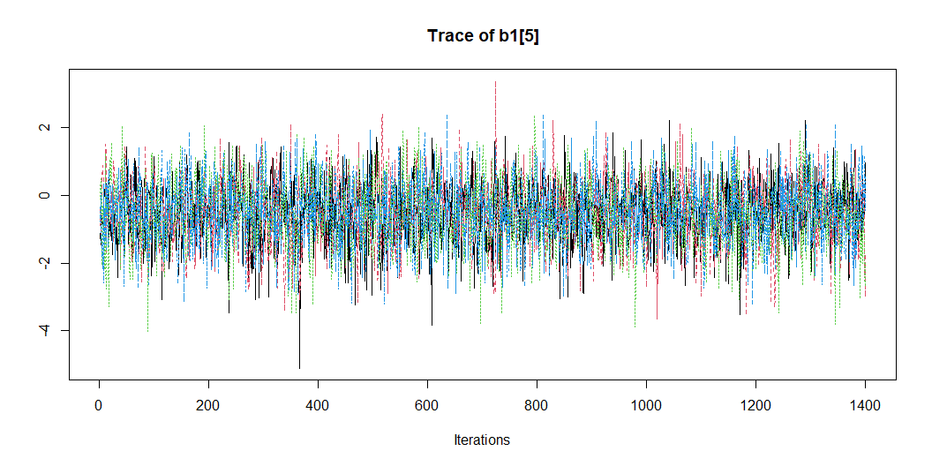

Slide 47
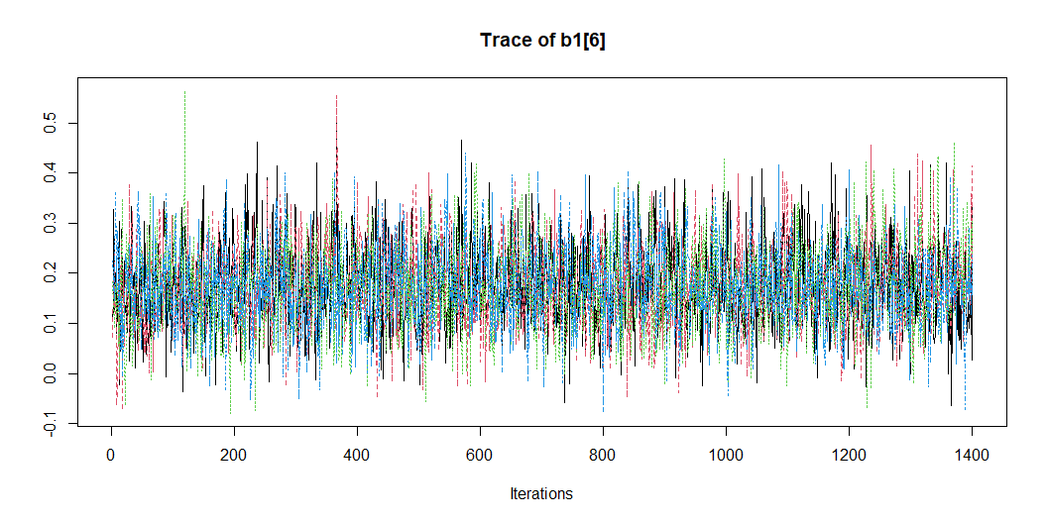

Slide 48
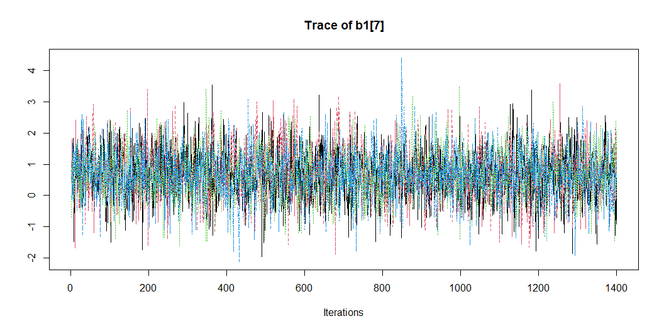

Slide 49
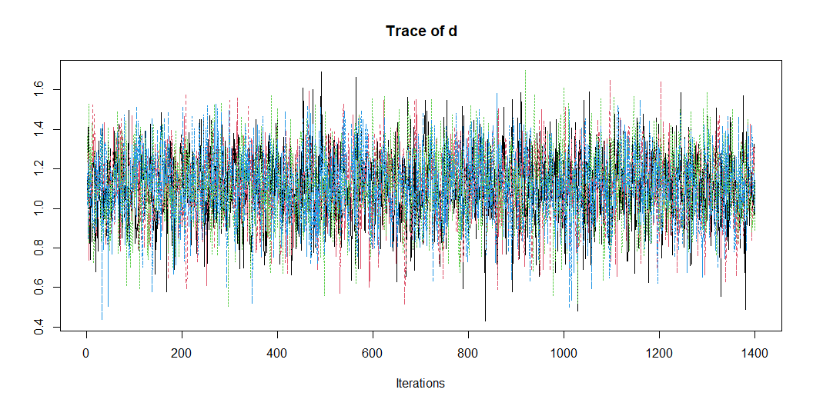

Slide 50
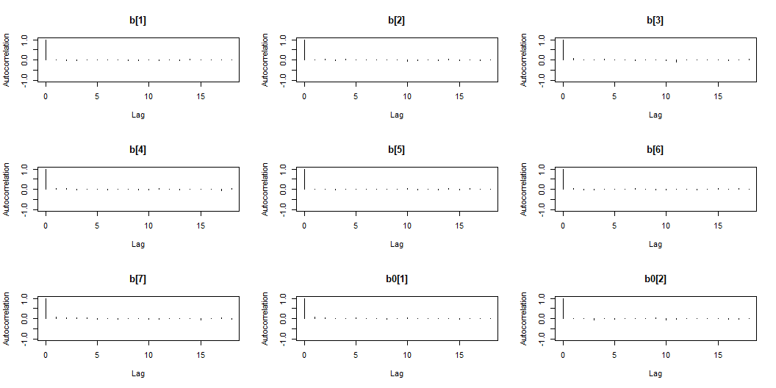
Autocorrelation plots
Pre-op

Slide 51
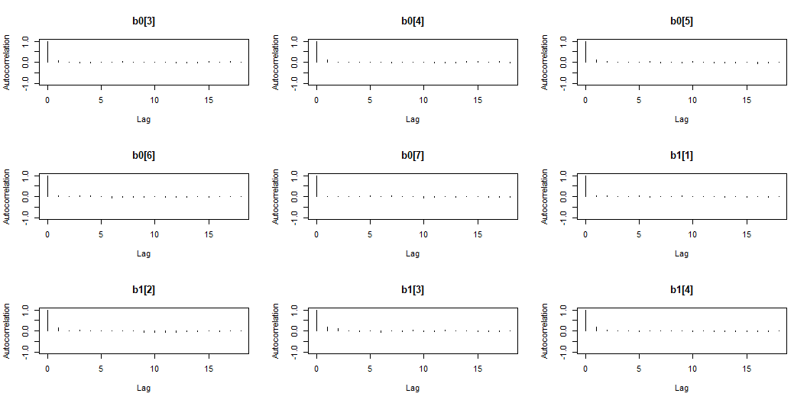

Slide 52
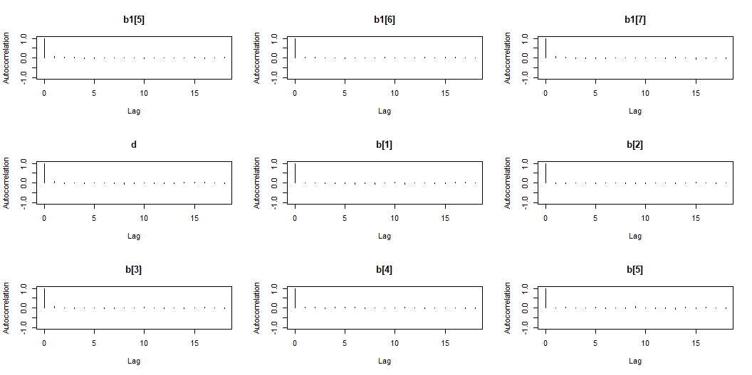

Slide 53
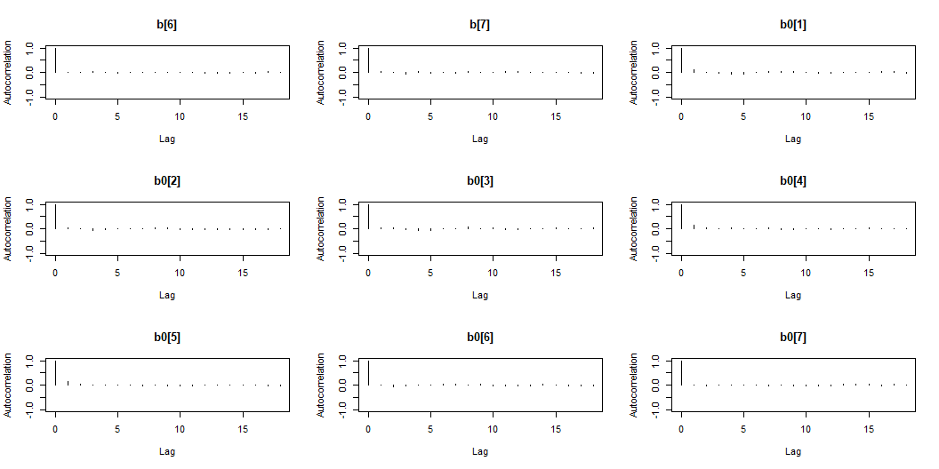

Slide 54
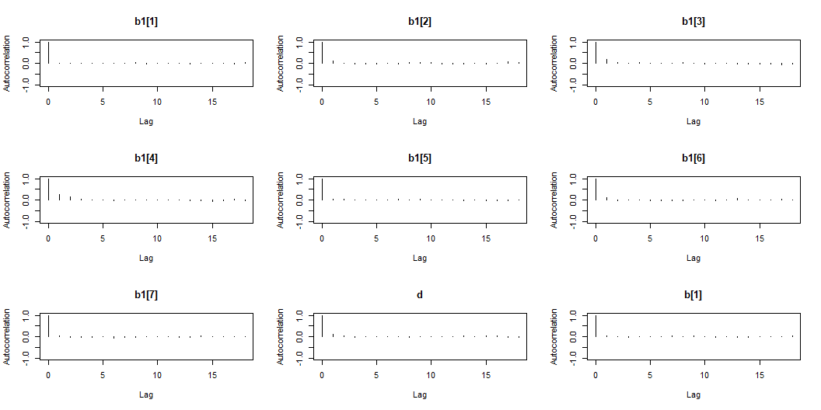

Slide 55
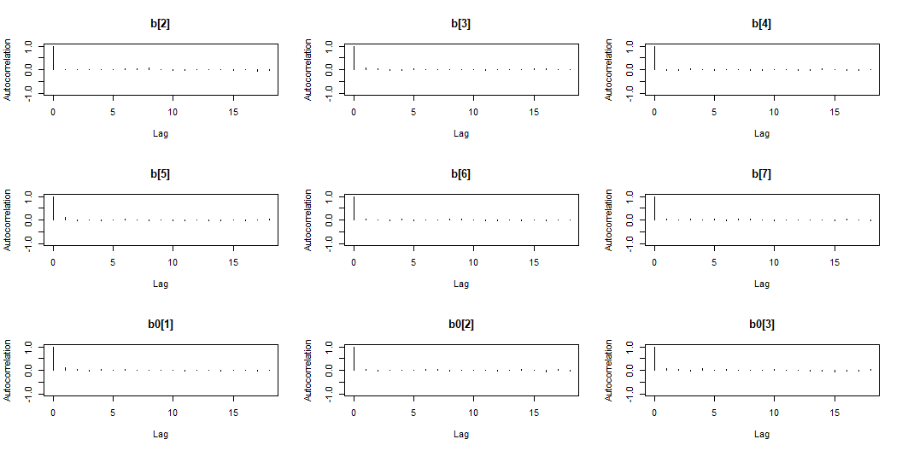

Slide 56


Slide 57


Slide 58


Slide 59


Slide 60

Post-op

Slide 61


Slide 62


Slide 63


Slide 64


Slide 65


Slide 66


Slide 67


Slide 68


Slide 69


Slide 70
Summary table

Slide 71
Pre-operation
Predictor | Odds of Oral Feed when oral feed between 0 and 1 |  |  | Odds of 0% Oral Feed |  |  | Odds of 100% Oral Feed
 | Mean | 2.5% | 97.5% | Mean | 2.5% | 97.5% | Mean | 2.5% | 97.5%
Baseline | 0.86 | 0.35 | 2.22 | 0.08 | 0.01 | 0.38 | 0.05 | 0.00 | 0.65
Attention Score | 1.68 | 0.95 | 2.93 | 0.79 | 0.29 | 2.02 | 5.15 | 1.02 | 32.39
Length of Intubation (d) | 0.87 | 0.76 | 0.98 | 1.35 | 1.13 | 1.67 | 0.72 | 0.49 | 1.03
Single Ventricle w/ Arch Obstruction | 1.59 | 0.74 | 3.32 | 6.54 | 2.08 | 22.83 | 0.66 | 0.02 | 9.69
Two Ventricles w/ Arch Obstruction | 0.85 | 0.44 | 1.62 | 3.23 | 1.07 | 10.50 | 0.66 | 0.10 | 4.08
Age | 0.97 | 0.91 | 1.03 | 0.97 | 0.87 | 1.07 | 1.18 | 1.01 | 1.40
Female | 0.65 | 0.38 | 1.12 | 0.50 | 0.18 | 1.29 | 1.87 | 0.36 | 10.29
ª Posterior variance is estimated to be 3.18 ( 2.22 , 4.49 )
Odds Ratio of Percent Oral Feed Model Results (Pre-Operation)

Slide 73
Post-operation
Predictor | Odds of Oral Feed when oral feed between 0 and 1 |  |  | Odds of 0% Oral Feed |  |  | Odds of 100% Oral Feed
 | Mean | 2.5% | 97.5% | Mean | 2.5% | 97.5% | Mean | 2.5% | 97.5%
Baseline | 0.81 | 0.30 | 2.19 | 0.07 | 0.01 | 0.34 | 0.13 | 0.01 | 1.64
Attention Score | 1.45 | 0.79 | 2.54 | 1.09 | 0.44 | 2.67 | 0.72 | 0.11 | 3.91
Length of Intubation (d) | 0.86 | 0.75 | 0.98 | 1.36 | 1.13 | 1.68 | 0.70 | 0.46 | 0.99
Single Ventricle w/ Arch Obstruction | 1.82 | 0.82 | 4.01 | 6.38 | 2.00 | 21.45 | 0.75 | 0.03 | 10.18
Two Ventricles w/ Arch Obstruction | 0.84 | 0.43 | 1.65 | 3.22 | 1.08 | 10.42 | 0.59 | 0.09 | 3.73
Age | 0.99 | 0.93 | 1.05 | 0.97 | 0.87 | 1.07 | 1.19 | 1.02 | 1.42
Female | 0.64 | 0.37 | 1.11 | 0.50 | 0.18 | 1.26 | 1.97 | 0.41 | 9.71
ª Posterior variance is estimated to be 3.04 ( 2.1 , 4.27 )
Odds Ratio of Percent Oral Feed Model Results (Post-Operation)

Slide 75
Posterior Predictive Check

Slide 76

Pre Op

Slide 77


Slide 78

Post Op

