Slide 1



Slide 2


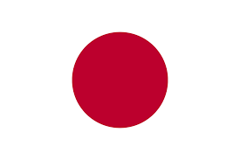
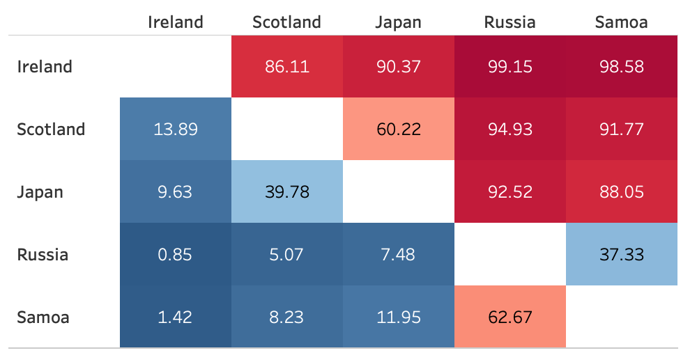
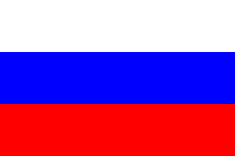


Slide 3
Finish First
Finish Second
Qualify for the QF

Slide 4



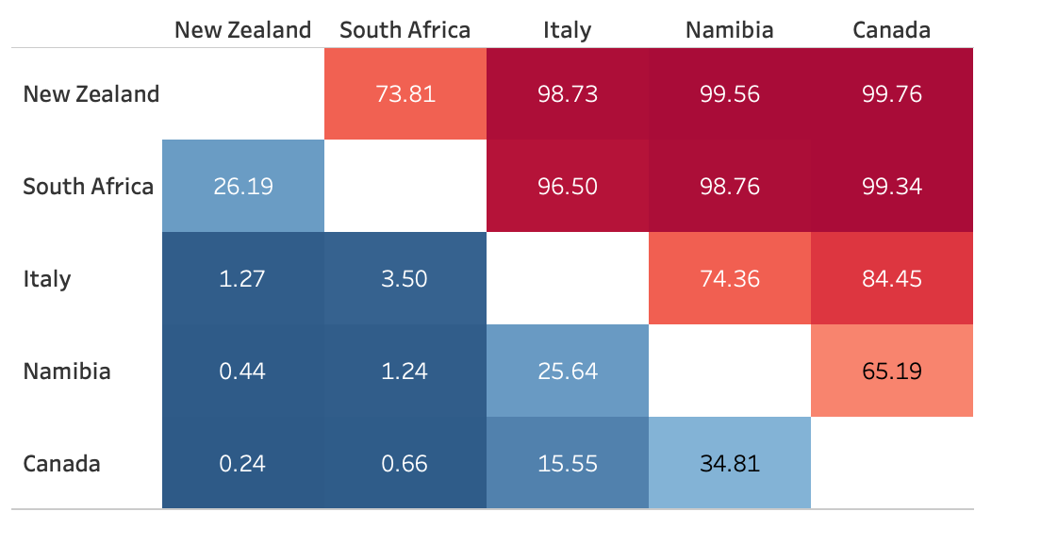



Slide 5
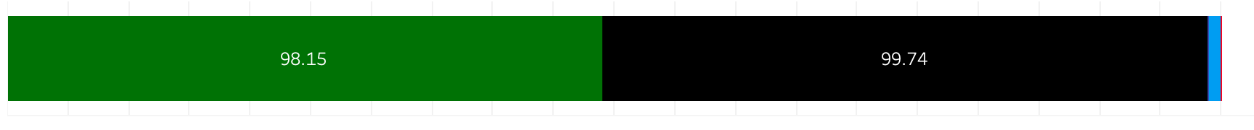
Finish First
Finish Second
Qualify for the QF

Slide 6

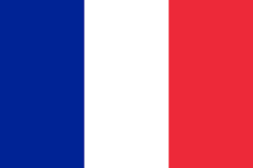

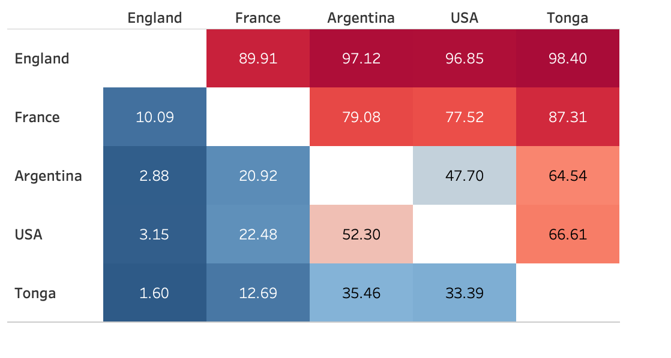



Slide 7
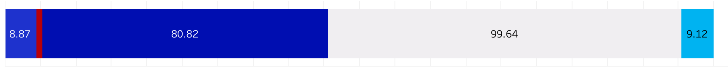
Finish First
Finish Second
Qualify for the QF

Slide 8



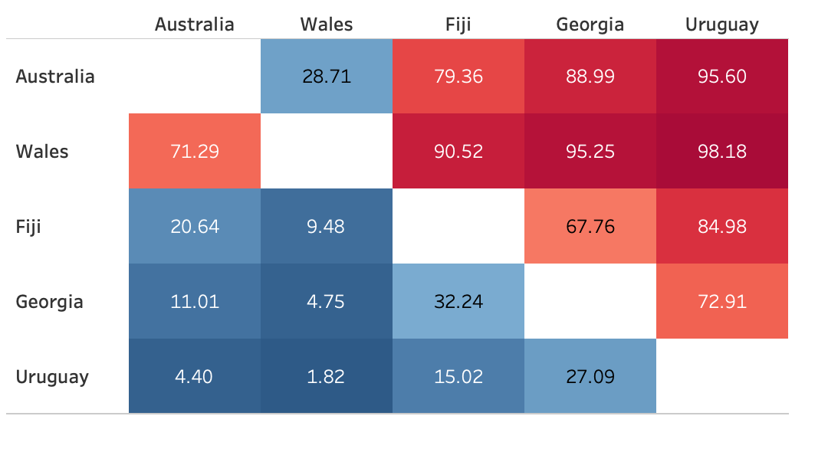



Slide 9
Finish First
Finish Second
Qualify for the QF

Slide 10
% Chance of Qualifying for Quarter-Finals
% Chance of Qualifying for Semi-Finals
% Chance of Qualifying for Final
% Chance of Winning Final

Slide 11

England 81.7%
Australia 18.3% | England 47.0%
 |  | New Zealand 57.3%
New Zealand 89.3% | New Zealand 53.0%
Scotland 11.7%
 | England 64.3% |  | New Zealand
 | Wales 35.7%
Wales 83.2%
France 16.8% | Wales 39.8%
 |  | Ireland 32.7%
Ireland 67.8% | Ireland 60.2%
South Africa 32.2%

Slide 12
Team | ELO Rating
New Zealand | 2831
England | 2810
Ireland | 2780
Wales | 2708
South Africa | 2651
Australia | 2550
Scotland | 2463
France | 2430
Fiji | 2316
Japan | 2316
USA | 2215
Argentina | 2199
Georgia | 2187
Tonga | 2095
Italy | 2075
Samoa | 2044
Uruguay | 2015
Russia | 1954
Namibia | 1890
Canada | 1781

Slide 13
Team | 1st | 2nd | 3rd | 4th | 5th | Qualify QF | QF Winner | SF Winner | Finish 4th | Finish 3rd | Runner-up | Winner
New Zealand | 75.244 | 24.515 | 0.24 | 0.001 | 0 | 99.759 | 80.366 | 49.948 | 8.665 | 21.753 | 19.07 | 30.878
England | 93.604 | 6.02 | 0.357 | 0.016 | 0.003 | 99.624 | 77.114 | 43.787 | 9.942 | 23.385 | 17.208 | 26.579
Ireland | 89.017 | 9.583 | 1.38 | 0.02 | 0 | 98.6 | 60.186 | 41.013 | 8.14 | 11.033 | 20.729 | 20.284
Wales | 63.649 | 33.412 | 2.738 | 0.195 | 0.006 | 97.061 | 65.585 | 29.453 | 18.198 | 17.934 | 17.279 | 12.174
South Africa | 24.726 | 73.444 | 1.793 | 0.037 | 0 | 98.17 | 45.461 | 21.261 | 13.072 | 11.128 | 14.024 | 7.237
Australia | 34.946 | 52.152 | 10.989 | 1.81 | 0.103 | 87.098 | 34.773 | 8.835 | 17.551 | 8.387 | 6.779 | 2.056
Scotland | 7.824 | 61.13 | 27.966 | 2.919 | 0.161 | 68.954 | 10.558 | 2.081 | 6.203 | 2.274 | 1.692 | 0.389
France | 5.828 | 74.974 | 12.861 | 5.69 | 0.647 | 80.802 | 19.547 | 2.959 | 13.395 | 3.193 | 2.618 | 0.341
Japan | 3.142 | 28.417 | 61.771 | 6.132 | 0.538 | 31.559 | 3.364 | 0.459 | 2.282 | 0.623 | 0.406 | 0.053
Fiji | 1.182 | 10.972 | 46.347 | 36.709 | 4.79 | 12.154 | 1.267 | 0.122 | 0.947 | 0.198 | 0.117 | 0.005
USA | 0.313 | 8.611 | 30.843 | 43.398 | 16.835 | 8.924 | 0.738 | 0.036 | 0.659 | 0.043 | 0.034 | 0.002
Argentina | 0.227 | 8.924 | 44.275 | 31.135 | 15.439 | 9.151 | 0.719 | 0.032 | 0.658 | 0.029 | 0.03 | 0.002
Tonga | 0.028 | 1.471 | 11.664 | 19.761 | 67.076 | 1.499 | 0.073 | 0.002 | 0.068 | 0.003 | 0.002 | 0
Italy | 0.028 | 1.821 | 76.347 | 17.998 | 3.806 | 1.849 | 0.051 | 0.002 | 0.048 | 0.001 | 0.002 | 0
Georgia | 0.213 | 3.27 | 36.035 | 44.399 | 16.083 | 3.483 | 0.183 | 0.01 | 0.157 | 0.016 | 0.01 | 0
Samoa | 0.015 | 0.704 | 6.202 | 49.957 | 43.122 | 0.719 | 0.01 | 0 | 0.01 | 0 | 0 | 0
Namibia | 0.002 | 0.19 | 16.278 | 57.662 | 25.868 | 0.192 | 0.002 | 0 | 0.002 | 0 | 0 | 0
Russia | 0.002 | 0.166 | 2.681 | 40.972 | 56.179 | 0.168 | 0.002 | 0 | 0.002 | 0 | 0 | 0
Uruguay | 0.01 | 0.194 | 3.891 | 16.887 | 79.018 | 0.204 | 0.001 | 0 | 0.001 | 0 | 0 | 0
Canada | 0 | 0.03 | 5.342 | 24.302 | 70.326 | 0.03 | 0 | 0 | 0 | 0 | 0 | 0

Slide 14
 | Team | 1st | 2nd | 3rd | 4th | 5th | Q | QW | Q1 | Q2 | Q3 | Q4 | SW | S1 | S2 | 3L | 3W | Runner-up | W
1 | Australia | 0 | 100 | 0 | 0 | 0 | 100 | 17.58 | 17.58 | 0 | 0 | 0 | 3.379 | 3.379 | 0 | 8.352 | 5.849 | 2.292 | 1.087
3 | England | 100 | 0 | 0 | 0 | 0 | 100 | 82.42 | 82.42 | 0 | 0 | 0 | 42.521 | 42.521 | 0 | 10.332 | 29.567 | 14.294 | 28.227
5 | France | 0 | 100 | 0 | 0 | 0 | 100 | 15.817 | 0 | 0 | 15.817 | 0 | 5.101 | 0 | 5.101 | 8.988 | 1.728 | 4.422 | 0.679
7 | Ireland | 0 | 100 | 0 | 0 | 0 | 100 | 32.122 | 0 | 32.122 | 0 | 0 | 13.685 | 13.685 | 0 | 6.735 | 11.702 | 6.406 | 7.279
9 | Japan | 100 | 0 | 0 | 0 | 0 | 100 | 24.465 | 0 | 0 | 0 | 24.465 | 4.921 | 0 | 4.921 | 16.58 | 2.964 | 4.371 | 0.55
11 | New Zealand | 100 | 0 | 0 | 0 | 0 | 100 | 67.878 | 0 | 67.878 | 0 | 0 | 40.415 | 40.415 | 0 | 6.35 | 21.113 | 12.297 | 28.118
15 | South Africa | 0 | 100 | 0 | 0 | 0 | 100 | 75.535 | 0 | 0 | 0 | 75.535 | 31.008 | 0 | 31.008 | 29.472 | 15.055 | 22.05 | 8.958
19 | Wales | 100 | 0 | 0 | 0 | 0 | 100 | 84.183 | 0 | 0 | 84.183 | 0 | 58.97 | 0 | 58.97 | 13.191 | 12.022 | 33.868 | 25.102

Slide 15
England 81.7%
Australia 18.3% | England 47.0%
 |  | New Zealand 57.3%
New Zealand 89.3% | New Zealand 53.0%
Scotland 11.7%
 | England 64.3% |  | New Zealand
 | Wales 35.7%
Wales 83.2%
France 16.8% | Wales 39.8%
 |  | Ireland 32.7%
Ireland 67.8% | Ireland 60.2%
South Africa 32.2%

Slide 16
QF
82.42%
17.58%
SF
42.52%
3.38%
40.42%
13.69%
3rd
29.58%
5.85%
21.11%
11.70%
12.02%
1.73%
2.96%
15.06%
28.23%
1.09%
28.12%
7.28%
25.10%
.68%
.55%
8.96%
67.88%
32.12%
84.18%
15.82%
58.97%
5.10%
4.92%
31.01%
24.47%
75.53%

