Slide 1
SQL2016/SQL2014/SQL2012 AlwaysOn Availability Groups
Automated Installing and Configuration Across Multiple Datacenters
=tg= Thomas Grohser, NTT Data
SQL Server MVP
SQL Server Performance Engineering
SQL Saturday #465 Providence, RI
December 12, 2015

Slide 2



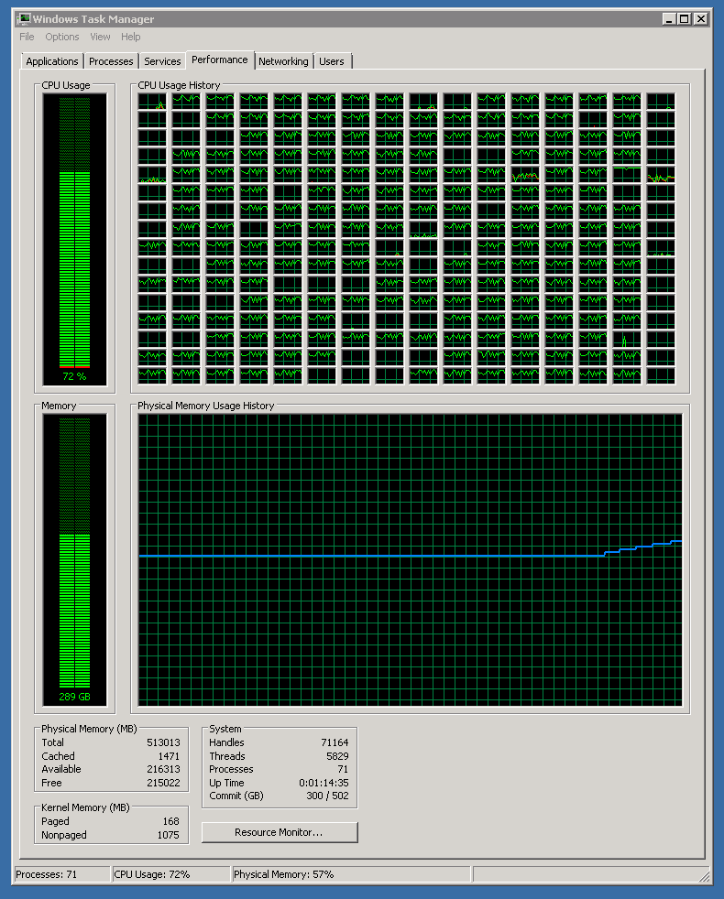


select * from =tg= where topic =
=tg= Thomas Grohser,
NTT DATA
Senior Director Technical Solutions Architecture
email: tg@grohser.com
Focus on SQL Server Security, Performance Engineering,
Infrastructure and Architecture
New white papers on security coming early 2016!
Close Relationship with
SQLCAT (SQL Server Customer Advisory Team)
SCAN (SQL Server Customer Advisory Network)
TAP (Technology Adoption Program)
Product Teams in Redmond
Active PASS member and
PASS Summit Speaker
@@Version | Remark
SQL 4.21 | First SQL Server ever used (1994)
SQL 6.0 | First Log Shipping with failover
SQL 6.5 | First SQL Server Cluster (NT4.0 + Wolfpack)
SQL 7.0 | 2+ billion rows / month in a single Table
SQL 2000 | 938 days with 100% availability
SQL 2000 IA64 | First SQL Server on Itanium IA64
SQL 2005 IA64 | First OLTP long distance database mirroring
SQL 2008 IA64 | First Replication into mirrored databases
SQL 2008R2 IA64 SQL 2008R2 x64 | First 256 CPUs & >500.000 STMT/sec First Scale out > 1.000.000 STMT/sec First time 1.2+ trillion rows in a table
SQL 2012 | > 220.000 Transactions per second > 1.3 Trillion Rows in a table
SQL 2014 | > 400.000 Transactions per second Fully automated deploy and management AlwaysOn Automatic HA and DR
SQL 2016 | Can’t wait to raise the bar again
22 Years with SQL Server

Slide 3
NTT DATA Overview
20,000 professionals – Optimizing balanced global delivery
$1.6B – Annual revenues with history of above-market growth
Long-term relationships – >1,000 clients; mid-market to large enterprise
Delivery excellence – Enabled by process maturity, tools and accelerators
Flexible engagement – Spans consulting, staffing, managed services, outsourcing, and cloud
Industry expertise – Driving depth in select industry verticals
Why NTT DATA for MS Services:
NTT DATA is a Microsoft Gold Certified Partner. We cover the entire MS Stack, from applications to infrastructure to the cloud
Proven track record with 500+ MS solutions delivered in the past 20 years

Slide 4

Drawing at the end of the session
Drop your business card or fill out provided blank card and drop in the red bag
Must be present at the time of drawing at the end of the session to win:

Slide 5
My favorite SQL 2008R2 / 2012 / 2014 / 2016 feature

Slide 6
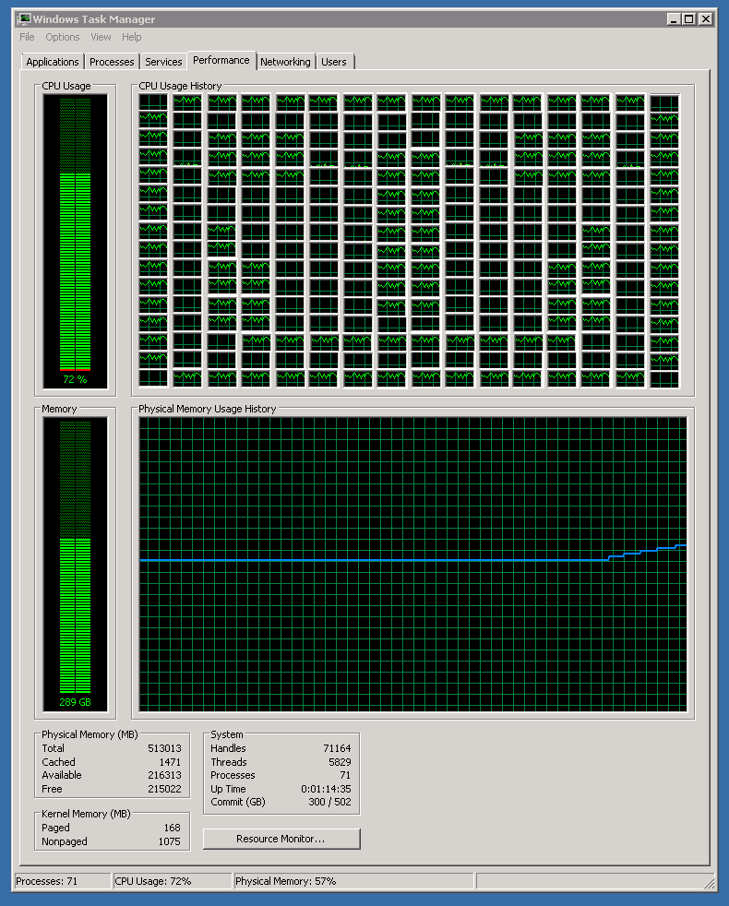
CREATE INDEX WITH A SMILE

Slide 7
Agenda
Setting the Goal
A quick History on HA/DR
AlwaysOn Availability Groups Across Datacenters
When and how Automation makes sense
The Details
Q&A
ATTENTION: Important Information may be displayed on any slide at any time!
! Without Warning !

Slide 8
Setting the Goal
BTW: It took 22 years to prepare this talk…

Slide 9
Setting the Goal
I like to sleep at night, all night long
I like to do interesting work during the day
Automatic failover in case of component failure (HA)
Automatic failover in case of datacenter failure (DR)
Both fully transparent to the applications so nobody calls me with I can’t get to the database…
Automatic Installation so I don’t spend all day watching progress bars

Slide 10
A Quick History on HA/DR

Slide 11
Once Upon a Time…
SQL 4.21
You could have a stand alone server
Take backups (full and log)
Restore them with your own scripts to a standby server

Slide 12
Once Upon a Time…
SQL 6.0
Introduced Log Shipping
With a good network connection (like 256kbit/s you could even do it across datacenters)
Source and target server are independent
Failover tedious manual process

Slide 13
Once Upon a Time…
SQL 6.5
Introduced Clustering
Not fun with the shared direct attached SCSI drives and power on and off instructions
Biggest issue the most important component (data) is the only one that does not exists twice
Only useable with both nodes next to each other as a HA solution (less than 10 feet) conducting cables between them.
Clustering as HA and Log Shipping as DR could be combined.

Slide 14
Once Upon a Time…
SQL 7.0
Made Clustering useful
Support for Fiber Channel Disk Arrays
Only useable with both nodes next to each other as a HA solution. Enhancements: the distance was now up to 300 feet
Clustering as HA and Log Shipping as DR could be combined.

Slide 15
Once Upon a Time…
SQL 2000
Cross datacenter clustering became possible
Support for Fiber Channel Disk Arrays that have storage replication (needed special support from storage vendor). Extreme $$$$
Needed a layer 2 network connection between the datacenters (IP’s from the same subnet in both datacenters – big issues with default gateways)

Slide 16
Once Upon a Time…
SQL 2005
Introduced Database Mirroring
Works great across datacenters, can be combined with Log Shipping and/or Clustering
Special connection string and witness in third location required for automatic failover
Cluster (HA) / Mirror (DR):
Problem that mirror failover was faster than cluster failover so DR happened before HA
Mirror (HA) / Log Shipping (DR):
Connection string for automatic failover needed changing in case of DR

Slide 17
Once Upon a Time…
SQL 2008 and SQL 2008 R2
NOTHING … ☹
See my 2008 PASS Summit presentation on how to get to the goal:
Failure is not an option, 24x7 OLTP Database Management for VLDB

Slide 18
Once Upon a Time…
SQL 2012
Introduced AlwaysOn
Combines Clustering and Database Mirroring
AlwaysOn Failover Cluster Instance (FCI)
AlwaysOn Availability Groups (AG)
Multiple Replicas (1 x Sync / 3 x Async)
Readable Replicas

Slide 19
Once Upon a Time…
SQL 2014
A few enhancements to AlwaysOn
More Replicas (1 x Sync, 6 x Async)
The Cloud …
SQL 2016
Even More Replicas (2 x Sync)
The first version that will support our goal out of the box
It took only 22 years … to get a good nights sleep

Slide 20
AlwaysOn Availability Groups Across Datacenters

Slide 21
How does it work
AlwaysOn uses an enhanced version of Database Mirroring to create multiple replicas of the database(s) on multiple servers
Windows failover clustering is used to move the network name and/or the IP address to access the databases from server to server
Fancy Name
Multi Subnet Majority Node Set Cluster

Slide 22
How does it work
Simple 2 node setup in the same datacenter
Virtual Server SQL01
IP: 10.0.1.3
Server A
IP: 10.0.1.1
Server B
IP: 10.0.1.2
Mirroring

Slide 23
How does it work
Adding a node in the second datacenter
Virtual Server SQL01
IP: 10.0.1.3 / 10.0.2.3
Virtual Server SQL01
IP: 10.0.1.3 / 10.0.2.3
Server A
IP: 10.0.1.1
Server B
IP: 10.0.1.2
Server C
IP: 10.0.2.1
Mirroring
Mirroring

Slide 24
How does it work
Full dual datacenter setup
Virtual Server SQL01
IP: 10.0.1.3 / 10.0.2.3
Server A
IP: 10.0.1.1
Server B
IP: 10.0.1.2
Server C
IP: 10.0.2.1
Server D
IP: 10.0.2.2
Mirroring
Mirroring
Mirroring

Slide 25
When and How Automation makes Sense

Slide 26
Not so fast ...
Before you can automate you must standardize
Options and features supported.
Sizes of the machines (Virtual or Physical)
Naming Conventions
IP Usage
File locations
….
And document it all (not kidding)

Slide 27
Not so fast ... (Part 2)
Decide on the level of automation
None (just go with the documentation and runbooks)
Might be fine with very small numbers of instances or if your company likes to employ a lot of people
Write scripts and run them on each machine
Good way to start and works for numbers of servers in the double digits
Have a central database (CMDB) that holds configuration and scripts that use it on each machine
Scales well into the triple digits
Also automate the VM layer
A must when you start hitting four digits
Also automate the physical layer
You work for Microsoft Azure, Amazon AWS, …

Slide 28
The Details

Slide 29
The Details / Assumptions
You got 5 Servers in Datacenter IP IP Mask
ServerA DCA 10.0.1.1 255.255.255.0
ServerB DCA 10.0.1.2 255.255.255.0
ServerC DCB 10.0.2.1 255.255.255.0
ServerD DCB 10.0.2.2 255.255.255.0
File DCC 10.0.3.1 255.255.255.0
All servers are joined to the Active Directory domain “Skynet”
All servers have disks configured
Additional IP’s to use for Installation
10.0.1.3 / 255.255.255.0
10.0.1.4 / 255.255.255.0
10.0.2.3 / 255.255.255.0
10.0.2.4 / 255.255.255.0
Your Account is local admin on all machines
You have a service account (svc_SQL) for SQL Server also local admin on all machines
The service account password is “TopSecret007”
The sa password will be “007TopSecret”
Both accounts can create a virtual computer object in AD
Carbon is downloaded http://get-carbon.org/ and in C:\Carbon
SQL Server Install Media is in C:\SQL\Install
File Server has a file share called ClusterFileShareWitness that is permissioned to full control for the two accounts
We will use
SQL01 as the name of the Cluster
SQL01AG01 as the name of our Availability Group

Slide 30
The Details / The Solution
File Share in 3rd Location
IP: 10.0.3.1
Virtual Server SQL01
IP: 10.0.1.3 / 10.0.2.3
Server A
IP: 10.0.1.1
Server B
IP: 10.0.1.2
Server C
IP: 10.0.2.1
Server D
IP: 10.0.2.2
Mirroring
Mirroring
Mirroring

Slide 31
The Details / Getting Windows Ready
PowerShell Script – Run on every machine
$ClusterInstalled = Get-WindowsFeature –Name “Failover-Clustering”
if ($ClusterInstalled.InstallState –ne “Installed”)
{
Install-WindowsFeature –Name Failover-Clustering -IncludeManagementTools
}
$DotNetInstalled = GetWindowsFeature –Name “Net-Framework-Features”
If ($DotNetInstalled.InstallState –ne “Installed”)
{
Install-WindowsFeature –Name Net-Framework-Features -IncludeManagementTools
}
& ‘C:\Carbon\Import-Carbon.ps1’
Grant-Privilege –Identity “SKYNET\svc_SQL” –Privilege SeManageVolumePrivilege
Grant-Privilege –Identity “SKYNET\svc_SQL” –Privilege SeLockMemoryPrivilege
Grant-Privilege –Identity “SKYNET\svc_SQL” –Privilege SeServiceLogonRight
Grant-Privilege –Identity “SKYNET\svc_SQL” –Privilege SeImpersonatePrivilege

Slide 32
The Details / Create Cluster
PowerShell Script – Run on first node
$Cluster = Get-Cluster –Name “SQL01”
–ErrorAction SilentlyContinue
if ($Cluster.Name –ne “SQL01”)
{
New-Cluster –Name “SQL01”
–Node “ServerA”
–StaticAddress “10.0.1.3”
–NoStorage
Set-ClusterQuorum –Cluster “SQL01”
–NodeAndFileShareMajority “\\File\ClusterFileShareWitness”
}

Slide 33
The Details / Add more nodes
Wait at least 15 minutes for AD to replicate cluster objects
Adding a cluster node in same datacenter
PowerShell Script - Run on each additional node in the same datacenter
Add-ClusterNode –Cluster “SQL01”
–Name “ServerB”
–NoStorage

Slide 34
The Details / Add more nodes
Adding a cluster node in second datacenter
PowerShell Script - Run on each node in second datacenter
Add-ClusterNode –Cluster “SQL01”
–Name “ServerC” # “ServerD”
–NoStorage
Add-ClusterResource –Name “Cluster IP DR”
–ResourceType “IP Address”
–Group “Cluster Group”
–Cluster “SQL01”
$res = Get-ClusterResource –Name “Cluster IP DR”
–Cluster “SQL01”
$p1 = New-Object Microsoft.FailoverCluster.PowerShell.ClusterParameter $res,Address,”10.0.2.3” # “10.0.2.4”
$p2 = New-Object Microsoft.FailoverCluster.PowerShell.ClusterParameter $res,SubnetMask,”255.255.255.0”
$p3 = New-Object Microsoft.FailoverCluster.PowerShell.ClusterParameter $res,Network,”Cluster Network 2”
$p = $p1,$p2,$p3
$p | Set-ClusterParamter –Cluster “SQL01”
Set –ClusterResourceDependency –Cluster “SQL01”
–Resource “Cluster Name”
–Dependency “[Cluster IP Address] OR [Cluster IP DR]”

Slide 35
The Details / Install SQL Server 2014
PowerShell Script
C:\SQL\Install\setup.exe
/ACTION=Install
/IACCEPTSQLSERVERLICENSETERMS
/UpdateEnabled=0
/FEATURES=SQL
/INSTANCEDIR=C:\SQL\System
/INSTANCENAME=MSSQLSERVER
/PID=“The beloved 25 character product key”
/Q
/SQMREPORTING=0
/AGTSVCACCOUNT=“SKYNET\svc_SQL”
/AGTSVCPASSWORD=“TopSecret007”
/AGTSVCSTARTUPTYPE=Automatic
/SECURITYMODE=SQL
/SAPWD=“007TopSecret”
/SQLSVCACOUNT=“SKYNET\svc_SQL”
/SQLSVCPASSWORD=“TopSecret007”
/SQLSVCSTARTUPTYPE=Automatic
/SQLSYSADMINACCOUNTS=“SKYNET\tg” “SKYNET\TheOtherDBA”
/SQLTEMPDBDIR=“C:\SQL\TempDB01”
/SQLTEMPDBLOGDIR=“C:\SQL\TempDBLog01”
/SQLUSERDBDIR=“C:\SQL\Data01”
/SQLUSERDBLOGDIR=“C:\SQL\Log01”
/TCPEnabled=1
/NPENABLED=0
/FILESTREAMLEVEL=1

Slide 36
The Details / Configure SQL Options
PowerShell Script – Run on every node
$Path = “Registry::HKEY_LOCAL_MACHINE\SOFTWARE\Mircosoft\Microsoft SQL Server\MSSQL12.MSSQLSERVER\MSSQLServer\Parameters”
# Different for every SQL Version
New-ItemProperty –Path $Path –Name “SQLArg0” –Value “-T1222”
New-ItemProperty –Path $Path –Name “SQLArg1” –Value “-T3605”
New-ItemProperty –Path $Path –Name “SQLArg2” –Value “-T3226”
Import-Module “C:\Program Files (x86)\Micorostf SQL Server\120\Tools\PowerShell\Modules\SQLPS”
–DisableNameChecking
# Different for every SQL Version
Enable-SQLAlwaysOn –Path SQLServer:\SQL\ServerA\DEFAULT –force

Slide 37
The Details / Create Endpoints
SQL Cmd Script
:Connect ServerA
CREATE LOGIN [SKYNET\svc_SQL] FROM WINDOWS
GO
CREATE ENDPOINT Hadr_Endpoint
AS TCP ( LISTENER_PORT = 5022 )
FOR DATA_MIRRORING
(
ROLE = ALL,
ENCRYPTION = REQUIRED ALGORITHM AES
)
GO
ALTER ENDPOINT Hadr_Endpoint STATE = STARTED
GRANT CONNECT ON ENDPOINT::[Hadr_Endpoint] TO [SKYNET\svc_SQL]
GO
IF EXISTS (SELECT * FROM sys.server_event_sessions WHERE name = 'AlwaysOn_health')
BEGIN
ALTER EVENT SESSION AlwaysOn_health ON SERVER WITH (STARTUP_STATE = ON);
END
IF NOT EXISTS (SELECT * FROM sys.dm_xe_sessions WHERE name = 'AlwaysOn_health')
BEGIN
ALTER EVENT SESSION AlwaysOn_health ON SERVER STATE = START;
END
GO
:Connect ServerB
--Repeat
:Connect ServerC
--Repeat
:Connect ServerD
--Repeat

Slide 38
The Details / Create Availability Group
SQL Cmd Script
:Connect ServerA
CREATE AVAILABILITY GROUP SQL01AG01
WITH ( AUTOMATED_BACKUP_PREFERENCE = SECONDARY )
FOR DATABASE [MyDatabase]
REPLICA ON 'ServerA' WITH (
ENDPOINT_URL = 'TCP://ServerA.skynet.internal:5022',
FAILOVER_MODE = MANUAL,
AVAILABILITY_MODE = SYNCHRONOUS_COMMIT,
BACKUP_PRIORITY = 50,
SECONDARY_ROLE ( ALLOW_CONNECTIONS = NO )
),
'ServerB' WITH (
ENDPOINT_URL = 'TCP://ServerB.skynet.internal:5022',
FAILOVER_MODE = MANUAL,
AVAILABILITY_MODE = ASYNCHRONOUS_COMMIT,
BACKUP_PRIORITY = 50,
SECONDARY_ROLE ( ALLOW_CONNECTIONS = READ_ONLY
)
),...

Slide 39
The Details / Create Availability Group
SQL Cmd Script
...
'ServerC' WITH (
ENDPOINT_URL = 'TCP://ServerC.skynet.internal:5022',
FAILOVER_MODE = AUTOMATIC,
AVAILABILITY_MODE = SYNCHRONOUS_COMMIT,
BACKUP_PRIORITY = 50,
SECONDARY_ROLE ( ALLOW_CONNECTIONS = NO )
),
'ServerD' WITH (
ENDPOINT_URL = 'TCP://ServerD.skynet.internal:5022',
FAILOVER_MODE = MANUAL,
AVAILABILITY_MODE = ASYNCHRONOUS_COMMIT,
BACKUP_PRIORITY = 50,
SECONDARY_ROLE ( ALLOW_CONNECTIONS = READ_ONLY )
)

Slide 40
The Details / Join Other Nodes
SQL Cmd Script
:Connect ServerA
BACKUP DATABASE [MyDatabase] TO DISK = '\\BackupFiler\Backups\MyDatabase.bak' WITH INIT
BACKUP LOG [MyDatabase] TO DISK = '\\BackupFiler\Backups\MyDatabaseLog.bak' WITH INIT
GO
:Connect ServerB
RESTORE DATABASE [MyDatabase] FROM DISK = '\\BackupFiler\Backups\MyDatabase.bak' WITH NORECOVERY
RESTORE LOG [MyDatabase] FROM DISK = '\\BackupFiler\Backups\MyDatabaseLog.bak' WITH NORECOVERY
GO
ALTER AVAILABILITY GROUP [SQL01AG01] JOIN
GO
ALTER DATABASE [MyDatabase] SET HADR AVAILABILITY GROUP = [SQL01AG01]
GO
:Connect ServerC
--Repeat
:Connect ServerD
--Repeat

Slide 41
THANK YOU!
Questions?
tg@grohser.com

