Slide 1


Advanced PowerShell Development
by Bryan Cafferky
Business Intelligence Consultant
BPC Global Solutions LLC
bryan256@msn.com
www.sql-fy.com

Slide 2
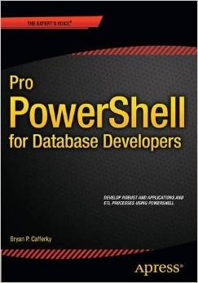
Author of…
Available on Amazon

Slide 3

PowerShell: The Final Frontier

Slide 4
Presentation Goals
To familiarize you with PowerShell features to support professional applications.
Demonstrate some techniques to implement these features.

Slide 5
Advanced PowerShell Development Features
Maximizing Reuse with Advanced Functions
Increasing Extensibility with Script Modules
Adding Support for User Interaction
Efficiently Accessing SQL Server
Adding Support for Application Configuration
Adding Support for Pipeline Processing

Slide 6


Slide 7
Advanced Function
function Invoke-UdfSQLStatement
{
[CmdletBinding()]
param (
[string]$Server,
[string]$Database,
[string]$SQL,
[switch]$IsSelect
)
write-verbose "open connecton"
$conn = new-object System.Data.SqlClient.SqlConnection("Data Source=$Server;Integrated Security=SSPI;Initial Catalog=$Database");
$conn.Open()
$command = new-object system.data.sqlclient.Sqlcommand($SQL,$conn)
if ($IsSelect)
{
$adapter = New-Object System.Data.sqlclient.SqlDataAdapter $command
$dataset = New-Object System.Data.DataSet
$adapter.Fill($dataset) | Out-Null
$conn.Close()
RETURN $dataset.tables[0]
}
Else
{
$command.ExecuteNonQuery()
$conn.Close()
}
}
Advanced function - CmdletBinding

Slide 8
Calling a Function
Invoke-UdfSQLStatement -Server '(local)' -Database 'Development' `
-SQL 'select top 10 * from dbo.orders' -IsSelect
Passing parameters by name

Slide 9
Demonstration
Fun with SAPI, Common Dialogs and Advanced Functions.
See about_Functions_Advanced_Parameters
- Out-UdfSpeech, Get-UdfFileName

Slide 10


Slide 11
Script Modules

Slide 12
Why Script Modules?
Serve as a function library. Once the module is loaded, all its exposed functions and variables are available.
Automatically located by PowerShell.
Simplify coding and deployment.

Slide 13
PowerShell Script Modules
Are completely written in PowerShell code.
Can have multiple functions in a script module.
Script has psm1 as file extension.
Must be placed in a folder PowerShell looks for modules.
Must be stored in a folder with the same name as the module.

Slide 14
Lets’ Create a Script Module
Determine where to locate it.
Create the subfolder to hold the module.
Save the script with the .psm1 extenstion.

Slide 15
Review: Lets’ Create a Script Module
Determine where to locate it.
Enter:
$env:psmodulepath
Returns the search path PowerShell is using to locate modules.
Generally we can use WindowsPowerShell\Modules under the current user’s Documents folder.

Slide 16
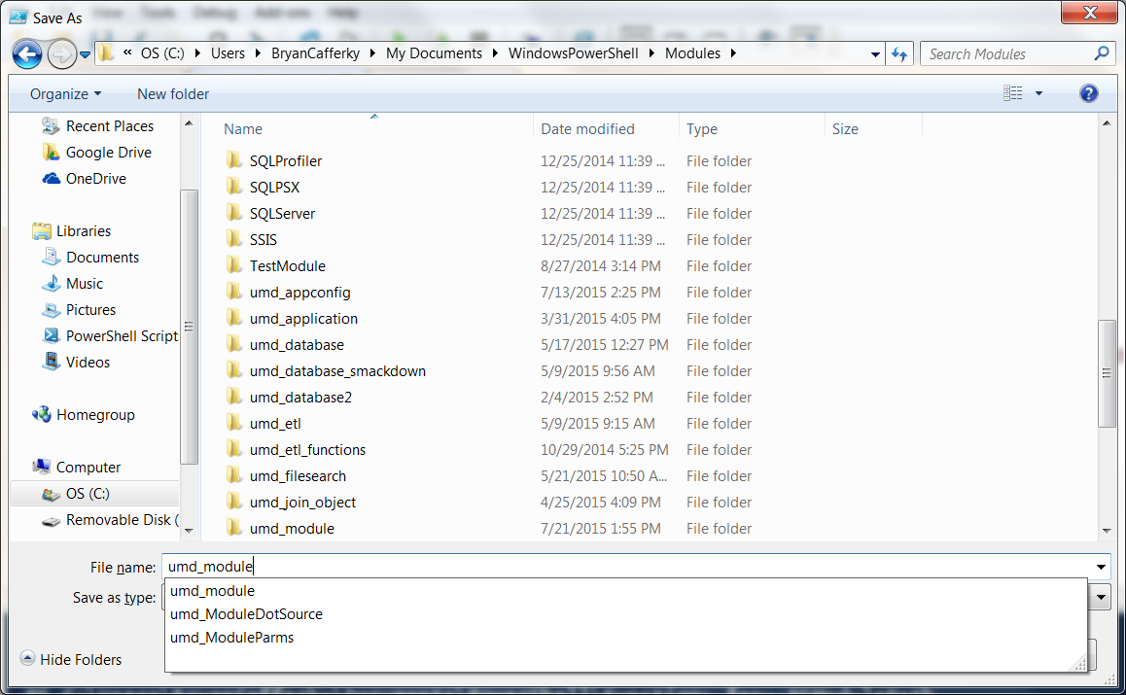
Review: Lets’ Create a Script Module
Create the sub folder to hold the module.

Slide 17
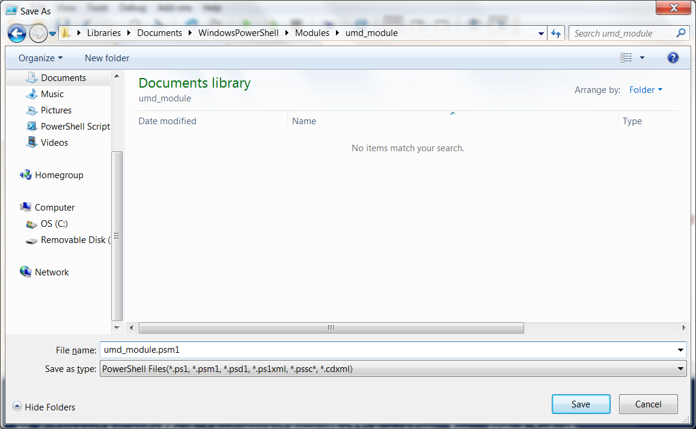
Review: Lets’ Create a Script Module
Save the script with the .psm1 extenstion

Slide 18
Using Modules
Load a module using the Import-Module cmdlet.
Import-Module umd_module
And call the module’s functions as shown below…
Invoke-UdfSQLStatement -Server '(local)' -Database 'Development' -SQL 'select top 10 * from dbo.orders' -IsSelect

Slide 19
Demonstration
Using and Creating Script Modules

Slide 20
Script Modules: A Couple of Notes
Consider creating a module manifest using New-ModuleManifest.
You can limit functions available using the Export-ModuleMember cmdlet at the bottom of the module script.

Slide 21
Script Modules: Making them Even Better
Problem: All the functions for a script module must be in a single script. This can cause maintenance and debugging issues.
How can we store our functions in separate script files while getting the benefits of having them in a script module?
Answer: We dynamically load the functions from indivual script files when the script module is loaded.

Slide 22
Script Modules: Making them Even Better
Dynamically Loading the Script Module Functions
umd_application, ModDotSourced
<#
.Author
Bryan Cafferky
.SYNOPSIS
A simple module that uses dot sourcing to load the functions.
.DESCRIPTION
When this module is imported, the functions are loaded using dot sourcing.
#>
# Get the path to the function files...
$functionpath = $PSScriptRoot + "\function\"
# Get a list of all the function file names...
$functionlist = Get-ChildItem -Path $functionpath -Name
# Loop over alll the files and dot source them into memory..
foreach ($function in $functionlist)
{
. ($functionpath + $function)
}

Slide 23
Script Modules: Dot Sourcing
Each function is stored in its own script in the Function subfolder of the module.
$PSScriptRoot has the path to the module while it is loading.
By concatenating $PSScriptRoot with ‘\Function’, we get the full path to the function scripts.
Then we just loop over each file in the function folder and Dot Source it into memory.

Slide 24
Script Modules: Benefits of Dot Sourcing
Each function can be checked out in a Source Code Management system like TFS and worked on without impacting other functions.
Different developers can work on various functions simultaneously.
Individual functions can be deployed without changing the module. To remove a function, just delete it from the function folder.
The module script is generic and reusable.

Slide 25
Module Cmdlets
Import-Module
Use Force parameter to reload if already loaded.
AsCustomObject parameter will return the module as an object.
Remove-Module – clear module from memory.
New-Module to create a dynamic module.
Get-Module to list modules and their contents.
New-ModuleManifest to create a module manifest.
Test-ModuleManifest – verifies manifest.

Slide 26
Module Cmdlets Using a Module as an Object
# Using a module as an object..
$mymathobject = Import-Module umd_application -AsCustomObject -Force
$mymathobject.'Invoke-UdfMultiplyNumber'(5, 10)

Slide 27


Slide 28
Adding a Windows GUI
Due to verbosity, best to use a third party tool like Sapien’s PowerShell Studio or Admin Script Editor.
PowerShell Winform applications are stand-alone, i.e. no external DLLs required.
Can support full blown Windows applications.

Slide 29
Demonstration
Adding a Windows GUI
scr_winform_sql, test1.Export
Free Winform and More PowerShell Development Environment tool can be downloaded at…
http://www.itninja.com/community/admin-script-editor

Slide 30
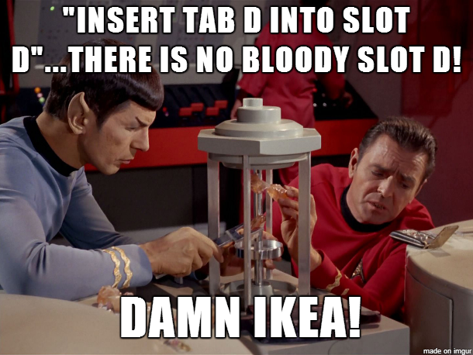

Slide 31
Accessing SQL Server
Can use the SQLPS module but it adds overhead.
For professional development, generally better to use a standard API like ODBC or ADO.Net.
Can be incorporated into a script module.

Slide 32
Demonstration
Accessing SQL Server

Slide 33


Slide 34
Application Configuration
Professional applications need flexible configuration to support changing application settings like server name, email distribution lists, folder names, etc.
PowerShell does not come with built-in support for this but it can be achieved easily with forethought.

Slide 35
Demonstration
Application configuration.
umd_appconfig, Invoke-UdfSQL

Slide 36


Slide 37
Processing the Pipeline
function Out-UdfPipeline
{
begin
{
"`nWe are going to start and there is no pipeline yet."
# Let do something initialization like...
[integer]$mycount = 0
}
process
{
$_
$mycount++
}
end
{
"`nThere are $mycount items."
}
}
Get-ChildItem | Out-UdfPipeline
Runs only once before the pipeline starts.
Runs once for each row in the pipeline.
Runs once at the end after the pipeline is exhausted.

Slide 38
Demonstration
Pipe Processing

Slide 39


Slide 40
Review: Advanced PowerShell Development Features
Maximizing Reuse with Advanced Functions
Increasing Extensibility with Script Modules
Adding Support for User Interaction
Efficiently Accessing SQL Server
Adding Support for Application Configuration
Adding Support for Pipeline Processing

Slide 41
Review: Advanced PowerShell - the 4 bilities
Maintainability.
Deployability.
Extensibility.
Scalability.

Slide 42
Q & A

