Slide 1
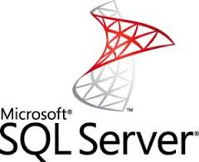


Dynamic Management Views a practical overview!

Slide 2
Introduction
Who the Heck am I?
I am a Nice person in the “What the Hell is Wrong with Me, kind of way”
Why do we need this?
Because DMVs Rock!!!!!
What is the scope?
Everything and anything we can fit in!
Who will benefit and why?
Unfortunately depends entirely on the individuals own cognitive reasoning and ability ☺

Slide 3

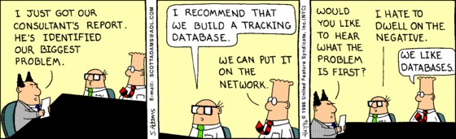

Slide 4


Slide 5
The Real Facts
Dynamic Management Objects (DMOs) (The real name)
They exist in the “sys” schema !!!!!!! Called Dynamic as the data is merely a tabular view of instrumentation points within SQL. These can be Point in Time as well as Cumulative. (Shift F1 when in Doubt)
Dynamic management Views
Dynamic management Functions
Helpers come in the form of:
System Compatibility Views
System Catalog Views

Slide 6

Connections, Sessions & Requests

Slide 7
Connections, Sessions & Requests
• sys.dm_exec_sessions
• sys.dm_exec_requests
• sys.dm_exec_connections
Helpers
• sys.dm_exec_sql_text
• sys.dm_exec_query_plan

Slide 8
Lets start with “sys.dm_exec_sessions”
Provides us with very useful metrics.
total_elapsed_time
last_request_start_time
last_request_end_time
cpu_time
memory_usage
And the list goes on!
PS – Internal Session are <=50 ( <51), often with Nulls in many of the columns

Slide 9

So what can we do with “sys.dm_exec_sessions”?

Slide 10
“sys.dm_exec_requests”
Broken down into 3 groups:
Id Columns – session_id, connection_id, transaction_id
Blocking/Locking – blockingsession_id, wait_type, wait_state, wait_time, wait_resource
Activity/Workload – percent_complete, cpu_time, row_count, granted_query memory, reads, writes, logical_reads

Slide 11
So what can we do with “sys.dm_exec_requests”?

Slide 12
Connections, Sessions & Requests: Summary!!!
• See who is connected?
• What Sessions are in play?
• What they are running?
• What they are using to run things?
• Who is Context Switching?
• Who is Inactive or Idle?
These allow you to deal with immediate problems.
A better approach is however needed for long term solutions to finding problems that need tuning.

Slide 13
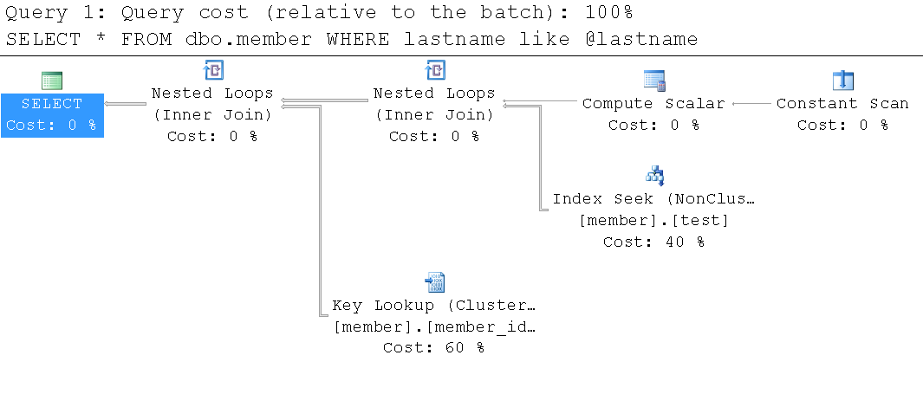
Query Plan Metadata &Statistics

Slide 14
Metadata and Statistics
sys.dm_exec_query_stats – returns aggregated performance statistics for a cached query plan. Returns one row per statement within the plan.
sys.dm_exec_procedure_stats – returns aggregated performance statistics for cached stored procedures (SQL Server 2008 only). Returns one row per stored procedure.
sys.dm_exec_cached_plans – provides detailed information about a cached plan, such as the number of times it has been used, its size, and so on. Returns a row for each cached plan.
sys.dm_exec_query_optimizer_info – returns statistics regarding the operation of the query optimizer, to identify any potential optimization problems. For example, you can find out how many queries have been optimized since the last time the server was restarted.

Slide 15
Helpers
• sys.dm_exec_query_plan – returns in XML format the query plan, identified by a plan_handle, for a SQL batch.
• sys.dm_exec_text_query_plan – returns in text format the query plan, identified by a plan_handle, for a SQL batch or, via the use of this DMF's offset columns, a specific statement within that batch.
• sys.dm_exec_plan_attributes – provides information about various attributes of a query plan, identified by a plan_handle, such as the number of queries currently using a given execution plan. It returns one row for each attribute

Slide 16
What does all this Metadata give us?

Slide 17
MetaData and Statistics Summary
• We can Extract Plans!
• We can extract Execution Text!
• Performance Metrics!
• What did the optimizer do?
Allows us to investigate query health of the system!

Slide 18
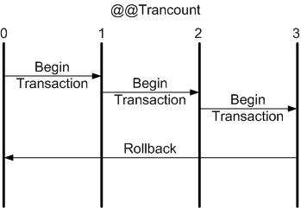
SQL Transactions

Slide 19
SQL Transactions
Needed to ensure ACID properties of the Database and allows us to:
Determine Locking.
Determine Blocking.
Isolation Levels
Some of the main players
sys.dm_tran_active_transactions
sys.dm_tran_locks
sys.dm_tran_active_transactions
sys.dm_tran_session_transactions
sys.dm_tran_active_snapshot_database_transactions
sys.dm_tran_transactions_snapshot
sys.dm_tran_currrent_snapshot

Slide 20
What can we get from Transaction DMV’s

Slide 21
Transaction Summary
• We can track Blocking
• We can track Locking
• Snapshot Isolation Levels are less of a mystery

Slide 22
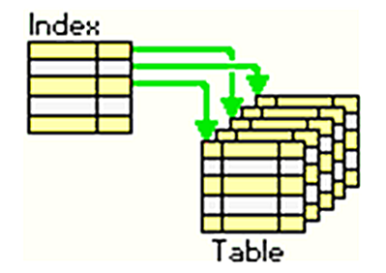
Indexing

Slide 23
Indexing
We all know why we need them!
SSMS gives only individual Index hints: View them subjectively and in some cases critically as the hinted index might not work well for your overall environment.
Can’t play in this arena without using the Catalog views to Help Out.
The main Players:
sys.dm_db_index_usage_stats
sys.dm_db_index_operational_stats
sys.dm_db_missing_index_group_stats
sys.dm_db_missing_index_groups
sys.dm_db_missing_index_details

Slide 24
Indexing Application

Slide 25
Indexing Summary
• Find potential Missing Indexes
• We can dive into Index activity and gauge performance and value
Used
Unused
Underperforming

Slide 26
Conclusion
It's not enough just to understand the metadata values for the DMOs.
Before acting on this data, you must also know and understand your environment, your data, and your users.
Sean.Cremer@Derivco.com (If you are desperate and google is not enough)
(Credit to the following: Ian Stirk, Louis Davidson, Tim Ford, Brent Ozar)

