Slide 1

Execution Plans Detail From Zero to Hero
@ismailadars
ismail.adar@silikonakademi.com
İsmail Adar

Slide 2




Sponsors
Main Sponsor
Media Sponsor
Swag Sponsor

Slide 3

What do we need ?
Just a quick blog post, update on LinkedIn, or a tweet on Twitter is all we need.

Slide 4
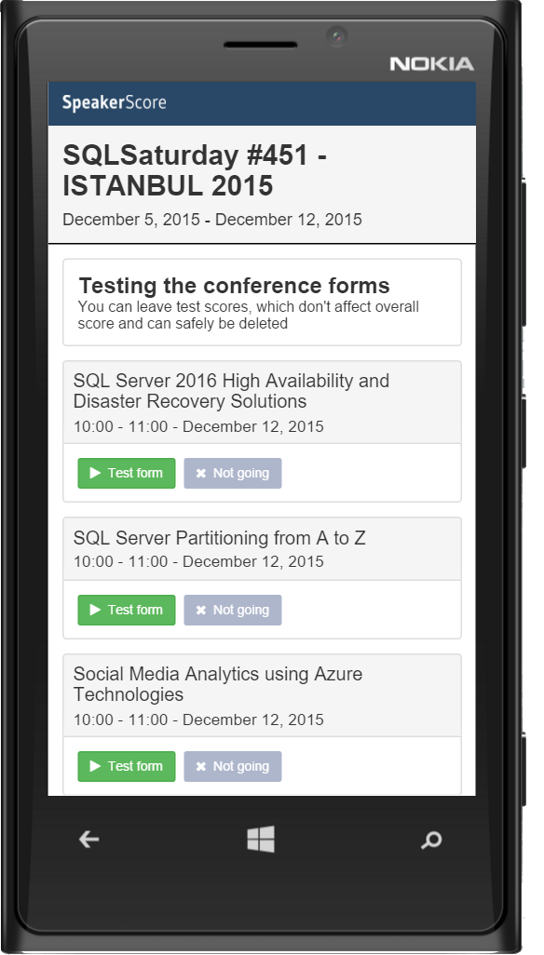
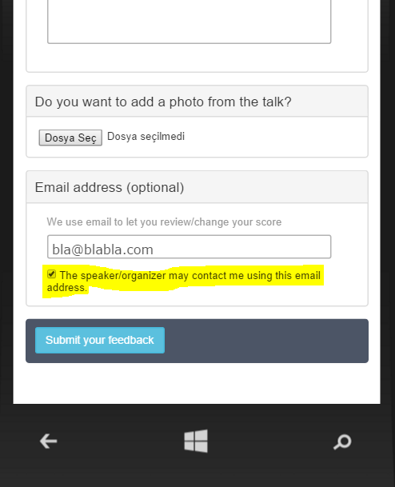
Session Evaluations
Evaluate sessions and get a chance for the raffle: http://spoke.at/sqlsat451

Slide 5

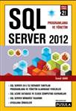

About.Me()
SQL Server Consultant/ Silikon Akademi
SQL Server DBA/ Doğan Online
MCT,MSCE,MCSA,MCITP,etc

Slide 6
Objectives
Query Life Cycle
Execution Plan Overview
Execution Plan Operators
Execution Plan Reuse
Parameter Sniffing
Question and Answers
Notes:
Giriş Konuşması ve Temel Tanımlar
Cost based , yandex her yol değil optimum vs

Slide 7

Query Life Cycle
Syntax Validation
Execution Plan Generation
OPTIMIZE
Simplification
Trivial Plan
PARSE
BIND
Statistic Update
Search 0
Search 1
Binding to Objects Loading MetaData
Search 2
The goal of Query Optimization is not to find BEST Execution plan, to find a good enough execution plan.
Notes:
After Parse : Logical Tree After Bing : Bound Tree
Stage 0 is called Transaction Processing, and it is targeted at scenarios that represent an
OLTP workload with multiple (at least three) table joins,
Stage 1 is called Quick Plan, and it applies most of the optimization rules available in SQL
Server. It may be run twice, looking for serial and parallel execution plans if needed. Most
queries in SQL Server find the execution plan during this stage
Stage 2 is called Full Optimization, and it performs the most comprehensive and, therefore,
longest running analysis, exploring all of the optimization rules available.
You can examine the details of the optimization process by using undocumented trace flag 8675. The usual
disclaimer about undocumented trace flags applies here: be careful, and do not use them in production. You also
need to use trace flag 3604 to redirect output to the console.

Slide 8
Execution Plan Overview
What is Execution Plan?
Which indexes to use?
How to perform JOIN operations?
How to order and group data?
In what order tables should be processed?
Can be cached plans reused?
Understanding Execution Plans is a prerequisite to performance tuning!

Slide 9
Execution Plan Overview
Execution Plan Types
Estimated Execution Plan
Created without ever running the query
Uses statistics for estimation
Good for long running query tuning
Actual Execution Plan
Created when the actual query runs
Uses the real data
They can be different
Statistics out of date
Estimated Execution Plan not valid any more

Slide 10
Execution Plan Overview
Execution Plan Types
Text Execution Plan
Depricated in further versions of SQL Server
Xml Execution Plan
Very good for further analysis
Can be queried
Graphic Execution Plan
Uses internally the XML based Execution Plan

Slide 11
Execution Plan Overview
Capturing Execution Plan
SET SHOWPLAN_TEXT (on deprecation path)
SET SHOWPLAN_ALL (on deprecation path)
SET SHOWPLAN_XML
sys.dm_exec_query_plan
Graphical Showplan
SET STATISTICS PROFILE (on deprecation path)
SET STATISTICS XML
Graphical Showplan

Slide 12
Execution Plan Overview
DEMO – CAPTURE EXECUTION PLAN

Slide 13
Execution Plan Operators
Table scan Indicating a retrieval of ALL rows from a table without a clustered index
▪Clustered Index scan Indicating a retrieval of ALL rows from a table with a clustered index
▪Columnstore Index Scan New as of SQL Server 2012, columnar storage index

Slide 14
Execution Plan Operators
Clustered Index Seek Retrieving rows based on a SEEK predicate from clustered index
Nonclustered Index Seek Same, but from a nonclustered index

Slide 15

Execution Plan Operators
Sort : Orders rows received from input
Top : Is just a bookmark lookup to a heap (using the RID)
Just like with Key Lookups, you’ll only see this with Nested Loop Joins

Slide 16
Execution Plan Operators
Stream Aggregate : Groups a sorted input rows by one or more columns
Requires ordered (sorted) input for grouping columns
If unordered then Query Optimizer can add a Sort operator

Slide 17
Execution Plan Operators
Hash Match Aggregate : Groups a sorted input rows by one or more columns in a hash table which is created in memory. Requires memory for hash table
Hash table values based on grouping columns
1) Generate hash
2) Check for existing row in hash table
3) Generate row if no match or update matching row

Slide 18
Execution Plan Join Types
But it is NOT related to the order you write them in your query, unless you’re forcing it
Outer = top = left Nested Loop: for each row in outer, find all rows in inner
Merge Join: inner/outer – not as important (will discuss why)
Hash Join: outer table is the “build” hash table
Inner = bottom = right Hash Match: inner table is probe table

Slide 19
Execution Plan Nested Loop
It is used when the outer input is small and the inner input has an index on the Columnby which the two data sets are joined
Algorithm: For one row in the outer (top) table, find matching rows in the inner (bottom) table and return them
After no matching rows on the inner table are found, retrieve the next row from the outer (top) table and repeat until end of outer (top) table rows
Notes:
What the “Nested Loops” operator basically does is: For each record from the outer input – find matching rows from the inner input.Technically, this means that the clustered index scan you see as the outer input is executed once to get all the relevant records, and the clustered index seek you see below it is executed for each record from the outer input.
The SQL Server Optimizer will prefer to choose this operator type when the outer input is small and the inner input has an index on the column(s) by which the two data sets are joined. The bigger the difference in number of rows between the outer and inner inputs, the more benefit this operator will provide over the other operator types.

Slide 20
Execution Plan Merge Join
The Merge Join is the most efficient way to join between two very large sets of data which are both sorted on the join key.
Algorithm:
Retrieve row from outer and inner tables
If a match: return the row
If no match: get a new row from the smaller input and iterate

Slide 21
Execution Plan Hash Match Join
It’s the one operator chosen when the scenario doesn’t favor in any of the other join types. This happens when the tables are not properly sorted, and/or there are no indexes.
Algorithm:
Build a hash table (hash buckets) via computed hash key values for each row of the “build” input (top/outer table)
For each probe row (bottom/inner table), compute a hash key value and evaluate for matches in the “build” hash table (buckets)
Output matches (or output based on logical operation)
Notes:
When SQL Server Optimizer chooses the Hash join type, it’s usually a bad sign because something probably could’ve been done better (for example, adding an index).

Slide 22
Execution Plan Operators
DEMO – EXECUTION PLAN OPERATORS

Slide 23
Execution Plan Reuse
SQL Server Plan Cache
Optimize for Ad Hoc Workloads
Parameterization
Notes:
When SQL Server Optimizer chooses the Hash join type, it’s usually a bad sign because something probably could’ve been done better (for example, adding an index).

Slide 24
Execution Plan Reuse
DEMO – EXECUTION PLAN OPERATORS
Notes:
When SQL Server Optimizer chooses the Hash join type, it’s usually a bad sign because something probably could’ve been done better (for example, adding an index).

Slide 25
Parameter Sniffing
DEMO – PARAMETER SNIFFING
Notes:
When SQL Server Optimizer chooses the Hash join type, it’s usually a bad sign because something probably could’ve been done better (for example, adding an index).

Slide 26
Question and Answers
http://ismailadar.com/
ismail.adar@silikonakademi.com
@ismailadars

Slide 27

Thank you

