Slide 1
Reading Execution Plans Successfully
Arthur Daniels

Slide 2

Arthur Daniels Twitter: ArthurDanSQL www.DBA-Art.com
Database Administrator
SAP Fieldglass
Started presenting last year
“I don’t care how long my query takes as long as it returns results”

Slide 3
Overview
Structure of the plan
First operators
Warnings and suggestions
Manipulating an execution plan

Slide 4
Disclaimer:
SQL Server 2014 and above
AdventureWorks 2014

Slide 5
Your environment matters
Hardware
SQL Settings
Min and max memory
Cost threshold for parallelism
Max DOP
SQL version

Slide 6
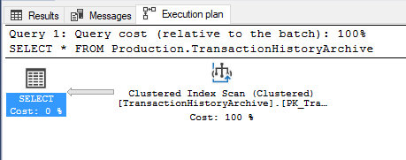
Structure: Graphical Execution Plan
What’s that?

Slide 7



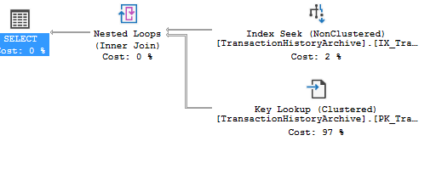
Other execution plan features
Flow and size of line

Slide 8




Graphical Execution Plan
Plan Operators
Index Seek Index Scan Key Lookup

Slide 9

Where and what are they?
Graphical Execution Plans are stored as XML
SQL Server Management Studio (SSMS)
Live Query Stats
SQL Server Plan Cache
Query Store?

Slide 10
The Plan Cache
sys.dm_exec_cached_plans (2008)
Plan cache contains estimates
Emptied when server restarts

Slide 11
Plan cache demo
To-do:
Build plan cache
Find our specific plan
Look at operator
View actual plan’s rows vs estimated.

Slide 12

Where do the estimates come from?
SQL Server automatically generates statistics
One statistic per index
One statistic per column once a query searches by that column
Search as in Where clause, JOINs

Slide 13
Statistics Demo
Open Statistics on IX_TransactionHistoryArchive_ProductID

Slide 14
Statistics General
Used for execution plan estimates
Automatically generated
One for each index
One for each column*
Statistics contain header, density vector and histogram

Slide 15
Compute Scalar Operator
Used for mathematical expressions
Referred to as “Expr”

Slide 16
Compute Scalar Demo
Demo here

Slide 17
Implicit Conversion
Why?
In actual and estimated

Slide 18
Reading Implicit Conversions
Demo

Slide 19
Missing Index Hints
Execution plan will contain index suggestions
Only the first missing index is shown

Slide 20
Missing Indexes
Demo

Slide 21
Tools inside SQL Server 2016
Query Store
Live Query Statistics

Slide 22



Manipulating an execution plan
Parallelism as operators
Gather Streams Distribute Streams Repartition Streams

Slide 23
Comparing a parallel query to serial query
Demo
Set Cost Threshold for Parallelism to 1 for this demo

Slide 24
Wrap-Up
Structure
Operators:
Seek, Scan, Lookup
Statistics and Indexes

Slide 25
Finally, what you can infer
Look at size of lines between operators
Discover what operators are doing
Pay attention to warnings

Slide 26
Questions?
You can also contact me on Twitter, @ArthurDanSQL or my website, www.DBA-Art.com

Slide 27
DBA-Art.com Twitter: @ArthurDanSQL
Presentation slides + demos
Step-by-step instructions for setting up a test server at home:
http://www.dba-art.com/setup-local-sql-server/

Slide 28
Useful links
Finding Implicit Conversions in your Plan Cache
Free graphical plan explorer:
https://www.sentryone.com/plan-explorer/

