Slide 1

SQL Server Query Design and Optimization Recommendations
@ismailadars
ismail.adar@silikonakademi.com
İsmail Adar

Slide 2




Sponsors
Main Sponsor
Media Sponsor
Swag Sponsor

Slide 3

What do we need ?
Just a quick blog post, update on LinkedIn, or a tweet on Twitter is all we need.

Slide 4
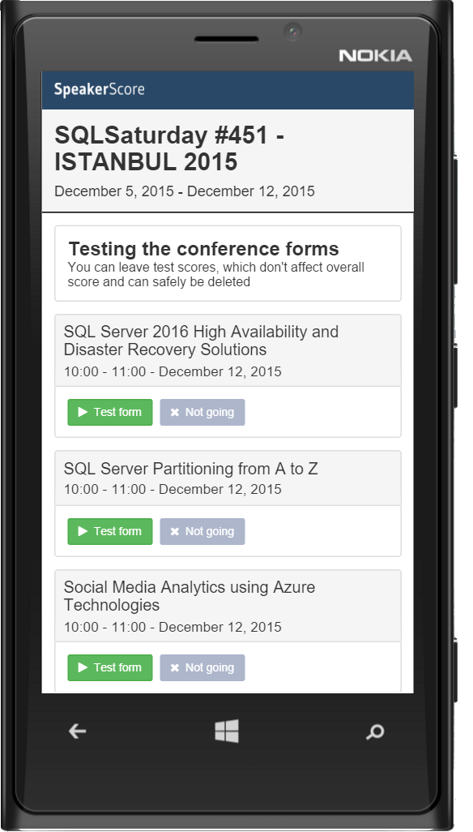
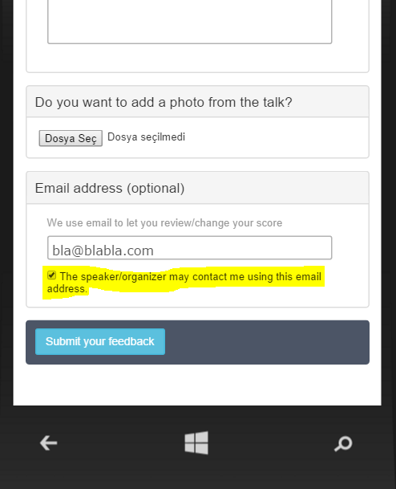
Session Evaluations
Evaluate sessions and get a chance for the raffle: http://spoke.at/sqlsat451

Slide 5




İsmail Adar
SQL Server Consultant/ Silikon Akademi
SQL Server DBA/ Doğan Online
MCT,MSCE,MCSA,MCITP,etc

Slide 6
Speed Up Queries Using Constraints
Primary Key
Foreign Key
Check Constraint
Default Constraint
Unique Constraint
Constraints are loaded during binding step

Slide 7
Horse Power of SQL Server - INDEX
Index Recap
Composite Index Selection
Advantage of Index Uniqueness
Using Filtered Index

Slide 8
Execute Dynamic SQL
When, Why Dynamic SQL?
Exec
Sp_execute_sql

Slide 9
Remove Unused Columns
Really Need All Columns?
How Can You Prevent SELECT * Statements?

Slide 10
Stored Procedure-Function
Stored Procedure With Optional Parametres
Parameter Sniffing
Table Value Function vs Scalar Value Function

Slide 11
Temporary Objects
Table Variable vs Temp Table
Temp Table Caching In SQL Server 2014

Slide 12
Other
Improving Query Performance by using correct Search Arguments Implicit Data Conversion
Union vs Union All
Using GUID When Create Table

Slide 13

Thank you

