Slide 1
Parameter Sniffing on SQL Server
Dean Savović

Slide 2
Sponsor

Slide 3
Who am I
Comminus d.o.o.
Zagreb - Croatia
Head of Data Management Department
SQL Server MCSE
18 years of experience
Conference speaker

Slide 4
Agenda
What is parameter sniffing
When is good?
When is bad?
How to deal with it when it is bad?
Demo
Conclusion

Slide 5
Let’s start

Slide 6
What is Parameter Sniffing?
Ability of SQL Server
Reuse execution plan from cache
Less CPU and memory usage
Important on high-load systems

Slide 7
When PS is good?
Data distribution is even
Cardinalities of sets of data execution plan deals with are similar

Slide 8
When PS is bad?
Data distribution is not even
Cardinalities are not similar
Duration variation
Reads variation

Slide 9
How to deal with bad PS?
Optimize for unknown
Trace flag 4136
ALTER DATABASE SCOPED CONFIGURATION SET PARAMETER_SNIFFING = OFF
Optimize for value
Option recompile
Dynamic sql
Dynamic sql with parameters
Dynamic sql with option recompile

Slide 10
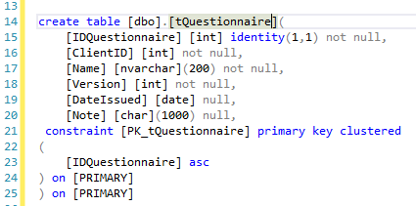
Demo
dbo.tQuestionnaire
3 m rows

Slide 11
Demo
Name – non clust index
Date Issued – non clust index

Slide 12
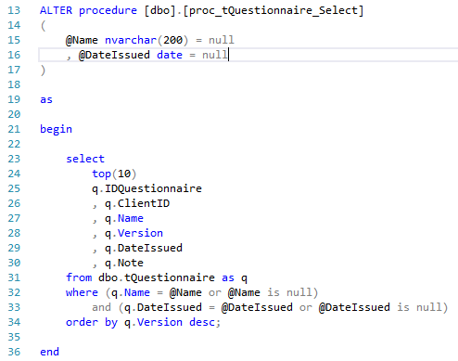
Demo
dbo.proc_tQuestionnaire_Select

Slide 13
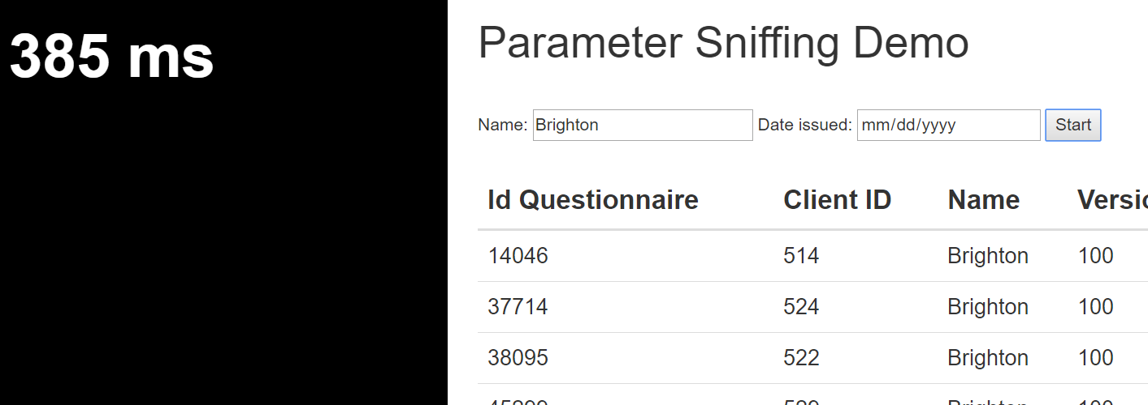
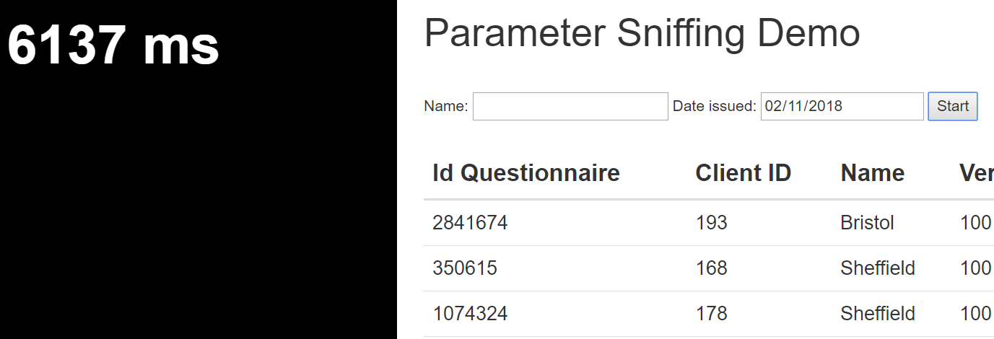
Demo
exec dbo.proc_tQuestionnaire_Select @Name=N'Brighton',@DateIssued=default
exec dbo.proc_tQuestionnaire_Select @Name=default,@DateIssued='2018-02-11 00:00:00'

Slide 14
Conclusions

Slide 15
Conclusions
Most of the time PS is good
Various methods to deal with bad parameter sniffing

