Slide 1
Introduction to Clustering
This session is intended to give an overview of Failover Clustering with regards to SQL Server
Chad Churchwell
Premier Field Engineer – SQL Server
Microsoft Corporation
@chadchurchwell | sqlchad@gmail.com

Slide 2

About Me
Premier Field Engineer with Microsoft
High Availability
Disaster Recovery
Replication
SQL Saturday Presenter
JSSUG
12+ years experience as DBA
Author for www.mssqltips.com
Twitter: @chadchurchwell

Slide 3
Agenda
Introduction
Clustering Architecture
Components in Failover Cluster
Quorum Models
Networks for clustering
What is differences between WSFC/FCI?
Installing SQL Server on a cluster
Administering SQL Server on a cluster

Slide 4
SQL Server Failover Cluster
What is a “SQL Server Cluster”??
Protects From…
Local resource failure (except disk)
Outages for patching
Local HA
Does not protect from…
Corruption
Deleted data
SAN outages (Shared Storage)

Slide 5
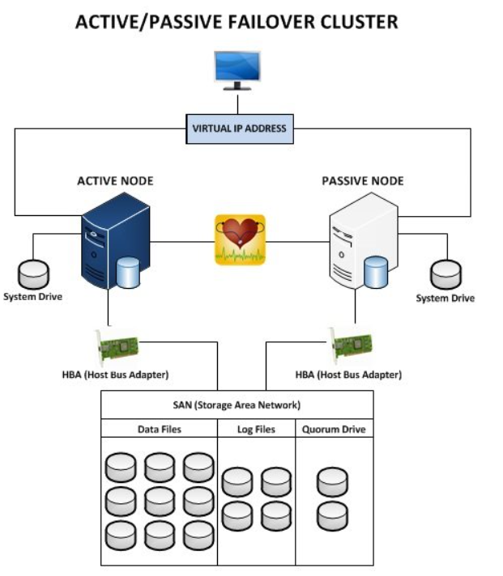
SQL Server Cluster Architecture

Slide 6
SQL Clustering Components
Two or more nodes
Shared Storage
Networking
Quorum
CNO (Cluster Name Object)
CLUSTERNAME$ in AD
Cluster IP and Network Name
SQL Virtual Network Name and IP
SQL Clustered Installation

Slide 7
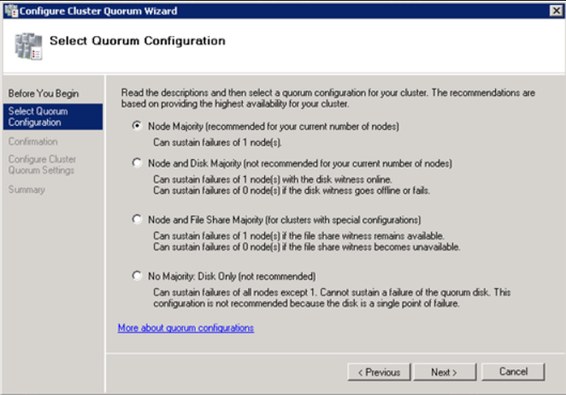
SQL Clustering Quorum Models
Considerations
ODD/EVEN
Local/Remote

Slide 8
Quorum – New in Server 2012/R2
Dynamic Quorum
Introduced in Windows Server 2012
Implements “Last Man Standing”
Dynamically removes voting rights
Dynamic Witness
Introduced in Windows Server 2012 R2
Cluster decides whether to use witness

Slide 9
Networking for SQL Clusters
Public
Normal LAN connectivity
Heartbeat
Used for Cluster communications between nodes
Storage (iSCSI)
TCP connectivity to iSCSI storage

Slide 10
WSFC vs FCI
WSFC
Windows Server Failover Cluster
OS Level Component
Requires “Failover Clustering” OS feature
Pre-requisite for SQL Cluster
FCI
Failover Cluster Instance
Clustered SQL Server Installation
Built on top of WSFC

Slide 11
Installing a SQL Server Cluster
Prerequisites
Enable “Failover Clustering” OS feature
Present Shared Storage to all nodes
Pre-stage cluster objects in AD (if needed)
Ensure NIC’s for all networks are configured
Create a WSFC in Windows Server
Obtain successful cluster validation report
Perform SQL Server Clustered Installation
“Add Node” to all secondary nodes

Slide 12
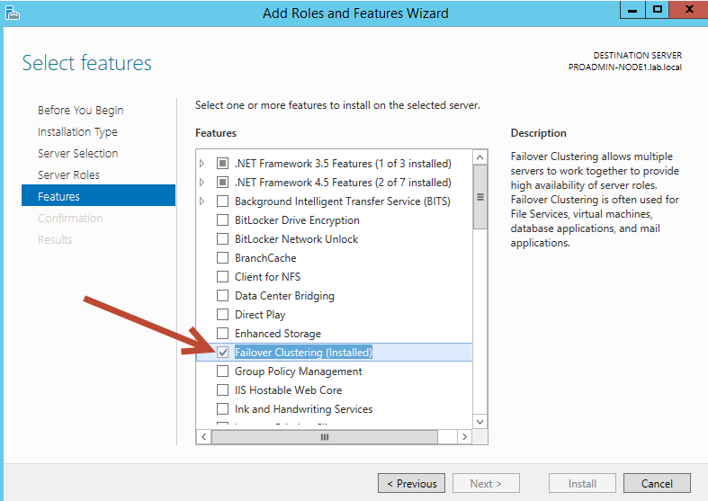
Installing a SQL Server Cluster

Slide 13
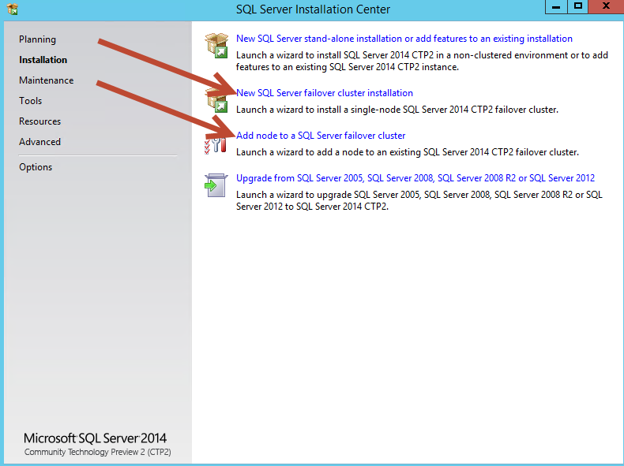
Installing a SQL Server Cluster

Slide 14
Administering a SQL Server Cluster
Use “Failover Cluster Manager”
For failover
Look at cluster resources and dependencies
What happens during failover
Primary node SQL services are stopped
Secondary SQL services start and gain control of shared storage
All system/user DB’s live on shared storage

Slide 15
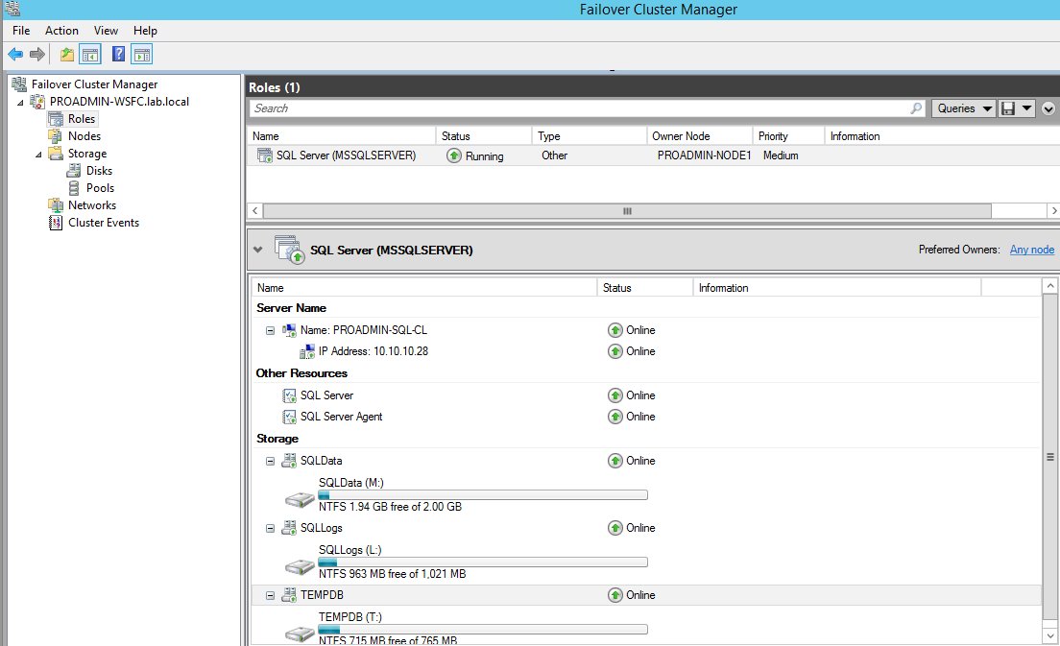
Administering a SQL Server Cluster

Slide 16
New Features in SQL Server 2012
Flexible Failover Policy
Levels 0-5
Default of 3
LooksAlive/IsAlive replaced
sp_server_diagnostics
Support for multi-subnet clusters
IP Binding using OR algorithm

Slide 17
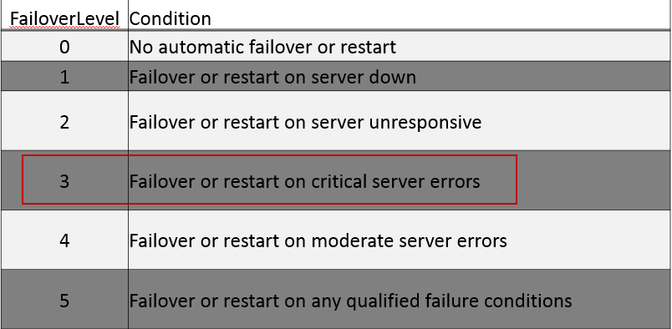
Flexible Failover in SQL Server 2012

Slide 18
Questions?
DEMO
Chad Churchwell
SQL Premier Field Engineer - Microsoft
Email: sqlchad@gmail.com
Twitter: @chadchurchwell

