Slide 1
Building your first SQL Server Cluster
Joe D’Antoni
SQL Saturday #69
Philadelphia
05 March 2011
Notes:
Hello, and welcome to SQL Saturday in Philadelphia. I hope everyone is enjoying themselves. My name is Joe Dantoni and this session is on building you first SQL Server cluster. I’ve kind of targeted it towards SQL admins who want to understand more about clustering, so that they can either attempt it themselves, or work with their Infrastructure teams to get a cluster going.

Slide 2
About Me
DBA with 10+ years of experience
Primarily in health care
Vice President of the Philadelphia SQL Server User Group
@jdanton on Twitter
Joedantoni.wordpress.com
Notes:
A little bit about myself, before I get too deep—I’m a DBA with over 10 years of experience, in SQL and Oracle. For the last 9 years I’ve been working in the Pharmaceutical and Medical Device sectors. I currently work for Synthes, a medical device company. I’m the Vice President of the Philadelphia SQL Users group, we’re off this month, but our meetings are typically the second Wednesday of every month at Microsoft Malvern, at 5:30 PM.
Also, you can find me on linked in, I’m @jdanton on Twitter, and I blog at joedantoni.wordpress.com
I’ll have these slides up at my blog following this presentation.

Slide 3
Agenda
High availability—why do you need it?
Architectures—HA and DR
Planning—who needs to be in the room?
Definitions—It helps to have a glossary
Technical—what do you need to do?
Support—How is supporting this environment different from supporting a standalone
Notes:
Today’s agenda—I’ll start by covering High Availability—the first step in this process is to think about what goals you are trying to accomplish by going to a clustered environment.
Architecture—Explaining the difference between High Availability and Disaster Recovery, and some sample architectures for both
Planning—This is not just a one person effort—unless your shop is really small, I’ll cover who needs to be involved and what their roles are.
Definitions—There will be a quiz after this presentation. Just kidding—there’s a lot of cluster specific terms, that may not be widely know, I’ll go through them, so you can speak the language
Technical—What needs to happen from a storage, network, Windows, and SQL point of view to make this cluster happen.
Support—What needs to be treated differently from a regular SQL environment

Slide 4

High Availability
Why do you need a HA environment?
Remember HA is not DR.
Notes:
High availability—Wikipedia—and this is kind of a general definition, so I trust them for it, is a system design and approach that ensures a prearranged level of operation performance will be met during a contractual measurement period. Ok, that sort of assumes you have an SLA. Anyway, in general, in system design high availability is a hardware design to protect from hardware and software faults, and attempting to maximize uptime.
What does this mean in the context of a SQL Server cluster—it means that you are protected from (most) hardware failures, and O/S failures, and that you can patch your Windows servers housing your cluster with minimal amounts of downtime. You can also do rolling SQL Server patches and/or upgrades. However, the weak link is still your SAN—if your SAN blows up, and it’s safe to call it a disaster—which brings me to my next topic—high availability and disaster recovery are two completely difference things.
So before you endeavor on a SQL Clustering project, think about what your applications and business can gain from it. The process is not nearly as expensive as it used to be, and more and more businesses are using SANs for storage, which was typically the biggest limiting factor.
I bring in this image of hurricane katrina approaching the gulf coast, because it’s near and dear to my heart. My wife and I both grew up in New Orleans, and both of our parents still live there, so we are frequent visitors to the area. If your SAN blows up that’s one thing—generally all of your techs are in the area, and in the worst case, you can be up and running in a couple of days, from backup tape. But, if you have a data center in a vulnerable location (in the Northeast we’re fairly decent in that regard), think about your plans, and what your real DR plans are and your recovery time and data loss needs are.

Slide 5
High Availability Options in SQL
SQL Server Clustering
SQL Server Mirroring
Peer to Peer Replication
SQL Server Log Shipping*
Notes:
SQL Server clustering is the most obvious high availability solution that everyone knows about. However, mirroring between two SQL Servers (with a witness server) can also provide a level a both h/a and D/R.
The other two options are a little bit more controversial and more complicated to setup. Both peer to peer replication and SQL Log Shipping can provide some measure of H/A, but there are caveats to this, and some data loss is possible. This is a little outside of the scope of this preso, so if you would like to know more detail around these topics, I highly recommend Paul Randal’s white paper on SQL HA and DR options. I’ll provide a link at the end of this presentation.

Slide 6
DR Options in SQL Server 2008
Backup and Recovery
Mirroring
Log Shipping
Replication
SAN Replication*
Virtualization*
Notes:
DR Options—yes backup and recovery is your first line of defense in the event of a disaster. You should have extensive monitoring and notification around your backup process, and take regular transaction log backups, if you need point in time recovery.
Mirroring is probably the best high availability option. With a witness server (a server that sits in between the two mirrors) you get automatic failover in the event of the failure of your primary instance goes down. Most applications that use Microsoft connections to your database can support mirroring. The only negative, is that unless you have enterprise edition, you are limited to synchronous mirroring, which can have a performance impact on your primary. Enterprise edition brings in asynchronous mirroring, which allows for greater flexibility and distance between sites with no performance impact.
Log shipping and Replication—both of these will require manual intervention in the event of a failure. However, they are very mature technologies and can work over great distances. This is not a DR scenario, but I have an application which replicates from the US to Switzerland over a nominal network connection, running on SQL 2000, and I haven’t had to touch it in two years. (Knocks on wood).
Lastly SAN replication—this is really cool technology, and can enable the concept of geo-distributed clusters (also covered in Paul’s white paper). This is pretty far out of scope for today’s presentation, but I’ll say this—while really cool, it’s really complex to setup, and really expensive. You need additional software from your SAN vendor, which is always pretty pricey, and the additional network bandwidth to transfer bits in real time over the network. When I was at Wyeth, we did this between Philadelphia and Pearl River NY for the SAP system that ran the business. But the cost made it prohibitive to do much else. Also, when it goes wrong, it can be ugly.

Slide 7
Clustering - Why
Hardware Protection
O/S Protection
High availability
Notes:
Clustering by itself provides you with a couple of options—you gain hardware redundancy as well as Windows redundancy. A clustered environment should also provide some level of storage redundancy—multiple SAN controllers, a RAID configuration. What clustering does not protect you from, is a site failure—that is where mirroring and/or replication come in.
Clustering is a little more expensive than just mirroring, if you don’t already own a SAN. However, unless you are running SQL Enterprise, you will need to run synchronous mirroring which will impact your primary system performance.
Replication and most of the other options don’t allow for automatic failover without some intervention.
Lastly, they reason to select clustering is that you are in this presentation on clustering…
-

Slide 8
Clustering—Who
Depends on size of your IT organization
Windows System Admins
DBAs
Storage Admins
Network Admins
Ideally—application leads
Notes:
Who needs to be involved in your clustering project? This is going to vary greatly depending on the size and maturity of your IT organization.
In a nutshell, you are going to need to have the following people in the same room to plan your architecture. Some of these people may fill more than one of these roles, and that is perfectly acceptable.
Ideally, you want to meet with your application leads, probably not up front, but you want to discuss their HA and DR needs, and where they intersect with your plans. Also, some applications aren’t big fans of failing over—more on that later.

Slide 9
Some Definitions
RTO—Recovery Time Objective. How long can your systems be down before impacting the business
RPO—Recovery Point Objective. How much data can you lose before affecting the business.
Cluster—The Windows cluster (consisting of 1 or more nodes) that your SQL Server instance runs on top of
Resource Group—services and disks that are associated with your clustered service (in this case SQL)
Multi-instance/single-instance—Official MS terms for active-active and active-passive clusters
Notes:
**ELS – I would give concrete examples of RTO and RPO. E.g. RTO – business may decide that you can be down for a half hour before business is impacted. RPO – business may decide that you can only lose 2 minutes worth of data. RTO does not have to equal RPO, and the lower they are, the more it will cost to meet them.
I said there would be definitions and a quiz—(assuming I have prizes), well pay attention here, as these terms will be the quiz answers later.
For the most part, I’ll let you just read these, but there are a few points I’d like to touch on. RTO and RPO are THE terms when it comes to defining your DR and HA strategies, your VPs and CIOs know these terms, and it’s the simplest way to ask the business what their needs are. How much data can you lose, and how long can you be down? Obviously, these are going to vary greatly both by industry and application. It’s a best practice to map these back to all of your key applications.
Multi instance and single instance—given the hardware we have available now, to me it makes almost no sense to run a single-instance (or active/passive) SQL cluster. You have to be careful around CPU and memory consumption, but since you aren’t sharing disks (the single biggest limiter to SQL performance), go ahead and utilize your servers.

Slide 10
More Definitions
SAN—storage area network, a box of many disks which can be presented to multiple servers
LUN—Officially Logical Unit Number, but practically a disk volume presented from SAN to a server(s)
Mount Points—Naming method for Windows disk devices, attaching many devices to single drive letter
Node—The physical (or virtual) Windows machine supporting your cluster
Notes:
**ELS – I don’t know how much you want people to know about drive letters vs. mount points. If you want them to understand it, I would recommend a diagram. If it’s just a concept they need to consider and read up on, then never mind.
Most of these are self explanatory, but I want to touch on mount points—this is huge, especially if you are running a multi-instance cluster. If you split up your storage the way your should (data, tempdb, logs, backups) you are looking at minimum of 4 drive letters in a given SQL instance. Using mount points you can reduce that to 1 letter. I cover this in a couple of blog posts—it’s extremely easy to set up, and there is absolutely no reason NOT to do it. There is one thing to note doing so will make monitoring the space utilization in your clustered disks a little difficult. We use a powershell script to get around this, but it does report some duplicate data, but since it’s just for the DBA’s it’s not that big of an issue.

Slide 11
More Definitions
Failover Cluster Manager—The utility in Windows that provides for cluster management and verification.
Quorum disk—Disk that verifies all of the nodes in the cluster can talk to each other
Looksalive/Isalive—Processes which verify if cluster services are still running and initiates failover
Notes:
Failover cluster manager will become your friend—this is where you do most of your administration, and where you add disks to your SQL instance, also, is the place you can check on the status of cluster and clustered services.
sharing. In a server cluster, the quorum disk contains a master copy of the server cluster configuration, and is also used as a tie-breaker if all network communication fails between cluster nodes. Depending on the type of server cluster you implement, the quorum disk might or might not be a physical disk on the shared cluster disk array. This is a larger issue, when you have a odd number of nodes, or a larger cluster.
Looks alive/isalive—
LooksAlive is a basic check in which the Cluster service queries the Windows Service Control Manager to check if the SQL Server service is still running. By default this check happens every 5 seconds. -- Read more: http://www.sqldbadiaries.com/2010/10/02/looksalive-and-isalive-checks-by-microsoft-cluster-service/#ixzz1FjSfuzJQ
During IsAlive check the Cluster Service connects to the SQL Server instance with the help of c:\windows\system32\sqsrvres.dll and runs SELECT @@SERVERNAME against the instance. This check does not check if the user databases are online or not. It just checks the SQL Server instance availability. This check happens every 60 seconds by default. -- Read more: http://www.sqldbadiaries.com/2010/10/02/looksalive-and-isalive-checks-by-microsoft-cluster-service/#ixzz1FjSv3ELU

Slide 12
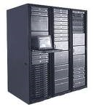
What you need to build a cluster?
Two Servers
SAN
Network
IP Addresses
Notes:
This is in it’s absolutely simplest form. Additionally, you need Windows Server, Enterprise Edition, in order to have failover clustering available. The SQL clustering will work on standard edition however.
You will need a switch, for your private network (though you can get away without one, this isn’t recommended), you will need some sort of shared storage presented to both nodes of your cluster. Lastly, you will need IP Addresses, for the cluster name itself, the DTC service, and any SQL instances which you cluster.
The first SQL cluster we built at my company, was two leftover servers, with an old compaq direct attached storage arrary. We used the iSCSI target feature that’s included in Windows 2008R2 to configure the storage, and presented it to both servers over iSCSI. This wasn’t an ideal environment for high performance. It was really good for learning about building a cluster from ground up. By, the end of this process I could build a cluster, from the ground up in about 2 hours (assuming I had storage presented to it).
In earlier versions of Windows, there was a requirement that the hardware be from the same generation in order to be supported—that has gone away in 2008. You just need to pass the validation testing—more on that later.

Slide 13


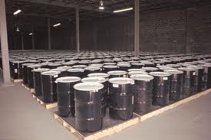
Storage Network
Notes:
No, not this kind of storage….

Slide 14

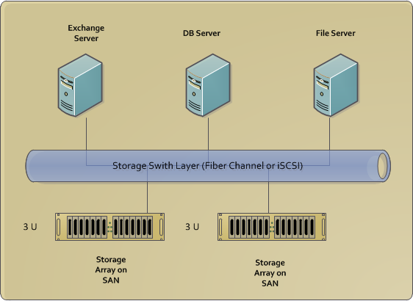
Storage Network
Notes:
**ELS – THIS kind of Storage (I know my pictures are lame, I don’t have internet. Forgive me!)

Slide 15
SAN
Almost all SANs will do
You may need to update your SAN firmware
Windows 2008R2 Requires iSCSI-3 persistent reservations
Work closely with your storage team, to ensure proper disks (mainly for performance)
LUNs must be presented to all cluster nodes
Notes:
In a nutshell, you need a SAN. Almost all of the major SAN vendors will suffice—we use hitachi, EMC is great, NetApp is fine. The one caveat is that Windows 2008R2 requires something called iSCSI-3 persistent reservations.
You do want work closely with your SAN administrators to layout the storage properly. I use 1 Lun each for tempdb, data, transaction logs and backups. If you have particularly hot databases, you may want to line them up with their own luns. Finally, all of you LUNs must be presented to cluster nodes.
Also, you’ll want to remind your SAN engineer to multi-path your disks for high availability—the worst thing that can happen to your cluster (short of fire or some other natural disaster) is to lose SAN connectivity. Lastly, and this applies for all SQL servers, make sure the disk partition alignment is setup correctly.
http://msdn.microsoft.com/en-us/library/dd758814%28v=sql.100%29.aspx

Slide 16
Windows
Add Failover Cluster feature to your server nodes
Windows Firewall
Antivirus
Validate your cluster
Name your cluster, and reserve its IP address
Start using mount points to label your disks!!!!
In a multi-instance cluster, it’s really easy to run out of drive letters
Notes:
**ELS – I moved this slide before the Network one (and should this be titled Server, and you talk about installing Windows, then adding the failover cluster to your server nodes, etc. And what the heck does add failover cluster feature to your server nodes mean? Does it mean that I’ve installed Windows, and then I do something else to install the failover cluster feature? Then I worry about firewall and antivirus, etc.?
Once again, depending on the size of your shop, you may or may not be responsible for building your Windows servers. In my shop, I am, and it helps to really understand how clustering works within Windows—it’s 95% of SQL Clustering, which kind of just sits on top of it.
Make sure both nodes are updated to the same level—it’s not a requirement, but Windows will balk.
The first thing I do is totally disable Windows firewall—in 2008 it’s fairly aggressive, and causes all sorts of problems. On our proof of concept cluster it was actually blocking iSCSI connections to the storage through Windows. The best practice here is to open what you need on the firewall. Lastly, NEVER disable the firewall service directly—you lose the ability to RDP into the server.
Antivirus—straight antivirus is fine, but you may run into issues if you are running an anti-spyware suite. We run Symantec, and if we run their whole suite, it breaks clustering, so have to stick with just the antivirus.
** ELS – should this paragraph be first??
In terms of Windows build—you can start out with a perfectly normal Windows 2008 build on your servers. From there you will need to add the failover cluster feature to the servers. While you are doing that go ahead and add .net 3.5, as you will need it for the SQL Server installs later. Also, you should see your disks on both servers through storage explorer. You need to go ahead and bring them online and initialize them.
From here, you will create your cluster. Failover cluster manager will guide you through a series of tests, to make sure everything is properly configured. SQL Server’s install is dependant on this, so you want to make sure it’s correct. It will go through your O/S, storage and network setup, and make sure everything is ok.
Once that passes, you will then create your cluster—select it’s name and add the nodes you want to it. Unlike SQL, you will only have to perform this action on one node.
Lastly, and I will preach it throughout this presentation—use mount points instead of drive letters to label your storage—you will still need a root drive letter, but you don’t want to be faced with running out of drive letters. I also add the disks to the cluster storage pool at this point, in advance of installing SQL.

Slide 17
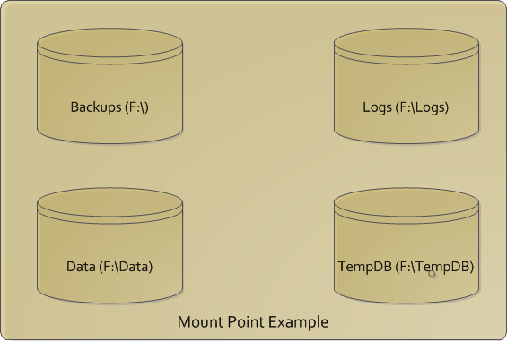
Mount Points--Visualized

Slide 18
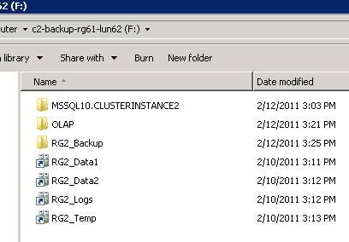
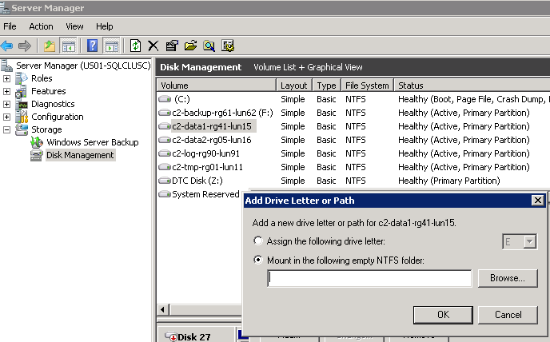
Mount Points -- Windows

Slide 19
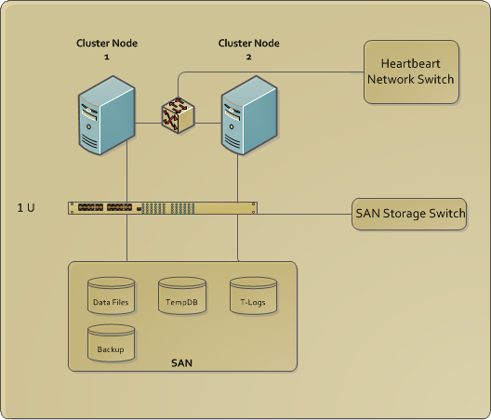
Storage Network + Server/Windows + Switch
Notes:
This is a diagram of what your physical hardware layout will look like—this is representative of a two node cluster, running a single instance of SQL Server. For extra high availability, you want to have redundant paths to your storage, and possibly redundant HBA or network cards.

Slide 20
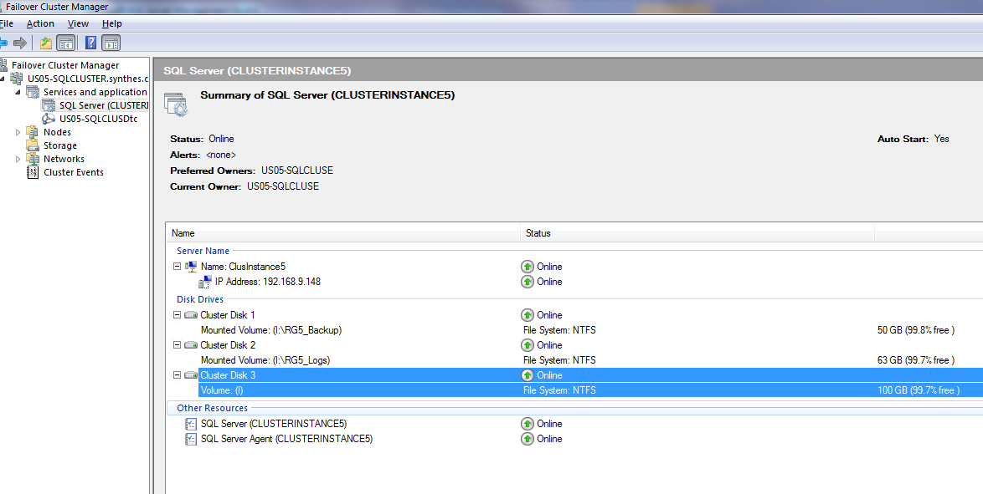
Failover Cluster Manager

Slide 21
Network
Many, many IP addresses and aliases
Heartbeat Network
DTC
Clustername
Instance Service
Of course, the base node
Verify ports are not blocked
I would put this slide after the windows one…I would build from the physical (SAN, Servers/Windows, switch), to the “less physical” (network)
Notes:
**ELS – I moved this slide to be after Windows (should it also include Switch in the title?)
A cluster takes up a surprising number of IP addresses. This isn’t a huge problem, but you’ll want to layout what your building with your network folks, to ensure that you have the IP space available on the subnets you need. The one caveat here is that both of the physical (or virtual) nodes need to be on the same subnet for SQL Server clustering.
Lastly ask them about any ports that are being blocked—the cluster uses some ports outside of just 1433, so you’d like to be aware what they are blocking—it can help troubleshooting down the road.

Slide 22
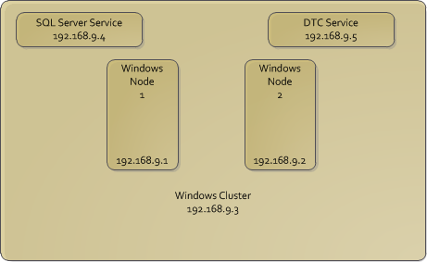
Storage Network + Server/Windows + Switch + IPs
Notes:
**ELS – This slide AFTER Network slide
Add all the Ips in here, so people can see where they go. (it would be nice to use animation to have them show up as you’re talking through them…start from one side of the slide and work to the other (e.g. left to right or right to left, whichever makes more sense)
Also, I drew basic lines, but you could take this same slide later and add a little more to it with the multi-pathing.

Slide 23
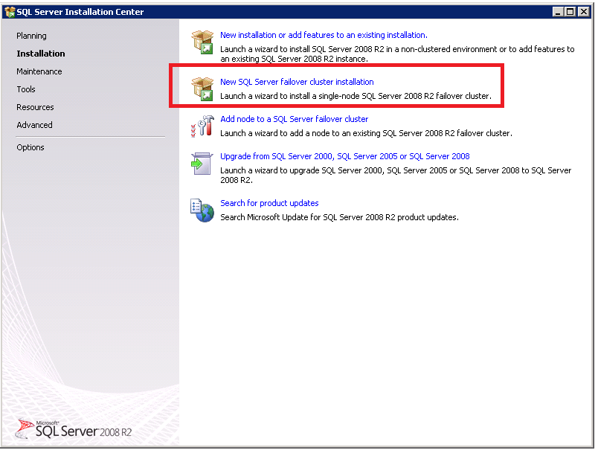
SQL Server
Notes:
This is where it all begins….
** ELS - So…do I assume that I have Windows installed on both, they’re set up as a Windows cluster, and now I go to one server and I’m going to start installing SQL Server? How do I know which server to pick? Does it matter?

Slide 24
SQL Server 2008 Install
Cluster DTC Service (requirement)
Slipstream SP1 installation
Install SQL using “Create New Failover Cluster Option”
Install first on the node that is the current owner of the disks you would like to use
Must install SQL on each node
Notes:
**ELS – Are you doing a demo? If not, then some screen shots might be useful here, if possible?? I don’t know how you are on time… I’m big on pictures, can you tell? ☺
Now finally, onto something we all know and love….SQL Server itself
Before you kick this off, you need to install SP1 of SQL Server via slipstream—this process was a bit buggy, the installation process threw kerberos errrors. I’ve included a link to the slipstream document in my bibliography. If you haven’t done it before slipstreaming is the process of installing a SP alongside a initial install.
As I showed in the slide above, you start the process, through the SQL installer, but first things first. Having the Distributed Transaction Coordinator clustered. That’s easy—the only thing to remember about it when planning is that it needs it’s own storage resource and IP address.
Go into to failover cluster manager and identify the disks you are planning to use for your cluster--
Install SQL using the create failover cluster option. The thing to note here is that you will have an instance identified and service name. This is just like a named instance, but instead of having your server name be in front of the the \, your SQL Server networkname will be. The instance ID will be the name of the instance—don’t accept the default of MSSQLServer. This resource will have it’s own IP address as well. This will also be the easiest way to track down which node your service is running on—just RDP to the virtual service name.
SQL will install some binary files to the C:\ drive on each of the nodes that is expected
You will be presented with the options of what to install. Analysis Services can be clustered, Integration Services and Reporting Services can not.
When you are presented with the disks to be used by your cluster, you will only see the root disk of your mount point. Note—when you select this it will be the root disk for all of the SQL files locations. You will want to change this to make sure that the disk layout you worked to create is preserved.
Security—you will be presented with the option the use the same account for all services. We used a limited privilege domain account for this.
You have the options to configure filestream, collation, and SA passwords in the following screens. Do it as you normally would—the only difference is that filestream is on a share cluster drive.

Slide 25
Second Node Installation
This should be pretty easy!!
Select the add node option—then select the instance you just created
You will then have to specify passwords for the services
Installation should be complete
Do a failover for test purposes
Notes:
This is just a subset of what you did on the first node. Some binaries will be installed on the C:\ drive.

Slide 26
Considerations for SQL Server
Memory pressure in multi-instance SQL
Backups and Restores must be performed from drives owned by the cluster service
This is more of a hardware consideration—but HBA traffic
Remember—this isn’t a shared everything environment
Notes:
Some considerations you need to have—you have to size the memory on your SQL Servers as though all instances could be running on one node—you want to have some headroom.
Backups must be performed to a cluster drive—and restores as well. This isn’t a huge issue, but every now and then it can be if you’re tight on space.
Traffic to your SAN connection should be monitored.
In some other vendor clustering (Oracle namely) everything is shared between all nodes. The storage is being utilized by all three nodes at once and memory is shared over the private network. That isn’t the case with SQL—basically, you have 1 instance running on any 1 node at a point in time.

Slide 27
Application Considerations
Performance is generally the same as in a standalone instance
Test your applications
SSIS—use MSDB storage and rely on server for security
Notes:
You need to work with your storage guys on any SAN issues, but generally performance tuning works the same way it does in a normal environment. This isn’t like VMWare, where you have to change the way you montior the environment.
If you have critical applications, you need to test failing them over. Most of ours work without any issues, but SharePoint likes to be restarted, also the application database for VMWare doesn’t play nicely with a failover—you just need to verify what your applications are doing.
Your SSIS packages must be deployed to MSDB, and use server security for encryption—any of the other options rely on individual server dependencies, so your jobs will fail when your instance fails over.

Slide 28
Leveraging your Cluster
Windows Updates
Firmware Upgrades
SQL Server CPs and SPs
Notes:
The big advantage to a cluster is being able to maintain your infrastructure with minimal amounts of downtime—it takes a small number of seconds to failover your instances. You can do your updates and then fail them back to the other node. This is huge and easy.

Slide 29
Summary
Understand your HA and DR priorities
Know who needs to be involved in planning process
Build your cluster
Test your applications!

Slide 30
Bibliography
Great book—Pro SQL Server 2008 Failover Clustering by Allan Hirt
Paul Randal—White Paper on HA Solutions in SQL 2008
Slipstreaming SQL Server Install
Building a cluster from MS

Slide 31
Questions

Slide 32
Contact Info
Blog—joedantoni.wordpress.com
Twitter--@jdanton

