Slide 1
Finding more space for your tight environment
Thomas Chan
SQL Saturday 638 - Philadelphia

Slide 2
















Thanks Vendors

Slide 3

Who am I ?
I work for Virginia state as SQL DBA
I have 18+ year in IT and use SQL since 7
I love computer, database and Sid Meier's Civilization

Slide 4
Agenda
How can I get more disk space?
Our solution, like downsize your house
compress data
shrink file
defrag indexes and update statistics.
Demo

Slide 5
How can we get more disk space?
Buy more disk space, means $$$
Purge/delete old or unnecessary data
Our solution (downsize your house)
Compress data – buy a smaller house
Shrink data file – move to smaller house as fast as possible
Defrag index and update statistics – organize your stuff
Share free space among servers using for example iSCSI protocol (file in a server is a hard disk in the target server)

Slide 6
Compression
Definition of data compression: reduction of space used to store a piece of information.
Enterprise only, except SQL 2016 SP1
Transparent to user or developer, no coding
Compressed pages remain compressed in memory/buffer pool
Type of page compression in SQL Server
Row
Page
Other (Unicode, column-store)
Backup - since 2008
It may improve performance of database

Slide 7
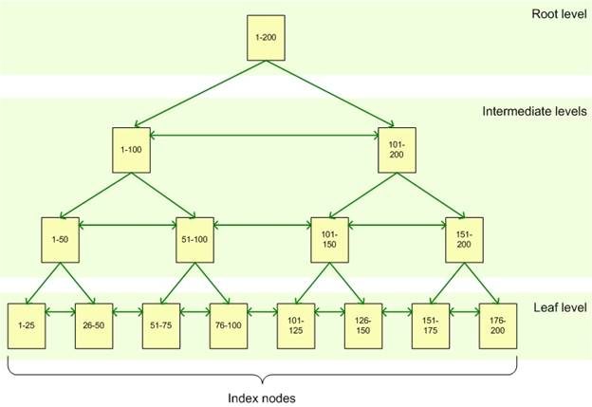
Compression – B-tree index
Row only
Row and Page

Slide 8
Row Compression
Compress data at row level
Smart way to store data
Use variable length for numeric type
Use variable length for fixed string format
Null and 0 require 0 bytes
Reduce metadata overhead associated with the records
https://msdn.microsoft.com/en-us/library/cc280576.aspx

Slide 9
Page Compression
Compress leaf pages at page level
The compression consist 3 phase:
Row compression
Prefix compression – compress common patterns
Dictionary compression – compress common patterns again (data and prefix)
https://msdn.microsoft.com/en-us/library/cc280464.aspx

Slide 10
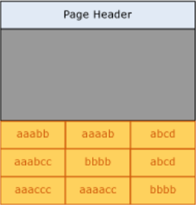
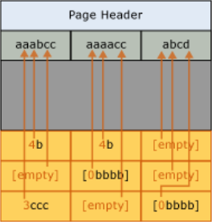
Page Compression - Prefix
Compress common patterns in the beginning of each columns

Slide 11
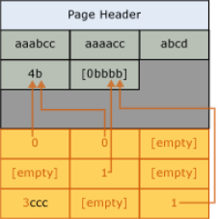
Page Compression - Dictionary
Compress common patterns across all columns after prefix compression

Slide 12
Page vs Row
Table | Savings ROW % | Savings PAGE % | S | U | Decision | Notes
T1 | 80% | 90% | 3.80% | 57.27% | ROW | Low S, very high U. ROW savings close to PAGE
T2 | 15% | 89% | 92.46% | 0% | PAGE | Very high S
T3 | 30% | 81% | 27.14% | 4.17% | ROW | Low S
T4 | 38% | 83% | 89.16% | 10.54% | ROW | High U
T5 | 21% | 87% | 0.00% | 0% | PAGE | Append ONLY table
T6 | 28% | 87% | 87.54% | 0% | PAGE | High S, low U
T7 | 29% | 88% | 0.50% | 0% | PAGE | 99% appends
T8 | 30% | 90% | 11.44% | 0.06% | PAGE | 85% appends
T9 | 84% | 92% | 0.02% | 0.00% | ROW | ROW savings ~= PAGE
T10 | 15% | 89% | 100.00% | 0.00% | PAGE | Read ONLY table
Data Compression: Strategy, Capacity Planning and Best Practices https://technet.microsoft.com/en-us/library/dd894051(v=sql.100).aspx

Slide 13
Compression Detail
Space to be save can estimate by each type of compression and table or index
Objects can be compressed: heap, index and indexed view, essentially partition
Partitioned data require less disk space to compress the same data than data with unique partition
New page allocated in a heap by DML will not use PAGE compression until it is rebuilt
Change compression type of heap will rebuild ALL non-clustered indexes
The non-leaf pages can only be compressed to row compression while leaf page can to both type: row and page
https://msdn.microsoft.com/en-us/library/cc280449.aspx

Slide 14
Compression Tips
Start from smaller partitions to bigger one (require workspace)
Start from heap (when compress heap, non-clustered are compress too)
Start from clustered index
Use sys.dm_db_index_operational_stats
High scan → page compression
High update → row compression
Use sys.sp_estimate_data_compression_savings to estimate saving
Durante the compression do not forget backup transaction log backup

Slide 15

Compression Syntax
ALTER TABLE Tab1 REBUILD WITH (MAXDOP=1, COMPRESSION=NONE | ROW | PAGE)
ALTER INDEX IX01 ON TABLE Tab1 REBUILD WITH (MAXDOP=1, COMPRESSION=NONE | ROW | PAGE)
ALTER TABLE Tab1 REBUILD WITH (PARTITION=1, MAXDOP=1, COMPRESSION=NONE | ROW | PAGE)
EXEC sp_estimate_data_compression_savings ‘Sch1’, ‘Tab1', ‘IX01', NULL | <Partit Num>, ‘NONE’ | ‘ROW’ | ‘PAGE’
Compression Partition
Shrink Data File
Defrag Index
Update statistics

Slide 16
Shrink Data File
Why? Because we need free space for OS and the space freed by data compression remain reserved to database
Shrink vs Defrag
Shrink = Downsize = release as fast is possible the free space to windows
Defrag/reorganize = Organize
USE db1 GO DBCC SHRINK (‘db1’, 1024);

Slide 17

Index Defragmentation
There are two defragmentation method:
Reorganize: defrag leaf page only, recommended average fragmentation between 5% to 30%
Rebuild: defrag leaf and root of index, recommended average fragmentation over 30%
Online defrag is enterprise only

Slide 18
Update Statistics
SQL query optimizer uses statistic to generate high quality query execution plan.
Consider update statistic after any major change of data distribution like table truncation, bulk insert or any large update.
To view the distribution of statistics use DBCC SHOW_STATISTICS (‘sch.table’, PK_table) WITH HISTOGRAM;
To update statistic uses
UPDATE STATISTICS sch.table;
UPDATE STATISTICS sch.table PK_table;
UPDATE STATISTICS sch.table(column) WITH SAMPLE 50 PERCENT;
EXEC sys. sp_updatestats;

Slide 19
Demo
Run query to estimate space saving, update and scan percentage with compression command
Run compression command
Backup with and without compression
Shrink data file
Defrag indexes
Update Statistics (show statistic distribution)

