Slide 1
No more waiting
An introduction to Wait Statistics

Slide 2
A big thank you to our sponsors!

Slide 3

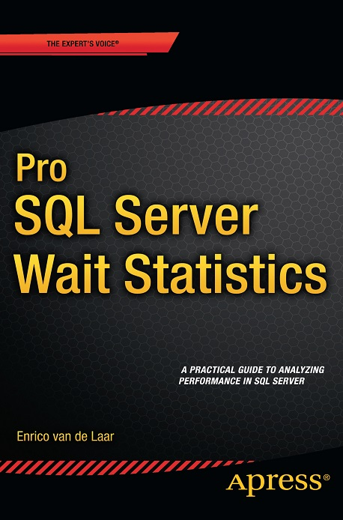



About me
Chief Consultant DotNine
MVP Data Platform
Blogger
Author
Speaker
@evdlaar
http://www.dotnine.net

Slide 4
Agenda
What are wait statistics?
How wait statistics are generated
Querying & analyzing wait statistics
Common wait statistics

Slide 5
What are wait statistics?

Slide 6
What are wait statistics?
When SQL Server executes a request but the resources are not available to complete the request a wait occurs
SQL Server records the time it has been waiting as wait time and what it has been waiting on as the wait type

Slide 7
What are wait statistics?
The wait time and wait type are logged at the instance level and are cumulative since last SQL Server start *
The wait statistics will show you what your SQL Server instance is spending most of it’s time waiting on!
* SQL Server 2016 introduces session based Wait Statistics collection

Slide 8
How wait statistics are generated

Slide 9
How wait statistics are generated
SQL Server uses schedulers to manage CPU time for threads
The number of schedulers = number of logical processors + 1 (DAC)
View schedulers using sys.dm_os_schedulers

Slide 10
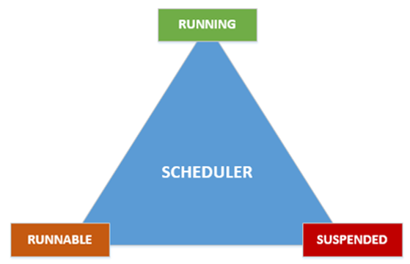
How wait statistics are generated
Notes:
Abstract example of a scheduler and its queue states

Slide 11
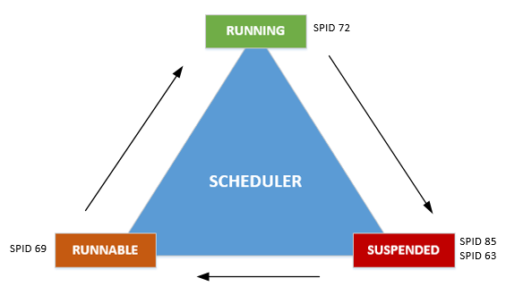
How wait statistics are generated
Signal wait time
Resource wait time
Runnable queue
Waiter list

Slide 12
How wait statistics are generated
Wait time
CPU time + Signal wait time + Resource wait time
Total execution time

Slide 13
Querying & analyzing wait statistics

Slide 14
Querying & analyzing wait statistics
2* DMV’s for wait statistics: - sys.dm_os_wait_stats - sys.dm_os_waiting_tasks
sys.dm_os_wait_stats cumulative wait times
Use sys.dm_os_waiting_tasks to find out what is waiting right now!
* SQL Server 2016 introduces session based Wait Statistics collection

Slide 15
Querying & analyzing wait statistics
Some wait types will log additional information in sys.dm_os_waiting_tasks that will help you troubleshoot!
Others you can safely ignore like LAZYWRITER_SLEEP (your mileage may vary)

Slide 16
Querying & analyzing wait statistics
Sys.dm_os_wait_stats perfect way to capture wait statistics baselines!
Without a baseline there is no way of saying a specific wait time is too long!

Slide 17
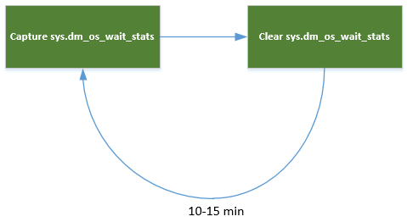
Querying & analyzing wait statistics
Wait statistics baseline methodology

Slide 18
Querying & analyzing wait statistics
Use sys.dm_os_waiting_tasks to find out what is slowing you down right now
Compare the wait times to your baseline
Focus on large increases or decreases for the top n wait types
Don’t freak out!

Slide 19
Common wait statistics

Slide 20
Common wait statistics
CXPACKET
LCK_M_xx
PAGEIOLATCH_xx
OLEDB
THREADPOOL

Slide 21
Common wait statistics
CXPACKET
CXPACKET waits always occur when you use parallelism (MDOP)
Investigate execution plans, tune MDOP cost threshold, check statistics
Don’t freak out and turn of parallelism!

Slide 22
Common wait statistics
LCK_M_xx
LCK_M_xx waits occur when blocking is occuring
Check if there is a blocking bottleneck, break up large updates, change isolation level

Slide 23
Common wait statistics
PAGEIOLATCH_xx
Latches are synchronization objects for buffer pages
PAGEIOLATCH_xx occurs when data is moved from disk to the buffer cache
Can indicate IO subsystem or memory issues, check indexes, statistics

Slide 24
Common wait statistics
OLEDB
OLEDB occurs when SQL Server calls the Microsoft SQL Native Client OLE DB provider
Will also occur when you are using linked servers
DBCC commands will also generate OLEDB waits!

Slide 25

Common wait statistics
THREADP L
THREADPOOL waits occur when there are no free worker threads available
Max nr. of worker threads (64bit): <= 4 CPU’s = 512 > 4 CPU’s = 512 + ((CPU’s – 4) * 16)

Slide 26
Common wait statistics
THREADP L
Can be caused by blocking, large query batches, increased number of user connections or large number of concurrent parallel plans
Check causes above before changing max worker threads!!!

Slide 27
Questions?

Slide 28
Additional reading
SQL Server 2005 Waits and Queues Tom Davidson - http://bit.ly/1o2NFoF
Paul Randal SQLskills.com blog http://bit.ly/1Dj4yoR
Microsoft MSDN sys.dm_os_wait_stats http://bit.ly/1le9dx0

Slide 29
A big thank you to our sponsors!

